Slide 1
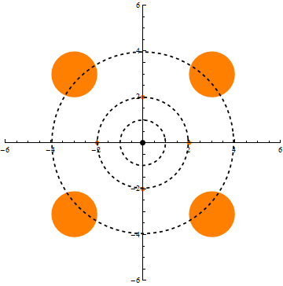
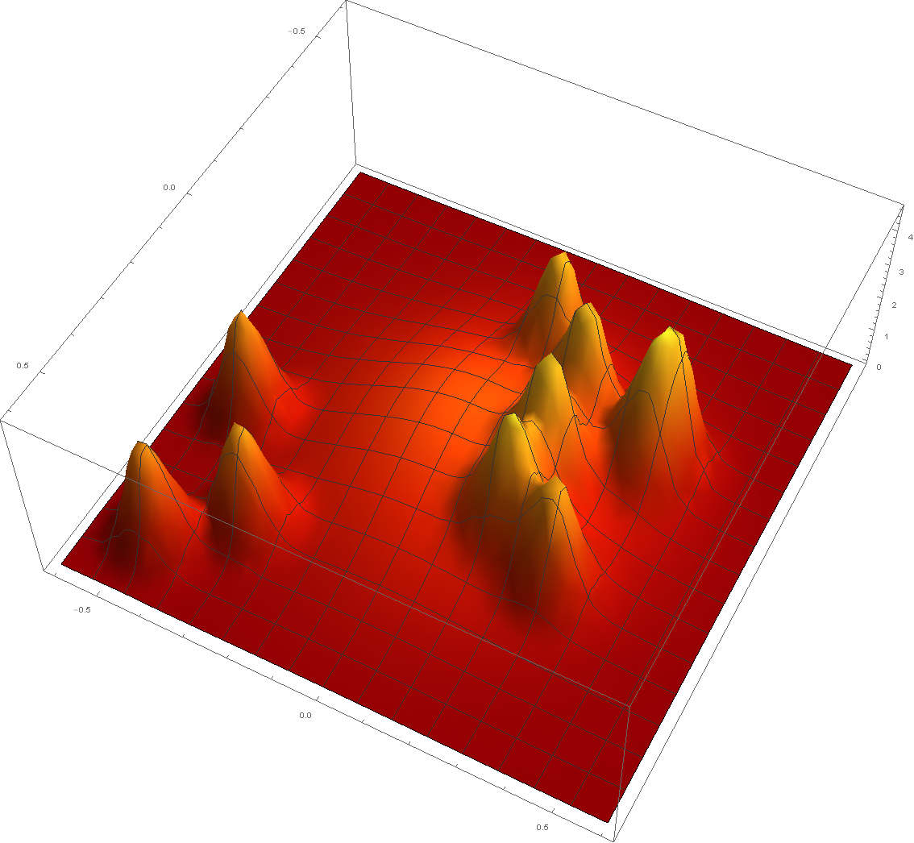
Talagrand’s convolution conjecture and anti-concentration of temperature
James R. Lee
University of Washington
Joint work with Ronen Eldan
[MSR, University of Washington,…]

Slide 2
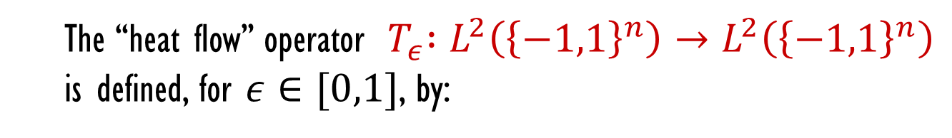


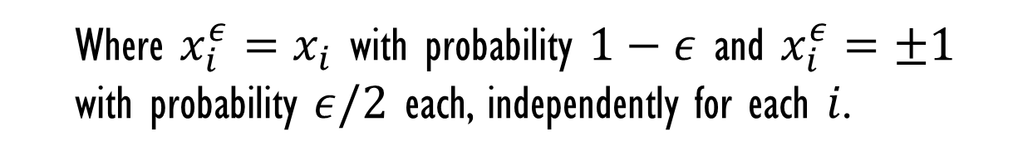

noise and smoothness
$$f :{\left\{−1,1\right\}}^{n}→ℝ$$
The “heat flow” operator ${ T}_{ε} :L^{2}\left({\left\{−1,1\right\}}^{n}\right)→L^{2}\left({\left\{−1,1\right\}}^{n}\right)$
is defined, for $ε∈[0,1]$, by:
$$T_{ε}f\left(x\right)= 𝔼\left[f\left(x_{1}^{ε},x_{2}^{ε},…,x_{n}^{ε}\right)\right]$$
Where $x_{i}^{ε}=x_{i}$ with probability $1−ε$ and $x_{i}^{ε}=±1$
with probability $ε/2$ each, independently for each $i$.
General principle: $f$ smooth $⇒$ $T_{ε}f$ smoother
Many applications: PCPs, hardness of approximation, social choice,
circuit complexity, information theory,
learning, data structures, ...

Slide 3
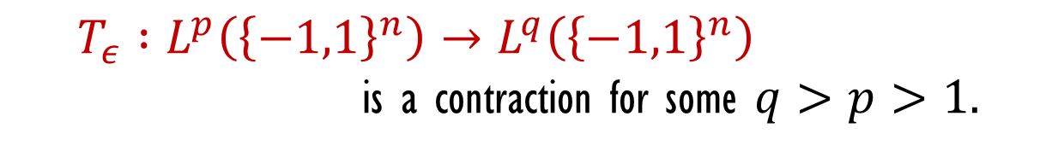
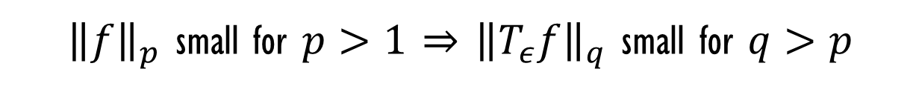
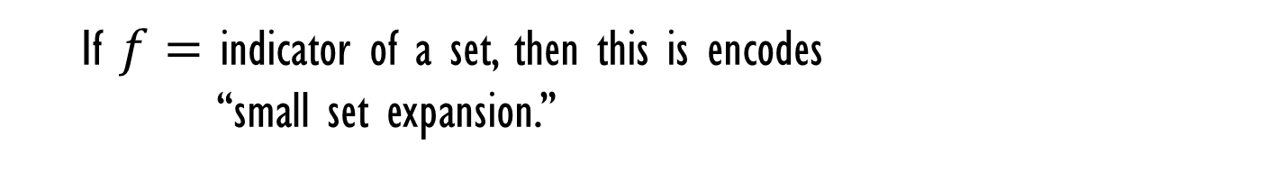

noise and smoothness
Hypercontractive inequality [Bonami, Gross, Nelson]:
For $ε>0:$
$T_{ε} :L^{p}\left({\left\{−1,1\right\}}^{n}\right)→L^{q}\left({\left\{−1,1\right\}}^{n}\right)$
is a contraction for some $q>p>1.$
${\left\|f\right\|}_{p}$ small for $p>1$ $⇒$ ${\left\|T_{ε}f\right\|}_{q}$ small for $q>p$
If $f=$ indicator of a set, then this is encodes
“small set expansion.”

Slide 4
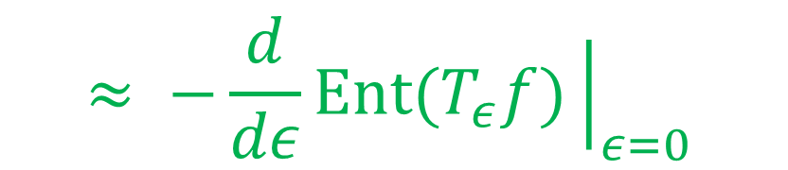

noise and smoothness
Relative entropy: For $f :{\left\{−1,1\right\}}^{n}→ℝ_{+}$ with $𝔼\left[f\right]=1$,
$$Ent(f)=𝔼\left[f\log{f}\right]=𝔼_{Z∼f}[\log{f\left(Z\right)]}$$
Gradient: $𝔼{\left|∇f\right|}^{2}=\sum_{i=1}^{n}{𝔼[{\left|f\left(x⊕e_{i}\right)−f\left(x\right)\right|}^{2}] }$
Log-Sobolev inequality: For every such $f :{\left\{−1,1\right\}}^{n}→ℝ_{+}$
$$Ent(f)≤𝔼{\left|∇\sqrt{f}\right|}^{2}$$
$$≈ −\frac{d}{dε}Ent(T_{ε}f){\left.​\right|}_{ε=0}$$

Slide 5




noise and hypercontractivity
Hypercontractive inequality:
For $ε>0$ and $p>1$, there is a $q>p$ such that
$${\left\|T_{ε}f\right\|}_{q}≤{\left\|f\right\|}_{p}$$
for all $f :{\left\{−1,1\right\}}^{n}→ℝ$.
$$Ent(f)≤𝔼{\left|∇\sqrt{f}\right|}^{2}$$
Log-Sobolev inequality:
Talagrand (1989): What about smoothing for arbitrary $f$?

Slide 6

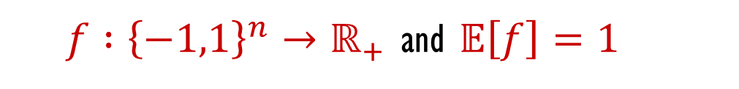
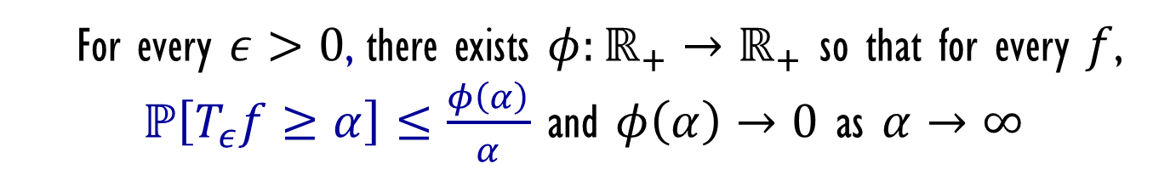

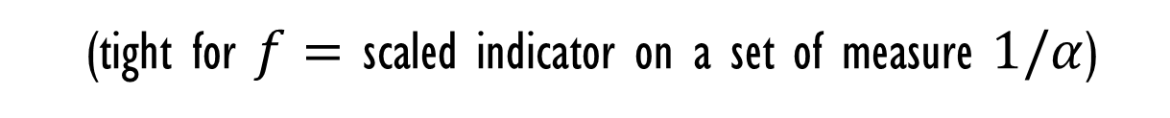
the convolution conjecture
$f :{\left\{−1,1\right\}}^{n}→ℝ_{+}$ and $𝔼\left[f\right]=1$
Markov’s inequality: $ℙ\left(f≥α\right)≤\frac{1}{α}$
(tight for $f=$ scaled indicator on a set of measure $1/α$)
Convolution conjecture [Talagrand 1989, $$1,000$]:
For every $ε>0$, there exists $φ:ℝ_{+}→ℝ_{+}$ so that for every $f$,
$ℙ\left[T_{ε}f≥α\right]≤\frac{φ\left(α\right)}{α}$ and $φ\left(α\right)→0$ as $α→∞$
- Best function is probably $φ\left(α\right)∼\frac{1}{\sqrt{log α}}$ (achieved for halfspaces)
- Conjecture unresolved for any fixed $ε>0$, $f=1_{S}$, $S⊆{\{−1,1\}}^{n}$

Slide 7
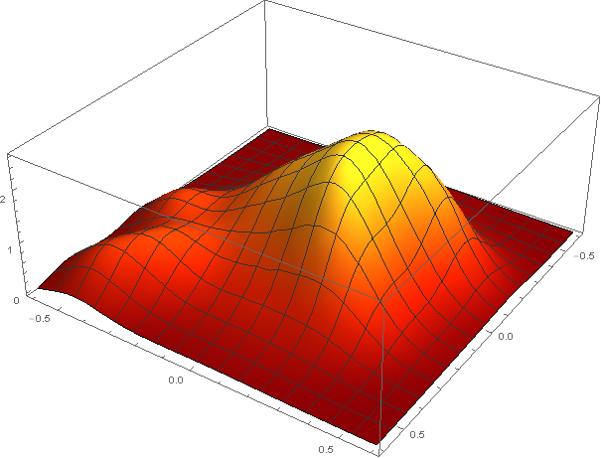

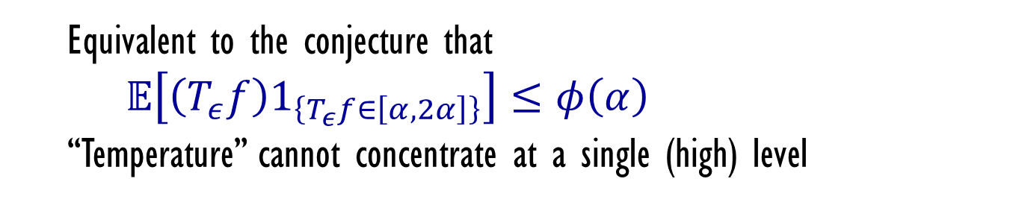
anti-concentration of temperature
Convolution conjecture [Talagrand 1989]:
For every $ε>0$, there exists $φ:ℝ_{+}→ℝ_{+}$ so that for every $f$,
$ℙ\left[T_{ε}f≥α\right]≤\frac{φ\left(α\right)}{α}$ and $φ\left(α\right)→0$ as $α→∞$
Equivalent to the conjecture that
$𝔼\left[\left(T_{ε}f\right)1_{\left\{T_{ε}f∈\left[α,2α\right]\right\}}\right]≤φ\left(α\right)$
“Temperature” cannot concentrate at a single (high) level

Slide 8
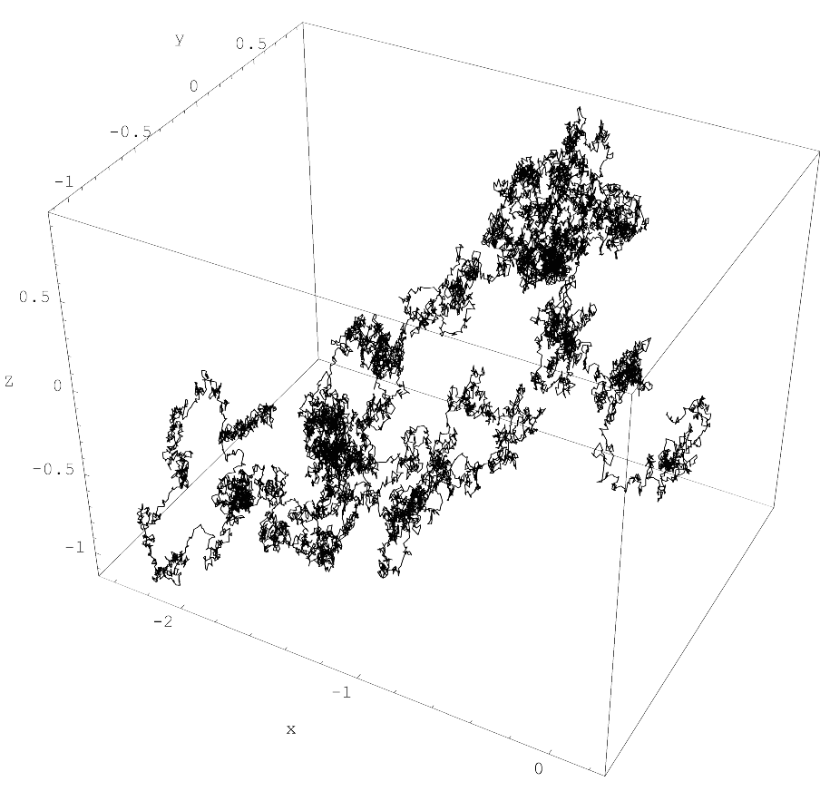
the Gaussian case
$f :ℝ^{n}→ℝ_{+}$ and $𝔼\left[f\right]=∫fdγ_{n}=1$ (gaussian measure)
Let $\left\{B_{t}\right\}$ be an $n$-dimensional Brownian motion with $B_{t}=0$.

Slide 9
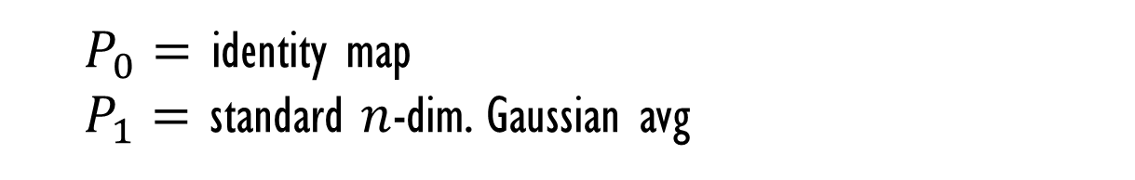

the Gaussian case
$f :ℝ^{n}→ℝ_{+}$ and $𝔼\left[f\right]=∫fdγ_{n}=1$ (gaussian measure)
Let $\left\{B_{t}\right\}$ be an $n$-dimensional Brownian motion with $B_{0}=0$.
Brownian semi-group: $P_{t}f\left(x\right)=𝔼[f\left(x+B_{t}\right)]$
$P_{0}=$ identity map
$P_{1}=$ standard $n$-dim. Gaussian avg

Slide 10

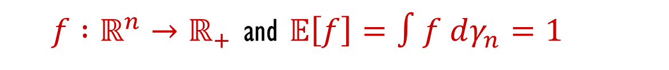
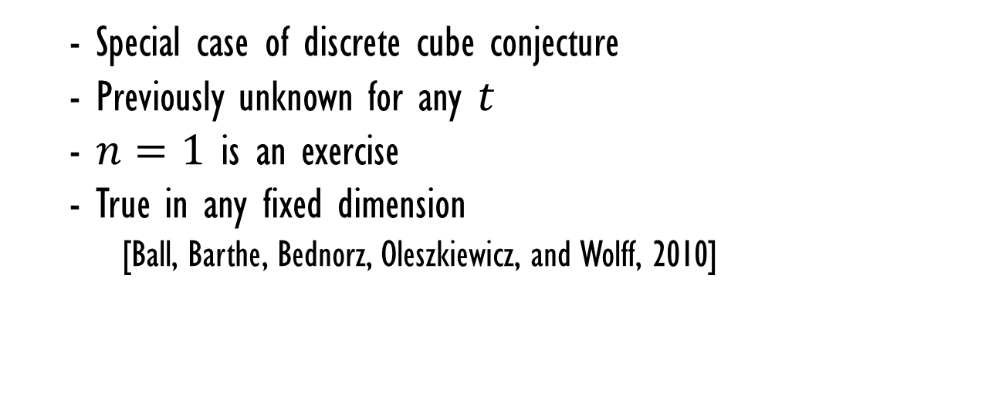
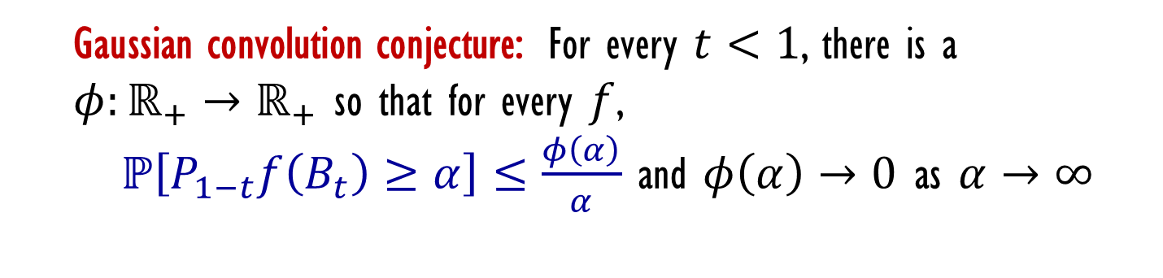
the Gaussian case
$f :ℝ^{n}→ℝ_{+}$ and $𝔼\left[f\right]=∫f dγ_{n}=1$
Brownian semi-group: $P_{t}f\left(x\right)=𝔼[f\left(x+B_{t}\right)]$
Gaussian convolution conjecture: For every $t<1$, there is a
$φ:ℝ_{+}→ℝ_{+}$ so that for every $f$,
$ℙ\left[P_{1−t}f\left(B_{t}\right)≥α\right]≤\frac{φ\left(α\right)}{α}$ and $φ\left(α\right)→0$ as $α→∞$
- Special case of discrete cube conjecture
- Previously unknown for any $t$
- $n=1$ is an exercise
- True in any fixed dimension
[Ball, Barthe, Bednorz, Oleszkiewicz, and Wolff, 2010]

Slide 11
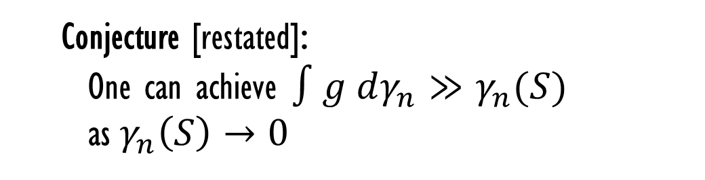






isoperimetric (dual) version
Fix $t>0$ and consider a subset $S⊆ℝ^{n}$.
Consider $g :ℝ^{n}→ℝ_{+}$ supported on $S$
such that ${\left\|U_{t}g\right\|}_{∞}≤1$.
Goal: Maximize $∫g dγ_{n}$ subject to these constraints.
$g=1_{S}$ gets $∫g dγ_{n}=γ_{n}(S)$
Conjecture [restated]:
One can achieve $∫g dγ_{n}≫γ_{n}(S)$
as$γ_{n}\left(S\right)→0$
$$S ⊆ℝ^{n}$$

Slide 12
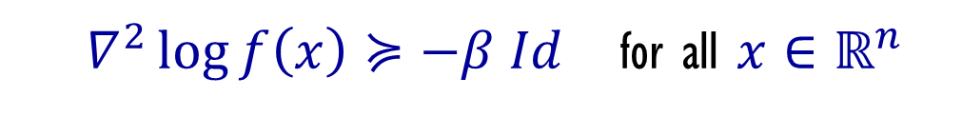

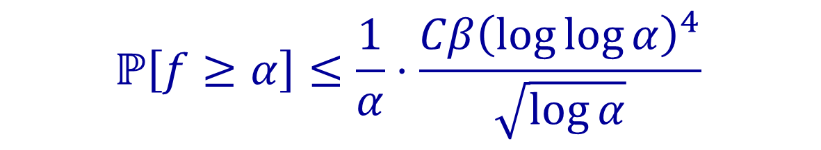
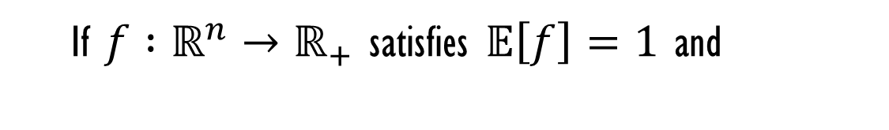
the Gaussian case
Theorem [Eldan-L 2014]:
If $f :ℝ^{n}→ℝ_{+}$ satisfies $𝔼\left[f\right]=1$ and
$∇^{2}\log{f\left(x\right)}≽−β Id$ for all $x∈ℝ^{n}$
then for all $α≥2$:
$$ℙ\left[f≥α\right]≤\frac{1}{α}⋅\frac{Cβ{\left(\log{\log{α}}\right)}^{4}}{\sqrt{\log{α}}}$$

Slide 13


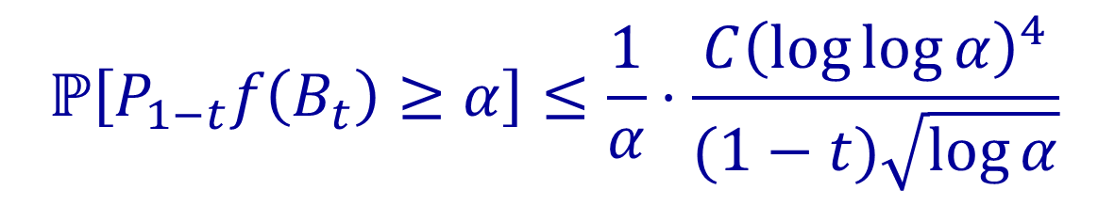
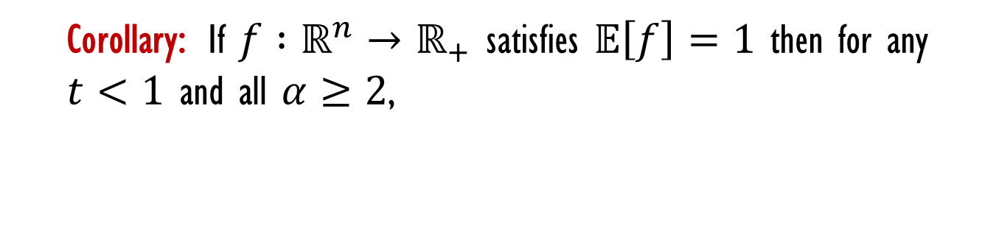
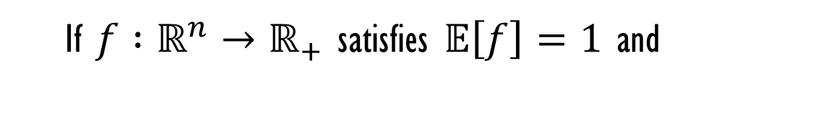
the Gaussian case
Theorem [Eldan-L 2014]:
If $f :ℝ^{n}→ℝ_{+}$ satisfies $𝔼\left[f\right]=1$ and
$∇^{2}\log{f\left(x\right)}≽−β Id$ for all $x∈ℝ^{n}$
then for all $α≥8$:
$$ℙ\left[f≥α\right]≤\frac{1}{α}⋅\frac{Cβ{\left(\log{\log{α}}\right)}^{4}}{\sqrt{\log{α}}}$$
Corollary: If $f :ℝ^{n}→ℝ_{+}$ satisfies $𝔼\left[f\right]=1$ then for any $t<1$ and all $α≥2$,
$$ℙ\left[P_{1−t}f\left(B_{t}\right)≥α\right]≤\frac{1}{α}⋅\frac{C{\left(\log{\log{α}}\right)}^{4}}{(1−t)\sqrt{\log{α}}}$$

Slide 14
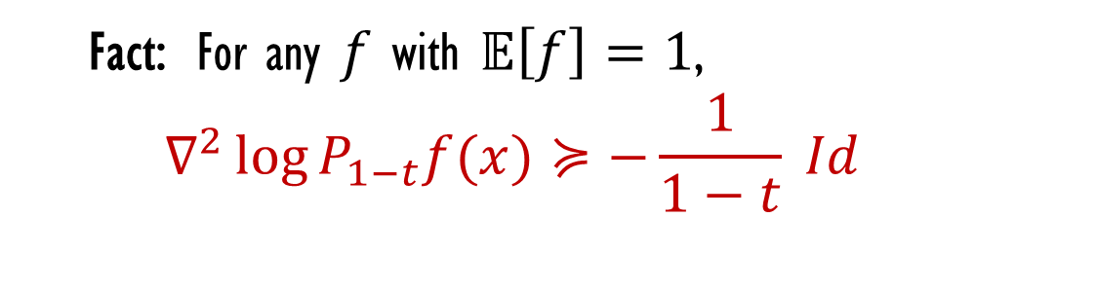
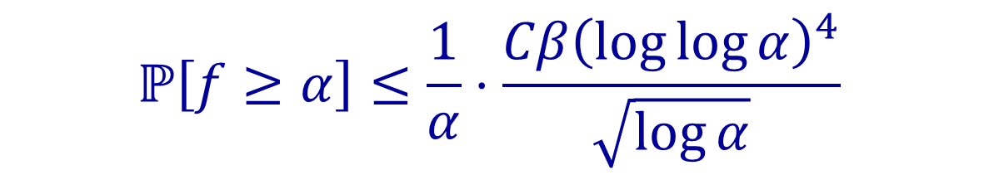
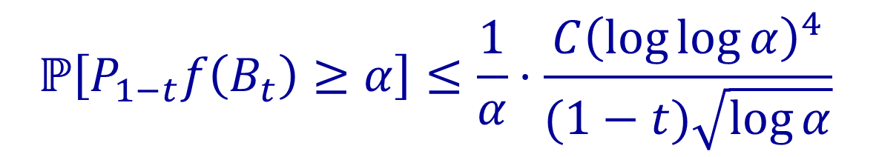
the Gaussian case
Theorem [Eldan-L 2014]:
If $f :ℝ^{n}→ℝ_{+}$ satisfies $𝔼\left[f\right]=1$ and
$∇^{2}\log{f\left(x\right)}≽−β Id$ for all $x∈ℝ^{n}$
then for all $α≥2$:
Fact: For any $f$ with $𝔼\left[f\right]=1$,
$$∇^{2}\log{P_{1−t}f(x)}≽−\frac{1}{1−t} Id$$
$$ℙ\left[f≥α\right]≤\frac{1}{α}⋅\frac{Cβ{\left(\log{\log{α}}\right)}^{4}}{\sqrt{\log{α}}}$$
Corollary: If $f :ℝ^{n}→ℝ_{+}$ satisfies $𝔼\left[f\right]=1$ then for any $t<1$ and all $α≥2$,
$$ℙ\left[P_{1−t}f\left(B_{t}\right)≥α\right]≤\frac{1}{α}⋅\frac{C{\left(\log{\log{α}}\right)}^{4}}{(1−t)\sqrt{\log{α}}}$$

Slide 15

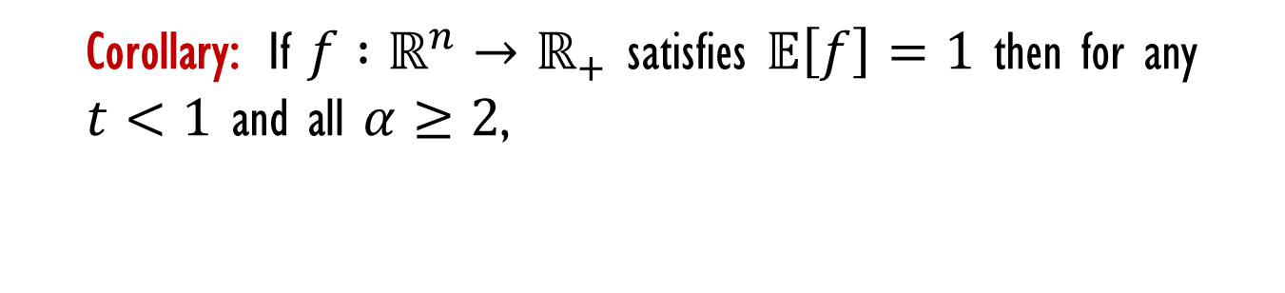

some difficulties
Corollary: If $f :ℝ^{n}→ℝ_{+}$ satisfies $𝔼\left[f\right]=1$ then for any $t<1$ and all $α≥2$,
$ℙ\left[P_{1−t}f\left(B_{t}\right)≥α\right]≤\frac{1}{α}⋅\frac{C(t){\left(\log{\log{α}}\right)}^{4}}{\sqrt{\log{α}}}$
What are the difficult functions $f$?
Good:
noise insensitive
Bad:
boundary far from origin
half space
dust

Slide 16


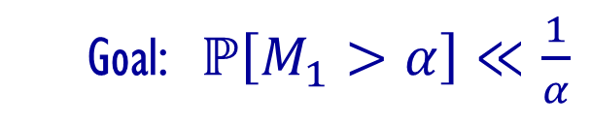


proof ideas
$$𝔼\left[f\right]=1, ∇^{2}\log{f\left(x\right)}≽−β Id$$
$M_{t}=P_{1−t}f\left(B_{t}\right)$ is a (Doob) martingale
$$M_{0}=𝔼\left[f\right]=1$$
$$M_{1}=f\left(B_{1}\right)$$
Goal: $ℙ\left[M_{1}>α\right]≪\frac{1}{α}$
arguing about small-probability events $=$ annoying
random measure

Slide 17
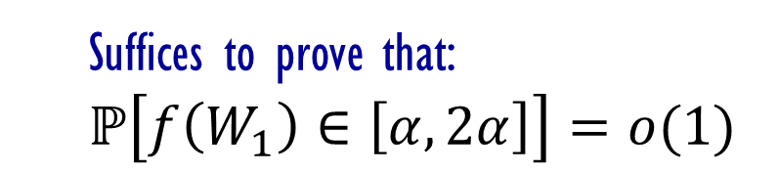

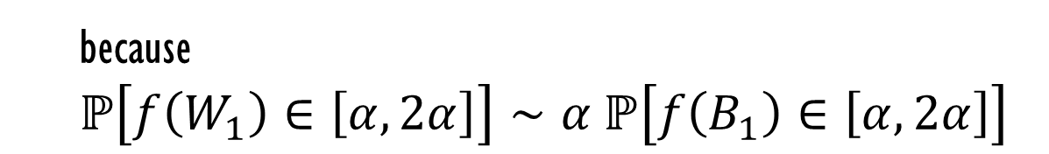
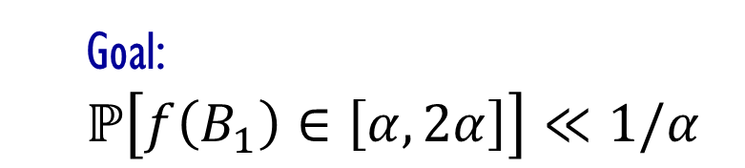
conditioning
$W_{t}=B_{t}$ conditioned on $B_{1}∼fdγ_{n}$
Goal:
$$ℙ\left[f\left(B_{1}\right)∈\left[α,2α\right]\right]≪1/α$$
Suffices to prove that:
$$ℙ\left[f\left(W_{1}\right)∈\left[α,2α\right]\right]=o(1)$$
because
$$ℙ\left[f\left(W_{1}\right)∈\left[α,2α\right]\right]∼α ℙ\left[f\left(B_{1}\right)∈\left[α,2α\right]\right]$$

Slide 18

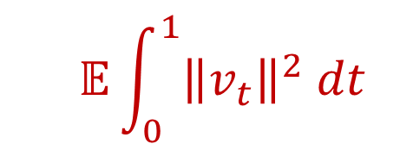

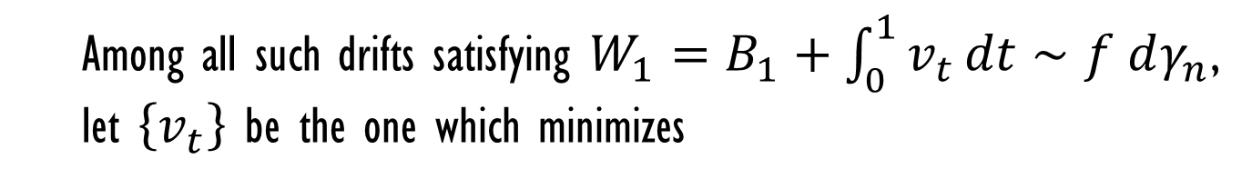
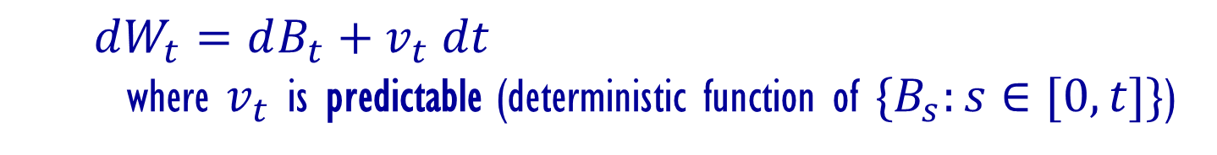
$W_{t}$ as an Itô process: Föllmer’s drift
Consider a process $\left\{W_{t}\right\}$ with $W_{0}=0$, and
$dW_{t}=dB_{t}+v_{t} dt$
where $v_{t}$ is predictable (deterministic function of ${\{B}_{s}:s∈[0,t]\}$)
Integrating: $W_{t}=B_{t}+\int_{0}^{t}{v_{s} ds}$ = Brownian motion $+$ drift
Among all such drifts satisfying $W_{1}=B_{1}+\int_{0}^{1}{v_{t}}dt∼f dγ_{n}$,
let $\left\{v_{t}\right\}$ be the one which minimizes
$$𝔼\int_{0}^{1}{{\left\|v_{t}\right\|}^{2} dt}$$

Slide 19
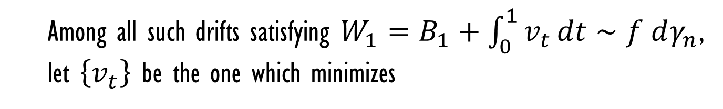

$W_{t}$ as an Itô process: Föllmer’s drift
Among all such drifts satisfying $W_{1}=B_{1}+\int_{0}^{1}{v_{t}}dt∼f dγ_{n}$,
let $\left\{v_{t}\right\}$ be the one which minimizes
$$𝔼\int_{0}^{1}{{\left\|v_{t}\right\|}^{2} dt}$$

Slide 20




$W_{t}$ as an Itô process: Föllmer’s drift
Among all such drifts satisfying $W_{1}=B_{1}+\int_{0}^{1}{v_{t}}dt∼f dγ_{n}$,
let $\left\{v_{t}\right\}$ be the one which minimizes
$$𝔼\int_{0}^{1}{{\left\|v_{t}\right\|}^{2} dt}$$
$$W_{t}$$
Lemma: $\left\{v_{t}\right\}$ is martingale.
$v_{t}=∇\log{P_{1−t}f\left(W_{t}\right)}=\frac{∇P_{1−t}f\left(W_{t}\right)}{P_{1−t}f\left(W_{t}\right)}$
Explicit form:
$$Ent(f) =\frac{1}{2}𝔼\int_{0}^{1}{{\left\|v_{t}\right\|}^{2} dt}$$
Theorem [Lehec 2010]:

Slide 21
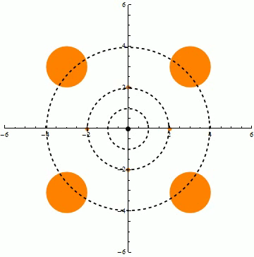
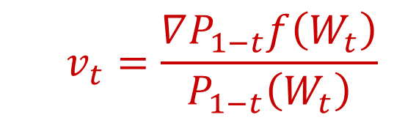
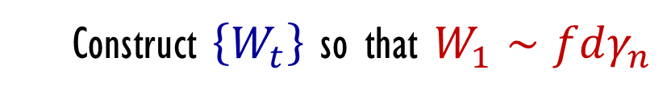
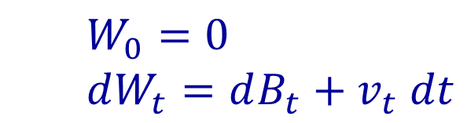
an optimal coupling
$\{B_{t}\}$ $n$-dim Brownian motion, $f :ℝ^{n}→ℝ_{+}$ with $𝔼f=1$
Construct $\left\{W_{t}\right\}$ so that $W_{1}∼fdγ_{n}$
$W_{0}=0$
$dW_{t}=dB_{t}+v_{t} dt$
$$v_{t}=\frac{∇P_{1−t}f\left(W_{t}\right)}{P_{1−t}\left(W_{t}\right)}$$
is a martingale

Slide 22
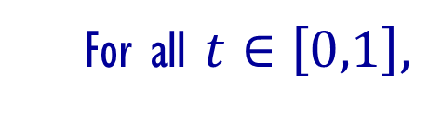
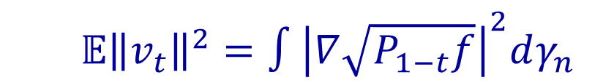
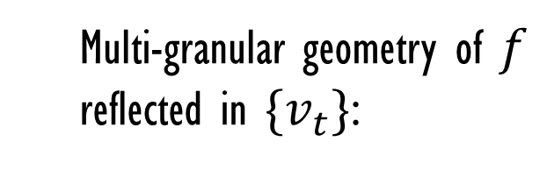
an optimal coupling
$\{B_{t}\}$ $n$-dim Brownian motion, $f :ℝ^{n}→ℝ_{+}$ with $𝔼f=1$
Construct $\left\{W_{t}\right\}$ so that $W_{1}∼fdγ_{n}$
$W_{0}=0$
$dW_{t}=dB_{t}+v_{t} dt$
Multi-granular geometry of $f$
reflected in $\{v_{t}\}$:
$$v_{t}=\frac{∇P_{1−t}f\left(W_{t}\right)}{P_{1−t}\left(W_{t}\right)}$$
For all $t∈\left[0,1\right],$
$𝔼{\left\|v_{t}\right\|}^{2}=∫{\left|∇\sqrt{P_{1−t}f}\right|}^{2}dγ_{n}$
is a martingale

Slide 23
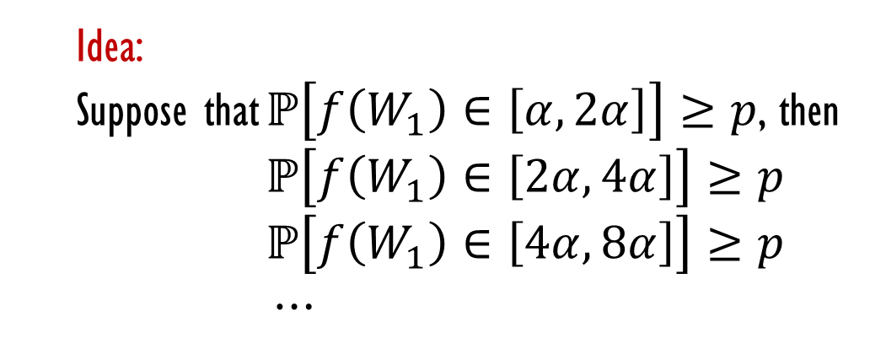


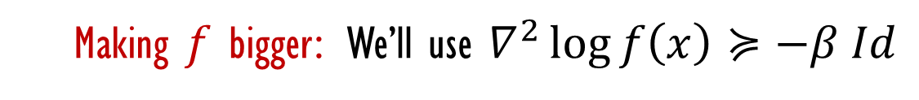
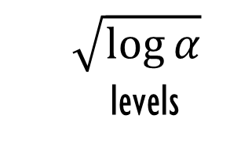
proof sketch
Suffices to prove that:
$$ℙ\left[f\left(W_{1}\right)∈\left[α,2α\right]\right]=o(1)$$
Idea:
Suppose that $ℙ\left[f\left(W_{1}\right)∈\left[α,2α\right]\right]≥p$, then
$ℙ\left[f\left(W_{1}\right)∈\left[2α,4α\right]\right]≥p$
$ℙ\left[f\left(W_{1}\right)∈\left[4α,8α\right]\right]≥p$
$⋯$
$$\sqrt{\log{α}}$$
levels
Making $f$ bigger: We’ll use $∇^{2}\log{f\left(x\right)}≽−β Id$
$$\log{f\left(W_{1}+u\right)≥\log{f\left(W_{1}\right)}+〈u,∇\log{f\left(W_{1}\right)}〉}$$
$−β{\left|u\right|}^{2}$
$$={\log{f\left(W_{1}\right)}+〈u,v_{1}〉} −β{\left|u\right|}^{2}$$

Slide 24

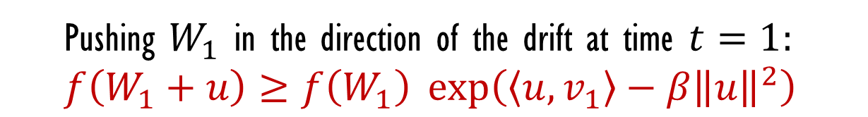

proof sketch
Pushing $W_{1}$ in the direction of the drift at time $t=1:$
$$f\left(W_{1}+u\right)≥f\left(W_{1}\right)\exp\left(〈u,v_{1}〉−β{\left\|u\right\|}^{2}\right)$$
Setting $u=δv_{1}$ ($δ$ small) multiplies the value of $f$.
want to say that $W_{1}$ could do it

Slide 25

Girsanov’s theorem
Consider any Itô process $dX_{t}=dB_{t}+v_{t} dt$ *under suitable conditions
Let $P$ be the BM measure of $B_{t}$ and $Q$ be the BM measure of $X_{t}$.
Then under the change of measure:
$$\frac{dQ}{dP}=\exp\left(−\int_{0}^{1}{〈v_{t}, dB_{t}〉} −\int_{0}^{1}{{\left|v_{t}\right|}^{2} dt}\right)$$
{$X_{t} :t∈[0,1]\}$ has the law of Brownian motion.

Slide 26






the masochistic part
$dW_{t}=dB_{t}+v_{t} dt$
$$v_{t}=∇\log{P_{1−t}f\left(W_{t}\right)}$$
$dX_{t}^{δ}=dB_{t}+{\left(1+δ\right)v}_{t} dt$
Now we can argue that $W_{t}≈X_{t}^{δ}$ (Girsanov’s theorem).
What about $f\left(X_{1}^{δ}\right)≫f\left(W_{1}\right)$ ?
Note that $X_{1}^{δ}=W_{1}+δ\int_{0}^{1}{v_{t} dt}$, and recall
$$f\left(W_{1}+u\right)≥f\left(W_{1}\right)\exp\left(〈u,v_{1}〉−o(1)\right)$$
Big question:
Does $\int_{0}^{1}{v_{t} dt}$ point in the direction of the gradient $v_{1}$?

Slide 27

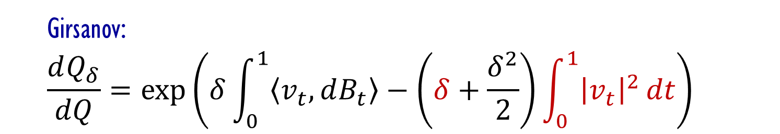
the calculations and concentration
$dW_{t}=dB_{t}+v_{t} dt$
$$v_{t}=∇\log{P_{1−t}f\left(W_{t}\right)}$$
$dX_{t}^{δ}=dB_{t}+{\left(1+δ\right)v}_{t} dt$
Let $Q$ be the BM law of $W_{1}$ and $Q_{δ}$ the BM law of $X_{1}^{δ}$.
Girsanov:
$$\frac{dQ_{δ}}{dQ}=\exp\left(δ\int_{0}^{1}{〈v_{t}, dB_{t}〉}−\left(δ+\frac{δ^{2}}{2}\right)\int_{0}^{1}{{\left|v_{t}\right|}^{2}}dt\right)$$
Gradient estimate:
$$f\left(X_{1}^{δ}\right)≥f\left(W_{1}\right)\exp\left(〈δ\int_{0}^{1}{v_{t}}dt,v_{1}〉\right)$$

Slide 28

the calculations and concentration
Since $\left\{v_{t}\right\}$ is a martingale $𝔼\left[v_{1} ∣ B_{t}\right]= 𝔼\left[v_{t} ∣ B_{t}\right]$, so
$$𝔼\left[〈δ\int_{0}^{1}{v_{t}dt, v_{1}}〉\right]=δ 𝔼\int_{0}^{1}{{\left|v_{t}\right|}^{2}} dt$$
Girsanov:
$$\frac{dQ_{δ}}{dQ}=\exp\left(δ\int_{0}^{1}{〈v_{t}, dB_{t}〉}−\left(δ+\frac{δ^{2}}{2}\right)\int_{0}^{1}{{\left|v_{t}\right|}^{2}}dt\right)$$
Gradient estimate:
$$f\left(X_{1}^{δ}\right)≥f\left(W_{1}\right)\exp\left(〈δ\int_{0}^{1}{v_{t}}dt,v_{1}〉\right)$$

Slide 29

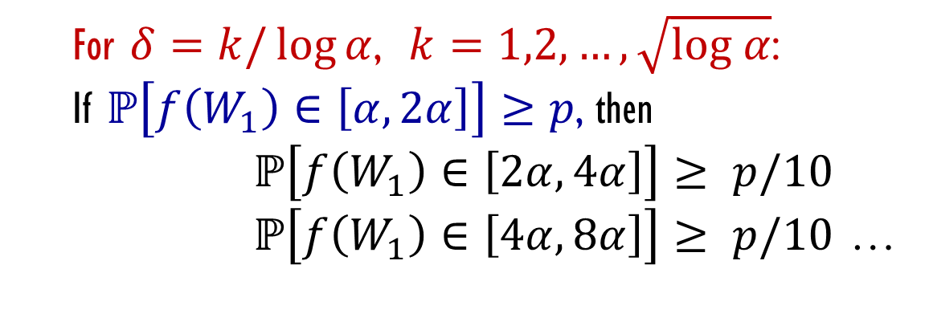
the calculations and concentration
For $δ=k/\log{α}$, $k=1,2,…,\sqrt{log α}$:
If $ℙ\left[f\left(W_{1}\right)∈\left[α,2α\right]\right]≥p$, then
$ℙ\left[f\left(W_{1}\right)∈\left[2α,4α\right]\right]≥ p/10$
$ℙ\left[f\left(W_{1}\right)∈\left[4α,8α\right]\right]≥ p/10$ …
Girsanov:
$$\frac{dQ_{δ}}{dQ}=\exp\left(δ\int_{0}^{1}{〈v_{t}, dB_{t}〉}−\left(δ+\frac{δ^{2}}{2}\right)\int_{0}^{1}{{\left|v_{t}\right|}^{2}}dt\right)$$
Gradient estimate:
$$f\left(X_{1}^{δ}\right)≥f\left(W_{1}\right)\exp\left(〈δ\int_{0}^{1}{v_{t}}dt,v_{1}〉\right)$$

Slide 30



conclusion
Process for ${\left\{−1,1\right\}}^{n}$ analogous to $W_{t}$: Sample coordiantes
one by one to have the right marginals conditioned on the past.
Can prove log-Sobolev and Talagrand’s Entropy-Transport inequality
in a few lines based on this. There is an information theory interpretation: Chain rule $↔$ Martingale property.
These proofs use first derivatives of $f$, while our proof of the
convolution conjecture in Gaussian spaces use second derivatives.
Prove for the discrete case? There is a difficulty because the drift
requires additional randomness.
Riemannian setting: Bakry-Emery curvature, gradient flow vs. optimal transport

Slide 31


Kumar-Courtade conjecture
$X∈{\left\{0,1\right\}}^{n}$uniformly at random
$$Y∼_{ε} X$$
Conjecture: $I(f\left(X\right) :Y)$ maximized among functions
$f:{\left\{0,1\right\}}^{n}→\left\{0,1\right\}$
by $f\left(X\right)=X_{1}$

