Slide 1
The mystery of over-parameterization in neural networks
Behnam Neyshabur
Institute for Advanced Study

Slide 2






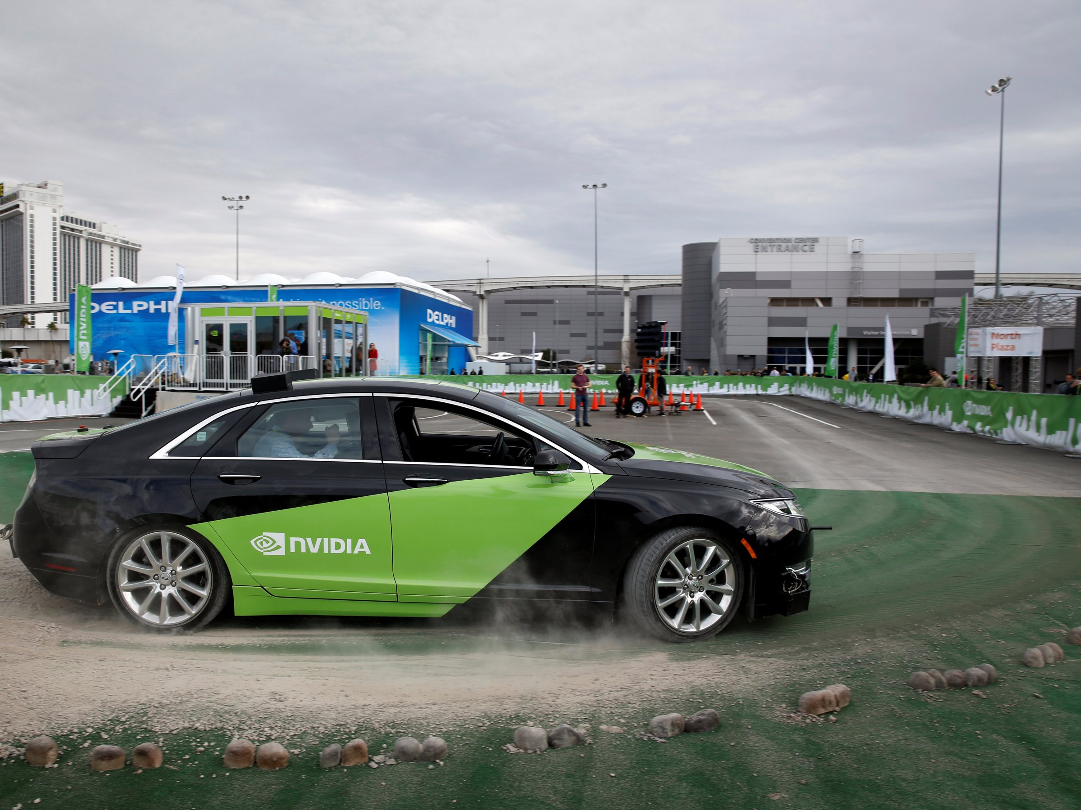
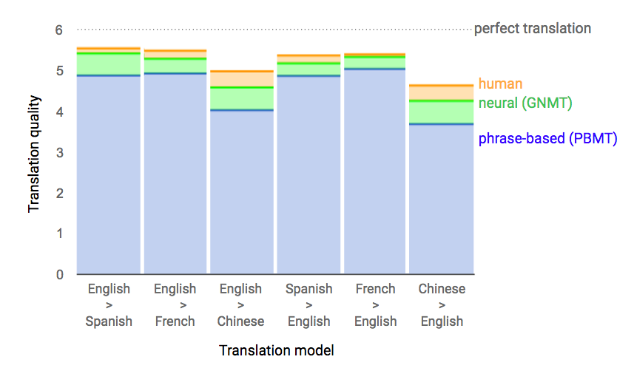


AI$≈$Deep Learning$≈$Neural Networks

Slide 3
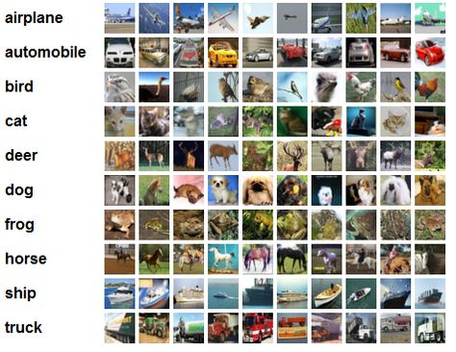

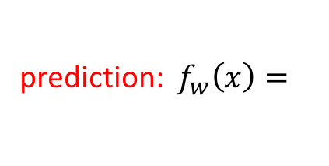
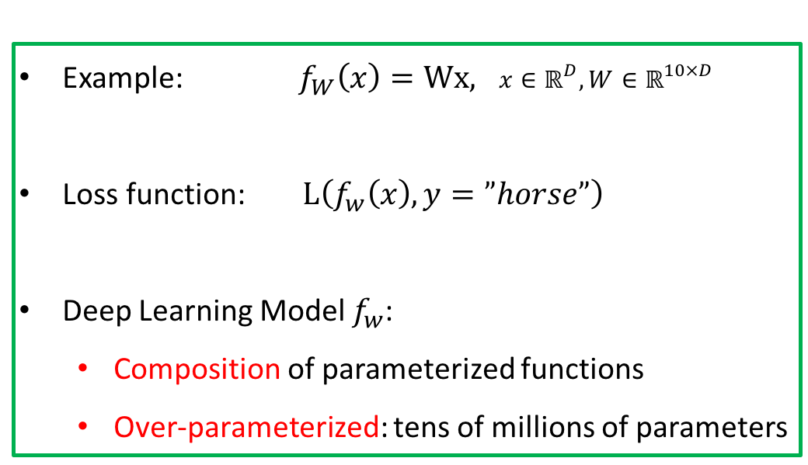


Classification
airplane | car | bird | cat | deer | dog | frog | horse | ship | truck
( , | , | , | , | , | , | , | , | , | )
prediction: $f_{w}\left(x\right)=$
0.01 | 0.01 | 0.01 | 0.03 | 0.2 | 0.1 | 0.02 | 0.6 | 0.01 | 0.01
Example: $f_{W}\left(x\right)=Wx, x∈ℝ^{D},W∈ℝ^{10×D}$
Loss function: $L\left(f_{w}\left(x\right),y=”horse”\right)$
Deep Learning Model $f_{w}$:
  Composition of parameterized functions
  Over-parameterized: tens of millions of parameters
$$f_{w}$$
Input: $x=$

Slide 4













2-layer Feedforward Network
Input
hidden units
Prediction
$$x[1]$$
$$v[i,k]$$
$$u[k,j]$$
$$U{\left[Vx\right]}_{+}$$
$$f\left(x\right)=U{\left[Vx\right]}_{+}$$
$${\left[Vx\right]}_{+}$$
$$Vx$$
$$x[2]$$
$$x$$
$$x[3]$$
$$⋯$$
activation ${\left[z\right]}_{+}=max\{0,z\}$
$$x[D]$$

Slide 5
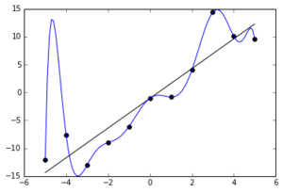
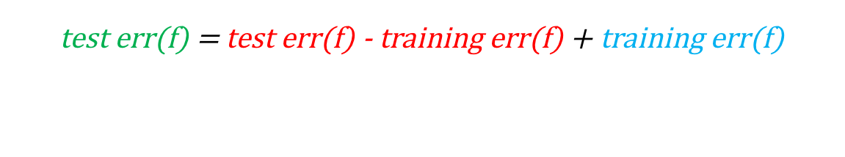

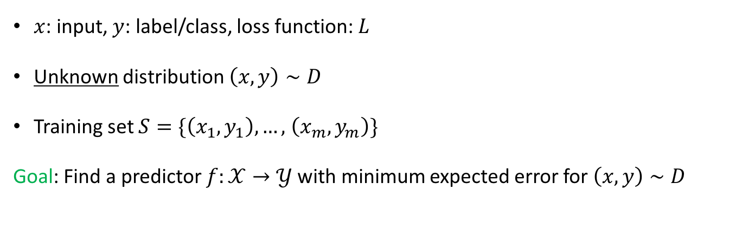
Learning Framework
$x$: input, $y$: label/class, loss function: $L$
Unknown distribution $\left(x,y\right)∼D$
Training set $S=\{\left(x_{1},y_{1}\right),…,$ $\left(x_{m},y_{m}\right)\}$
Goal: Find a predictor $f:𝒳→𝒴$with minimum expected error for $\left(x,y\right)∼D$
test err(f)
test err(f) = test err(f) - training err(f) + training err(f)
generalization error(f)
What we know:
Capacity(#Samples to generalize) $≈$ #parameters
For neural nets, no algorithm can always minimize the training error. ☹
We choose predictor $f$ from the model class F.
  Example: fitting polynomials to a set of points
size of F
generalization error(f)
training err(f)

Slide 6
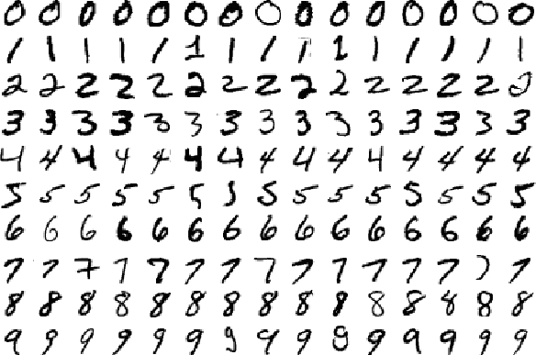
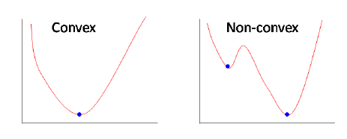
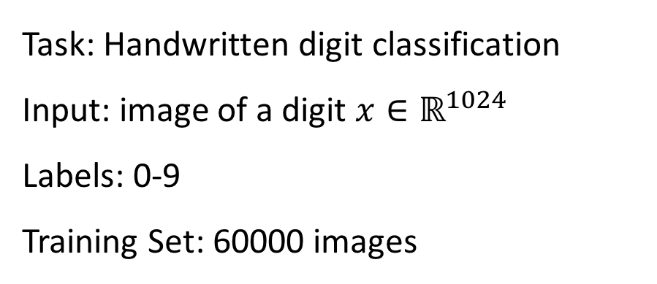
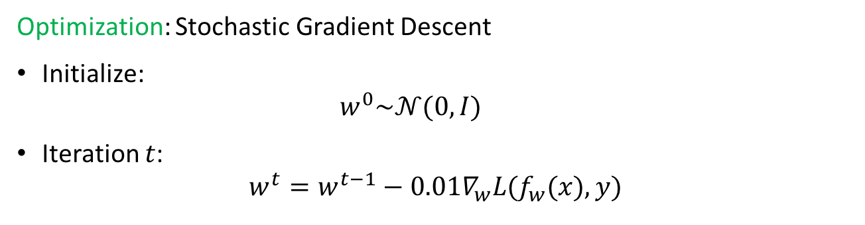
Simple Experiment
Task: Handwritten digit classification
Input: image of a digit $x∈ℝ^{1024}$
Labels: 0-9
Training Set: 60000 images
Optimization: Stochastic Gradient Descent
Initialize:
  $$w^{0}\sim 𝒩(0,I)$$
Iteration $t$:
$w^{t}=w^{t−1}−0.01∇_{w}L(f_{w}(x),y)$
We train networks with different number of hidden units $H$.

Slide 7
Increasing the Network Size
(Number of Hidden Units)
!!
?
What is the magic property of the reality that makes local search work?
[Neyshabur, Tomioka, Srebro. ICLR’15]

Slide 8



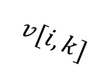







Two Layer Networks with Linear Transfer
(aka Matrix Factorization)
$$x[1]$$
$$v[i,k]$$
$$u[k,j]$$
$$x[2]$$
$$x[3]$$
$$⋯$$
$$f\left(x\right)=UVx$$
$$x[D]$$
$$f(x)=U\left(Vx\right)=Wx$$
$$W=UV$$
$r$ hidden units $⇔$ $rank\left(W\right)≤r$

Slide 9
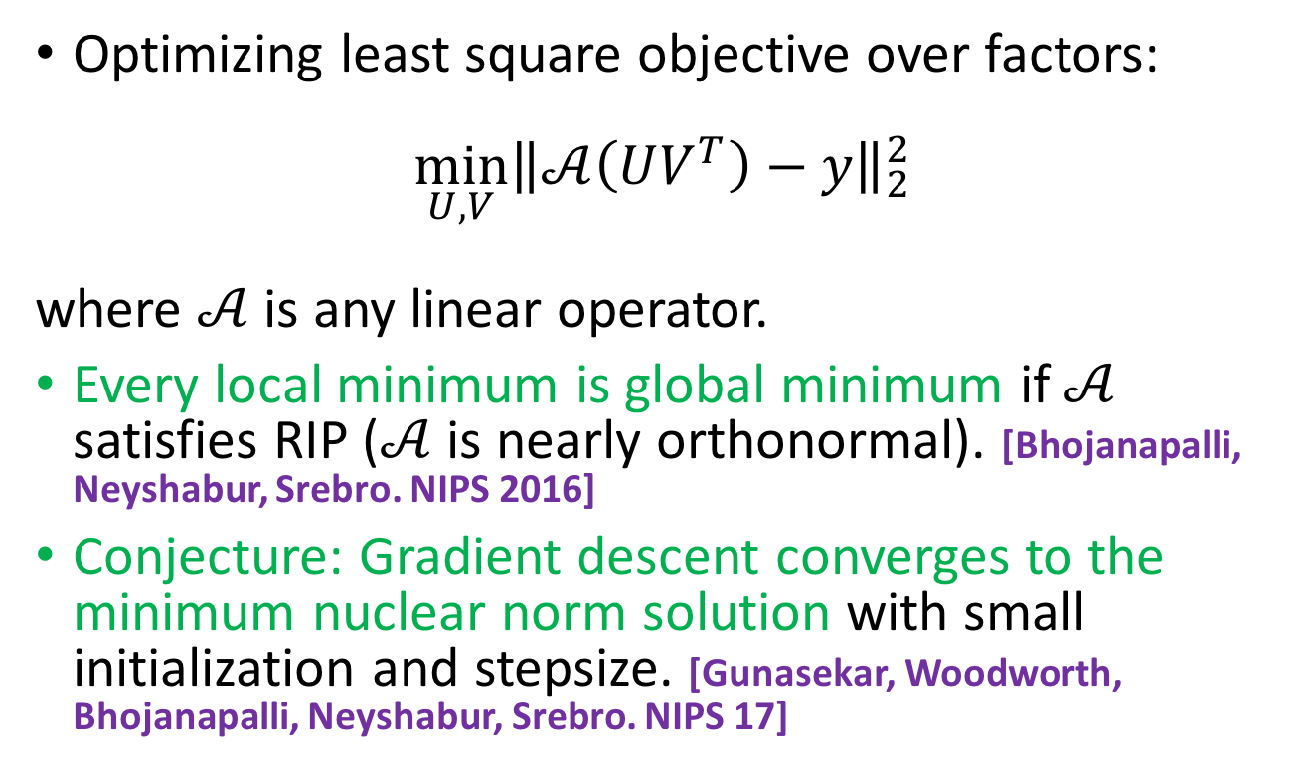
Optimization
Optimizing least square objective over factors:
$$\min_{U,V}{{\left\|𝒜\left(UV^{T}\right)−y\right\|}_{2}^{2}}$$
where $𝒜$ is any linear operator.
Every local minimum is global minimum if $𝒜$ satisfies RIP ($𝒜$ is nearly orthonormal). [Bhojanapalli, Neyshabur, Srebro. NIPS 2016]
Conjecture: Gradient descent converges to the minimum nuclear norm solution with small initialization and stepsize. [Gunasekar, Woodworth, Bhojanapalli, Neyshabur, Srebro. NIPS 17]

Slide 10
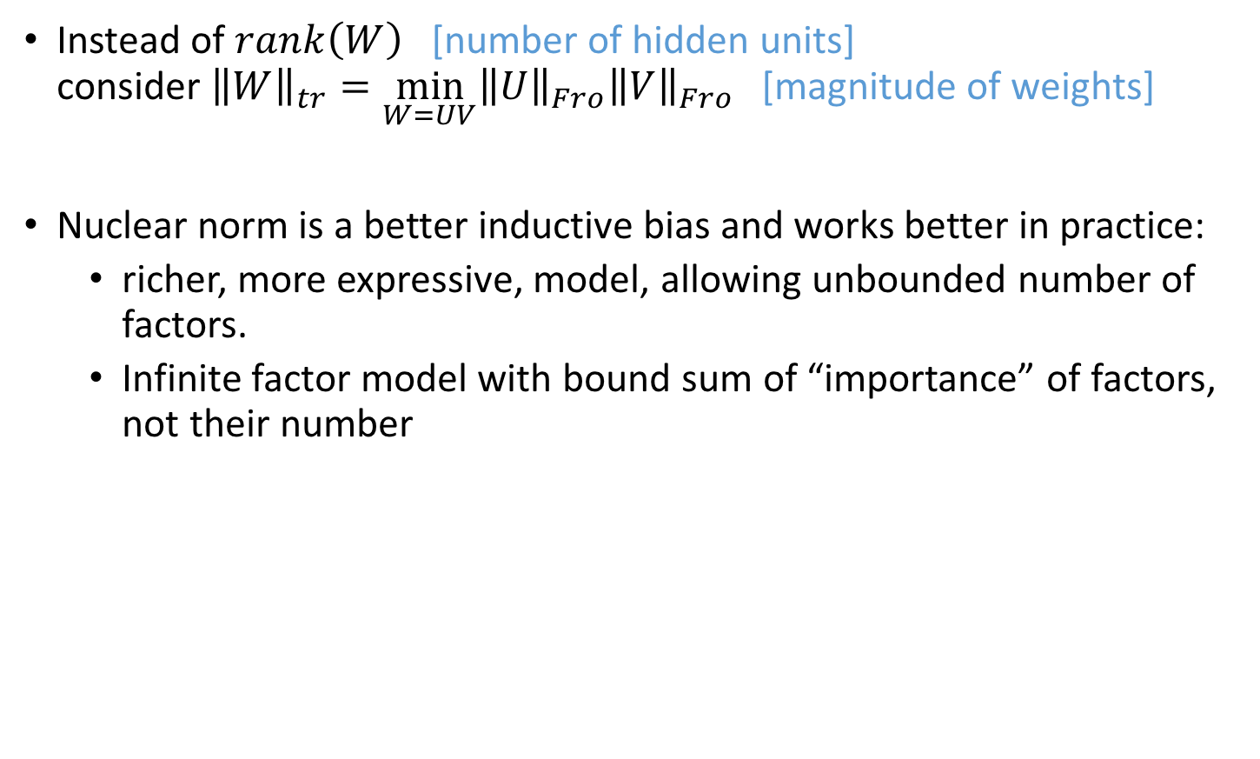
Norm-Bounded Factorization
Instead of $rank\left(W\right)$ [number of hidden units]
consider ${\left\|W\right\|}_{tr}=\min_{W=UV}{{\left\|U\right\|}_{Fro}{\left\|V\right\|}_{Fro}}$ [magnitude of weights]
Nuclear norm is a better inductive bias and works better in practice:
  richer, more expressive, model, allowing unbounded number of factors.
  Infinite factor model with bound sum of “importance” of factors, not their number
Can we bound the capacity of a bounded-norm network with many (possibly infinite) hidden units?

Slide 11

Norm-Based Capacity Control
  Capacity of networks with small norm can be bounded independent of number of hidden units [Neyshabur, Tomioka, Srebro. COLT 15] [Neyshabur, Bhojanapalli, McAllester, Srebro, arXiv 17]
  For two layer networks, capacity is O(${\left\|U\right\|}_{F}^{2}{\left\|V\right\|}_{F}^{2})$
  Experimental evaluation of suggested norm-based generalization bounds. [Neyshabur, Bhojanapalli, McAllester, Srebro, NIPS 17]
250
4%
r
200
3%
o
r
m
r
r
150
E
o
2%
t
N
100
s
e
1%
T
50
0
32
64
256
1K
4K
#Hidden Units

Slide 12
Review: Interesting Problems
Optimization/Geometry: Prove under “reasonable” assumptions on the distribution that every local minimum is a global minimum.
Generalization/Complexity: Find a complexity measure that explains generalization behavior.
  Hint 1: Weights matrices look like random matrices based on several measurements.
  Hint 2: The information is distributed in weights in such a way that no single hidden unit learns a meaningful concept.

Slide 13
Thanks!

