Slide 1
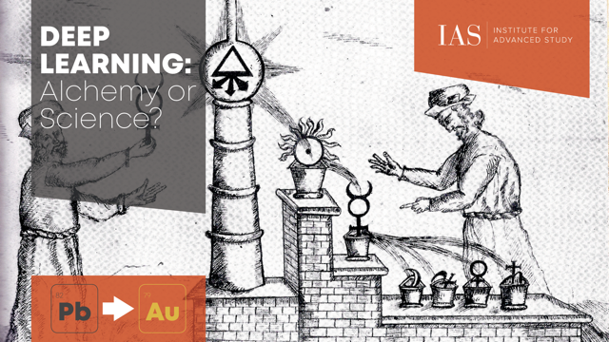

Slide 2
Introduction to deep learning and the “Alchemy” debate
Institute for Advanced Study Feb 22 2019 Deep Learning: Alchemy or Science?
Sanjeev Arora
Institute for Advanced Study
and
Princeton University
(Funding: NSF, Simons Foundation, ONR, Schmidt Foundation, Amazon Research, Mozilla Research)

Slide 3
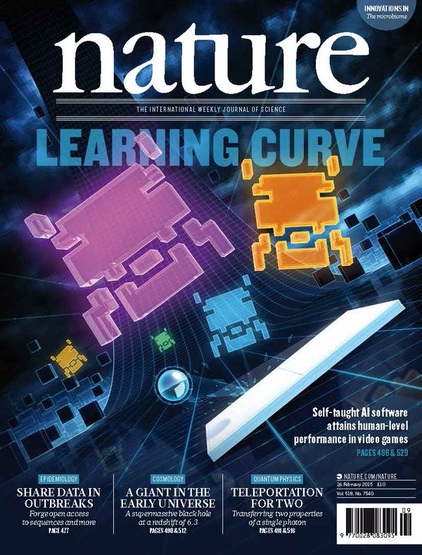
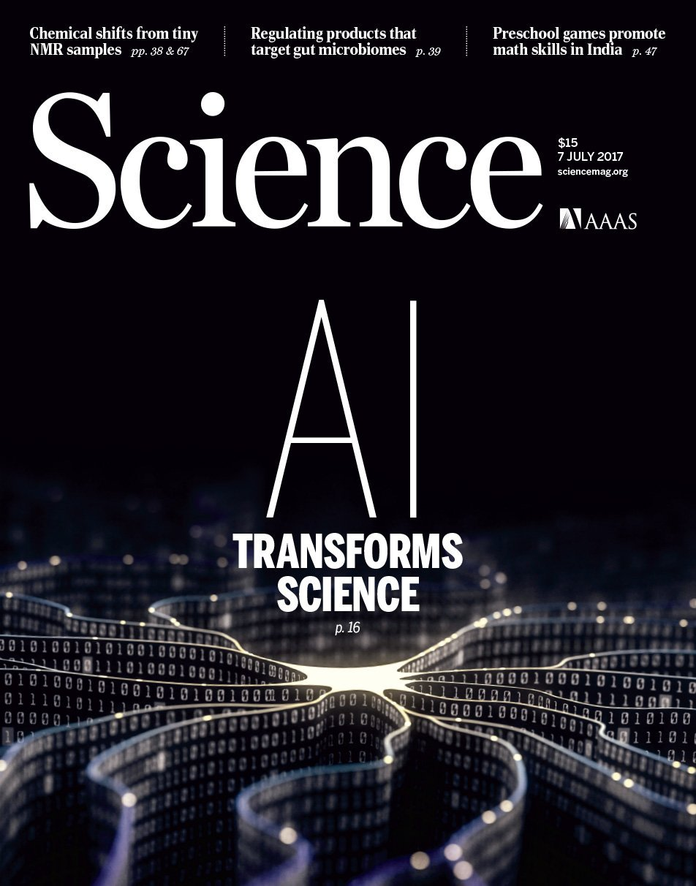
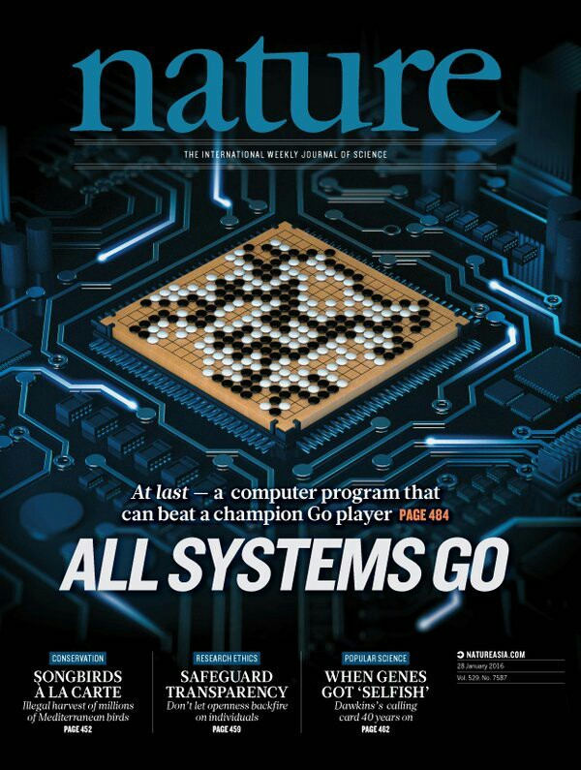
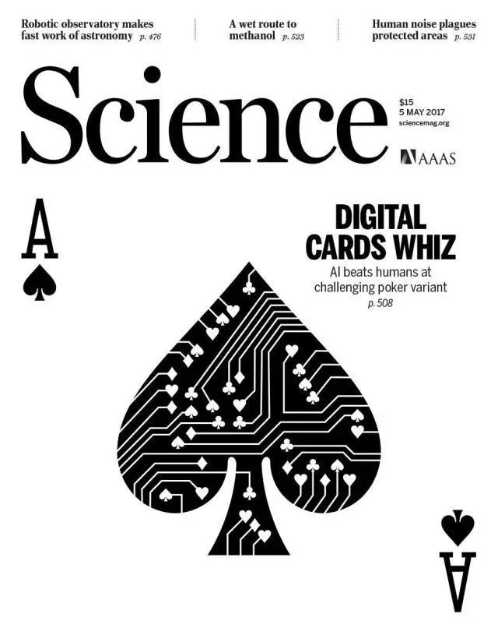
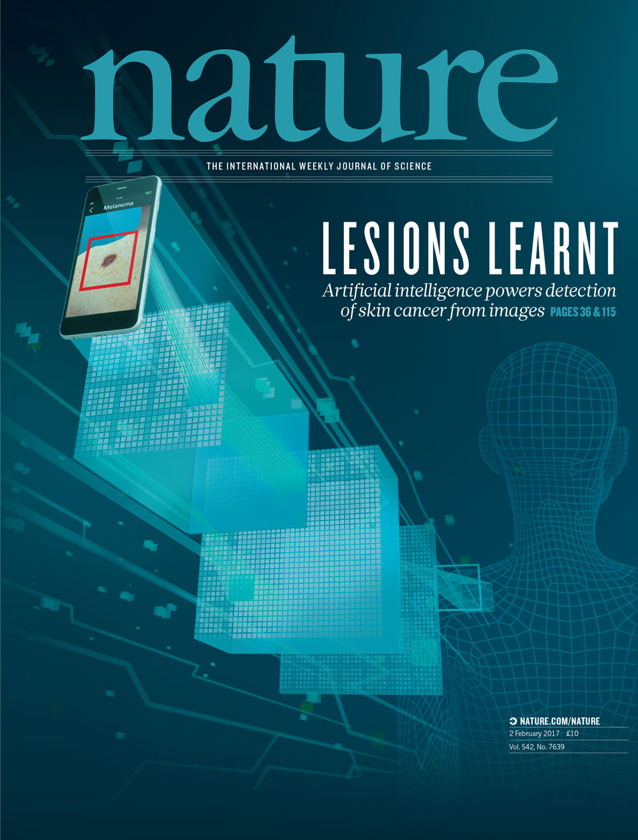
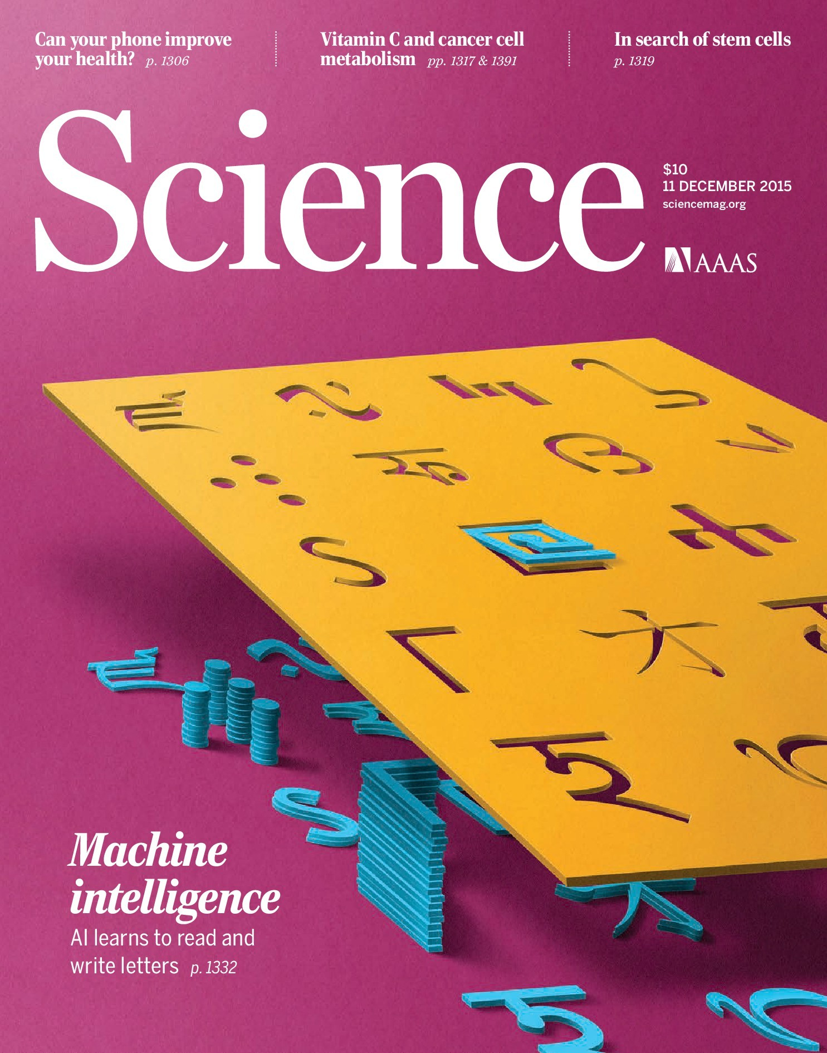
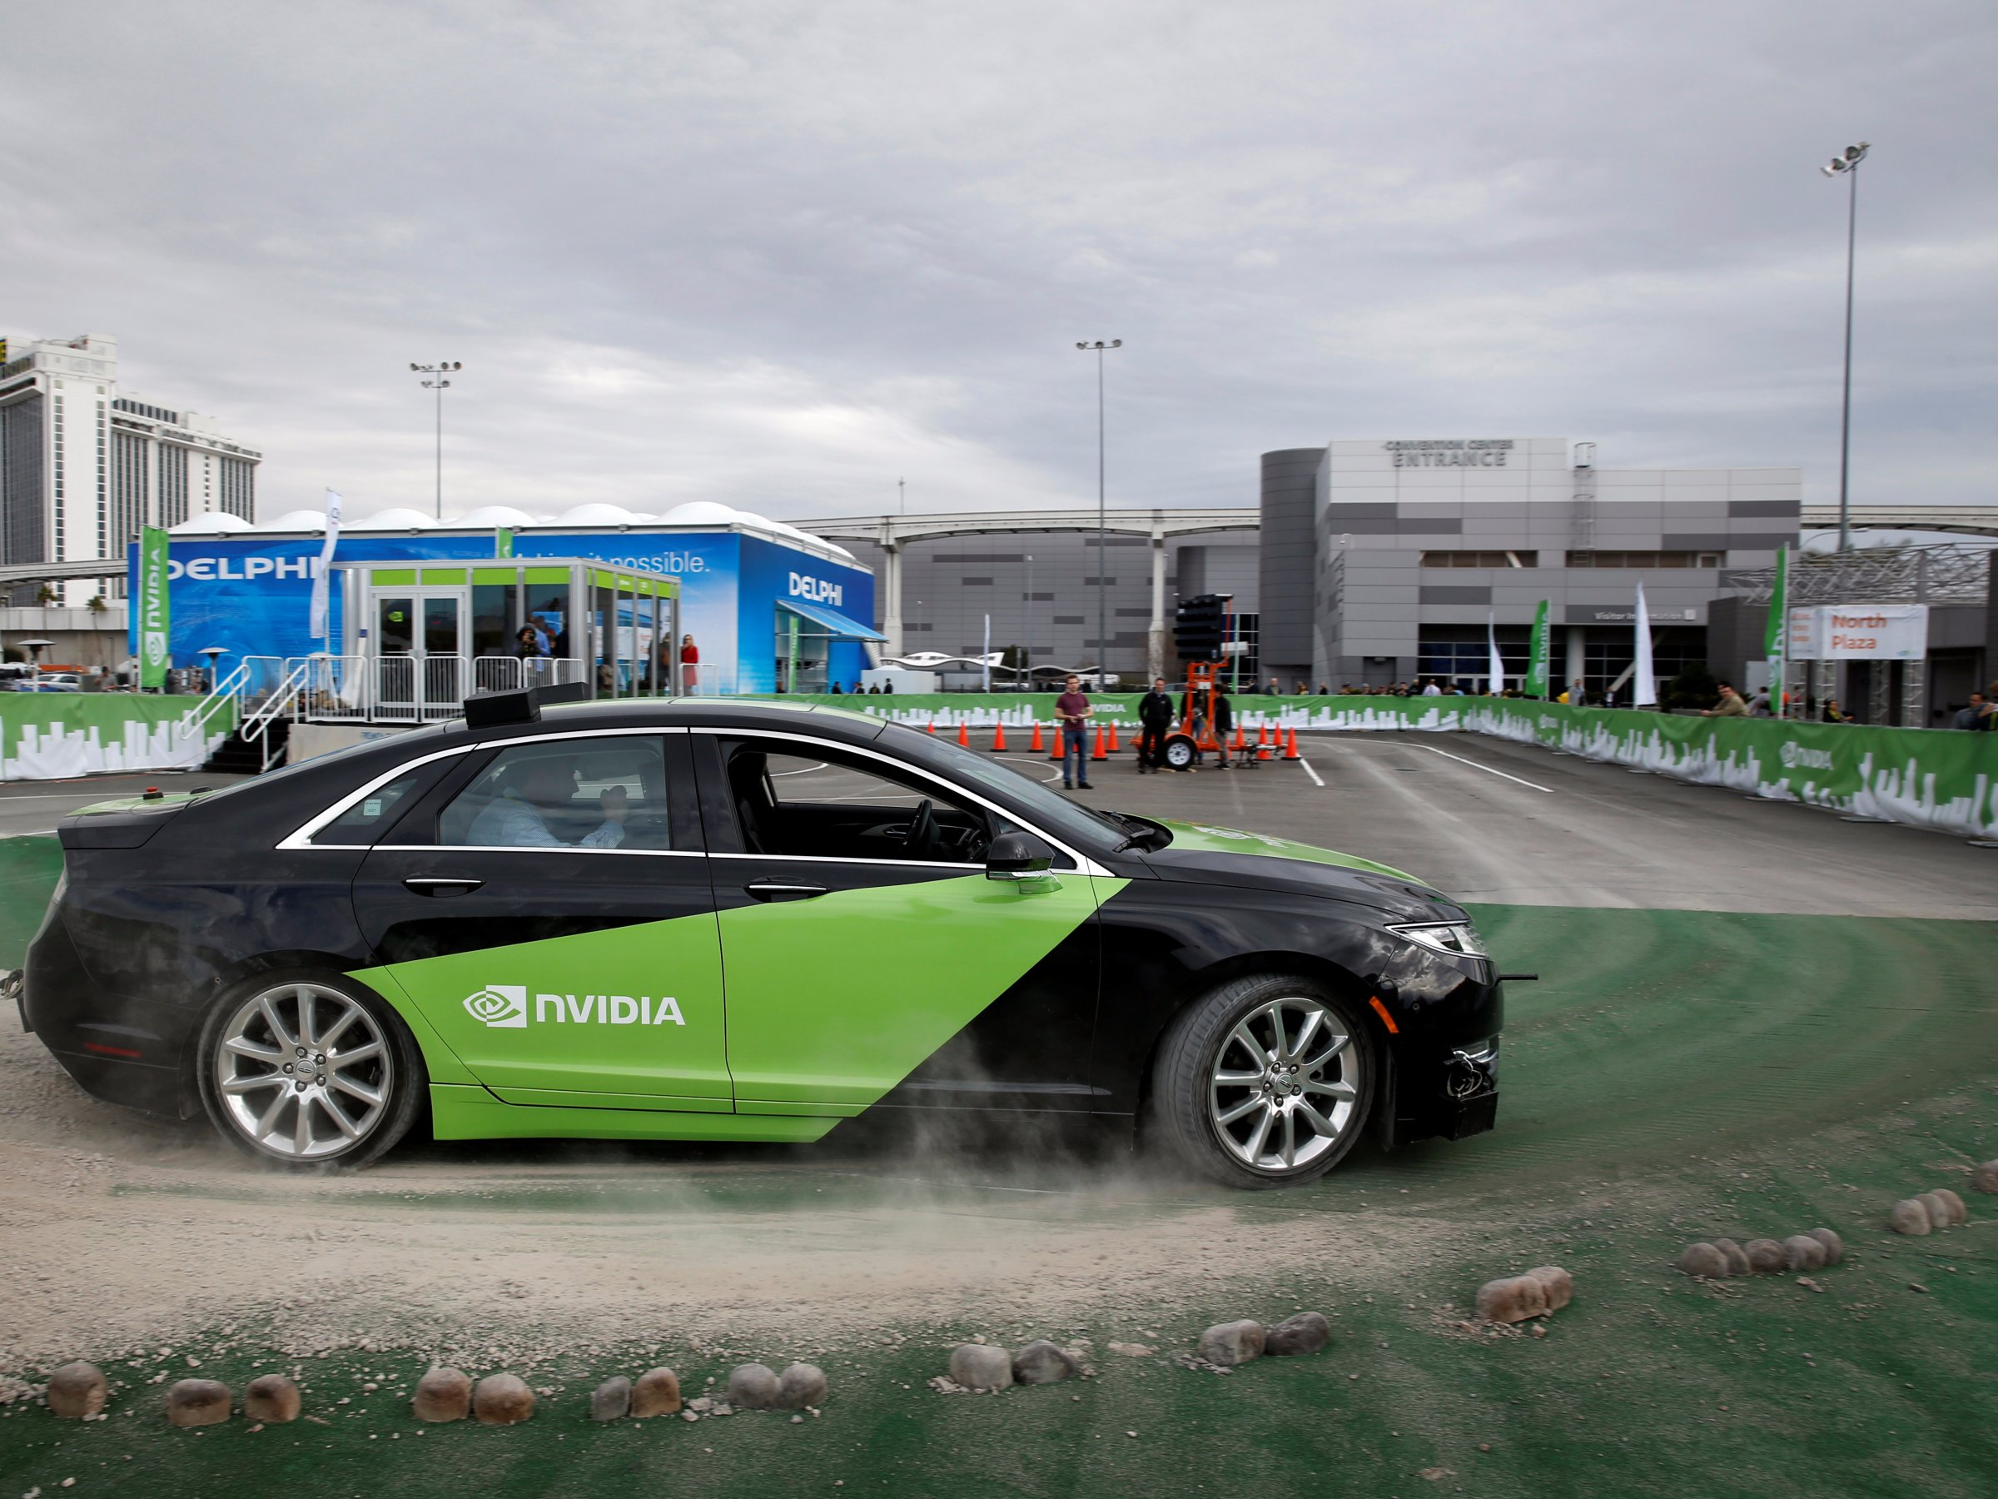
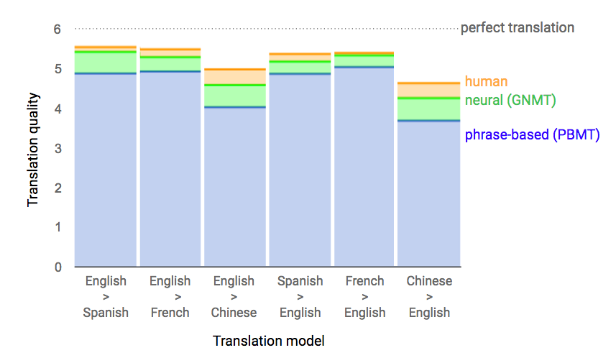
Deep learning in the news

Slide 4
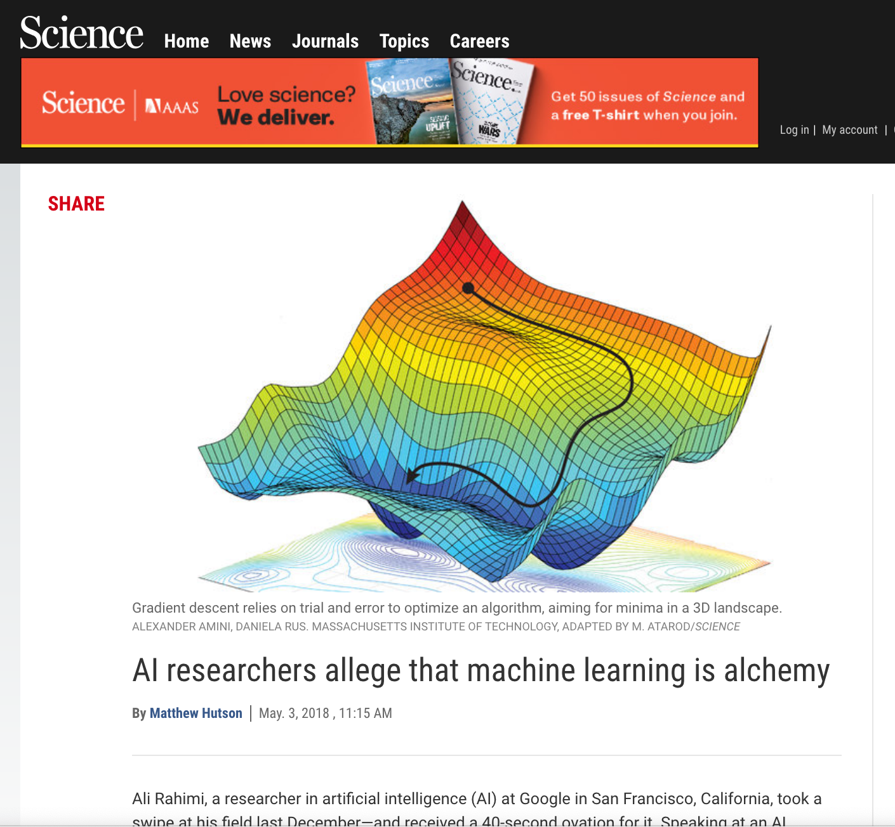
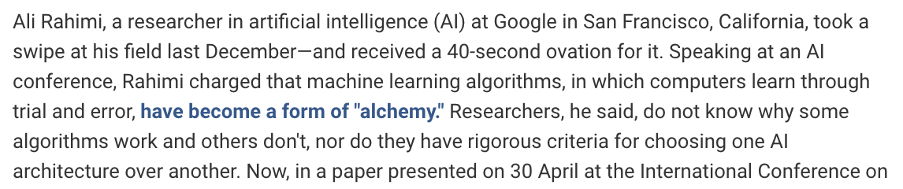

Slide 5
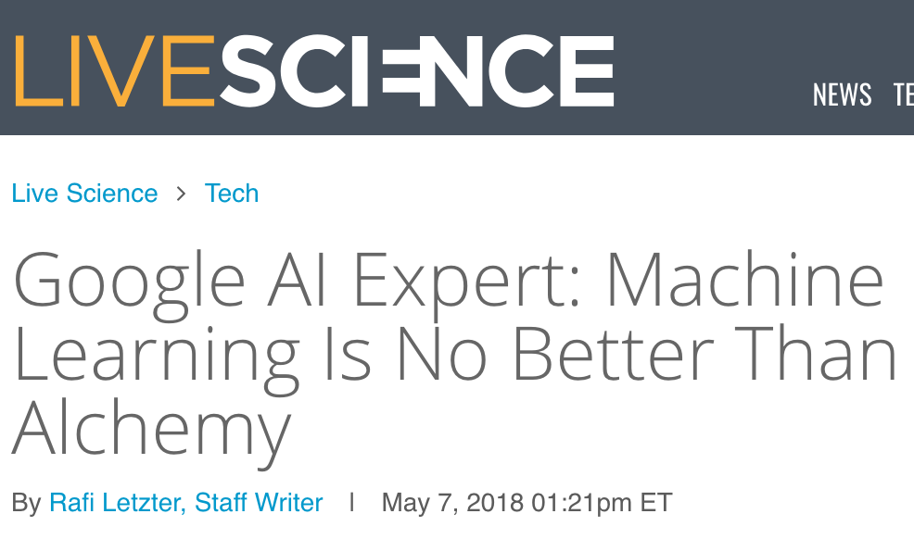
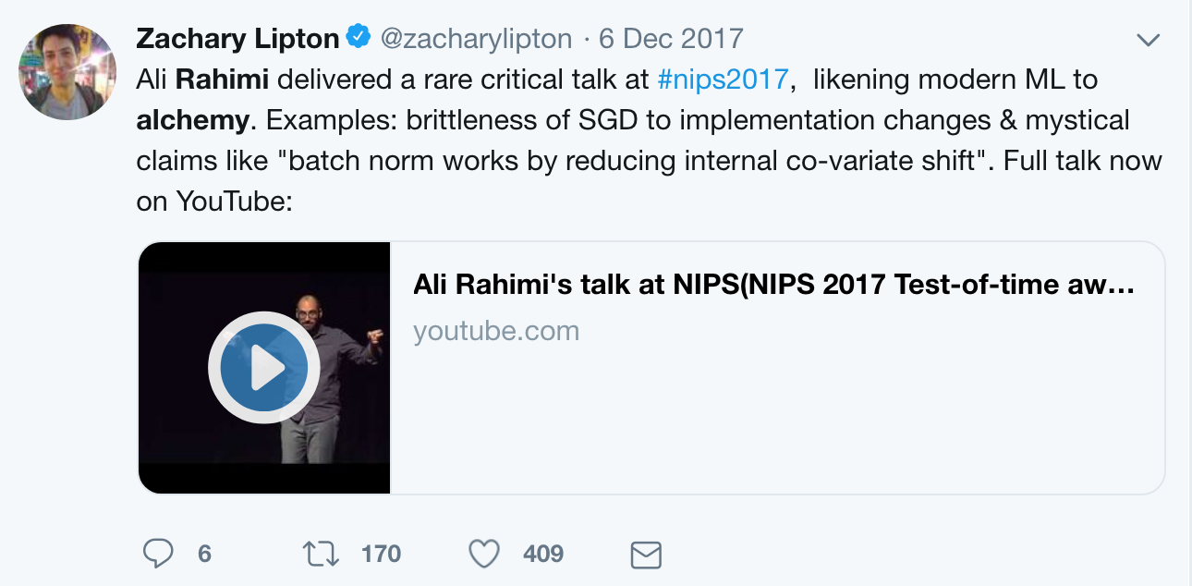
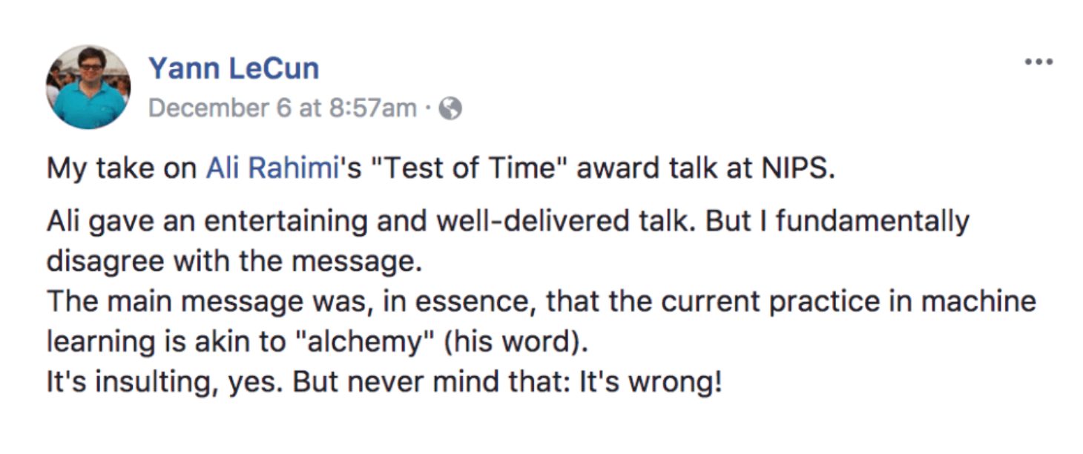

Slide 6
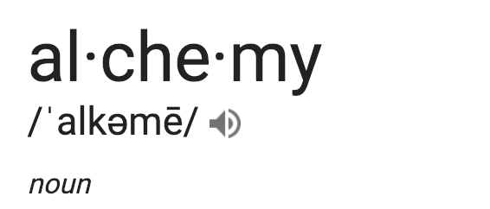
medieval forerunner of chemistry based on supposed transformation of matter. It was concerned mostly with converting lead into gold and with finding a universal elixir
--seemingly magical process of transformation, creation, or combination

Slide 7
Alchemy Analogies?
Gold Rush..
Cheap Data ➜ Artificial Intelligence
Attracts top scientists of its age; solid advances: Go Playing, Translation... (Isaac Newton was an alchemist; and alchemy transformed metallurgy, glassmaking, …)
Possibly questionable science, but may lead to new fields…

Slide 8
This talk
What is machine learning (ML) and deep learning?
Some idea of what Rahimi meant.
Brief introduction to the other speakers.

Slide 9
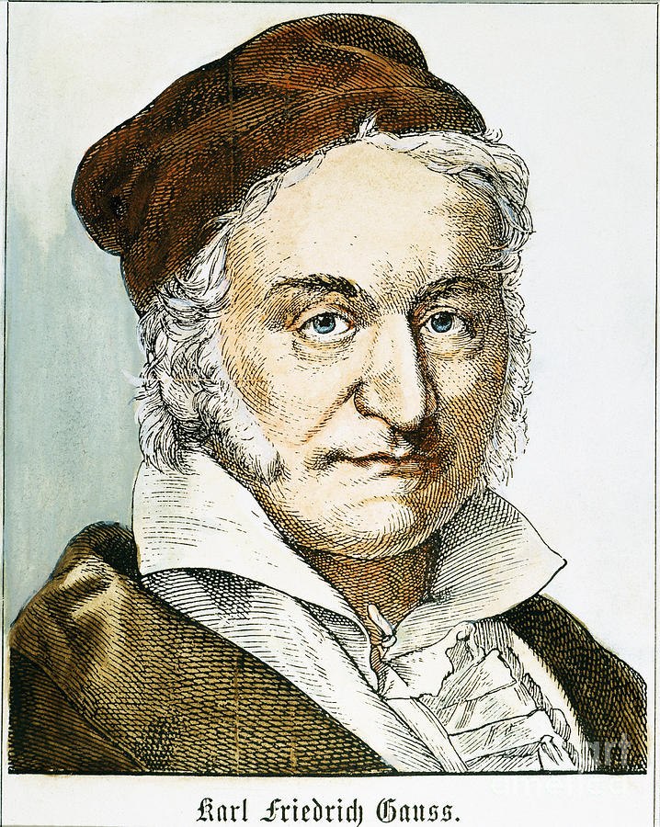
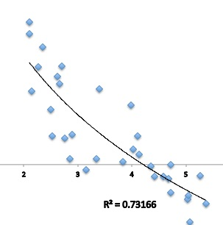
Main idea of ML: Curve fitting (Gauss, c. 1800)
Gas Law (c. 1800) PV = nRT
Phillips curve (1958):
Inflation
Unemployment
Machine Learning = Surface fitting, with many more variables. (”Learning patterns in data.”)

Slide 10
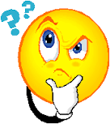
Example of “Training Data” in machine learning
Lots of pictures, each labeled with “Cat” or “Dog.”
The ”Law” of Cat vs Dog Pictures??
Dog
Dog
Cat
Cat
Picture = sequence of numbers (pixel values) The label “Dog” is treated as 0, and “Cat” as 1.
Goal: Train a machine to determine proper label (0/1) given pixels in a new cat/dog image (previously unseen)

Slide 11
Deep Net (simplistic!)
_{Action 1}
_{Action 2}
_{Action N}
. . .
Input
Output
“0”
Important: Effect of each knob depends on knob settings of previous layers.
Each action depends on large bank of parameters (“tunable knobs”)
(“Electrical Circuit of knobs”)
Notes:
You can think of it as a radio. But there is an important twist. The effect of each knob depends on knob settings of previous layers. (Repeat). Let me point out that this is not like the knobs in your car stereo. In your car each knob has a single purpose. The volume knob adjusts the volume in the same way no matter how you have set the other knobs. In a deep net, the effect of a knob depends on the knobs of the previous layer. If the knobs in your car radio depended on each other like this you would go crazy trying to make it do what you want it to do.

Slide 12
Deep Net (simplistic!)
_{Action 1}
_{Action 2}
_{Action N}
. . .
Input
Output
0 for “Dog” 1 for “Cat”
Training Procedure: Using large training
set of labeled inputs, adjust tunable knobs to make the Net’s output match the labeled outputs as closely as possible.
Each action depends on large bank of parameters (“tunable knobs”) Millions!!
Notes:
Analog??

Slide 13
Deep Net (simplistic!)
_{Action 1}
_{Action 2}
_{Action N}
. . .
Input
Output
1 for “Dog” 0 for “Cat”
Each action depends on large bank of parameters (“tunable knobs”) Millions!!
Training Procedure: Using large training
set of labeled inputs, adjust tunable knobs to have the Net’s output match the labeled outputs as closely as possible.
Training objective: Minimize sum of squared errors (True label – Net’s output)²
Notes:
Analog??

Slide 14
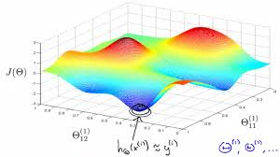
Mystery 1: Efficient Optimization is possible
Training Objective
Gradient Descent (G.D.): Incrementally adjust the
knobs in the direction of maximum change (available via simple calculus)
Unclear why G.D. works so well! Flies against experts’ intuitions!
CONVEX
NONCONVEX
Many tricks for modifying G.D. and /or knob structure (“architecture”)
Notes:
Why is this a mystery? For simplicity let us visualize in 3-dimensions what this optimization involves. Here you will already see the main issue. In this picture, we assume for simplicity the net only has two knobs. We plot the value of the training objective versus the settings of the two knobs. So this plot has 3 coordinates, the x and y coordinates are settings of the two knobs, and the third coordinate is the value of the training objective for

Slide 15
Mystery 2: Overfitting
NO
Large deep nets (using more parameters than datapoints) outperform smaller models
Rule of thumb: Overcomplicated explanations overfit to training data and do not “generalize” to explaining new data.

Slide 16
Textbook vs Reality of “Overfitting” in Deep Learning
Generalization error
Real Life Deep learning
Notes:
Should change graphic to show zero training error?

Slide 17
Summarizing prev. slides
No good theory/math explanation for why/when deep learning works and with how many training samples (though some partial progress)
Many papers rely on “semi-theory” to justify/explain phenomena. Could evolve into being more rigorous some day..
This primarily affects ML experts; necessitates extensive trial and error.
The “Alchemy” debate was primarily about this. Many prior approaches
In the field used simpler models (“convex”) with more predictable properties.

Slide 18
The interpretability problem
_{Action 1}
_{Action 2}
_{Action N}
. . .
Input
Output
“Dog”
Recall: Training algorithm adjusts tens of millions “knobs” to achieve desired input-output behavior.
Each action depends on large bank of parameters (“tunable knobs”)
Difficult/impossible to detect why machine gave the answer it did (e.g., ”loan denied.”)

Slide 19
Designed vs Learnt Systems..
We’re surrounded by complicated objects designed by vast teams using millions of lines of computer code
But somebody (or the team) knows what each component is doing and how they all fit.
Contrast with deep net: Designer uses trial and error to select architecture and optimization (“knob tuning”) algorithm. Sets initial knob settings randomly, and lets the net learn some knob settings from data.
Nobody really understands what various components learnt and how they affect each other…

Slide 20
I would like to live in a society whose systems are built on top of verifiable, rigorous, thorough knowledge, and not on alchemy
Engineering artifacts have almost always preceded the theoretical understanding. …(it is important to) invent new techniques, and yes, new tricks
Ali Rahimi at NIPS 2018
Yann Le Cun
Boltzmann’s 2nd Law of Thermodynamics 1879
Stephenson Rocket, 1829

Slide 21
Subsequent manifesto…
Need “Pedagogical nuggets” to help people understand: theorems for simple subcases, simple experiments. More scientific and honest reporting of what does/doesn’t work; honest comparisons with baselines,..
Along the lines of existing practices in physics, biology etc…
Ben Recht, Berkeley

Slide 22
Today’s speakers (represent diverse fields that leverage deep learning)
Today’s speaker line-up (represent diverse fields that leverage deep learning)
Expertise: Machine Learning (ML) and its societal impact,
especially in healthcare. Issues of robustness, fairness and sample complexity. Author, Blogger, Expositor, Saxophonist. (“Deep Learning: The Straight Dope.” “Troubling Trends in Machine Learning Scholarship”)
Zach Lipton, @zacharylipton
Asst. Prof, CMU. (recently moved from industry)

Slide 23
Today’s speakers (represent diverse fields that leverage deep learning)
Today’s speaker line-up (contd.)
Pioneer of deep learning, especially
Convolutional Neural Nets (CNNs). Foundational work in all types of deep learning.
Yann LeCun
Director of AI Research, Facebook
NYU Center for Data Science Member, NAE
Neural Network Pioneer Award

Slide 24
Today’s speakers (represent diverse fields that leverage deep learning)
Today’s speaker line-up (contd.)
World expert in decision-making for robotics,
Especially algorithms for planning and learning
in partially observable domains.
Very interested in how to improve Reproducibility of ML Research. (“Machine Learning Reproducibility Checklist.”)
Joelle Pineau Co-Director, McGill Reasoning and Learning Lab, Head of Facebook Research, Montreal.
President, International ML Society,
Fellow of CIFAR and AAAI.

Slide 25
Today’s speakers (represent diverse fields that leverage deep learning)
Today’s speaker line-up (contd.)
World expert in theoretical machine learning, lately interested in problems arising in design of self-driving cars.
Early (but cautious) adopter of deep learning in the theory world.
Shai Shalev-Shwartz Professor, Hebrew University
Also, Mobileye .

Slide 26
Today’s speakers (represent diverse fields that leverage deep learning)
Today’s speaker line-up (contd.)
World expert in Natural Language Processing (NLP) and one of its deep thinkers. Now leverages deep learning for NLP.
Mike Collins Professor, Columbia University
Google Research.
ACL Fellow.
Long list of best paper awards at top venues,

Slide 27
Some points of discussion today
How have the various speakers adopted deep learning in their domains?
Heuristics/Engineering/Science/Rigor : How does the field split currently around these, and what is the right mix going forward?
How can “alchemy” (if any) evolve into “science” ? How desirable is it, and how realistic is it to completely understand machine intelligence (given we don’t understand ourselves)?
What kind of problems (societal, technological) can arise from lack of understanding in deep learning?

Slide 28
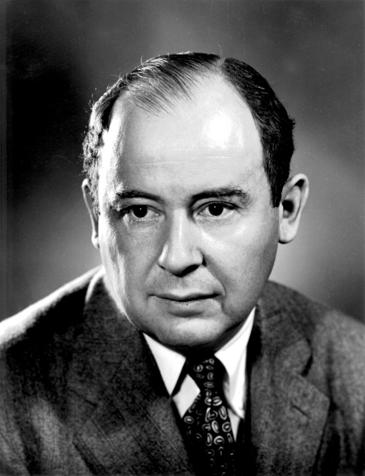
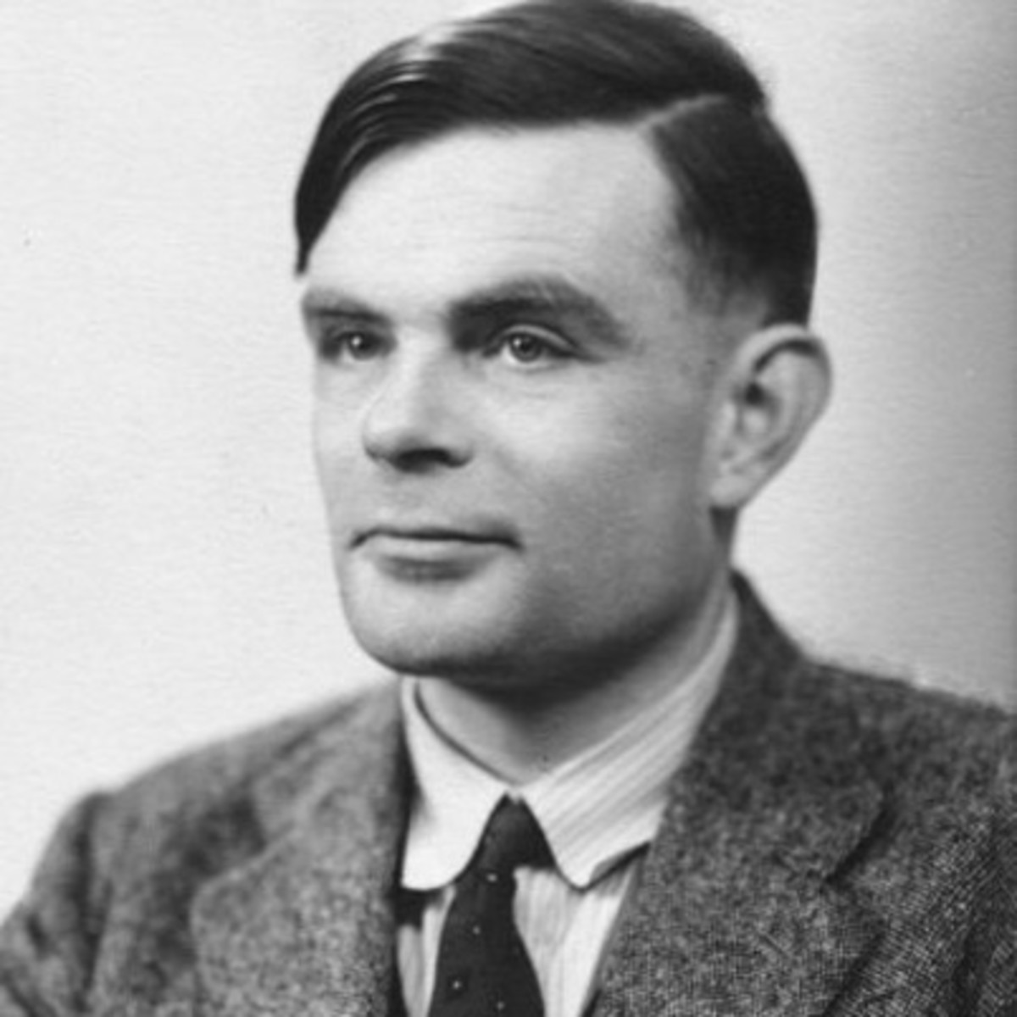
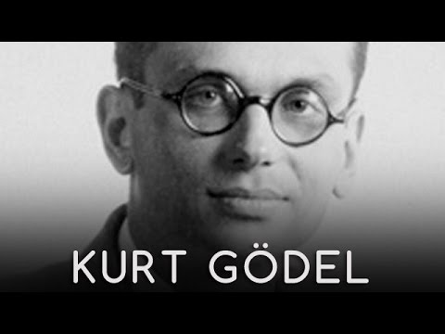
Concluding thoughts…
Intelligent machines, an old dream, (including at Princeton!)
Von Neumann
Becoming a reality thanks to ability
to train vast models (vast reams of data + fast optimization methods + tons of tricks)
Turing
Lady Ada
Intelligent behavior is complicated; let’s hear from our distinguished experts how they are probing its mysteries while navigating the alchemy/science spectrum!!

Slide 29
Today’s speakers (represent diverse fields that leverage deep learning)
Next
Expertise: Machine Learning (ML) in healthcare. Issues of robustness, fairness and sample complexity. Author, Blogger, Expositor, Saxophonist. (“Deep Learning: The Straight Dope.” “Troubling Trends in Machine Learning Scholarship” “Approximately Correct” blog)
Zach Lipton, @zacharylipton
Asst. Prof, CMU.

