Slide 1
Population Recovery from Corrupted Samples
Michael Saks, Rutgers University
joint work w
Ankur Moitra (2013)
Anindya De and Sijian Tang (2016)

Slide 2
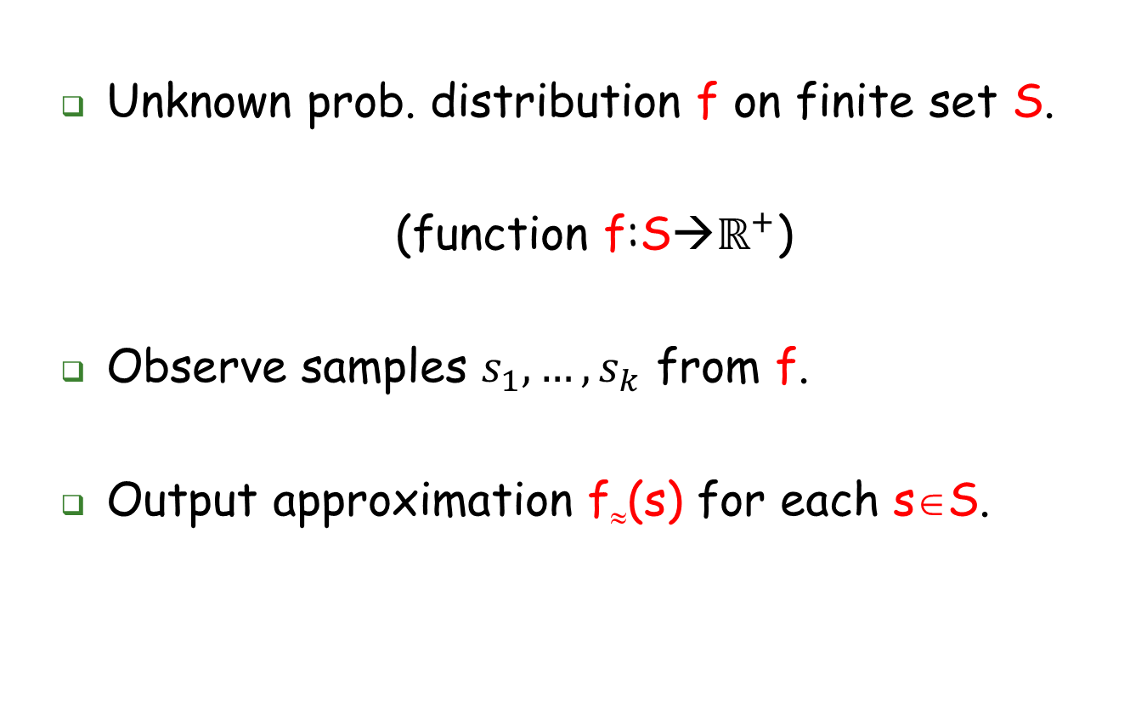
Classic statistical learning problem
Unknown prob. distribution f on finite set S.
(function f:S$→ℝ^{+}$)
Observe samples $s_{1},…,s_{k}$ from f.
Output approximation f≈(s) for each s∈S.

Slide 3
Classic statistical learning problem
Estimate f≈(s) for each s∈S.
Estimation parameter ε > 0
Require |f≈(s)-f(s)| < ε for all s with prob ≥.99
Format of output:
Output H ⊆ S
Output f≈(s) for each s ∈ H
Implicitly f≈(s)=0 for each s ∉ H.
Algorithm: Use Empirical frequencies
Number of samples and running time: poly(1/ε)
Avi is 60! October 5-8, 2016

Slide 4
Meta Question:
Can we efficiently estimate f if each individual observation is
corrupted/distorted?
[Kearns, Mansour, Ron, Rubinfeld, Schapire, Sellie 1994]
Avi is 60! October 5-8, 2016

Slide 5

Noisy/Lossy Population Recovery
Idealized model (Dvir,Rao,Wigderson,Yehudayoff 2012)
f defined on ${\left\{0,1\right\}}^{n}$ (binary strings)
Sample:
Lossy Corruption
1
1
0
0
0
1
1
1
0
0
1
1
1
Noisy Corruption
0
1
0
1
0
1
?
1
0
?
?
1
1
1
0
0
1
1
1
1
?
0
?
1
Avi is 60! October 5-8, 2016

Slide 6
Noisy/lossy population recovery
Reliability parameter μ in [0,1]
Lossy model: Each bit erased w.p. 1-μ
Noisy model: Each bit randomized w.p. 1-μ
μ=1 No corruption
μ=0 Complete Corruption
Goal: Recovery in time poly(n, 1/ε)
for any fixed μ>0.
Avi is 60! October 5-8, 2016

Slide 7
Noisy/lossy population recovery
Goal: Recovery in poly(n, 1/ε) time
for any fixed μ>0.
Lossy Model: Completely solved (Mostly solved?)
Techniques:
Linear Programming + Complex analysis
Noisy Model: Partially solved (Mostly solved?)
Techniques: Fourier analysis + Mobius inversion
(+ Linear Programming + Complex analysis)
Avi is 60! October 5-8, 2016

Slide 8
Plan….
Overview of solution for
….Lossy Case
….Noisy Case
Avi is 60! October 5-8, 2016

Slide 9
Lossy model
Recovery in time poly(n, 1/ε) in lossy model
….provided μ>.365 [Dvir,Rao,Wigderson,Yehudayoff 2011]
….provided μ>. .293 [Batman,Impagliazzo,Murray,Paturi 2012]
….provided μ> 0 [Moitra, S. 2013]
Avi is 60! October 5-8, 2016

Slide 10
Lossy model: Proof Sketch
WLOG, focus on f≈(0)
From samples compute:
a(j) = Fraction of observed samples with exactly j 1’s
Questions:
(1)How best to estimate f(0) from (a(j): 0 ≤ j ≤ n)?
(2) How many samples are needed so that this estimate is (probably) within ε of correct?
Avi is 60! October 5-8, 2016

Slide 11
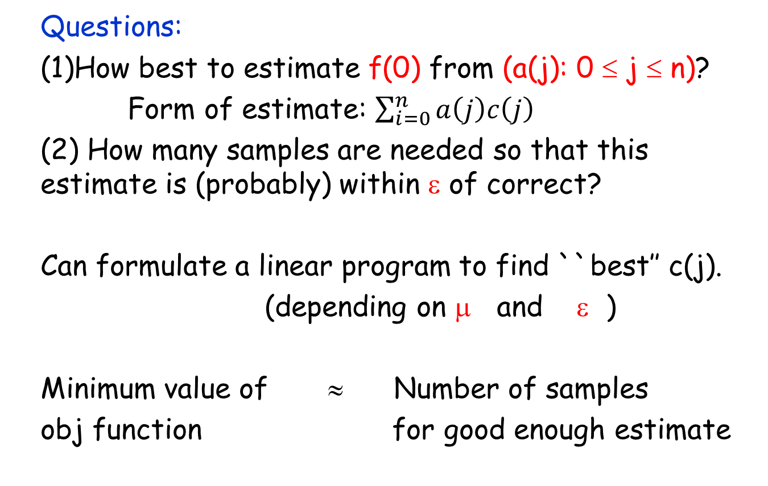
Lossy model: Proof Sketch
Questions:
(1)How best to estimate f(0) from (a(j): 0 ≤ j ≤ n)?
Form of estimate: $\sum_{i=0}^{n}{a\left(j\right)c\left(j\right)}$
(2) How many samples are needed so that this estimate is (probably) within ε of correct?
Can formulate a linear program to find ``best’’ c(j).
(depending on μ and ε )
Minimum value of ≈ Number of samples
obj function for good enough estimate
Avi is 60! October 5-8, 2016

Slide 12
Lossy model: Proof Sketch
Linear program (depending on μ and ε )
Minimum value of ≈ Number of samples
obj function (OF) for good enough estimate
Dvir, Rao, Wigderson, Yehudayoff:
Construct explicit feasible solution
OF Value is poly(n, 1/ε) provided μ>.365
Batman, Impagliazzo, Murray, Paturi:
Same feasible solution, improved analysis
OF is poly(n, 1/ε) provided μ>.292
Avi is 60! October 5-8, 2016

Slide 13
Lossy model: Proof Sketch
LP:
Minimum value of ≈ Number of samples
obj function (OF) for good enough estimate
Moitra, S:
Look at dual LP and try to upper bound max value
LP duality usually used to prove a Lower Bound on the minimum, by finding a feasible solution to dual.
Here we need an Upper Bound on the minimum
Want to use LP duality in the opposite of the usual way.
Avi is 60! October 5-8, 2016

Slide 14
Lossy mode:l Proof Sketch
Minimum value of ≈ Number of samples
obj function (OF) for good enough estimate
Form dual LP
Stare at it
Massage it
Transform it to:
Avi is 60! October 5-8, 2016

Slide 15
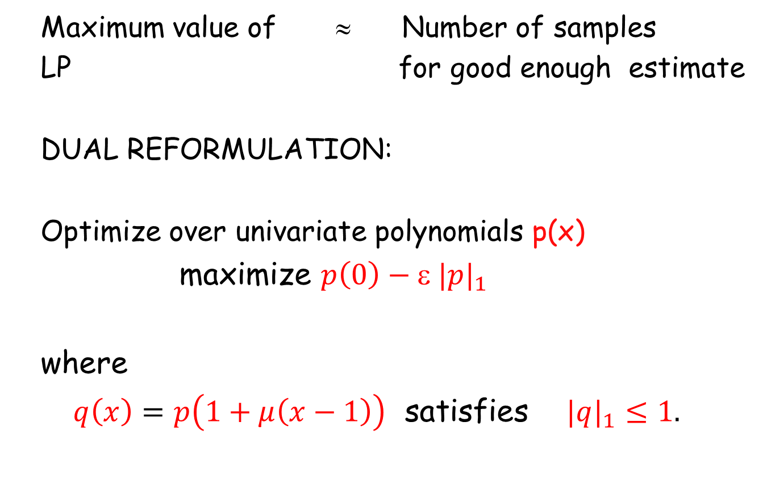
Lossy model: Proof Sketch
Maximum value of ≈ Number of samples
LP for good enough estimate
DUAL REFORMULATION:
Optimize over univariate polynomials p(x)
maximize $p\left(0\right)−\text{ε} |p|_{1}$
where
$q\left(x\right)=p\left(1+μ\left(x−1\right)\right)$ satisfies $|q|_{1}≤1.$
|Σa_{k}x ^{k}|₁ means Σ|a_{k}|
Avi is 60! October 5-8, 2016

Slide 16
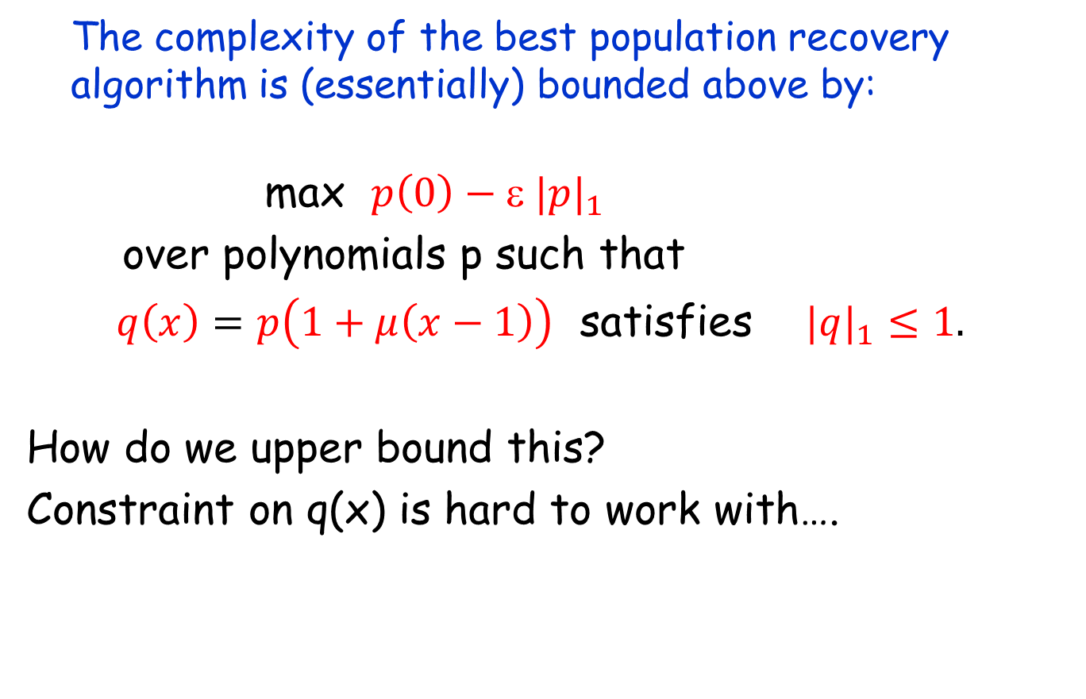
Lossy model: Proof Sketch
The complexity of the best population recovery algorithm is (essentially) bounded above by:
max $p\left(0\right)−\text{ε} |p|_{1}$
over polynomials p such that
$q\left(x\right)=p\left(1+μ\left(x−1\right)\right)$ satisfies $|q|_{1}≤1.$
How do we upper bound this?
Constraint on q(x) is hard to work with….
Avi is 60! October 5-8, 2016

Slide 17
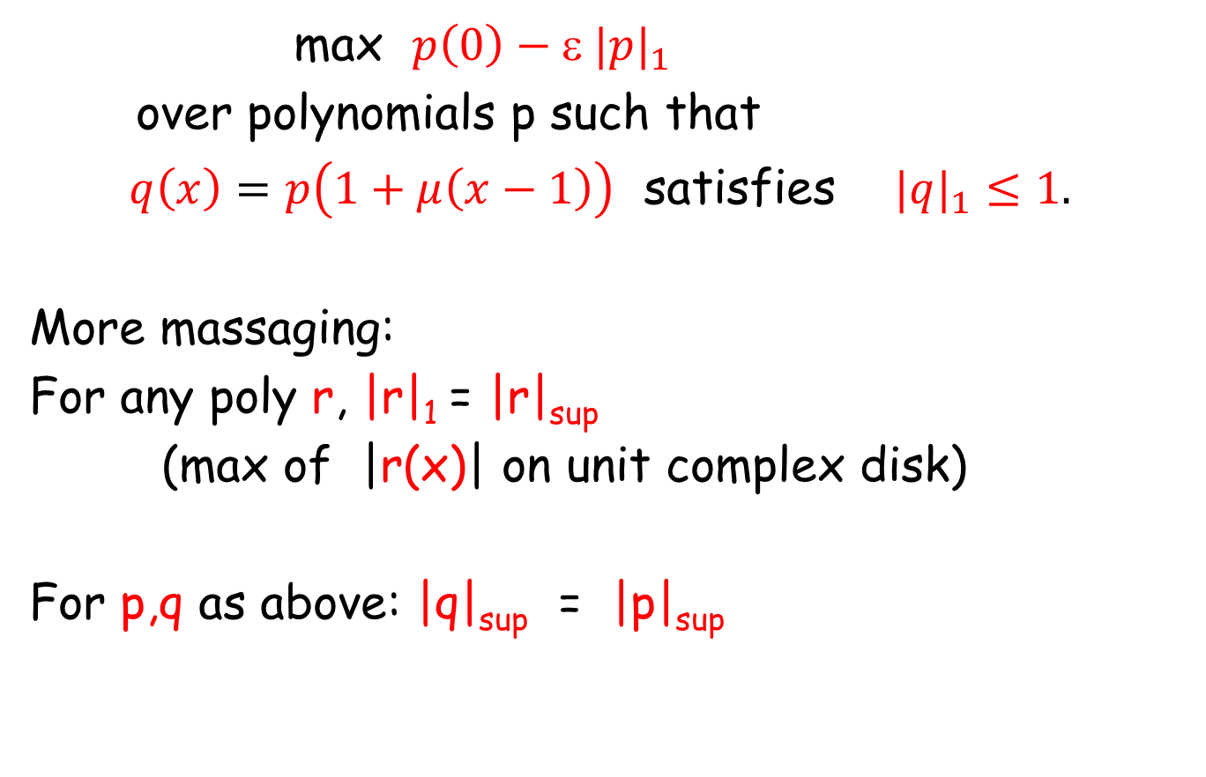
Lossy model: Proof Sketch
max $p\left(0\right)−\text{ε} |p|_{1}$
over polynomials p such that
$q\left(x\right)=p\left(1+μ\left(x−1\right)\right)$ satisfies $|q|_{1}≤1.$
More massaging:
For any poly r, |r|₁ = |r|_{sup}
(max of |r(x)| on unit complex disk)
For p,q as above: |q|_{sup} = |p|_{sup}
D₁
D₁
D_{μ}(1-μ)
Avi is 60! October 5-8, 2016

Slide 18

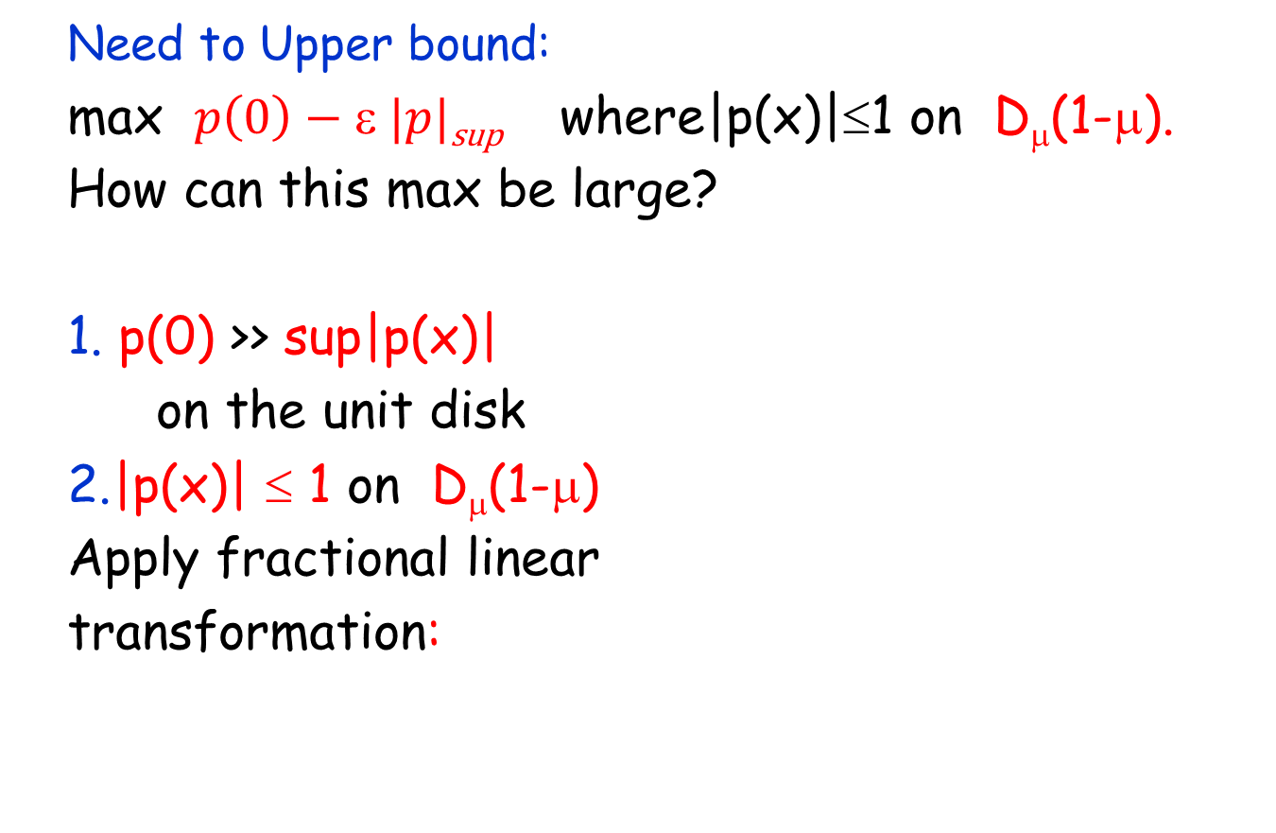
Lossy model: Proof Sketch
Need to Upper bound:
max $p\left(0\right)−\text{ε} |p|$_{sup} where|p(x)|≤1 on D_{μ}(1-μ).
How can this max be large?
1. p(0) >> sup|p(x)|
on the unit disk
2.|p(x)| ≤ 1 on D_{μ}(1-μ)
Apply fractional linear
transformation:
D₁
p(0)

Slide 19

Lossy model: Proof Sketch
Need to Upper bound:
max $p\left(0\right)−\text{ε} |p|$_{sup} where|p(x)|≤1 on D_{μ}(1-μ).
How can this max be large?
1. p(0) >> sup|p(x)|
on the unit disk
2.|p(x)| ≤ 1 on D_{μ}(1-μ)
Apply fractional linear
transformation:
Use Hadamard 3-circle theorem.
D₁

Slide 20

Lossy model: Proof Sketch
D₁
Need to Upper bound: max$p\left(0\right)−\text{ε} |p|_{sup}$
where|p(x)| ≤ 1 on the disk D_{μ}(1-μ).
.
After a suitable transformation of p,
Hadamard 3-circle theorem says 1+2 implies
p(0) can’t be too large
Avi is 60! October 5-8, 2016

Slide 21
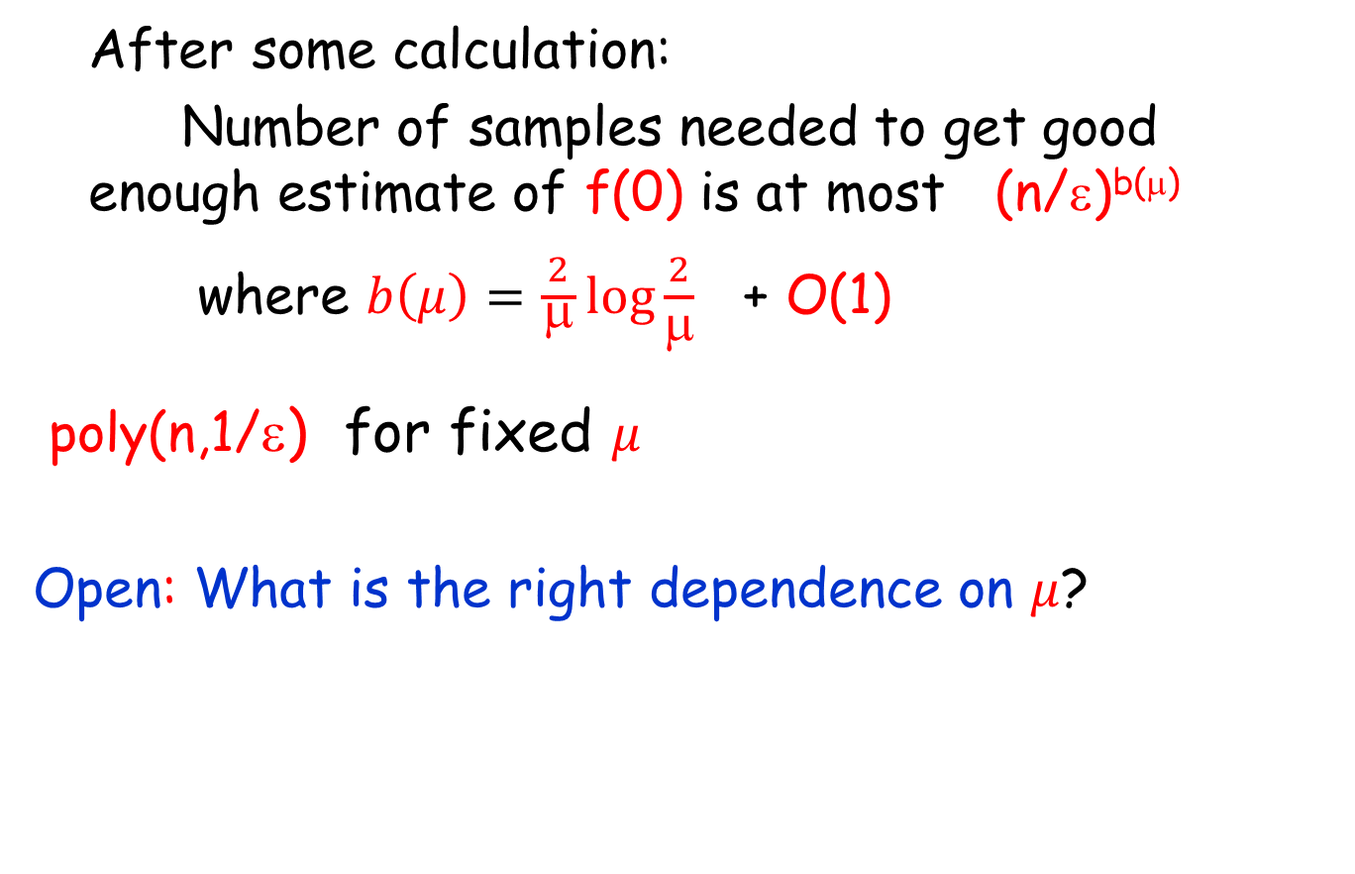
Lossy model: Proof Sketch
D₁
After some calculation:
Number of samples needed to get good enough estimate of f(0) is at most (n/ε)^{b(μ)}
where $b\left(μ\right)=\frac{2}{\begin{aligned} \\ \end{aligned}}log\frac{2}{μ}$ + O(1)
poly(n,1/ε) for fixed $μ$
Open: What is the right dependence on $μ$?
Avi is 60! October 5-8, 2016

Slide 22
Up Next…
NOISY MODEL
Avi is 60! October 5-8, 2016

Slide 23
Noisy Model
Noisy observations from f
independently w.p. 1-μ,
replace each coordinate by random bit
Approximate f pointwise
If no prior assumptions on f,
no subexponential time algorithm is known
(Unlike Lossy Model)
Avi is 60! October 5-8, 2016

Slide 24
Noisy Model
Strong assumption on f:
KSA known support assumption.
Known subset X of Boolean strings
with support(f) ⊆ X
Goal: Estimate f in time poly(n,1/ε,|X|)
Avi is 60! October 5-8, 2016

Slide 25
Noisy Model
Results for KSA (any fixed μ>0 )
Wigderson-Yehudayoff 2013: poly(n,1/ε,|X|^{log|X|} )
Lovett-Zhang 2015 poly(n,1/ε,|X|^{loglog|X|} )
De-S.-Tang 2016 poly(n,1/ε,|X|)
Unknown μ
Lovett-Zhang 2016 poly(n,1/ε,|X|l^{log|X|} )
Dvir-Rao-Wigderson-Yehudayoff 2011: Can weaken KSA assumption
(Later…if time)
Avi is 60! October 5-8, 2016

Slide 26
Noisy Model
Results for KSA (any fixed μ>0 )
De-S.-Tang 2016 poly(n,1/ε,|X|)
Avi is 60! October 5-8, 2016

Slide 27
Noisy Model
Results for KSA (any fixed μ>0 )
De-S.-Tang 2016 poly(n,1/ε,|X|)
Avi is 60! October 5-8, 2016

Slide 28
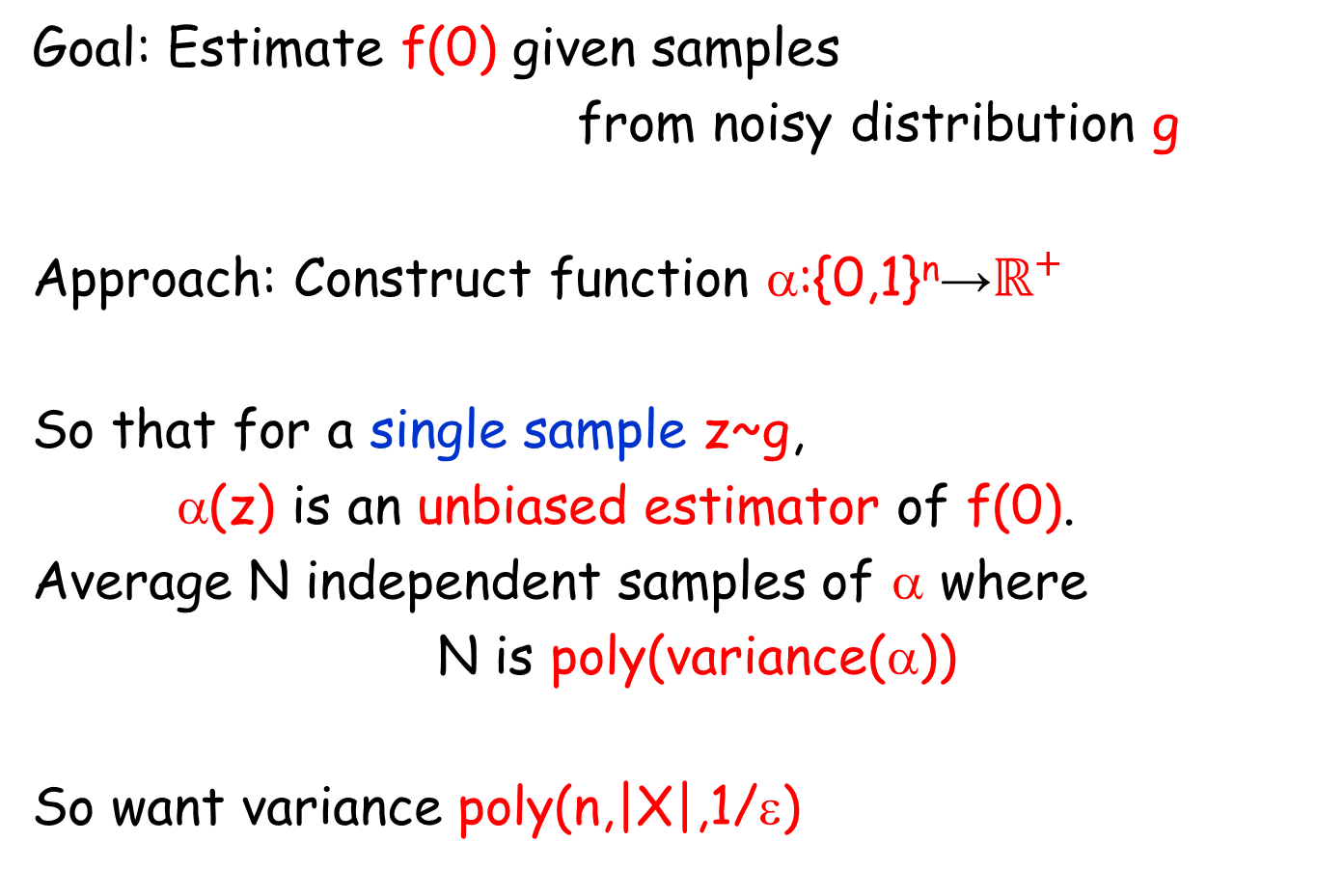
Noisy Model:Proof Sketch
Goal: Estimate f(0) given samples
from noisy distribution g
Approach: Construct function α:{0,1}^{n}→$ℝ^{+}$
So that for a single sample z~g,
α(z) is an unbiased estimator of f(0).
Average N independent samples of α where
N is poly(variance(α))
So want variance poly(n,|X|,1/ε)
Avi is 60! October 5-8, 2016

Slide 29
Noisy Model:Proof Sketch
Known: support(f) ⊆ X
Observations are points in {0,1}^{n} selected from distribution g = T_{μ} f
T_{μ} is a well-known easy-to-describe linear operator:
(Bonami-Beckner noise operator)
Avi is 60! October 5-8, 2016

Slide 30
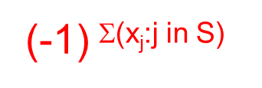
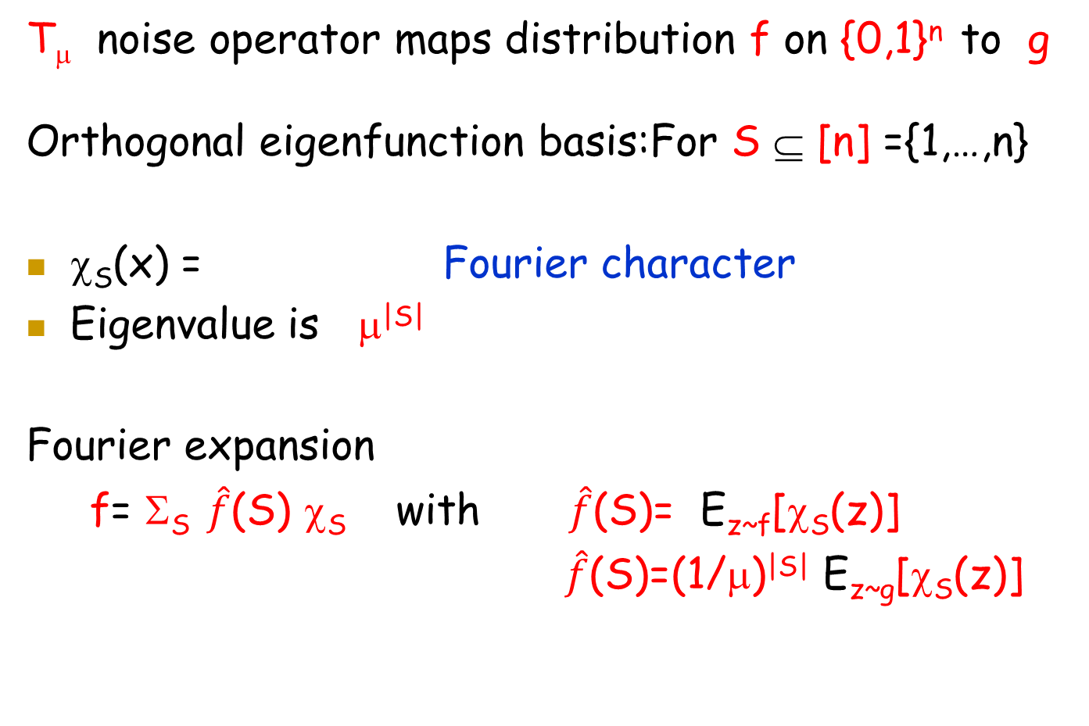
Noisy Model:Proof Sketch
T_{μ} noise operator maps distribution f on {0,1}^{n} to g
Orthogonal eigenfunction basis:For S ⊆ [n] ={1,…,n}
χ_{S}(x) = Fourier character
Eigenvalue is μ^{|S|}
Fourier expansion
f= Σ_{S} $\hat{f}$(S) χ_{S} with $\hat{f}$(S)= E_{z~f}[χ_{S}(z)]
$\hat{f}$(S)=(1/μ)^{|S|} E_{z~g}[χ_{S}(z)]
Avi is 60! October 5-8, 2016

Slide 31
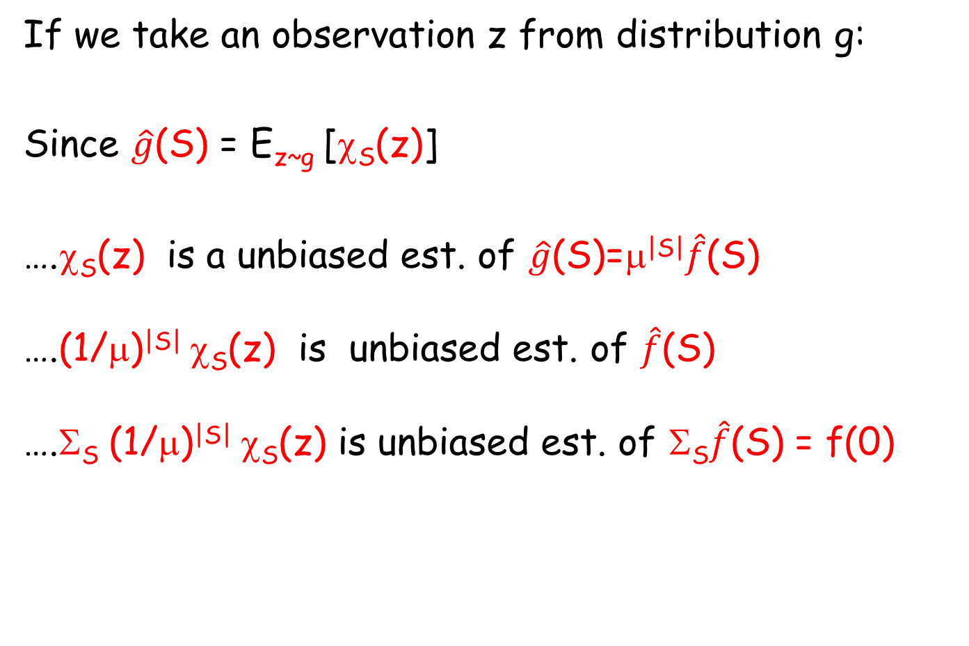
Noisy Model:Proof Sketch
If we take an observation z from distribution g:
Since $\hat{g}$(S) = E_{z~g} [χ_{S}(z)]
….χ_{S}(z) is a unbiased est. of $\hat{g}$(S)=μ^{|S|}$\hat{f}$(S)
….(1/μ)^{|S|} χ_{S}(z) is unbiased est. of $\hat{f}$(S)
….Σ_{S} (1/μ)^{|S|} χ_{S}(z) is unbiased est. of Σ_{S}$\hat{f}$(S) = f(0)
Avi is 60! October 5-8, 2016

Slide 32
Noisy Model:Proof Sketch
.Σ_{S} (1/μ)^{|S|} χ_{S}(z) is unbiased est. of f(0)
Are we done?
Two problems:
2^{n} terms in sum (costly to evaluate)
Coefficients are exponentially large →
High Variance
So we need another way to build unbiased estimator
Avi is 60! October 5-8, 2016

Slide 33
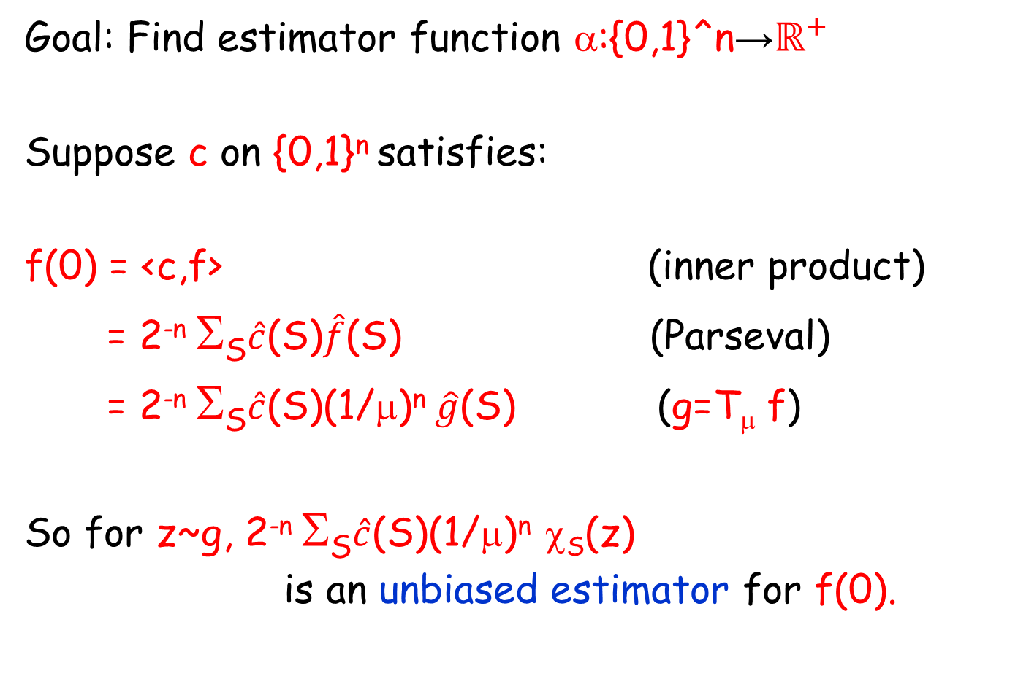
Noisy Model:Proof Sketch
Goal: Find estimator function α:{0,1}^n→$ℝ^{+}$
Suppose c on {0,1}^{n} satisfies:
f(0) = <c,f> (inner product)
= 2^{-n} Σ_{S}$\hat{c}$(S)$\hat{f}$(S) (Parseval)
= 2^{-n} Σ_{S}$\hat{c}$(S)(1/μ)^{n} $\hat{g}$(S) (g=T_{μ} f)
So for z~g, 2^{-n} Σ_{S}$\hat{c}$(S)(1/μ)^{n} χ_{S}(z)
is an unbiased estimator for f(0).
Avi is 60! October 5-8, 2016

Slide 34
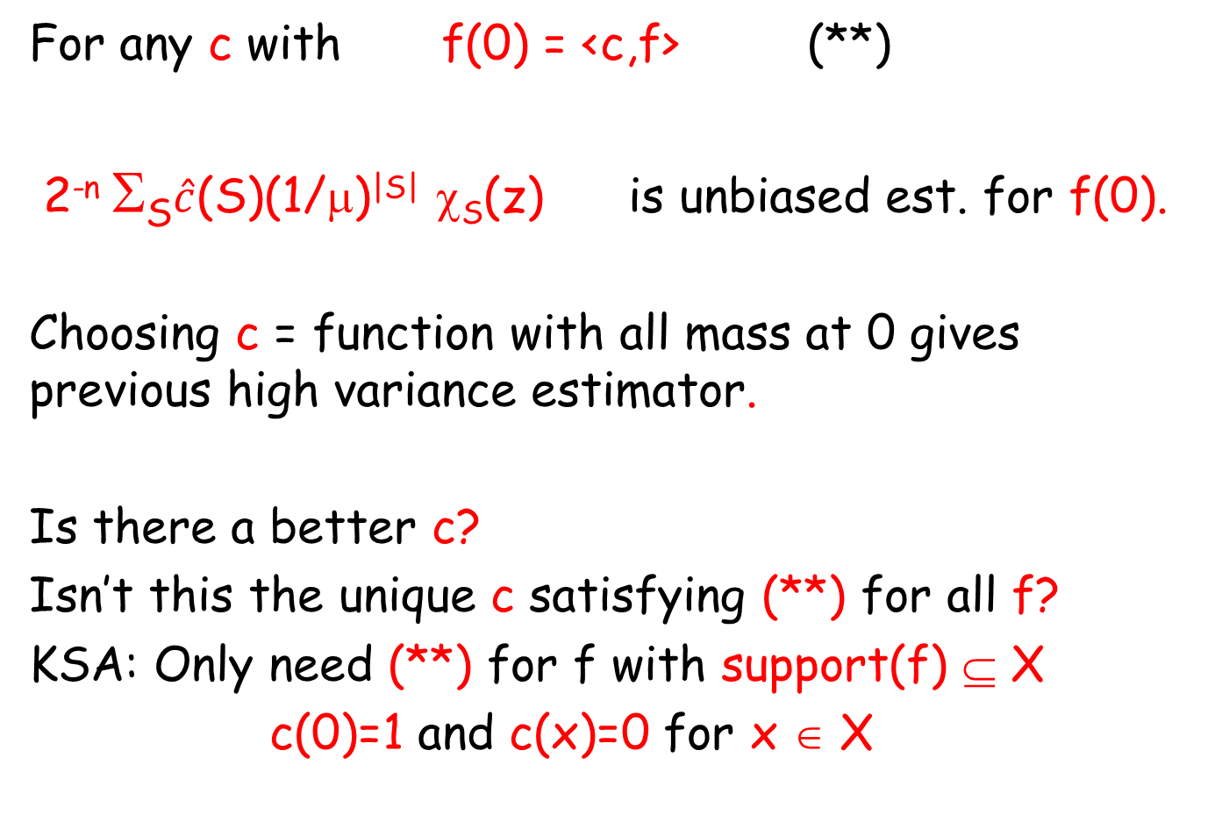
Noisy Model:Proof Sketch
For any c with f(0) = <c,f> (**)
2^{-n} Σ_{S}$\hat{c}$(S)(1/μ)^{|S|} χ_{S}(z) is unbiased est. for f(0).
Choosing c = function with all mass at 0 gives previous high variance estimator.
Is there a better c?
Isn’t this the unique c satisfying (**) for all f?
KSA: Only need (**) for f with support(f) ⊆ X
c(0)=1 and c(x)=0 for x ∈ X
Avi is 60! October 5-8, 2016

Slide 35
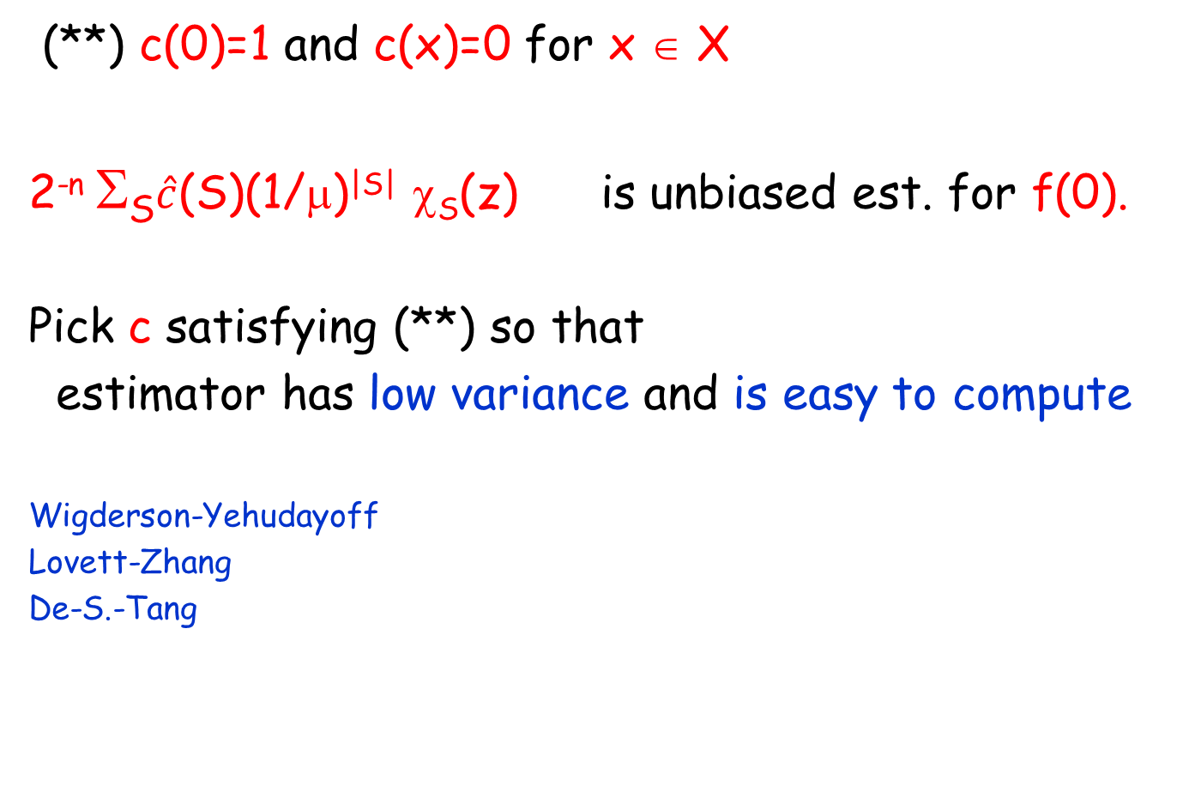
Noisy Model:Proof Sketch
(**) c(0)=1 and c(x)=0 for x ∈ X
2^{-n} Σ_{S}$\hat{c}$(S)(1/μ)^{|S|} χ_{S}(z) is unbiased est. for f(0).
Pick c satisfying (**) so that
estimator has low variance and is easy to compute
Wigderson-Yehudayoff
Lovett-Zhang
De-S.-Tang
Increasingly better choices of c
Avi is 60! October 5-8, 2016

Slide 36
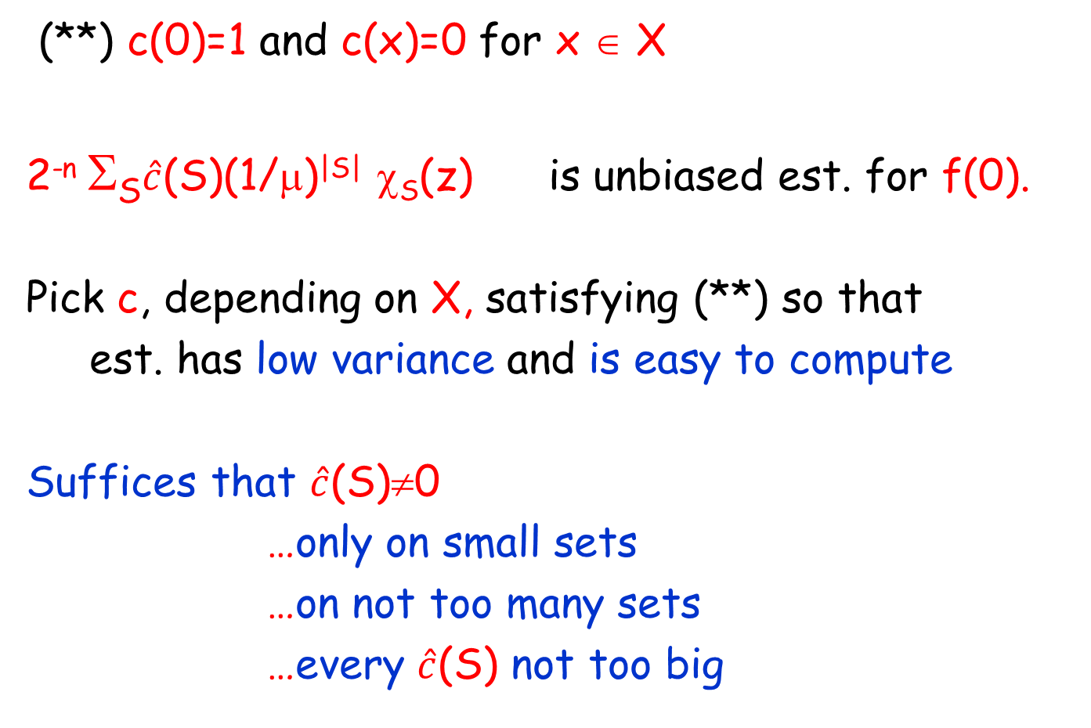
Noisy Model:Proof Sketch
(**) c(0)=1 and c(x)=0 for x ∈ X
2^{-n} Σ_{S}$\hat{c}$(S)(1/μ)^{|S|} χ_{S}(z) is unbiased est. for f(0).
Pick c, depending on X, satisfying (**) so that
est. has low variance and is easy to compute
Suffices that $\hat{c}$(S)≠0
…only on small sets
…on not too many sets
…every $\hat{c}$(S) not too big
Avi is 60! October 5-8, 2016

Slide 37
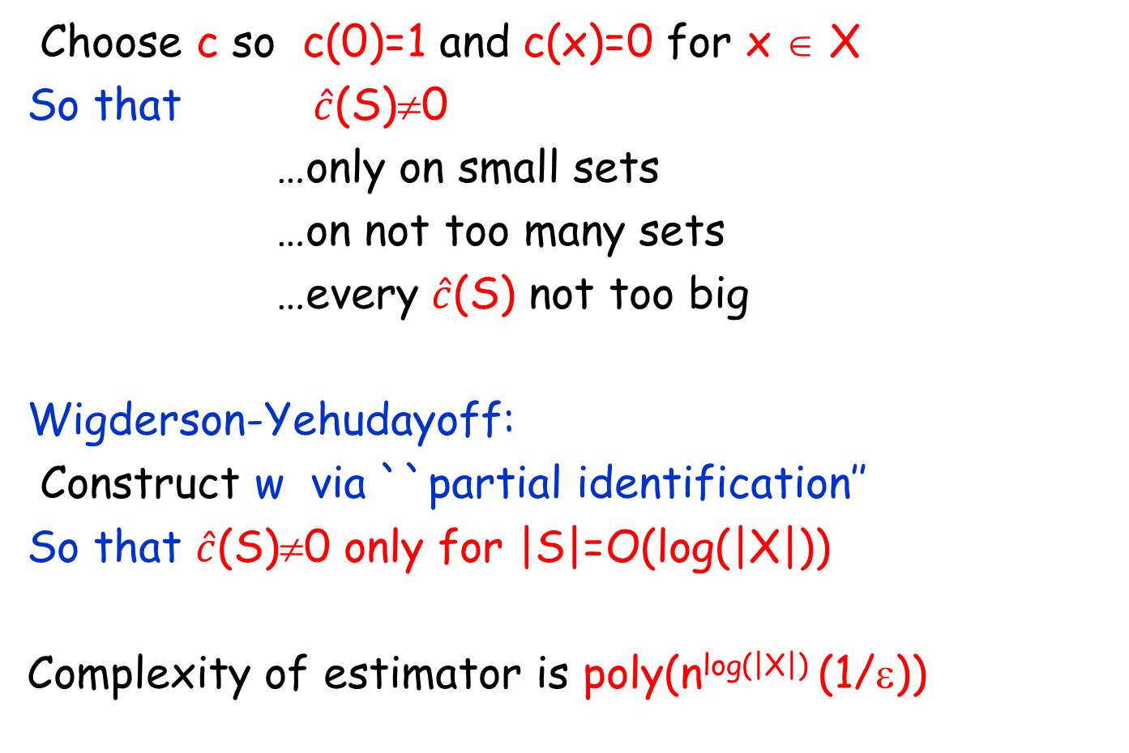
Noisy Model:Proof Sketch
Choose c so c(0)=1 and c(x)=0 for x ∈ X
So that $\hat{c}$(S)≠0
…only on small sets
…on not too many sets
…every $\hat{c}$(S) not too big
Wigderson-Yehudayoff:
Construct w via ``partial identification’’
So that $\hat{c}$(S)≠0 only for |S|=O(log(|X|))
Complexity of estimator is poly(n^{log(|X|)} (1/ε))
Avi is 60! October 5-8, 2016

Slide 38
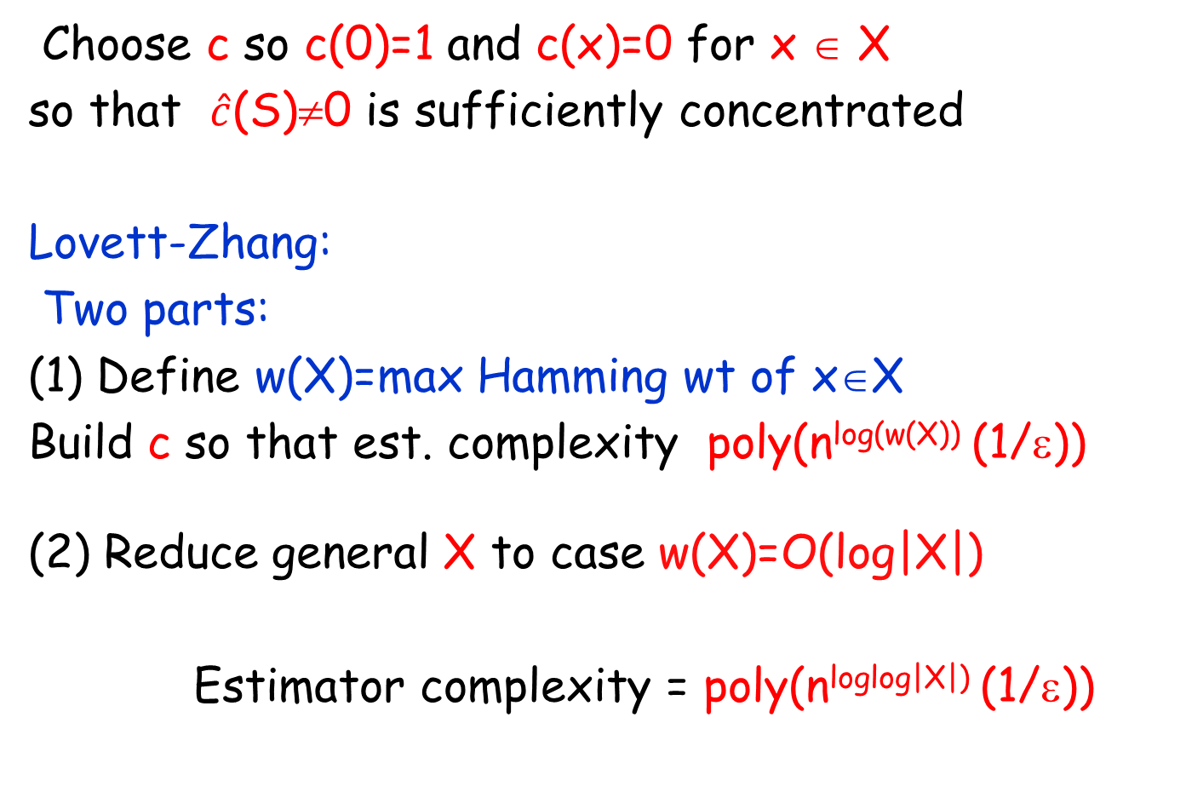
Noisy Model:Proof Sketch
Choose c so c(0)=1 and c(x)=0 for x ∈ X
so that $\hat{c}$(S)≠0 is sufficiently concentrated
Lovett-Zhang:
Two parts:
(1) Define w(X)=max Hamming wt of x∈X
Build c so that est. complexity poly(n^{log(w(X))} (1/ε))
(2) Reduce general X to case w(X)=O(log|X|)
Estimator complexity = poly(n^{loglog|X|)} (1/ε))
Avi is 60! October 5-8, 2016

Slide 39
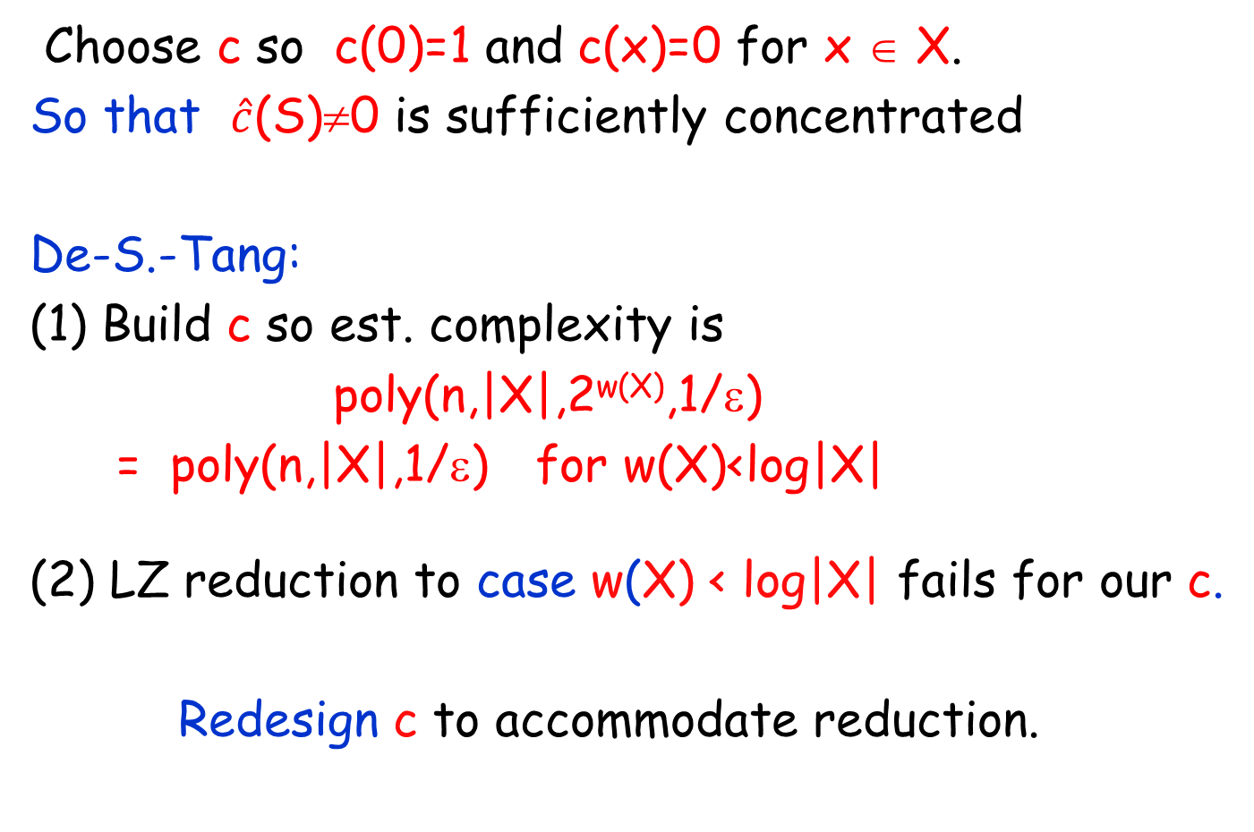
Noisy Model:Proof Sketch
Choose c so c(0)=1 and c(x)=0 for x ∈ X.
So that $\hat{c}$(S)≠0 is sufficiently concentrated
De-S.-Tang:
(1) Build c so est. complexity is
poly(n,|X|,2^{w(X)},1/ε)
= poly(n,|X|,1/ε) for w(X)<log|X|
(2) LZ reduction to case w(X) < log|X| fails for our c.
Redesign c to accommodate reduction.
Avi is 60! October 5-8, 2016

Slide 40
Noisy Model:Proof Sketch
DST:improved c (again when w(X) small)
For point z, Function u_{z}
u_{z}(x)=1 for x≥z, 0 else
choose
c = Σ_{z in D(X)}(-1)^{w(x)}u_{z}
Yields Complexity
poly(n,|X|,2^{w(X)},1/ε)
…but is incompatible with
LZ reduction.
(1,….1)
D(X)
(0,….0)
Avi is 60! October 5-8, 2016

Slide 41

Noisy Model:Proof Sketch
Nice properties of
c = Σ_{z in D(X)}(-1)^{w(x)}u_{z}
c(0)=1
c(x)=0 for x ∈ D(X)
Support($\hat{c}$)⊆D(X)
Bad property of c
(for LZ reduction)
c(x) can be 2^{Ω(n)}
for x∉D(X)
(1,….1)
D(X)
(0,….0)
Avi is 60! October 5-8, 2016

Slide 42
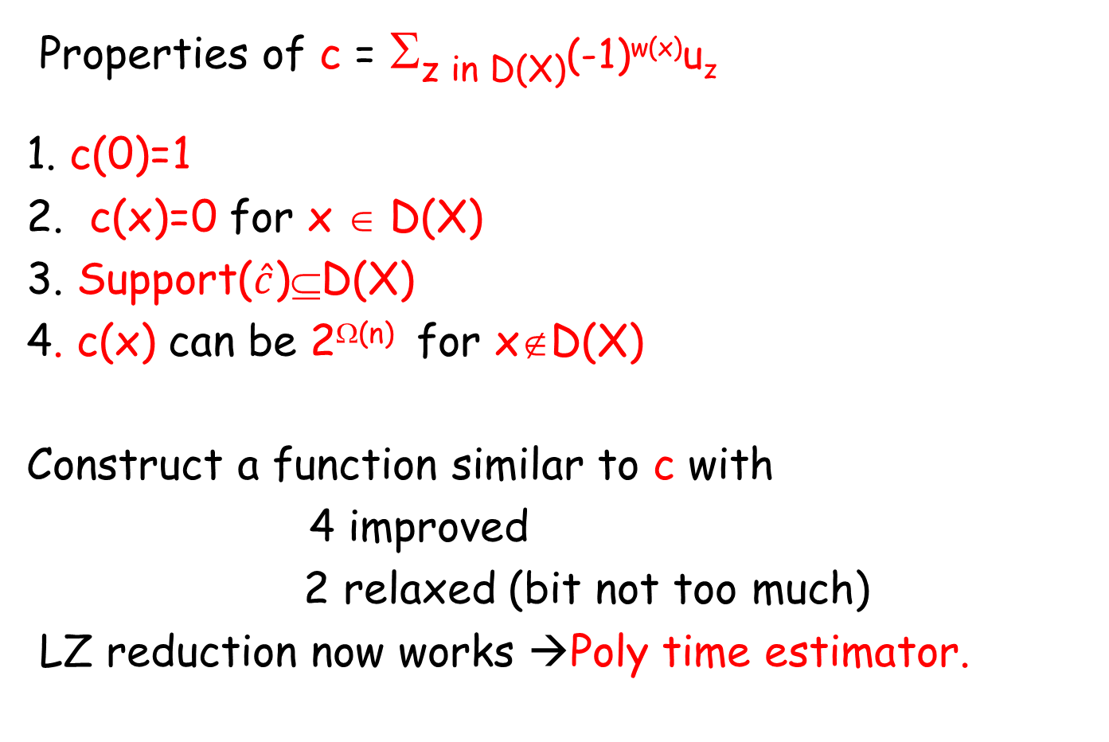
Noisy Model:Proof Sketch
Properties of c = Σ_{z in D(X)}(-1)^{w(x)}u_{z}
1. c(0)=1
2. c(x)=0 for x ∈ D(X)
3. Support($\hat{c}$)⊆D(X)
4. c(x) can be 2^{Ω(n)} for x∉D(X)
Construct a function similar to c with
4 improved
2 relaxed (bit not too much)
LZ reduction now works →Poly time estimator.
. c(x) small for x ∈ D(X)
c(x) = O((1+δ)^{n})
Avi is 60! October 5-8, 2016

Slide 43
Noisy Model:Proof Sketch
How do we build d(x)?
Construct nice family of c-like functions
c_{j,δ} for 1≤j ≤n and δ ∈ (0,1]
For fixed δ, choose d_{δ} = best linear comb. of c_{j,δ}
(Then choose best δ ∈ (0,1] )
Finding best linear combination can be expressed as a minimization LP….
…which turns out to be LP analyzed in
Moitra-S. for Lossy case (!)
Avi is 60! October 5-8, 2016

Slide 44
FINAL REMARKS……
Avi is 60! October 5-8, 2016

Slide 45
Relaxing KSA Assumption
Results for noisy case rely on KSA: known support
Weaken assumption?
Bounded support assumption (BSA): |support(f)| ≤ k
Lower bound assumption (LBA):
f(x)>0 has nonzero probability implies f(x)≥ε
Dvir-Rao-Wigderson-Yehudayoff:
Reduction: Solution under KSA implies
solution under BSA
LBA
Avi is 60! October 5-8, 2016

Slide 46
Noisy Model:Open problems
Weaken lower bound assumption?
What’s the right dependence on μ?
Unknown μ ?
(Lovett-Zhang, poly(n,|X|^{log|X|},1/ε)
Avi is 60! October 5-8, 2016

Slide 47
HAPPY BIRTHDAY AVI!
Avi is 60! October 5-8, 2016

Slide 48
Noisy Model:Proof Sketch
Known: support(f) ⊆ X
Observations come from f’ = noisy f = T_{μ} f
T_{μ} is a well-known easy-to-describe linear operator:
(Bonami-Beckner noise operator)
Eigenfunctions of T_{μ}
For each subset S of [n]={1…n}
χ_{S}(x) = Fourier character
Eigenvalue is μ^{|S|}
(-1)
Σ(x_{j}:j in S)
Avi is 60! October 5-8, 2016

Slide 49
Longest increasing subsequence (LIS) problem

Slide 50
4
4
24
10
10
9
15
15
17
17
20
18
18
4
19
19
3
Given array f:[n] → N, find (length of)
Longest Increasing Subsequence (LIS)
Textbook dynamic programming problem
[CLRS 01] Chapter 15.4 (Longest Common Subsequence), Starred Problem 15.4-6
[Schensted, Fredman] O(n log n) algorithm

Slide 51
A partial list of references….
[Schensted 61] [Fredman 75] [Apostolica Guerra 87] [Atshul et al 90] [Ramanan 97] [Goldreich Goldwasser Ron 97] [Baik Deift Johansson 99] [Delcher et al 99] [Dodis et al 99] [Aldous Diaconis 99] [Ergun et al 99] [Bespamyatnuikh Segal 00] [Fischer 01] [Liben-Nowell Vee Zhu 03] [Zhang 03] [Ailon et al 03] [Parnas Ron Rubinfeld 03] [Gal Gopalan 07] [Gopalan et al 07] [Sun Woodruff 07] [Ergun Jowhari 08]

Slide 52
Massive data sets
Algorithm
Array f is extremely large
Algorithm has limited access to the array
How well can we approximate |LIS|?

Slide 53
What does limited access mean?
Algorithm
Two meanings considered here:
Unrestricted access but limited time
Streaming (one way) access with limited memory

Slide 54
Unrestricted Access - Limited Time
Algorithm
5
7
4
8
9
2
Algorithm should run in time much less than size of array
In particular, can read only a small fraction of array locations

Slide 55
Streaming Access -- Limited Memory
Algorithm
5
7
4
8
9
2
Algorithm sees each array location once
Algorithm has much less memory than size of array

Slide 56
Main results
Approximation algorithms for each model.
DM = Distance to monotonicity = n - |LIS|
For any (constant) δ > 0, Both algorithms give a
multiplicative (1+δ) approximation to |DM|
This gives an estimate ALIS to LIS satisfying:
|LIS| - δDM ≤ ALIS ≤ |LIS|
Streaming algorithm: polylog(n)/ δ memory
(Randomized: with C. Seshadhri 2013)
(Deterministic+Lower bounds: with Tim Naumovitz 2014)
Random access algorithm: C(δ)polylog(n) time
(Randomized: with C. Seshadhri 2010)
Best previous for both problems was
multiplicative (2+δ) approximation to |DM|
[Ergun-Jowhari 08] [Parnas Ron Rubinfeld 03] [Ailon Chazelle Comandur Liu 03]

Slide 57
Additive approximation
For any (constant) δ > 0
Algorithms gives additive δn approximation to |LIS|
|LIS| - δn < APPROX < |LIS|+ δn
Previously: only known (in both models) for δ > 1/4

Slide 58
The streaming algorithm

Slide 59
Our results-streaming
(1+δ) DM
0
DM
|LIS|
n
DM = distance to monotonicity = n - |LIS|
For any (constant) δ > 0
Algorithm gives a 1+δ - factor approximation to DM.
|DM| ≤ APPDM ≤ |DM| (1+ δ)
Memory used is O((log(n)² / δ)

Slide 60
Our results-streaming II
For any (constant) δ > 0
Algorithm gives a 1+δ - factor approximation to DM.
|DM| ≤ APPDM ≤ |DM| (1+ δ)
Memory used is O( (log(n)² / δ)
Previously,
Factor 2 approximation with polylog(n) memory [Ergun-Jowhari 2008]
Stronger approximation using O(n^{1/2}) memory
[Gopalan, Jayram,Krauthgamer,Kumar 2007 ]

Slide 61
Our results
|LIS| in this range
δn
Algorithm
0
n
|LIS|
In streaming setting
For any (constant) δ > 0
Algorithm gives additive δn approximation to |LIS|
Running time is C(δ)(log n)^{c}
(C(δ) =2^{O(1/δ)} )

Slide 62

Massive data sets
|LIS| is in range
[0.4n, 0.6n]
Mathematical question: How to locate small portion of array that tells about |LIS|?
Do such portions even exist?
Algorithm
5
7
4
8
9
2
Array f is extremely large, don’t want to read all of it
What can we say about LIS length, if we see very little?
|LIS| = LIS length
Read only poly(log n) positions
Obviously randomized

Slide 63
Exact LIS via streaming
Dynamic Programming
5
7
2
8
4
9
1
2
1
3
2
4
5
7
2
8
4
9
For each array location j remember:
(array value, length of LIS ending at j)

Slide 64
Exact LIS via streaming
Approximate
For k=1 to n
LIS(k) := max(LIS(i)+1: i <k and A(i) < A(k) )
Remember (i, A(i), LIS(i)) for all i<k.
Gives exact answer but….
….requires memory linear in n
Remember (i, A(i), ALIS(i)) for only a few i<k.

Slide 65
Approximate LIS via streaming
Algorithm remembers:
Set R of indices in {1,….,n}
For each i in R, (i, A(i), ALIS(i))
R= ∅
For t=1 to n
ALIS(t) := max(ALIS(i)+1: i in R AND A(i)<A(t) )
For each i in R forget i with probability p(i,t)
0 if t-i < C log(n)/δ
p(i,t) =
1/(t-i) otherwise
{

Slide 66
Algorithm Step j
Distribution of remembered indices gets sparser going back in time
1
3
6
6
7
5
7
1
2
4
3
11
19
25
28
17
23
j
Look at A(j)
Compute ALIS(j)
Randomly forget some indices from R

Slide 67
Analysis
Need to show:
ALIS is close to LIS
Memory used is small

Slide 68
Analysis: Memory usage
Memory is O(max |R|)
R_{t} = remembered indices after step t
E[R_{t} ] is O(log(n)/δ )
Max |R_{t} | is O(log²(n)/δ ) whp

Slide 69
Sketch of analysis
For every index i,
ALIS(i) ≤ LIS(i)
Want:
LIS(n)- ALIS(n) ≤ δDM

Slide 70
Analysis: ALIS is large
Fix an LIS L
Goal: |L|-|ALIS| is small
We define a subset M of L of memorable indices (M is a random set depending on the run of algorithm)
Show:
|ALIS| is at least as large as |M|
|L|- |M| is small with high probability.

Slide 71
Memorable Indices
For i≤t, Q_{t}(i)
= Indices of L …
… remembered at time t
… index value at least i
Index i is memorable if
i ∈ L and Q_{t}(i) ≠ ∅ for all t ≥ i
…algorithm never forgets i’s impact on LIS
M = set of memorable indices

Slide 72
Properties of memorable set M
M ⊂ L (so M forms an LIS)
ALIS(t) ≥ |M(t)| for each time t.
(Easy induction on t).
Main part: With high probability:
(n-|M|) ≤ (1+δ) (n - |L|)
(Few unmemorable indices outside LIS)

Slide 73
Recent (Joint with Tim Naumovitz)

Slide 74
Few nonmemorable indices
(L, γ)-sparse subsegment I of array:
density of L within I is at most γ
S = Union of all (L, γ)-sparse subsegments
|S| ≤ (1+ γ) /(1-γ) (n-|L|) = (1+γ) /(1-γ) DM
Set γ = δ/(2+ δ),
so |S| ≤ (1+ δ)DM
With high probability, all points outside of S are memorable, so
ALIS ≥ n-|S| ≥ n- (1+ δ)DM ≥ LIS- δ DM

Slide 75
Open problem
We just showed:
multiplicative (1+ δ) approx to DM
[GJJK 07] Deterministic multiplicative approx. to LIS O(n^{1/2}) space
Matching lower bound [Gal-Gopalan 07; Ergun-Jowhari 08] but only for deterministic algorithms
What about randomized algorithms?

Slide 76
The very fast unrestricted access algorithm

Slide 77
Unrestricted Access – Limited Time
Algorithm
5
7
4
8
9
2
Algorithm should run in time polylog(n).
In particular, can read only a small fraction of array locations

Slide 78
How about:
Compute the exact LIS on a
small uniform random sample ?
+

Slide 79
Compute the exact LIS on a
small uniform random sample ?
+

Slide 80
Uniform sampling in action
1
4
4
3
6
5
8
7
10
9
2
9
Choose uniform random sample of polylog(n) size
|LIS| = n/2, but random sample (almost) always totally increasing
Similar examples where |LIS|=o(n) but sample always increasing.

Slide 81
Our result
|LIS| in this range
δn
Algorithm
0
n
|LIS|
For any (constant) δ > 0
Algorithm gives additive δn approximation to |LIS|
Running time is C(δ)(log n)^{c}
(C(δ) =2^{O(1/δ)} )

Slide 82
Our result
δn
0
n/2
n
|LIS|
For any (constant) δ > 0
Algorithm outputs an interval of width δn
that almost surely contains |LIS|
= additive δn approximation.
Running time is C(δ)(log n)^{c}
(C(δ) =2^{O(1/δ)} )
Previously: only known for δ >= ½
[Parnas Ron Rubinfeld 03] [Ailon Chazelle Liu Seshadhri 04]

Slide 83
Sketch multiplicative 2+δ to DM (additive n/2) approximation [Ailon Chazelle Comandur Liu]
Obstacles to improvement
Interactive proof of an approximate lower bound
The two main algorithmic components:
Finding good splitters
Boosting approximation quality
The first algorithm and why it fails
Refining the two algorithmic components
Some details of analysis (as time allows)
Speeding up the algorithm

Slide 84
Geometric view
20
15
10
P(1)
4
4
20
10
10
9
15
15
4
1
2
3
Index x maps to point P(x)= (x,f(x))

Slide 85
Geometric View
Violation
Increasing sequence
Increasing sequence is a set of points
going up and right

Slide 86
The use of randomness
How many green balls?
Find fraction of green
Randomized - in constant time
[Chernoff-Hoeffding] Estimate to within γ fraction with probability 1- α using O(log(1/ α)/γ²) samples
Used in many places in the algorithm

Slide 87
The multiplicative 2+δ to DM (additive n/4) approximation of [Ailon Chazelle Comandur Liu]

Slide 88
A general approach
Point Classification: Takes as input a single index and outputs good or bad

Slide 89
Point classification
Classify an index as good or bad
Good indices form an increasing sequence
At most (|DM|+ δn) bad indices.
Classification of a single index runs very fast

Slide 90
From Classification to Estimation
Given the classification algorithm:
Choose random sample of indices and run Classify on each.
Output the fraction of indices that are classified as good

Slide 91
How can we ensure that Good is increasing?
We need:
For any violation P(x),P(z)
At least one of x,z is classified bad

Slide 92
The violation counting trick
Every point is violation
with P(x) or P(z)
P(x)
P(z)
x
z
Every index in [x,z] is a violation with x or z
[Ergun Kannan Kumar Rubinfeld Viswanathan 99]
So at least half the points in [x,z] are violation with x or violation with z

Slide 93
Criterion for bad index
For any violation x,z,
at least half the points in [x,z]
form a violation with x or with z
We would like to declare x to be bad if …
…there is an interval with endpoint x such that x forms a violation with at least half the points.

Slide 94
The ideal Bad points
More than half the points in
[x,z] are violations with x
P(x)
P(z)
x
z
If we declare x as bad and others as good, the good points form an increasing sequence

Slide 95
Checking if a point is bad
To decide if P(x) is bad:
Check each interval with x as endpoint
For each interval, check all points within the interval
Approximate checking:
Check only intervals of size (1+γ)^{k} (logarithmically many)
Check only a random sample of points in each intervals
Declare x bad if 1/(2+δ) fraction of samples in an interval form a violation with x (so as not to miss any ideal bad points).
Good points form an increasing sequence.

Slide 96
How good is the approximation
Lemma [ACCL] There are:
at most 2DM ideal bad points
at most (2+δ)DM declared Bad points
Putting it together
Sample a set of points
Determine the fraction ADM of points that are declared bad.
DM ≤ (approx) ADM ≤ (approx) 2DM

Slide 97
Where are we…
Sketch of algorithm of [ACCL]
multiplicative 2+δ approximation to DM
Good if DM is small, but useless if DM≥n/2

Slide 98
Where we are going…
Have a multiplicative 2+δ approximation to DM
Want a multiplicative 1+δ approximation to DM
Can we improve the analysis of the existing algorithm?
Can we modify the existing algorithm?

Slide 99
The generic algorithm
P(x)
Small random sample
x

Slide 100
The generic algorithm
P
P

Slide 101
The algorithm of [PRR], [ACCL]
P(x)
Study samples in “neighborhoods” of P(x)
If > ½- ε violations in any neighborhood then bad else good
Neighborhoods of length (1+ε)^{k}, so O(log n) neighborhoods

Slide 102
Is there a better analysis?
No…
1
4
4
3
6
5
8
7
10
9
2
9
LIS has size n/2 but….
….Classify will declare every index to be bad

Slide 103
Can we modify the previous algorithm?
High level structure: Classification algorithm into good and bad points
|Bad| (over)-estimates DM
and |Good| (under)-estimates |LIS|
To classify a point P(x): Take a random sample of indices (with distribution depending on x) and examine the points.
How does the distribution of the sample depend on x?

Slide 104
Structure of Sample for Classify(x)
x
Neighborhood sample:
Density of sample decreases exponentially with distance from x
Is there a better way to classify x using neighborhood samples?

Slide 105
Limitation of neighborhood sample
Can construct two input arrays A and B
There is an interval J of n/6 indices:
For array A, classify(x) must return bad for almost all
x in J ...
...or else approximation has at least n/6 error
For each x in J, neighborhood samples of x in A look the same as neighborhood samples of x in B.
So for B, classify(x) returns bad for almost all x in J.
In array B, excluding almost all x in J results in approximation error at least n/6

Slide 106
Neighborhood sampling is insufficient
k
k
k
k
10 points in each
|LIS| = 4k
|LIS| = 2k
k
3k
k
3k
Indicated point must be
bad in first example
good in second example
The decision of good/bad for a point depends on small scale properties of “far away” portions

Slide 107

Back to the drawing board….

Slide 108
An easier goal…
Can a wizard quickly convince an algorithm that there is an increasing sequence of length at least |LIS|-δn?
Construct a very fast interactive protocol between a wizard and skeptic with the following properties:
On input x, protocol outputs good or bad
The wizard has a strategy so that the probability that a random x is accepted is |LIS|/n.
For any strategy of the wizard, the probability that a random x is accepted is at most |LIS|/n.

Slide 109
Interactive classification…
Skeptic (secretly) selects x at random
I=[1,n]
Repeat log(n) times
Let mid(I) be midpoint of I
Wizard supplies a value v(I) such that Q(I)=(mid(I),v(I)) is consistent with LIS. (Q(I) is a splitter)
Skeptic tells wizard the half H of I containing x.
Replace I by H
Call x good if P(x) is consistent with all answers

Slide 110
A closer look at what the wizard does…
Each round is restricted to an interval I = (a,b).
The wizard has previously announced Q(a) and Q(b) that are consistent with the LIS
The points Q(a) and Q(b) define a Box=B(Q(a),Q(b)
Q(b)
Q(a)
a
\
b

Slide 111
Q(b)
Q(I)
Q(a)
mid(I)
Needs to provide Q(I) consistent with LIS(B)

Slide 112
Properties of interactive protocol…
If wizard fixes an LIS L and answers consistently then good indices are exactly those in L
The wizard can lie but this only reduces the probability that output is good.
Repeat the protocol several times.
The fraction of points declared good provides an approximate lower bound on |LIS|.
If the wizard behaves properly this approximate lower bound will be about |LIS|/n

Slide 113
Can an algorithm simulate the wizard?
Wizard must give points consistent with the LIS ….
…which is what the algorithm doesn’t know(!)

Slide 114
Relaxing the wizard….
P(b)
Q(I)
P(a)
mid(I)
Give point Q(I) that has few violations with LIS(B).
μ-approximate splitter has at most μ|LIS(B)| violations with LIS(B).

Slide 115
Plan for algorithm classify(x)…
P(b)
P(x)
Q(I)
P(a)
x
To perform Classify(x):
Given box B, find μ-approximate splitter Q(I)
If P(x) violates Q(I) output bad
Otherwise continue recursively on subbox

Slide 116
Fantasy algorithm and analysis…
To perform Classify(x):
Given box B, find μ-approximate splitter
If P(x) violates P(s) output bad
Otherwise continue recursively
Classify(x) runs in log(n) iterations
In each iteration, lose μ-fraction of the LIS.
Probability random x is classified good
is reduced by μ log(n).
OK provided that μ is log(n)/C.
This assumes the algorithm can find a μ-approx splitter at each iteration…

Slide 117
μ-evident splitter
Total no. of points outside blue< μn
μ-evident splitter
n/2
Finding a μ-evident splitter:
Can estimate the number of violations with s by random sampling.

Slide 118
Classify (at this point)
Perform iterative simulation of wizard by looking for a μ-evident splitter.
Has the desired properties…
…..provided that in each iteration
a μ-evident splitter is found.
What if no such splitter is found?

Slide 119
A closer look at what the wizard does…
In each round the wizard has an interval I = (a,b).
He has already announced that P(a) and P(b) are on the LIS
The points P(a) and P(b) define a Box=B(P(a),P(b))
Wizard’s job: given interval I, supply some s(I) in I so that P(s(I)) is on the LIS
Relaxed wizard: supply s(I) which is in violation with at most a μ fraction of points

Slide 120
An approximate splitter
n/2

Slide 121
An approximate splitter
LIS points lost
Approximate splitter
n/2
No. of LIS points lost < μn (violations with splitter)

Slide 122
An approximate splitter
n/4
n/2

Slide 123
An approximate splitter
No. of LIS pts < μ(n/2)
n/4
n/2
We lose a μ-fraction of LIS points at each round
Total loss = μn log n
Set μ = 1/(100 log n), then total loss is n/100 (1% of points)

Slide 124
How do we find approximate splitters?

Slide 125

The interactive protocol
Is this point
on LIS?
LIS is in blue
region
Approximate splitter
n/2
Where is the splitter?
Here is an
approximate splitter

Slide 126
The interactive protocol
Is this point
on LIS?
LIS is in blue
region
Approximate splitter
But even to find approximate splitters, you need the LIS!
n/2
Where is the splitter?
Here is an
approximate splitter

Slide 127
Count fraction of sample outside blue
Because μ = 1/(100 log n), poly(log n) samples checks this accurately
With this, we can simulate the prover

Slide 128
Getting a conservative splitter
n/2
We can sample (log n) different candidates and check all of them
You might miss a conservative splitter…
What if no conservative splitter exists?

Slide 129
For example …
.1n
Every point is in violation with ≥ n/10 points

Slide 130
If no μ-evident splitter is found…
Number of points outside
> μn
Choose any line
n/2
In particular this implies |LIS| < (1-μ) n
Need another idea: Boosting approximation

Slide 131
Boosting Approximations
Given an additive δ-approximation algorithm, can we use it to get a δꞌ-approx (δ > δꞌ)?

Slide 132
Boosting approximations
Suppose number
of points outside
at least μn
n/2

Slide 133
Boosting approximations
Run δ-approx
on points in box
Suppose at least μm points
outside of blue boxes
m₂ points
Run δ-approx
on points in box
Best splitter
m₁ points
Take sum of outputs as total LIS estimate
|LIS| = |LIS₁| + |LIS₂|, Est = Est₁ + Est₂
|Est₁ – LIS₁| < δm₁ |Est₂ – LIS₂| < δm₂
So |Est – LIS| < δ(m₁ + m₂)
n₁+n₂ < (1-μ)m, so |Est – LIS| < δ(1-μ)m

Slide 134
Putting it together
evident splitter?
n/2
Choose polylog sample of candidate splitters
Check whether each is a μ-evident splitter
If find one, then go to next step of interactive protocol
Otherwise…

Slide 135
Putting it together
Run δ-approx
on points in box
S
Run δ-approx
on points in box
n/2
One of these is “close enough” to best splitter
Est(S) = Left-Est(S) + Right-Est(S)
Only polylog(n) calls to weaker approximation algorithm
We go from error δ to δ(1- μ). Recurse to keep improving approximation

Slide 136
Putting it together
Run δ-approx
on points in box
S
Run δ-approx
on points in box
n/2
For each failed splitter candidate:
Est(S) = Left-Est(S) + Right-Est(S)
Final Estimate = max_{S} Est(S)
We go from error δ to δ(1- μ). Recurse to keep improving approximation

Slide 137
A critical gap…..
Alg
δ₀ = δ₁(1-μ)
Alg
Alg
δ₁
1/μ
Alg
Alg
Alg
Alg
δ₂
Alg
Alg
Alg
Alg
½
As we go up each level, approx gets better by (1-μ).
To improve from ½ to ¼ how many levels needed?
¼ = ½ (1-μ)^{t} So t = 1/μ
Running time at least 2^{1/μ}……. μ needs to be > 1/log log n.

Slide 138
A critical gap…..
For the boosting algorithm to be fast…
…. μ needs to be > 1/log log n.
For the IP simulation to be accurate……
….. μ needs to be < 1/Clog n.

Slide 139
The DP revisited
Run δ-approx
on points in box
Run δ-approx
on points in box
s/2
If no splitter, then only (1-μ)s points in any division
We take max of all possible sums
We get δ(1-μ)-approx

Slide 140
An approximate splitter
Remember?
No. of LIS pts < μ(n/2)
n/4
n/2
No. of LIS points lost < μn (violations with splitter)
In interval of size k, we lose μk LIS points
Total loss = μn log n
Set μ = 1/(100 log n), then total loss is n/100 (1% of points)

Slide 141
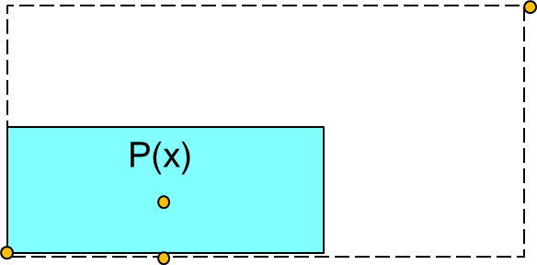
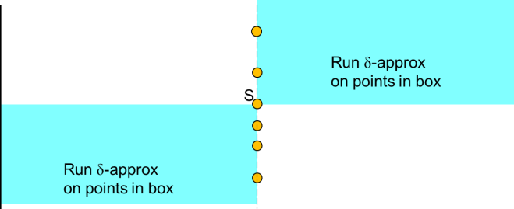
The hoped-for dichotomy
Continue IP
P
We find splitter
Cannot find μ-evident splitter
Modify
Modify
The “Interactive Protocol”
branch
The “Dynamic Programming”
branch
Dichotomy gap—no one μ works for both sides

Slide 142
Modifiying the splitter requirements
R
S
ρ
P(s)
ρ
Q
s
(μ,γ,ρ)-splitter
For every strip S adjoining P(s) …
…number of violations with P(s) inside S is at most
μ|S ∩ F| + γ width(S)
Definition connected to algorithm of [ACCL]

Slide 143
A new dichotomy
No. of points outside
at least μs
s/(log² n)
Run δ-approx
in each box
Suppose that P(s) is a (every “chain” has at most (1-μ)s points
Find chain with largest sum of estimates
We get δ(1-μ)-approx
But there are more than poly(n) chains!

Slide 144

A weaker splitter
0.01n
n/2
Every point is violation with at least n/100 points
No conservative splitter
But surely, splitters are easy to find
We’re being too conservative

Slide 145
The dichotomy fails….
Weaken
Strengthen
Continue IP
P
We find splitter
Cannot find splitter
The “Interactive Protocol”
phase
The “Dynamic Programming”
phase
For IP, we need μ < 1/log n
μn is error in each “level” of IP
For boosting, we need μ > 1/log log n
(1-μ) is decrease in error

Slide 146
A small generalization
s/3
2s/3
Suppose every “3-way” division has at most (1-μ)s points

Slide 147
A small generalization
Run δ-approx
on points in box
No. of points outside
at least μs
Run δ-approx
on points in box
Run δ-approx
on points in box
s/3
2s/3
Suppose every “3-way” division has at most (1-μ)s points
Do this for all 3-way splits (only poly(log n) many)
Take max over all sums – we get δ(1-μ)-approx

Slide 148
A generalization
Chain
s/(log² n)
s/(log n)
Suppose every “chain” has at most (1-μ)s points

Slide 149
Use dynamic programming
s/(log² n)
Run δ-approx
s/(log n)
Run δ-approx on all poly(log n) such boxes
Use Dynamic Program to find chain with largest sum of estimates
Longest path in DAG
Can solve in poly(log n) time

Slide 150
s/(log² n)
s/(log n)
Suppose every “chain” has at most (1-μ)s points
In poly(log n) time, with poly(log n) calls to δ-approx,
we get δ(1-μ)-approx

Slide 151
The basic dichotomy
Weaken
Strengthen
Continue IP
P
We find splitter
Cannot find splitter
The “Interactive Protocol”
phase
The “Dynamic Programming”
phase
For IP, we need μ < 1/log n
μn is error in each “level” of IP
For boosting, we need μ > 1/log log n
(1-μ) is decrease in error

Slide 152
Improved splitters
Allow splitters that are off center
but not too close to either end
Look for splitters that are input points P(x)
P(x) is a (μ,w) - splitter if for all indices z:
Number of violations with x in [z,x] (or [x,z]) is at most:
μ |x-z| + w
μ = small constant w = O(n/log n)
Search for x and check condition (approximately) by random sampling
Neighborhood sample of x
(Compare to 2-approx Classify)

Slide 153
Improved splitters
(μ,w) - Splitter is point P(x) not to close to either end such that for all z:
Number of violations with x in [z,x] (or [x,z]) is at most:
μ |x-z| + w
Key point: Instead of requiring:
μ = O(1/log n)
we need:
μ = small enough constant
w=O(n/log n)

Slide 154
Weaker splitters
n/3
Allow splitters that are off center
but not too close to either end
We set μ to be constant (say μ = 1/50)

Slide 155
The new and improved…
Size s
μs outside blue
n/2
We set μ to be constant (say μ = 1/50)
But we now ask for < μ-fraction of violations in every interval
As long as interval size s > n/(100log n)
This is “improved splitter”

Slide 156
The dichotomy, again
w
w/(log n)
If we are unable to find improved splitter in this box
Build grid in the box
Dichotomy Lemma: If no (μ,w)-splitter, no chain has more than (1-μ)n points
We can find δ(1-μ)-approx for LIS in box

Slide 157
The algorithm, in one slide
Continue IP
P
We find splitter
Cannot find splitter
Make poly(log n) calls to
δ-approx. Solve DP of poly(log n) size.
We get δ(1-μ)-approx
Overall running time becomes (log n)^{1/δ}
*&^#$% miracle that the math works out

Slide 158
Algorithm classify in one slide
Continue IP
P(x)
We find splitter
Cannot find splitter
P(x)
P(x)
Make poly(log n) calls to δ-approx.
Solve polylog n size DP
Classify P(x) recursively within smaller box.
We get δ(1-μ)-approx
Overall running time (log n)^{1/δ}

Slide 159
The even better version
Don’t exactly solve this dynamic program!
Use our sublinear algo to approximately solve in (loglog n) time. Then do it recursively…
Greek list: α β γ δ ε ζ λ μ ξ ρ θ τ ψ
We had ν, but got rid of it

Slide 160
Overall running time (log n)^{1/δ}
Improving the running time to K(δ) (log n)^{c}

Slide 161
A faster version…
Don’t solve this dynamic program exactly!
Use our sublinear algo to approximately solve in (loglog n) time. Then apply it recursively.
This sounds like a horrendous mess but…..
….Recursion doesn’t actually appear in implementation: accomplished implicitly by dynamically adjusting various parameters in the basic algorithm.
Running time is C(d) (log n)^{c}

Slide 162
What next?
We get C(δ) (log n)^{c} time, C(δ) is (at least) K^{1/δ}
Can we get (log n)/δ time?
Applications for other dynamic programs?
Longest common subsequence
Approximating edit distance
…?

Slide 163
A dynamic program
Splitter
n/2
Splitter: point P(x) on the LIS
Find LIS in each blue region and piece together.

Slide 164
A dynamic program
S
n/2
But we don’t know right splitter.
So try all n possible splitters
Choose the one that gives the largest sum of LIS’s
Max_{S} (|LIS-below-S| + |LIS-above-S|)

Slide 165
The dynamic program
n/2
LIS in all small boxes gives LIS for bigger boxes
Essentially a special case of Savitch’s algorithm
Exact version is not so efficient
Is this approach relevant for a fast approximation algorithm?

Slide 166
Classification via splitter finding
P
S
n/2
Search for a splitter.
Guess the splitter (somehow!)
Recurse on subbox containing P

Slide 167
How do we guess a splitter?
n/2

Slide 168
Sufficient: an approximate splitter
LIS points lost
Approximate splitter
n/2
No. of LIS points lost < μn (violations with splitter)

Slide 169
An approximate splitter
n/4
n/2

Slide 170
An approximate splitter
No. of LIS pts < μ(n/2)
n/4
n/2
We lose a μ-fraction of LIS points at each level
Total loss = μn log n
Set μ = 1/(100 log n), then total loss is n/100 (1% of points)

Slide 171
How do we find approximate splitters?

Slide 172
μ - Conservative splitters
Total no. of points outside blue< μn
μ -Conservative splitter
n/2
μ - Conservative splitter is an approximate splitter
μ - Conservative splitters are easily found by random sampling…
…provided that there is a nontrivial number of them

Slide 173
Getting a conservative splitter
n/2
We can sample (log n) different candidates and check all of them
You might miss a conservative splitter…
What if no conservative splitter exists?

Slide 174
Getting a conservative splitter
n/2
We can sample (log n) different candidates and check all of them
What if they are few or no conservative splitters?

Slide 175
No conservative splitters
.01n
n/2
Every point is in violation with at least μ n points
No conservative splitter

Slide 176
If no conservative splitter….
Number of points outside
> μn
Choose any spliiter
S
n/2
So we know that |LIS| < (1-μ) n
Leads to the next idea. Boosting approximations

Slide 177
Boosting Approximations
Given:
an additive δn-approximation algorithm
Want δꞌn-approximation algorithm (δ’ < δ)?

Slide 178

Boosting approximations
Run δ-approx
on points in box
No. of points outside
at least μn
n₂
Run δ-approx
on points in box
Real splitter
n₁
n/2
Take sum of outputs as total LIS estimate
|LIS| = |LIS₁| + |LIS₂|, Est = Est₁ + Est₂
|Est₁ – LIS₁| < δn₁ |Est₂ – LIS₂| < δn₂
So |Est – LIS| < δ(n₁ + n₂)
n₁+n₂ < (1-μ)n, so |Est – LIS| < δ(1-μ)n

Slide 179
Boosting approximations
Find Est₂ = δ-approx to LIS₂
No. of points outside
at least μn
n₂ points
Find Est₁ = δ-approx to LIS₁
True splitter S
n₁ points
n/2
Assume we know the true splitter S
But S is not a conservative splitter.
n₁+n₂ < (1-μ)n
|LIS| = |LIS₁| + |LIS₂|,
|Est₁ - LIS₁| < δn₁ and |Est₂ - LIS₂| < δn₂
So |Est – LIS| < δ(1-μ) n Reduced relative error!
But we don’t know S!

Slide 180
We don’t know the best splitter
Run δ-approx to get Est₂(S)
S
Run δ-approx to get Est₁(S)
n/2
Assume no conservative splitter
Try O(log n) random splitters; one is “close enough” to best
For each S,
Est(S) = Est₁(S) + Est₂(S)
Est = max (Est(S):S) is a δ(1-μ) approximation to LIS
Only polylog(n) calls to δ - approximation algorithm

Slide 181
The hoped-for dichotomy
Continue
P
Find μ−conservative splitter
No μ−conservative splitter
Use approximate DP with lower quality approximations in subproblems
Recurse on subbox
But what is μ?
Need μ <log(n)/C
Need μ>Cloglog(n)

Slide 182
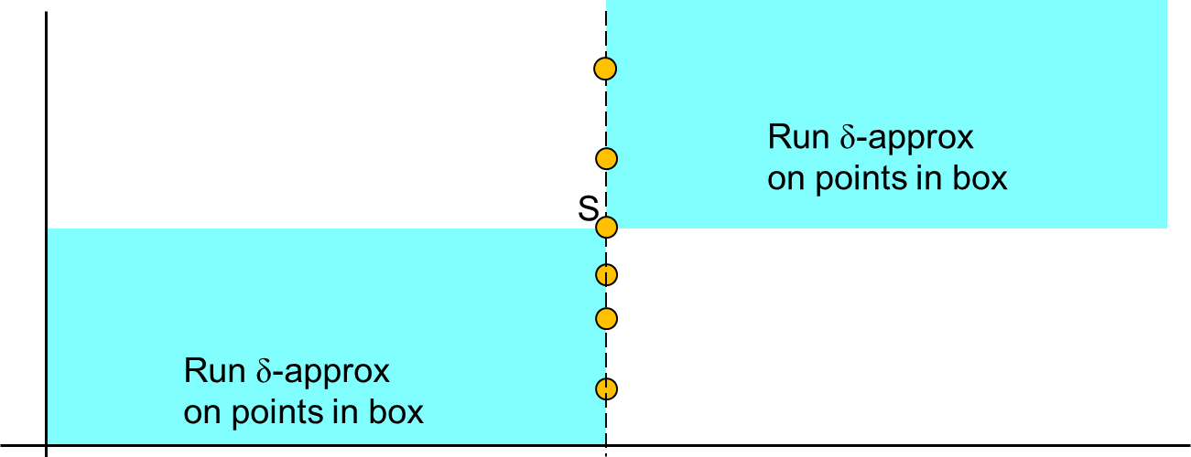
The DP revisited
Try splitter S
If not μ - evident, then at least μn points excluded by S
Add the LIS estimates in each box to get overall LIS estimate
We take max over a sample of S’s
Gives a δ(1-μ)-approx

Slide 183
A generalization
Chain
n/(log² n)
n/(log n)
Suppose every “chain” has at most (1-μ)n points

Slide 184
A generalization
No. of points outside
at least μn
n/(log² n)
Run δ-approx
in each box
n/(log n)
Suppose every “chain” has at most (1-μ)n points
Find chain with largest sum of estimates
We get δ(1-μ)-approx
But there are more than poly(n) chains!

Slide 185
Use dynamic programming
n/(log² n)
Run δ-approx
n/(log n)
Run δ-approx on all poly(log n) such boxes
Use Dynamic Program to find chain with largest sum of estimates
Longest path in DAG
Can solve in poly(log n) time

Slide 186
n/(log² n)
n/(log n)
Suppose every “chain” has at most (1-μ)s points
In poly(log n) time, with poly(log n) calls to δ-approx,
we get δ(1-μ)-approx

Slide 187
μ - Improved splitters
Total no. of points outside blue< μn
splitter S
n/2
μ - Conservative splitter: can only afford μ=O(log n)
A more sensitive condition:
For every interval I around n/2,
no more than μ|I|+O(n/log n) violations with S

Slide 188
μ - Improved splitters over
Recurrence for Classify works provided:
We have μ – Improved splitters with μ at most some small constant.
(Needed μ = O(log n) before)

Slide 189
The dichotomy, again
w
w/(log n)
If we are unable to find μ-improved splitter in this box
Build grid in the box
Dichotomy Lemma: If no μ-improved splitter, no chain has more than (1-μ)n + n/log(n) points
We can use boosting find δ(1-μ)-approx for LIS in box

Slide 190
Algorithm classify in one slide
Continue IP
P
We find splitter
Cannot find splitter
1.Make poly(log n) calls to δ-approx.
2. Solve polylog n size DP
3.Classify P recursively within smaller appropriate box.
We get δ(1-μ)-approx
Overall running time becomes (log n)^{1/δ}

Slide 191
The even better version
Don’t solve this dynamic program exactly!
Use our sublinear algo to approximately solve in (loglog n) time. Then apply it recursively.
This sounds like a horrendous mess but…..
….Recursion doesn’t actually appear in implementation: accomplished implicitly by dynamically adjusting various parameters in the basic algorithm.
Running time is C(δ) (log n)^{c}

Slide 192
Final remarks
We get C(δ) (log n)^{c} time, C(δ) is (at least) K^{1/δ}
Can we get (log n)/δ time?
Recent related work (S.-Seshadhri): multiplicative
(1+ δ) approximation to n-|LIS| in streaming model with space O(log(n)/ δ)
(Best previous: factor 2 approximation) Ergun-Jowhari 08
Other dynamic programs?

