Slide 1
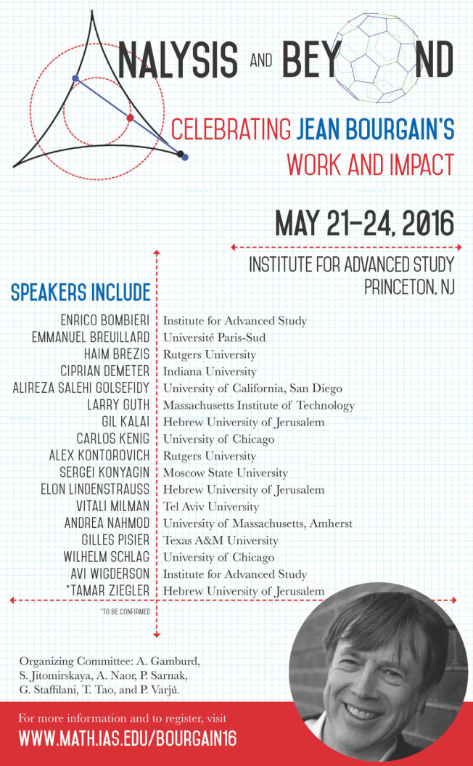
Questions for Bourgain
Celebrating Jean Bourgain’s mathematics
Gil Kalai
Einstein Institute of Mathematics
Hebrew University of Jerusalem.
IAS, Princeton, May 2016

Slide 2
The cap set problem
A cap set in {0,1,2}^{n} is a set containing no 3 distinct elements that sum up to zero (equivalently, no 3-term arithmetic progression(AP), no affine line). Let f(n) denotes the maximum size of such a cap set.
Let g(n) be the maximum size of a set without 3-term AP in
{0,1,2,3}^{n}.
f(n)=o(3^{n}) (`87) Frankl, Graham, and Rodl
f(n)=O(3^{n}/n) Meshulam (`95)
g(n)=o(4^{n}/n) Sanders (`09)
f(n)=O(3^{n}/n^{1+a}) a>0 Bateman and Katz (`12)

Slide 3
The cap sat problem
May 5, 2016 g(n) =O(3.61^{n}) (Ernie Croot, Seva Lev, and Peter Pach)
May 13, 2016 f(n)=O(2.756^{n}) (Jordan Ellenberg, Dion Gijswijt)
The cap set problem has been solved!
(It would be interesting to understand the constant.)

Slide 4
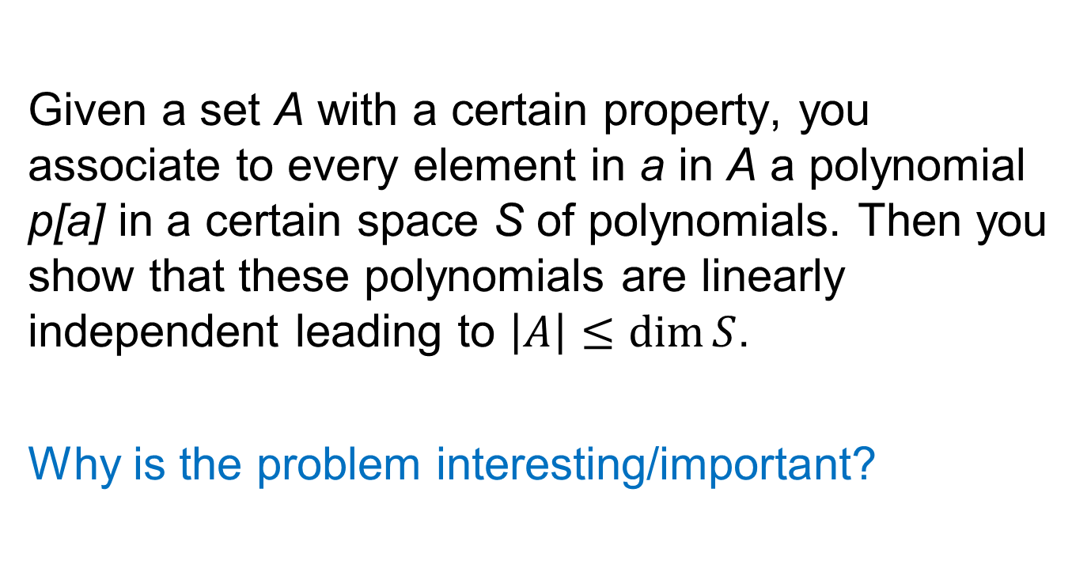
A word about the proof (The polynomial method).
Given a set A with a certain property, you associate to every element in a in A a polynomial p[a] in a certain space S of polynomials. Then you show that these polynomials are linearly independent leading to $\left|A\right|≤\dim{S}$.
Why is the problem interesting/important?

Slide 5
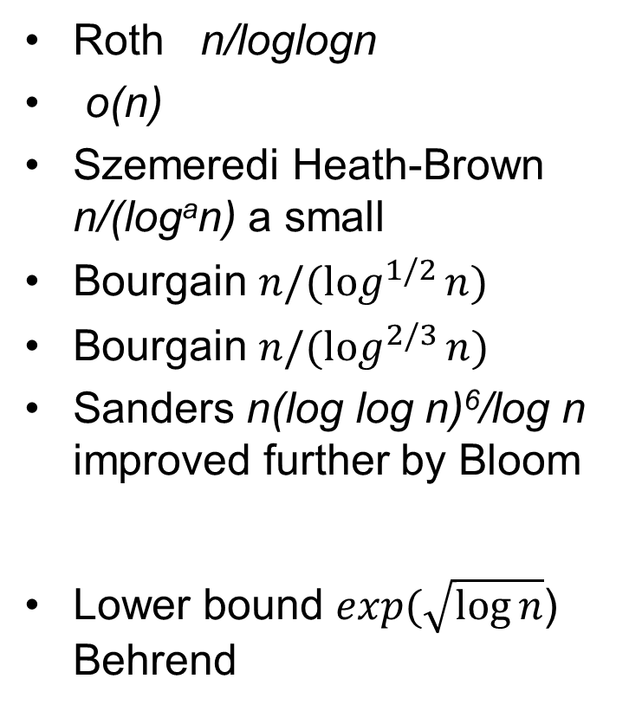
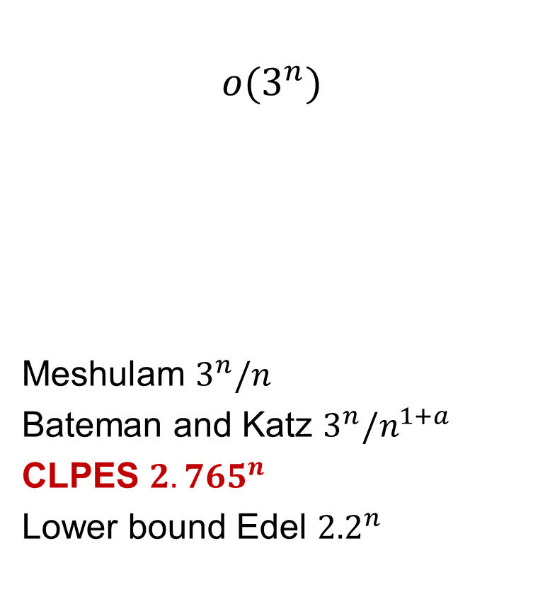
The cap set problem and Roth’s theorem
Bounds on 3-AP free sets in [n] r₃(n)
Bounds on 3-AP free
sets in Z₃^{n}
Roth n/loglogn
o(n)
Szemeredi Heath-Brown n/(logªn) a small
Bourgain $n/(log_{}^{1/2}{n)}$
Bourgain $n/(log_{}^{2/3}{n)}$
Sanders n(log log n)⁶/log n improved further by Bloom
Lower bound $exp(\sqrt{\log{n}}$) Behrend
$$o(3^{n})$$
Meshulam $3^{n}/n$
Bateman and Katz $3^{n}/n^{1+a}$
CLPES ${2.765}^{n}$
Lower bound Edel ${2.2}^{n}$

Slide 6
The challenge
Apply (or adapt) the polynomial method to obtain a Behrend-quality lower bound for r₃(n)
Additional/alternate challenges: AP with more terms; Some bounds for r₃(n); …

Slide 7
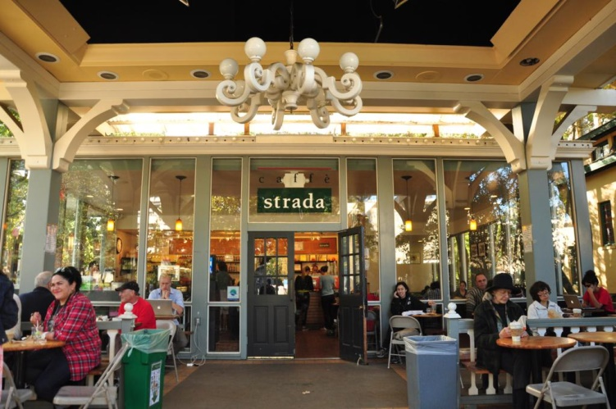
Berkeley, 2013
Schulman’s `93 tree-codes and exponential sums (Schulman and Moore)

Slide 8
Tree codes
You have a small alphabet Ω and a large alphabet Σ. You want to encode all words of length n with letters in Ω by words of length n with letters from Σ
Ordinary codes: in an arbitrary way
Schulman tree codes (93): in a prefix-preserving way.
You want to be able to correct a constant fraction of errors.
There are no explicit constructions for tree-codes. Schulman and Moore found examples based on certain exponential sum conjecture.

Slide 9
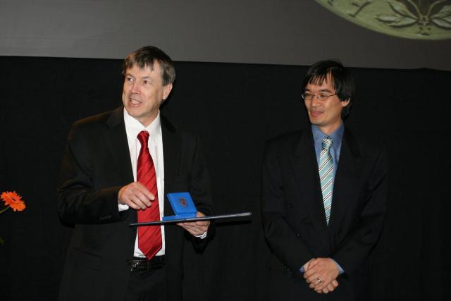
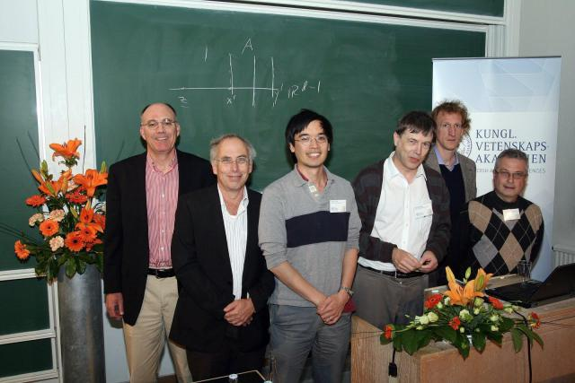
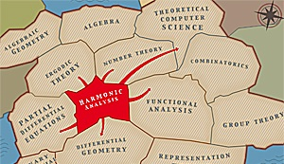
Lund 2012

Slide 10
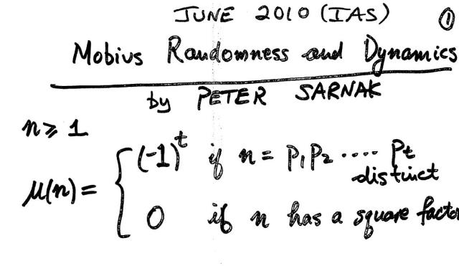
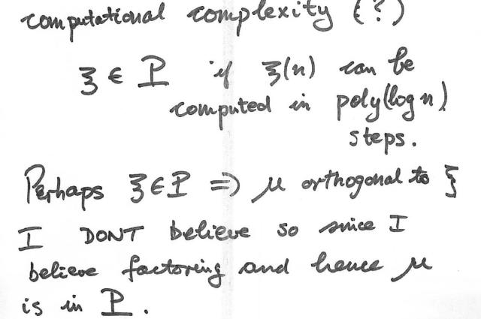
Mobius Randomness and complexity 2011/2012
Questions initiated from Peter’s Sarnak 2011 Colloquium lecture at HUJI
And from questions raised during his lecture by me, Dorit Aharonov, and Michael Ben-Or

Slide 11

Mobius randomness
PNT (or Mobius randomness) for f(n) with values 1,-1,
$\sum_{k=1}^{n}{η\left(k\right)f\left(k\right)=o(n)}$

Slide 12
Mobius Randomness and complexity 2011/12
PNT for digital arithmetic functions defined by bounded depth circuits? (Yes, Green)
PNT for digital arithmetic functions defined by linear Z/2Z forms? (Yes, Bourgain)
PNT for digital arithmetic functions defined by monotone expression? (Yes, Bourgain)
PNT for digital arithmetic functions defined by low degree Z/2Z forms? (Largely Open)
Why are digital arithmetic functions interesting, and what’s next?

Slide 13
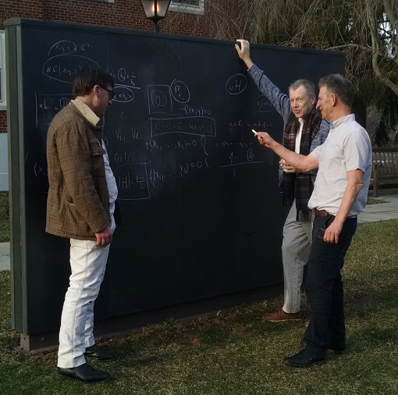

Slide 14
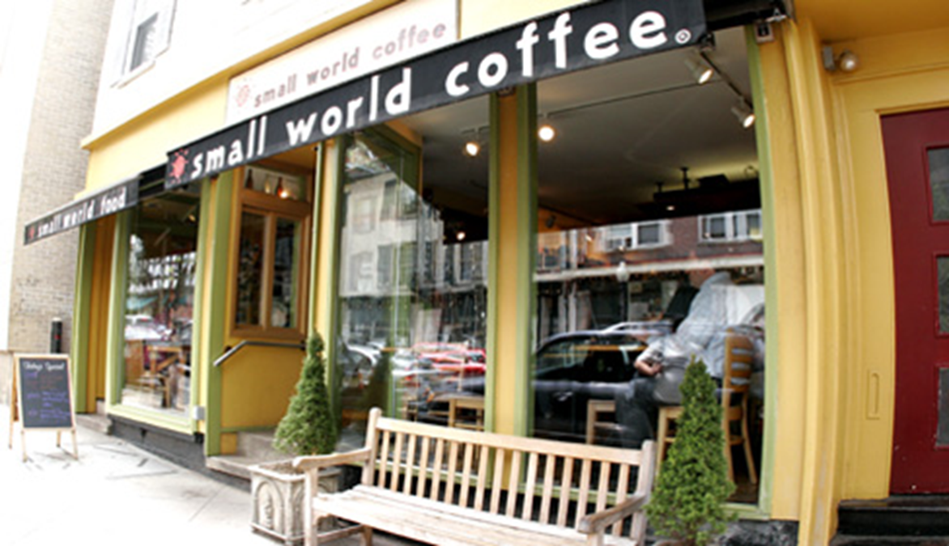
Projections of subsets of the discrete cube
Bourgain, Kahn, Kalai (2012-2013)

Slide 15
Projections of subsets of the discrete cube
is the set of 0-1 vectors of length n.

Slide 16

An IAS lecture we both attended: Jonathan Israel, Nov `12

Slide 17
Edinburgh `02 ; Vancouver `02
Finite metric spaces
Connection to computation; statistical physics; random matrices; …
Restriction and Kakeya, also over finite fields
Classical convexity
Classical harmonic analysis
Geometry of Banach spaces
Szemeredi type theorems
….

Slide 18
Threshold behavior and influence IAS 1995, 2000
(and some related open problems and later works)
The Erdos-Renyi model and my work with Jean.
Given a graph G we study a new graph H obtained by taking every edge of G at random with probability p. (Independently)
G = complete graph- Random graph theory
G = Grid in R^{d} – Percolation model

Slide 19
Monotone Boolean functions

Slide 20
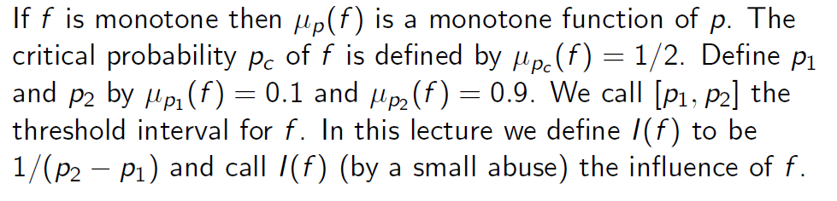
Threshold intervals

Slide 21
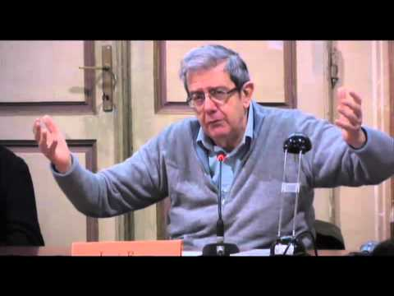
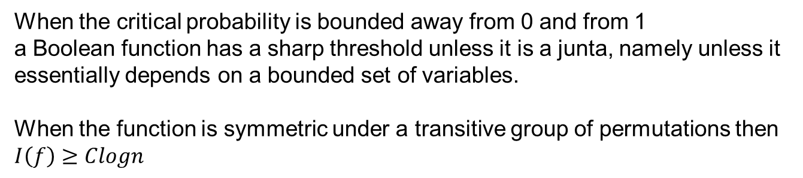
Russo 0-1 law, KKL, BKKKL, Talagrand, FK, Friedgut
Lucio Russo
When the critical probability is bounded away from 0 and from 1
a Boolean function has a sharp threshold unless it is a junta, namely unless it
essentially depends on a bounded set of variables.
When the function is symmetric under a transitive group of permutations then
$I\left(f\right)≥Clogn$

Slide 22
Threshold under symmetry I

Slide 23
Thresholds under symmetry II

Slide 24
A new surprising application
Reed-Muller Codes Achieve Capacity on Erasure Channels by Santhosh Kumar, Henry D. Pfister (2015)
This is a breakthrough result in error-correcting codes and it is based on our improvement for the influence from logn to logn loglogn when the function is invariant under a group of permutations of linear type.

Slide 25
Friedgut, Bourgain and Hatami
When the critical probability is o(1)
Friedgut (1999): A monotone graph-property with coarse threshold has local structure.
Bourgain (1999): A Boolean function with coarse threshold has substantial locally-defined ingredient
Hatami (2010): A Boolean function with coarse threshold has local structure.

Slide 26
Random k-sat and recent startling developments
Theorem (Friedgut): Random k-sat has a sharp threshold.
Theorem (Jian Ding, Allan Sly, Nike Sun, 2014): Physicists’ predictions (based on the replica method) for the critical probability are valid for large values of k.

Slide 27
Erdos Renyi again and the expectation threshold conjecture
A major challenge (Kahn and Kalai 06): Extend the Friedgut-Bourgain-Hatami results away from the critical probability.

Slide 28

Bourgain’s Junta theorem
Theorem (Bourgain 2002): For a Boolean function $f$, if the Fourier weights $\sum_{S:\left|S\right|=k}{|}\hat{f}$ ${\left(S\right)|}^{2}$ decay faster than $\sqrt{k}$then the function is a junta.

Slide 29
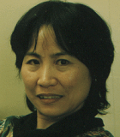
The Chang’s inequality
Mei Chu Chang, Jean’s wife, is a prominent researcher in additive number theory and other areas. Mei Chu was not involved directly in the analysis of Boolean functions. However, one of Mei Chu’s results known as the Chang inequality (`02) has important role in analysis of Boolean function, and, for example, in my recent works with Friedgut, Kahn, Keller and Mossel on correlation inequalities related to the Chvatal’s conjecture. It is about the “energy” contributed by “height-one” Fourier coefficients for Boolean functions.

Slide 30
Percolation in 2D
Russo; RSW; Kesten p_{c}=1/2; no percolation at criticality; critical exponents, conformal invariance (Smirnov); Schramm’s SLE₆; Garban, Pete, Schramm;…

Slide 31
Percolation in 3D
1) Conj: At the critical point for (infinite) 3D percolation, there is no percolation (with prob. 1)
2) Conj: The threshold window for the crossing event for finite 3D percolation is of length nª for 0 < a < ½ (where n is the number of bonds.)
(There are recent hopes among experts like Hugo Duminil-Copin, Vincent Tassion, Gady Kozma, and Vincent Beffara that time is ripe for that.)
3) (Kozma and Kalai) Little progress towards: “Understand the Fourier distribution for crossing events for 3D percolation,” based on techniques from the 1998 paper.

Slide 32
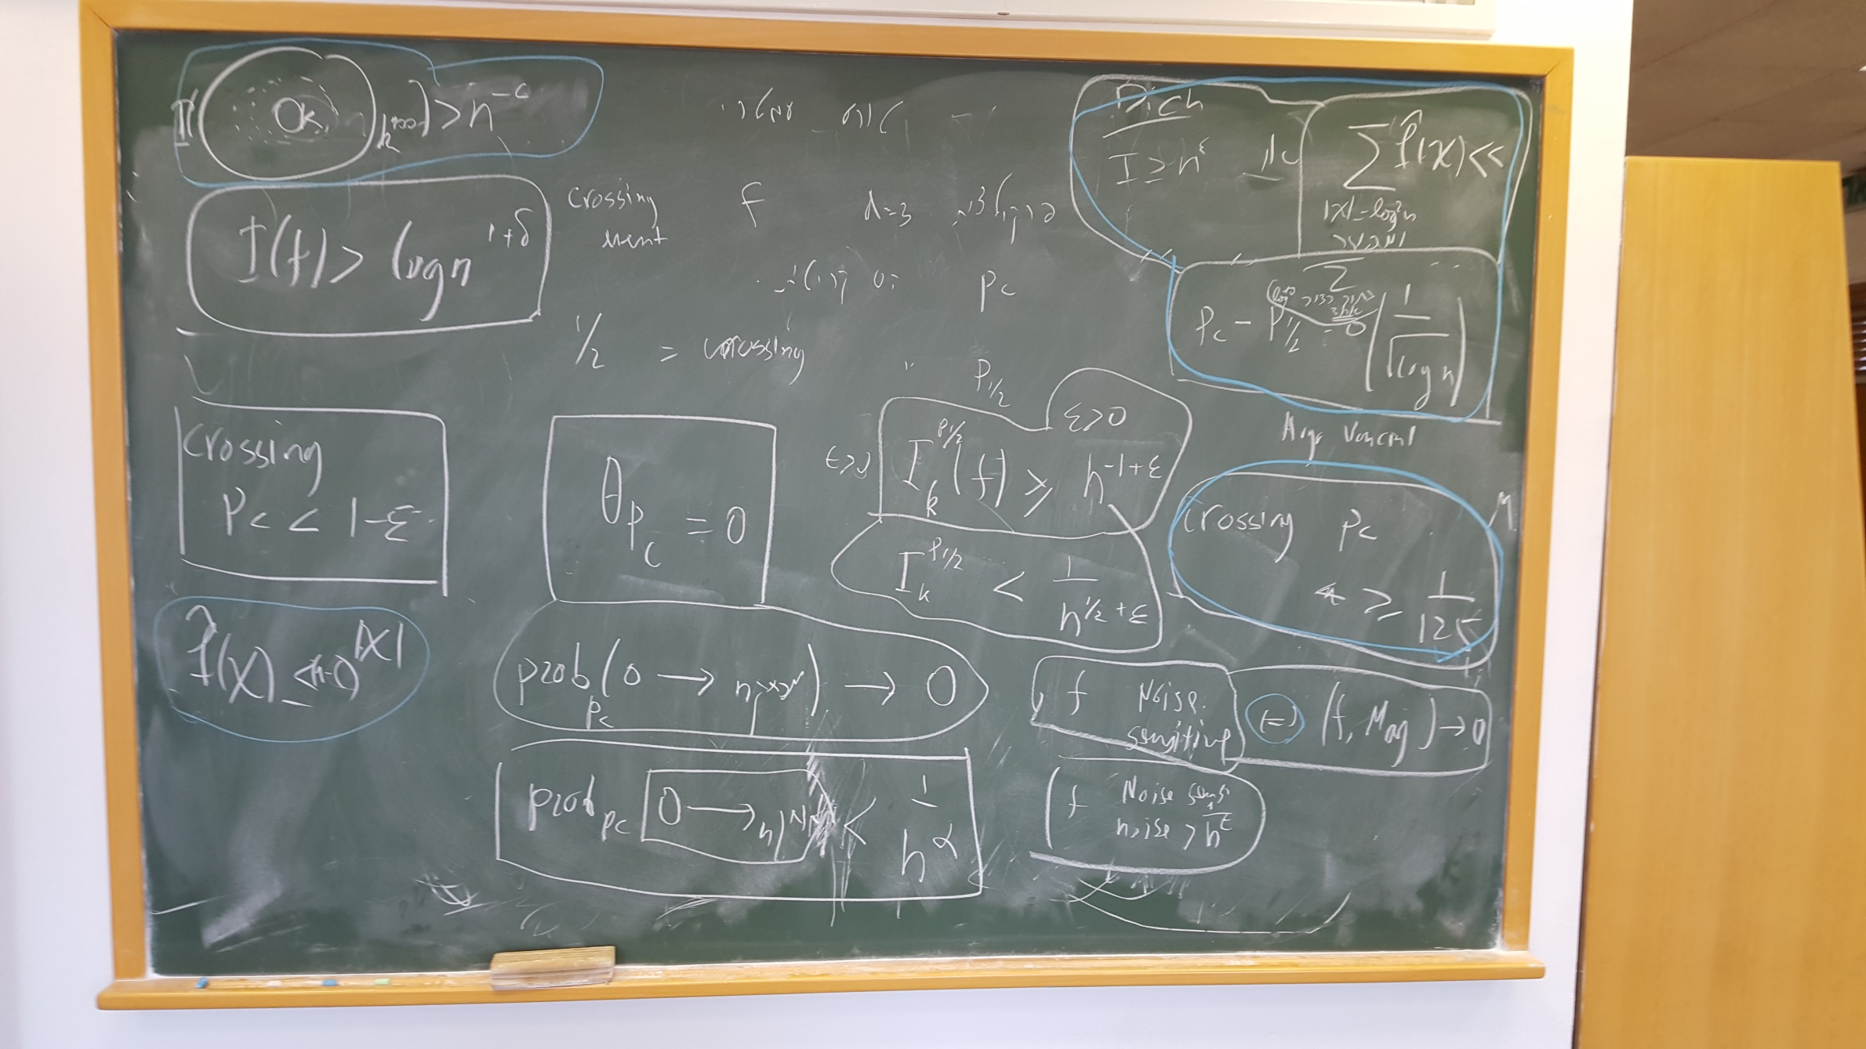

Slide 33
Zurich 94

Slide 34
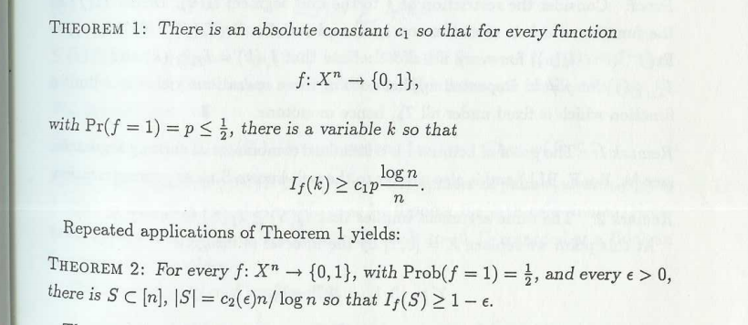
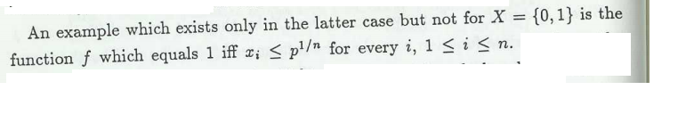
An embarrassing fact regarding our first 1992-paper
A few lines later

Slide 35
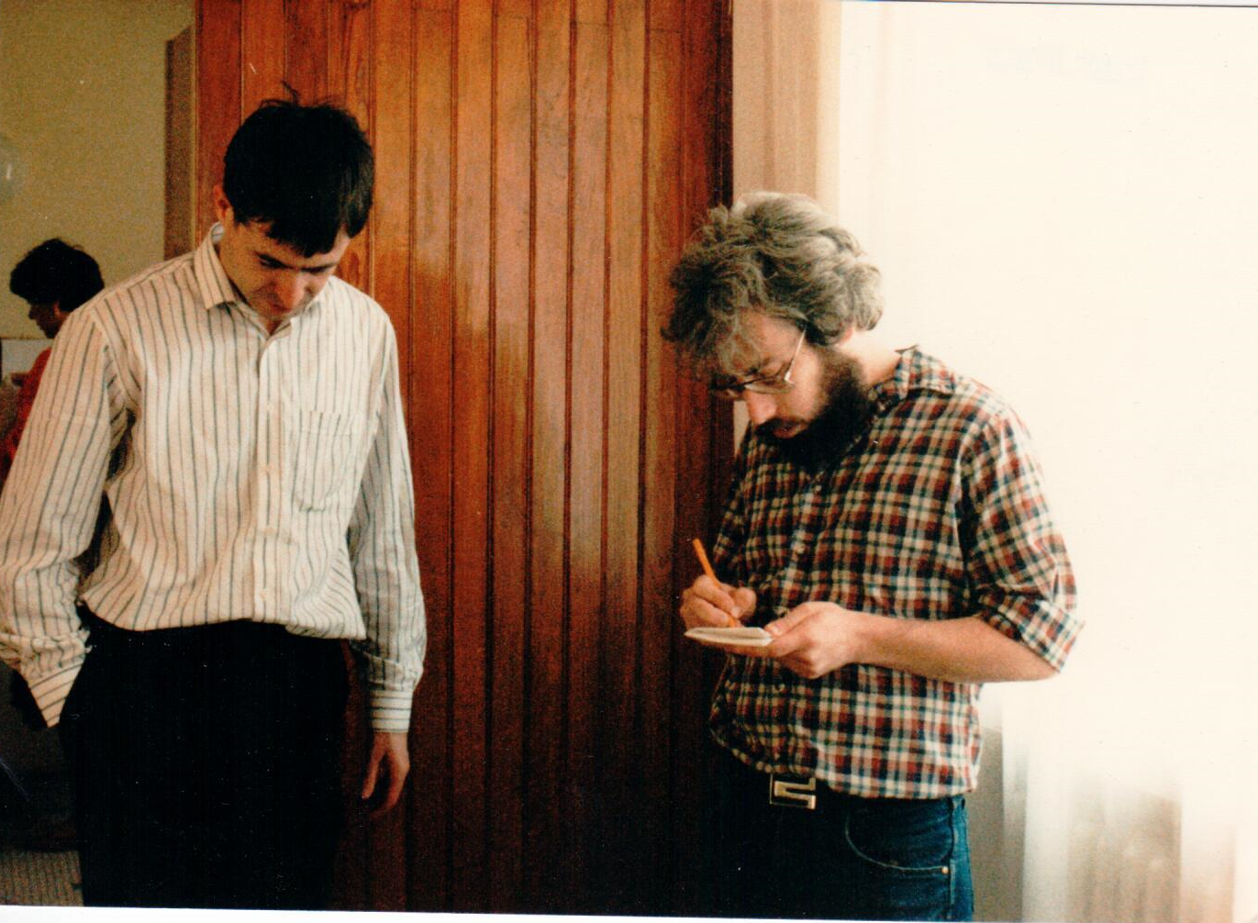
I.H.E.S late 80s

Slide 36
Λ_{p}

Slide 37
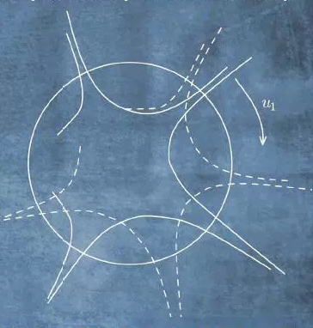
The Oberwolfach Convexity Conferences

Slide 38
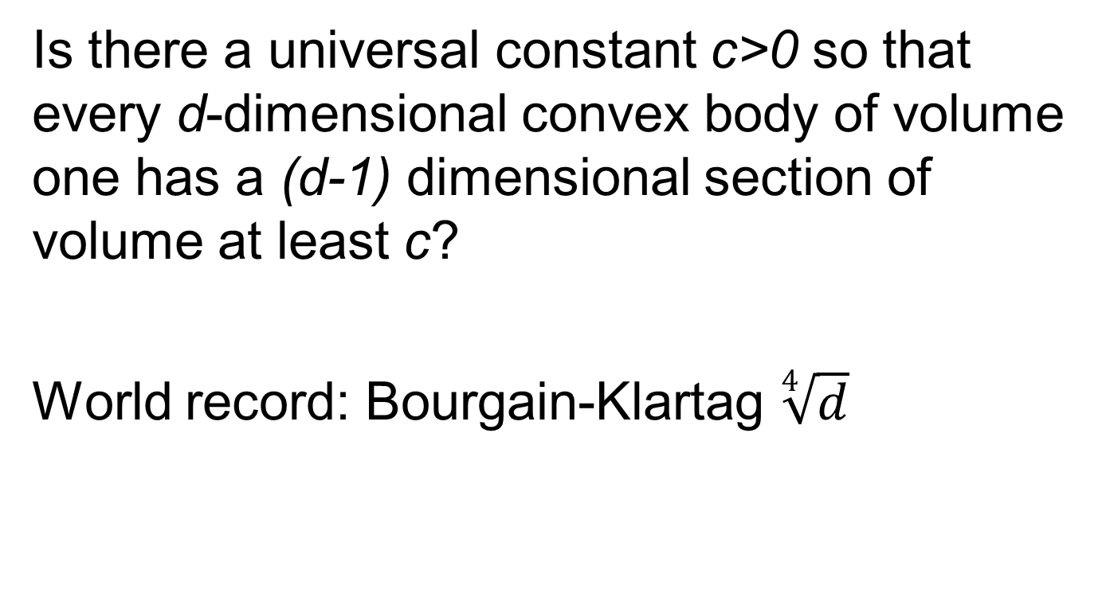
Busseman-Petty problem and the slicing conjecture
Is there a universal constant c>0 so that every d-dimensional convex body of volume one has a (d-1) dimensional section of volume at least c?
World record: Bourgain-Klartag $\sqrt[4]{d}$

Slide 39
Jerusalem mid-late 80s onward
Banach theory group (Joram Lindenstrauss, Lior Tzafriri, Mori Zippin, Tomek Schankowski, and others)
The Ergodic theory group (Furstenberg, Weiss, Katznelson.)
PDE group (Agmon, Pazy, Kaniel, Ben Artzi,)
Algebra group (Amitzur, Mann, Lubotzky,…)
Combinatorics; CS; logic; probability; game theory…

Slide 40
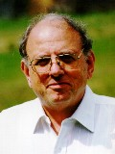
Jean and Joram
One common theme of interest: Banach spaces defined by classical theorems from finite dimentional convexity.
(with Vitali Milman) Approximation of Zonoids by zonotopes; the “mixing time” for symmetrization.

Slide 41
Covering convex sets by sets of smaller diameter
(Schramm 89) Every convex set K in Rd can be covered by 1.2248..^{d} smaller homothets of a constant width completion of K.
(Bourgain and Lindenstrauss 91) Every convex set in R^{d} can be covered by 1.2248..^{d} balls of smaller diameter. (same=smaller)
Can you beat the 1.2248..^{d} bound? Even if you just care about sets of smaller diameter. (Use, larger balls, perhaps?) This is related to Borsuk’s problem.

Slide 42
Jean, Lior, and the Kadison Singer conjecture
The Kadison-Singer conjecture is about coloring the rows of certain n by n matrices with C colors.
First you need to show that you can find n/C rows that can be colored by the same color. Bourgain and Lior Tzafriri proved that.
In fact, they proved more, that a fractional coloring with C colors exists.
In 2013 the full conjecture was settled by Marcus, Spielman and Srivastava.
Jean told me, referring to the proof, that a proof of this kind is how a proof of the RH would look like.

Slide 43
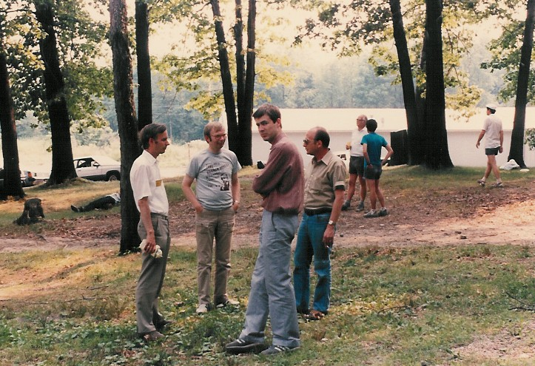
Konig, Figiel, Bourgain, Tzafriri

Slide 44
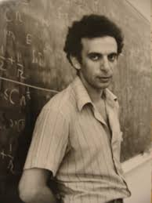
Jean and Vitali

Slide 45
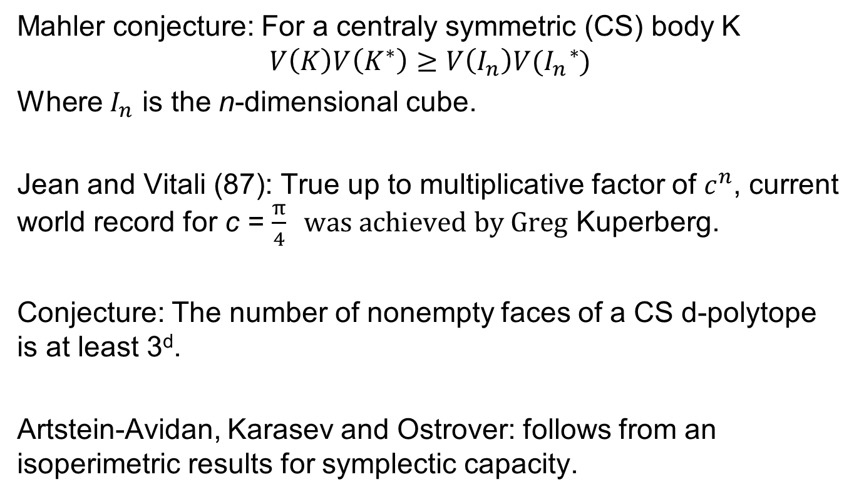
Mahler’s conjecture, face-numbers, and new avenues
Mahler conjecture: For a centraly symmetric (CS) body K
$$V\left(K\right)V\left(K^{∗}\right)≥V\left(I_{n}\right)V(I_{n}^{}{}_{}^{∗})$$
Where $I_{n}$ is the n-dimensional cube.
Jean and Vitali (87): True up to multiplicative factor of $c^{n}$, current world record for c = $\frac{π}{4} was achieved by Greg$ Kuperberg.
Conjecture: The number of nonempty faces of a CS d-polytope is at least 3^{d}.
Artstein-Avidan, Karasev and Ostrover: follows from an isoperimetric results for symplectic capacity.

Slide 46
Jean and Alex, Noga, Avi, Yuval, Elon, Gady, Zeev, Amir, Tali, and many others
Can you hear the degree of a function?
Lubotzky’s 1-2-3 conjecture
Unique quantum ergodicity…

Slide 47
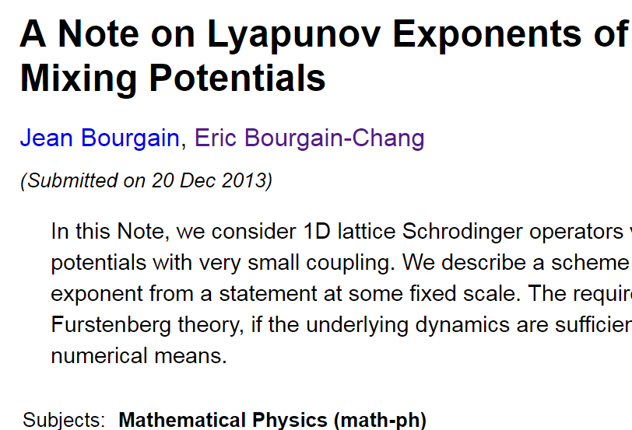

Slide 48
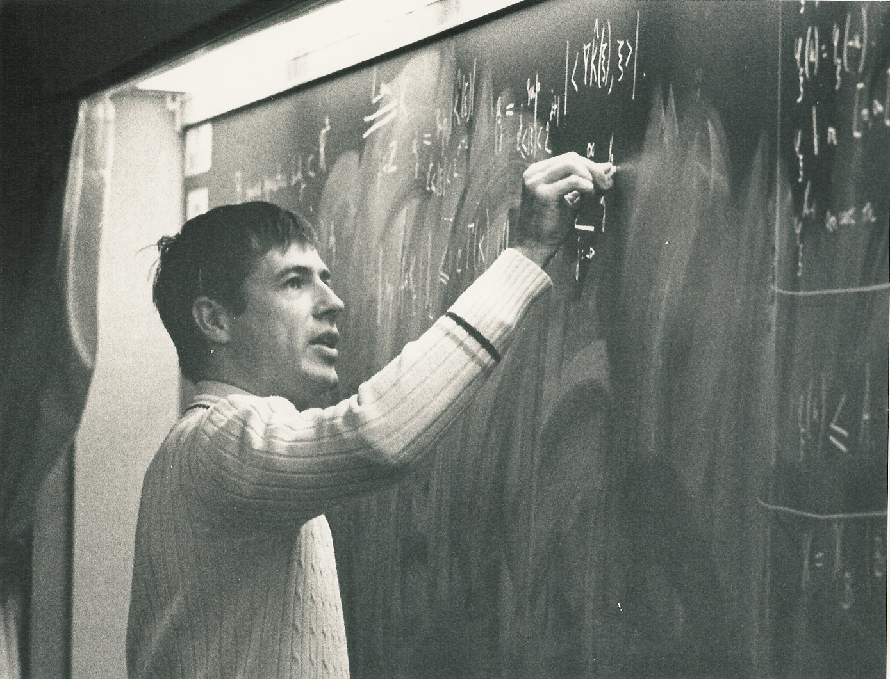

Slide 49
When we run the story forward in time we are amazed by how many startling new connections and applications where found, new tools where discovered, hard problems where cracked, via remarkable new proofs, at times very difficult and at times surprisingly simple. We are also amazed by the many new wonderful young people who join our scene.
Jean stands out as one of the greatest mathematicians in our time and quite possibly in all times.
Thank you!

Slide 51
Mathematics regarded as a religion is a very strange relegion but we do have some nice shrines to practice it
IAS; IHES; Mittag-Leffler;

