Slide 1
Peter Bürgisser
Cole Franks
Ankit Garg
Rafael Oliveira
Michael Walter
Avi Wigderson
Non-commutative optimization:
geodesic 1st & 2nd order methods for moment maps & polytopes

Slide 2
Contents
1
Motivation
Null cone & norm minimization
Moment maps & polytpes
Non-commutative optimization
Algorithms
Future directions

Slide 3
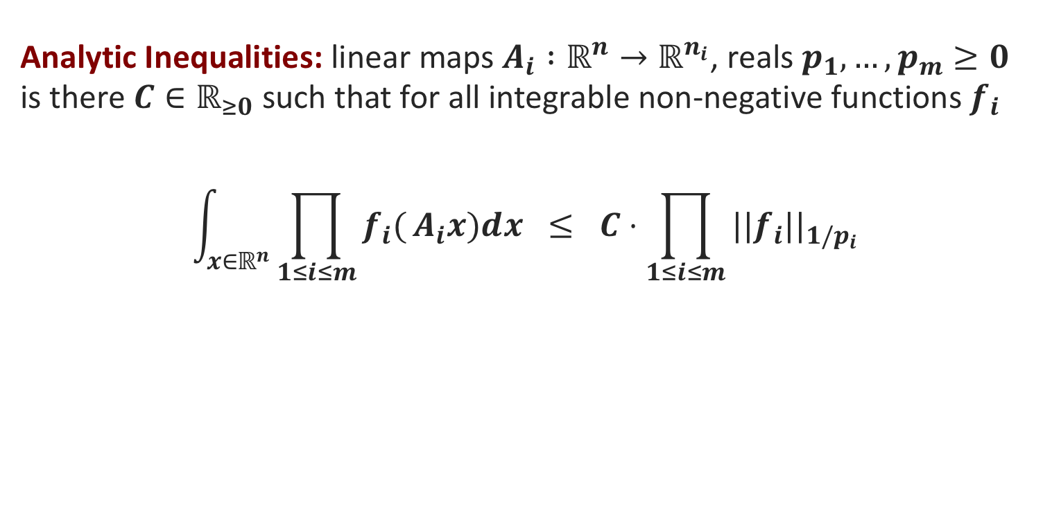
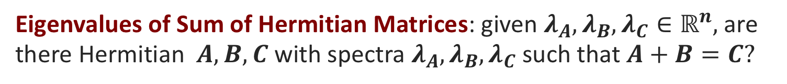
Unexpected applications
Algebraic Identities: given arithmetic formula with inversion gates, is it identically zero?
Quantum Information: density matrices describing local quantum states of particles, is there consistent global pure state?
Analytic Inequalities: linear maps $A_{i} :ℝ^{n}→ℝ^{n_{i}}$, reals $p_{1}, …,p_{m}≥0$
is there $C∈ℝ_{≥0}$ such that for all integrable non-negative functions $f_{i}$
$$\int_{x∈ℝ^{n}}{\prod_{1≤i≤m}{f_{i}(}A_{i}x)dx} ≤ C⋅\prod_{1≤i≤m}{||f_{i}||_{1/p_{i}}}$$
Eigenvalues of Sum of Hermitian Matrices: given $λ_{A},λ_{B}, λ_{C}∈ℝ^{n},$are there Hermitian $A, B, C$ with spectra $λ_{A},λ_{B}, λ_{C}$ such that $A+B=C?$
Obs: all are instances of optimization over non-commutative groups
Notes:
First problem: Rational Identity Testing (algebraic complexity) or Word Problem in Free skew field (NC algebra)
Second problem: one-body quantum marginal problem
Third problem: celebrated Brascamp-Lieb inequalities
Fourth problem: Horn’s problem

Slide 4
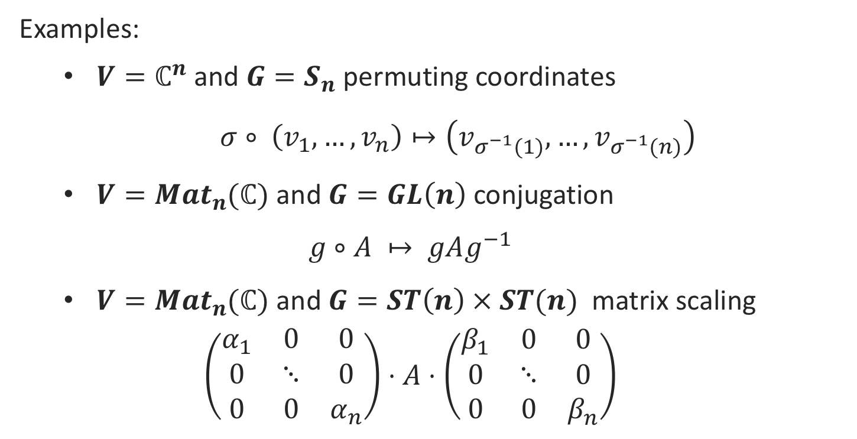
Invariant Theory - Basics
Group $G$ acts linearly on vector space $V$
Examples:
  $V=ℂ^{n}$ and $G=S_{n}$ permuting coordinates
  $σ∘ \left(v_{1},…,v_{n}\right)↦\left(v_{σ^{−1}(1)}, …,v_{σ^{−1}(n)}\right)$
  $V=Mat_{n}(ℂ)$ and $G=GL\left(n\right)$ conjugation
  $$g∘A ↦ gAg^{−1}$$
  $V=Mat_{n}(ℂ)$ and $G=ST\left(n\right) × ST(n)$ matrix scaling
  $$\left(\begin{matrix}α_{1} & 0 & 0 \\ 0 & ⋱ & 0 \\ 0 & 0 & α_{n}\end{matrix}\right)⋅A⋅\left(\begin{matrix}β_{1} & 0 & 0 \\ 0 & ⋱ & 0 \\ 0 & 0 & β_{n}\end{matrix}\right)$$
Our groups will be continuous. (connected, reductive, algebraic)
Notes:
Write on board: GL(n) invertible n by n matrices, ST(n) diagonal n by n matrices with determinant one, T(n) invertible diagonal matrices

Slide 5

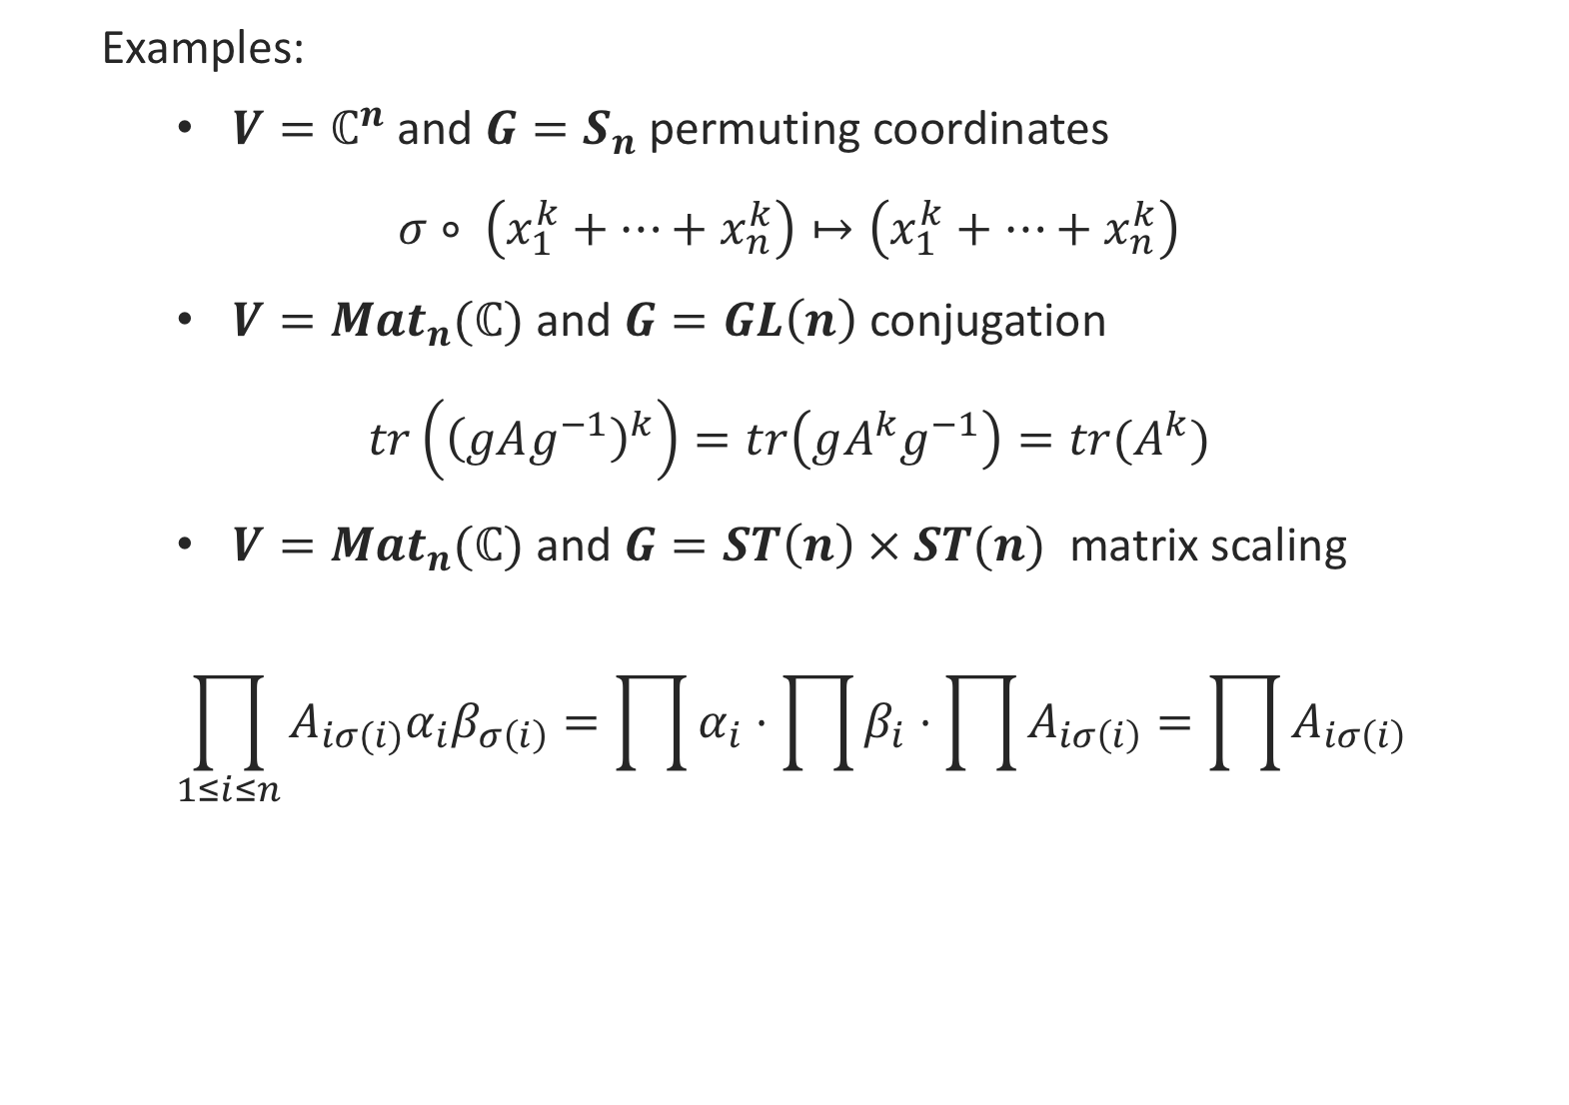
Invariant Theory - Basics
Invariant polynomial: doesn’t change by action of $G$
$p\left(g∘x\right)=p\left(x\right), ∀ g∈G$
Examples:
  $V=ℂ^{n}$ and $G=S_{n}$ permuting coordinates
  $$σ∘ \left(x_{1}^{k}+⋯+x_{n}^{k}\right)↦\left(x_{1}^{k}+⋯+x_{n}^{k}\right)$$
  $V=Mat_{n}(ℂ)$ and $G=GL\left(n\right)$ conjugation
  $$tr\left({\left(gAg^{−1}\right)}^{k}\right)=tr\left(gA^{k}g^{−1}\right)=tr(A^{k})$$
  $V=Mat_{n}(ℂ)$ and $G=ST\left(n\right) × ST(n)$ matrix scaling
  $$\prod_{1≤i≤n}{A_{iσ(i)}α_{i}β_{σ\left(i\right)}}=\prod{α_{i}}⋅\prod{β_{i}}⋅\prod{A_{iσ\left(i\right)}}=\prod{A_{iσ\left(i\right)}}$$

Slide 6
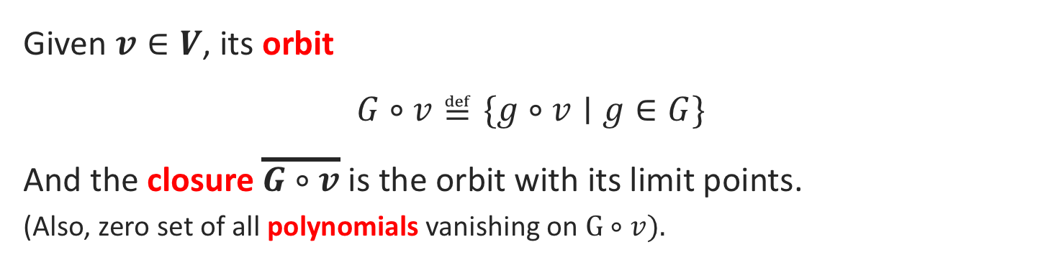
Invariant Theory - Basics
Given $v∈V$, its orbit
$$G∘v≝\{g∘v∣g∈G\}$$
And the closure $\overline{G∘v}$ is the orbit with its limit points.
(Also, zero set of all polynomials vanishing on $G∘v$).
Null cone: set of all vectors $v∈V$ such that $0∈\overline{G∘v}$
Null-cone Problem: given $v∈V$, is $0∈\overline{G∘v}$?
[Hilbert 1893, Mumford 1965]: Null cone is zero set of homogeneous non-constant invariants
It is also an optimization problem!
Captures many interesting problems in math, physics & TCS
Notes:
When V is a complex vector space, closure is also the Zariski closure

Slide 7
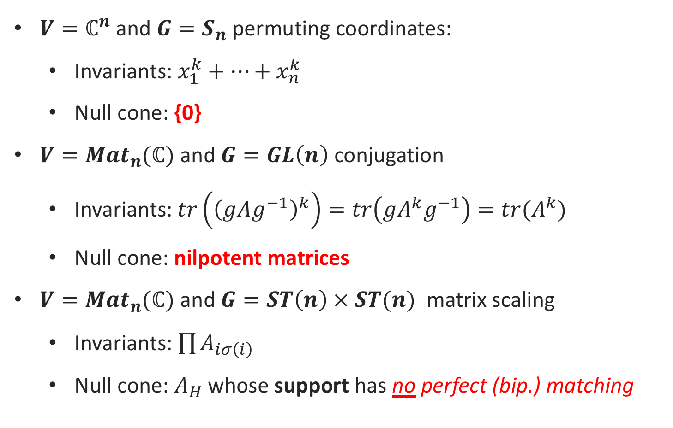
Examples of Null Cone problems
$V=ℂ^{n}$ and $G=S_{n}$ permuting coordinates:
  Invariants: $x_{1}^{k}+⋯+x_{n}^{k}$
  Null cone: {0}
$V=Mat_{n}(ℂ)$ and $G=GL\left(n\right)$ conjugation
  Invariants:$tr\left({\left(gAg^{−1}\right)}^{k}\right)=tr\left(gA^{k}g^{−1}\right)=tr(A^{k})$
  Null cone: nilpotent matrices
$V=Mat_{n}(ℂ)$ and $G=ST\left(n\right) × ST(n)$ matrix scaling
  Invariants: $\prod{A_{iσ\left(i\right)}}$
  Null cone: $A_{H}$ whose support has no perfect (bip.) matching
And we’ll see many more!
Notes:
Talk about the matrix scaling and adjacency matrix correspondence on the board

Slide 8
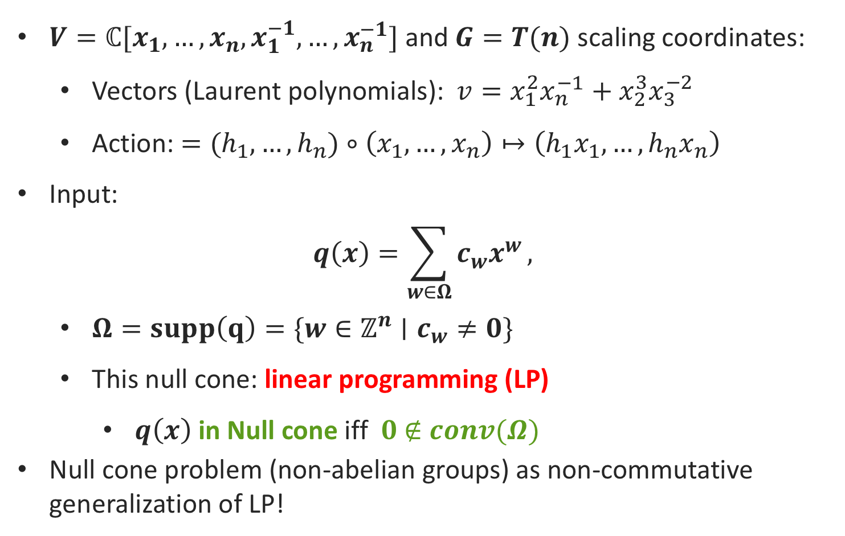
Linear Programming as Null Cone
$V=ℂ[x_{1},…,x_{n},x_{1}^{−1},…,x_{n}^{−1}]$ and $G=T(n)$ scaling coordinates:
  Vectors (Laurent polynomials): $v=x_{1}^{2}x_{n}^{−1}+x_{2}^{3}x_{3}^{−2}$
  Action: $=(h_{1},…,h_{n})∘\left(x_{1},…,x_{n}\right)↦\left({h_{1}x}_{1},…,h_{n}x_{n}\right)$
Input:
$$q\left(x\right)=\sum_{w∈Ω}{{c_{w}x}^{w}},$$
  $Ω=supp\left(q\right)=\{w∈ℤ^{n}∣c_{w}≠0\}$
  This null cone: linear programming (LP)
    $q\left(x\right)$ in Null cone iff $0 \text{∉} conv(Ω)$
Null cone problem (non-abelian groups) as non-commutative generalization of LP!
Notes:
More precisely the membership in the moment polytope…

Slide 9
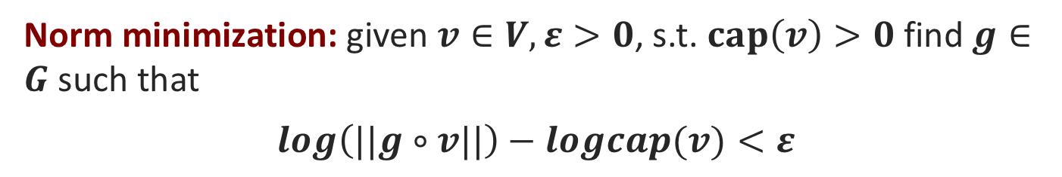


Non-commutative optimization
Setup: Group $G$ acting linearly on vector space $V$.
Capacity: optimization over the orbit closure
$cap(v)≝\inf_{g∈G}{||g∘v||}$
Norm minimization: given $v∈V, ε>0$, s.t. $cap\left(v\right)>0$find $g∈G$ such that
$$log\left(||g∘v||\right)−logcap(v)<ε$$
Null-cone problem: given $v∈V,$ is $cap\left(v\right)=0?$
Question 0: can we efficiently solve the norm min. problem?
Clearly non-convex problem.
Question 1: which $ε$ solves null cone?
Notes:
I.e., we want a (1+$ε$) multiplicative approximation to the minimizer of the norm function
Norm minimization problem generalizes geometric programming!

Slide 10
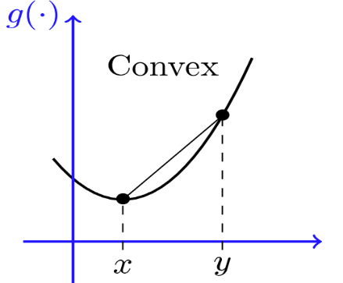

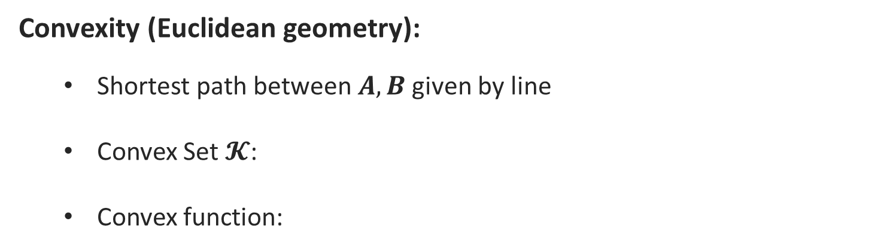
Convexity
Convexity (Euclidean geometry):
  Shortest path between $A,B$ given by line
  Convex Set $𝓚$:
  Convex function:
B
$$𝓚$$
A
Ellipsoid
Interior Point Methods
2nd order methods
Notes:
Euclidean geometry good, but not always applicable
Need to advance with the times

Slide 11
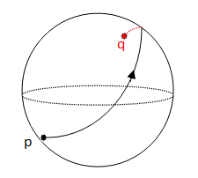
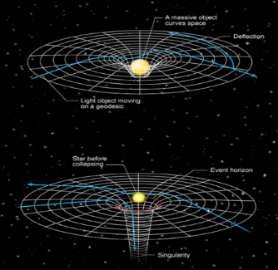
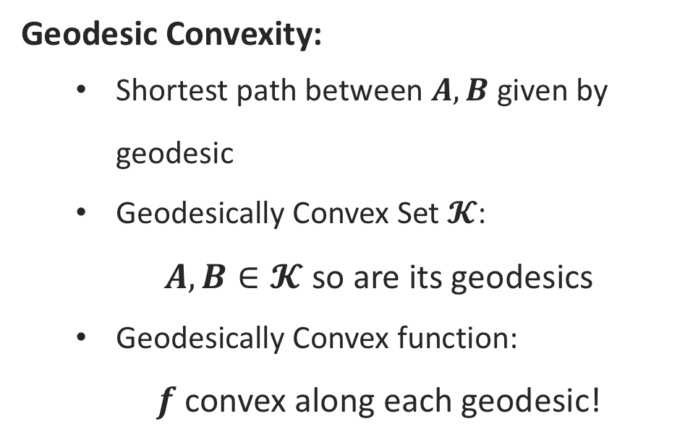
What is Geodesic Convexity?
Geodesic Convexity:
  Shortest path between $A,B$ given by geodesic
  Geodesically Convex Set $𝓚$:
  $A,B∈𝓚$ so are its geodesics
  Geodesically Convex function:
  $f$ convex along each geodesic!
q
Literature:
[Udriste ‘94, AMS’09,
W’12, ZS’16]
Little Known
Where do we see these geodesics?
  Norm minimization problem!
Notes:
Earth is geodesically convex
[U’94] Udriste (book)
[AMS’09] Absil, Mahony, Sepulchre
[W’12] Wiesel
[ZS’16] Zhang-Sra

Slide 12

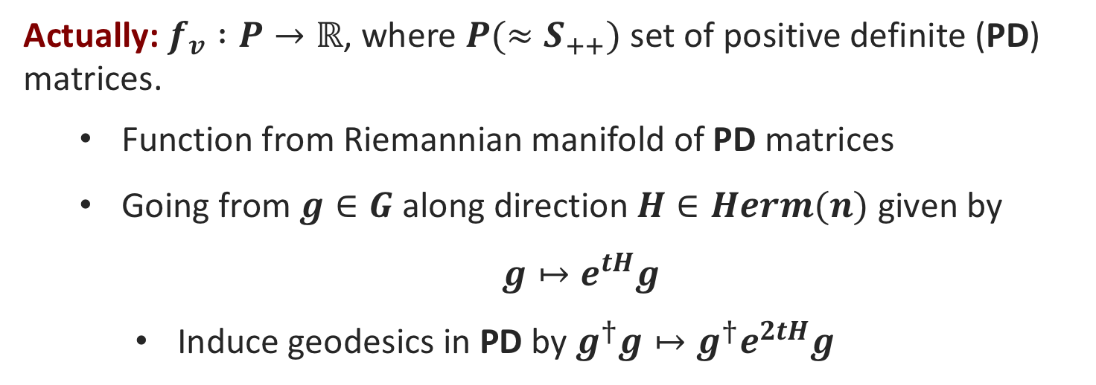
Geodesic Convexity
Log-Norm function: $f_{v} :G→ℝ$ given by
$$f_{v}\left(g\right)≝\log{||g∘v||}=log(v^{†}g^{†}gv)$$
Actually: $f_{v} :P→ℝ$, where $P(≈S_{++})$ set of positive definite (PD) matrices.
  Function from Riemannian manifold of PD matrices
  Going from $g∈G$ along direction $H∈Herm(n)$ given by
  $g↦e^{tH}g$
    Induce geodesics in PD by $g^{†}g↦g^{†}e^{2tH}g$
Fact: $f_{v} :P→ℝ$ is geodesically convex (g-convex)!
Question 2: how well can we optimize g-convex functions?
Notes:
We only need to travel along Hermitian directions because the norm function is invariant under rotations (i.e. the unitary group)
and also because of polar decomposition (g = u e^h) where u unitary and h is Hermitian
We call NC optimization the optimization problems that arise from groups acting linearly on vector spaces.

Slide 13
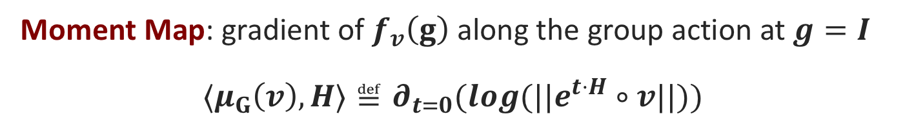
Moment map – gradient along group action
Setup: Group $G$ acting linearly on vector space $V$.
Log-Norm function: $f_{v} :G→ℝ$ given by
$$f_{v}\left(g\right)≝\log{||g∘v||}=log(v^{†}g^{†}gv)$$
Moment Map: gradient of $f_{v}\left(g\right)$ along the group action at $g=I$
$${⟨μ}_{G}\left(v\right), H⟩≝∂_{t=0}(log(||e^{t⋅H}∘v||))$$
Gradient
Inner prod with direction
Derivative
Direction H
How much norm changes by infinitesimal group action.
[Kempf, Ness’79]: $cap\left(v\right)>0$ iff there is $w∈\overline{G∘v}$ s.t. $||μ_{G}\left(w\right)||=0$!
Local minimum $⇒$ global minimum. (“convexity” property)
Notes:
Quantitative answer: we’ll see later
Kempf, Ness: non-commutative duality theory, generalizing linear programming duality.
We provide quantitative bounds on it!

Slide 14
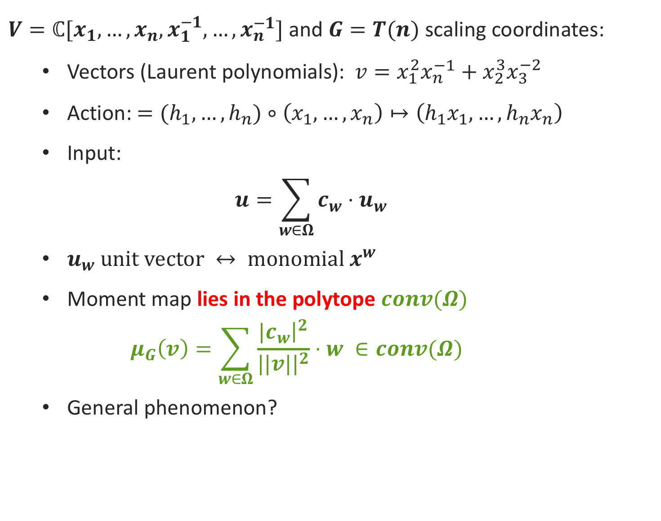
Moment Map – commutative actions
$V=ℂ[x_{1},…,x_{n},x_{1}^{−1},…,x_{n}^{−1}]$ and $G=T(n)$ scaling coordinates:
  Vectors (Laurent polynomials): $v=x_{1}^{2}x_{n}^{−1}+x_{2}^{3}x_{3}^{−2}$
  Action: $=(h_{1},…,h_{n})∘\left(x_{1},…,x_{n}\right)↦\left({h_{1}x}_{1},…,h_{n}x_{n}\right)$
  Input:
  $$u=\sum_{w∈Ω}{c_{w}⋅u_{w}}$$
  $u_{w} \text{unit} \text{vector} ↔ \text{monomial} x^{w}$
  Moment map lies in the polytope $conv(Ω)$
    $$μ_{G}\left(v\right)=\sum_{w∈Ω}{\frac{|c_{w}{\left.​\right|}^{2}}{||v||^{2}}⋅w} ∈conv(Ω)$$
  General phenomenon?
Notes:
More precisely the membership in the moment polytope…

Slide 15
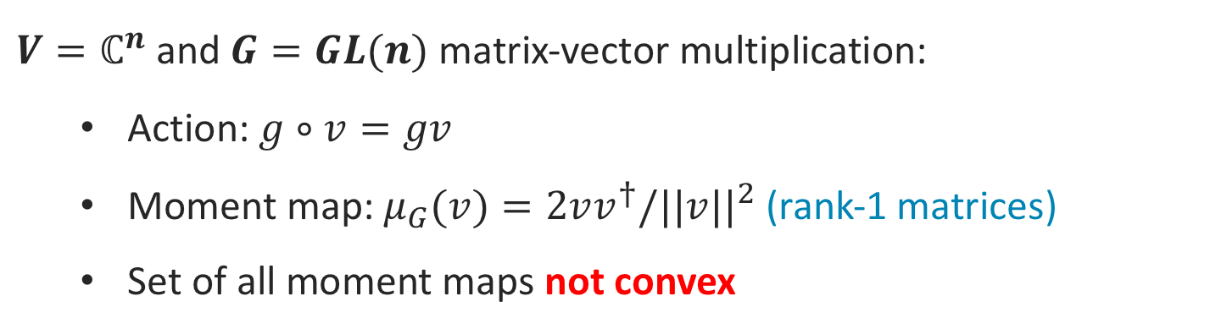
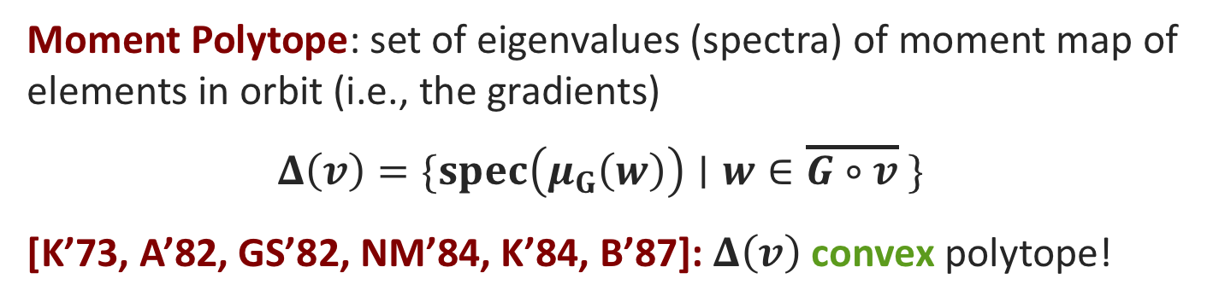

Moment polytope – magical convexity!
Setup: Group $G$ acting linearly on vector space $V$.
Moment Map: gradient along the group action
$${⟨μ}_{G}\left(v\right),H⟩≝∂_{t=0}(log(||e^{t⋅H}∘v||))$$
$V=ℂ^{n}$ and $G=GL(n)$ matrix-vector multiplication:
  Action: $g∘v=gv$
  Moment map: $μ_{G}(v)=2vv^{†}/||v||^{2}$ (rank-1 matrices)
  Set of all moment maps not convex
Moment Polytope: set of eigenvalues (spectra) of moment map of elements in orbit (i.e., the gradients)
$$Δ\left(v\right)=\{spec\left(μ_{G}\left(w\right)\right)∣w∈\overline{G∘v} \}$$
[K’73, A’82, GS’82, NM’84, K’84, B’87]: $Δ\left(v\right)$ convex polytope!
Notes:
Quantitative answer: we’ll see later
Kempf, Ness: non-commutative duality theory, generalizing linear programming duality.
We provide quantitative bounds on it!

Slide 16
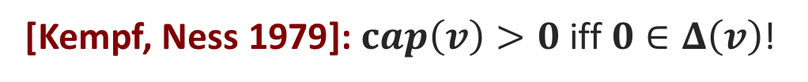

Moment Polytope & capacity
Setup: Group $G (=GL(n))$ acting linearly on vector space $V$.
Moment Polytope: set of eigenvalues (spectra) of moment map of elements in orbit
$$Δ\left(v\right)=\{spec\left(μ_{G}\left(w\right)\right)∣w∈\overline{G∘v} \}$$
Moment polytope problem: given $v∈V, p∈ℝ^{n},$ is $p∈Δ\left(v\right)?$
Question 3: how is this related to capacity?
Our work: quantitative
version
[Kempf, Ness 1979]: $cap\left(v\right)>0$ iff $0∈Δ\left(v\right)$!
Notes:
Quantitative answer: we’ll see later
Kempf, Ness: non-commutative duality theory, generalizing linear programming duality.
We provide quantitative bounds on it!

Slide 17

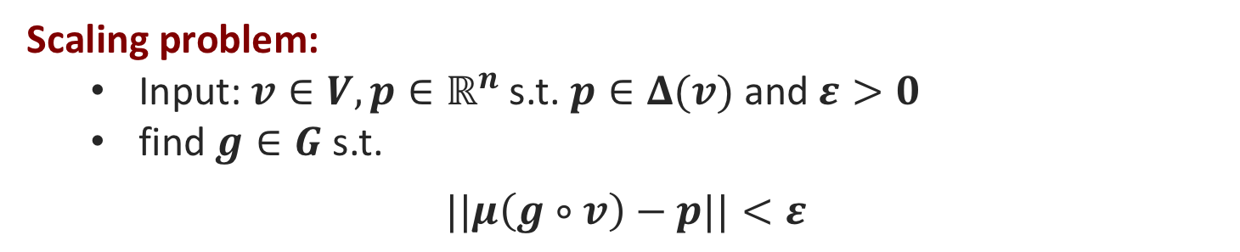
Scaling Problem
Setup: Group $G (=GL(n))$ acting linearly on vector space $V$.
Scaling problem:
  Input: $v∈V, p∈ℝ^{n}$ s.t. $p∈Δ(v)$and $ε>0$
  find $g∈G$ s.t.
$$||μ\left(g∘v\right)−p||<ε$$
Moment polytope problem: given $v∈V, p∈ℝ^{n},$ is $p∈Δ\left(v\right)?$
Question 4: which $ε$ solves membership in moment polytope?
[Brion 1987]: shifting trick reduces moment polytope to norm minimization!
$cap_{p}\left(v\right)>0$ iff $p∈Δ\left(v\right)$!
Our work: effective algorithm
Notes:
Quantitative answer: we’ll see later
Kempf, Ness: non-commutative duality theory, generalizing linear programming duality.
We provide quantitative bounds on it!

Slide 18
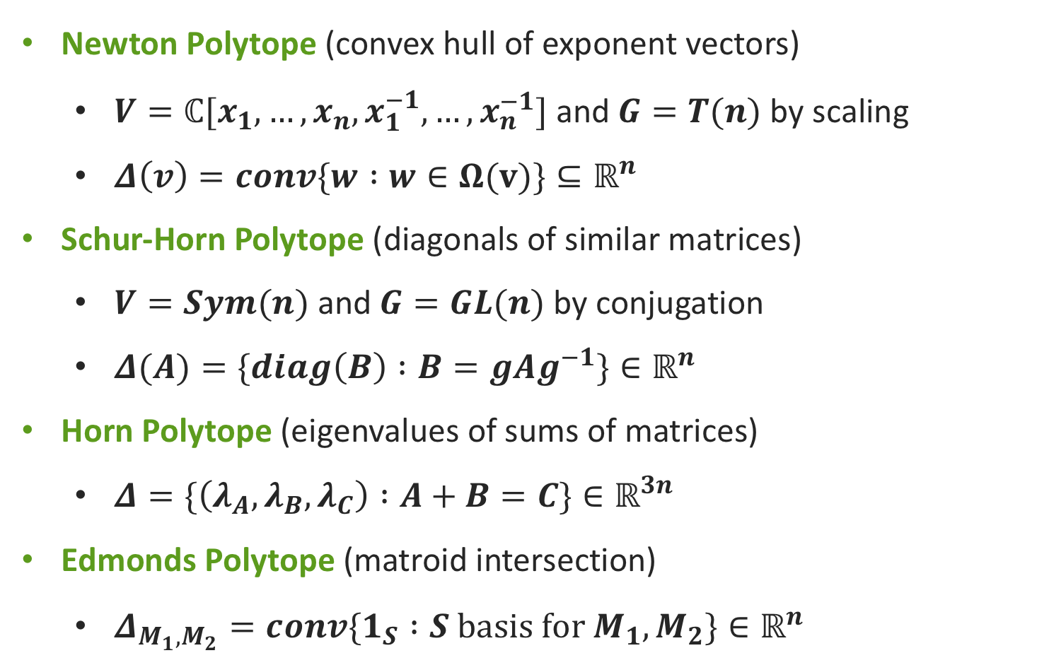
Examples of Moment Polytopes
Newton Polytope (convex hull of exponent vectors)
  $V=ℂ[x_{1},…,x_{n},x_{1}^{−1},…,x_{n}^{−1}]$ and $G=T(n)$ by scaling
  $Δ\left(v\right)=conv\{w :w∈Ω(v)\}⊆ℝ^{n}$
Schur-Horn Polytope (diagonals of similar matrices)
  $V=Sym(n)$ and $G=GL(n)$ by conjugation
  $Δ(A)=\{diag\left(B\right) :B=gAg^{−1}\}∈ℝ^{n}$
Horn Polytope (eigenvalues of sums of matrices)
  $Δ=\{\left(λ_{A},λ_{B}, λ_{C}\right) :A+B=C\}∈ℝ^{3n}$
Edmonds Polytope (matroid intersection)
  $Δ_{M_{1},M_{2}}=conv\{1_{S} :S basis for M_{1},M_{2}\}∈ℝ^{n}$
Notes:
More precisely the membership in the moment polytope…

Slide 19

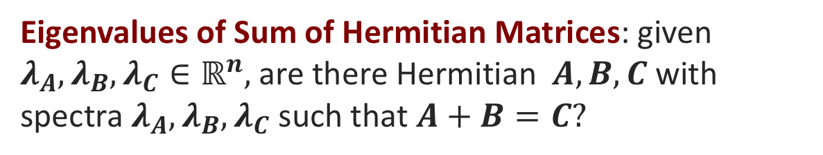
Unexpected applications
Algebraic Identities: given arithmetic formula with inversion gates, is it identically zero?
Null cone
Quantum Information: density matrices describing local quantum states of particles, is there consistent global pure state?
Moment Polytope
Analytic Inequalities: linear maps $A_{i} :ℝ^{n}→ℝ^{n_{i}}$, reals $p_{1}, …,p_{m}≥0$
is there $C∈ℝ_{≥0}$ such that for all integrable non-negative functions $f_{i}$
$$\int_{x∈ℝ^{n}}{\prod_{1≤i≤m}{f_{i}(}A_{i}x)dx} ≤ C⋅\prod_{1≤i≤m}{||f_{i}||_{1/p_{i}}}$$
“Moment Polytope”
Null cone
Eigenvalues of Sum of Hermitian Matrices: given $λ_{A},λ_{B}, λ_{C}∈ℝ^{n},$are there Hermitian $A, B, C$ with spectra $λ_{A},λ_{B}, λ_{C}$ such that $A+B=C?$
Moment Polytope
Notes:
First problem: Rational Identity Testing (algebraic complexity) or Word Problem in Free skew field (NC algebra)
Second problem: one-body quantum marginal problem
Third problem: celebrated Brascamp-Lieb inequalities
Fourth problem: Horn’s problem

Slide 20
Our Results
2
1st & 2nd order methods
Main Parameters
Non-commutative duality
Open questions

Slide 21
Our Function - Recap
Log-Norm function: $f_{v} :G→ℝ$ given by
$$f_{v}\left(g\right)≝\log{||g∘v||}=log(v^{†}g^{†}gv)$$
Actually: $f_{v} :P→ℝ$, where $P(≈S_{++})$ set of positive definite (PD) matrices.
  Function from Riemannian manifold of PD matrices
  Going from $g∈G$ along direction $H∈Herm(n)$ given by
  $g↦e^{tH}g$
    Induce geodesics in PD by $g^{†}g↦g^{†}e^{2tH}g$
Fact: $f_{v} :P→ℝ$ is geodesically convex (g-convex)!
Question: how well can we optimize g-convex functions?
Notes:
We only need to travel along Hermitian directions because the norm function is invariant under rotations (i.e. the unitary group)
and also because of polar decomposition (g = u e^h) where u unitary and h is Hermitian
We call NC optimization the optimization problems that arise from groups acting linearly on vector spaces.

Slide 22
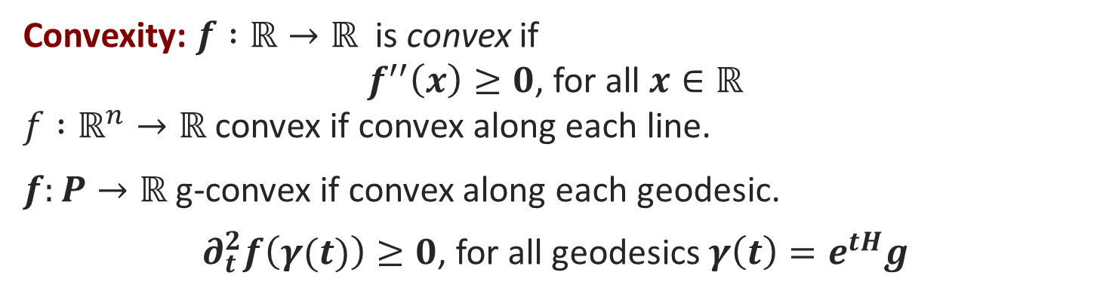
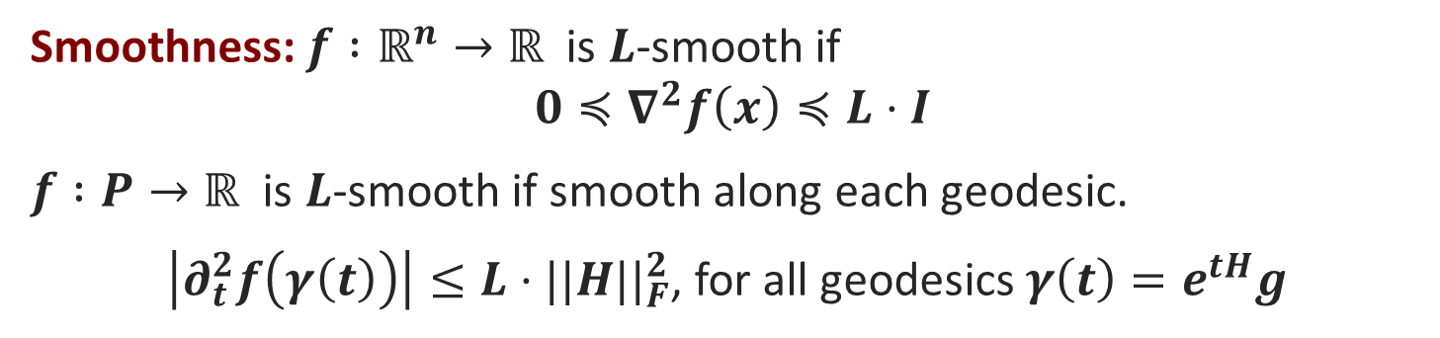
Geodesic convexity & smoothness
Convexity: $f :ℝ→ℝ$is convex if
$f^{′′}\left(x\right)≥0$, for all $x∈ℝ$
$f :ℝ^{n}→ℝ$ convex if convex along each line.
$f:P→ℝ$ g-convex if convex along each geodesic.
$∂_{t}^{2}f\left(γ(t)\right)≥0$, for all geodesics $γ\left(t\right)=e^{tH}g$
Smoothness: $f :ℝ^{n}→ℝ$is $L$-smooth if
$$0≼∇^{2}f\left(x\right)≼L⋅I$$
$f :P→ℝ$ is $L$-smooth if smooth along each geodesic.
$\left|∂_{t}^{2}f\left(γ\left(t\right)\right)\right|≤L⋅||H||_{F}^{2}$, for all geodesics $γ\left(t\right)=e^{tH}g$
1st order algorithms
Log-norm is smooth!
Question: Can we efficiently optimize g-smooth functions?

Slide 23
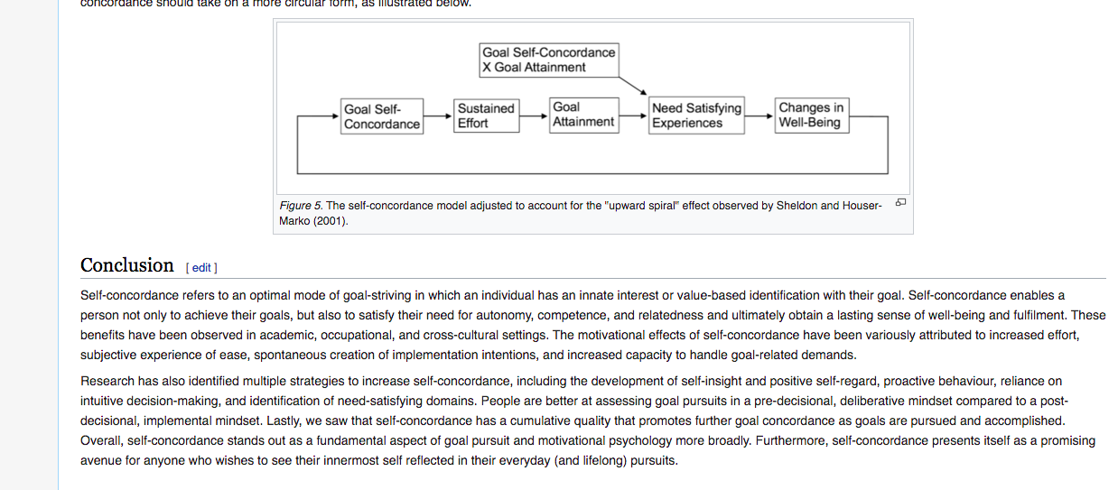
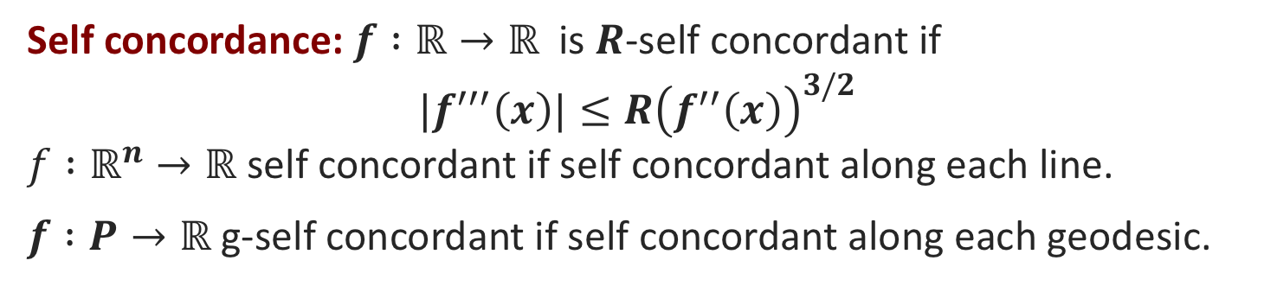
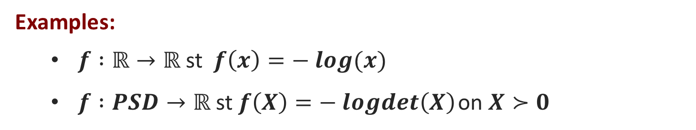
Self Concordance
Self concordance: $f :ℝ→ℝ$is $R$-self concordant if
${|f}^{′′′}\left(x\right)|≤R{\left(f^{′′}\left(x\right)\right)}^{3/2}$
$f :ℝ^{n}→ℝ$ self concordant if self concordant along each line.
$f :P→ℝ$ g-self concordant if self concordant along each geodesic.
Examples:
  $f :ℝ→ℝ$ st $f\left(x\right)=− log(x)$
  $f :PSD→ℝ$ st $f\left(X\right)=− logdet\left(X\right)$ on $X≻0$
Obs: self concordance is scale invariant.
  Great for Newton’s method
Trust region
2nd order methods
Unfortunately, log-norm is NOT self-concordant.
Q: Can we relax self concordance condition and still optimize well?
Notes:
Generalizing the concept of robustness developed for matrix scaling
Generalization of the “Box-constrained Newton methods” developed in the matrix scaling and operator scaling algorithms.

Slide 24
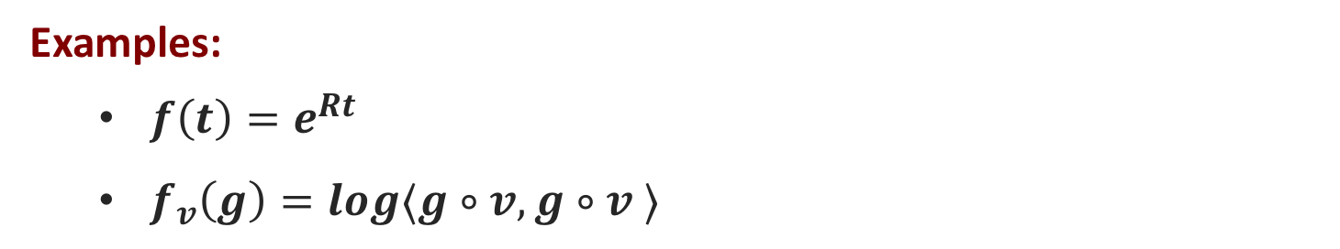
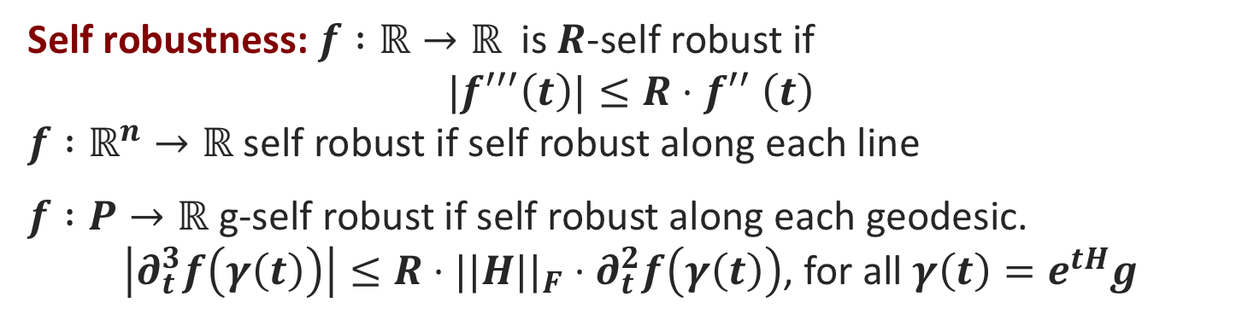
Self Robustness
Self robustness: $f :ℝ→ℝ$is $R$-self robust if
$${|f}^{′′′}\left(t\right)|≤R{⋅f}^{′′}\left(t\right)$$
$f :ℝ^{n}→ℝ$ self robust if self robust along each line
$f :P→ℝ$ g-self robust if self robust along each geodesic.
$\left|∂_{t}^{3}f\left(γ\left(t\right)\right)\right|≤R⋅||H||_{F}⋅∂_{t}^{2}f\left(γ\left(t\right)\right)$, for all $γ\left(t\right)=e^{tH}g$
locally quadratic
Examples:
  $f\left(t\right)=e^{Rt}$
  $f_{v}\left(g\right)=log⟨g∘v,g∘v ⟩$
2nd order methods
Log-norm is self-robust!
Question: Can we efficiently optimize g-self robust functions?
Generalize robustness from matrix & operator scaling [ALOW’17, CMTV’17, AGLOW’18].
Notes:
Generalizing the concept of robustness developed for matrix scaling
Generalization of the “Box-constrained Newton methods” developed in the matrix scaling and operator scaling algorithms.

Slide 25
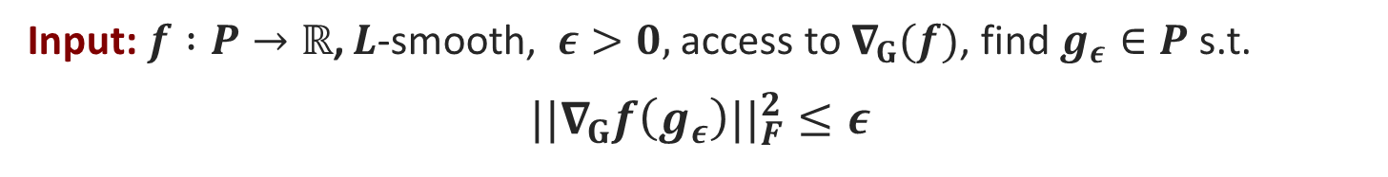
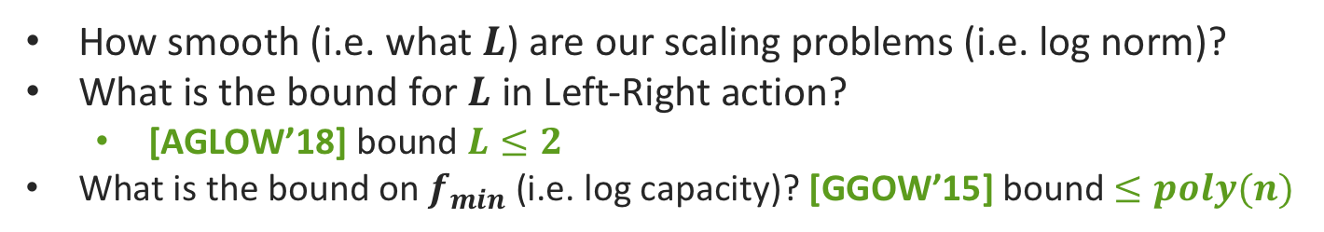
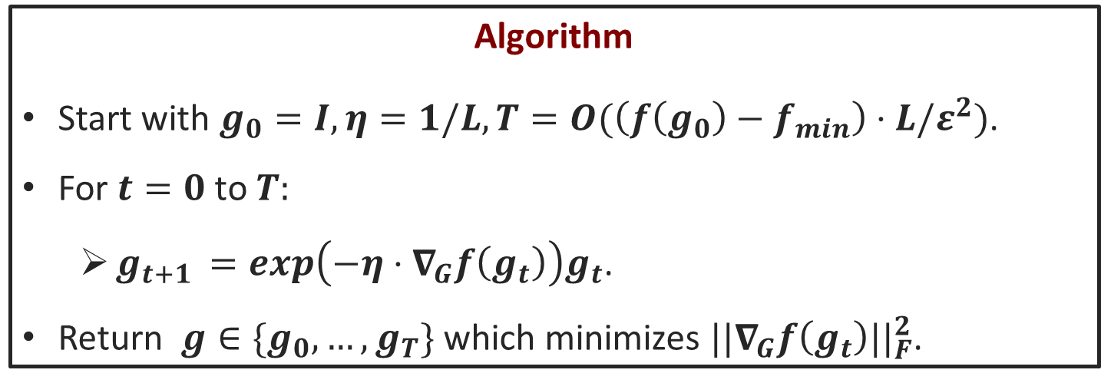
NC First order scaling algorithm [BFGOWW’19]
Input:$f :P→ℝ$, $L$-smooth, $ε>0,$ access to $∇_{G}(f)$, find $g_{ε}∈P$ s.t.
$${||∇}_{G}f\left(g_{ε}\right)||_{F}^{2}≤ε$$
Algorithm
Start with $g_{0}=I, η=1/L, T=O(\left(f\left(g_{0}\right)−f_{min}\right)⋅L/ε^{2})$.
For $t=0$ to $T:$
  $g_{t+1 }=exp\left(−η⋅∇_{G}f\left(g_{t}\right)\right)g_{t}$.
Return $g∈\{g_{0},…, g_{T}\}$ which minimizes ${||∇}_{G}f\left(g_{t}\right)||_{F}^{2}$.
How smooth (i.e. what $L$) are our scaling problems (i.e. log norm)?
What is the bound for $L$ in Left-Right action?
  [AGLOW’18] bound $L≤2$
What is the bound on $f_{min}$ (i.e. log capacity)? [GGOW’15] bound $≤poly(n)$
Notes:
Standard gradient descent

Slide 26
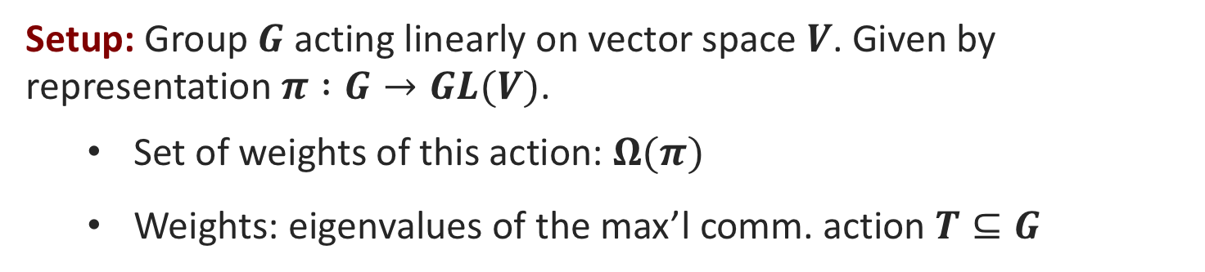
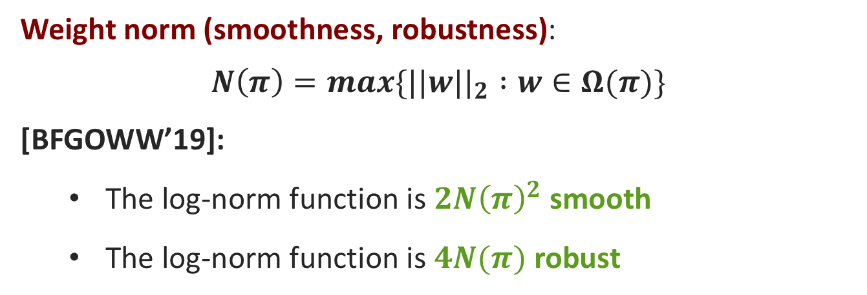
Smoothness and robustness of group action
Setup: Group $G$ acting linearly on vector space $V$. Given by representation $π :G→GL(V)$.
  Set of weights of this action: $Ω(π)$
  Weights: eigenvalues of the max’l comm. action $T⊆G$
Weight norm (smoothness, robustness):
$$N\left(π\right)=max\{||w||_{2} :w∈Ω(π)\}$$
[BFGOWW’19]:
  The log-norm function is $2N{\left(π\right)}^{2}$ smooth
  The log-norm function is $4N(π)$ robust

Slide 27
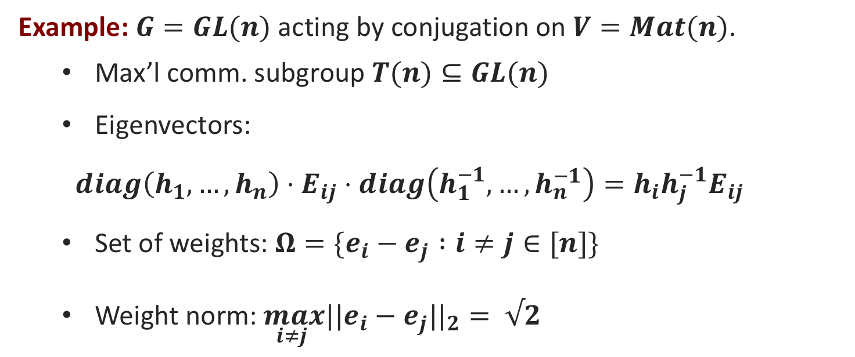

Getting weights of group action
Example: $G=GL(n)$ acting by conjugation on $V=Mat(n)$.
  Max’l comm. subgroup $T(n)⊆GL(n)$
  Eigenvectors:
  $$diag\left(h_{1},…,h_{n}\right)⋅E_{ij}⋅diag\left(h_{1}^{−1},…,h_{n}^{−1}\right)=h_{i}h_{j}^{−1}E_{ij}$$
  Set of weights: $Ω=\{e_{i}−e_{j} :i≠j∈[n]\}$
  Weight norm: $\max_{i≠j }||e_{i}−e_{j}||_{2}= √2$
As consequence:
  The log-norm function is $4$-smooth
  The log-norm function is $4\sqrt{2}$-robust

Slide 28
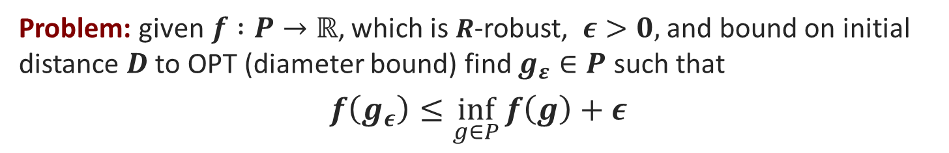

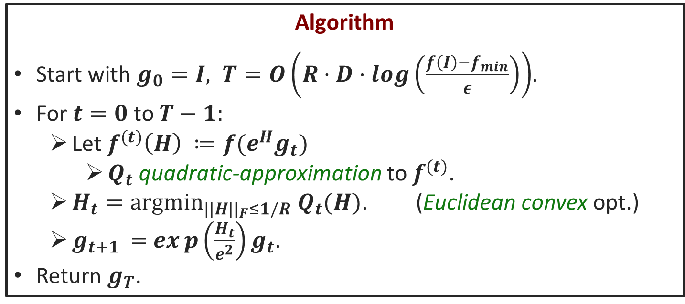
2nd order methods [BFGOWW’19]
Problem: given$f :P→ℝ$, which is $R$-robust, $ε>0,$ and bound on initial distance $D$ to OPT (diameter bound) find $g_{ε}∈P$ such that
$$f\left(g_{ε}\right)≤\inf_{g∈P}{f\left(g\right)}+ε$$
Algorithm
Start with $g_{0}=I, T=O\left(R⋅D⋅log\left(\frac{f\left(I\right)−f_{min}}{ε}\right)\right)$.
For $t=0$ to $T−1:$
  Let $f^{(t)}\left(H\right) ≔f(e^{H}g_{t})$
    $Q_{t}$ quadratic-approximation to $f^{(t)}$.
  $H_{t}={argmin}_{||H{||}_{F}≤1/R} Q_{t}(H)$. (Euclidean convex opt.)
  $g_{t+1 }=$ $exp\left(\frac{H_{t}}{e^{2}}\right)g_{t}$.
Return $g_{T}$.
Can we get general bounds on $R$ and $D$?
[AGLOW’18] polynomial bound for $D, R$ for left-right action
Notes:
I am not mentioning the presence of a regularizer here (to avoid too much detail)

Slide 29

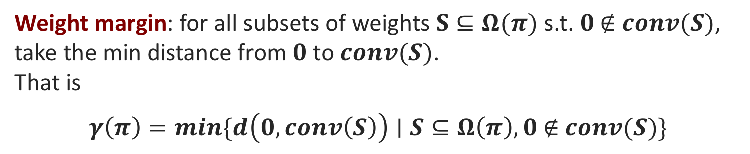
Diameter bounds for group action
Setup: Group $G$ acting linearly on vector space $V$. Given by representation $π :G→GL(V)$.
  Set of weights of this action: $Ω(π)$
  Weights: eigenvalues of the max’l comm. action $T⊆G$
Weight margin: for all subsets of weights $S⊆Ω(π)$ s.t. $0 \text{∉} conv(S)$, take the min distance from $0$ to $conv(S)$.
That is
$$γ\left(π\right)=min\{d\left(0, conv\left(S\right)\right)∣S⊆Ω\left(π\right), 0 \text{∉ }conv(S)\}$$
Remark: weight margin used to obtain diameter bounds for log-norm (capacity optimization)
Also appears in the NC duality

Slide 30

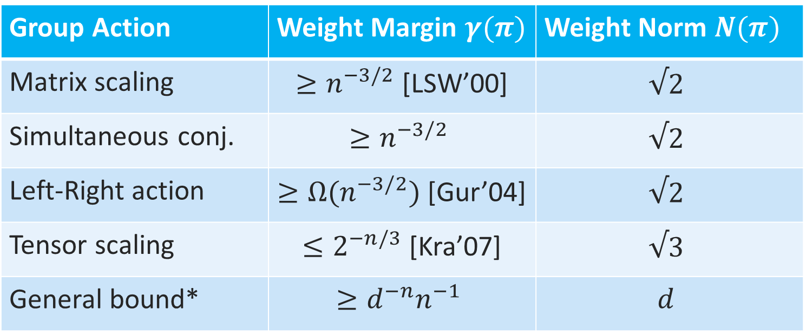
Bounds on weight margin and weight norm
Setup: Group $G$ acting linearly on vector space $V$. Given by representation $π :G→GL(V)$.
Group Action | Weight Margin $γ(π)$ | Weight Norm $N(π)$
Matrix scaling | $≥n^{−3/2}$ [LSW’00] | $$√2$$
Simultaneous conj. | $$≥n^{−3/2}$$ | $$√2$$
Left-Right action | $≥Ω(n^{−3/2})$ [Gur’04] | $$√2$$
Tensor scaling | $≤2^{−n/3}$ [Kra’07] | $$√3$$
General bound* | $$≥{d^{−n}n}^{−1}$$ | $$d$$
Notes:
Polynomial GL(n) action of degree d
Without reference we proved it

Slide 31
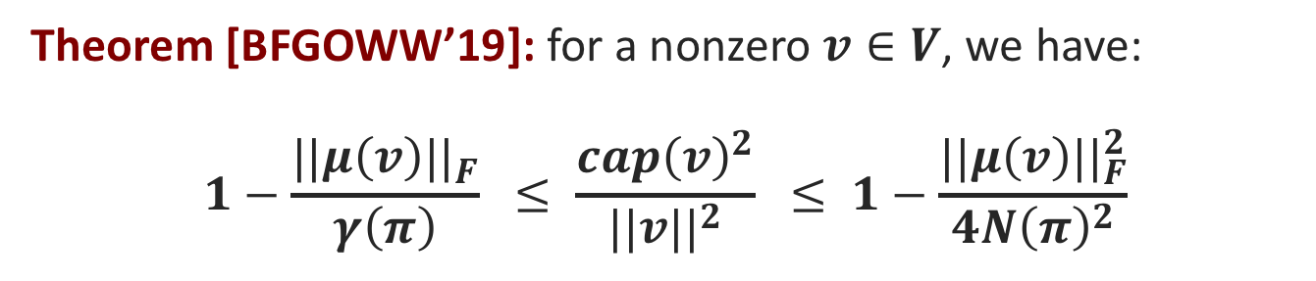

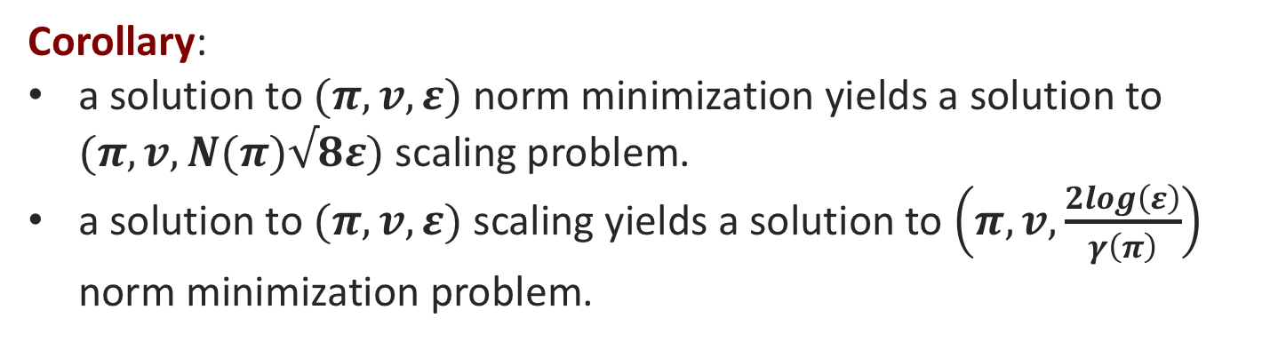
Quantitative NC duality
Setup: Group $G$ acting linearly on vector space $V$. Given by representation $π :G→GL(V)$.
Theorem [BFGOWW’19]: for a nonzero $v∈V$, we have:
$$1−\frac{||μ\left(v\right)||_{F}}{γ\left(π\right)} ≤ \frac{cap{\left(v\right)}^{2}}{||v||^{2}} ≤ 1−\frac{||μ\left(v\right)||_{F}^{2}}{4N{\left(π\right)}^{2}}$$
1st Inequality: if gradient is small, then norm is close to minimum
2nd Inequality: if norm is close to min, then gradient is small
Corollary:
a solution to $(π,v, ε)$ norm minimization yields a solution to $(π,v, N(π)√8ε)$ scaling problem.
a solution to $(π,v, ε)$ scaling yields a solution to $\left(π,v,\frac{2log\left(ε\right)}{γ\left(π\right)}\right)$ norm minimization problem.

Slide 32
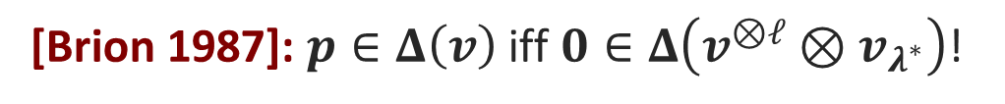


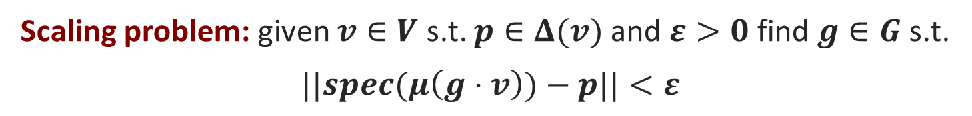
p-scaling problem
Setup: Group $G$ acting linearly on vector space $V$.
Moment Map: gradient along the group action
$$μ_{G}\left(v\right)⋅H≝∂_{t=0}(log(||e^{t⋅H}⋅v||))$$
Moment Polytope: set of eigenvectors of moment map of elements in orbit (i.e., the gradients)
$$Δ\left(v\right)=\{spec\left(μ_{G}\left(w\right)\right)∣w∈\overline{G⋅v} \}$$
Scaling problem: given $v∈V$ s.t. $p∈Δ(v)$and $ε>0$find $g∈G$ s.t.
$$||spec(μ\left(g⋅v\right))−p||<ε$$
Moment polytope problem: given $v∈V,$ is $p∈Δ\left(v\right)?$
Question: is this related to capacity?
[Brion 1987]: $p∈Δ\left(v\right)$ iff $0∈Δ\left(v^{⊗ℓ}⊗v_{λ^{∗}}\right)$!
Notes:
Quantitative answer: we’ll see later
Kempf, Ness: non-commutative duality theory, generalizing linear programming duality.
We provide quantitative bounds on it!

Slide 33
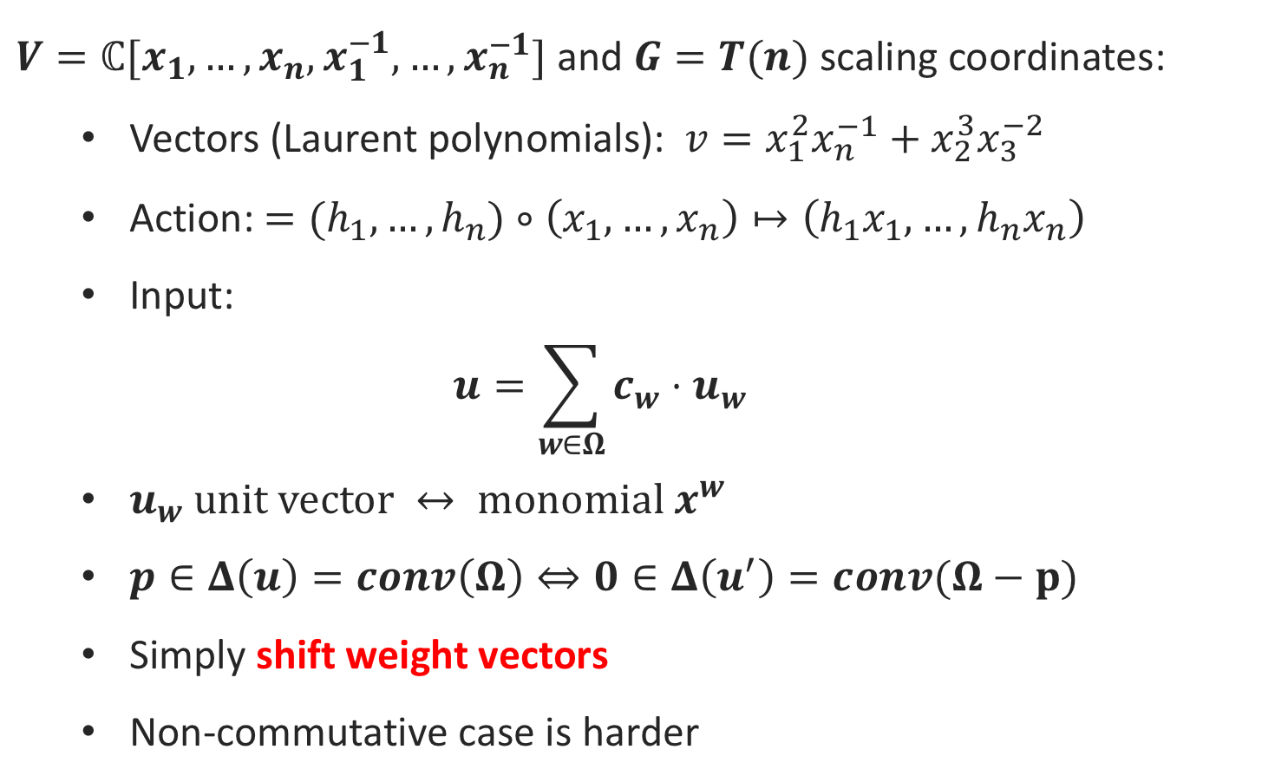
p-scaling for commutative actions
$V=ℂ[x_{1},…,x_{n},x_{1}^{−1},…,x_{n}^{−1}]$ and $G=T(n)$ scaling coordinates:
  Vectors (Laurent polynomials): $v=x_{1}^{2}x_{n}^{−1}+x_{2}^{3}x_{3}^{−2}$
  Action: $=(h_{1},…,h_{n})∘\left(x_{1},…,x_{n}\right)↦\left({h_{1}x}_{1},…,h_{n}x_{n}\right)$
  Input:
  $$u=\sum_{w∈Ω}{c_{w}⋅u_{w}}$$
  $u_{w} \text{unit} \text{vector} ↔ \text{monomial} x^{w}$
  $p∈Δ\left(u\right)=conv\left(Ω\right)⇔0∈Δ\left(u^{′}\right)=conv(Ω−p)$
  Simply shift weight vectors
  Non-commutative case is harder
Notes:
More precisely the membership in the moment polytope…

Slide 34

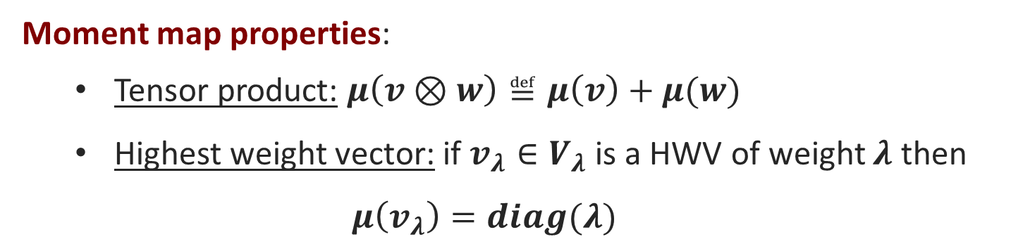
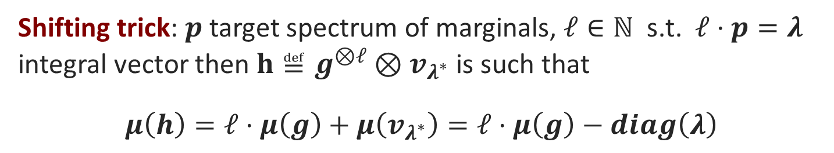
Shifting to different representation
Moment polytope problem: given $v∈V,$ is $p∈Δ\left(v\right)?$
Natural attempt: is there another representation where the moment maps for image of $v∈V$ is given by $spec\left(μ\left(v\right)\right)−p$?
Moment map properties:
  Tensor product: $μ\left(v⊗w\right)≝μ\left(v\right)+μ(w)$
  Highest weight vector: if $v_{λ}∈V_{λ}$ is a HWV of weight $λ$ then
  $$μ\left(v_{λ}\right)=diag(λ)$$
Shifting trick: $p$ target spectrum of marginals, $ℓ∈ℕ$ s.t. $ℓ⋅p=λ$ integral vector then $h≝g^{⊗ℓ}⊗v_{λ^{∗}}$ is such that
$$μ\left(h\right)=ℓ⋅μ\left(g\right)+μ\left(v_{λ^{∗}}\right)=ℓ⋅μ\left(g\right)−diag\left(λ\right)$$
Reduces arbitrary marginal problem to uniform case!*
Notes:
(*) There are a couple of caveats here:
0. We will still run our algorithm on original input g
Need to scale by elts of Borel (since HWV is eigenvalue of Borel subgroup)
Have randomized choice of “generic group elt.” before doing the scaling (by Michael’s talk)
HWV are the “invariants”
Capacity will be slightly modified…

Slide 35
Capacity & Moment polytope: How they relate?
“shifting trick”
[Brion 1987]
Norm Minimization
“capacity”
Moment Map
“gradient”
“Geodesic Convexity”
How can moment map help with optimization (capacity)?
  Intuition (convexity): “gradient equals zero = global minimum”
  Formally: [Kempf, Ness 1979]
Our work: quantitative
version
How can capacity help with moment polytope?
  Shifting trick: [Brion 1987]. Convert moment polytope problem into a norm minimization problem (in a bigger space)!

Slide 36



Open questions
Efficient algorithms for more classes of g-convex functions?
?
Is the null-cone problem in P for general group actions?
  Not even known if in NP $∩$ coNP
More applications of NC-optimization?
  For which actions is weight margin ($γ(π)$) large?
    For such actions our algorithms are enough
Extend commutative methods to NC-optimization?
  For instance, can we have a geodesic ellipsoid algorithm?
Thank you!

