Slide 1
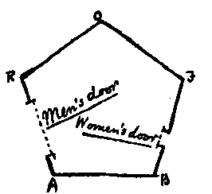
Entropy-based Bounds on Dimension Reduction in L₁
Oded Regev
Tel Aviv University &
CNRS, ENS, Paris
IAS, Princeton
2011/11/28
TexPoint fonts used in EMF.
Read the TexPoint manual before you delete this box.: AAAAAAA

Slide 2
Dimension Reduction
Given a set X of n points in ^{d’}, can we map them to ^{d} for d<<d’ in a way that preserves pairwise l₂ distances well?
More precisely, find f:X→^{d} such that for all x,y∈X,
||x-y||₂ ≤ ||f(x)-f(y)||₂ ≤ D ||x-y||₂
We call D the distortion of the emebdding
The Johnson-Lindenstrauss lemma [JL82] says that this is possible for any distortion D=1+ε with dimension d=O((logn)/ε²)
The proof is by a random projection
The lemma is essentially tight [Alon03]
Many applications in computer science and math

Slide 3
Dimension Reduction
The situation in other norms is far from understood
We focus on l₁
One can always reduce to (^{n}₂) dimensions with no distortion (i.e., D=1)
This is essentially tight [Ball92]
With distortion 1+ε, one can get dimension O(n/ε²) [Schechtman87,Talagrand90,NewmanRabinovich10]
Lower bounds:
For distortion D, n^{Ω(1/D2)} [CharikarBrinkman03,LeeNaor04]
(For D=1+ε this gives roughly n^{1/2})
For distortion 1+ε, n^{1-O(1/log(1/ε))} [AndoniCharikarNeimanNguyen11]
Notes:
Not mentioning work by Indyk (one-sided distortion embeddings) and Charikar-Sahai (linear embeddings)
The n choose 2 can be seen using Caratheodory and the cut metric formulation of \ell_1

Slide 4
Our Results
We give one simple proof that implies both lower bounds
The proof is based on an information theoretic argument and is intuitive
We use the same metrics as in previous work
Notes:
Not mentioning work by Indyk (one-sided distortion embeddings) and Charikar-Sahai (linear embeddings)

Slide 5

The Proof

Slide 6

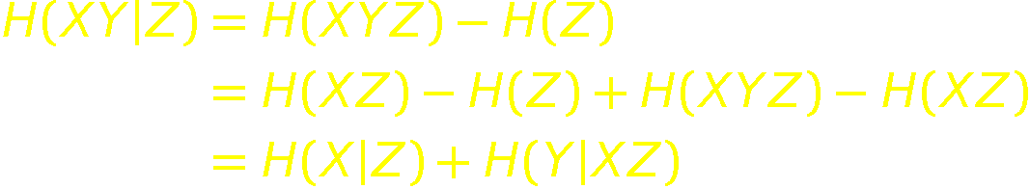
Information Theory 101
The entropy of a random variable X on {1,…,d}, is
We have 0 ≤ H(X) ≤ logd
The conditional entropy of X given Z is
Chain rule:
The mutual information of X and Y is
and is always between 0 and min(H(X),H(Y))
The conditional mutual information is
Chain rule:

Slide 7
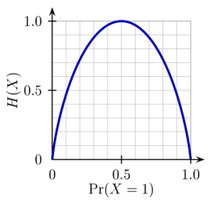
Information Theory 102
Claim: if X is a uniform bit, and Y bit s.t. Pr[Y=X]≥p≥½ then I(X:Y)≥1-H(p)
(where H(p)=-plogp-(1-p)log(1-p))
Proof:
I(X:Y)=H(X)-H(X|Y)=1-H(X|Y)
H(X|Y)=H(1_{X=Y},X|Y)=H(1_{X=Y}|Y)+H(X|1_{X=Y},Y)
≤H(1_{X=Y})+H(X|1_{X=Y},Y) ≤H(p)
Corollary (Fano’s inequality): if X is a uniform bit and there is a function f such that Pr[f(Y)=X] ≥p≥½ then I(X:Y)≥1-H(p)
Proof: By the data processing inequality,
I(X:Y)≥I(X:f(Y))≥1-H(p)

Slide 8
Compressing Information
Suppose X is distributed uniformly over {0,1}^{n}
Can we find a (possibly randomized) function f:{0,1}^{n}->{0,1}^{k} for k<n/2 such that given f(X) we can recover X (say with probability >90%)?
No!
And if we just want to recover any bit i of X with probability >90%?
No!
And if we just want to recover any bit i of X w.p. 90% when given X₁,…,X_{i-1}?
No!
And when given X₁,…,X_{i-1},X_{i+1},…,X_{n}?
Yes! Just store the XOR of all bits!

Slide 9
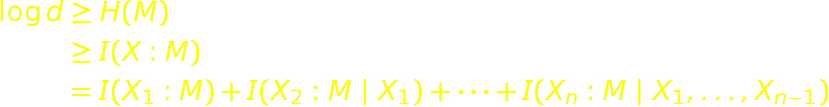
Random Access Code
Assume we have a mapping that maps each string in {0,1}^{n} to a probability distribution over some domain [d] such that any bit can be recovered w.p. 90% given all the previous bits; then d>2^{0.8n}
The proof is one line:
The same is true if we encode {1,2,3,4}^{n} and able to recover the value mod 2 of each coordinate given all the previous coordinates
This simple bound is quite powerful; used e.g., in lower bounds on 2-query-LDC using quantum

Slide 10
Recursive Diamond Graph
0011
n=1
n=2
0010
1011
0001
0111
0000
1111
1000
1101
0100
1110
1100
Number of vxs is ~4^{n}
The graph is known to be in l₁
Notes:
Actually the graph is not in L_1, but the diagonals and anti-diagonals can be embedded isometrically in l_1 of dim 2^n

Slide 11
The Embedding
Assume we have an embedding of the graph into l₁^{d}
Assume for simplicity that there is no distortion
Consider an orientation of the edges:
Each edge is mapped to a vector in R^{d} whose l₁ norm is 1

Slide 12
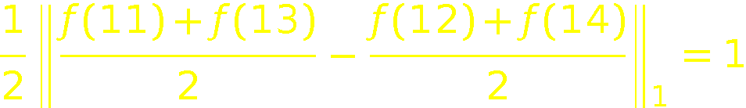
The Embedding
Assume that each edge is mapped to a nonnegative vector
Then each edge is mapped to a probability distribution over [d]
Notice that
We can therefore perfectly distinguish the encodings of 11 and 13 from 12 and 14
Hence we can recover the
second digit mod 2 given
the first digit

Slide 13
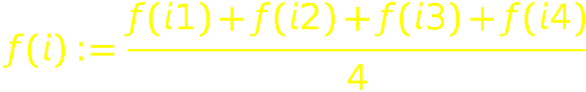
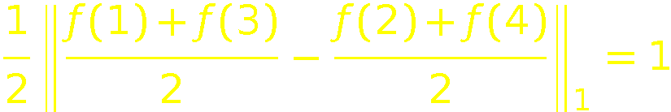
The Embedding
We can similarly recover the first digit mod 2
Define
This is also a probability distribution
Then

Slide 14



Diamond Graph: Summary
When there is no distortion, we obtain an encoding of {1,2,3,4}^{n} into [d] that allows us to decode any coordinate mod 2 given the previous coordinates. This gives
In case there is distortion D>1, our decoding is correct w.p. ½ + 1/(2D). By Fano’s inequality the mutual information with each coordinate is at least
and hence we obtain a dimension lower bound of
This recovers the result of [CharikarBrinkman03,LeeNaor04]
For small distortion, we cannot get better than N^{1/2}…

Slide 15
Recursive Cycle Graph [AndoniCharikarNeimanNguyen11]
k=3,n=2
Number of vxs is ~(2k)^{n}
We can encode k^{n} possible strings

Slide 16
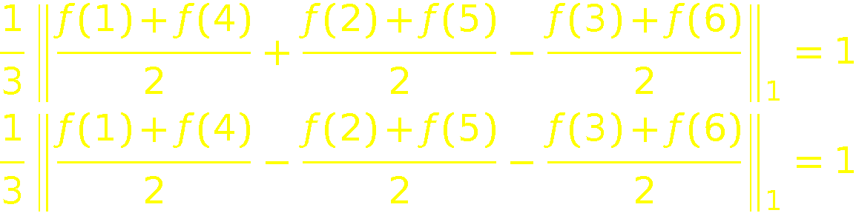


Recursive Cycle Graph
We obtain an encoding from {1,…,2k}^{n} to [d] that allows to recover the value mod k of each coordinate given the previous ones
E.g.,
So when there is no distortion, we get a dimension lower bound of
When the distortion is 1+ε, Fano’s inequality gives dimension lower bound of
where δ:=(k-1)ε/2
By selecting k=1/(εlog1/ε) we get the desired n^{1-O(1/log(1/ε))}

Slide 17
One Minor Remaining Issue
How do we make sure that all the vectors are nonnegative and of l₁ norm exactly 1?
We simply split positive and negative coordinates and add an extra coordinate so that it sums to 1, e.g.
(0.2,-0.3,0.4) → (0.2,0,0.4, 0,0.3,0, 0.1)
It is easy to see that this can only increase the length of the “anti diagonals”
Since the dimension only increases by a factor of 2, we get essentially the same bounds for general embeddings

Slide 18
Conclusion and Open Questions
Using essentially the same proof using quantum information, our bounds extend automatically to embeddings into matrices with the Schatten-1 distance
Open questions:
Other applications of random access codes?
Close the big gap between n^{Ω(1/D2)} and O(n) for embeddings with distortion D

Slide 19

Thanks!

