Slide 1
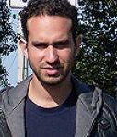
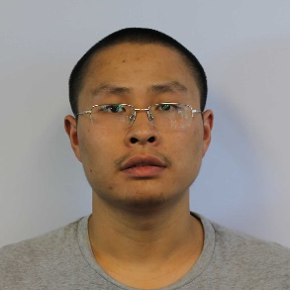
Active learning with restricted membership queries
Shachar Lovett (UCSD)
Joint with Shay Moran (UCSD/Simons) and Jiapeng Zhang (UCSD)

Slide 2
Overview
Active learning – basic definitions
Positive example: when it is useful
Negative example: when it is useless
New model, allowing “restricted” additional queries
Application: active learning of half-spaces
Open problems

Slide 3
Active learning

Slide 4
What is active learning?
Active learning extends classical PAC learning
In PAC (passive) learning, a learning algorithm is given a sample of labeled data and needs to predict an unknown concept
In active learning, a learning algorithm is given a sample of unlabeled data, it can ask for the labels of (hopefully) a few data points, and still predict as well as the passive algorithm
This is certainly useful, as it is much easier in practice to obtain unlabeled data; however, when is it possible?

Slide 5
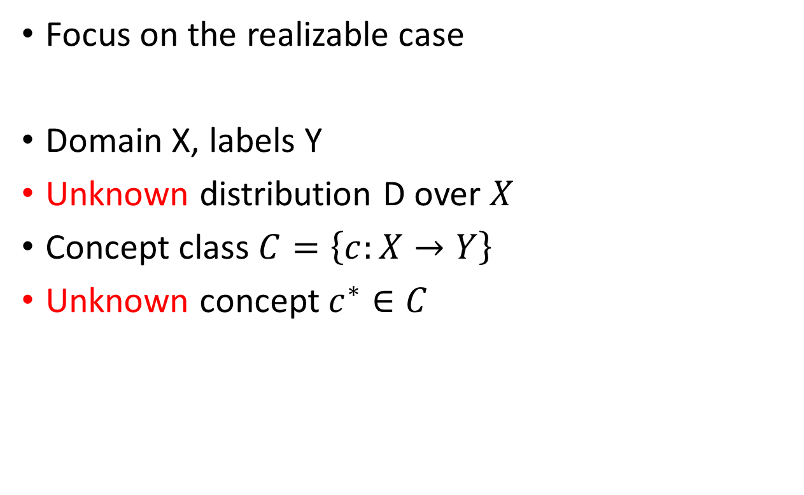
PAC learning
Focus on the realizable case
Domain X, labels Y
Unknown distribution D over $X$
Concept class $C=\left\{c:X→Y\right\}$
Unknown concept $c^{∗}∈C$

Slide 6
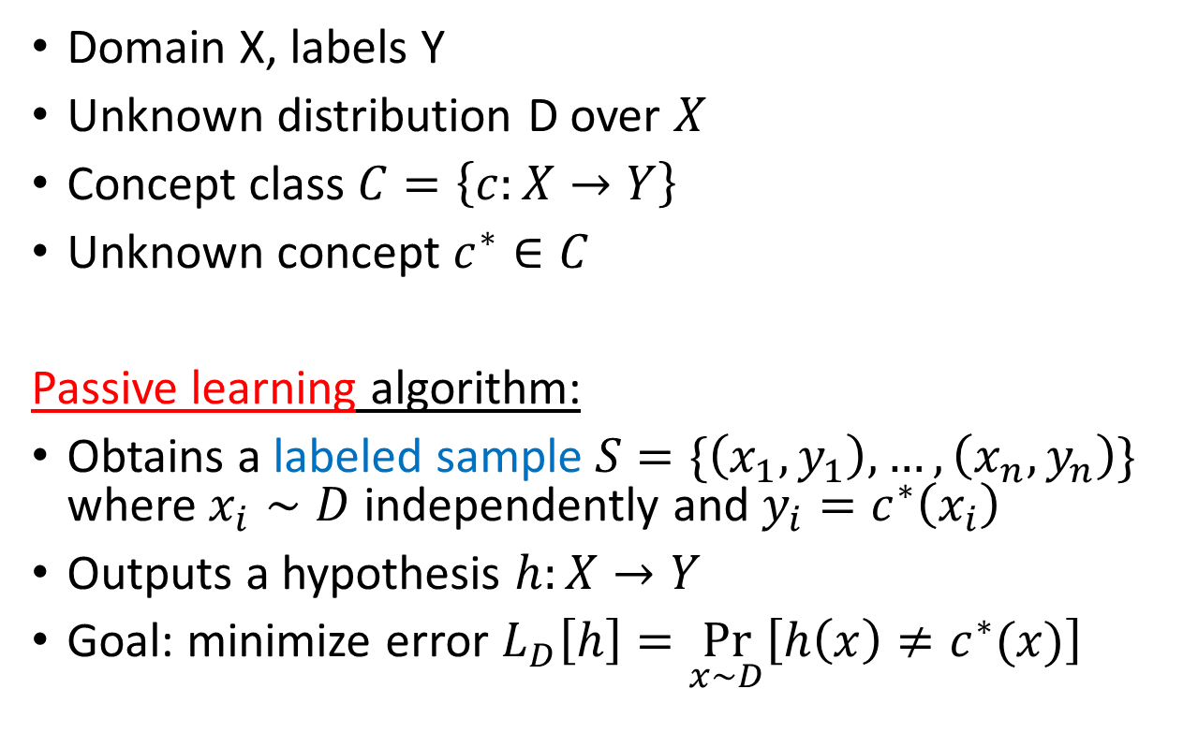
PAC learning
Domain X, labels Y
Unknown distribution D over $X$
Concept class $C=\left\{c:X→Y\right\}$
Unknown concept $c^{∗}∈C$
Passive learning algorithm:
Obtains a labeled sample $S=\{\left(x_{1},y_{1}\right),…,\left(x_{n},y_{n}\right)\}$ where $x_{i}∼D$ independently and $y_{i}=c^{∗}\left(x_{i}\right)$
Outputs a hypothesis $h:X→Y$
Goal: minimize error $L_{D}\left[h\right]=\underset{x∼D}{Pr}\left[h\left(x\right)≠c^{∗}(x)\right]$

Slide 7
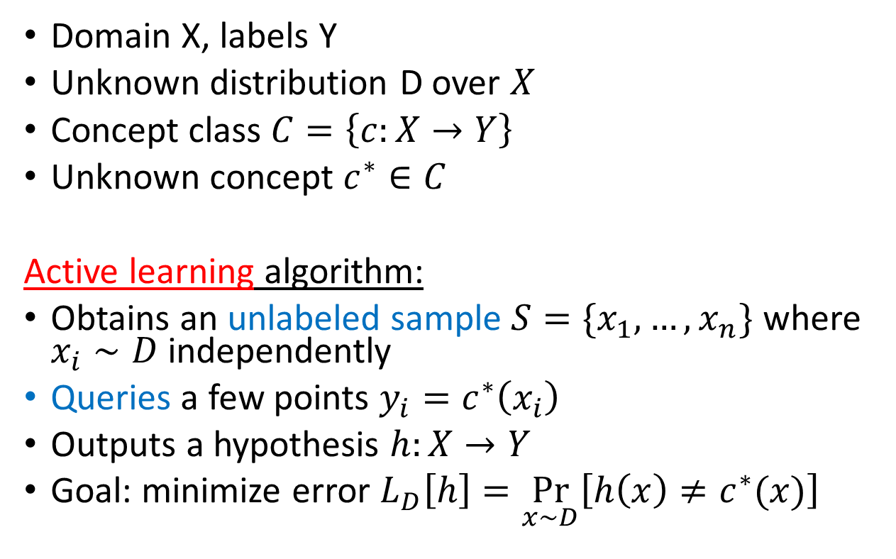
PAC learning
Domain X, labels Y
Unknown distribution D over $X$
Concept class $C=\left\{c:X→Y\right\}$
Unknown concept $c^{∗}∈C$
Active learning algorithm:
Obtains an unlabeled sample $S=\{x_{1},…,x_{n}\}$ where $x_{i}∼D$ independently
Queries a few points $y_{i}=c^{∗}\left(x_{i}\right)$
Outputs a hypothesis $h:X→Y$
Goal: minimize error $L_{D}\left[h\right]=\underset{x∼D}{Pr}\left[h\left(x\right)≠c^{∗}(x)\right]$

Slide 8
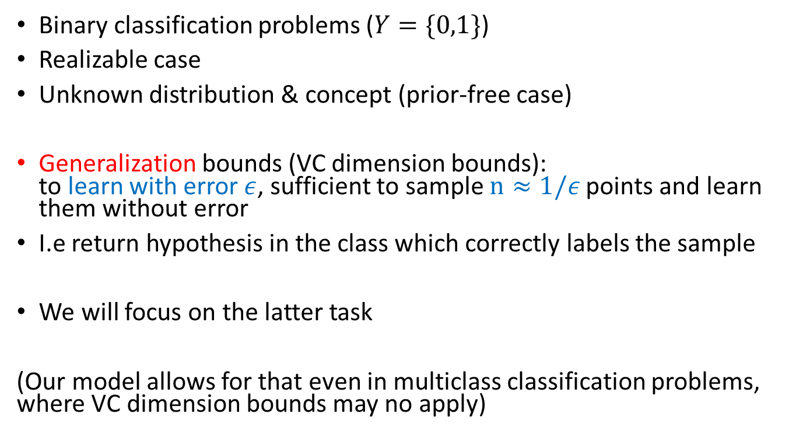
Some simplifying assumptions
Binary classification problems ($Y=\{0,1\}$)
Realizable case
Unknown distribution & concept (prior-free case)
Generalization bounds (VC dimension bounds):
to learn with error $ε$, sufficient to sample $n≈1/ε$ points and learn them without error
I.e return hypothesis in the class which correctly labels the sample
We will focus on the latter task
(Our model allows for that even in multiclass classification problems, where VC dimension bounds may no apply)

Slide 9
Thresholds in 1D
A canonical example for the power of active learning

Slide 10
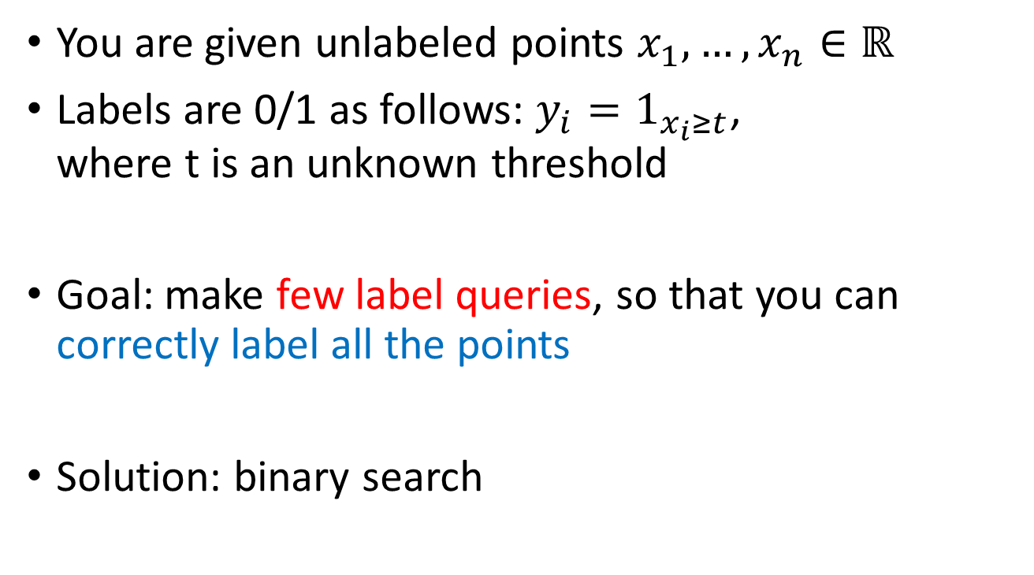
Thresholds in 1D
You are given unlabeled points $x_{1},…,x_{n}∈ℝ$
Labels are 0/1 as follows: $y_{i}=1_{x_{i}≥t}$,
where t is an unknown threshold
Goal: make few label queries, so that you can correctly label all the points
Solution: binary search

Slide 11
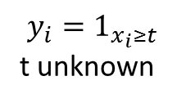
Thresholds in 1D
$$y_{i}=1_{x_{i}≥t}$$
t unknown

Slide 12
Thresholds in 1D
$$y_{i}=1_{x_{i}≥t}$$
t unknown
1

Slide 13
Thresholds in 1D
$$y_{i}=1_{x_{i}≥t}$$
t unknown
1
1
1
1
1
1

Slide 14
Thresholds in 1D
$$y_{i}=1_{x_{i}≥t}$$
t unknown
0
1
1
1
1
1
1

Slide 15
Thresholds in 1D
$$y_{i}=1_{x_{i}≥t}$$
t unknown
0
0
0
0
1
1
1
1
1
1

Slide 16
Thresholds in 1D
$$y_{i}=1_{x_{i}≥t}$$
t unknown
0
0
0
0
0
1
1
1
1
1
1

Slide 17
Thresholds in 1D
$$y_{i}=1_{x_{i}≥t}$$
t unknown
0
0
0
0
0
0
1
1
1
1
1
1

Slide 18
Thresholds in 1D
Binary search performs great!
To correctly label a sample of size n, we only need to query log(n) labels, and we can infer the rest ☺
Can we extend this to more interesting classes?
Unfortunately, no… [Dasgupta] ☹

Slide 19
Half-planes in 2D
A canonical example for the weakness of active learning

Slide 20
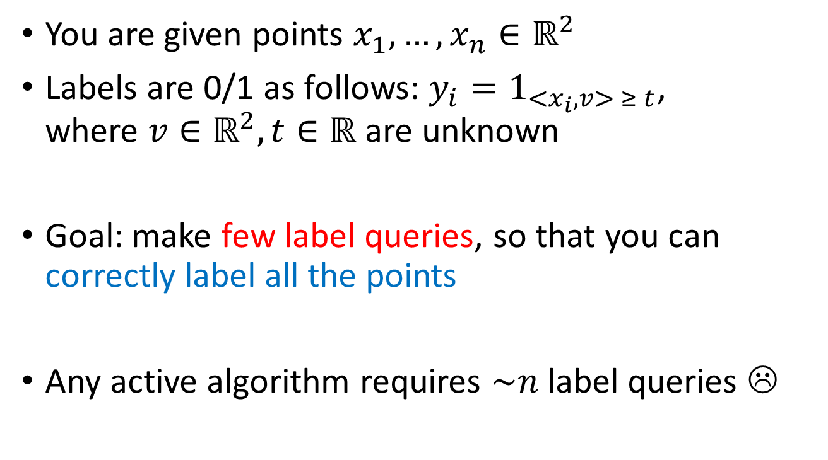
Half-planes in 2D
You are given points $x_{1},…,x_{n}∈ℝ^{2}$
Labels are 0/1 as follows: $y_{i}=1_{{<x}_{i},v> ≥ t}$,
where ${v∈ℝ}^{2},t∈ℝ$ are unknown
Goal: make few label queries, so that you can correctly label all the points
Any active algorithm requires $\sim n$ label queries ☹

Slide 21
Half-planes in 2D
Unknown line
Hard case: line separates exactly one point from the rest.
Need to query essentially all points to find out which one.

Slide 22
Can we salvage active learning?
Various suggestions how to rectify this
Average case analysis [Dasgupta; Hanneke]
Restrictions on the target concept / distribution [Gonen]
Distribution dependent [Dasgupta-Kalai-Monteleoni; Balcan-Broder-Zhang; El Yaniv-Wiener; Balcan-Long; Hanneke]
Target concept dependent [Dasgupta; Balcan-Hanneke-Vaughan; Hanneke]

Slide 23
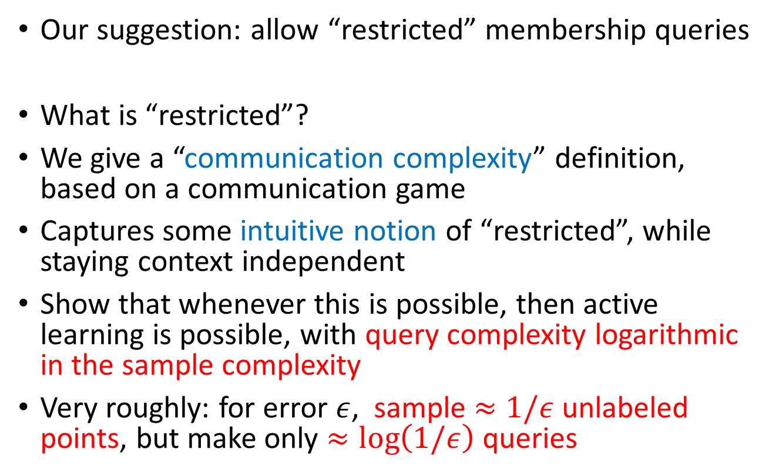
New model:
Restricted membership queries
Our suggestion: allow “restricted” membership queries
What is “restricted”?
We give a “communication complexity” definition, based on a communication game
Captures some intuitive notion of “restricted”, while staying context independent
Show that whenever this is possible, then active learning is possible, with query complexity logarithmic in the sample complexity
Very roughly: for error $ε$, sample $≈1/ε$ unlabeled points, but make only $≈log\left(1/ε\right)$ queries

Slide 24
Half-planes in 2D
How membership queries restore the power of active learning

Slide 25
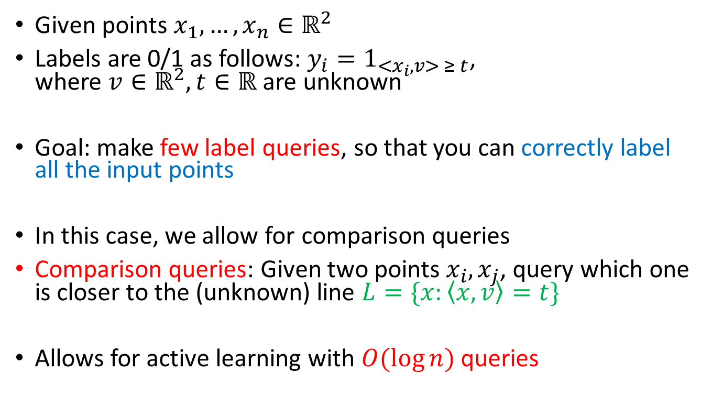
Active learning half-planes in 2D
Given points $x_{1},…,x_{n}∈ℝ^{2}$
Labels are 0/1 as follows: $y_{i}=1_{{<x}_{i},v> ≥ t}$,
where ${v∈ℝ}^{2},t∈ℝ$ are unknown
Goal: make few label queries, so that you can correctly label all the input points
In this case, we allow for comparison queries
Comparison queries: Given two points $x_{i}, x_{j}$, query which one is closer to the (unknown) line $L=\{x:\left\langle x,v\right\rangle =t\}$
Allows for active learning with $O(\log{n)}$ queries

Slide 26
Active learning half-planes in 2D
Unlabeled Input: size n
unknown line

Slide 27
Active learning half-planes in 2D
Unlabeled Input: size n
unknown line
1. Sample S of size 40

Slide 28
Active learning half-planes in 2D
Unlabeled Input: size n
unknown line
1. Sample S of size 40
2. Label S

Slide 29
Active learning half-planes in 2D
Unlabeled Input: size n
unknown line
1. Sample S of size 40
2. Label S
3. Find points in S closest to line

Slide 30
Active learning half-planes in 2D
Unlabeled Input: size n
unknown line
1. Sample S of size 40
2. Label S
3. Find points in S closest to line
4. Build cones

Slide 31
Active learning half-planes in 2D
Unlabeled Input: size n
unknown line
1. Sample S of size 40
2. Label S
3. Find points in S closest to line
4. Build cones
5. Forget points not defining cones

Slide 32
Active learning half-planes in 2D
Unlabeled Input: size n
unknown line
1. Sample S of size 40
2. Label S
3. Find points in S closest to line
4. Build cones
5. Forget points not defining cones
6. Label inputs in cones
(must be correct!)
-
+

Slide 33
Active learning half-planes in 2D
Unlabeled Input: size n
unknown line
1. Sample S of size 40
2. Label S
3. Find points in S closest to line
4. Build cones
5. Forget points not defining cones
6. Label inputs in cones
(must be correct!)

Slide 34
Active learning half-planes in 2D
Unlabeled Input: size n
unknown line
1. Sample S of size 40
2. Label S
3. Find points in S closest to line
4. Build cones
5. Forget points not defining cones
6. Label inputs in cones
(must be correct!)
7. Repeat on unlabeled points

Slide 35
Active learning half-planes in 2D
Unlabeled Input: size n
unknown line
1. Sample S of size 40
2. Label S
3. Find points in S closest to line
4. Build cones
5. Forget points not defining cones
6. Label inputs in cones
(must be correct!)
7. Repeat on unlabeled points

Slide 36
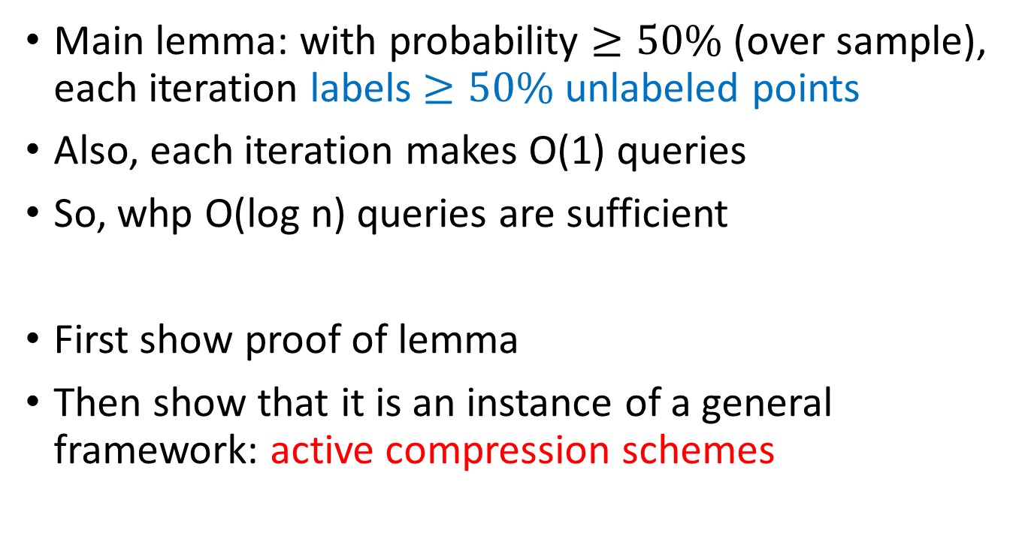
Active learning half-planes in 2D
Main lemma: with probability $≥50\%$ (over sample), each iteration labels $≥50\%$ unlabeled points
Also, each iteration makes O(1) queries
So, whp O(log n) queries are sufficient
First show proof of lemma
Then show that it is an instance of a general framework: active compression schemes

Slide 37
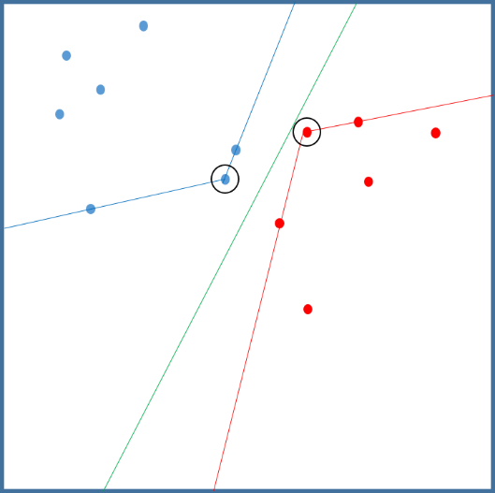
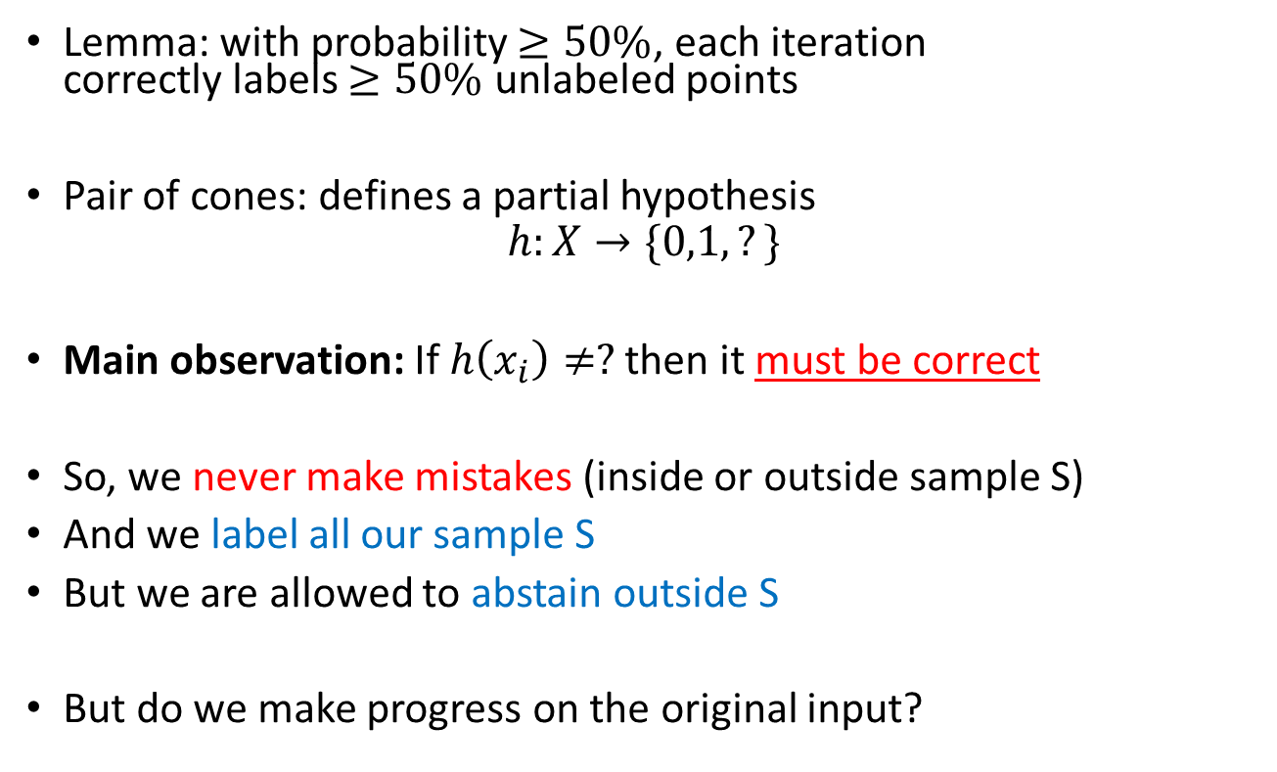
Proof of lemma
Lemma: with probability $≥50\%$, each iteration
correctly labels $≥50\%$ unlabeled points
Pair of cones: defines a partial hypothesis
$$h:X→\{0,1,?\}$$
Main observation: If $h\left(x_{i}\right)≠?$ then it must be correct
So, we never make mistakes (inside or outside sample S)
And we label all our sample S
But we are allowed to abstain outside S
But do we make progress on the original input?

Slide 38
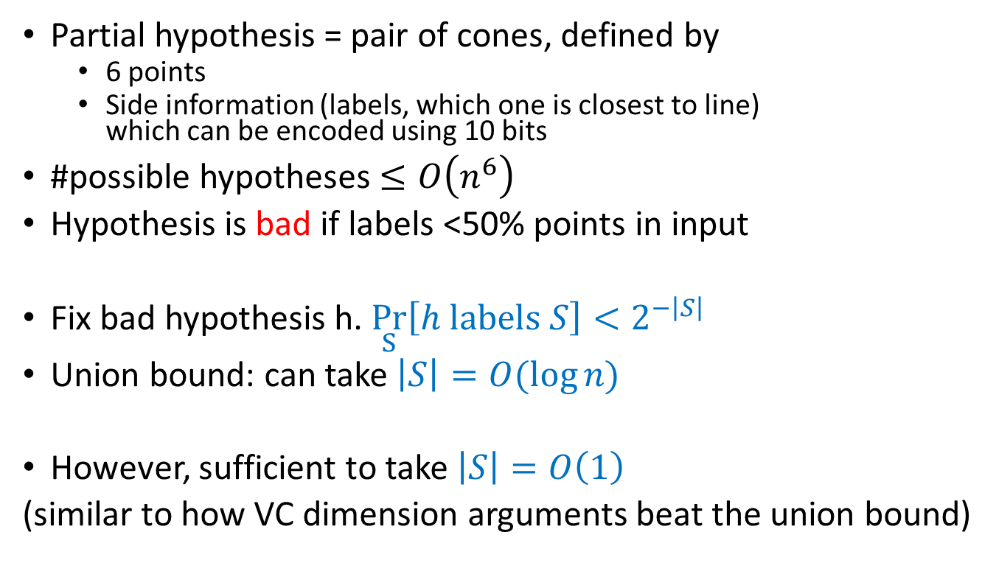
Proof of lemma
Partial hypothesis = pair of cones, defined by
  6 points
  Side information (labels, which one is closest to line)
  which can be encoded using 10 bits
#possible hypotheses $≤O\left(n^{6}\right)$
Hypothesis is bad if labels <50% points in input
Fix bad hypothesis h. $\underset{S}{Pr}\left[h labels S\right]<2^{−\left|S\right|}$
Union bound: can take $\left|S\right|=O(\log{n)}$
However, sufficient to take $\left|S\right|=O\left(1\right)$
(similar to how VC dimension arguments beat the union bound)

Slide 39
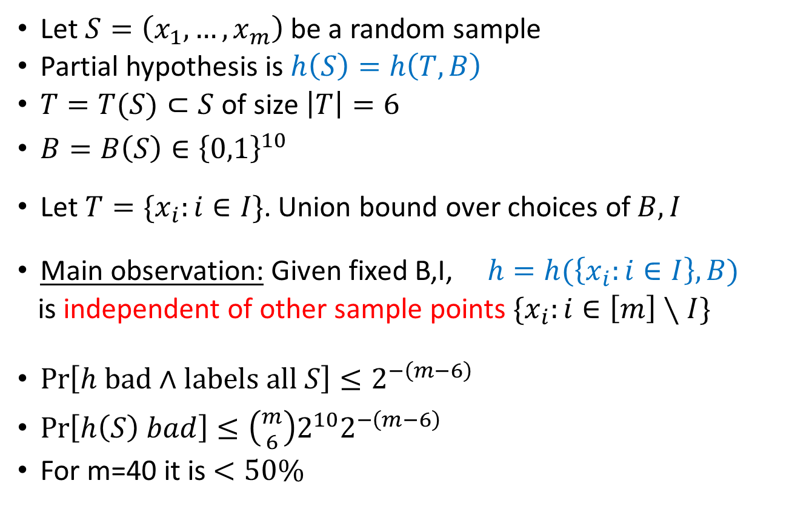
Proof of lemma
Let $S=\left(x_{1},…,x_{m}\right)$ be a random sample
Partial hypothesis is $h\left(S\right)=h\left(T,B\right)$
$T=T(S)⊂S$ of size $\left|T\right|=6$
$B=B\left(S\right)∈{\left\{0,1\right\}}^{10}$
Let $T=\{x_{i}:i∈I\}$. Union bound over choices of $B,I$
Main observation: Given fixed B,I, $h=h(\left\{x_{i}:i∈I\right\},B)$
is independent of other sample points $\{x_{i}:i∈\left[m\right]∖I\}$
${\operatorname{Pr}\left[h bad∧labels all S\right]≤2}^{−\left(m−6\right)}$
$\operatorname{Pr}\left[h\left(S\right) bad\right]≤\left({m \atop 6}\right)2^{10}2^{−\left(m−6\right)}$
For m=40 it is $<50\%$

Slide 40
Active learning half-planes in 2D
Simple iterative algorithm
In each iteration:
  Sample 40 points
  Query them (label + comparison)
  Design a confident partial hypothesis:
  must be correct whenever it does not abstain
  labels all our sample correctly
  Remove labeled points and repeat
Analysis:
  Partial hypothesis defined by few points + side information

Slide 41
General framework:
Active compression schemes

Slide 42
Sample compression schemes
Littlestone and Warmuth (1986) conjectured that PAC learnability can be characterized by a communication game, called sample compression schemes
Moran and Yehudayoff (2016) proved this conjecture (at least qualitatively)
Here, we generalize these notions to active learning
Extends version space compression [BenDavid-Urner, ElYaniv-Wiener] to allow for additional queries

Slide 43
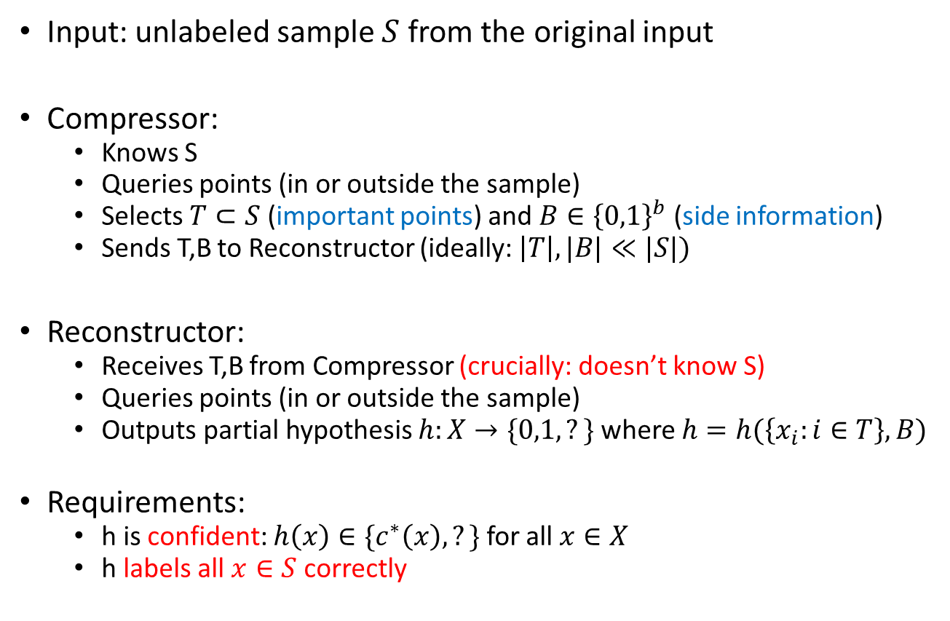
Active compression schemes
Input: unlabeled sample $S$ from the original input
Compressor:
  Knows S
  Queries points (in or outside the sample)
  Selects $T⊂S$ (important points) and $B∈{\left\{0,1\right\}}^{b}$ (side information)
  Sends T,B to Reconstructor (ideally: $\left|T\right|,|B|≪|S|)$
Reconstructor:
  Receives T,B from Compressor (crucially: doesn’t know S)
  Queries points (in or outside the sample)
  Outputs partial hypothesis $h:X→\{0,1,?\}$ where $h=h(\left\{x_{i}:i∈T\right\},B)$
Requirements:
  h is confident: $h\left(x\right)∈\{c^{∗}\left(x\right),?\}$ for all $x∈X$
  h labels all $x∈S$ correctly

Slide 44
Active compression scheme: half-planes
Input: sample S of size |S|=40
Compressor queries labels+which is closest to line
Sends |T|=6 points + b=10 bits of side information

Slide 45
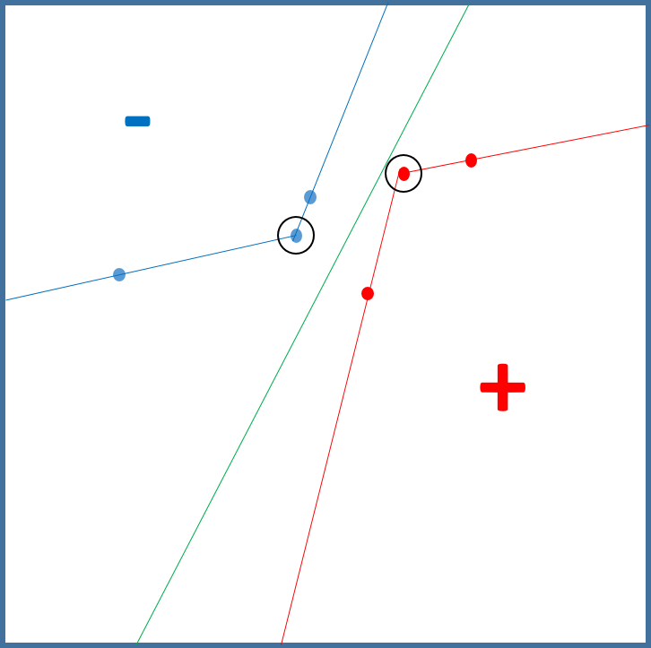
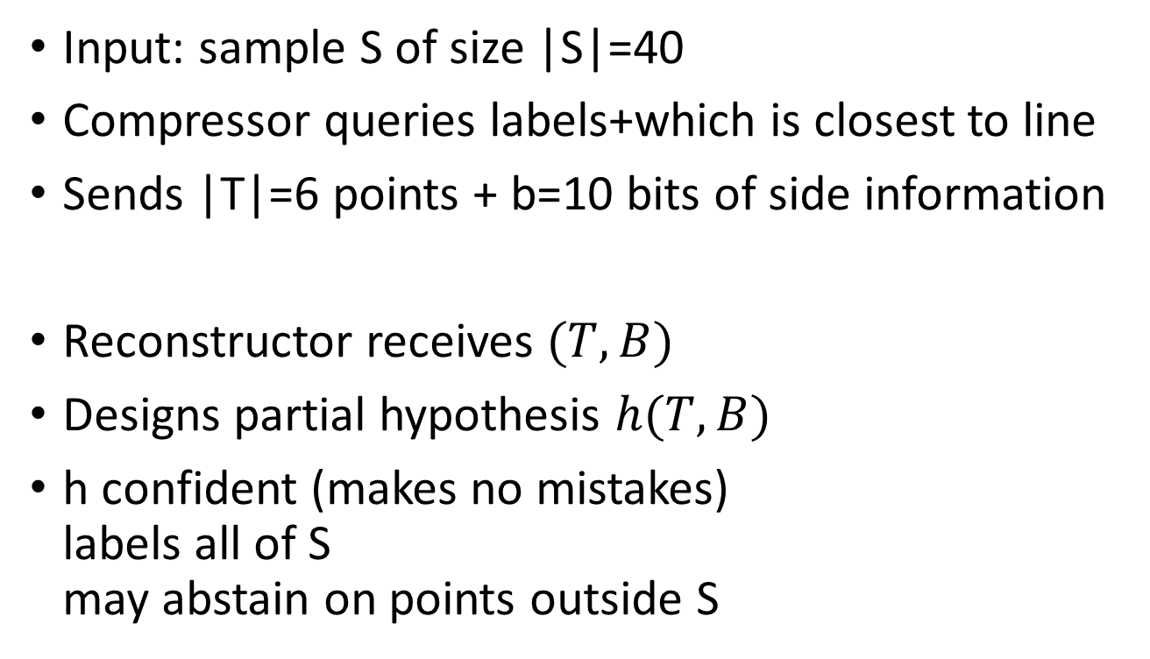
Active compression scheme: half-planes
Input: sample S of size |S|=40
Compressor queries labels+which is closest to line
Sends |T|=6 points + b=10 bits of side information
Reconstructor receives $(T,B)$
Designs partial hypothesis $h(T,B)$
h confident (makes no mistakes)
labels all of S
may abstain on points outside S
?

Slide 46
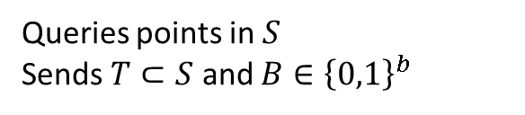

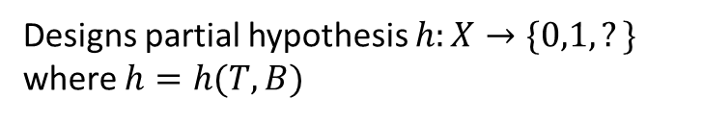
Active compression schemes
Input: unlabeled sample $S=\left(x_{1},…,x_{m}\right)$
h is confident (doesn’t make mistakes) and labels all of S
Communication: $cost\left(m\right)=$ max $\left|T\right|+b$
Theorem: $cost(m)≤m/6$ $⇒$active learning
Compressor
Reconstructor
T,B
Queries points in $S$
Sends $T⊂S$ and $B∈{\left\{0,1\right\}}^{b}$
Designs partial hypothesis $h:X→\{0,1,?\}$ where $h=h(T,B)$

Slide 47
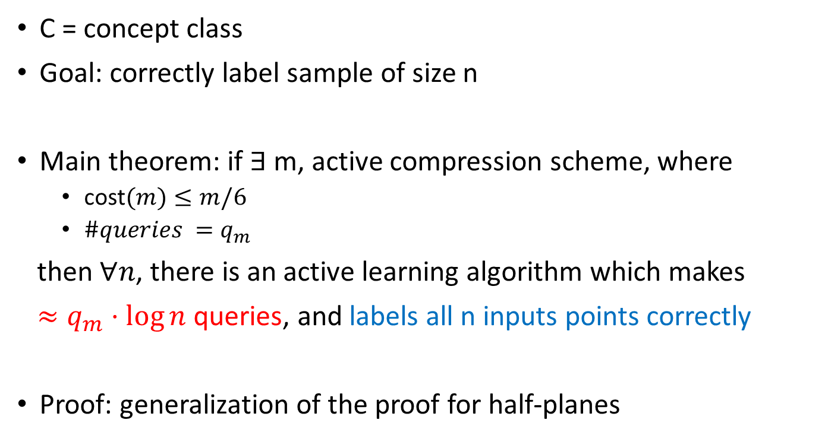
Active compression schemes imply efficient active learning
C = concept class
Goal: correctly label sample of size n
Main theorem: if $∃$ m, active compression scheme, where
  cost$(m)≤m/6$
  $\#queries =q_{m}$
then $∀n$, there is an active learning algorithm which makes
$≈q_{m}⋅\log{n}$ queries, and labels all n inputs points correctly
Proof: generalization of the proof for half-planes

Slide 48
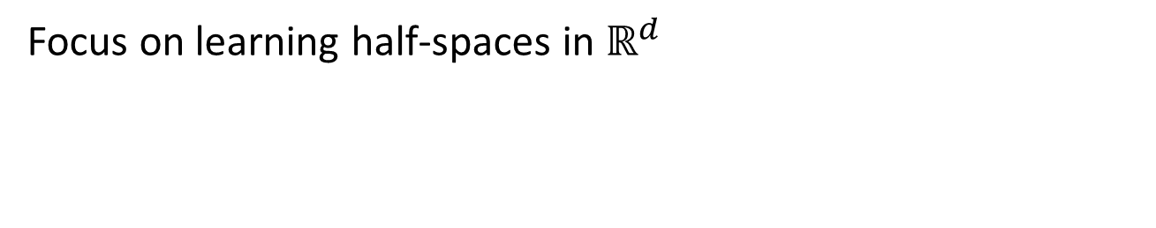
Designing active compression schemes
Focus on learning half-spaces in $ℝ^{d}$

Slide 49
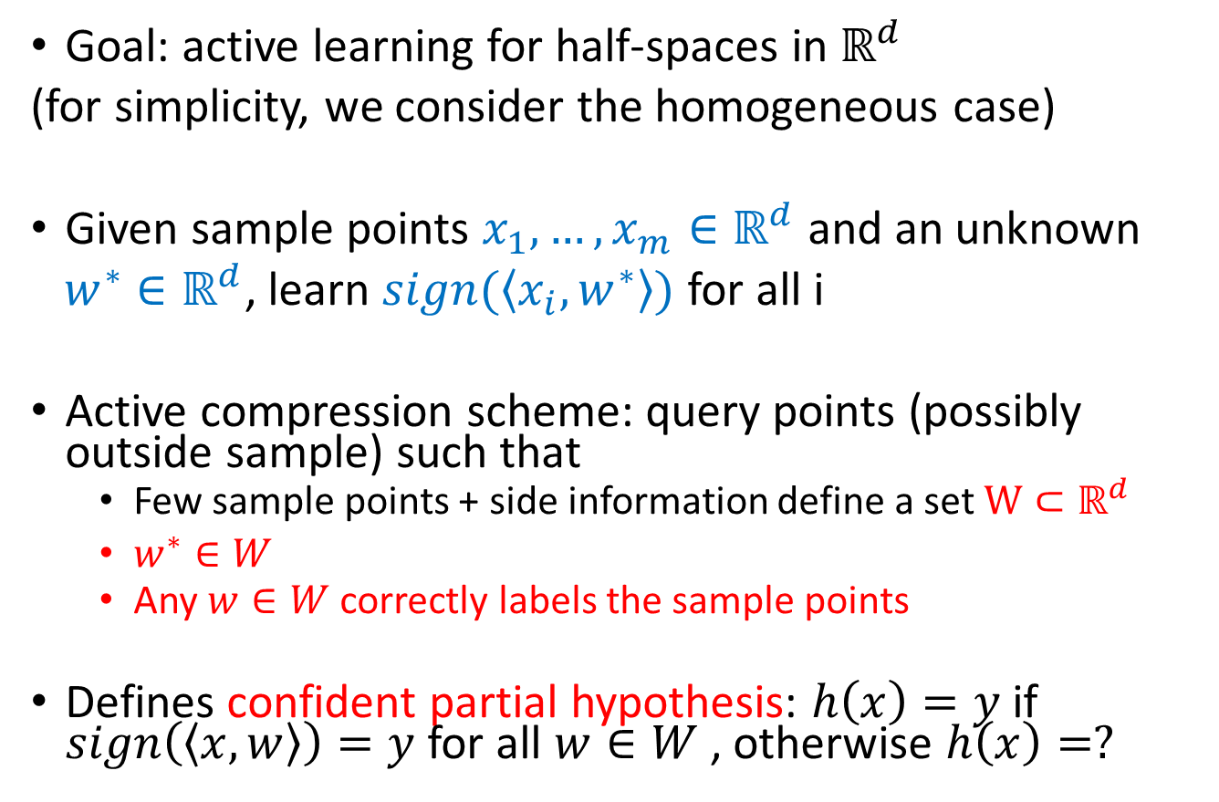
Half-spaces
Goal: active learning for half-spaces in $ℝ^{d}$
(for simplicity, we consider the homogeneous case)
Given sample points $x_{1},…,x_{m}∈ℝ^{d}$ and an unknown
$w^{∗}∈ℝ^{d}$, learn $sign(〈x_{i},w^{∗}〉)$ for all i
Active compression scheme: query points (possibly outside sample) such that
  Few sample points + side information define a set $W⊂ℝ^{d}$
  $w^{∗}∈W$
  Any $w∈W$ correctly labels the sample points
Defines confident partial hypothesis: $h\left(x\right)=y$ if $sign\left(〈x,w〉\right)=y$ for all $w∈W$, otherwise $h\left(x\right)=?$

Slide 50
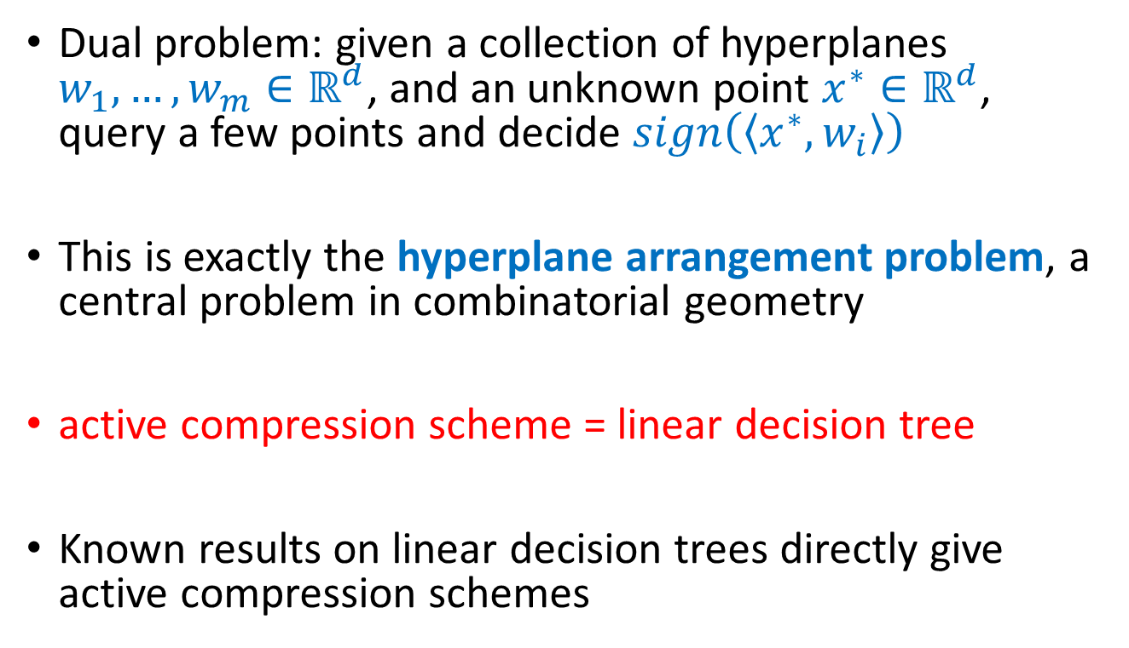
Dual problem
Dual problem: given a collection of hyperplanes $w_{1},…,w_{m}∈ℝ^{d}$, and an unknown point $x^{∗}∈ℝ^{d}$, query a few points and decide $sign\left(〈x^{∗},w_{i}〉\right)$
This is exactly the hyperplane arrangement problem, a central problem in combinatorial geometry
active compression scheme = linear decision tree
Known results on linear decision trees directly give active compression schemes

Slide 51
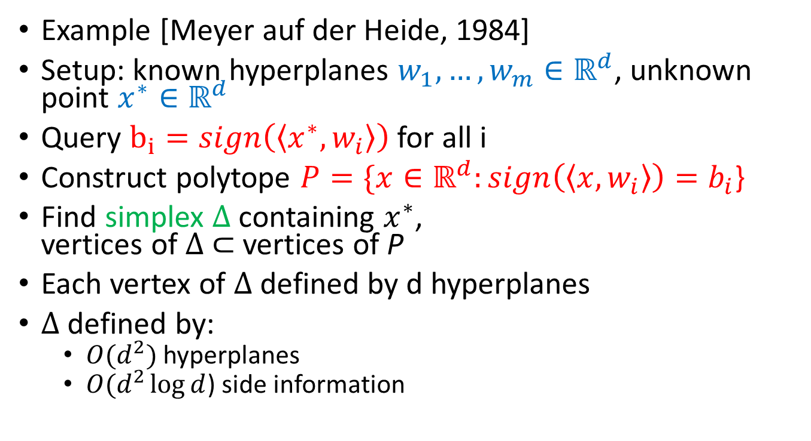
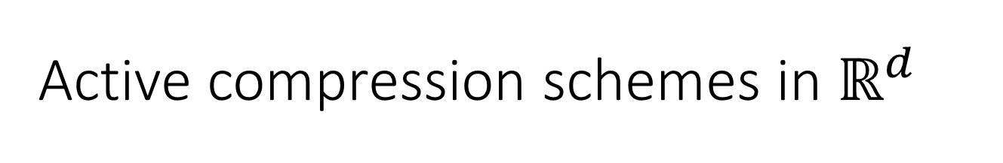
Active compression schemes in $ℝ^{d}$
Example [Meyer auf der Heide, 1984]
Setup: known hyperplanes $w_{1},…,w_{m}∈ℝ^{d}$, unknown point $x^{∗}∈ℝ^{d}$
Query $b_{i}=sign\left(〈x^{∗},w_{i}〉\right)$ for all i
Construct polytope $P=\{x∈ℝ^{d}:sign\left(〈x,w_{i}〉\right)=b_{i}$}
Find simplex $Δ$ containing $x^{∗}$,
vertices of $Δ$ $⊂$ vertices of P
Each vertex of $Δ$ defined by d hyperplanes
$Δ$ defined by:
  $O(d^{2})$ hyperplanes
  $O(d^{2}\log{d}$) side information

Slide 52
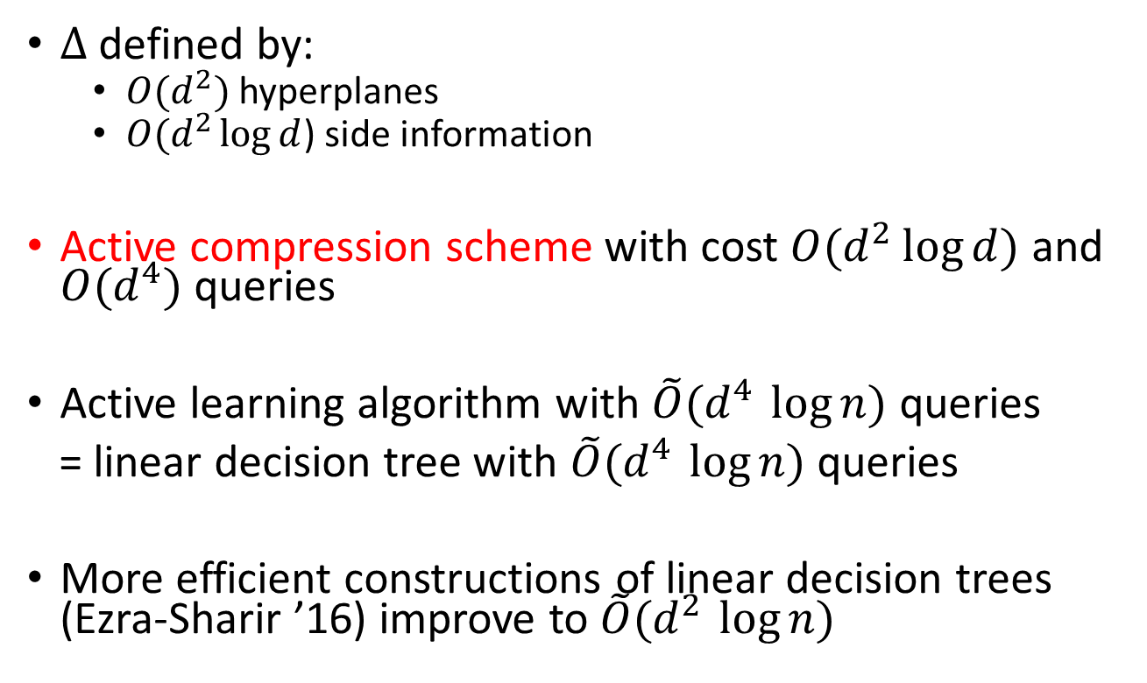
Active compression schemes in $ℝ^{d}$
$Δ$ defined by:
  $O(d^{2})$ hyperplanes
  $O(d^{2}\log{d}$) side information
Active compression scheme with cost $O(d^{2}\log{d})$ and $O(d^{4})$ queries
Active learning algorithm with $\tilde{O}(d^{4 }\log{n)}$ queries
= linear decision tree with $\tilde{O}(d^{4 }\log{n)}$ queries
More efficient constructions of linear decision trees (Ezra-Sharir ’16) improve to $\tilde{O}(d^{2 }\log{n)}$

Slide 53
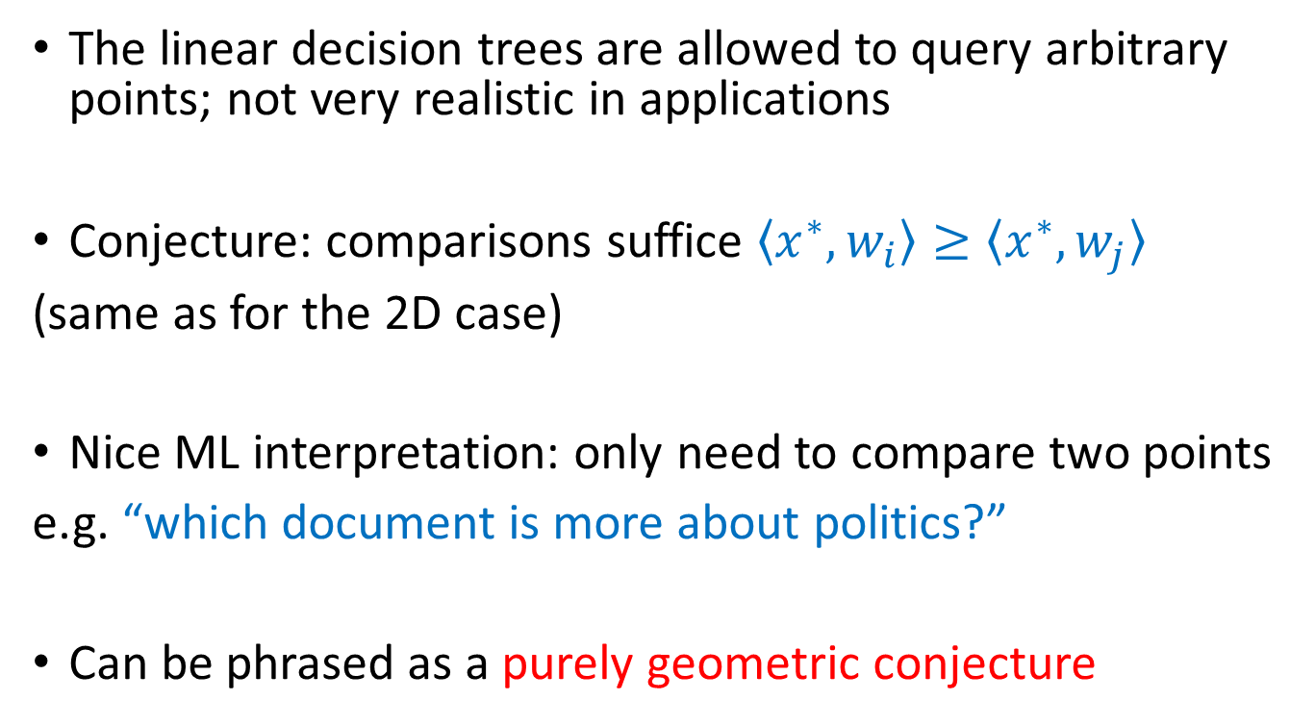
Are comparisons enough?
The linear decision trees are allowed to query arbitrary points; not very realistic in applications
Conjecture: comparisons suffice $〈x^{∗},w_{i}〉≥〈x^{∗},w_{j}〉$
(same as for the 2D case)
Nice ML interpretation: only need to compare two points
e.g. “which document is more about politics?”
Can be phrased as a purely geometric conjecture

Slide 54
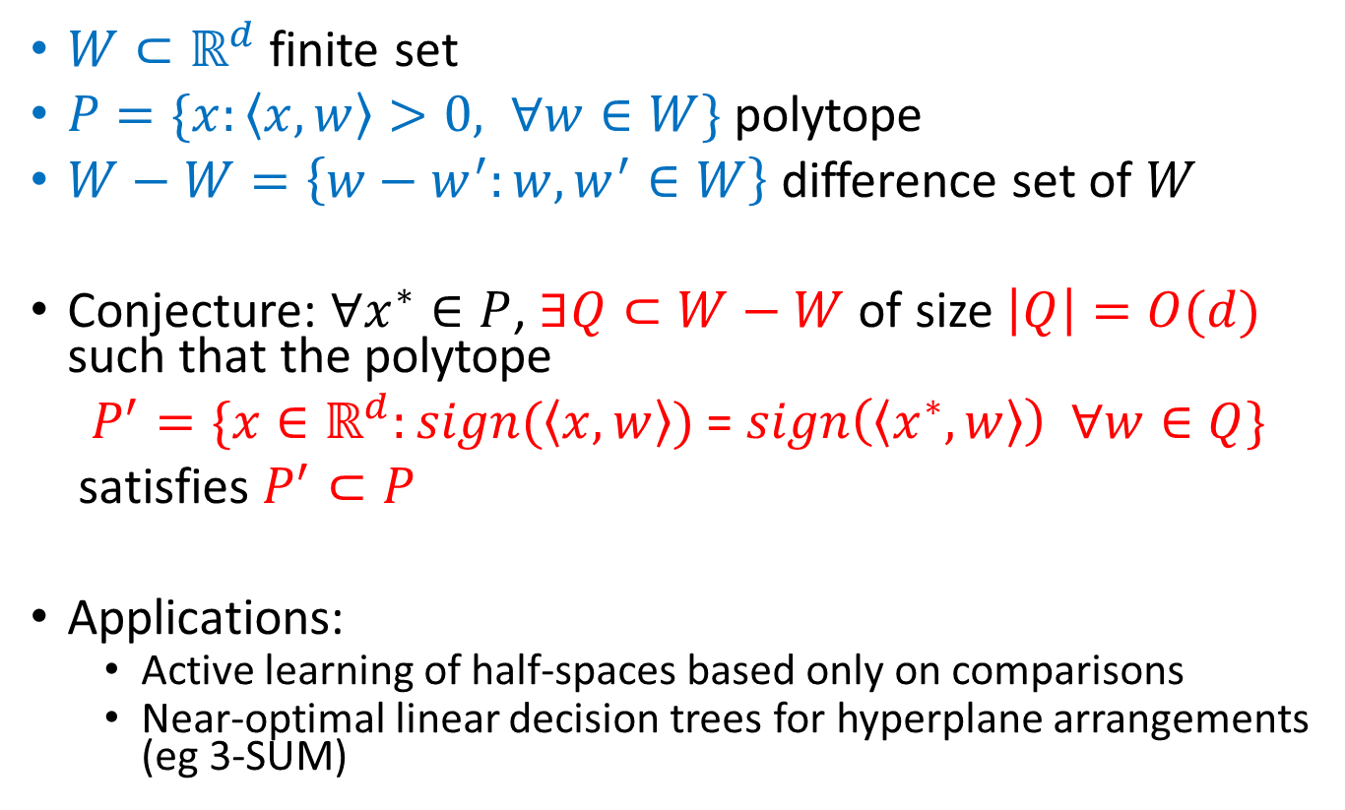
Geometric conjecture
$W⊂ℝ^{d}$ finite set
$P=\{x:〈x,w〉>0, ∀w∈W\}$ polytope
$W−W=\left\{w−w^{′}:w,w^{′}∈W\right\}$ difference set of $W$
Conjecture: $∀x^{∗}∈P$, $∃Q⊂W−W$ of size $\left|Q\right|=O(d)$ such that the polytope
$P^{′}=\{x∈ℝ^{d}:sign(〈x,w〉)$ = $sign\left(〈x^{∗},w〉\right) ∀w∈Q\}$
satisfies $P^{′}⊂P$
Applications:
  Active learning of half-spaces based only on comparisons
  Near-optimal linear decision trees for hyperplane arrangements
  (eg 3-SUM)

Slide 55
Are active compression schemes complete?

Slide 56
Are active compression schemes complete?
Moran and Yehudayoff (2016) proved the sample compression conjecture of Littlestone and Warmuth (1986)
It shows that for PAC learning, sample compression schemes are complete (at least qualitatively) [David-Moran-Yehudayoff]
Question: does this hold for active learning with membership queries?
We don’t know, but it does when membership queries are not allowed
Implies a dichotomy of standard active learning (also follows from [Hanneke-Lang])

Slide 57
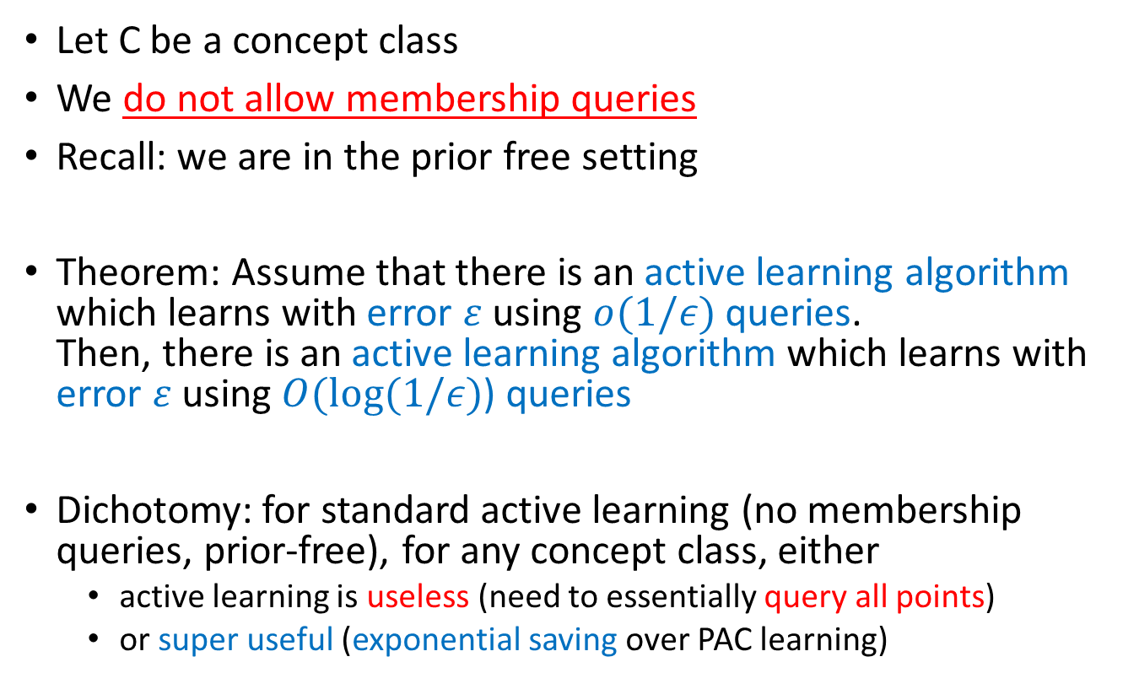
A dichotomy for active learning
(without membership queries)
Let C be a concept class
We do not allow membership queries
Recall: we are in the prior free setting
Theorem: Assume that there is an active learning algorithm which learns with error $ε$ using $o(1/ε)$ queries.
Then, there is an active learning algorithm which learns with error $ε$ using $O(log⁡(1/ε)$) queries
Dichotomy: for standard active learning (no membership queries, prior-free), for any concept class, either
  active learning is useless (need to essentially query all points)
  or super useful (exponential saving over PAC learning)

Slide 58
A dichotomy for active learning
(without membership queries)
Proof sketch:
Sub-linear queries: can perfectly learn sample of size m using o(m) queries
Active learning = randomized decision tree
Sub-linear queries: each concept has a constant size certificate (=teaching dimension)
Certificate gives an active compression scheme

Slide 59
Summary

Slide 60
Summary
Active compression schemes: communication based model for active learning
If it exists, gives exponential savings over PAC learning in the number of queries
Communication model for simplicity of queries:
query whatever you want, but you need to describe it using a few original sample points + few extra bits of side information
Example application: active learning of half-spaces = linear decision trees for hyperplane arrangemenents

Slide 61
Open problems
1. Are active compressions schemes complete for active learning with membership queries?
2. More applications besides half-spaces
(we can also handle large margin classifiers)
3. Can it be useful in practice? Can we formulate intuitive definitions of simplicity in our model?
4. Geometric conjecture
Thank you!

