Slide 1
Weyl Lectures
Daniel A. Spielman
Yale University
Sparsification of Graphs and Matrices
The Solution of the Kadison-Singer Problem
Ramanujan Graphs of Every Degree
IAS, Nov 3, 2014

Slide 2
Sparsification of Graphs and Matrices
joint work with
Joshua Batson (MIT)
Nikhil Srivastava (MSR India/Berkeley)
Shang-Hua Teng (USC)
IAS, Nov 3, 2014

Slide 3
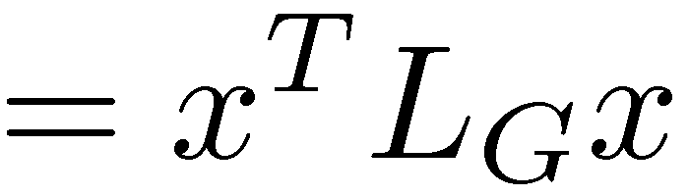
Spectral Sparsification [S-Teng]
Approximate any (weighted) graph by a
sparse weighted graph.
Graph Laplacian

Slide 4
Laplacian Quadratic Form, examples
All edge-weights are 1

Slide 5
Laplacian Quadratic Form, examples
All edge-weights are 1
Sum of squares of differences across edges

Slide 6
Laplacian Quadratic Form, examples
All edge-weights are 1
Sum of squares of differences across edges

Slide 7
Laplacian Quadratic Form, examples
When x is the characteristic vector of a set S,
sum the weights of edges on the boundary of S
S

Slide 8
Laplacian Matrices
E.g.

Slide 9
Laplacian Matrices
Sum of outer
products
where

Slide 10
Laplacian Matrices
Positive semidefinite
If connected, nullspace = Span(1)

Slide 11
Inequalities on Graphs and Matrices
For matrices and
if
for all
For graphs and
if

Slide 12
Inequalities on Graphs and Matrices
For matrices and
if
for all
For graphs and
if
if

Slide 13
Approximations of Graphs and Matrices
if
For graphs and
if

Slide 14
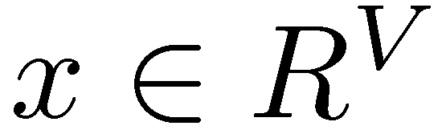
Approximations of Graphs and Matrices
if
For graphs and
if
That is, for all

Slide 15
Implications of Approximation
L_{H} and L_{G} have similar eigenvalues
Boundaries of sets are similar.
Solutions to systems of linear equations are similar.

Slide 16
Spectral Sparsification [S-Teng]
For an input graph G with n vertices,
find a sparse graph H having edges
so that

Slide 17
Approximations of Complete Graphs are Expanders
Expanders:
d-regular graphs on n vertices (n grows, d fixed)
every set of vertices has large boundary
random walks mix quickly
incredibly useful

Slide 18
Approximations of Complete Graphs are Expanders
Expanders:
d-regular graphs on n vertices (n grows, d fixed)
weak expanders: eigenvalues bounded from 0
strong expanders: all eigenvalues near d

Slide 19
Example: Approximating a Complete Graph
For G the complete graph on n vertices
all non-zero eigenvalues of L_{G} are n.
For ,

Slide 20
Example: Approximating a Complete Graph
For G the complete graph on n vertices
all non-zero eigenvalues of L_{G} are n.
For ,
For H a d-regular strong expander,
all non-zero eigenvalues of L_{H} are close to d.
For ,

Slide 21
Example: Approximating a Complete Graph
For G the complete graph on n vertices
all non-zero eigenvalues of L_{G} are n.
For ,
For H a d-regular strong expander,
all non-zero eigenvalues of L_{H} are close to d.
For ,
is a good approximation of

Slide 22
Best Approximations of Complete Graphs
Ramanujan Expanders
[Margulis, Lubotzky-Phillips-Sarnak]

Slide 23
Best Approximations of Complete Graphs
Ramanujan Expanders
[Margulis, Lubotzky-Phillips-Sarnak]
Cannot do better if n grows while d is fixed
[Alon-Boppana]

Slide 24
Best Approximations of Complete Graphs
Ramanujan Expanders
[Margulis, Lubotzky-Phillips-Sarnak]
Can we approximate every graph this well?

Slide 25
Main Theorem for Graphs
For every , there is a s.t.
and

Slide 26
Main Theorem for Graphs
For every , there is a s.t.
and
Within a factor of 2 of the Ramanujan bound

Slide 27
Matrix Sparsification

Slide 28
Matrix Sparsification

Slide 29
Matrix Sparsification

Slide 30
Main Theorem (Batson-S-Srivastava)
For , there exist so that for
and
at most are non-zero

Slide 31
Simplification of Matrix Sparsification
is equivalent to

Slide 32
Simplification of Matrix Sparsification
Set
“Decomposition of the identity”

Slide 33
Simplification of Matrix Sparsification
Set
We need

Slide 34
Simplification of Matrix Sparsification
Set
We need
Kadison-Singer all non-zero same

Slide 35
Simplification of Matrix Sparsification
Set
We need
Plan: build set of vectors one-by-one

Slide 36

What happens when we add a vector?
Notes:
So the starting point for this work is the question what happens to the eigenvalues of a matrix when I add a rank one matrix to it?
The answer is well known.
Suppose I start with a matrix A whose eigenvalues \lambda(A) are as follows.

Slide 37
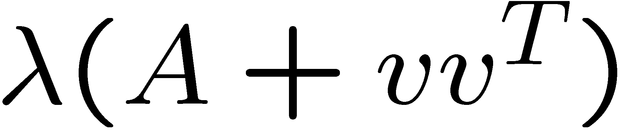
Interlacing
Notes:
If I add a vector v, that is, I take A+vv^T, then the eigenvalues shift forward in a way such that they interlace the old eigenvalues.

Slide 38
More precisely
Characteristic Polynomial:
Notes:
By applying the rank-one update formula for the determinant, we get that the characteristic poly of A+vv^T is just the old characteristic poly times this quantity, which depends on the projections of the new vector onto the eigenvectors.

Slide 39
More precisely
Characteristic Polynomial:
Rank-one update:
Where
Notes:
By applying the rank-one update formula for the determinant, we get that the characteristic poly of A+vv^T is just the old characteristic poly times this quantity, which depends on the projections of the new vector onto the eigenvectors.

Slide 40
Adding a random
Because are decomposition of identity,
Notes:
By applying the rank-one update formula for the determinant, we get that the characteristic poly of A+vv^T is just the old characteristic poly times this quantity, which depends on the projections of the new vector onto the eigenvectors.

Slide 41
Many random
Notes:
By applying the rank-one update formula for the determinant, we get that the characteristic poly of A+vv^T is just the old characteristic poly times this quantity, which depends on the projections of the new vector onto the eigenvectors.

Slide 42
Many random
Is an associated Laguerre polynomial!
For ,
roots lie between and
Notes:
By applying the rank-one update formula for the determinant, we get that the characteristic poly of A+vv^T is just the old characteristic poly times this quantity, which depends on the projections of the new vector onto the eigenvectors.

Slide 43
The Expected Characteristic Polynomial
For ,
roots lie between and
Notes:
By applying the rank-one update formula for the determinant, we get that the characteristic poly of A+vv^T is just the old characteristic poly times this quantity, which depends on the projections of the new vector onto the eigenvectors.

Slide 44
The Expected Characteristic Polynomial
For ,
roots lie between and
But, in general*, the roots of the individual polynomials have nothing to do with the roots of the expected polynomial.
Notes:
By applying the rank-one update formula for the determinant, we get that the characteristic poly of A+vv^T is just the old characteristic poly times this quantity, which depends on the projections of the new vector onto the eigenvectors.

Slide 45
The Expected Characteristic Polynomial
For ,
roots lie between and
But, in general*, the roots of the individual polynomials have nothing to do with the roots of the expected polynomial.
* In the next two lectures, they do.
Notes:
By applying the rank-one update formula for the determinant, we get that the characteristic poly of A+vv^T is just the old characteristic poly times this quantity, which depends on the projections of the new vector onto the eigenvectors.

Slide 46
Matrix Sparsification Proof Sketch
Have
Want
Will do with
All eigenvalues between 1 and 13,

Slide 47

Broad outline: moving barriers
-n
0
n
Notes:
Ok, so we’re going to get a little more aggressive now in moving our eigenvalues along.
Let’s consider a process where we start with the zero matrix and add one vector at each step.

Slide 48
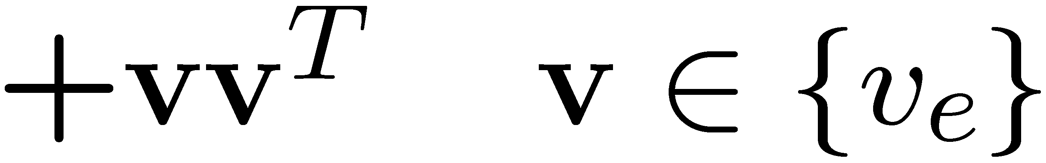
Step 1
-n
0
n
Notes:
We will also maintain two real numbers which we will treat as fences or barriers, and we will make sure that the eigenvalues of our matrix always lie between the barriers.

Slide 49

Step 1
-n
0
n
-n
0
n
Notes:
This process will evolve as follows.
We have a matrix between the barriers. We find a vector to add. This shifts the eigenvalues.

Slide 50
Step 1
-n
0
n
+1/3
+2
0
n+2
-n+1/3
Notes:
And we shift the barriers by constants ½ and 2.
I

Slide 51
Step 1
0
looser constraint
-n
n
tighter constraint
+1/3
+2
0
n+2
-n+1/3
Notes:
And we shift the barriers by constants ½ and 2.
I

Slide 52

Step i+1
0
Notes:
If we can prove that we can always do these things simultaneously we are done, since we will just repeat this for 6n steps

Slide 53
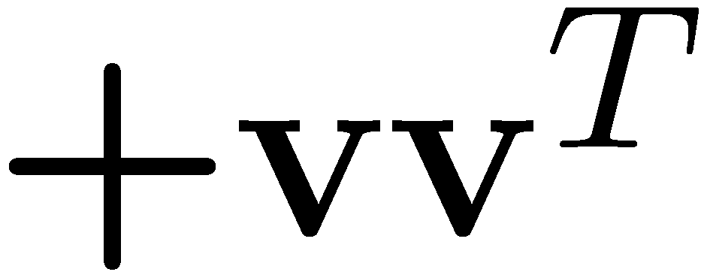
Step i+1
+1/3
+2
0
Notes:
Each time marching the barriers forward

Slide 54
Step i+1
0

Slide 55
Step i+1
+1/3
+2
0

Slide 56
Step i+1
0

Slide 57
Step i+1
+1/3
+2
0

Slide 58
Step i+1
0

Slide 59
Step i+1
0

Slide 60
Step i+1
0

Slide 61
Step i+1
0

Slide 62
Step 6n
0
…
n
13n
Notes:
And eventually after 6n steps the lower barrier will be at n nad the larger at 13n, whose ratio is 13.

Slide 63
Step 6n
0
…
n
13n
2.6-approximation with 6n vectors.
Notes:
Ok, and that will finish the proof.

Slide 64
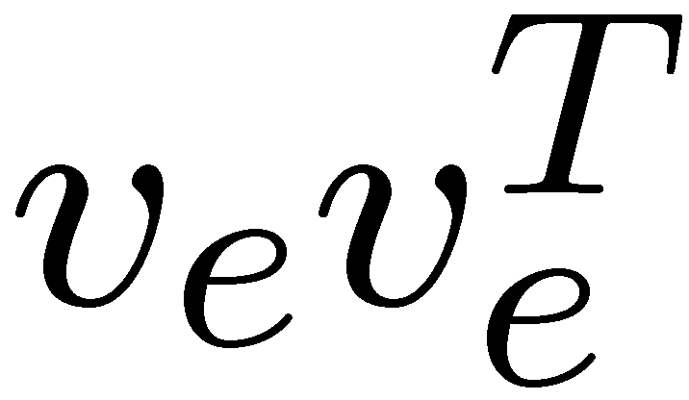
Problem
need to show that an appropriate
always exists.
Notes:
The only thing we need to do in this proof is prove the induction hypothesis. If I have a matrix whose eigs are between the barriers, then an appropriate vectors always exists.

Slide 65
Problem
need to show that an appropriate
always exists.
Is not strong enough for induction
Notes:
The only thing we need to do in this proof is prove the induction hypothesis. If I have a matrix whose eigs are between the barriers, then an appropriate vectors always exists.

Slide 66
Problems
If many small eigenvalues, can only move one
Bunched large eigenvalues
repel the highest one
Notes:
The only thing we need to do in this proof is prove the induction hypothesis. If I have a matrix whose eigs are between the barriers, then an appropriate vectors always exists.

Slide 67

The Lower Barrier Potential Function

Slide 68
The Lower Barrier Potential Function

Slide 69
The Lower Barrier Potential Function
No λ_{i} within dist. 1
No 2 λ_{i} within dist. 2
No 3 λ_{i} within dist. 3
.
.
No k λ_{i} within dist. k

Slide 70

The Upper Barrier Potential Function

Slide 71
The Beginning
-n
0
n

Slide 72
The Beginning
-n
0
n

Slide 73
Step i+1
0

Slide 74
Step i+1
+1/3
+2
0
Lemma.
can always choose
so that potentials do not increase

Slide 75
Step i+1
0

Slide 76
Step i+1
0

Slide 77
Step i+1
0

Slide 78
Step i+1
0

Slide 79
Step 6n
0
…
n
13n

Slide 80
Step 6n
0
…
n
13n
2.6-approximation with 6n vectors.

Slide 81
Goal
Lemma.
can always choose
so that potentials do not increase
+1/3
+2

Slide 82
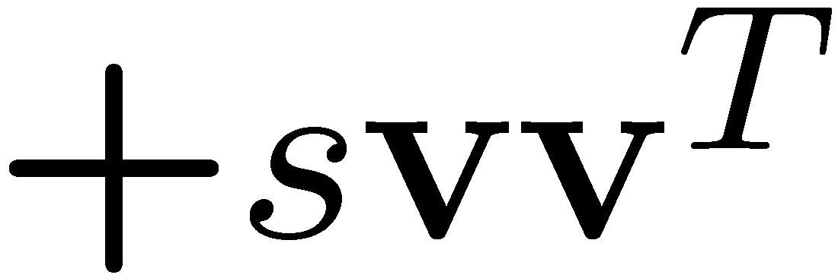

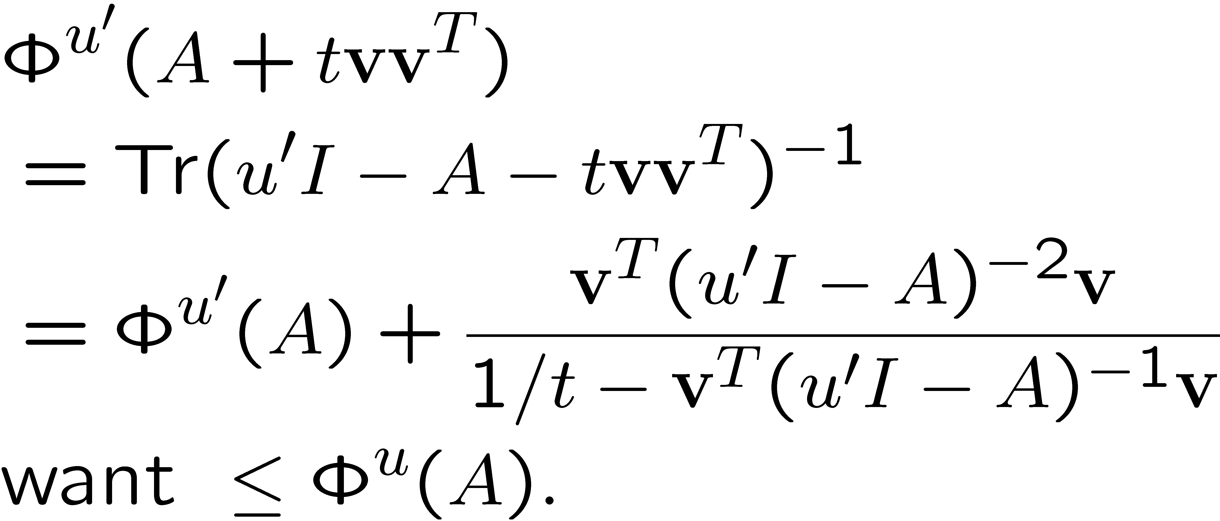
Upper Barrier Update
+2
Add and set

Slide 83
Upper Barrier Update
+2
Add and set

Slide 84
Upper Barrier Update
+2
Add and set
By Sherman-Morrison Formula

Slide 85
Upper Barrier Update
+2
Add and set
Need

Slide 86
How much of can we add?
Rearranging:
iff

Slide 87
How much of can we add?
Rearranging:
iff
Write as

Slide 88
Lower Barrier
Similarly:
iff
Write as

Slide 89
Goal
Show that we can always add some vector while respecting both barriers.
+1/3
+2
Need:

Slide 90
Two expectations
Need:
Can show:

Slide 91
Two expectations
Need:
Can show:
So:
And, exists

Slide 92
Two expectations
Need:
Can show:
So:
And, exists
And that puts between them

Slide 93
Two expectations
Need:
Can show:
So:
And, exists
And that puts between them

Slide 94
Bounding expectations

Slide 95
Bounding expectations
As barrier function is
monotone decreasing

Slide 96
Bounding expectations
Numerator is derivative
of barrier function.
As barrier function is convex,

Slide 97
Bounding expectations
“Similarly”,

Slide 98
Step i+1
+1/3
+2
0
Lemma.
can always choose
so that potentials do not increase

Slide 99

Twice-Ramanujan Sparsifiers
Fixing steps and tightening parameters gives ratio
Less than twice as many edges as used by Ramanujan Expander of same quality

Slide 100
Open Questions
Ramanujan sparsifiers?
Properties of vectors from graphs?
Faster algorithm
union of random Hamiltonian cycles?

Slide 101
What’s next
Exploit expected characteristic polynomials
Kadison-Singer
Ramanujan Graphs of every degree

