Slide 1
How to Keep your Secrets in a Post-Quantum World? WAM: Uhlenbeck Lectures
Kristin Lauter
Microsoft Research

Slide 2
Course Goals
Goal: Convey context and status of
Post-Quantum Cryptography (PQC)
What is PQC?
Current Proposals for PQC
Familiarity with algorithms and running times
Introduce Supersingular Isogeny Graphs (SIG)
Introduce Ring-Learning With Errors (RLWE)

Slide 3
Course Outline
Day 1: Supersingular Isogeny Graphs—definitions and applications
Day 2: Hard Problems—number theory attacks
Day 3: RLWE—motivation and definition of schemes
Day 4: Attacks on Ring-LWE for special rings.

Slide 4
Cryptography:
The science of keeping secrets!
But more than that…
Confidentiality
Authenticity
Tools:
Encryption/Decryption
Digital signatures
Key exchange

Slide 5
Public Key Cryptography
Key exchange: two parties agree on a common secret using only publicly exchanged information
Signature schemes: allows parties to authenticate themselves
Encryption: preserve confidentiality of data
Examples of public key cryptosystems:
RSA, Diffie-Hellman, ECDH, DSA, ECDSA

Slide 6
Public Key Cryptography:
Each party has a *publicly available* key
Public key encryption
Publicly verifiable signatures
Public Key Exchange
Security of systems in based on some hard math problem:
Factoring large integers (RSA)
Discrete logarithm problem in (Z/pZ)* (DLP)
Elliptic curve groups (ECC):
Discrete logarithm problem (ECDLP)
Weil pairing on elliptic curves

Slide 7
Applications:
Secure browser sessions (https: SSL/TLS)
Signed, encrypted email (S/MIME)
Virtual private networking (IPSec)
Authentication (X.509 certificates)

Slide 8
Quantum Computers!
1980-82-85: Idea introduced by Benioff, Manin, Feynman, Deutsch
1994 Shor's poly time quantum algorithm for factoring
2001 factorization of 15 using a 7-qubit NMR computer.
2011 researchers factored 143 using 4 qubits
2016: Station Q, Microsoft Research, Quantum Compiler, LiQuiD

Slide 9
Quantum Arithmetic
Basic arithmetic is different
Requires quantum circuits consisting of quantum gates
Quantum logic gates are represented by unitary matrices
Dependent on architecture design

Slide 10
Polynomial time Quantum algorithms
m = # bits
Shor’s algorithm for factoring 4m³ time and 2m qbits
ECC attack requires 360m³ time and 6m qbits
(Proos-Zalka, 2004)
Conclusion:
RSA: m = 2048
Discrete log m = 2048
Elliptic Curve Cryptography m = 256 or 384
Are not resistant to quantum attacks once a quantum computer exists at scale!

Slide 11
Timeline for ECC
(2006) Suite B set requirements for the use of Elliptic Curve Cryptography
(2016) CNSA requirements increase the minimum bit-length for ECC from 256 to 384. Advises that adoption of ECC not required.
(2017) NIST international competition to select post-quantum solutions: PQC Competition

Slide 12
Post-quantum cryptography
Code-based cryptography (McEliece 1978)
Multivariate cryptographic systems (Matsumoto-Imai,1988)
Hash-based cryptosystems (Merkle, 1989)
Lattice-based cryptography (Hoffstein-Pipher-Silverman, NTRU 1996)
Supersingular Isogeny Graphs (Charles-Goren-Lauter 2006)
Challenge! Need to see if these new systems are resistant to *both* classical and quantum algorithms!

Slide 13
Supersingular Isogeny Graphs
New hard problem introduced in 2006: [Charles-Goren-Lauter]
Finding paths between nodes in a Supersingular Isogeny Graph
Graphs: G = (V, E) = (vertices, edges)
k-regular, undirected graphs, with optimal expansion
No known efficient routing algorithm

Slide 14
Hash functions
A hash function maps bit strings of some finite length to bit strings of some fixed finite length
h : {0,1}^{n} → {0,1}^{m}
easy to compute
unkeyed (do not require a secret key to compute output)
Collision resistant
Uniformly distributed output

Slide 15
Cryptographic Hash functions: Practical applications
Security of most cryptographic protocols
Password verification
Integrity check of received content
Signed hashes
Encryption protocols
Message digest
Microsoft source code (720 uses of MD5)

Slide 16
Collision-resistance
A hash function h is collision resistant if it is computationally infeasible to find two distinct inputs, x, y, which hash to the same output h(x) = h(y).
A hash function h is preimage resistant if, given any output of h, it is computationally infeasible to find an input, x, which hashes to that output.

Slide 17
Application: cryptographic hash function [CGL’06]
k-regular graph G
Each vertex in the graph has a label
Input: a bit string
Bit string is divided into blocks
Each block used to determine which edge to follow for the next step in the graph
No backtracking allowed!
Output: label of the final vertex of the walk

Slide 18
Simple idea
Random walks on expander graphs are a good source of pseudo-randomness
Are there graphs such that finding collisions is hard? (i.e. finding distinct paths between vertices is hard)
Bad idea: hypercube (routing is easy, can be read off from the labels)

Slide 19
What kind of graph to use?
Random walks on expander graphs mix rapidly: ~log(p) steps to a random vertex, p ~ #vertices
Ramanujan graphs are optimal expanders
To find a collision: find two distinct walks of the same length which end at same vertex

Slide 20
Walk on a graph: 110
1
1
0
1
0
0
0
1
1
0

Slide 21
Colliding walks: 1100 and 1011
1
1
0
1
0
0
0
1
1
0
0
1

Slide 22
Graph of supersingular elliptic curves modulo p with isogeny edges (Pizer graphs)
Vertices: supersingular elliptic curves mod p
Curves are defined over GF(p²) (or GF(p))
Labeled by j-invariants
E₁ : y² = x³ + ax + b
j(E₁)= 1728*4a³/(4a³+27b²)
Edges: Isogenies between elliptic curves

Slide 23
Need to define:
Elliptic curve
Supersingular
Isogeny
J-invariant
Lots of deep and beautiful theorems in number theory describe the properties of these graphs…
Supersingular is key:
Graph is Ramanujan (Eichler, Shimura)
Size, regularity of the graph
Undirected if we assume p == 1 mod 12

Slide 24
Graph of supersingular elliptic curves modulo p (Pizer)
Vertices: supersingular elliptic curves mod p
# vertices ~ p/12
p ~ 2²⁵⁶
Curves are defined over GF(p²)
Labeled by j-invariants
Edges: degree ℓ isogenies between them
k = ℓ+1 – regular

Slide 25
Isogenies
The degree of a separable isogeny is the size of its kernel
To construct an ℓ -isogeny from an elliptic curve E to another, take a subgroup-scheme C of size ℓ, and take the quotient E/C.
Formula for the isogeny and equation for E/C were given by Velu.

Slide 26
One step of the walk: (ℓ=2)
E₁ : y² = x³ +ax+b
j(E₁)=1728*4a³/(a³+27b²)
2-torsion point Q = (r, 0)
E₂ = E₁ /Q (quotient of groups)
E₂ : y² = x³ − (4a + 15r²)x + (8b − 14r³).
E₁ → E₂
(x, y) → (x +(3r² + a)/(x-r), y − (3r² + a)y/(x-r)²)

Slide 27
Science magazine 2008

Slide 28
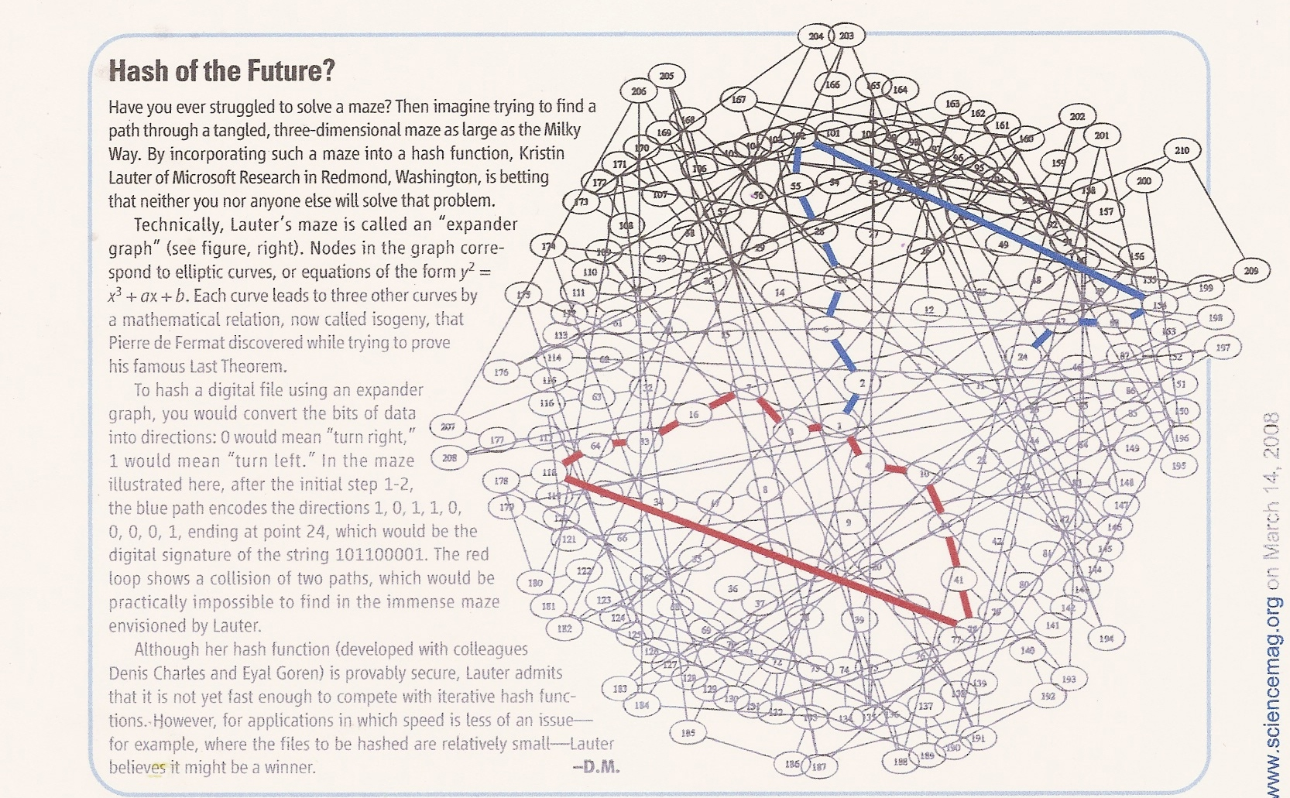

Slide 29
History
Charles-Goren-Lauter presented at NIST 2005 competition, IACR eprint 2006, published J Crypto 2009
Later in 2006, two papers on eprint, never published:
Couveignes, ordinary case (Hard Homogeneous Spaces)
Rostovtsev-Stolbunov, ordinary case (Encryption)
Ordinary case is very different for many reasons:
Volcanoe structure of graph
Action of an abelian class group
Known subexponential classical algorithms to attack

Slide 30
Back-up slides

Slide 31
RSA cryptosystems (~1975)
Security based on hardness of factoring n=p*q
φ(n) = φ(p)φ(q) = (p − 1)(q − 1) = n - (p + q -1)
Choose an integer e such that gcd(e, φ(n)) = 1
Determine d as d ≡ e⁻¹ (mod φ(n));
Public key (n, e)
Private key (n,d)
p, q, and φ(n) secret
(because they can be used to calculate d)
Encryption
Decryption

Slide 32
Diffie-Hellman Key Exchange
Given a cyclic group G generated by g
Alice picks random a
Alice sends gª
Secret :
g ^{ab =} (g ^{b}) ª = (g ª) ^{b}
Bob picks random b
Bob sends g^{b}

Slide 33
Elliptic Curve Cryptography
Elliptic Curve Cryptography (ECC) is an alternative to RSA and Diffie-Hellman, primarily signatures and key exchange
Proposed in 1985 (vs. 1975 for RSA) by Koblitz and Miller
Security is based on a hard mathematical problem different than factoring ECDLP
ECC 25th anniversary conference October 2010 hosted at MSR Redmond
Pairing-based cryptography currently entirely on pairings on elliptic curves

Slide 34
Elliptic CURVE Groups
Group of points (x, y) on an elliptic curve,
y ² = x ³ + a x + b,
Over a field of minimum size: 256-bits
(short Weierstrass form, characteristic not 2 or 3)
Identity in the group is the “point at infinity”
Group law computed via “chord and tangent method”

Slide 35
Group Law on an Elliptic Curve
R₁
Q₂
Q₁
−R₁
Q₁ + Q₂ = −R₁

Slide 36
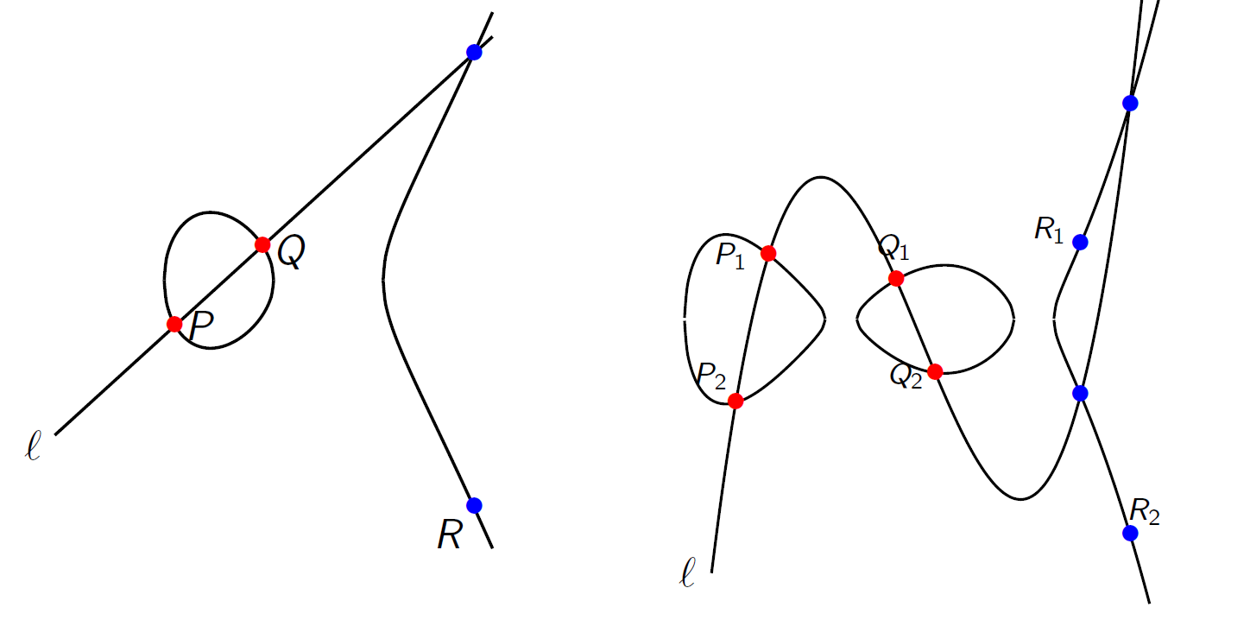
Genus 2 Jacobians
$$y^{2}=x^{3}+a_{2}x^{2}+a_{1}x+a_{0}$$
$$y^{2}=x^{5}+a_{4}x^{4}+a_{3}x^{3}+a_{2}x^{2}+a_{1}x+a_{0}$$
How to add pairs of points?
$$\#E\left(F_{p}\right)≈p \#Jac_{C}\left(F_{p}\right)≈p^{2}$$

Slide 37
RSA Security
Security based on hardness of factoring n=p*q
p and q have equal size
Otherwise: Elliptic curve factoring method finds factors in time proportional to the size of the factor (H. Lenstra, `85)
Quadratic Sieve (Fermat, Kraitchik, Lehmer-Powers, Pomerance)
Number field sieve (NFS) runs in subexponential time
O(e^{c (log n)^1/3 (log log n)^2/3})
c=1.526… Special NFS;
c=1.92… General NFS
Pollard `88, Lenstra-Lenstra-Manasse `90, Coppersmith `93,

Slide 38
Discrete logarithm problem in (Z/pZ)*
Square-root algorithms:
Baby-Step-Giant-Step (Shanks `71)
Pollard rho (Pollard, `78)
Pohlig-Hellman, `78
Subexponential:
Index calculus (Adleman, `79)
Recent significant breakthroughs, improving the exponent in subexponential algorithms for DLP to ¼ for small characteristic:
Function Field Sieve (Joux 2013)

Slide 39
Elliptic Curve Cryptography
Menezes–Okamoto–Vanstone (MOV) attack `93:
supersingular elliptic curves
Semaev, Satoh, Smart `98-`99 (Trace 1)
Generic square-root algorithms:
Baby-Step Giant-Step, Pollard's rho
No generic, classical sub-exponential algorithm known

