Slide 1
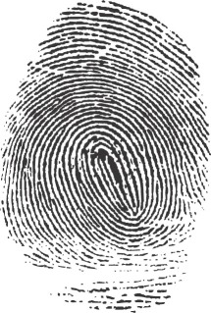
Dusting for Fingerprints in Private Data
Jonathan Ullman, Northeastern University

Slide 2
This talk
tracing attacks: privacy breaches beyond re-identification
a counterpoint to the previous two talks: the limits of privacy in high-dimensional datasets
a positive note: DP matches the limits imposed by tracing attacks

Slide 3
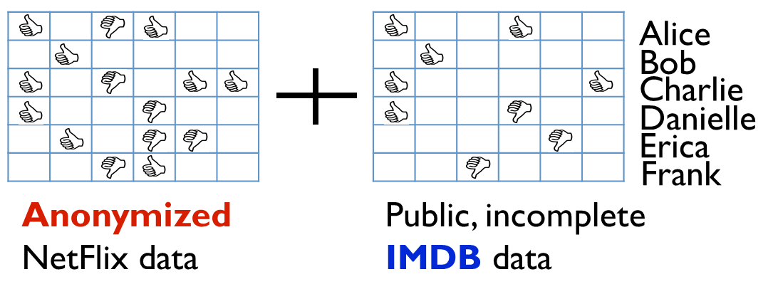
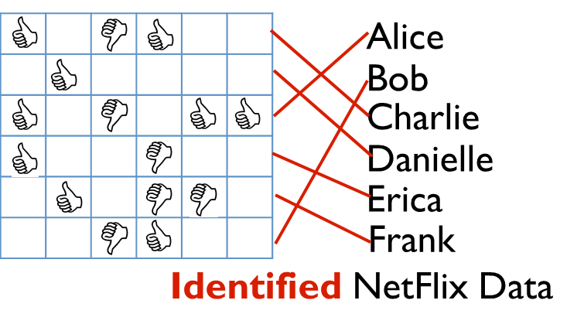
The usual story: re-identification attacks
Anonymized data can invariably be re-identification by linking PII with external sources of information.
well-known example: Netflix challenge [Narayanan, Shmatikov ’08]
“Anonymization is increasingly easily defeated by the very techniques that are being developed for many legitimate applications of big data.”
-PCAST Report on Big Data and Privacy
“De-identified data isn’t.”
-Cynthia Dwork

Slide 4
A surprise: reconstruction attacks
The entire dataset can be reconstructed given “too many”, “overly accurate”, statistics on the dataset [Dinur, Nissim, ’03]
1.0 | 0.6 | 0.8 | 0.1 | 0.2 | 0.5
0.4 | 1.0 | 0.3 | 0.2 | 0.8 | 0.7
Reconstructed NetFlix Data
Extremely simple statistics like:
How many people like Napolean Dynamite?
Is liking this movie predictive of liking Napoleon Dynamite?
Is this a good clustering of movies based on tastes?

Slide 5
Today: tracing attacks on aggregated data
[Homer et al.’08]: determining membership in genomic datasets using only frequencies of certain alleles
Given genomic information about an individual, an attacker can detect if that individual is in the case group or control group
Led NIH to change policy on access to data from studies they fund
Sensitive info was leaked, even though no PII was made available and no one was re-identified!
case group statistics
control group statistics

Slide 6
Today: tracing attacks on aggregated data
Individual data leaves a fingerprint in aggregate statistics that can be traced to an individual
Our work: robust tracing attacks [DSSUV’15]
Extremely tolerant to noise in the released statistics
Very mild assumptions, very little external information
Techniques inspired by fingerprinting codes [BS’98, T’03, BUV’14].
Differential privacy comes at very little cost beyond the limits imposed by tracing attacks

Slide 7
Roadmap
A model for tracing attacks
releasing the mean
the attacker’s resources and objective
Results
statements
the inner product attack
snapshots of the analysis
a demonstration of the tightness of DP
Extensions
selecting significant statistics

Slide 8
Featured Players
$$+1$$
$$+1$$
$$−1$$
Dataset
$$X∈\{±1\}^{n×d}$$
$$.31$$
Noisy mean $\hat{q}\left(X\right)≈q$
$$.33$$
Dataset mean $q=\frac{1}{n}\sum{x_{i}}$
Two Goals: 1) Preserve privacy of individual rows of $X$.
2) $\hat{q}$ accurately estimates the mean of the dataset $q$.

Slide 9
Tracing Attacks
$$IN/OUT$$
Population mean $p=𝔼_{x∼P}[x]$
Product dist. $P$ over $\{±1\}^{d}$
$$.30$$
Target individual $t∈\{±1\}^{d}$
$$P$$
$$−1$$
Attacker
$P$ can be anything within some class of distributions
$$+1$$
$$+1$$
$$−1$$
Dataset
$$X∈\{±1\}^{n×d}$$
$$.31$$
Noisy mean $\hat{q}\left(X\right)≈q$
$$.33$$
No PII, no one to re-identify!
Dataset mean $q=\frac{1}{n}\sum{x_{i}}$
The attacker is given a targeted individual $t$, statistics $\hat{q}$, population $p$:
IN: $t$ is a random member of the dataset $X$
OUT: $t$ is a random member of the same population $X$ was drawn from.
Goal: Determine whether $t$ is IN or OUT.

Slide 10
Tracing Attacks: Exact Statistics
$$IN/OUT$$
Population mean $p=𝔼_{x∼P}[x]$
Product dist. $P$ over $\{±1\}^{d}$
$$.30$$
Target individual $t∈\{±1\}^{d}$
$$P$$
$$−1$$
Attacker
$P$ can be anything within some class of distributions
$$+1$$
$$+1$$
$$−1$$
Dataset
$$X∈\{±1\}^{n×d}$$
$$.33$$
Dataset mean $q=\frac{1}{n}\sum{x_{i}}$
Theorem [Homer+’08, SOHJ’09]: Given
the target’s data $t$
“exact” mean $q$ of a dataset with $d≳n$
the exact population mean $p$,
the attacker can determine if $t$ is in the dataset whp.*
*Unless $P$is “very biased.”

Slide 11
Noisy Means: Sampling Error
Population mean $p=𝔼_{x∼P}[x]$
Product dist. $P$ over $\{±1\}^{d}$
$$.30$$
$$P$$
There is already noise in the data!
$$+1$$
$$+1$$
$$−1$$
Dataset
$$X∈\{±1\}^{n×d}$$
$$.33$$
Dataset mean $q=\frac{1}{n}\sum{x_{i}}$
$$\frac{1}{d}{\left\|q −p\right\|}_{1}≲\frac{1}{\sqrt{n}}$$
We know we need some noise for privacy, do we need noise larger than the sampling error?

Slide 12
Tracing Attacks: Exact Statistics
$$IN/OUT$$
Population mean $p=𝔼_{x∼P}[x]$
Product dist. $P$ over $\{±1\}^{d}$
$$.30$$
Target individual $t∈\{±1\}^{d}$
$$P$$
$$−1$$
Attacker
$P$ can be anything within some class of distributions
$$+1$$
$$+1$$
$$−1$$
Dataset
$$X∈\{±1\}^{n×d}$$
$$.33$$
Dataset mean $q=\frac{1}{n}\sum{x_{i}}$
Theorem [Homer+’08, SOHJ’09]: Given
the target’s data $t$
error-$o(1/\sqrt{n}$) mean $\hat{q}$ of a dataset with $d≳n$
the exact population mean $p$,
the attacker can determine if $t$ is in the dataset whp.*
*Unless $P$is “very biased.”

Slide 13
Noisy Means: DP
$\hat{q}=q+N\left(0, {\left(\frac{\sqrt{d}}{n}\right)}^{2}𝕀_{d}\right)$
$$+1$$
$$+1$$
$$−1$$
Dataset
$$X∈\{±1\}^{n×d}$$
$$.31$$
Noisy mean
$$\frac{1}{d}{\left\|\hat{q}\left(X\right)−q\right\|}_{1}≤\frac{\sqrt{d}}{n}$$
$$.33$$
Dataset mean $q=\frac{1}{n}\sum{x_{i}}$
Recall from Guy Rothblum’s talk:
Adding independent Gaussian noise to $q$ ensures both differential privacy and accuracy when $d≲n^{2}$.

Slide 14
Noisy Means: Subsampling
Sample $O(1)$ rows, take their mean
$$+1$$
$$+1$$
$$−1$$
Dataset
$$X∈\{±1\}^{n×d}$$
$$.31$$
Noisy mean
$${\frac{1}{d}\left\|\hat{q}\left(X\right)−q\right\|}_{1}≤\frac{1}{10}$$
$$.33$$
Dataset mean $q=\frac{1}{n}\sum{x_{i}}$
If we subsample $O\left(1\right)$ people in the dataset, we get error $\frac{1}{10}$ . Most people are fine, some people people lose everything!

Slide 15
Robust Tracing Attacks
$$IN/OUT$$
Reference sample $z∼P$
Product dist. $P$ over $\{±1\}^{d}$
$$+1$$
Target individual $t∈\{±1\}^{d}$
$$P$$
$$−1$$
Attacker
$$+1$$
$$+1$$
$$−1$$
Dataset
$$X∈\{±1\}^{n×d}$$
$$.31$$
Noisy mean
$${\frac{1}{d}\left\|\hat{q}\left(X\right)−q\right\|}_{1}≤\frac{1}{10}$$
“well-spread” dist. $μ$
over populations $P$
$$.33$$
Dataset mean $q=\frac{1}{n}\sum{x_{i}}$
Theorem [BUV’14, DSSUV’15]: Given
the target’s data $t$
extremely noisy mean $\hat{q}$ of a dataset with $d≳n^{2}$
one reference sample from the population,
the attacker can trace at least one target individual in $X$.
*Population mean $p$ is chosen from some “well-spread” distribution $μ$

Slide 16
Noisy Means: DP
Private if $d≪α^{2}n^{2}$
$\hat{q}=q+N\left(0, α^{2}𝕀_{d}\right)$
$$+1$$
$$+1$$
$$−1$$
Dataset
$$X∈\{±1\}^{n×d}$$
$$.31$$
Noisy mean
$${\frac{1}{d}\left\|\hat{q}\left(X\right)−q\right\|}_{1}≲α$$
$$.33$$
Dataset mean $q=\frac{1}{n}\sum{x_{i}}$
Recall from Guy Rothblum’s talk:
Adding independent Gaussian noise to $q$ ensures both differential privacy and $α$-accuracy when $d≲{α^{2}n}^{2}$.

Slide 17
Noisy Means: Subsampling
Sample $1/{α^{2}}$ rows, take their mean
$$+1$$
$$+1$$
$$−1$$
Dataset
$$X∈\{±1\}^{n×d}$$
$$.31$$
Noisy mean
$${\frac{1}{d}\left\|\hat{q}\left(X\right)−q\right\|}_{1}≤α$$
$$.33$$
Dataset mean $q=\frac{1}{n}\sum{x_{i}}$
If we subsample $1/{α^{2}}≪n$ people in the dataset, we get error $α$. Most people are fine, $1/{α^{2}}$ people lose everything.

Slide 18
Robust Tracing Attacks
$$IN/OUT$$
Reference samples $z_{1}…, z_{m}∼P$
Product dist. $P$ over $\{±1\}^{d}$
$$+1$$
Target individual $t∈\{±1\}^{d}$
$$P$$
$$−1$$
Attacker
$$+1$$
$$+1$$
$$−1$$
Dataset
$$X∈\{±1\}^{n×d}$$
$$.31$$
Noisy mean
$${\frac{1}{d}\left\|\hat{q}\left(X\right)−q\right\|}_{1}≤α$$
“well-spread” dist. $μ$
over populations $P$
$$.33$$
Dataset mean $q=\frac{1}{n}\sum{x_{i}}$
Theorem [BUV’14, DSSUV’15]: Given
the target’s data $t$
$α$-accurate mean $\hat{q}$ of a dataset with $d≳{α^{2}n}^{2}$
$Ω(1/{α^{2}})$ reference samples from the population,
the attacker can trace at least $Ω(1/{α^{2}})$ target individuals in $X$.
*Population mean $p$ is chosen from some “well-spread” distribution $μ$

Slide 19
Robust Tracing Attacks
$$IN/OUT$$
Reference sample $z∼P$
Product dist. $P$ over $\{±1\}^{d}$
$$+1$$
Target individual $t∈\{±1\}^{d}$
$$P$$
$$−1$$
Attacker
$$+1$$
$$+1$$
$$−1$$
Dataset
$$X∈\{±1\}^{n×d}$$
$$.31$$
Noisy mean
$${\frac{1}{d}\left\|\hat{q}\left(X\right)−q\right\|}_{1}≤\frac{1}{10}$$
“well-spread” dist. $μ$
over populations $P$
$$.33$$
Dataset mean $q=\frac{1}{n}\sum{x_{i}}$
Theorem [BUV’14, DSSUV’15]: Given
the target’s data $t$
extremely noisy mean $\hat{q}$ of a dataset with $d≳n^{2}$
one reference sample from the population,
the attacker can trace at least one target individual in $X$.
*Population mean $p$ is chosen from some “well-spread” distribution $μ$

Slide 20
The Inner Product Attack
Is the released mean significantly closer to the target or to a random member of the population?
correlation of noisy marginals with the target
correlation of noisy marginals with a random member of the population
$$A\left(t, \hat{q}, z\right)= \left\{\begin{aligned}IN \\ OUT\end{aligned}\right.$$
if$\left\langle t,\hat{q}\right\rangle − \left\langle z,\hat{q}\right\rangle ≥T$
otherwise
significance threshold
It’s so simple it fits on one slide in a rather large font

Slide 21
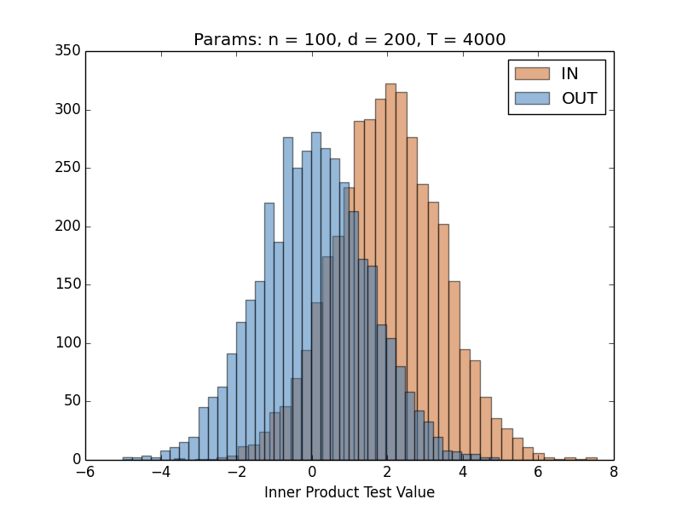
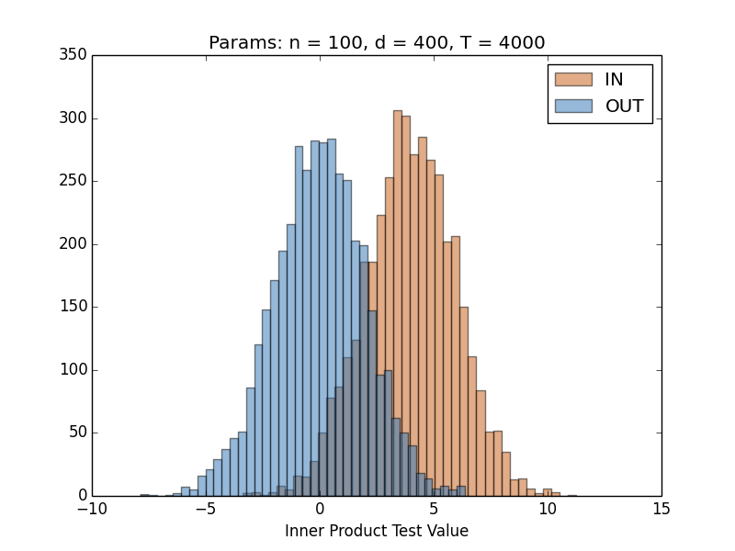
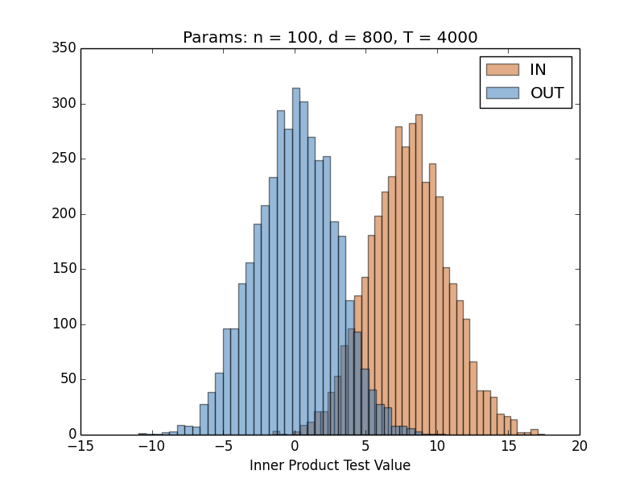
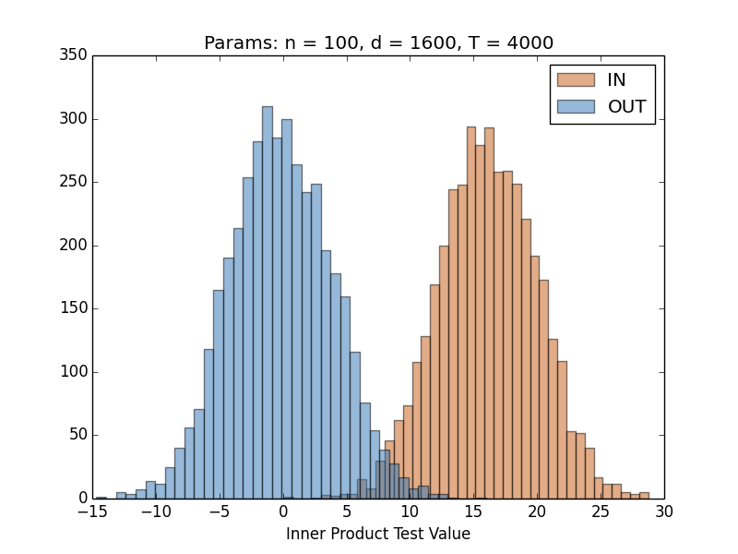
Demo: Exact Mean
Uniform data: $p=0$
Exact mean: $q=\frac{1}{n}∑x_{i}$
Dist. of $\left\langle t,q\right\rangle$ where $t∼X$ ($IN$)
Dist. of $\left\langle t,q\right\rangle$ where $t∼P$ ($OUT$)
Fixed $n=100$, varying $d$.
$$A\left(t, q, p\right)= \left\{\begin{aligned}IN \\ OUT\end{aligned}\right.$$
if$\left\langle t,q\right\rangle − \left\langle p,q\right\rangle ≥T≈\sqrt{{(d}/{n)}\log\left(1/δ\right)}$
otherwise

Slide 22
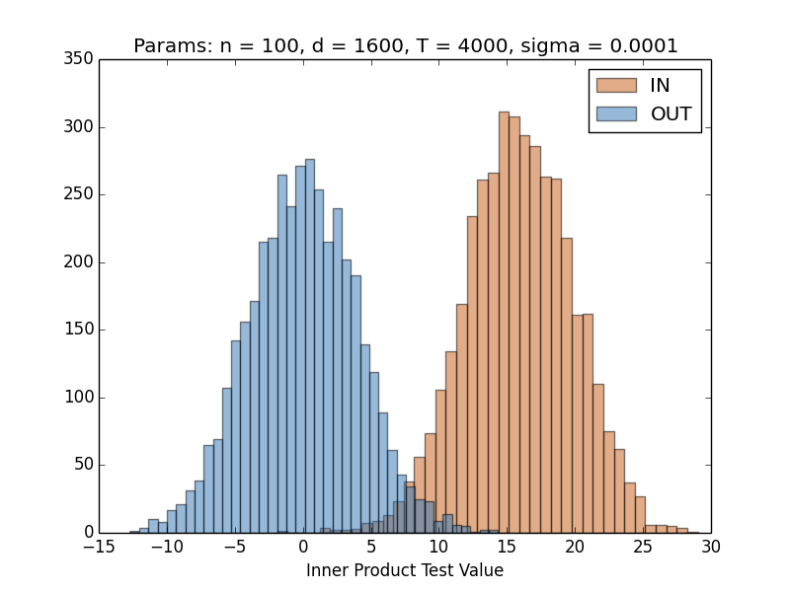
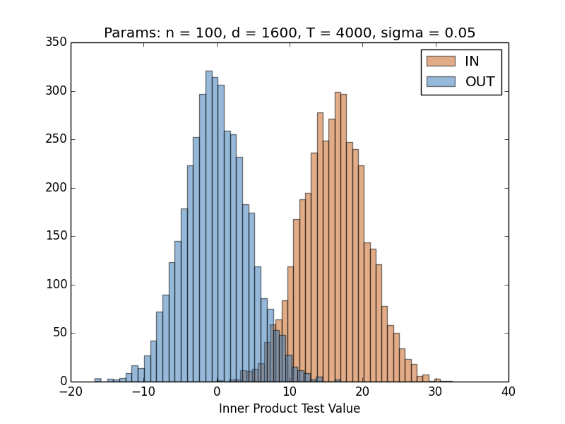
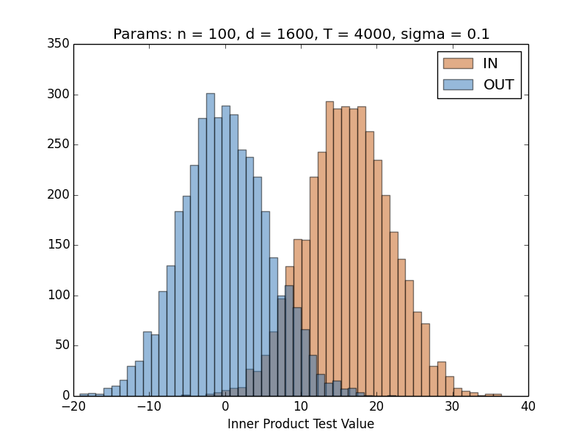
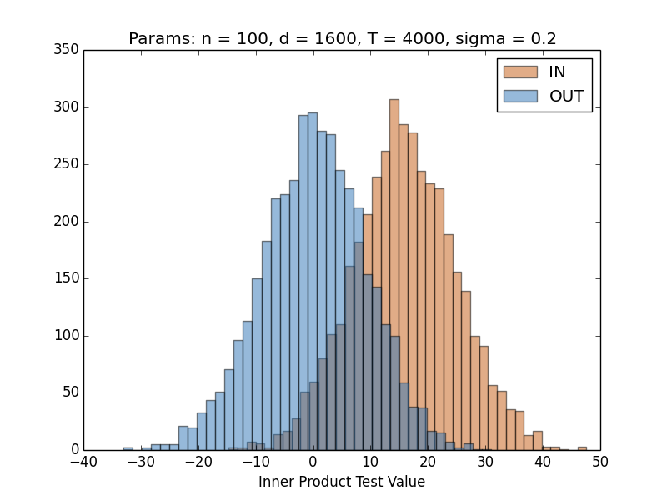
Demo: Gaussian Noise for DP
$$ε=∞$$
$$ε=8.0$$
Uniform data: $p=0$
Gaussian noise: $\hat{q}=q+N\left(0,σ^{2}\right)$
Dist. of $\left\langle t,q\right\rangle$ where $t∼X$ ($IN$)
Dist. of $\left\langle t,q\right\rangle$ where $t∼P$ ($OUT$)
$n=100, d=1600$, varying $σ$
Similar pictures for other types of noise, even those that don’t preserve dp.
$$ε=4.0$$
$$ε=2.0$$
$$A\left(t, \hat{q}, p\right)= \left\{\begin{aligned}IN \\ OUT\end{aligned}\right.$$
if$\left\langle t,\hat{q}\right\rangle − \left\langle p,\hat{q}\right\rangle ≥T$
otherwise

Slide 23
Analysis Overview: No Noise
$$IN/OUT$$
Population mean $p=𝔼_{x∼P}[x]$
Product dist. $P$ over $\{±1\}^{d}$
$$.30$$
Target individual $t∈\{±1\}^{d}$
$$P$$
$$−1$$
Attacker
$P$ can be anything within some class of distributions
$$+1$$
$$+1$$
$$−1$$
Dataset
$$X∈\{±1\}^{n×d}$$
$$.33$$
Dataset mean $q=\frac{1}{n}\sum{x_{i}}$
Theorem [Homer+’08, SOHJ’09]: Given
the target’s data $t$
exact mean $q$ of a dataset with $d≳n$
the exact population mean $p$,
the attacker can determine if $t$ is in the dataset whp.*
*Unless $P$is “very biased.”

Slide 24
Analysis Overview: No Noise
$$d/n$$
Uniform data: $p=0$
Exact mean: $q=\frac{1}{n}∑x_{i}$
Dist. of $\left\langle t,q\right\rangle$ where $t∼X$ ($IN$)
Dist. of $\left\langle t,q\right\rangle$ where $t∼P$ ($OUT$)
$$O\left(\sqrt{d/n}\right)$$
$$A\left(t, q, p\right)= \left\{\begin{aligned}IN \\ OUT\end{aligned}\right.$$
if$\left\langle t,q\right\rangle − \left\langle p,q\right\rangle ≥T≈\sqrt{{(d}/{n)}\log\left(1/δ\right)}$
otherwise

Slide 25
Analysis Overview: No Noise
Claim (“$OUT$ case”): $ℙ_{t,X}\left[A\left(t, q, p\right)=OUT\right]≥1−δ$
Proof:
$t$ is a sample from $P$, so $𝔼\left[t\right]=p$
For every fixed $X,$ $𝔼_{t}\left[\left\langle t,q\right\rangle \right]=\left\langle p,q\right\rangle$. So, $𝔼_{t,X}\left[\left\langle t,q\right\rangle −\left\langle p,q\right\rangle \right]=0$.
$\left\langle t,q\right\rangle$ is the sum of $d$ independent, bounded random variables.
By Hoeffding, $ℙ_{t,X}\left[\left\langle t,q\right\rangle −\left\langle p,q\right\rangle ≤\left.c\sqrt{\frac{d}{n}⋅\log\left(\frac{1}{δ}\right)}\right.\right]≥1−δ$
$$A\left(t, q, p\right)= \left\{\begin{aligned}IN \\ OUT\end{aligned}\right.$$
if$\left\langle t,q\right\rangle − \left\langle p,q\right\rangle ≥T≈\sqrt{{(d}/{n)}\log\left(1/δ\right)}$
otherwise

Slide 26
Analysis Overview: No Noise
Claim (“$IN$ case”): $ℙ_{t,X}\left[A\left(t, q, p\right)=IN\right]≥1−δ$
Proof: (Idea: focus on the case of $d=1$, then use linearity.)
The target is a random element of the dataset $X$, let $t=x_{j}$
When, $d=1, p=0$, $𝔼_{X}\left[tq −pq\right]$ = $𝔼_{X}\left[x_{j}⋅\frac{1}{n}∑x_{i}\right]$ = ${\frac{1}{n}𝔼}_{X}\left[x_{j}^{2}\right]$ = $\frac{1}{n}$
By linearity of expectation and Hoeffding,
$$ℙ_{t,X}\left[\left\langle t,q\right\rangle −\left\langle p,q\right\rangle ≥\frac{d}{n} −\left.c\sqrt{\frac{d}{n}⋅\log\left(\frac{1}{δ}\right)}\right.\right]≥1−δ$$
More generally, for $p≠0$, $𝔼_{X}\left[tq −pq\right]$ = $\frac{1−p^{2}}{n}$
We only need the dataset to have some variance.
$$A\left(t, q, p\right)= \left\{\begin{aligned}IN \\ OUT\end{aligned}\right.$$
if$\left\langle t,q\right\rangle − \left\langle p,q\right\rangle ≥T≈\sqrt{{(d}/{n)}\log\left(1/δ\right)}$
otherwise

Slide 27
Analysis Overview: Robust
$$IN/OUT$$
Reference sample $z∼P$
Product dist. $P$ over $\{±1\}^{d}$
$$+1$$
Target individual $t∈\{±1\}^{d}$
$$P$$
$$−1$$
Attacker
$$+1$$
$$+1$$
$$−1$$
Dataset
$$X∈\{±1\}^{n×d}$$
$$.31$$
Noisy mean
$${\frac{1}{d}\left\|\hat{q}\left(X\right)−q\right\|}_{1}≤\frac{1}{10}$$
“well-spread” dist. $μ$
over populations $P$
$$.33$$
Dataset mean $q=\frac{1}{n}\sum{x_{i}}$
Theorem [BUV’14, DSSUV’15]: Given
the target’s data $t$
extremely noisy mean $\hat{q}$ of a dataset with $d≳n^{2}$
one reference sample from the population,
the attacker can trace at least one target individual in $X$.
*Population mean $p$ is chosen from some “well-spread” distribution $μ$

Slide 28
Analysis Overview: Robust
Claim (“$OUT$ case”): $ℙ_{t,X, \hat{q},z}\left[A\left(t,\hat{q}, z\right)=OUT\right]≥1−δ$
Proof: Not much changes except the threshold.
$t,z$, are two independent samples from $p$, so $𝔼\left[t−z\right]=0$
For every fixed $\hat{q}$, $𝔼_{t,z}\left[\left\langle t−z,\hat{q}\right\rangle \right]=0$. Therefore, $𝔼_{t,X,\hat{q},z}\left[\left\langle t−z,\hat{q}\right\rangle \right]=0$.
$\left\langle t −z,q\right\rangle$ is the sum of $d$ independent, bounded random variables.
By Hoeffding, $ℙ_{t,X, \hat{q},z}\left[\left\langle t −z,q\right\rangle ≤O\left(\sqrt{d \log\left(1/δ\right)}\right)\right]≥1−δ$
$$A\left(t, \hat{q}, z\right)= \left\{\begin{aligned}IN \\ OUT\end{aligned}\right.$$
if$\left\langle t,\hat{q}\right\rangle − \left\langle z,\hat{q}\right\rangle ≥T≈\sqrt{d \log\left(1/δ\right)}$
otherwise

Slide 29
Analysis Overview: Robust
Claim (“$IN$ case”): $ℙ_{X,\hat{q},z}\left[∃ i∈\left[n\right], A\left(x_{i},\hat{q}, z\right)=IN\right]≥1−δ$
Proof:
$𝔼\left[〈x_{i},\hat{q}〉\right]$ can be large for some targets, we show $𝔼\left[\frac{1}{n}\sum_{i}{〈x_{i},\hat{q}〉}\right]$ is large.
Key Lemma [DSSUV’15, SU’15]: Either $\hat{q}$ correlates with a random target individual $t=x_{i}$ or else it has large (constant) error.
Let $p∼[±1]$, let $x=\left(x_{1},…,x_{n}\right)∼p$, let $q=\frac{1}{n}\sum_{i}{x_{i}}$ and $\hat{q}:\{±1\}^{n}→[±1]$ be any function
$$𝔼_{p,x,\hat{q}}\left[\frac{1}{n}\sum_{i}{x_{i}⋅\hat{q}\left(x\right)}\right]≥\frac{1}{3n} −\frac{2}{n}𝔼[|\hat{q}\left(x\right) −q|]$$
Proof via biased Fourier analysis
$$A\left(t, \hat{q}, z\right)= \left\{\begin{aligned}IN \\ OUT\end{aligned}\right.$$
if$\left\langle t,\hat{q}\right\rangle − \left\langle z,\hat{q}\right\rangle ≥T≈\sqrt{d \log\left(1/δ\right)}$
otherwise

Slide 30
Analysis Overview: Robust
$$IN/OUT$$
Reference sample $z∼P$
Product dist. $P$ over $\{±1\}^{d}$
$$+1$$
Target individual $t∈\{±1\}^{d}$
$$P$$
$$−1$$
Attacker
$$+1$$
$$+1$$
$$−1$$
Dataset
$$X∈\{±1\}^{n×d}$$
$$.31$$
Noisy mean
$${\frac{1}{d}\left\|\hat{q}\left(X\right)−q\right\|}_{1}≤α$$
“well-spread” dist. $μ$
over populations $P$
$$.33$$
Dataset mean $q=\frac{1}{n}\sum{x_{i}}$
Theorem [BUV’14, DSSUV’15]: Given
the target’s data $t$
$α$-accurate mean $\hat{q}$ of a dataset with $d≳{α^{2}n}^{2}$
one reference sample from the population,
the attacker can trace at least $Ω(1/{α^{2}})$ target individuals in $X$.
*Population mean $p$ is chosen from some “well-spread” distribution $μ$

Slide 31
This talk
tracing attacks: privacy breaches beyond re-identification
a counterpoint to the previous two talks: the price of privacy in high-dimensional datasets
a positive note: DP matches the limits imposed by tracing attacks
Conjecture: this phenomenon is extremely pervasive.

Slide 32
Extension: Variable Selection
What if we only get the largest $k$ entries of the mean?
E.g. selecting statistically significant variables
Can release a DP approximation with error $o\left(\frac{1}{\sqrt{n}}\right)$ if $n ≳k\log\left(\frac{d}{k}\right)$
$$+1$$
$$+1$$
$$−1$$
Dataset
$$X∈\{±1\}^{n×d}$$
$$.31$$
“Noisy” top $k$ columns ${\hat{q}}_{k}$
(noise in selection and in value)
$$.33$$
Top $k$ most biased columns $q_{k}∈{\left[±1\right]}^{k}$

Slide 33
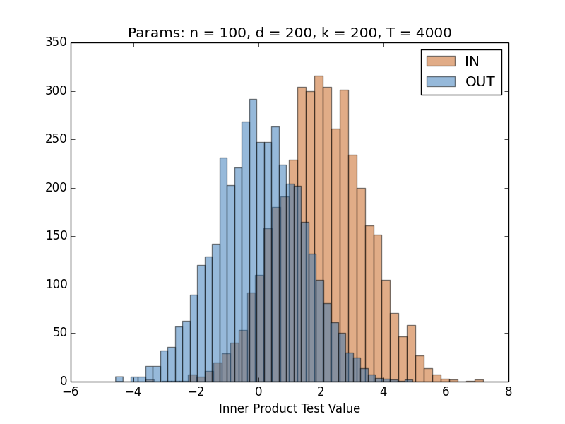
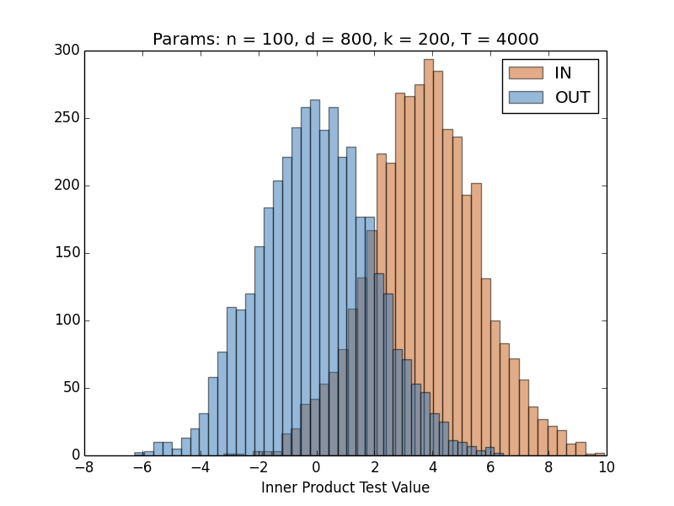
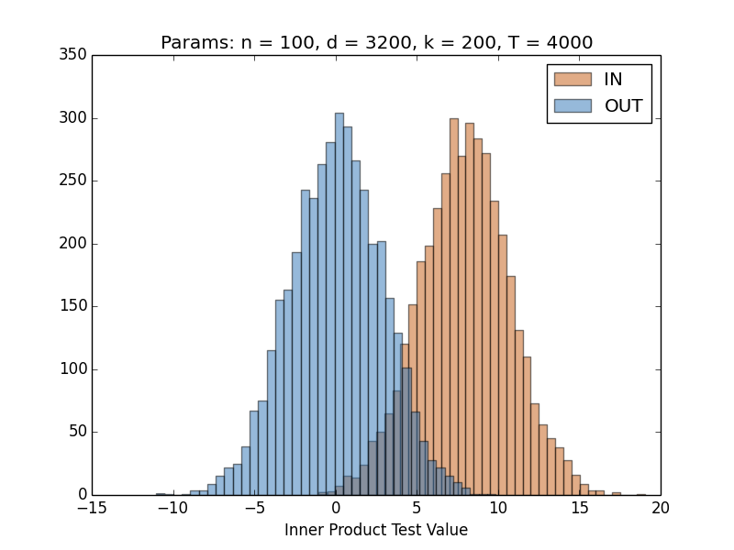
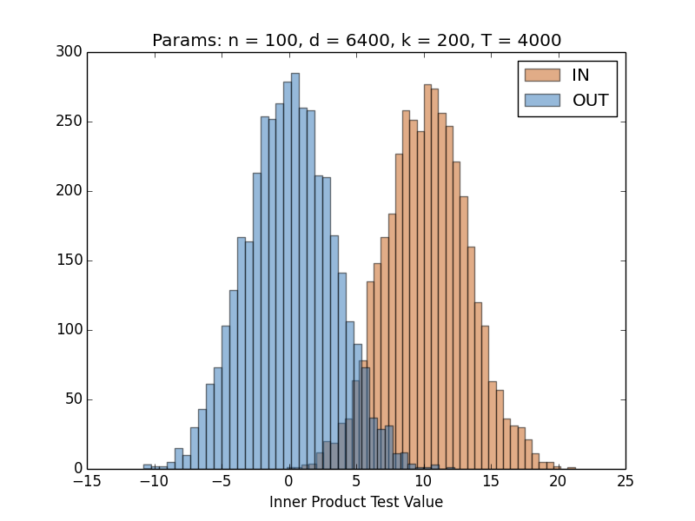
Demo: Variable Selection
$$d=200$$
$$d=800$$
Uniform data: $p=0$
No noise: $q$ = exact top-$k$
Dist. of $\left\langle t,q\right\rangle$ where $t∼X$ ($IN$)
Dist. of $\left\langle t,q\right\rangle$ where $t∼P$ ($OUT$)
$n=100, k=200$, varying $d$
$$d=3200$$
$$d=6400$$
$$A\left(t, \hat{q}, p\right)= \left\{\begin{aligned}IN \\ OUT\end{aligned}\right.$$
if$\left\langle t,\hat{q}\right\rangle − \left\langle p,\hat{q}\right\rangle ≥T$
otherwise

Slide 34
Extension: Variable Selection
What if we only get the largest $k$ entries of the mean?
E.g. selecting statistically significant variables
Can release a DP approximation with error $o\left(\frac{1}{\sqrt{n}}\right)$ if $n ≳k\log\left(\frac{d}{k}\right)$
$$+1$$
$$+1$$
$$−1$$
Dataset
$$X∈\{±1\}^{n×d}$$
$$.31$$
“Noisy” top $k$ columns ${\hat{q}}_{k}$
(noise in selection and in value)
$$.33$$
Top $k$ most biased columns $q_{k}∈{\left[±1\right]}^{k}$
Theorem (BU): Given
the target’s data $t$,
“slightly noisy” ${\hat{q}}_{k}$ of a dataset with $k\log\left(\frac{d}{k}\right)≳n$,
the population mean $p$,
the attacker can determine if $t$ is in the dataset whp.*
*Technical conditions…

Slide 35
Summary
Individual data leaves a fingerprint in aggregate statistics that can be traced to an individual
Sensitive information is leaked even when there is no PII and no one to reidentify
Our work: robust tracing attacks [DSSUV’15]
Extremely tolerant to noise in the released statistics
Very mild assumptions, very little external information
Techniques inspired by fingerprinting codes [BS’98, T’03, BUV’14].
Differential privacy comes at very little cost beyond the limits imposed by tracing attacks

Slide 36
Thank you!
Notes:
Make more compelling.

