Slide 1
Low-Degree Polynomials
Madhu Sudan
Harvard University

Slide 3
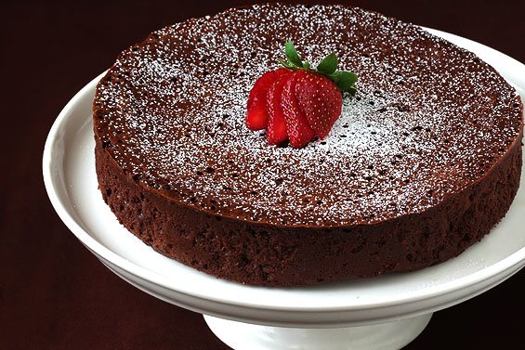
Happy Birthday, Avi!!

Slide 4
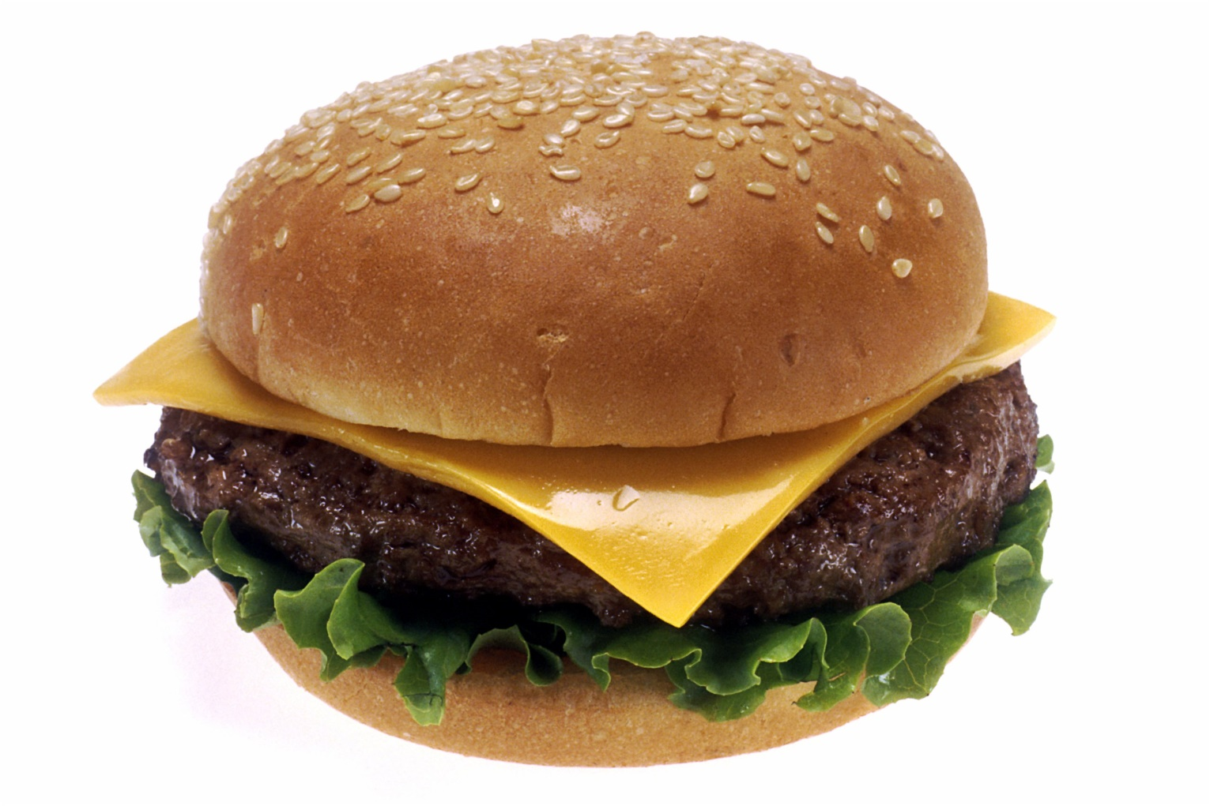
Happy Birthday Avi!!
Polynomials
Cheeseburger again!

Slide 5
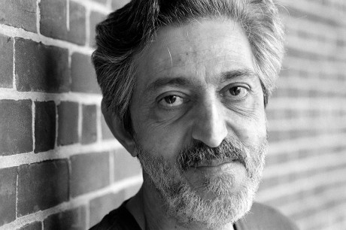

This talk
Polynomials
How to correct them?
How to test them?
Some history
Current status
(Why?)
!!!
$$⇑$$

Slide 6
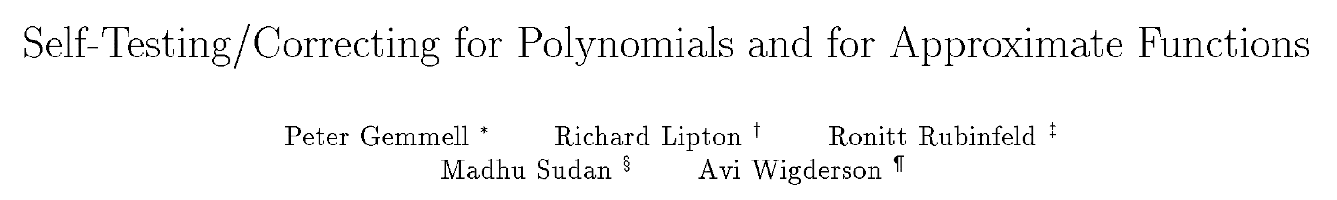
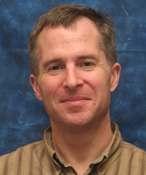
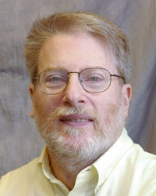
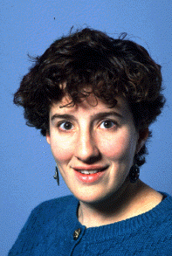
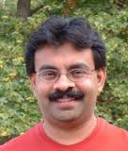
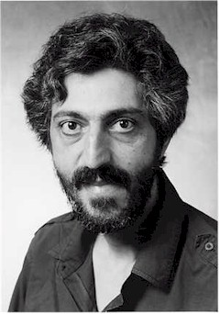
GLRSW-91

Slide 7


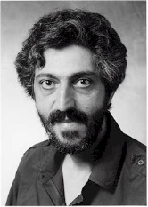

Main Results
Thm 1: deg. $d$ poly’s are $\left(O\left(d\right),Ω\left(1\right)\right)$-resilient.
Defn: Family of functions $F$ is $\left(k,δ_{0}\right)$-resilient if $∃D$ s.t. $∀ f∈F, g,x$ s.t. $δ\left(f,g\right)≤δ_{0},$ $D^{g}\left(x\right)=f\left(x\right),$ and $D$ makes $≤k$ calls to $g$.
Thm 2: deg. $d$ polynomials are $\left(d+2,\frac{1}{d^{3}}\right)$-robust.

Slide 8

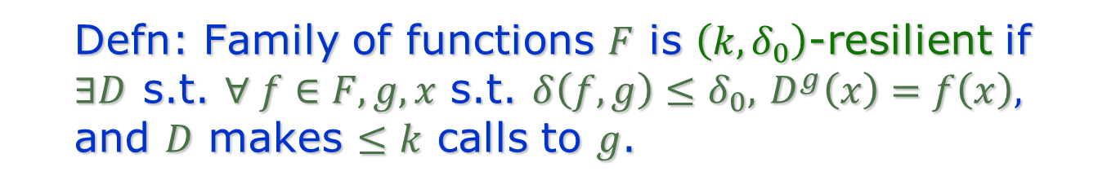



Resilience (visually)
$$x$$
$$f∈F$$
$$D^{g}(x)$$
1
k
2
$$g≈_{δ}f$$
Defn: Family of functions $F$ is $\left(k,δ_{0}\right)$-resilient if $∃D$ s.t. $∀ f∈F, g,x$ s.t. $δ\left(f,g\right)≤δ_{0},$ $D^{g}\left(x\right)=f\left(x\right),$ and $D$ makes $≤k$ calls to $g$.

Slide 9
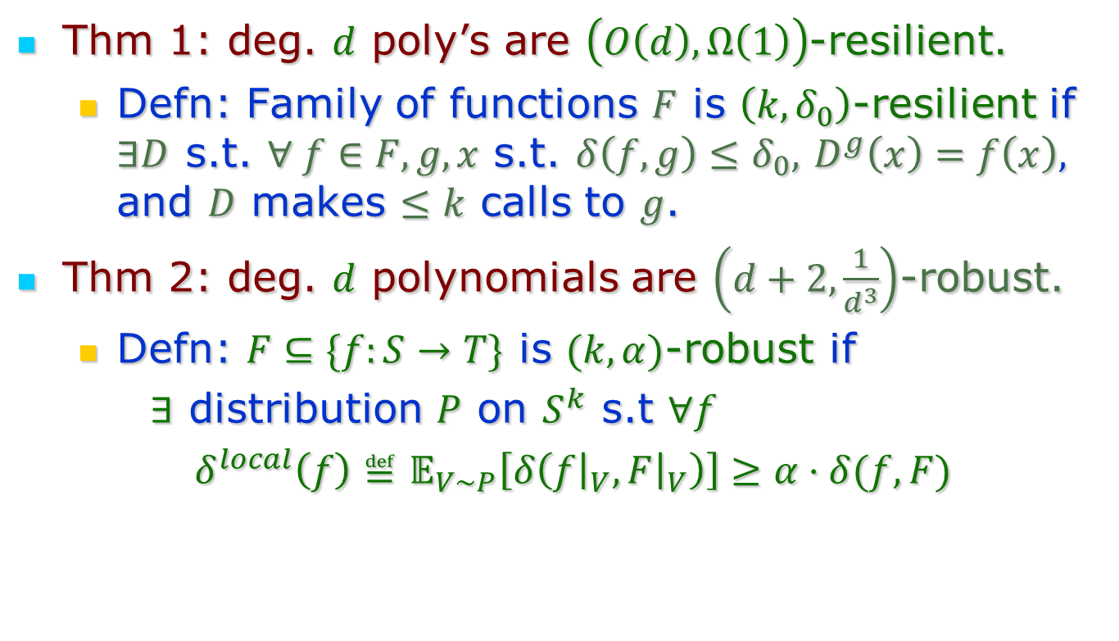
Main Results
Thm 1: deg. $d$ poly’s are $\left(O\left(d\right),Ω\left(1\right)\right)$-resilient.
Defn: Family of functions $F$ is $\left(k,δ_{0}\right)$-resilient if $∃D$ s.t. $∀ f∈F, g,x$ s.t. $δ\left(f,g\right)≤δ_{0},$ $D^{g}\left(x\right)=f\left(x\right),$ and $D$ makes $≤k$ calls to $g$.
Thm 2: deg. $d$ polynomials are $\left(d+2,\frac{1}{d^{3}}\right)$-robust.
Defn: $F⊆\{f:S→T\}$ is $(k,α)$-robust if
$∃$ distribution $P$ on $S^{k}$ s.t $∀f$
$δ^{local}\left(f\right)≝𝔼_{V∼P}\left[δ\left(f{\left.​\right|}_{V},F{\left.​\right|}_{V}\right)\right]≥α⋅δ(f,F)$

Slide 10


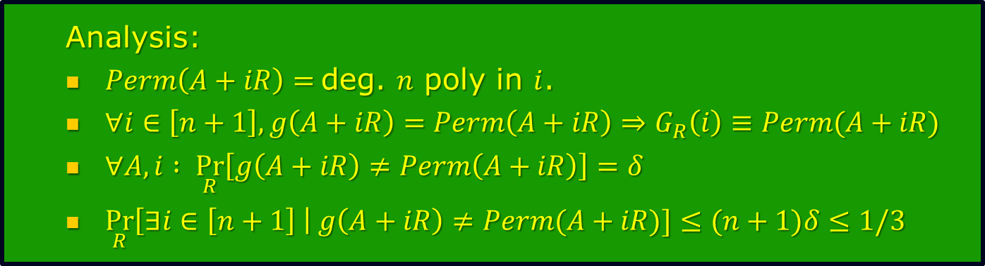

Background/Motivation: Permanent: Worst-case $≡$ Average-case
Analysis:
$Perm\left(A+iR\right)=$deg. $n$ poly in $i$.
$∀i∈\left[n+1\right], g\left(A+iR\right)=Perm\left(A+iR\right)⇒G_{R}\left(i\right)≡Perm(A+iR)$
$∀A,i : \underset{R}{Pr}\left[g\left(A+iR\right)≠Perm\left(A+iR\right)\right]=δ$
$\underset{R}{Pr}\left[∃i∈\left[n+1\right] \right| g\left(A+iR\right)≠Perm(A+iR)]≤(n+1)δ≤1/3$
[Lipton’90]: (building on [Beaver-Feigenbaum]):
Thm: Deg. $d$poly’s are $\left(O(d),Ω\left(d^{−1}\right)\right)$-resilient.
Cor: $n×n$-Permanent is $\left(O\left(n\right),Ω\left(n^{−1}\right)\right)$-resilient.
$⇔$ Worst-case complexity of permanent $≡$ average-case complexity of permanent.
Proof of Cor:
Suppose $\underset{M}{Pr}\left[g\left(M\right)≠Perm\left(M\right)\right]=δ≤O\left(n^{−1}\right)$
Then $∀ A$, $Perm\left(A\right)=G_{R}(0)$ w.h.p. over $R$ where $G_{R}=Poly−Interpolate\left(\left\{\left(i,g\left(A+iR\right)\right) | i∈\left[n+1\right]\right\}\right).$
Union Bound

Slide 11
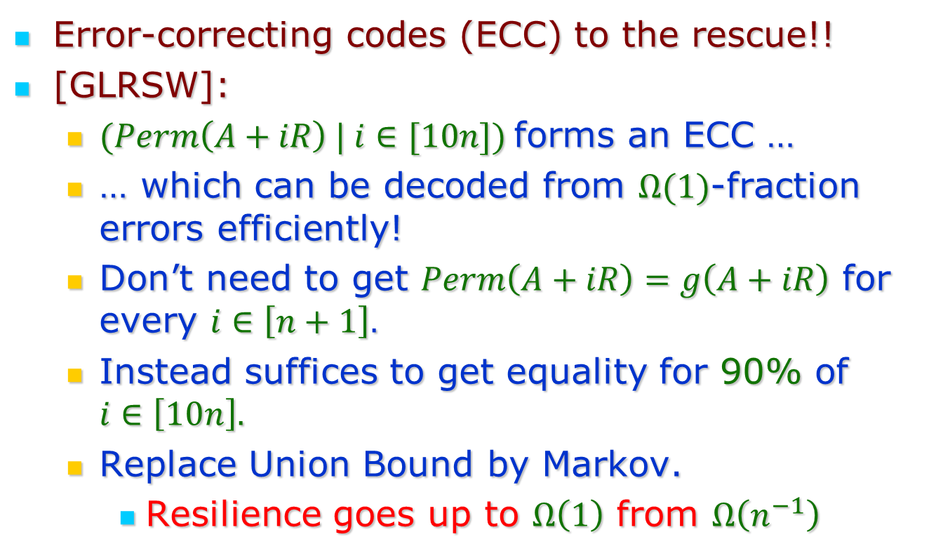
Improving Resilience?
Error-correcting codes (ECC) to the rescue!!
[GLRSW]:
$(Perm\left(A+iR\right) | i∈[10n])$forms an ECC …
… which can be decoded from $Ω(1)$-fraction errors efficiently!
Don’t need to get $Perm\left(A+iR\right)=g\left(A+iR\right)$ for every $i∈\left[n+1\right].$
Instead suffices to get equality for 90% of $i∈\left[10n\right].$
Replace Union Bound by Markov.
Resilience goes up to $Ω\left(1\right)$ from $Ω\left(n^{−1}\right)$
Reed-Solomon Codes!

Slide 12
Error-Correcting Codes!!
In TCS/1990: ECCs not widely used/understood.
My first introduction to ECCs!
Thanks, Avi & Dick!
!!!!

Slide 13

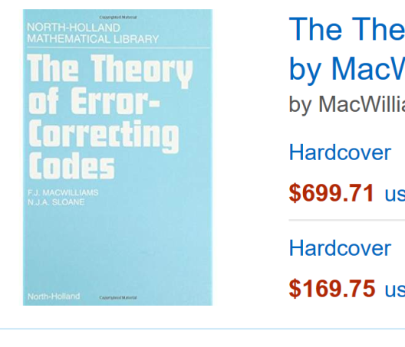
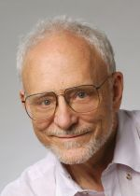
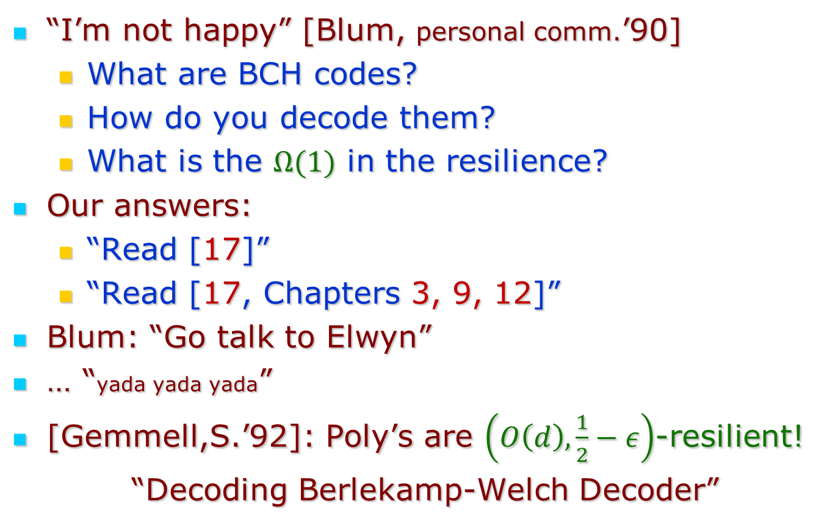
Some followup
“I’m not happy” [Blum, personal comm.’90]
What are BCH codes?
How do you decode them?
What is the $Ω(1)$ in the resilience?
Our answers:
“Read [17]”
“Read [17, Chapters 3, 9, 12]”
Blum: “Go talk to Elwyn”
… “yada yada yada”
[Gemmell,S.’92]: Poly’s are $\left(O\left(d\right),\frac{1}{2}−ε\right)$-resilient!
“Decoding Berlekamp-Welch Decoder”

Slide 14
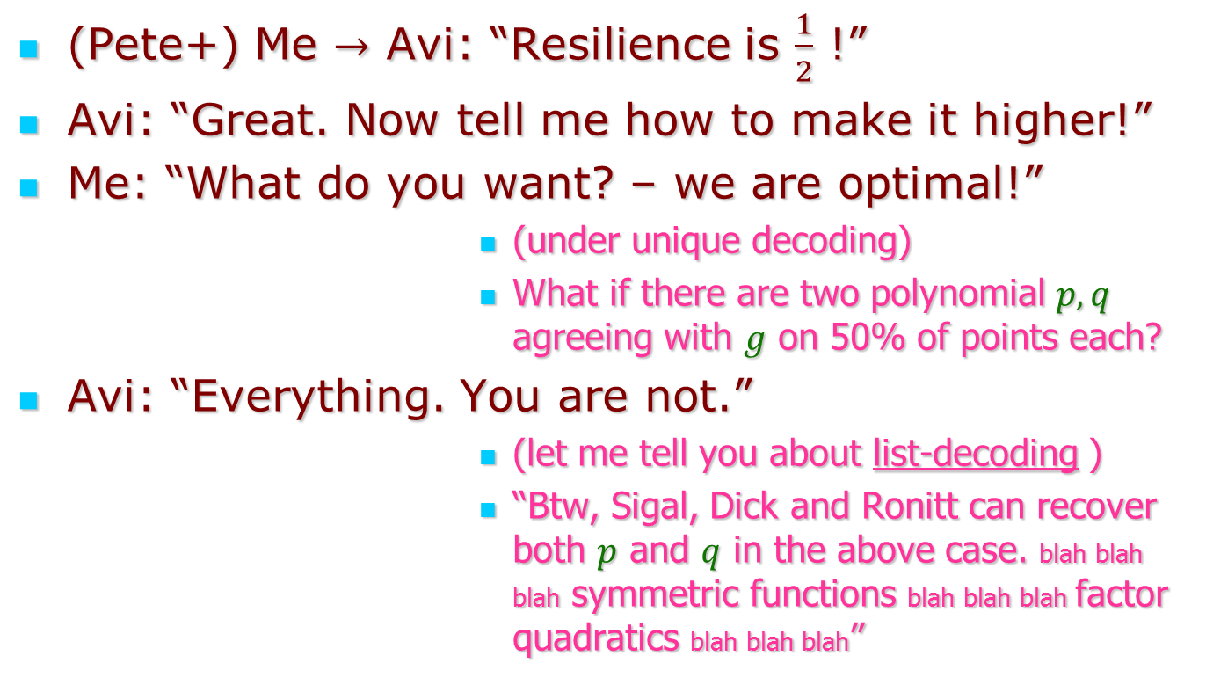
1991: Avi visits Berkeley!
(Pete+) Me $→$ Avi: “Resilience is $\frac{1}{2}$ !”
Avi: “Great. Now tell me how to make it higher!”
Me: “What do you want? – we are optimal!”
(under unique decoding)
What if there are two polynomial $p,q$ agreeing with $g$ on 50% of points each?
Avi: “Everything. You are not.”
(let me tell you about list-decoding )
“Btw, Sigal, Dick and Ronitt can recover both $p$ and $q$ in the above case. blah blah blah symmetric functions blah blah blah factor quadratics blah blah blah”

Slide 15
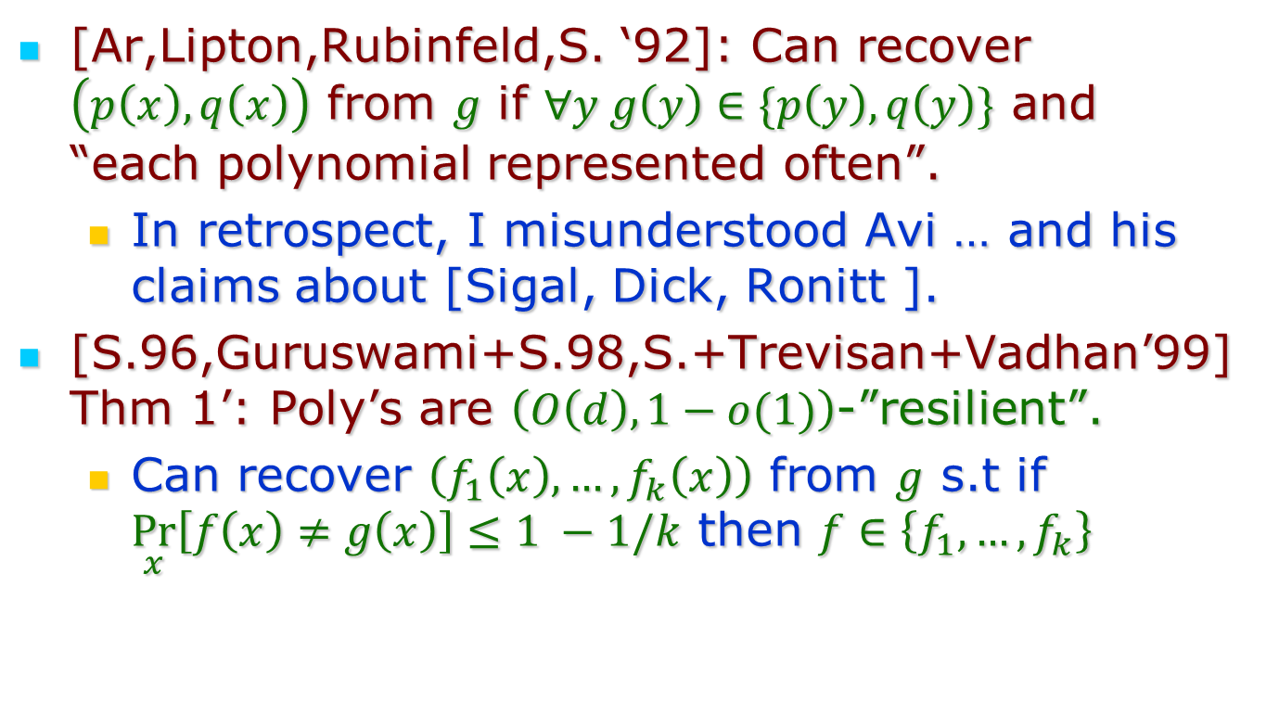
Damage Report from Avi’s visit
[Ar,Lipton,Rubinfeld,S. ‘92]: Can recover $\left(p\left(x\right),q\left(x\right)\right)$ from $g$ if $∀y g\left(y\right)∈\{p\left(y\right),q\left(y\right)\}$ and “each polynomial represented often”.
In retrospect, I misunderstood Avi … and his claims about [Sigal, Dick, Ronitt ].
[S.96,Guruswami+S.98,S.+Trevisan+Vadhan’99] Thm 1’: Poly’s are $\left(O\left(d\right),1−o(1)\right)$-”resilient”.
Can recover $\left(f_{1}\left(x\right),…,f_{k}\left(x\right)\right)$ from $g$ s.t if $\underset{x}{Pr}\left[f\left(x\right)≠g\left(x\right)\right]≤1 −1/k$ then $f∈\left\{f_{1}, …, f_{k}\right\}$
=

Slide 16
Concluding Part 1
Thanks to Avi
for introducing me …
… to the many wonders of polynomials!
… to error-correcting codes
… to list-decoding
to (accidentally?) triggering follow up.
For his curiosity and (infectious?) optimism.

Slide 17
Part 2: Testing Polynomials

Slide 18
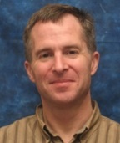
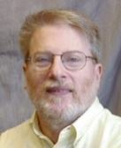
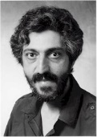

Main Results
$1−o(1)$ [STV’99]
X
Thm 1: deg. $d$ poly’s are $\left(O\left(d\right),Ω\left(1\right)\right)$-resilient.
Defn: Family of functions $F$ is $\left(k,δ_{0}\right)$-resilient if $∃D$ s.t. $∀ f∈F, g,x$ s.t. $δ\left(f,g\right)≤δ_{0},$ $D^{g}\left(x\right)=f\left(x\right),$ and $D$ makes $≤k$ calls to $g$.
Thm 2: deg. $d$ polynomials are $\left(d+2,\frac{1}{d^{3}}\right)$-robust.
Defn: $F⊆\{f:S→T\}$ is $(k,α)$-robust if
$∃$ distribution $P$ on $S^{k}$ s.t $∀f$
$δ^{local}\left(f\right)≝𝔼_{V∼P}\left[δ\left(f{\left.​\right|}_{V},F{\left.​\right|}_{V}\right)\right]≥α⋅δ(f,F)$

Slide 19
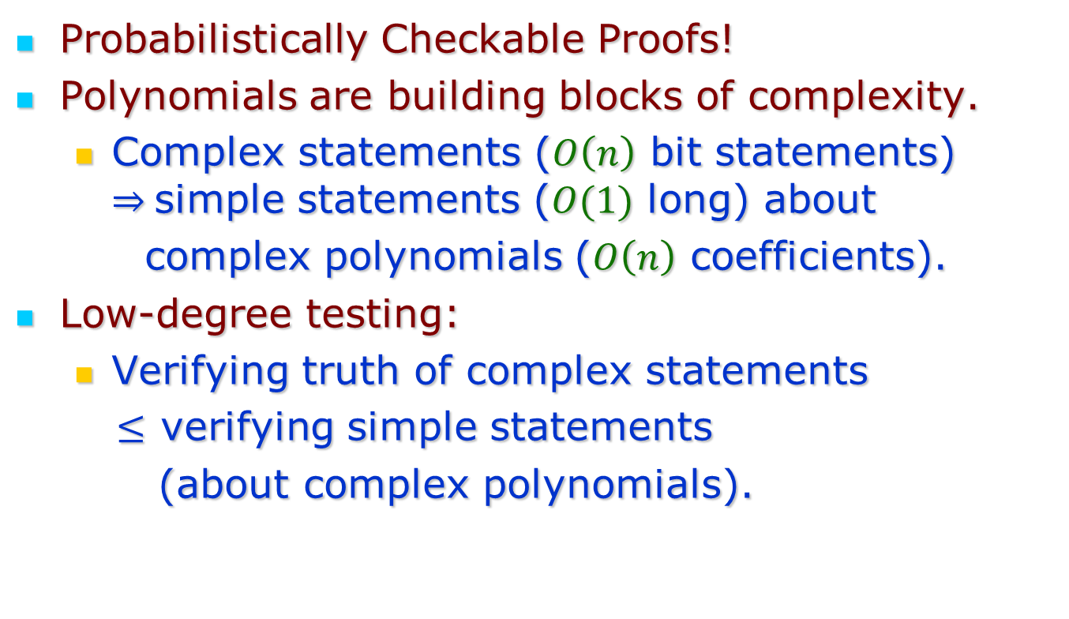
Why test?
Probabilistically Checkable Proofs!
Polynomials are building blocks of complexity.
Complex statements ($O\left(n\right)$ bit statements) $⇒$simple statements ($O(1)$ long) about
complex polynomials ($O\left(n\right)$ coefficients).
Low-degree testing:
Verifying truth of complex statements
$≤$ verifying simple statements
(about complex polynomials).

Slide 20
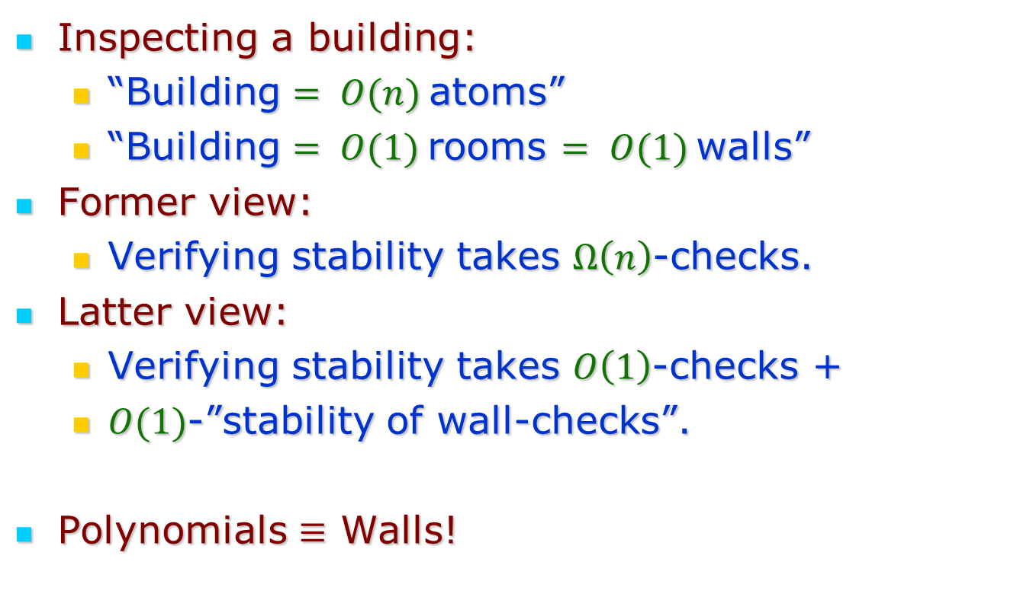
An Analogy
Inspecting a building:
“Building $= O(n)$atoms”
“Building $= O(1)$rooms $= O(1)$walls”
Former view:
Verifying stability takes $Ω\left(n\right)$-checks.
Latter view:
Verifying stability takes $O\left(1\right)$-checks +
$O(1)$-”stability of wall-checks”.
Polynomials $≡$ Walls!
… OR

Slide 21
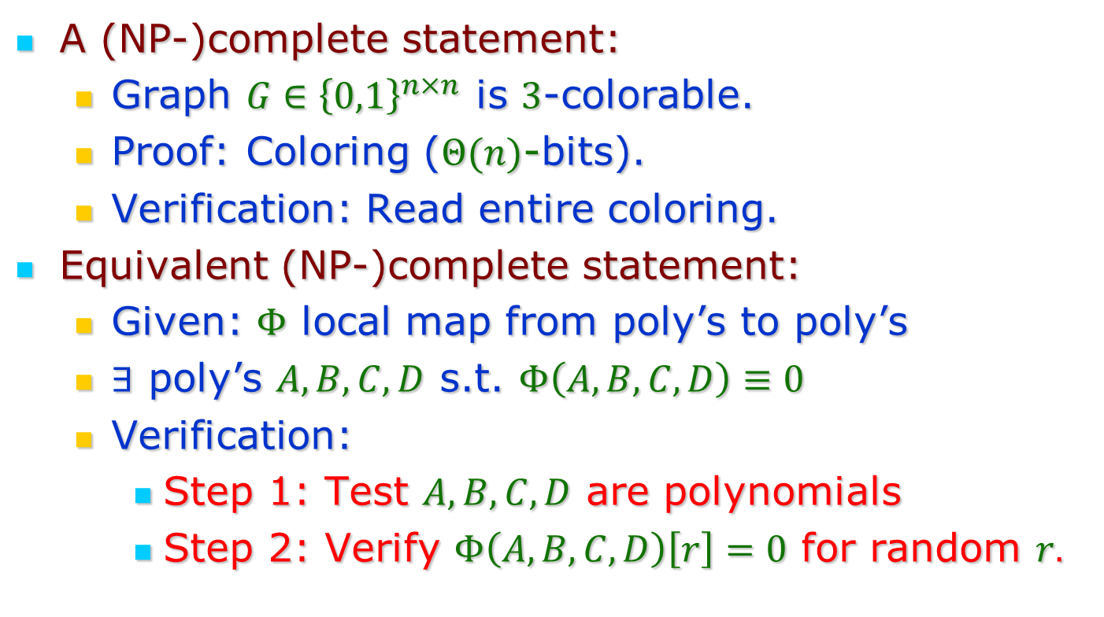
Polynomials = Walls?
A (NP-)complete statement:
Graph $G∈{\left\{0,1\right\}}^{n×n}$ is $3$-colorable.
Proof: Coloring ($Θ(n)$-bits).
Verification: Read entire coloring.
Equivalent (NP-)complete statement:
Given: $Φ$ local map from poly’s to poly’s
$∃$ poly’s $A,B,C,D$ s.t. $Φ\left(A,B,C,D\right)≡0$
Verification:
Step 1: Test $A,B,C,D$ are polynomials
Step 2: Verify $Φ\left(A,B,C,D\right)\left[r\right]=0$ for random $r.$

Slide 22
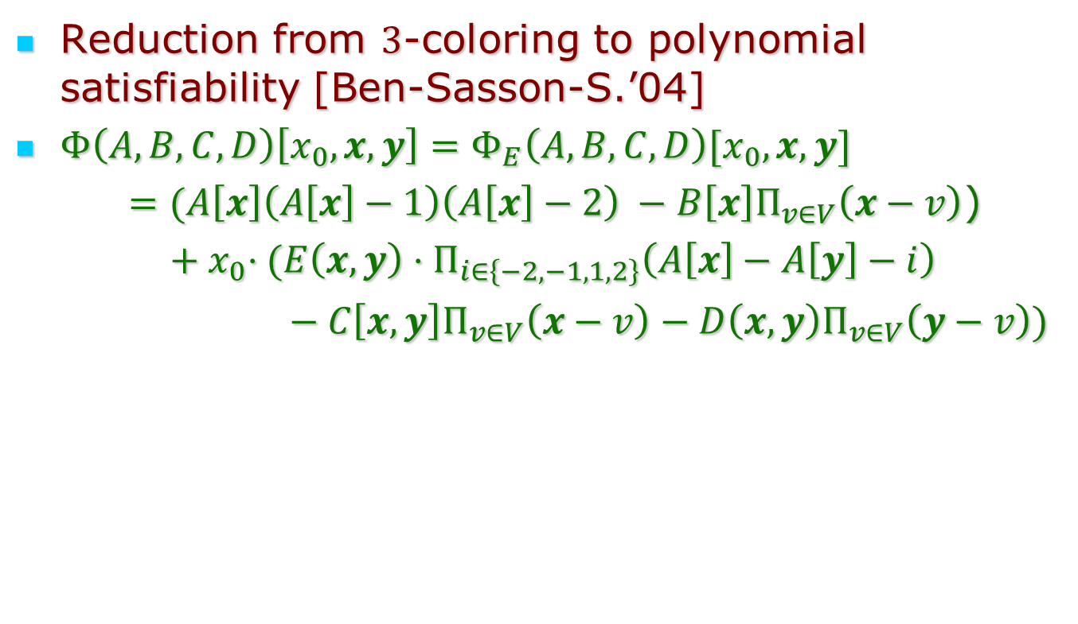
Polynomials = Wall - II
Reduction from $3$-coloring to polynomial satisfiability [Ben-Sasson-S.’04]
$Φ\left(A,B,C,D\right)\left[x_{0},x,y\right]=Φ_{E}\left(A,B,C,D\right)[x_{0},x,y]$
$=(A\left[x\right]\left(A\left[x\right]−1\right)\left(A\left[x\right]−2\right) −B\left[x\right]Π_{v∈V}\left(x−v\right)$)
${ + x}_{0}⋅(E\left(x,y\right)⋅Π_{i∈\left\{−2,−1,1,2\right\}}\left(A\left[x\right]−A\left[y\right]−i\right)$
$− C\left[x,y\right]Π_{v∈V}\left(x−v\right)−D\left(x,y\right)Π_{v∈V}\left(y−v\right))$

Slide 23
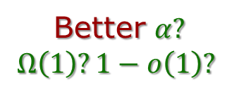
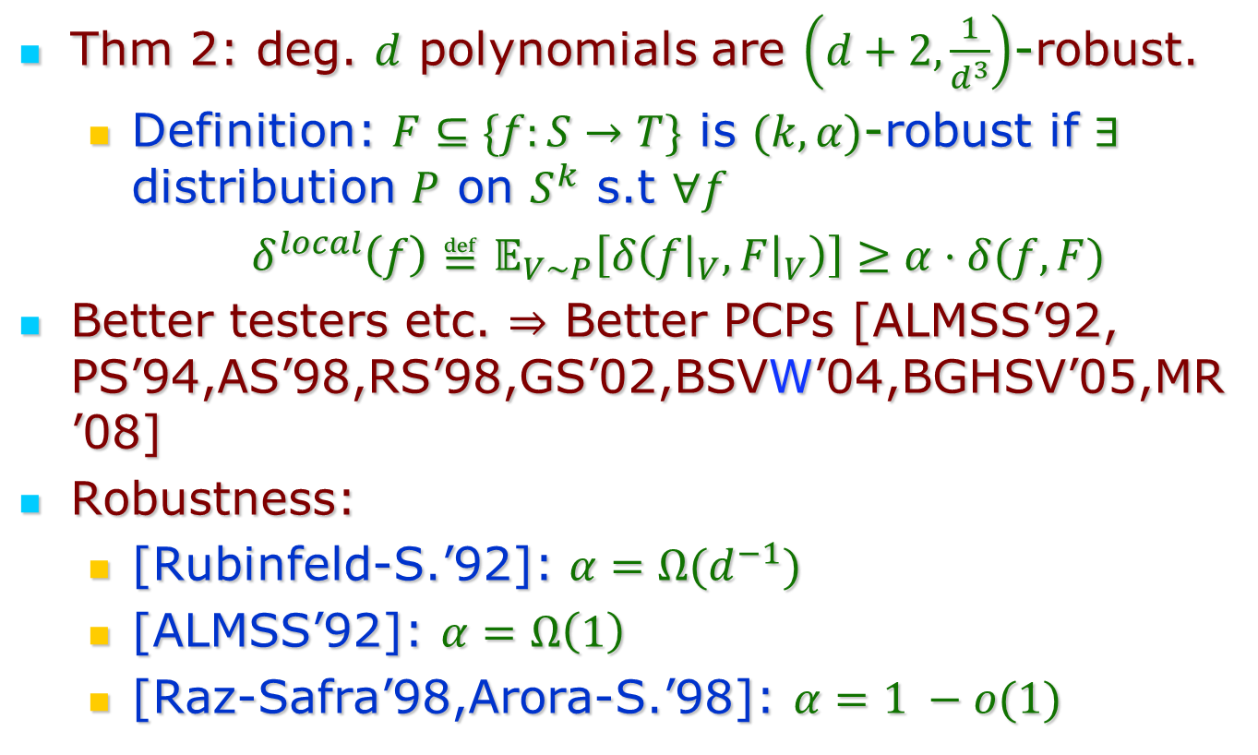
Low-degree Testing
Better $α?$
$$Ω\left(1\right)?1−o\left(1\right)?$$
Thm 2: deg. $d$ polynomials are $\left(d+2,\frac{1}{d^{3}}\right)$-robust.
Definition: $F⊆\{f:S→T\}$ is $(k,α)$-robust if $∃$ distribution $P$ on $S^{k}$ s.t $∀f$
$δ^{local}\left(f\right)≝𝔼_{V∼P}\left[δ\left(f{\left.​\right|}_{V},F{\left.​\right|}_{V}\right)\right]≥α⋅δ(f,F)$
Better testers etc. $⇒$ Better PCPs [ALMSS’92, PS’94,AS’98,RS’98,GS’02,BSVW’04,BGHSV’05,MR’08]
Robustness:
[Rubinfeld-S.’92]: $α=Ω(d^{−1})$
[ALMSS’92]: $α=Ω\left(1\right)$
[Raz-Safra’98,Arora-S.’98]: $α=1 −o(1)$
Thanks again, Avi!

Slide 24
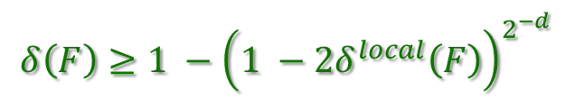
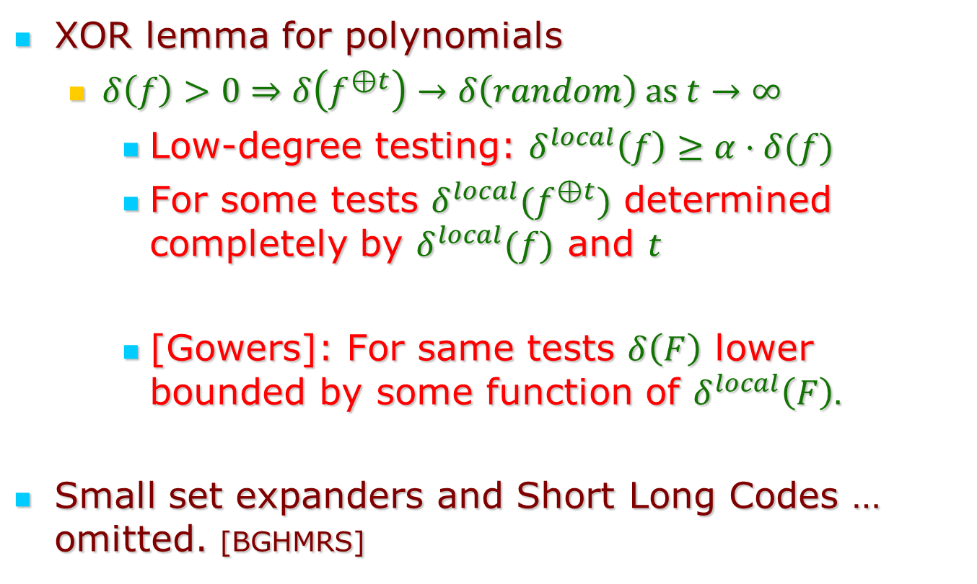
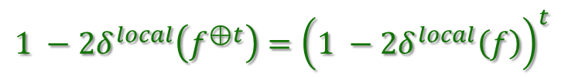
Other reasons to test
[ViolaWigderson’04]:
XOR lemma for polynomials
$δ\left(f\right)>0⇒δ\left(f^{⊕t}\right)→δ\left(random\right) as t→∞$
Low-degree testing: $δ^{local}\left(f\right)≥α⋅δ(f)$
For some tests $δ^{local}(f^{⊕t})$ determined completely by $δ^{local}(f)$ and $t$
[Gowers]: For same tests $δ\left(F\right)$ lower bounded by some function of $δ^{local}\left(F\right).$
Small set expanders and Short Long Codes … omitted. [BGHMRS]
$$1 −2δ^{local}\left(f^{⊕t}\right)={\left(1 −2δ^{local}\left(f\right)\right)}^{t}$$
$$δ\left(F\right)≥1 −{\left(1 −2δ^{local}\left(F\right)\right)}^{2^{−d}}$$

Slide 25
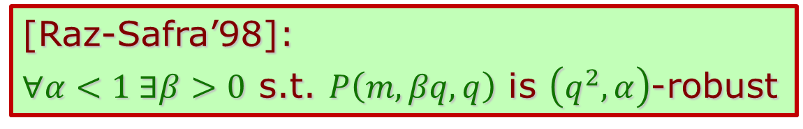

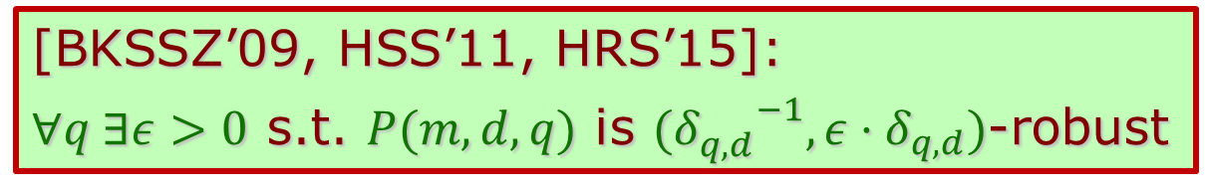
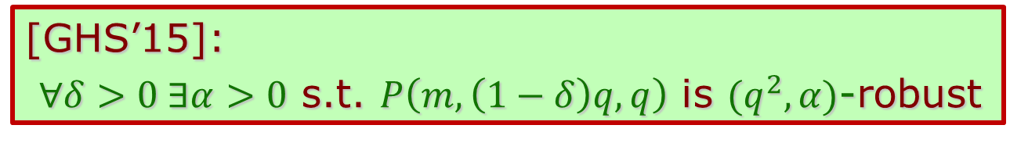
State-of-the-art: Low-degree testing
Long history omitted, Variations omitted.
Families of interest:
$P(m,d,q)$: $m$-var. deg. $d$ over $𝔽_{q}$
Benchmark: distance $δ_{q,d}$ of code $P(m,d,q)$
Thm. 1: $δ_{q,d}→1⇒α→1$
Thm. 2: $δ_{q,d}>0⇒α>0$
Thm. 3: $δ_{q,d}=o\left(1\right)⇒α=Ω(δ_{q,d})$
[Raz-Safra’98]:
$∀α<1 ∃β>0$ s.t. $P\left(m,βq,q\right)$ is $\left(q^{2}, α\right)$-robust
[GHS’15]:
$∀δ>0 ∃α>0$ s.t. $P\left(m,\left(1−δ\right)q,q\right)$ is $(q^{2}, α)$-robust
[BKSSZ’09, HSS’11, HRS’15]:
$∀q ∃ε>0$ s.t. $P(m,d,q)$ is $({δ_{q,d}^{}}^{−1},ε⋅δ_{q,d})$-robust

Slide 26
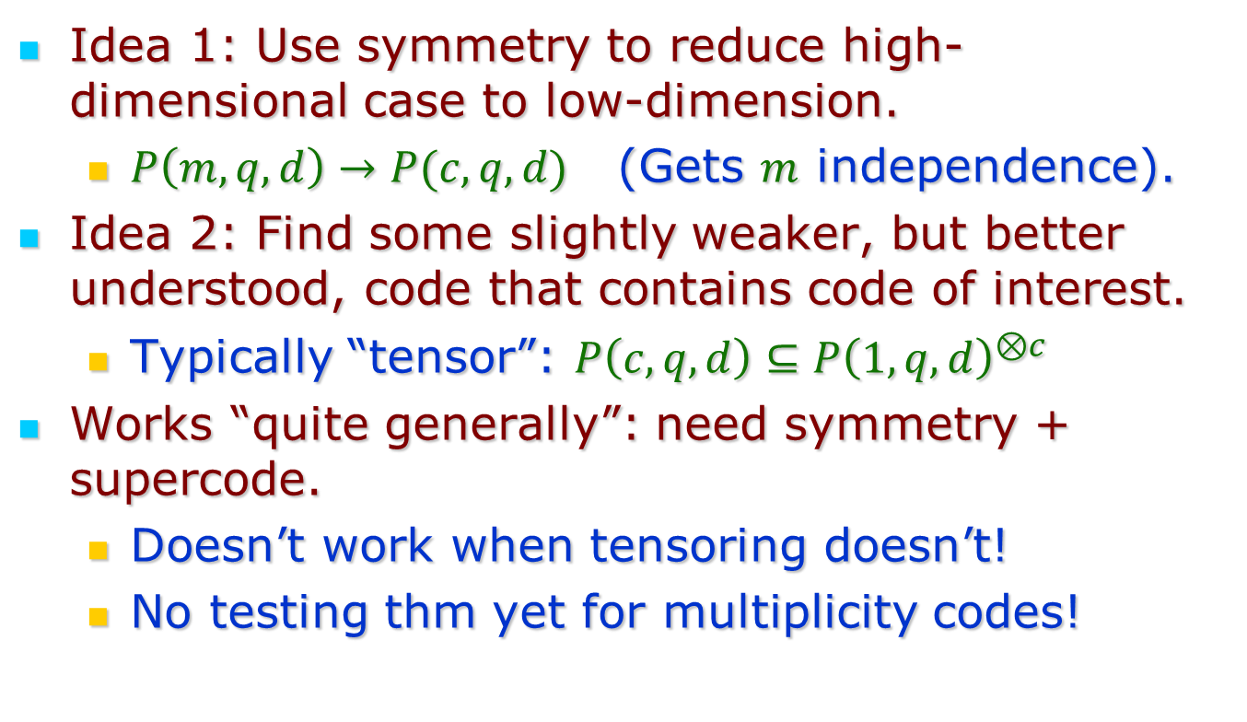
Techniques?
Idea 1: Use symmetry to reduce high-dimensional case to low-dimension.
$P\left(m,q,d\right)→P(c,q,d)$ (Gets $m$ independence).
Idea 2: Find some slightly weaker, but better understood, code that contains code of interest.
Typically “tensor”: $P\left(c,q,d\right)⊆P{\left(1,q,d\right)}^{⊗c}$
Works “quite generally”: need symmetry + supercode.
Doesn’t work when tensoring doesn’t!
No testing thm yet for multiplicity codes!

Slide 27

Summary:
Thanks again Avi!
For generously contributing ideas
(and your students …)
Many inspiring moments (about low-degree polynomials, and everything else!)

