Slide 1


New Algorithms and Lower Bounds for Monotonicity Testing of Boolean Functions
Rocco Servedio
Joint work with Xi Chen and Li-Yang Tan
Columbia University
Institute for Advanced Study
March 2014

Slide 2
Property Testing
Simplest question about a Boolean function: Does it have some property P?
All Boolean functions
Property P
Far from P
Unreasonable:
Easy lower bound of
Query access to unknown f on any input x
With as few queries as possible, decide if
f has Property P vs. f does not have Property P
f is far from having Property P
Notes:
Let me spend a few slides describing what property testing is about.

Slide 3
Rules of the game
All Boolean functions
Property P
Far from P
Query access to unknown f on any input x
If f has Property P, accept w.p. > 2/3.
If f is ε-far from having Property P, reject w.p. > 2/3.
Otherwise: doesn’t matter what we do.

Slide 4
Super-efficient algorithms
Sublinear Space
Streaming,
Sketching
Sublinear Time
Property Testing
Sublinear Measurement
Sparse Recovery,
Compressed Sensing
Two recurring messages:
Many properties P testable with surprisingly few queries.
Rich connections with many other areas:
Learning theory
Hardness of approximation
Communication complexity
...
Notes:
Family of super efficient algorithms. Usually happy with polynomial time, even happier with linear time.

Slide 5
This work: P = monotonicity
Notes:
A property testing classic

Slide 6
This work: P = monotonicity
Monotone
Far from monotone
Well-studied problem:
[GGR98, GGL+98, DGL+99, FLN+02, HK08, BCGM12, RRS+12, BBM12, BRY13, CS13, …]
but still significant gaps in our understanding.
Notes:
A property testing classic

Slide 7
Background and prior results
Notes:
A property testing classic

Slide 8
Quick reminder about monotonicity
Monotone
Far from monotone
A monotone function is one that satisfies:
For all monotone functions g:
“Flipping an input bit from 0 to 1 cannot make f go from 1 to 0”

Slide 9
Monotone
1^{n}
1^{n}
1
1
1
0
0
1
0^{n}
0^{n}
Far from monotone
Notes:
Reiterate goal of tester w.r.t. these pictures

Slide 10

First test that comes to mind
x
x = 1 1 1 1 0 0 1 1 1 0 1 0 0 1
?
Pick random edge
y
y = 1 1 1 1 0 0 1 0 1 0 1 0 0 1
f(x) = 0
f(x) = 1
f(x) = 0
f(x) = 1
f(y) = 1
f(y) = 1
f(y) = 0
f(y) = 0
Reject!
Repeat
Call such an edge a
“violating edge”

Slide 11
An observation and a theorem
?
x
f(x) = 0
Call such an edge a
“violating edge”
y
f(y) = 1
Reject!
Tester = Sample random edges, check for violations.
Simple observation: If f is monotone, tester never rejects.
Question: If f is ε-far from monotone, how likely to catch violating edge?
Theorem [Goldreich et al. 1998]
If f is ε-far from monotone, Ω(ε/n) fraction of edges are violations. Therefore tester will reject within O(n/ε) queries.

Slide 12
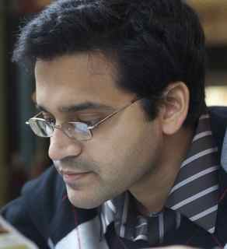

An exponential gap between upper and lower bounds
Goldreich et al. [FOCS 1998]
Introduced problem, gave tester with O(n) query complexity.
Fischer et al. [STOC 2002]
Any non-adaptive tester must make Ω(log n) queries.
Therefore, any adaptive tester must make Ω(log log n) queries.
[GGR98, DGL+99, HK08, BCGM12, RRS+12, BRY13, CS13, …]
Chakrabarty-Seshadhri [STOC 2013]
O(n^{7/8})-query non-adaptive tester!

Slide 13



Our results
Lower bound:
Any non-adaptive tester must make queries.
Therefore, any adaptive tester must make queries.
Exponential improvements over Ω(log n) and Ω(log log n) lower bounds of Fischer et al. (2002)
Upper bound:
There is a non-adaptive tester that make queries.
Polynomial improvement over O(n^{7/8}) upper bound of Chakrabarty and Seshadhri (2013)

Slide 14
Rest of talk
The lower bound
Main idea of the argument in a simpler setting
Key technical ingredient: Multidimensional Central Limit Theorems
Generalizing the lower bound: Testing monotonicity on hypergrids

Slide 15

Yao’s minimax principle
Lower bound against randomized algorithms
Tricky distribution over inputs to deterministic algorithms
implies

Slide 16
Yao’s principle in our setting
Monotone
Far from Monotone
Distribution D_{yes} supported on monotone functions
Distribution D_{no} supported on far from monotone functions
Indistinguishability. For all T = deterministic tester that makes o(n^{1/5}) queries,

Slide 17
Our D_{yes} and D_{no} distributions
Both supported on Linear Threshold Functions (LTFs) over {−1,1}^{n}:
D_{yes} : = uniform from {1,3}
D_{no} : = −1 with prob 0.1, 7/3 with prob 0.9
Verify: D_{yes} LTFs are monotone, D_{no} LTFs far from monotone w.h.p.
Main Structural Result: Indistinguishability
Any deterministic tester that makes few queries cannot tell D_{yes} from D_{no}
Key property: , .
Notes:
LTFs are Boolean functions that can be written as….
Note that this is a strict subclass, not all BFs can be written this way.
In order to describe an LTF, suffices to tell you the w_i’s.
Intuition as to why D_no are non-monotone

Slide 18
Indistinguishability: starting small
q = 1 query
Claim. For all T = deterministic tester that makes q = o(n^{1/5}) queries,

Slide 19
Non-trivial proof of a triviality
Claim. Let T = deterministic tester that makes 1 query, on string z. Then:
(*)
Tester sees:
vs.
Notes:
Tester sees R_yes and R_no.
Real-valued random variables, drawn suggestively to look like a Gaussian.

Slide 20
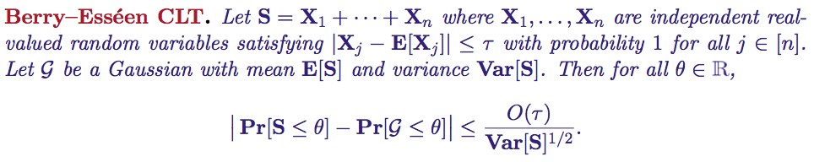
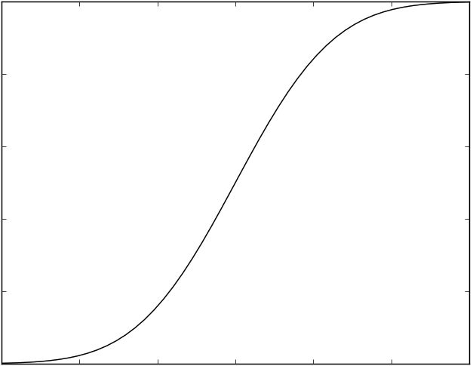
Central Limit Theorems. Sum of many independent “reasonable” random variables converges to Gaussian of same mean and variance.
Main analytic tool (Baby version):

Slide 21
Goal: Upper bound
Recall key property:

Slide 22
We just proved:
Claim. Let T = deterministic tester that makes 1 query. Then:
Plenty of room to spare!
Would be happy with < 0.1
Notes:
Of course too weak to be meaningful because it is only a lower bound against 1 query.
But also stronger than we need in a sense.
What we do: increase 1 to q at the expense of the \sqrt{n}

Slide 23
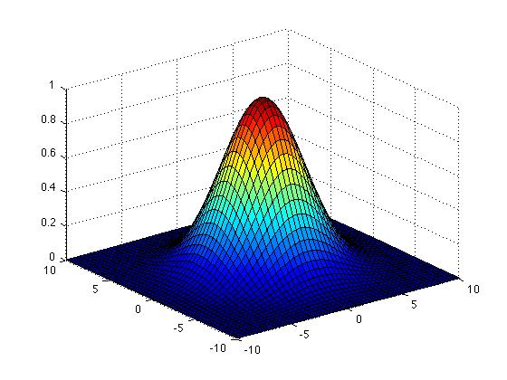
q queries instead of 1
Main analytic tool (Grown-up version):
Multidimensional CLTs. Sum of many independent “reasonable” q-dimensional random variables converge to q-dimensional Gaussian of same mean and variance.

Slide 24


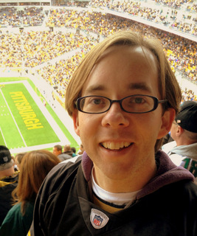
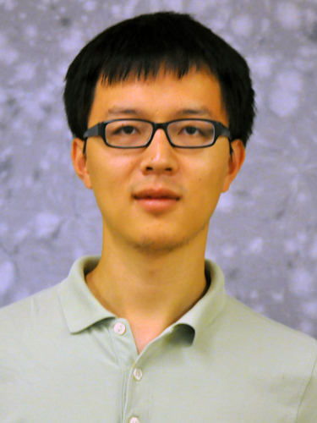

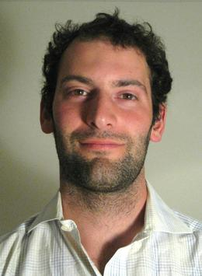
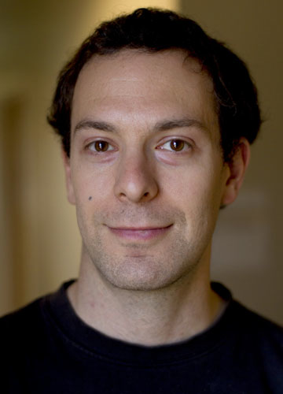
Multidimensional CLTs
Lower bound
[Mossel 08, Gopalan-O’Donnell-Wu-Zuckerman 10]
Main technical work:
Adapting multidimensional CLT for Earth Mover Distance to get
[Valiant-Valiant 11]

Slide 25
Let’s prove the real thing:
Claim. For all T = deterministic tester that makes q = o(n^{1/5}) queries,

Slide 26
Setting things up
Arrange the q queries of tester T in a q x n matrix Q
i-th query string
Recall: Tester’s goal is to distinguish
versus

Slide 27
What does the tester see?
Tester sees:
(coordinate-wise sign)
Goal: Upper bound
Notes:
Tester either receives a yes function or a no function, each the sign of a linear form.
With a yes function we can associate with it a vector in Rq, the q values of the linear form on each of the q queries. This is *not* what the tester sees. The tester does not see the values, only the sign fo them.

Slide 28
Goal: Upper bound
Random variables supported on 2^{q} orthants of R^{q}
union of orthants
“roughly equal weight on any union of orthants”

Slide 29
Fixed
Ditto:
from product distribution over R^{n}
sum of n independent vectors in R^{q}

Slide 30
The final setup
Goal: Two sums of n independent vectors in R^{q} are “close”
where closeness = roughly equal weight on any union of orthants.
Furthermore, since
suffices to show each are close to q-dimensional Gaussian with matching mean and covariance matrix.

Slide 31

Valiant-Valiant Multidimensional CLT
Sum of many independent “reasonable” q-dimensional random variables is close to q-dimensional Gaussian of same mean and variance.
with respect to Earth Mover Distance:
Minimum amount of work necessary to “change one PDF into the other one”, where work := mass x distance
Technical lemma:
Closeness in EMD roughly equal weight on any union of orthants
Notes:
Let me state the VV CLT, and then prove the key lemma

Slide 32
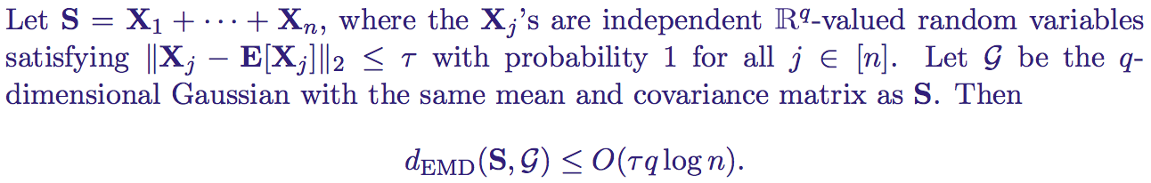
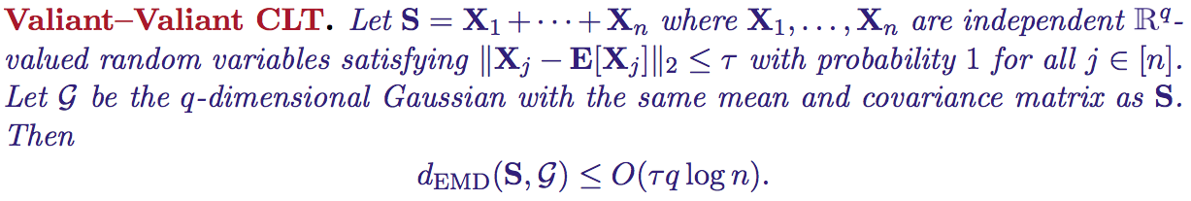
Valiant-Valiant Multidimensional CLT

Slide 33
Key technical lemma
Closeness in EMD
Roughly equal weight on any union of orthants

Slide 34
for all unions of orthants
Let’s consider the contrapositive:
If we want to make S look like G,
≥ 0.1 unit of mass must be moved out of
Recall:
work = mass x distance
Slight technical obstacle:
What if this 0.1 unit of mass only moves a tiny distance?
Solution:
Then G has ≥ 0.1 weight on red boundary.
Not possible thanks to anti-concentration of G

Slide 35
In slightly more detail
, has to be moved out of
For all r > 0,
define B_{r} := radius r boundary around
B_{r}
Therefore:

Slide 36
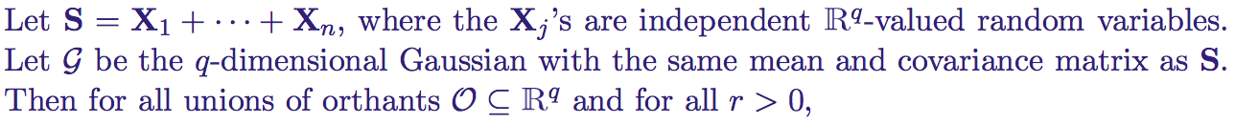
We just proved
Valiant-Valiant
CLT
Gaussian
anti-concentration
Recall the Valiant-Valiant CLT:

Slide 37
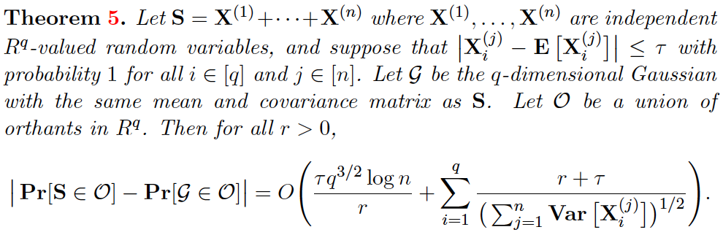

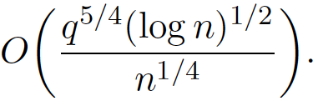


The details
τ=O(1) in our setting
= in our setting
Optimal choice of makes RHS
Pick , and RHS is o(1) as desired.
Recall the Valiant-Valiant CLT:

Slide 38
Recap
Indistinguishability. For all T = deterministic tester that makes q = o(n^{1/5}) queries,
Lower bound:
Any non-adaptive tester must make queries.
Therefore, any adaptive tester must make queries.

Slide 39
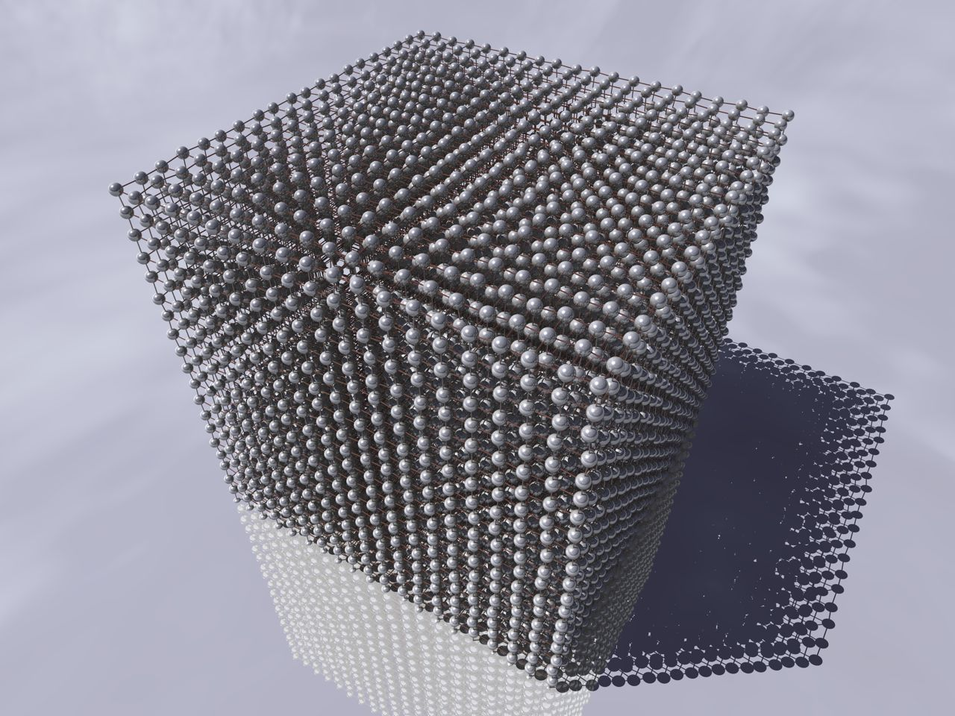
Testing monotonicity of Boolean functions over general hypergrid domains

Slide 40
Boolean functions over hypergrids
Testing monotonicity of Boolean functions over hypergrids
All Boolean-valued functions over hypergrid
All Boolean functions
Monotone
Far from monotone
Notes:
Testing monotonicity of these functions makes sense
Natural notion of monotonicity. Obvious generalization of distance to monotonicity

Slide 41
Lower bound: *
Any non-adaptive tester for testing monotonicity of .must make queries.
Proof by reduction to m=2 case (Boolean hypercube)
* only for even m

Slide 42
A useful characterization
Theorem. [Fischer et al. 2002]
is ε-far from monotone
There exists ε . m^{n} vertex-disjoint pairs
such that and .
“violating pair”
0
0
0
0
0
0
(Upward direction is easy)
1
1
1
1
1
0
1
1

Slide 43
Reducing to m = 2
Given any , define as follows:
numbers in [m]
bits in {0,1}
Easy: If f is monotone then so is F.
Remains to argue:
If f is ε-far from monotone then so is F.
Useful characterization
Useful characterization
Exists ε2^{n} vertex-disjoint pairs in {0,1}^{n} that are violations w.r.t. f
suffices to show:
Exists ε . m^{n} vertex-disjoint pairs in [m]^{n} that are violations w.r.t. F
Each violating pair
(m/2)^{n} vertex-disjoint violating pairs

Slide 44
f(x) = 0
0
S(x)
f(y) = 1
{0,1}^{n}
S(y)
1
[m]^{n}
where
|S(x)| = |S(y)| = (m/2)^{n}
Easy end game: exhibit order-preserving bijection between S(x) and S(y)

Slide 45
Conclusion
A polynomial lower bound for testing monotonicity of Boolean functions
Lower bound:
Any non-adaptive tester must make queries.
Therefore, any adaptive tester must make queries.
Main technical ingredient: multidimensional central limit theorems
Proof extends to testing monotonicity over general hypergrid domains (when m is even)
Open Problem: Polynomial lower bounds against adaptive testers?

Slide 46
What I didn’t talk about
An improved one-sided, non-adaptive tester
Upper bound:
There is a non-adaptive tester that make queries.
Builds on ingredients from [Chakrabarty and Seshadhri 2013]: trade off edge tester versus “path tester”
We give a different “path tester” with an improved analysis
Open Problems: can we exploit adaptivity or two-sided error to obtain more efficient testers?

Slide 47
Thank you!

