Slide 1
Adaptive Data Analysis via Differential Privacy: General Tools for Post-Selection Inference
Aaron Roth

Slide 2
Unreliable results: a crisis in data science?
Trouble at the Lab – The Economist

Slide 3
Most published research findings
are probably false.
– John Ioannidis
[…] three-quarters of published scientific papers in the field of machine learning are bunk because of ‘overfitting’ says Sandy Pentland
– The Economist
Irreproducible biology research costs put at $28 billion per year
– Nature News (2015)
Notes:
“If you want to believe them, then you shouldn’t believe them.”
Amgen: Of 53 landmark studies in cancer research, 6 reproduced
Bayer: Of 67 studies, 14 reproduced
28bln = 4 X NSF budget

Slide 4
Preventing overfitting/false discovery
Decades old subject
Lots of tools:
holdout method, cross-validation, FDR control, Bonferroni correction,…
Designed for static data analysis

Slide 5
Static data analysis
Method
Data
Outcome
Can’t revise method and reuse data

Slide 6
Static vs Adaptive
Method
Method
Data
Data
Outcome
Outcome

Slide 7
What do we want to protect against?
Over-fitting from fixed algorithmic procedures (easiest – might hope to analyze exactly)
e.g. variable/parameter selection followed by model fitting
From: “Evaluating Machine Learning Models”. Alice Zheng, Dato.

Slide 8
What do we want to protect against?
2) “Researcher Degrees of Freedom”
Example from Gelman and Loken, “The Garden of Forking Paths”, 2013

Slide 9
What do we want to protect against?
3) Multi-researcher re-use of data sets

Slide 10
Desiderata
An information measure flexible enough to reason about many different algorithms.
Robustness to arbitrary post-processing.
Both precisely defined:
And imprecisely defined:
Graceful degradation under composition:

Slide 11
Choosing a Formalism: Linear Functionals
A data universe $X$
A distribution $P∈ΔX$
A dataset $D⊆X$ consisting of $n$ points $x∈X$ sampled i.i.d. from $P$.
$$P$$
$$D$$

Slide 12
Choosing a Formalism: Linear Functionals
A linear functional is defined by a predicate
$φ:X→[0,1]$.
The value of a linear functional is
$$φ\left(P\right)=E_{x∼P}[φ\left(x\right)]$$
A statistical estimator is an algorithm for estimating linear functionals: $A_{D}(φ)→[0,1]$

Slide 13
Choosing a Formalism: Linear Functionals
$$P$$
Adaptively Chosen Queries:
$$A$$
$$φ_{1}$$
$$D$$
$$a_{1}$$

Slide 14
Choosing a Formalism: Linear Functionals
$$P$$
Adaptively Chosen Queries:
$$A$$
$$φ_{2}$$
$$D$$
$$a_{2}$$

Slide 15
Choosing a Formalism: Linear Functionals
$$P$$
Adaptively Chosen Queries:
A statistical estimator $A$ is $\left(ε,δ\right)$-accurate for sequences of $k$ adaptively chosen queries $φ_{1},…,φ_{k}$ if for all and , with probability $1−δ$:
$\max_{i}\left|A_{D}\left(φ_{i}\right)−φ_{i}\left(P\right)\right|≤ε$.
$$A$$
$$φ_{i}$$
$$φ_{k}$$
$$D$$
$$a_{k}$$
$$a_{i}$$
$$P$$

Slide 16
A Baseline
$$P$$
Non-Adaptive Queries:
The “empirical average mechanism”: $A_{D}\left(φ\right)=φ\left(D\right)≔ \frac{1}{n}\sum_{x∈D}{φ\left(x\right)}$ can answer $k$ non-adaptive queries with $(0.01,0.01)$-accuracy where:
$$k=e^{Θ(n)}$$
$$φ_{1}$$
$$A$$
$$a_{1}$$
$$D$$
$$a_{k}$$
$$φ_{k}$$

Slide 17
A Baseline
$$P$$
Non-Adaptive Queries:
The “empirical average mechanism”: $A_{D}\left(φ\right)=φ\left(D\right)≔ \frac{1}{n}\sum_{x∈D}{φ\left(x\right)}$ can answer $k$ adaptive queries with $(0.01,0.01)$-accuracy where:
$$k=O(n)$$
$$A$$
$$a_{1}$$
$$D$$
$$a_{k}$$

Slide 18
Question:
Can we do better with a different statistical estimator?

Slide 19
Differential Privacy [Dwork-McSherry-Nissim-Smith 06]
D
Bob
Xavier
Alice
Chris
Donna
Ernie
Algorithm
Pr [r]

Slide 20
A stability condition on the output distribution:
$A:X^{n}→𝒪$ is $(ε,δ)$-differentially private if for every pair of neighboring datasets $D,D′$, and outcome $S$:
$$\operatorname{Pr}\left[A\left(D\right)∈S\right]≤e^{ε}\operatorname{Pr}\left[A\left(D^{′}\right)∈S\right]+δ$$
Crucial: Stability on the distribution.
No metric on $𝒪$.

Slide 21
Distributional Stability Yields Robustness to Postprocessing
An “Information Processing” inequality:
Theorem: If $A:X^{n}→𝒪$ is $(ε,δ)$-differentially private, and $f:𝒪→𝒪^{′}$ is an arbitrary algorithm, then $f∘A :X^{n}→𝒪^{′}$ is $(ε,δ)$-differentially private.
Important:
Don’t need to understand anything about $f.$
$$f= f=$$

Slide 22
Distributional Stability Degrades Gracefully Under Composition
Compose( ;D)
For $i$ = 1 to $k$:
Let choose an $ε$-DP $A_{i}$ based on $o_{1},…,o_{i−1}$.
Let $o_{i}=A_{i}(D)$
Output ($o_{1},…,o_{n}$).
Theorem* [DRV10]: For every , and $δ^{′}$, Compose( ;D) is $\left(ε^{′},δ^{′}\right)$-differentially private for:
$ε^{′}$=$O\left(ε⋅\sqrt{k⋅\ln\left(\frac{1}{δ^{′}}\right)}\right)$

Slide 23
A simple, private method for answering linear functionals
For $i$ = 1 to $k$:
Let choose a LF $φ_{i}$ based on $a_{1},…,a_{i−1 }$
Output $a_{i}=φ_{i}(D)+N(0,σ^{2})$
for $σ=O\left(\frac{\sqrt{k⋅ln⁡(\frac{1}{δ})}}{εn}\right)$
This is $(α,β)$-accurate with respect to the sample for:
$$α=O\left(\frac{\sqrt{k⋅\log{(k)}⋅\ln\left(\frac{1}{δ}\right)⋅\ln\left(\frac{1}{β}\right)}}{εn}\right)$$

Slide 24
Who Cares About Accuracy on the Sample?
A “Transfer-Theorem”: If an algorithm is both differentially private, and accurate in sample, it is also accurate out of sample.

Slide 25
Who Cares About Accuracy on the Sample?
Theorem: [DFHPRR’15,BNSSSU’16]:
Let $A$ be a statistical estimator for adaptively chosen linear functionals. Let $P$ be any distribution, and let $D∼P^{n}$. If:
$A$ is $\left(ε,ε⋅δ\right)$-differentially private, and
$A$ is $(ε, ε⋅δ)$-accurate with respect to the sample $D$, then:
$A$ is ($O(ε), O(δ))$-accurate with respect to the distribution $P$.

Slide 26
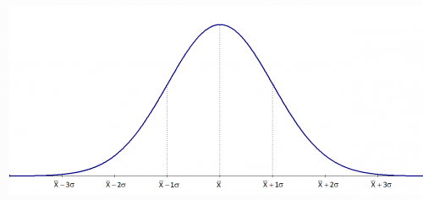
Applications
Using Independent Gaussian Perturbation
Theorem: There exists a simple, computationally efficient statistical estimator that can answer $k$ adaptive queries with $(0.01,0.01)$-accuracy where:
$$k=\tilde{Θ}(n^{2})$$
A quadratic improvement over the empirical average mechanism!

Slide 27
Applications
Using State of the Art Differentially Private Mechanisms ([HR10])
Theorem: There exists a statistical estimator that can answer $k$ adaptive queries with $(0.01,0.01)$-accuracy where:
$$k=e^{Θ\left(\frac{n}{\log\left|X\right|}\right)}$$
An exponential improvement if the data universe $X$ is finite and $n≫\log{|X|}$.

Slide 28
Beyond Linear Functionals
Definition: Let $X,Z$ be jointly distributed R.V.s. The $β$-approximate max-information between $X$ and $Z$ is:
$I_{∞}^{β}\left(X;Z\right)=\log{\sup_{O:\operatorname{Pr}\left[\left(X,Z\right)∈O\right]≥β}{\frac{\operatorname{Pr}\left[\left(X,Z\right)∈O\right]−β}{Pr⁡[X⊗Z∈O]}}}$
An algorithm $M:𝒳^{n}→𝒵$ has $β$-approximate max-information of $k$ if for every distribution $P$ over $𝒳$, when $D∼P^{n}$:
$$I_{∞}^{β}\left(D;A\left(D\right)\right)≤k$$

Slide 29
Beyond Linear Functionals
Theorem [DFHPRR15, RRST16]: If $A:X^{n}→𝒵$ is $\left(ε,δ\right)$-differentially private, then:
$$I_{∞}^{β}\left(D;A\left(D\right)\right)≤O\left(\left(ε^{2}+\sqrt{\frac{δ}{ε}}\right)⋅n\right)$$
For $β=O\left(\sqrt{\frac{δ}{ε}}\right)$.

Slide 30
Beyond Linear Functionals
Algorithms with bounded max information control the probability of “bad events” that occur as a result of dependence of $M(D)$ on $D$:
$$\operatorname{Pr}\left[\left(D, A\left(D\right)\right)∈O\right]≤2^{k}⋅\operatorname{Pr}\left[D⊗A\left(D\right)∈O\right]+β$$
E.g. $O=\left\{\left(D, φ\right):\left|φ\left(D\right)−φ\left(P\right)\right|≥α\right\}$
Generalization for linear functionals or any other well concentrated class of statistics.

Slide 31
$p$-value Corrections.
Definition: A function $γ:\left[0,1\right]→[0,1]$ is a valid $p$-value correction function for a selection procedure $A$ if for all $α∈[0,1]$ the procedure:
Select a test statistic $φ=A(D)$ (and a corresponding null hypothesis)
Compute the $p$-value $p(φ\left(D\right))$ as if $φ$ were independent of $D$.
Reject the null hypothesis if:
$$p\left(φ\left(D\right)\right)≤γ\left(α\right)$$
results in a false discovery with probability at most $α$

Slide 32
$p$-value Corrections.
Claim: Let $A$ be such that $I_{∞}^{β}\left(D;A\left(D\right)\right)≤k$. Then:
$$γ\left(α\right)=\frac{α−β}{2^{k}}$$
is a valid $p$-value correction function.
Upshot: Hypothesis tests selected adaptively as part of differentially private data analysis can have their p-values corrected to account for effects of adaptivity.

Slide 33
$p$-value Corrections.
Theorem [RRST16]: Let $A$ be $\left(ε,δ\right)$-differentially private. Then:
$$γ\left(α\right)=\frac{α−\sqrt{\frac{δ}{ε}}}{2^{ε^{2}n}}$$
is a valid $p$-value correction function.

Slide 34
Applications
training data
unrestricted
access
Data
Reusable
holdout
can be used
many times
adaptively
valid estimate every time you use the holdout

Slide 35
Thresholdout [DFHPRR15]
thresholdout.py:
from numpy import *
def Thresholdout(sample, holdout, q, sigma, threshold):
sample_mean = mean([q(x) for x in sample])
holdout_mean = mean([q(x) for x in holdout])
if (abs(sample_mean - holdout_mean)
< random.normal(threshold, sigma)):
# q does not overfit
return sample_mean
else:
# q overfits
return holdout_mean + random.normal(0, sigma)

Slide 36
The Guarantee
Theorem*: Thresholdout guarantees $(0.01,0.01)$-accuracy, and can be run until the number of over-fitting queries asked is:
$$Θ(n^{2})$$

Slide 37
Reusable holdout example
Data set with 2n = 20,000 rows and d = 10,000 variables. Class labels in {-1,1}
Analyst performs stepwise variable selection:
Split data into training/holdout of size n
Select “best” k variables on training data
Only use variables also good on holdout
Build linear predictor out of k variables
Find best k = 10,20,30,…

Slide 38
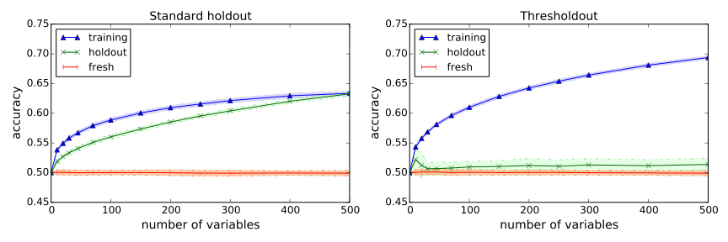
Classification after feature selection
No signal: data are random gaussians
labels are drawn independently at random from {-1,1}
Thresholdout correctly detects overfitting!

Slide 39
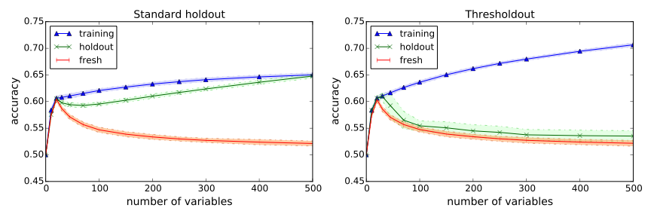
Classification after feature selection
Strong signal: 20 features are mildly correlated with target
remaining attributes are uncorrelated
Thresholdout correctly detects right model size!

Slide 40
Thanks!

Slide 41
Adaptive Data Analysis Bibliography
Differential Privacy and Low Sensitivity Statistics:
[DFHPRR15] Dwork, Feldman, Hardt, Pitassi, Reingold, Roth, “Preserving Statistical Validity in Adaptive Data Analysis”, STOC 2015.
[BNSSSU16] Bassily, Nissim, Stemmer, Smith, Steinke, Ullman, “Algorithmic Stability for Adaptive Data Analysis”, STOC 2016.
Occam Bounds and Differential Privacy Control Arbitrary Dependencies:
[DFHPRR15b] Dwork, Feldman, Hardt, Pitassi, Reingold, Roth, “Generalization in Adaptive Data Analysis and Holdout Reuse”, NIPS 2015.
[RRST16] Rogers, Roth, Smith, Thakkar, “Max Information, Differential Privacy, and Post-Selection Hypothesis Testing”, FOCS 2016.
Holdout Reuse:
[DFHPRR15c] Dwork, Feldman, Hardt, Pitassi, Reingold, Roth, “The Reusable Holdout: Preserving Validity in Adaptive Data Analysis”, Science, August 7 2015.
[BH15] Blum, Hardt, “The Ladder: A Reliable Leaderboard for Machine Learning Competitions”, ICML 2015.

Slide 42
Adaptive Data Analysis Bibliography
Sample Compression Schemes and Adaptive Learning:
[CLNRW16] Cummings, Ligett, Nissim, Roth, Wu, “Adaptive Learning with Robust Generalization Guarantees”, COLT 2016.
Mutual Information and Adaptive Data Analysis:
[Ala15] Alabdulmohsin, “Algorithmic Stability and Uniform Generalization”, NIPS 2015.
[RZ16] Russo, Zou, “Controlling Bias in Adaptive Data Analysis Using Information Theory”, AISTATS 2016.
Computational and Statistical Lower Bounds:
[HU14] Hardt, Ullman, “Preventing False Discovery in Interactive Data Analysis is Hard”, FOCS 2014.
[SU15] Steinke, Ullman, “Interactive Fingerprinting Codes and the Hardness of Preventing False Discovery”, COLT 2015.
[WLF16] Wang, Lei, Feinberg, “A Minimax Theory for Adaptive Data Analysis”, 2016.

Slide 43
Adaptive Data Analysis Bibliography
Bayesian Approaches
[Eld16] Elder, “Challenges in Bayesian Adaptive Data Analysis”, 2016.
Privacy Composition Theorems for Adaptive Data Analysis
[RRUV16] Rogers, Roth, Ullman, Vadhan, “Privacy Odometers and Filters: Pay as you Go Composition”, NIPS 2016.
Large Statistical Literature on Post Selection Inference (Tiny Sample)
[BBBZZ13] Berk, Brown, Buja, Zhang, Zhao, “Valid Post Selection Inference”, Annals of Statistics, 2013.
[Efr14] Efron, “Estimation and Accuracy After Model Selection”, JASA 2014.
[FST14] Fithian, Sun, Taylor, “Optimal Inference After Model Selection”, 2014.
[TT15] Tian, Taylor, “Selective Inference with a Randomized Response”, 2015.
[BC16] Barber, Candes, “A Knockoff Filter for High Dimensional Selective Inference”, 2016.

Slide 44
Adaptive Data Analysis Bibliography
Differential Privacy
[DMNS06] Dwork, McSherry, Nissim, Smith, “Calibrating Noise to Sensitivity in Private Data Analysis”, TCC 2006.
[DRV10] Dwork, Rothblum, Vadhan, “Boosting and Differential Privacy”, FOCS 2010.
[HR10] Hardt, Rothblum, “A Multiplicative Weights Mechanism for Privacy Preserving Data Analysis”, FOCS 2010.

