Slide 1
Propositional Proof Complexity: Fifteen (or so) Years After
Alexander A. Razborov
University of Chicago
Steklov Mathematical Institute
IAS, Avi is 60 conference, October 5, 2016

Slide 2
Subtitle: on my (and others’) largely unsuccessful attempts to make Avi work in proof complexity
In 2000-2001, we are holding a Special Year on Computational Complexity!
Disclaimer: this is not even an attempt at a coherent survey on proof complexity, see my article in SIGACT News, 47(2), 2016 (not that that one is comprehensive, either).

Slide 3
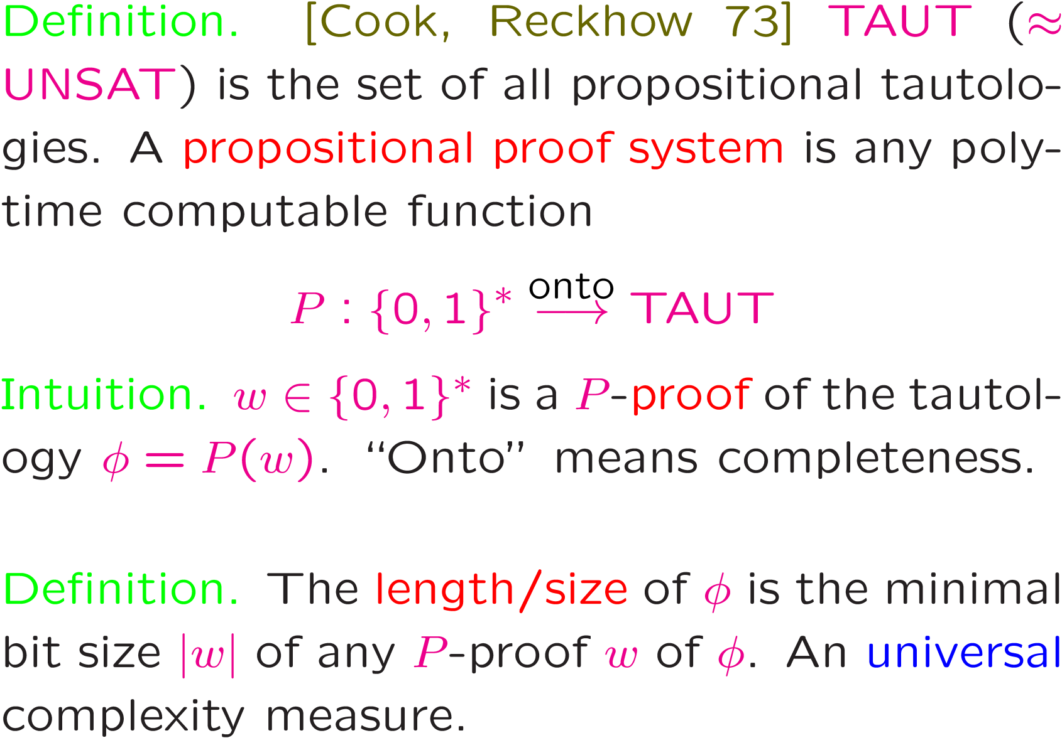
Basic Definitions

Slide 4
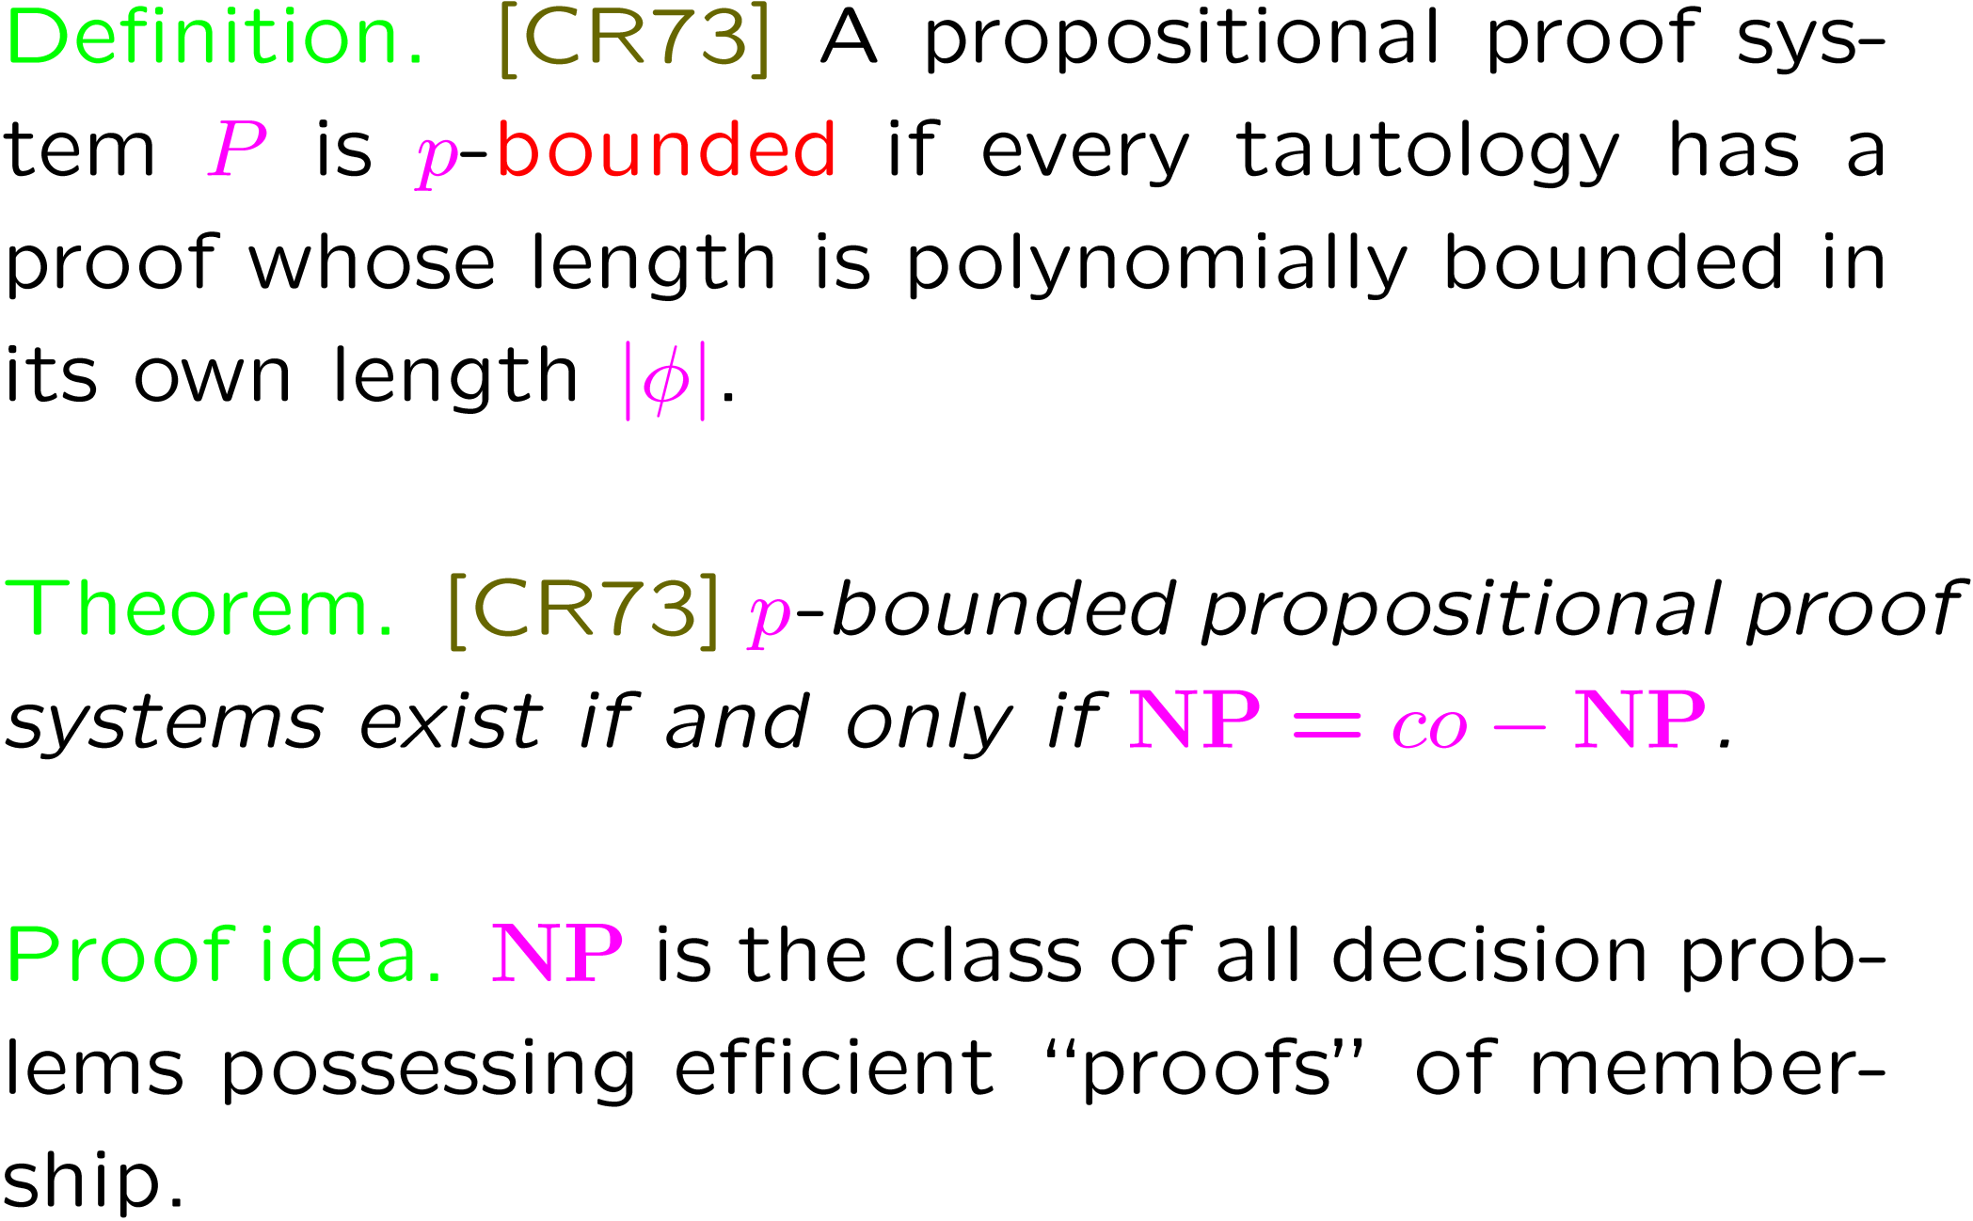

Slide 5
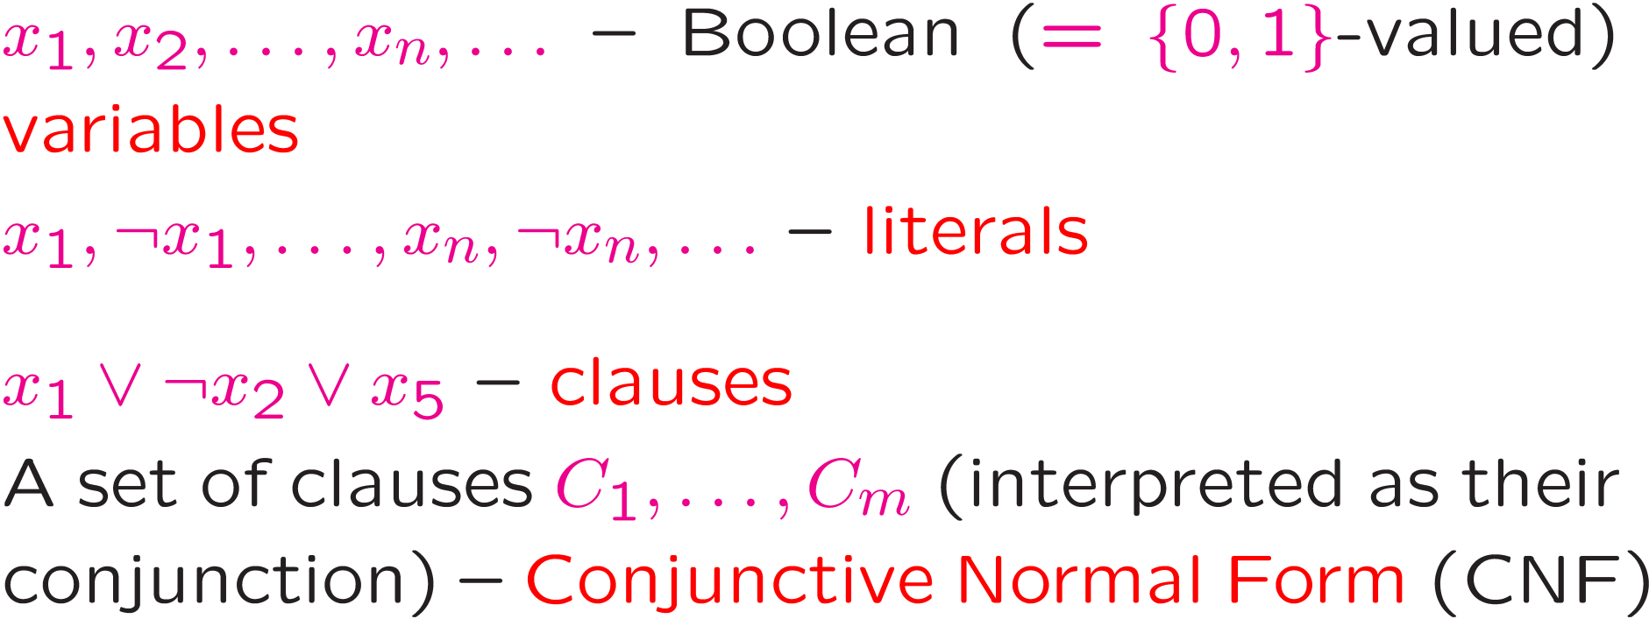
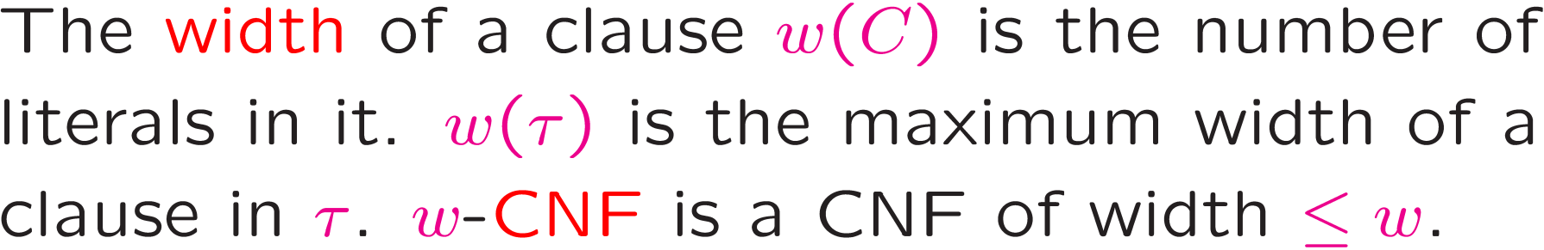
Some terminology

Slide 6
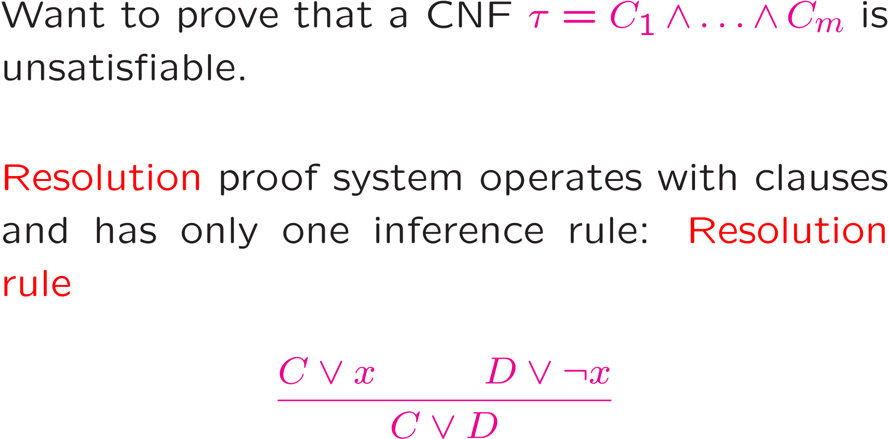
Resolution proof system

Slide 7
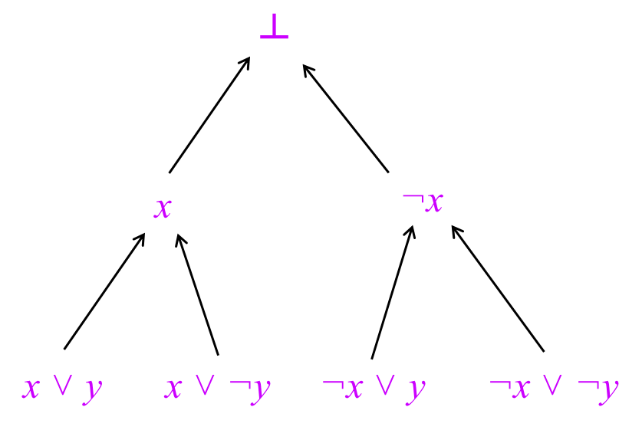
Two ways to present proofs
(paper vs. whiteboard)
Sequential, Hilbert-style, DAG-like proofs are just like Boolean circuits: a sequence of “lemmas” resulting in the contradiction.
Tree-like proofs are like Boolean formulas.

Slide 8
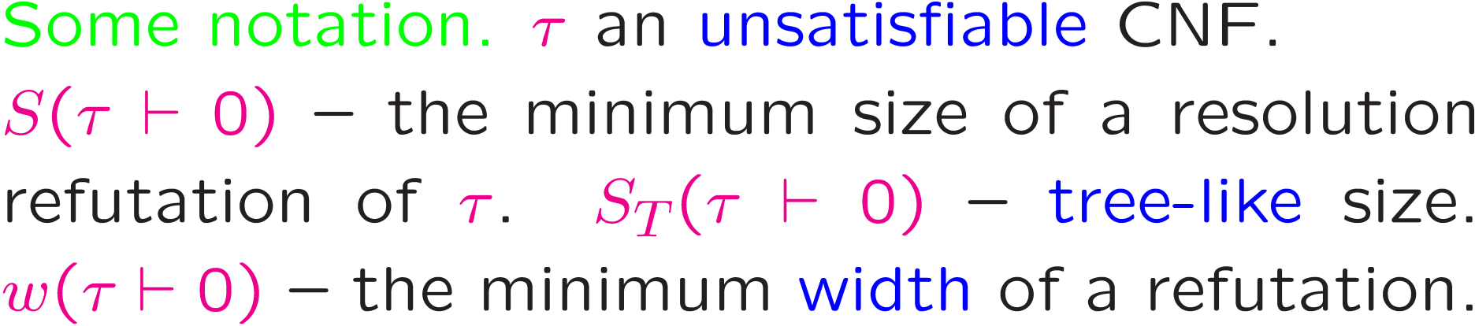

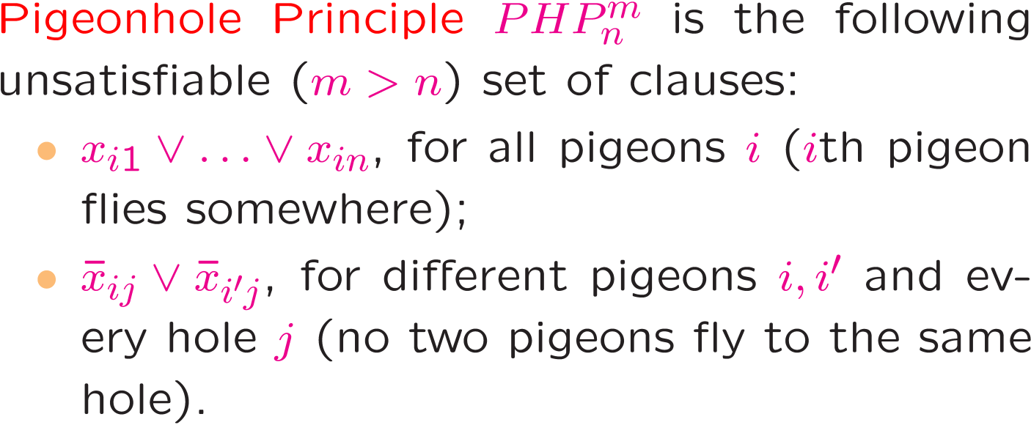
Some (combinatorial) principles
2
i
1
m
x_{ij}
j
1
n

Slide 9
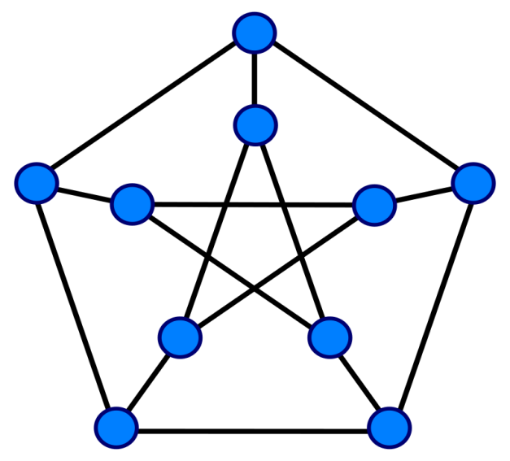
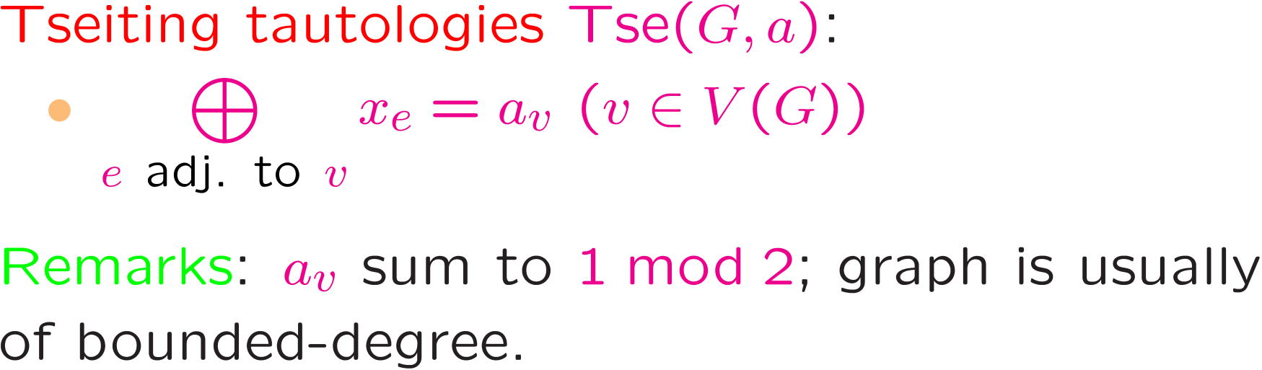
Tseitin tautologies: quintessence of modular counting.
x_{e}
v

Slide 10
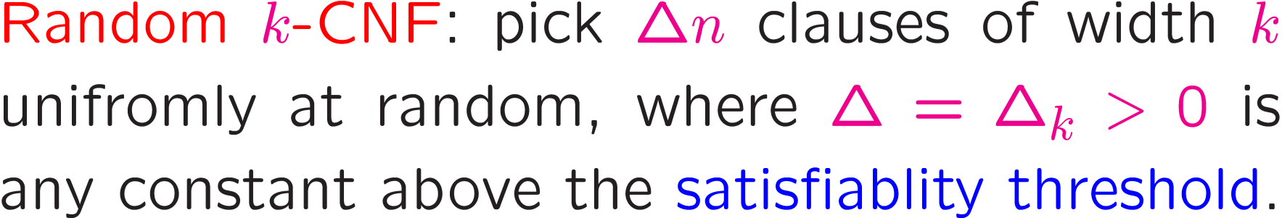
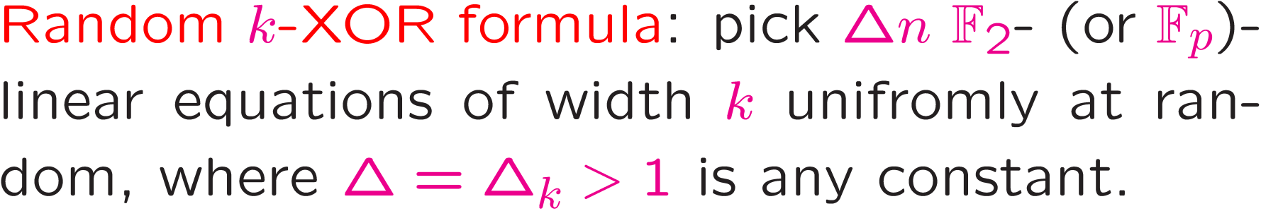
Random tautologies

Slide 11
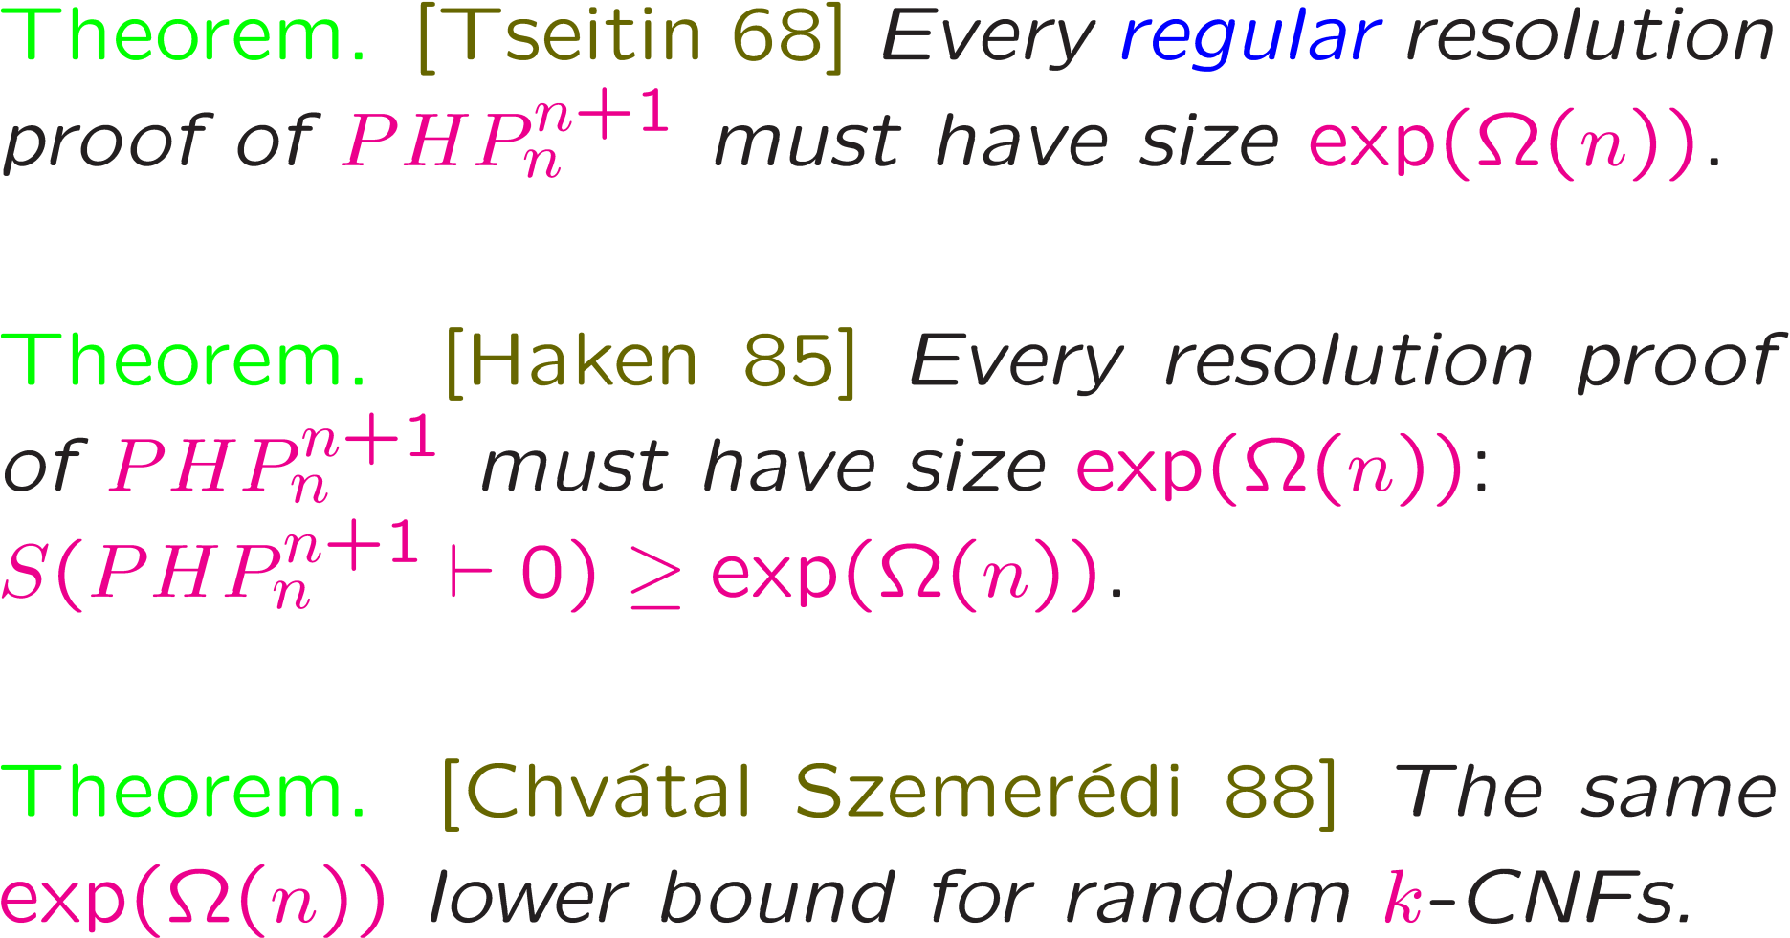
Early results…

Slide 12
And early attempts at a general theory.
[Beame Pitassi 96]: width lower bounds often imply strong size lower bounds. Simplified and improved proofs of some results on the previous slide.
[Clegg Edmonds Impagliazzio 96]: degree lower bounds (in polynomial calculus) always imply strong size lower bounds.

Slide 13
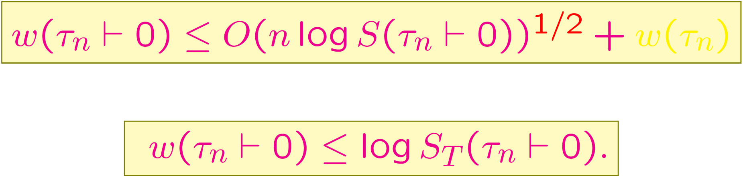
Width-size relation
[Ben-Sasson Wigderson 01]: width lower bounds always imply strong size lower bounds.
Linear lower bounds on width ➔ exponential lower bounds on size.

Slide 14
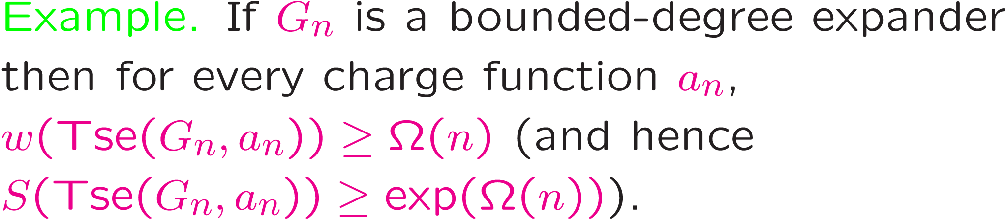
Width bounds from expansion
[Ben-Sasson Wigderson 01], ad hoc in previous papers
Sub-additive complexity measures in proof complexity.
The only general method for proving resolution lower bounds even today.

Slide 15
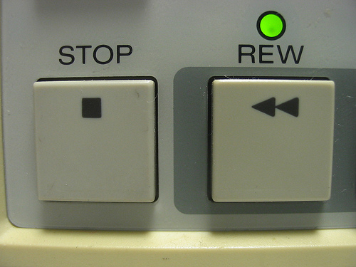

Other messages from [BW01]
It is not out of the question that proof-complexity measures can be non-trivially related to each other.
Width (and width-like) measures, while seemingly weak, are quite important to study.
Expansion, expansion and a bit more of expansion…

Slide 16
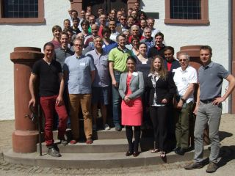
Practical SAT Solving and Proof Complexity
It is well-known that practitioners solve NP-complete problems at the snap of their fingers.
They are as deeply perplexed by this fact as
theoreticians, and both sides are actively looking
for theoretical explanations of this phenomenon.

Slide 17
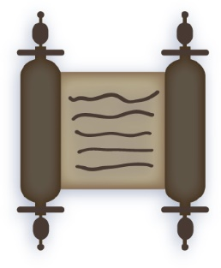
General Paradigm
SAT solver
Underlying proof system
Rigorous proof that τ is unsatisfiable
Satisfiable formula
Unsatisfiable formula τ

Slide 18
DPLL Solvers: the basic engine
φ (a CNF)
splitting rule
branching literal
φ|_{x=0}
φ|_{x=1}
φ|_{x=0, y=0}
φ|_{x=0, y=1}
φ|_{x=1, z=0}
φ|_{x=1, z=1}
CDCL (conflict-driven clause learning) solvers: the golden standard today

Slide 19
Tree-Like vs. DAG
z
┴
x
¬x
x ˅ z
x ˅ y
x ˅ ¬y
¬x ˅ y
¬x ˅ ¬y

Slide 20
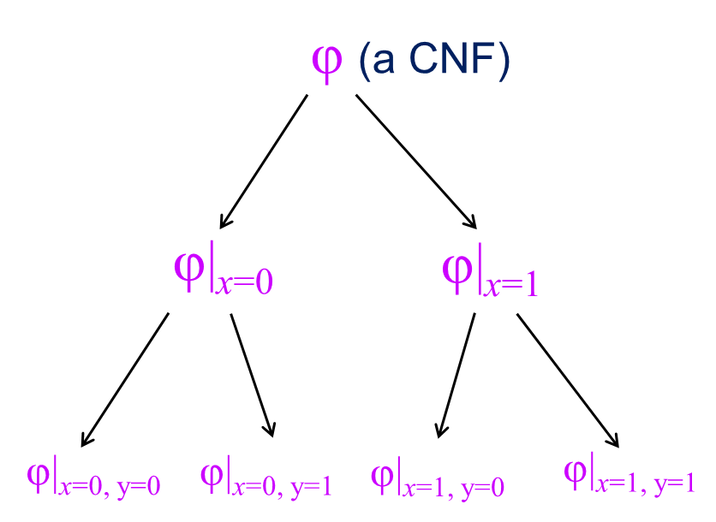
DPLL = Tree-Like Resolution

Slide 21


Unit propagation and clause learning
Unit propagation

Slide 22
Conflict-driven clause learning = highly structured and highly engineered approach to building up general resolution refutations.
Theorem [Beame Kautz Sabharwal 04] Under some technical restrictions on CDCL, it can polynomially simulate general resolution.
Engineering part: branching heuristics? What are good clauses to learn? Do we keep them indefinitely or dispose of some of them? Backtracking and restarts Etc.
Great demand for theoretical explanations

Slide 23
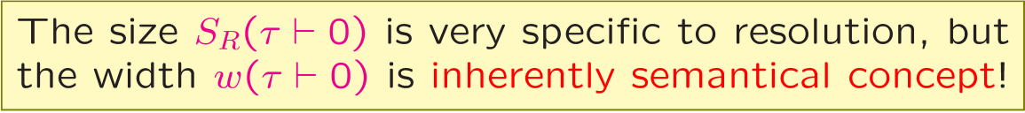
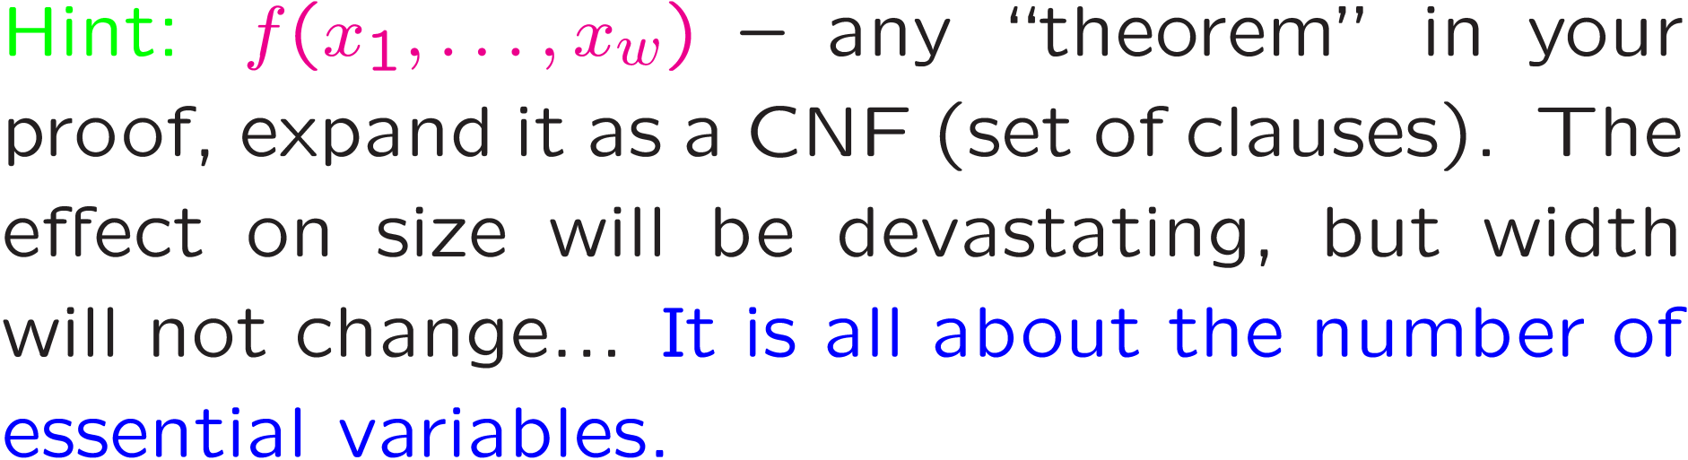
The life of width (and its family)
Paradigm: every low ``width’’ proof must be ``natural’’ (in the primitive sense).

Slide 24
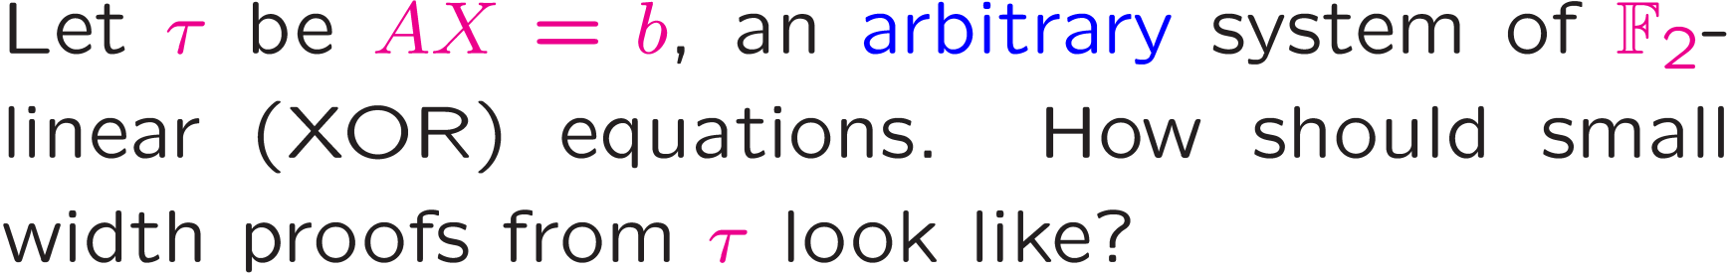
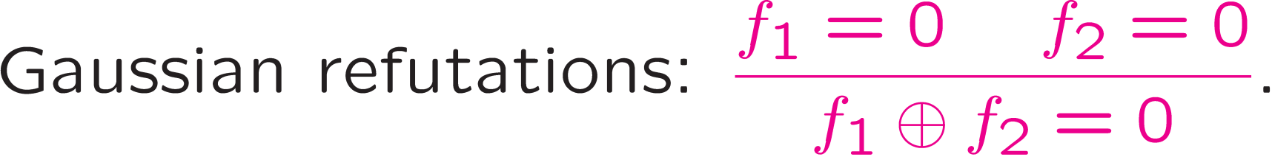
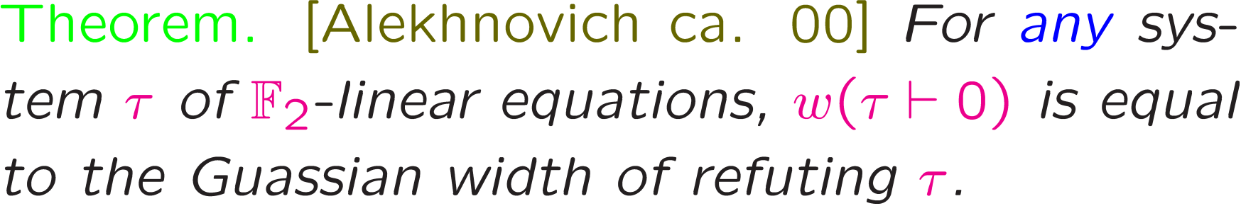
Gaussian Width
[Alekhnovich]

Slide 25
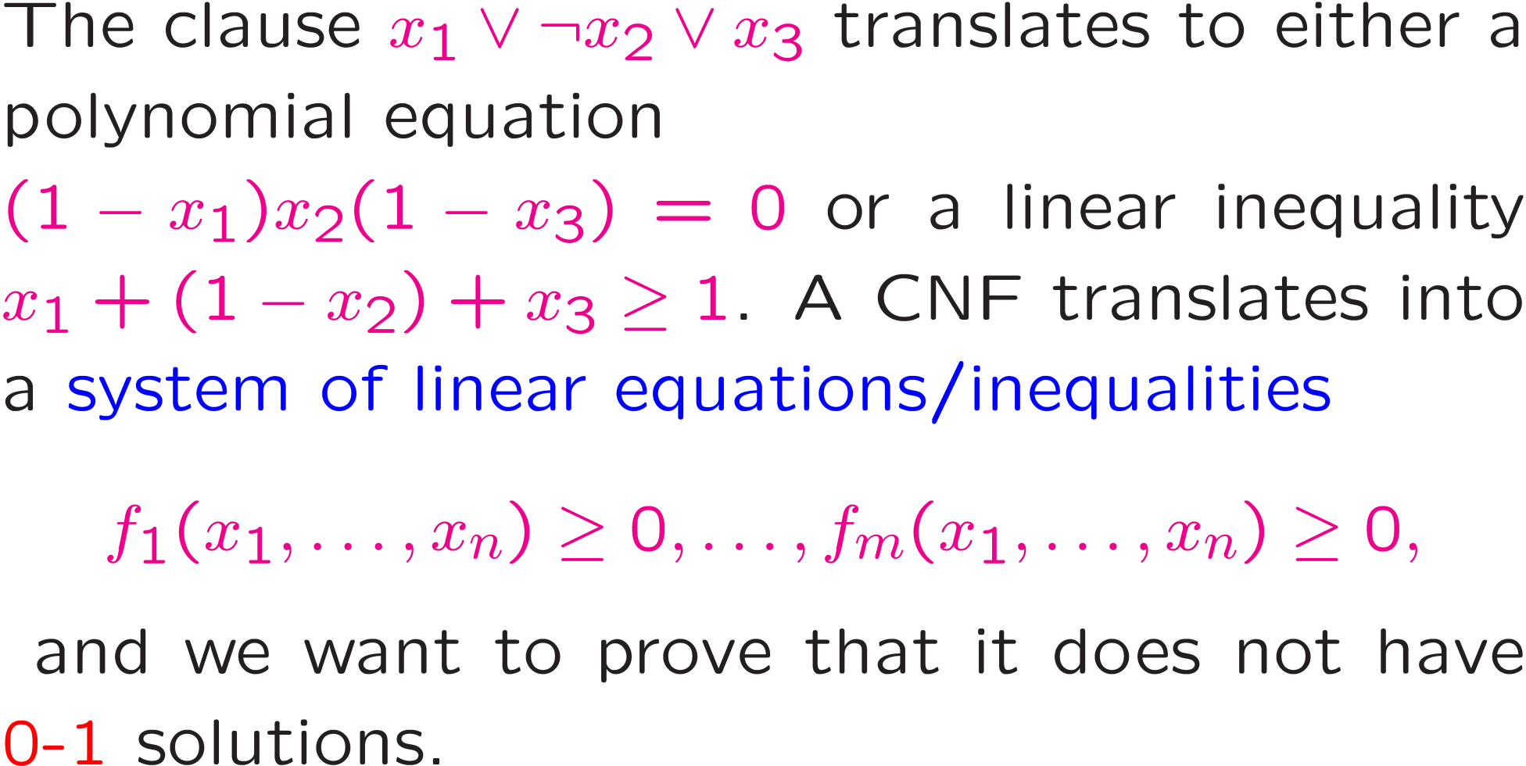
Translation to algebraic/semi-algebraic proof systems

Slide 26
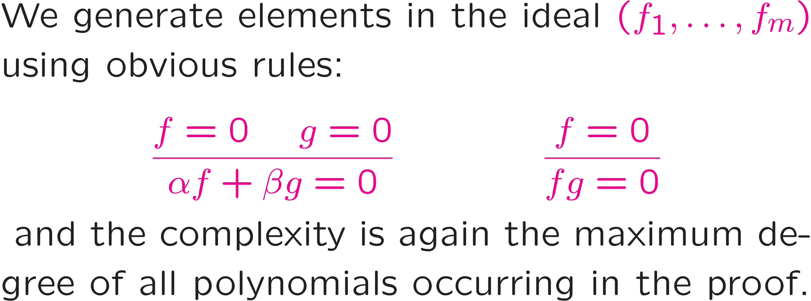
Polynomial Calculus
[Clegg Edmonds Impagliazzo 96]
``Efficient’’ = constant-degree.

Slide 27
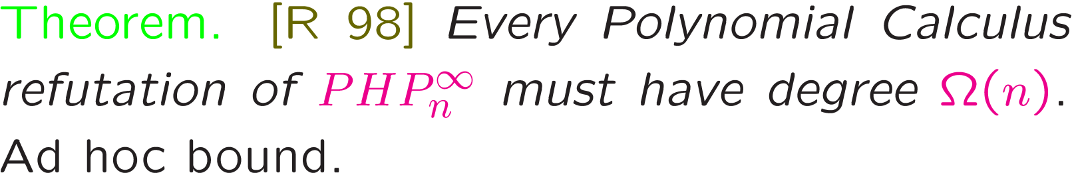
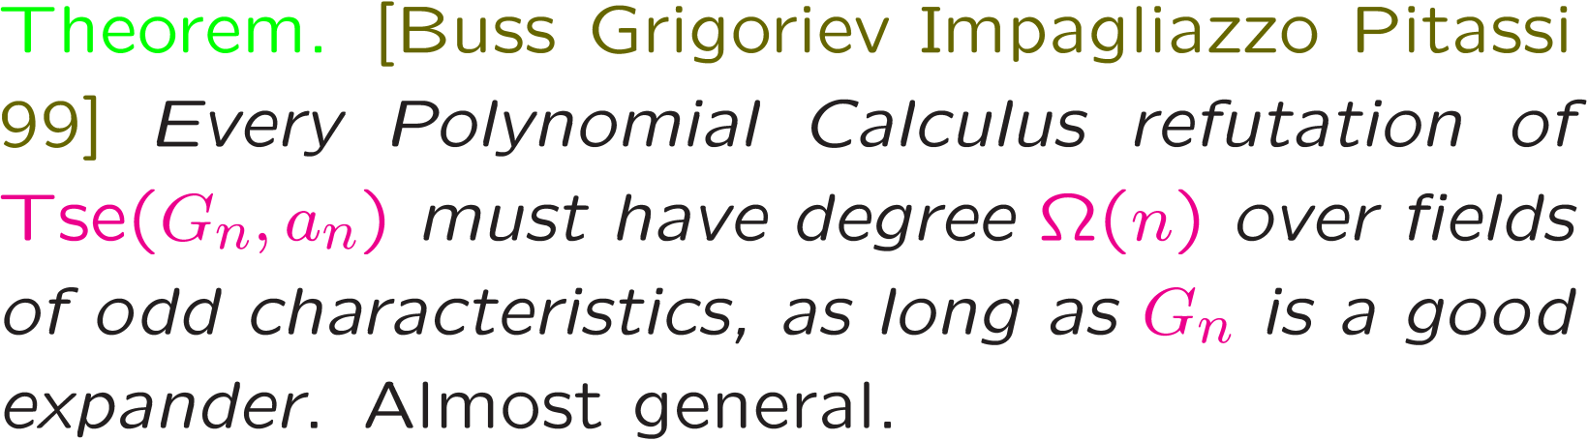
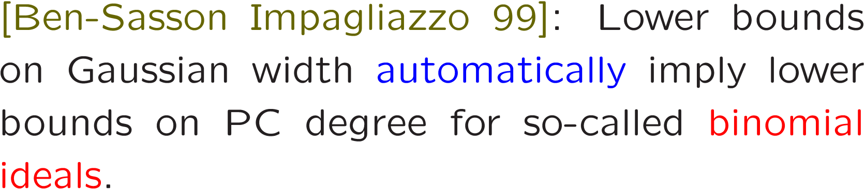

Slide 28
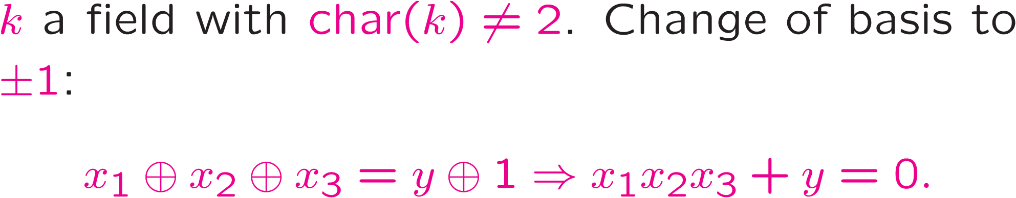
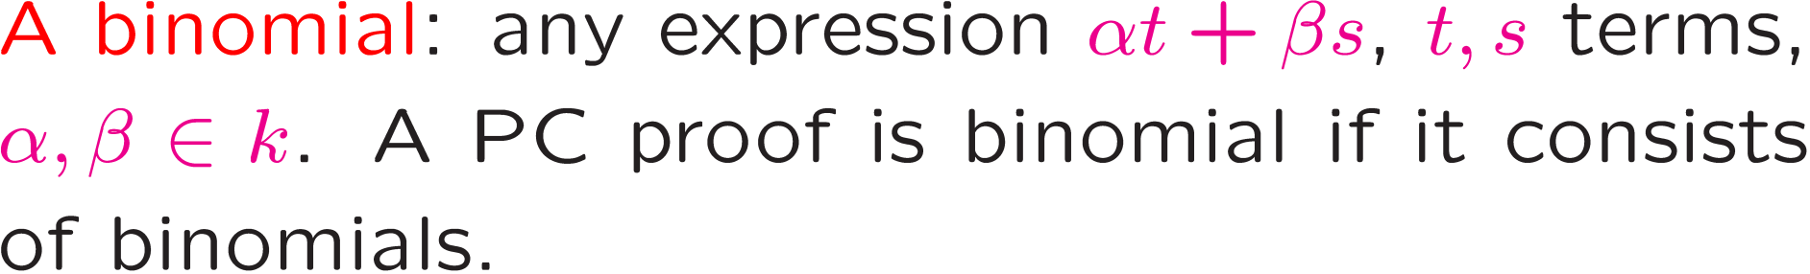
Binomial Proofs
[Buss Grigoriev Impagliazzo Pitassi 99, Ben-Sasson Impagliazzo 99]: Any PC proof from binomial axioms can be converted into a binomial form.

Slide 29
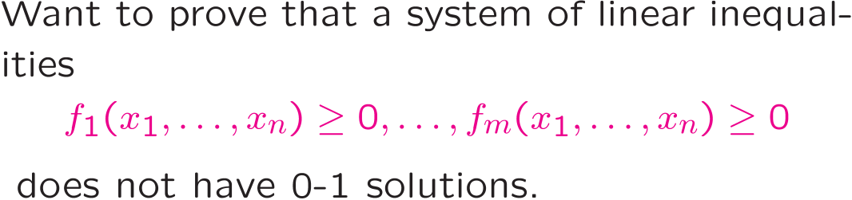
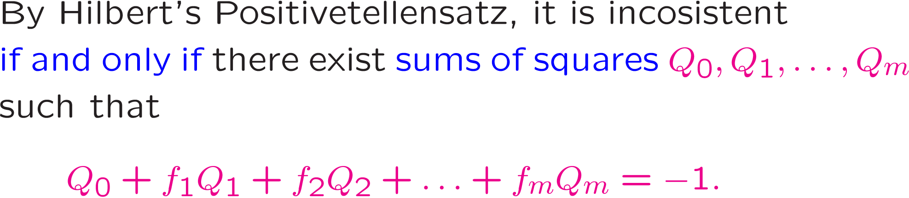
Positivestellensatz Proof System (aka Lassierre hierarchy aka Sum-of-Squares)

Slide 30
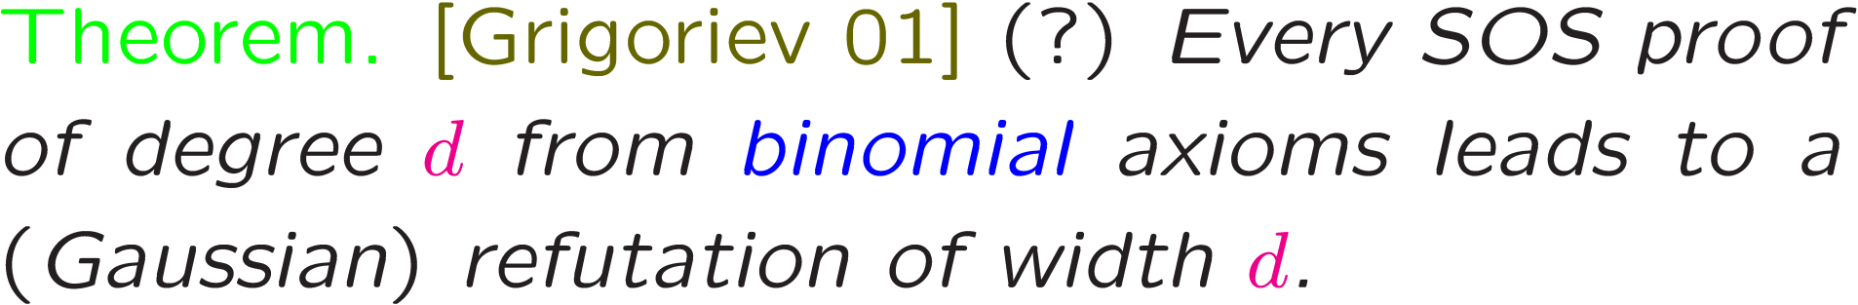
His proof is algebraic in nature (studying cancellations) and, as a result, is applicable in rigidly defined situations like Tseitin tautologies…
That can be alleviated a bit via reductions [Schoenebeck 08, Tulsiani 09]…
… and in any case, for a rather long time since the SOS renaissance started, it was the only lower bound technique available.

Slide 31
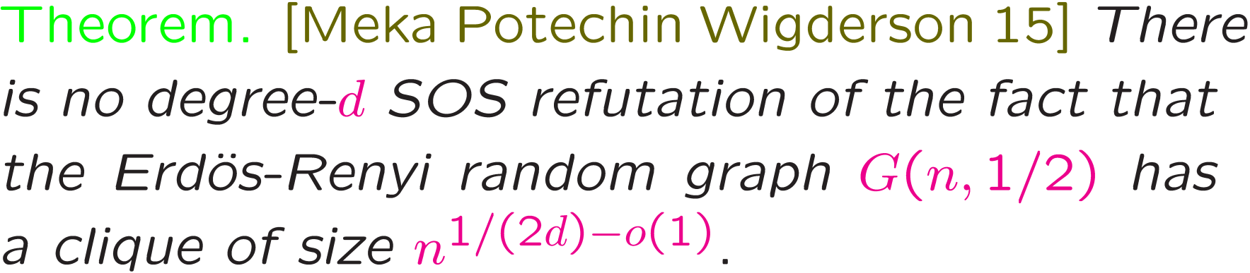
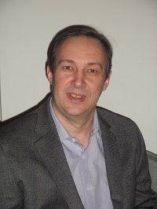
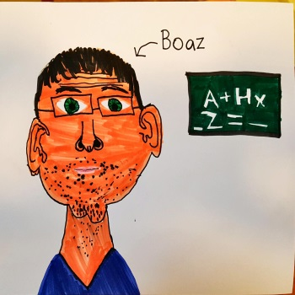
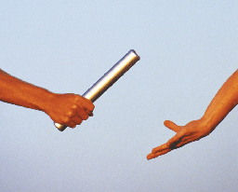
Analytical (SDP-friendly) methods of proving SOS lower bounds
Based on constructing a tangible ``harndess certificate’’: protection matrices, pseudo-distributions etc.

Slide 32
Supercritical tradeoffs
Ultimate tradeoffs
History of tradeoff results goes back (at least) to the 70s.
Reflect our inherent inability to achieve two conflicting tasks at once.
Originally: time-space. Now: literally anything.
T a task. P_{T} a set of protocols achieving this task.
μ and ν – two complexity measures on P_{T}.

Slide 33

Examples:
Algorithms: μ = SPACE and ν = TIME.
Resolution: μ = WIDTH and ν = SIZE.
μ
μ_{min}
μ_{max}

Slide 34
T ϵ T_{n} , the class of all problems of size n. ν_{cr}(n) –
the “obvious” upper bound (2^{n} in our examples).
Supercritical tradeoff
ν_{cr}(n)
μ
μ_{min}
μ_{max}

Slide 35
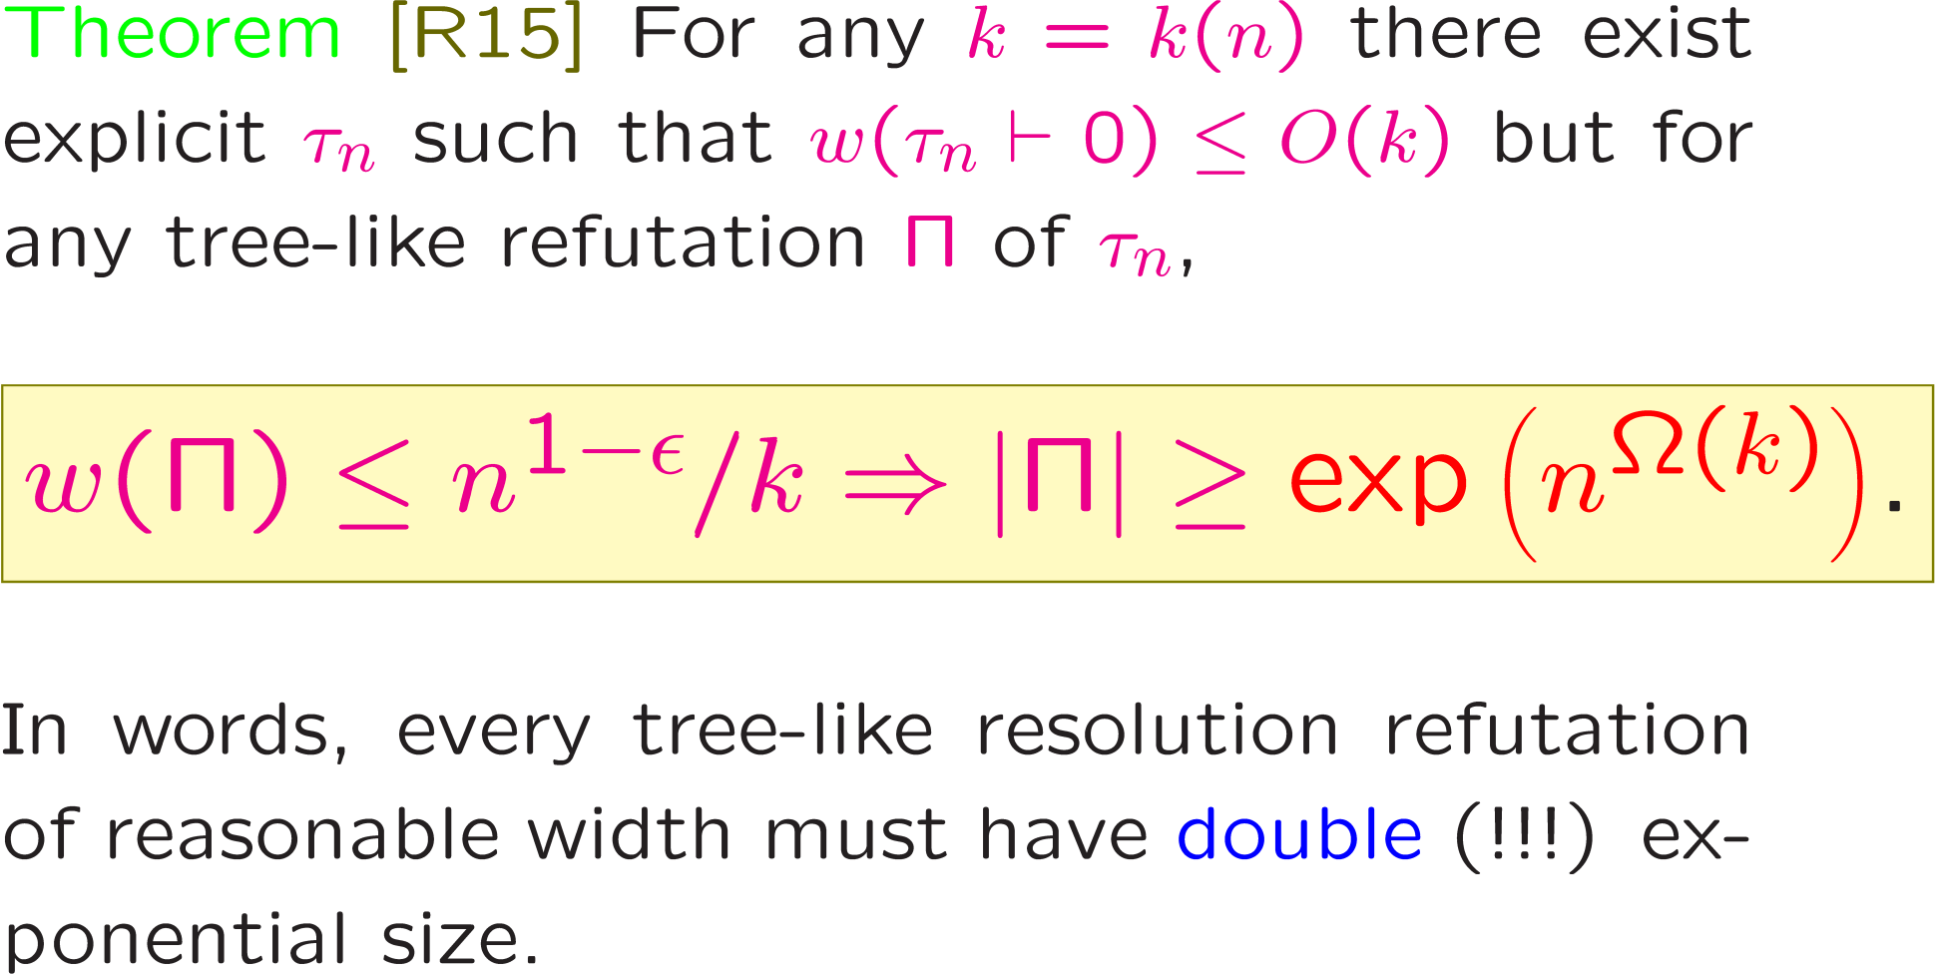
Further examples of this phenomenon: [Berkholz Nordström 16]

Slide 36
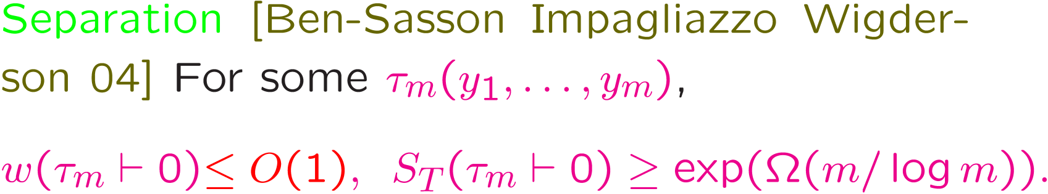
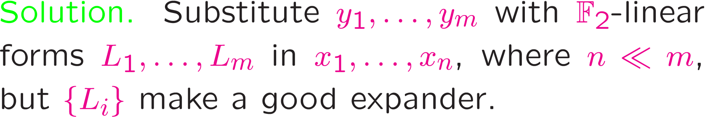
Proof idea: apply expansion for variable compression.
Buzz words: convert separation into ultimate tradeoff
using hardness compression.

Slide 37
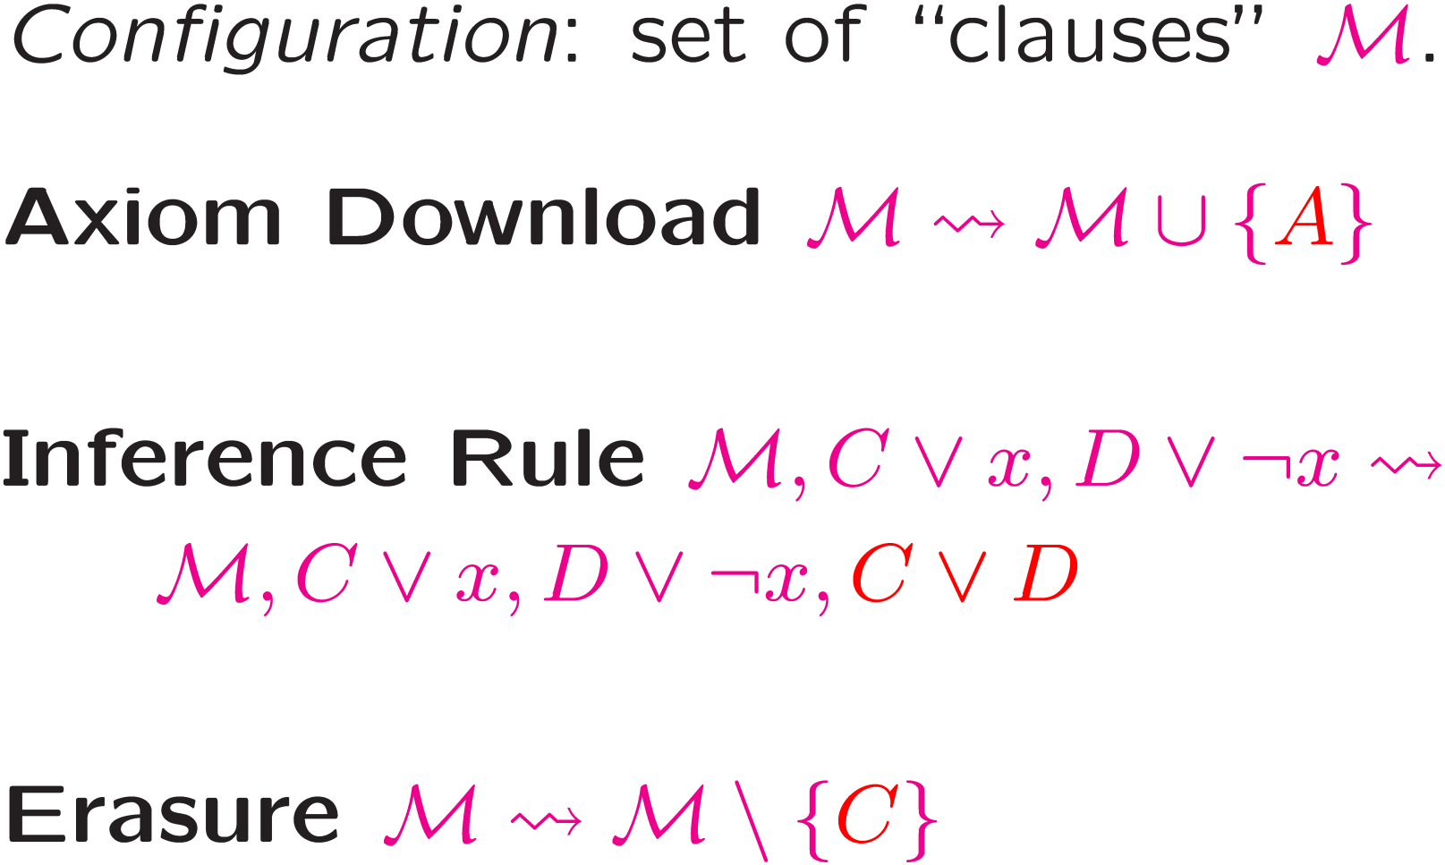
Space: what and when to keep on the whiteboard?
[Esteban Toran 99; Alekhnovich Ben-Sasson R. Wigderson 01]
Notes:
Resolution only, say a few words about more general situation.

Slide 38
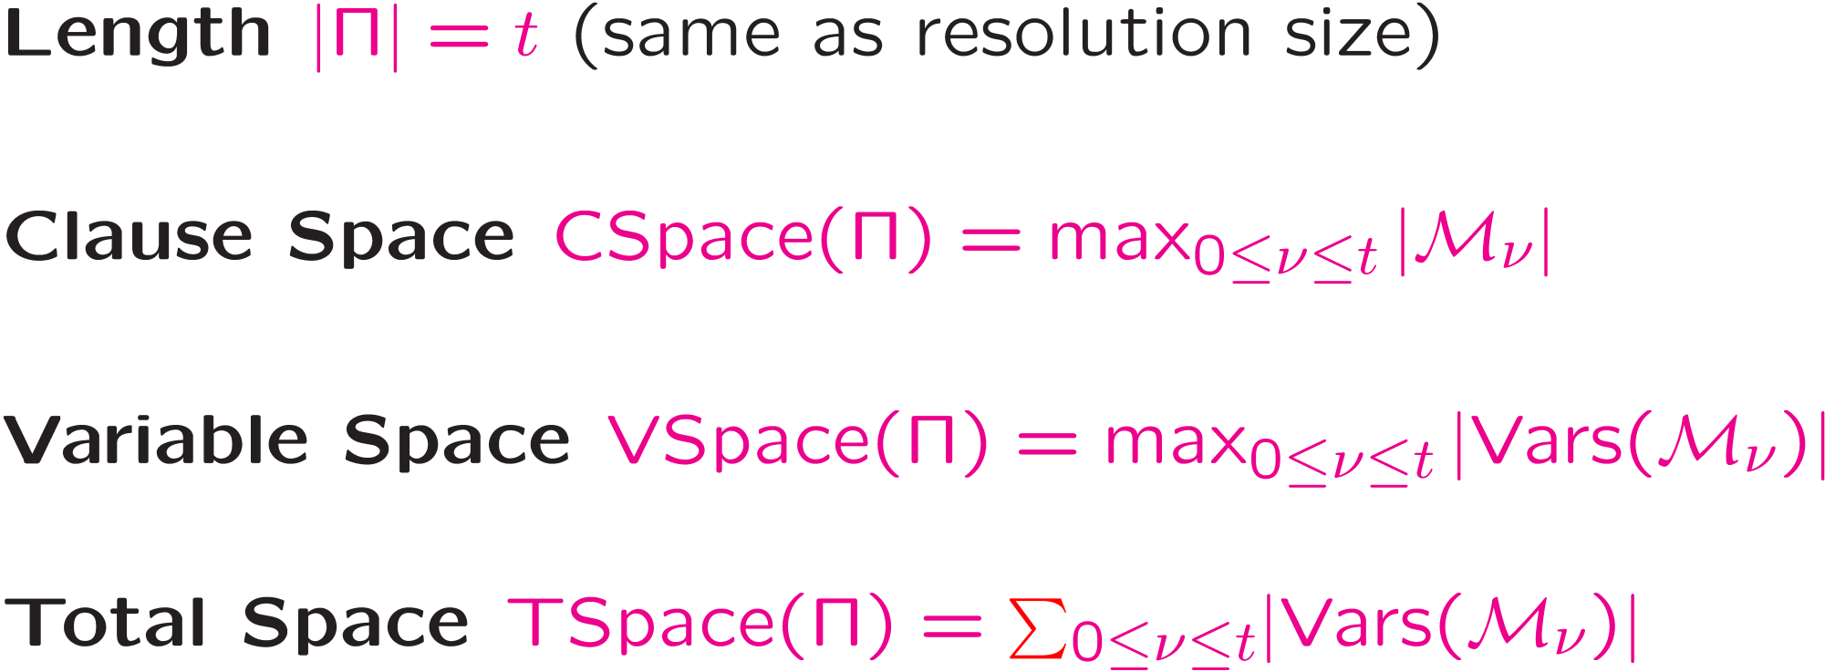

Slide 39
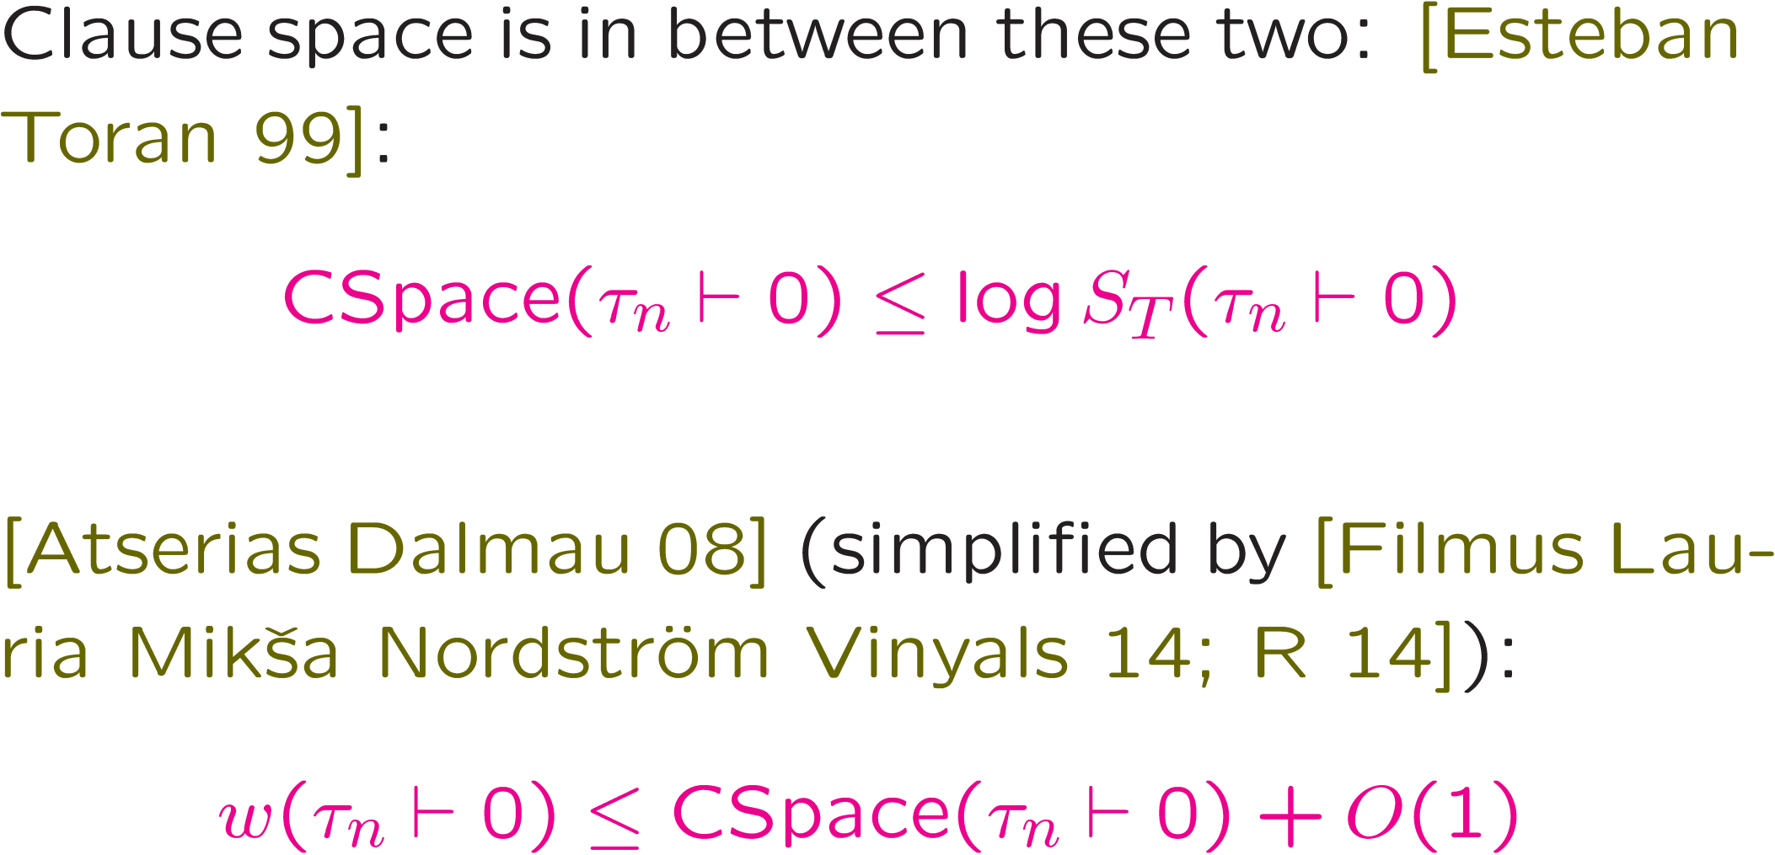
Clause Space vs. Size/Length

Slide 40
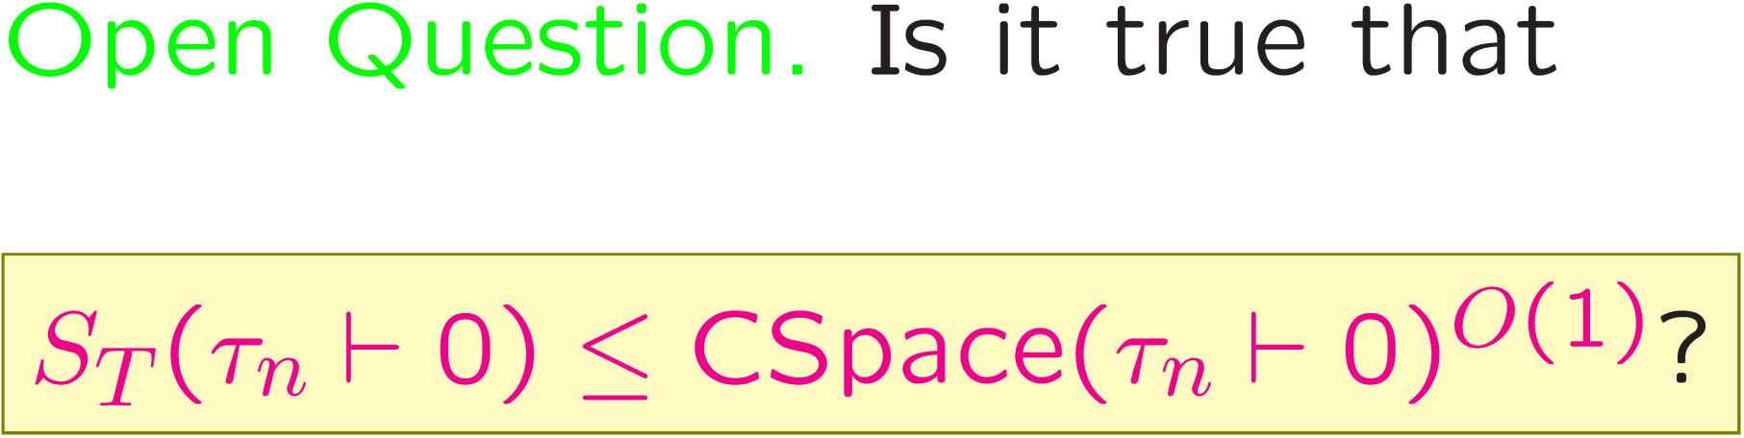
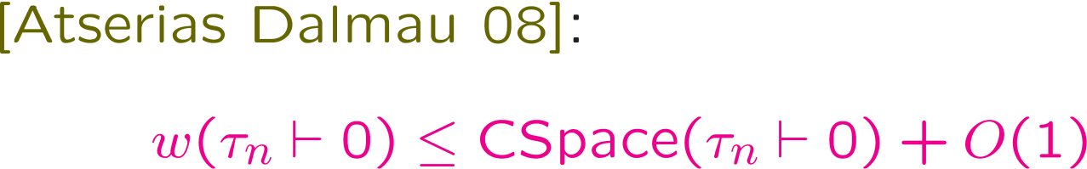
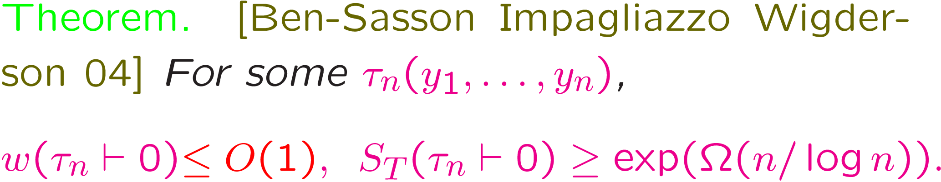
Notes:
We do not really understand space.

Slide 41
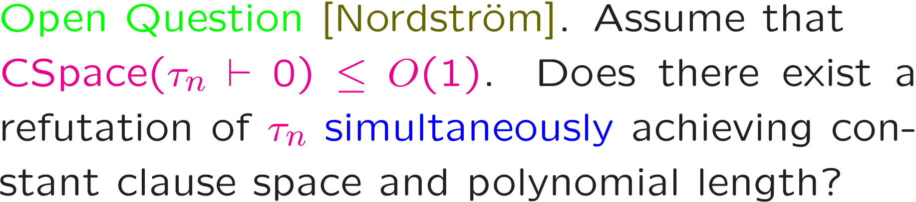
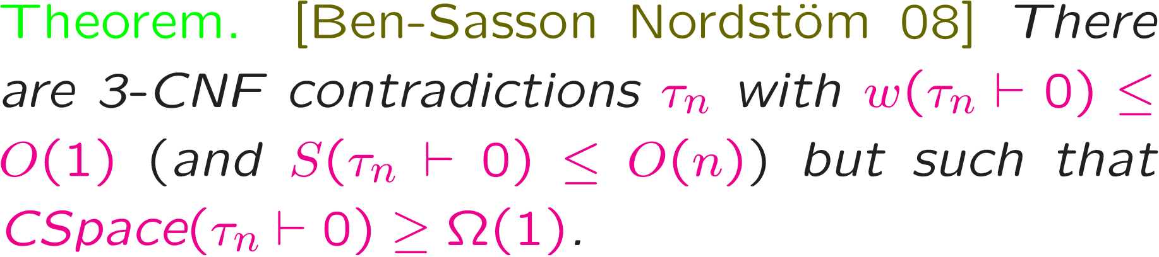

Slide 42
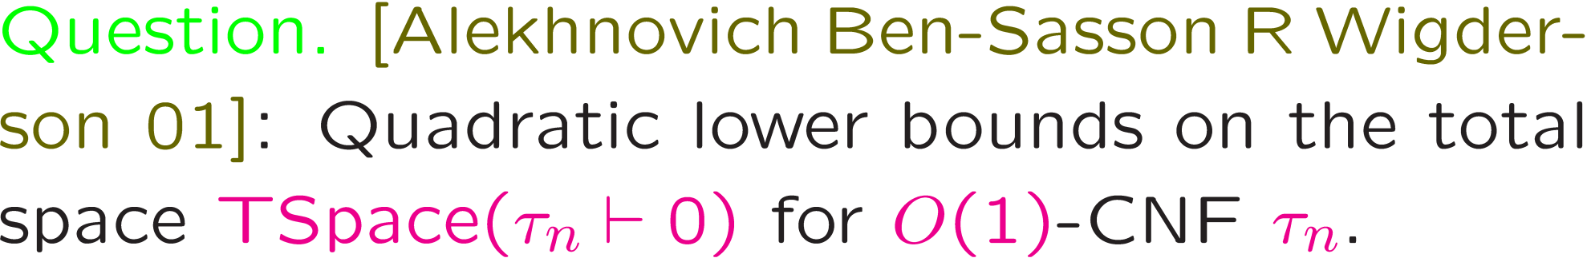



Slide 43

Problem. Lower bounds for (Extended) Frege
modulo any “reasonable” complexity or cryptographic assumption.
Natural proofs [R, Rudich 95] provide a conclusive realization of this hope in a not so dissimilar context, and the other part works perfectly.
[Alekhnovich Ben-Sasson R Wigderson 01]: pseudo-random generators in proof complexity as an approach.
Got stuck, and not clear why, given natural proofs.

Slide 44
Pseudorandom Generators in Proof Complexity
[Alekhnovich, Ben-Sasson, Razborov, Wigderson 01; Krajicek 01]
b
{0,1}^{m}
m ≫ n
{0,1}^{n}

Slide 45
Nisan-Wigderson generator: very popular and important type in computational complexity expressly based upon the idea of locality.
Some results for weak systems mentioned (and not) above are based on this generator…
But we can not even do resolution without tweaks.
[R 15]: Pseudorandom Generators Hard for k-DNF Resolution and Polynomial Calculus Resolution, Ann. of Math., Vol. 181, No 2, 2015, pages 415-472

Slide 46



Limitations of the width-size relation

Slide 47


… and conjectural…
Small Clique Problem

Slide 48

Happy Birtdhay, Avi!

