Slide 1
General Strong Polarization
Madhu Sudan
Harvard University
Joint work with Jaroslaw Blasiok (Harvard), Venkatesan Gurswami (CMU), Preetum Nakkiran (Harvard) and Atri Rudra (Buffalo)

Slide 2

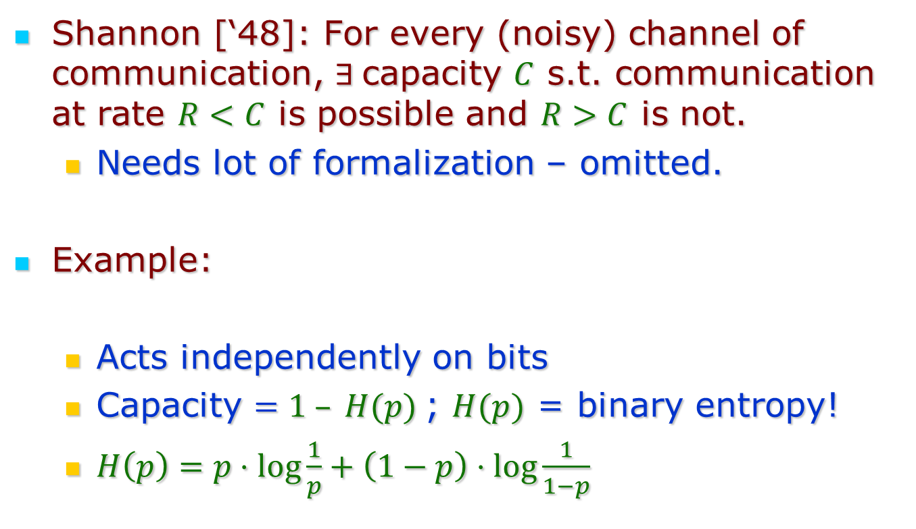



Shannon and Channel Capacity
Shannon [‘48]: For every (noisy) channel of communication, $∃$capacity $C$ s.t. communication at rate $R<C$ is possible and $R>C$ is not.
Needs lot of formalization – omitted.
Example:
Acts independently on bits
Capacity $=1 – H(p)$; $H(p)$ = binary entropy!
$H\left(p\right)=p⋅\log{\frac{1}{p}}+\left(1−p\right)⋅\log{\frac{1}{1−p}}$
$$X∈𝔽_{2}$$
$X$ w.p. $1−p$
$$BSC(p)$$
$1−X$ w.p. $p$

Slide 3
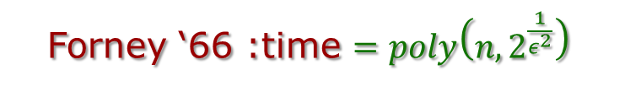
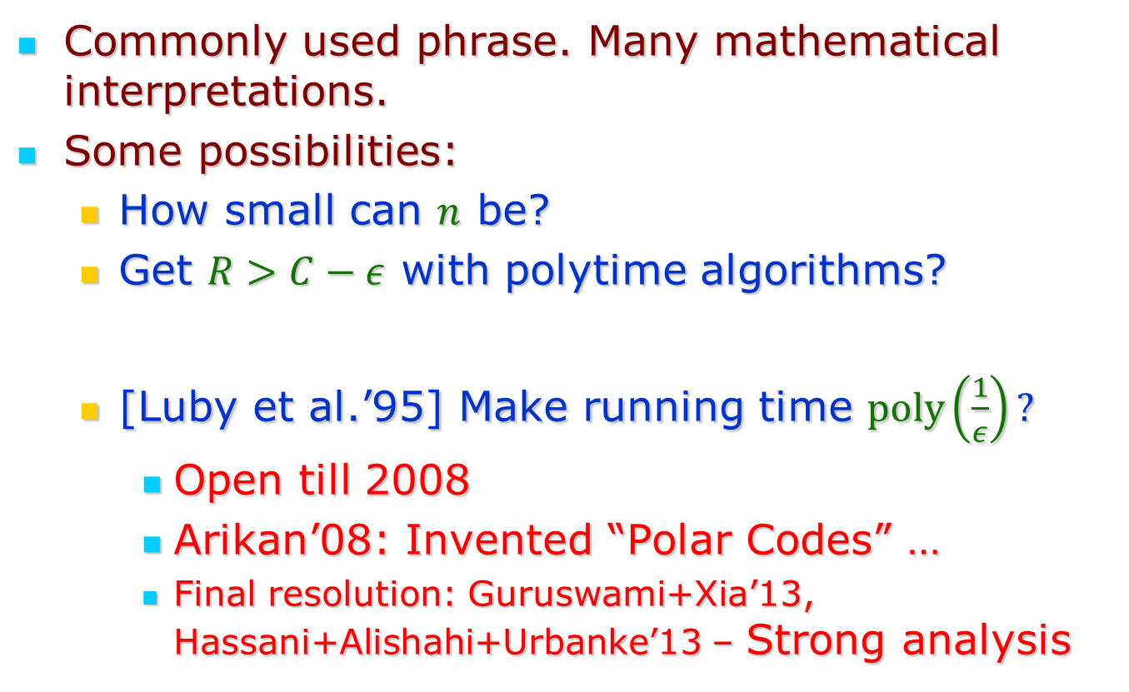

“Achieving” Channel Capacity
Commonly used phrase. Many mathematical interpretations.
Some possibilities:
How small can $n$ be?
Get $R>C−ε$ with polytime algorithms?
[Luby et al.’95] Make running time $poly\left(\frac{1}{ε}\right)?$
Open till 2008
Arikan’08: Invented “Polar Codes” …
Final resolution: Guruswami+Xia’13, Hassani+Alishahi+Urbanke’13 – Strong analysis
Shannon ‘48 : $n=O{\left(C−R\right)}^{−2}$
Forney ‘66 :time $=poly\left(n,2^{\frac{1}{ε^{2}}}\right)$

Slide 4
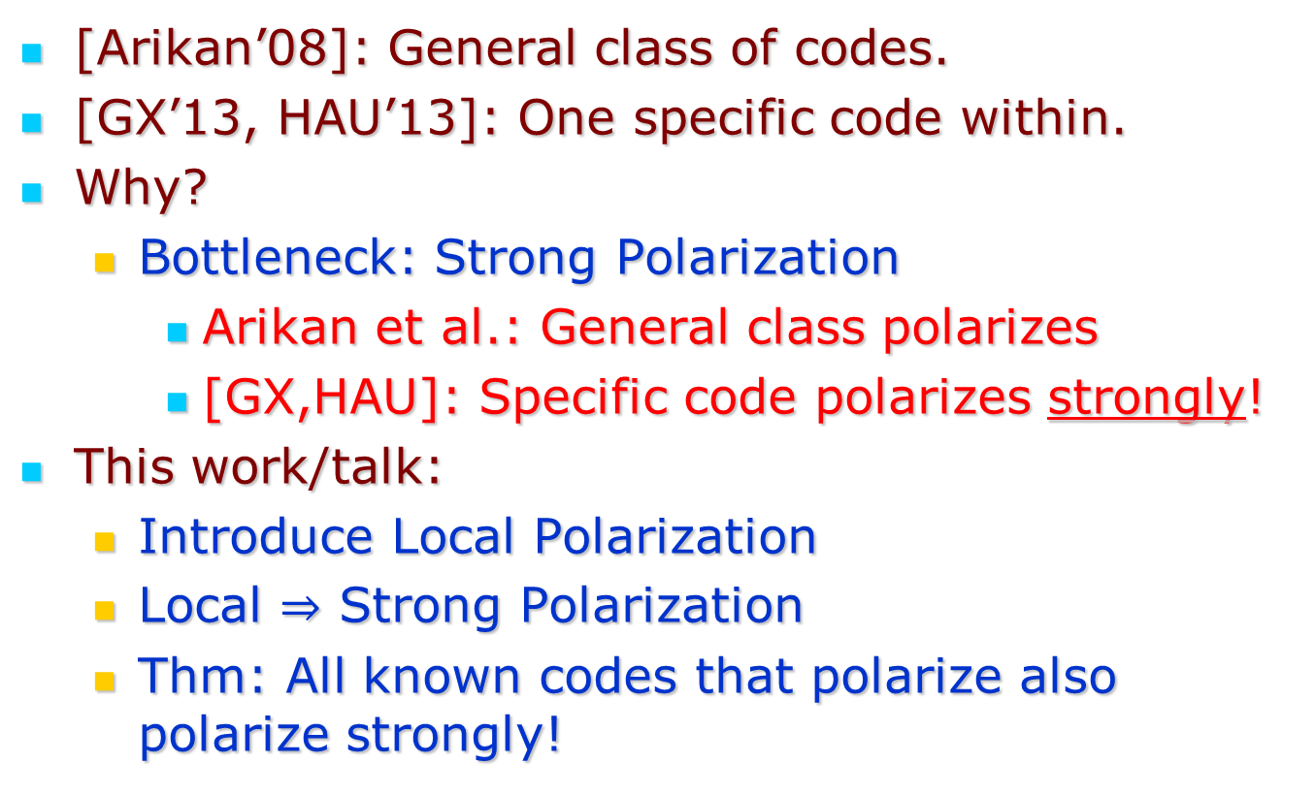
Context for today’s talk
[Arikan’08]: General class of codes.
[GX’13, HAU’13]: One specific code within.
Why?
Bottleneck: Strong Polarization
Arikan et al.: General class polarizes
[GX,HAU]: Specific code polarizes strongly!
This work/talk:
Introduce Local Polarization
Local $⇒$ Strong Polarization
Thm: All known codes that polarize also polarize strongly!

Slide 5
This talk:
What are Polar Codes
“Local vs. Global” (Strong) Polarization
Analysis of Polarization

Slide 6
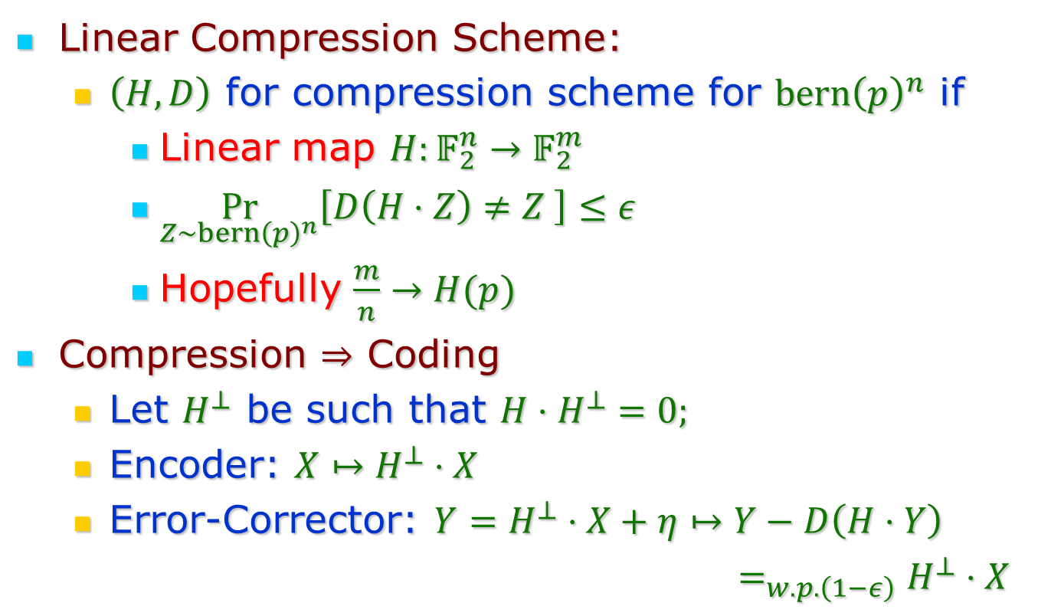
Lesson 0: Compression $⇒$ Coding
Linear Compression Scheme:
$\left(H,D\right)$ for compression scheme for $bern{\left(p\right)}^{n}$ if
Linear map $H:𝔽_{2}^{n}→𝔽_{2}^{m}$
$\underset{Z∼bern{\left(p\right)}^{n}}{Pr}\left[D\left(H⋅Z\right)≠Z \right]≤ε$
Hopefully $\frac{m}{n}→H(p)$
Compression $⇒$ Coding
Let $H^{⊥}$ be such that ${H⋅H}^{⊥}=0;$
Encoder: $X↦H^{⊥}⋅X$
Error-Corrector: $Y=H^{⊥}⋅X+η↦Y−D\left(H⋅Y\right)$
$=_{w.p. \left(1−ε\right)}H^{⊥}⋅X$

Slide 7
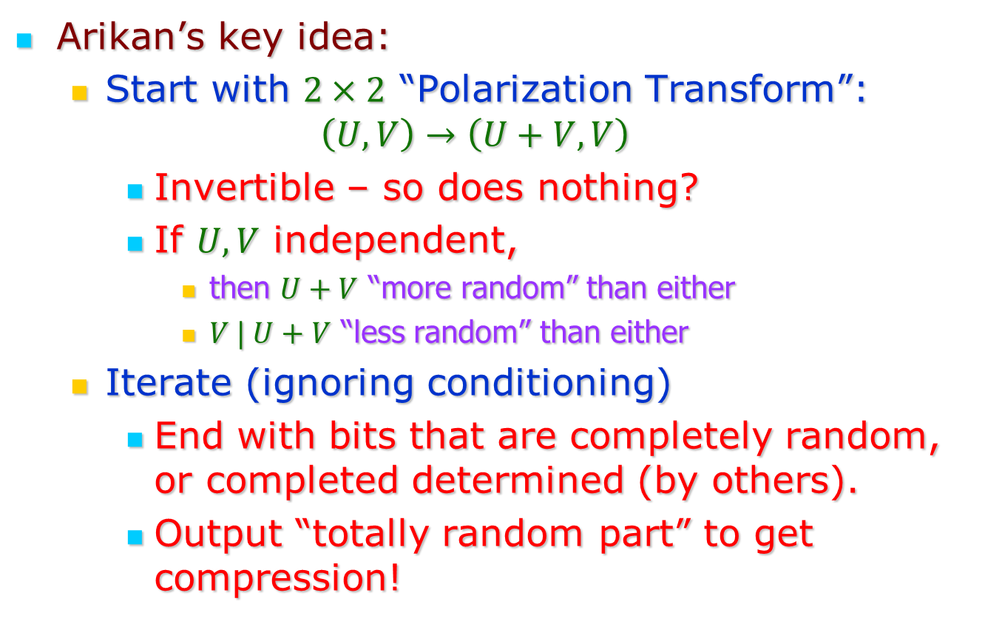
Question: How to compress?
Arikan’s key idea:
Start with $2×2$ “Polarization Transform”:
$$\left(U,V\right)→\left(U+V,V\right)$$
Invertible – so does nothing?
If $U,V$ independent,
then $U+V$ “more random” than either
$V | U+V$ “less random” than either
Iterate (ignoring conditioning)
End with bits that are completely random, or completed determined (by others).
Output “totally random part” to get compression!

Slide 8
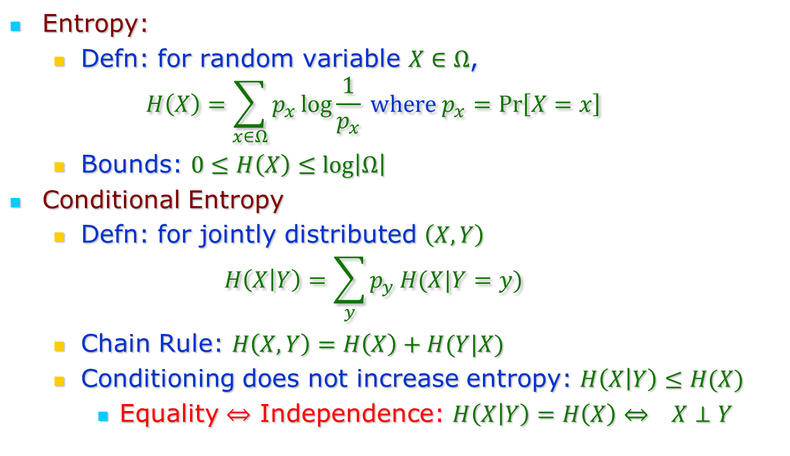
Information Theory Basics
Entropy:
Defn: for random variable $X∈Ω$,
$$H\left(X\right)=\sum_{x∈Ω}{p_{x}\log{\frac{1}{p_{x}}}} where p_{x}=\operatorname{Pr}\left[X=x\right]$$
Bounds: $0≤H\left(X\right)≤\log\left|Ω\right|$
Conditional Entropy
Defn: for jointly distributed $\left(X,Y\right)$
$$H\left(X | Y\right)=\sum_{y}{p_{y}}H(X|Y=y)$$
Chain Rule: $H\left(X,Y\right)=H\left(X\right)+H(Y|X)$
Conditioning does not increase entropy: $H\left(X | Y\right)≤H(X)$
Equality $⇔$ Independence: $H\left(X | Y\right)=H\left(X\right)⇔ X⊥Y$

Slide 9







Iteration by Example:
$\left(A,B,C,D\right)→\left(A+B+C+D,B+D,C+D, D\right)$
$\left(E,F,G,H\right)→\left(E+F+G+H,F+H,G+H,H\right)$
$$B+D$$
$$B+D+F+H$$
$$H\left(B+D \right|A+B+C+D)$$
$$H\left(B+D+F+H| \left\{\begin{aligned}A+B+C+D, \\ E+F+G+H\end{aligned}\right\}\right)$$
$$F+H$$
$$F+H$$
$$H\left(F+H \right|E+F+G+H)$$
$$H\left(F+H| \left\{\begin{aligned}A+B+C+D, \\ E+F+G+H, \\ B+D+F+H\end{aligned}\right\}\right)$$

Slide 10
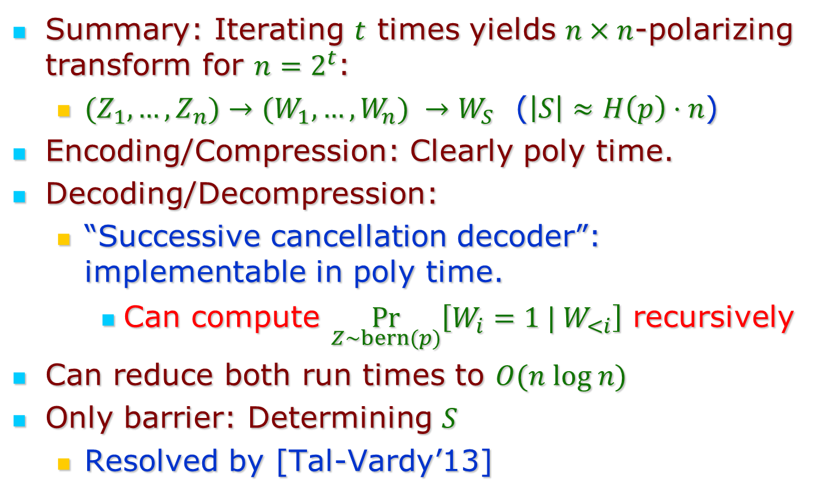
Algorithmics
Subliminal channel:
details in appendix.
Summary: Iterating $t$ times yields $n×n$-polarizing transform for $n=2^{t}$:
${(Z}_{1},…,Z_{n})→(W_{1},…,W_{n}) →W_{S}$ ($\left|S\right|≈H\left(p\right)⋅n$)
Encoding/Compression: Clearly poly time.
Decoding/Decompression:
“Successive cancellation decoder”: implementable in poly time.
Can compute $\underset{Z∼bern(p)}{Pr}\left[W_{i}=1 | W_{<i}\right]$ recursively
Can reduce both run times to $O(n log n)$
Only barrier: Determining $S$
Resolved by [Tal-Vardy’13]

Slide 11
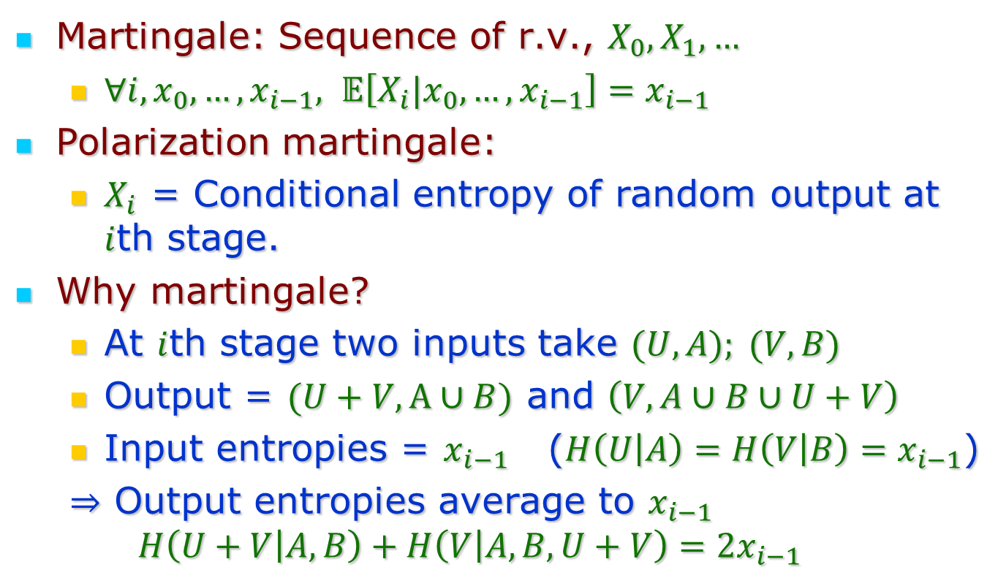
Analysis: The Polarization martingale
Martingale: Sequence of r.v., $X_{0},X_{1},…$
$∀i, x_{0},…, x_{i−1}, 𝔼\left[X_{i}|x_{0},…,x_{i−1}\right]=x_{i−1}$
Polarization martingale:
$X_{i}$ = Conditional entropy of random output at $i$th stage.
Why martingale?
At $i$th stage two inputs take $(U,A); (V,B)$
Output = $(U+V, A∪B)$ and $\left(V, A∪B∪U+V\right)$
Input entropies = $x_{i−1}$ ($H\left(U | A\right)=H\left(V | B\right)=x_{i−1}$)
$⇒$ Output entropies average to $x_{i−1}$
$$H\left(U+V | A,B\right)+H\left(V | A,B,U+V\right)=2x_{i−1}$$

Slide 12
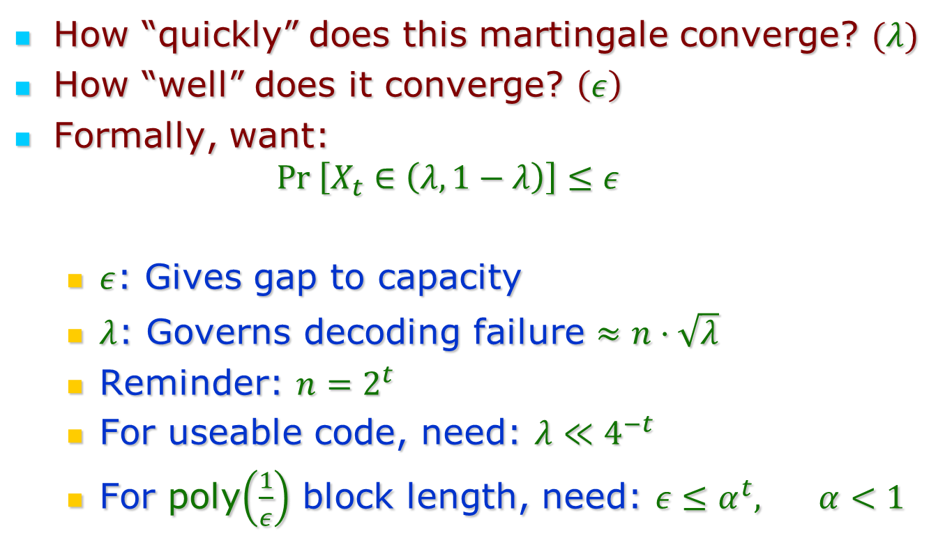
Quantitative issues
How “quickly” does this martingale converge? $(λ)$
How “well” does it converge? $\left(ε\right)$
Formally, want:
$$Pr \left[X_{t}∈\left(λ,1−λ\right)\right]≤ε$$
$ε$: Gives gap to capacity
$λ$: Governs decoding failure $≈n⋅\sqrt{λ}$
Reminder: $n=2^{t}$
For useable code, need: $λ≪4^{−t}$
For poly$\left(\frac{1}{ε}\right)$ block length, need: $ε≤α^{t},$ $α<1$

Slide 13
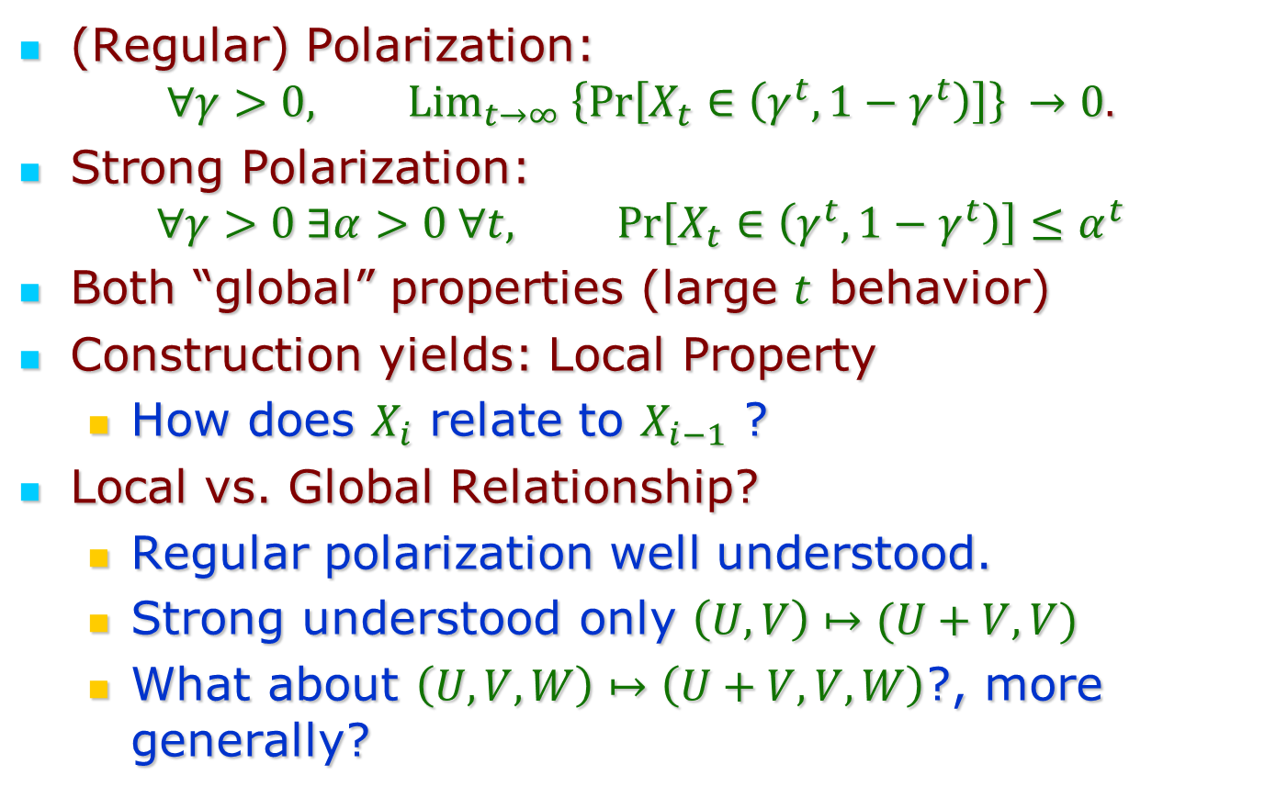
Regular and Strong Polarization
(Regular) Polarization:
$$∀γ>0, {Lim}_{t→∞} \left\{Pr\left[X_{t}∈\left(γ^{t},1−γ^{t}\right)\right]\right\} →0.$$
Strong Polarization:
$$∀γ>0 ∃α>0 ∀t, Pr\left[X_{t}∈\left(γ^{t}, 1−γ^{t}\right)\right]≤α^{t}$$
Both “global” properties (large $t$ behavior)
Construction yields: Local Property
How does $X_{i}$ relate to $X_{i−1}$ ?
Local vs. Global Relationship?
Regular polarization well understood.
Strong understood only $\left(U,V\right)↦(U+V,V)$
What about $\left(U,V,W\right)↦\left(U+V,V,W\right)$?, more generally?

Slide 14
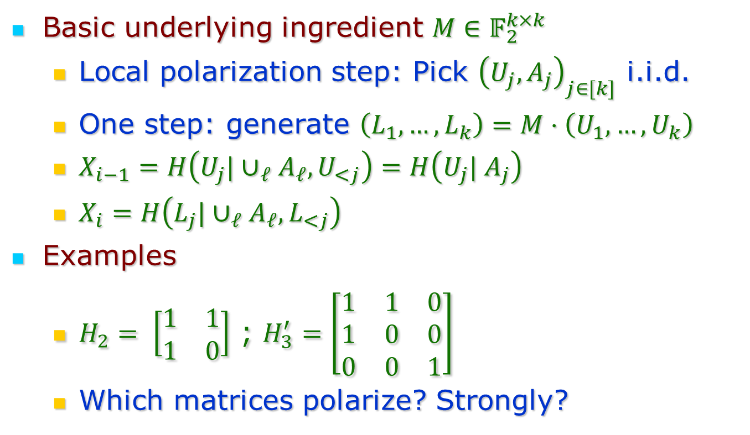
General Polarization
Basic underlying ingredient $M∈𝔽_{2}^{k×k}$
Local polarization step: Pick ${\left(U_{j},A_{j}\right)}_{j∈[k]}$ i.i.d.
One step: generate $\left(L_{1},…,L_{k}\right)=M⋅\left(U_{1},…,U_{k}\right)$
$X_{i−1}=H\left(U_{j}|∪_{ℓ}A_{ℓ}, U_{<j}\right)=H\left(U_{j}| A_{j}\right)$
$X_{i}=H\left(L_{j}|∪_{ℓ}A_{ℓ}, L_{<j}\right)$
Examples
$H_{2}= \left[\begin{matrix}1 & 1 \\ 1 & 0\end{matrix}\right]$ ; $H_{3}^{′}=\left[\begin{matrix}1 & 1 & 0 \\ 1 & 0 & 0 \\ 0 & 0 & 1\end{matrix}\right]$
Which matrices polarize? Strongly?

Slide 15
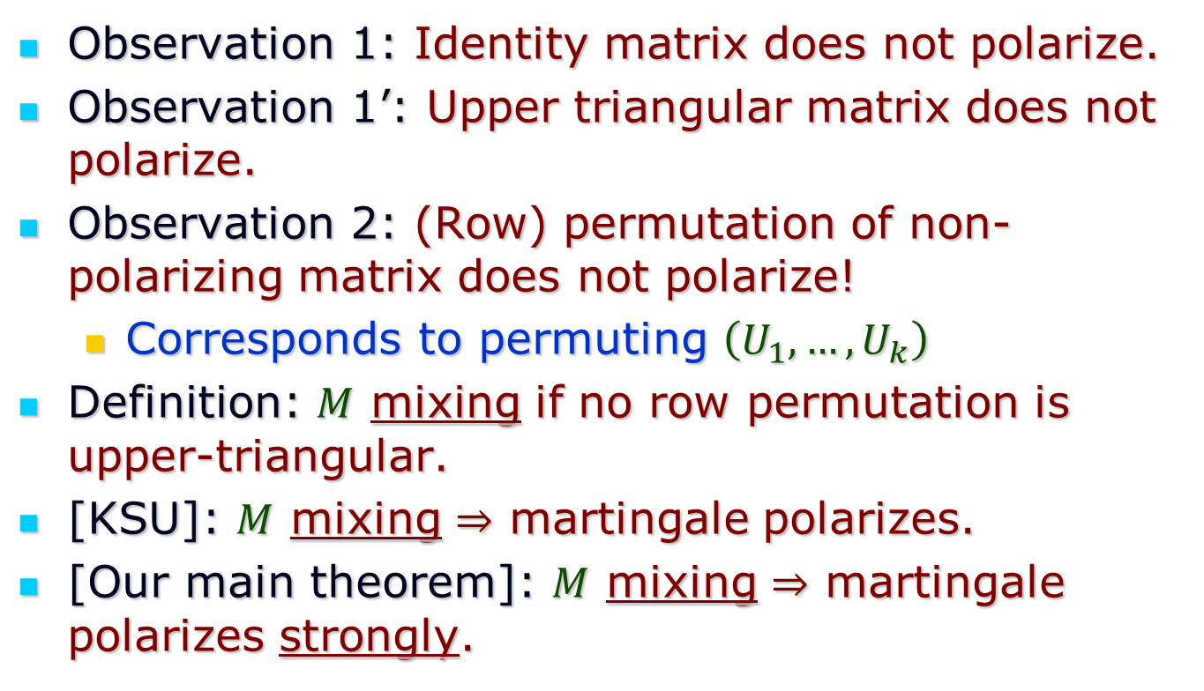
Mixing matrices
Observation 1: Identity matrix does not polarize.
Observation 1’: Upper triangular matrix does not polarize.
Observation 2: (Row) permutation of non-polarizing matrix does not polarize!
Corresponds to permuting $\left(U_{1},…,U_{k}\right)$
Definition: $M$ mixing if no row permutation is upper-triangular.
[KSU]: $M$ mixing $⇒$ martingale polarizes.
[Our main theorem]: $M$ mixing $⇒$ martingale polarizes strongly.

Slide 16
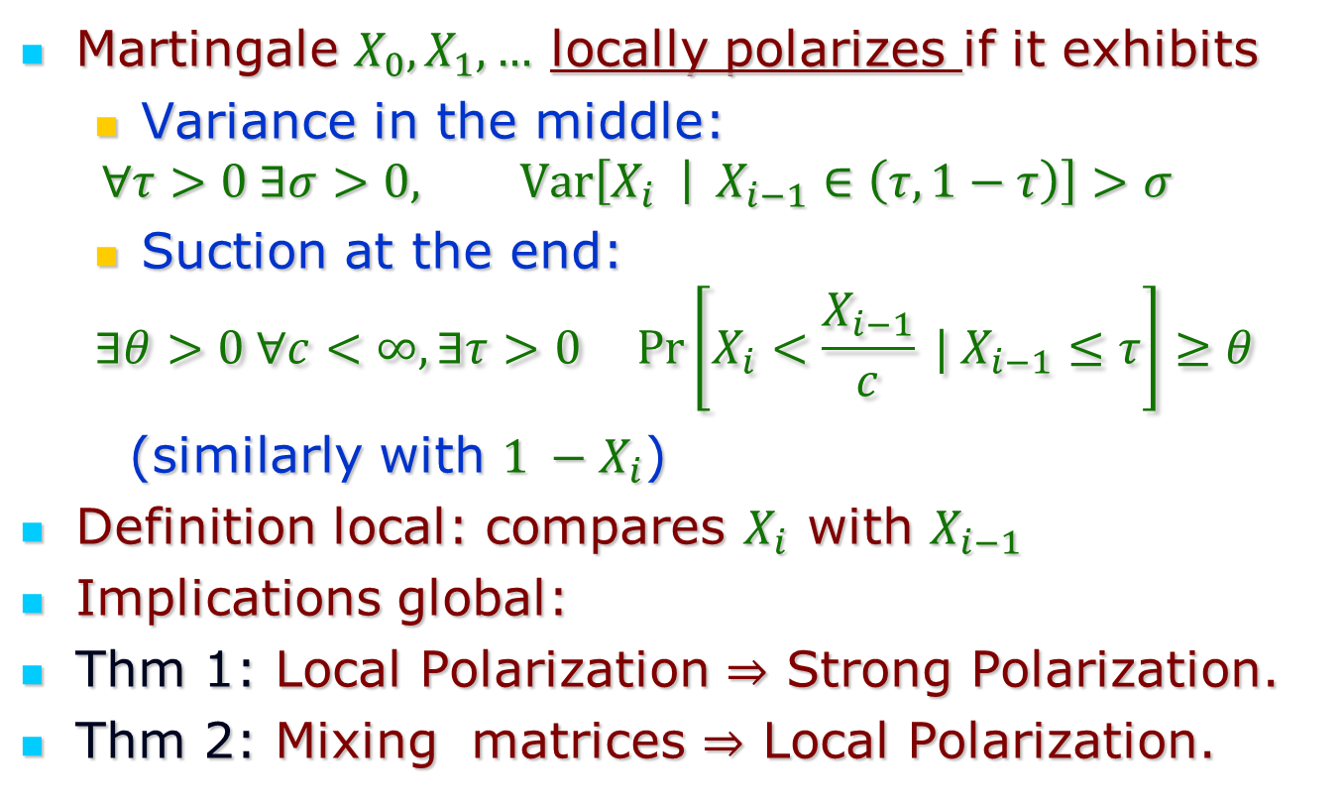
Key Concept: Local (Strong) Polarization
Martingale $X_{0},X_{1},…$ locally polarizes if it exhibits
Variance in the middle:
$$∀τ>0 ∃σ>0, Var\left[X_{i} | X_{i−1}∈\left(τ,1−τ\right)\right]>σ$$
Suction at the end:
$$∃θ>0 ∀c<∞, ∃τ>0 Pr\left[X_{i}<\frac{X_{i−1}}{c} | X_{i−1}≤τ\right]≥θ$$
(similarly with $1 −X_{i}$)
Definition local: compares $X_{i}$ with $X_{i−1}$
Implications global:
Thm 1: Local Polarization $⇒$ Strong Polarization.
Thm 2: Mixing matrices $⇒$ Local Polarization.

Slide 17
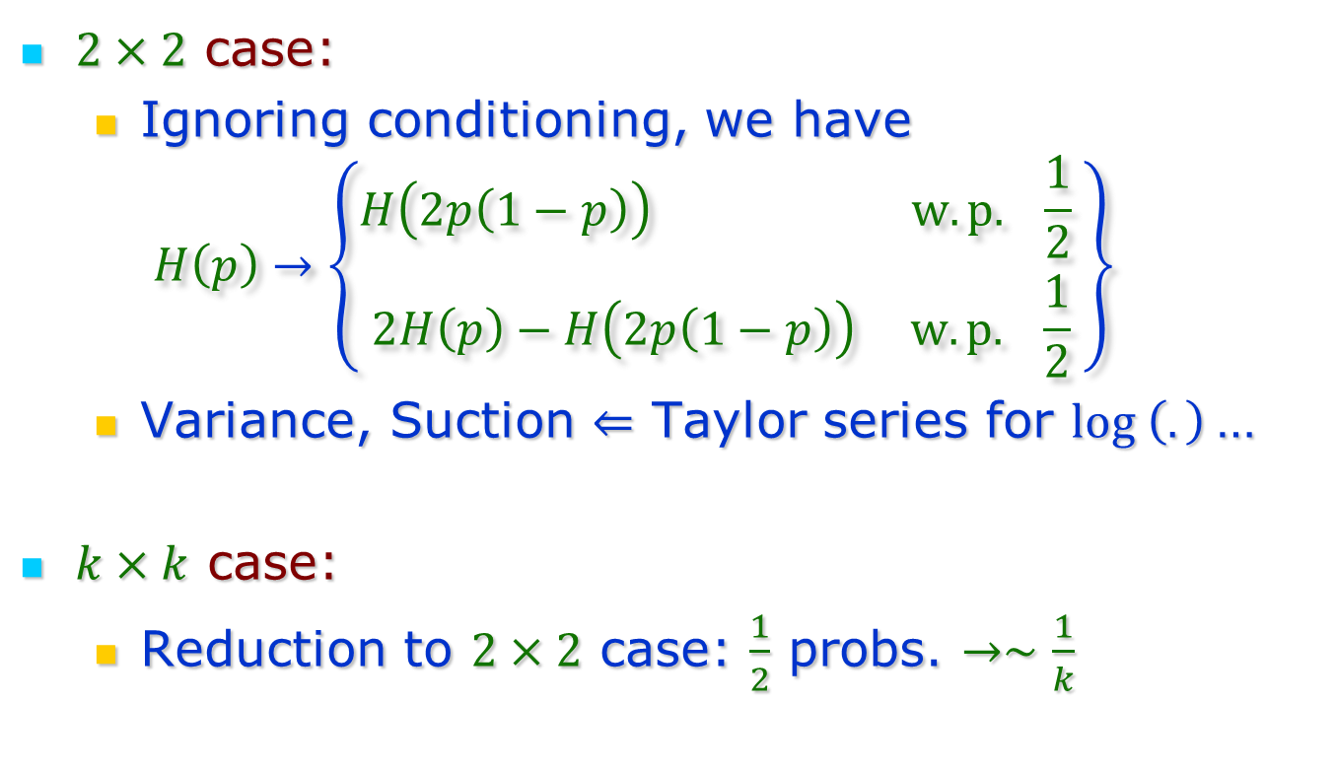
Mixing Matrices $⇒$ Local Polarization
$2×2$ case:
Ignoring conditioning, we have
$$H\left(p\right)→\left\{\begin{matrix}H\left(2p\left(1−p\right)\right) w.p. \frac{1}{2} \\ 2H\left(p\right)−H\left(2p\left(1−p\right)\right) w.p. \frac{1}{2}\end{matrix}\right\}$$
Variance, Suction $⇐$ Taylor series for $log \left(.\right)$…
$k×k$ case:
Reduction to $2×2$ case: $\frac{1}{2}$ probs. $→∼\frac{1}{k}$

Slide 18
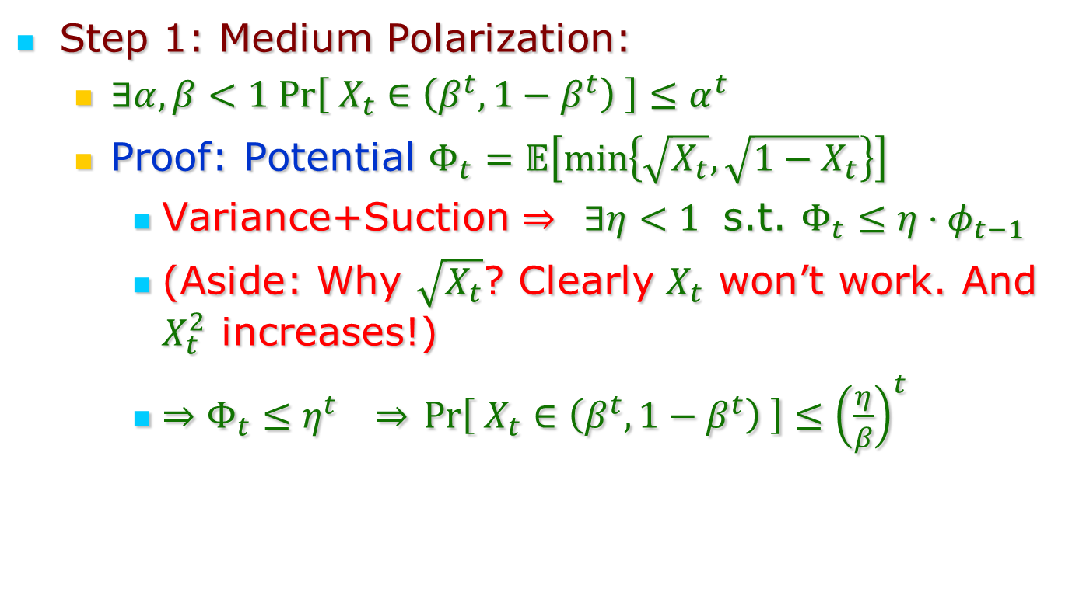
Local $⇒$ (Global) Strong Polarization
Step 1: Medium Polarization:
$∃α,β<1 Pr\left[ X_{t}∈\left(β^{t},1−β^{t}\right) \right]≤α^{t}$
Proof: Potential $Φ_{t}=𝔼\left[\min\left\{\sqrt{X_{t}}, \sqrt{1−X_{t}}\right\}\right]$
Variance+Suction $⇒ ∃η<1$ s.t. $Φ_{t}≤η⋅φ_{t−1}$
(Aside: Why $\sqrt{X_{t}}$? Clearly $X_{t}$ won’t work. And $X_{t}^{2}$ increases!)
$⇒Φ_{t}≤η^{t} ⇒$ $Pr\left[ X_{t}∈\left(β^{t},1−β^{t}\right) \right]≤{\left(\frac{η}{β}\right)}^{t}$

Slide 19
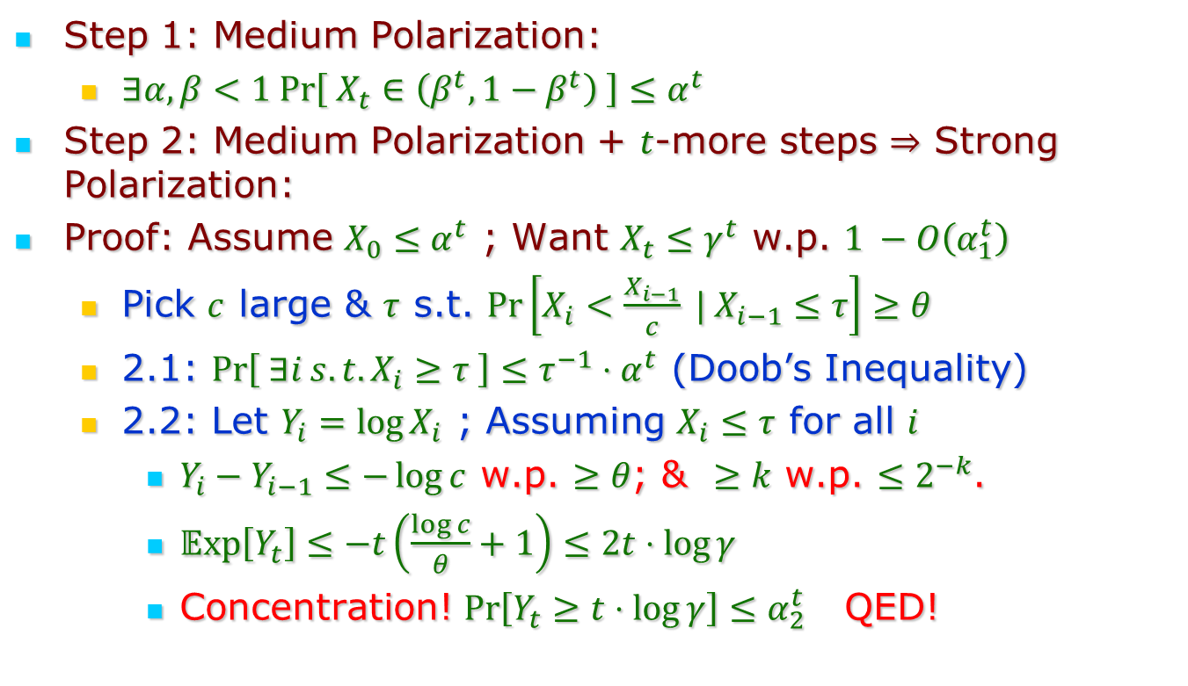
Local $⇒$ (Global) Strong Polarization
Step 1: Medium Polarization:
$∃α,β<1 Pr\left[ X_{t}∈\left(β^{t},1−β^{t}\right) \right]≤α^{t}$
Step 2: Medium Polarization + $t$-more steps $⇒$ Strong Polarization:
Proof: Assume $X_{0}≤α^{t}$ ; Want $X_{t}≤γ^{t}$ w.p. $1 −O\left(α_{1}^{t}\right)$
Pick $c$ large & $τ$ s.t. $\operatorname{Pr}\left[X_{i}<\frac{X_{i−1}}{c} | X_{i−1}≤τ\right]≥θ$
2.1: $\operatorname{Pr}\left[ ∃i s.t. X_{i}≥τ \right]≤τ^{−1}⋅α^{t}$ (Doob’s Inequality)
2.2: Let $Y_{i}=\log{X_{i}}$ ; Assuming $X_{i}≤τ$ for all $i$
$Y_{i}−Y_{i−1}≤−\log{c}$ w.p. $≥θ$; & $≥k$ w.p. $≤2^{−k}$.
$𝔼xp\left[Y_{t}\right]≤−t\left(\frac{\log{c}}{θ}+1\right)≤2t⋅\log{γ}$
Concentration! $\operatorname{Pr}\left[Y_{t}≥t⋅\log{γ}\right]≤α_{2}^{t}$ QED!

Slide 20
Conclusion
Simple General Analysis of Strong Polarization
But main reason to study general polarization:
Maybe some matrices polarize even faster!
This analysis does not get us there.
But hopefully following the (simpler) steps in specific cases can lead to improvements.

Slide 21
Thank You!

Slide 22
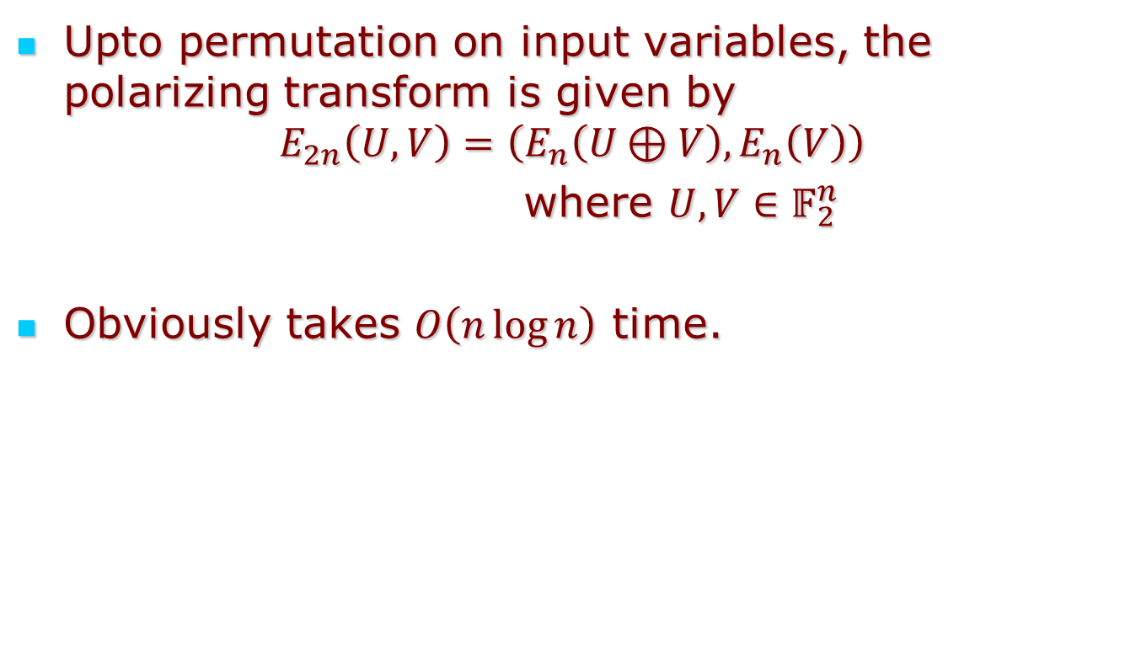
Algorithmics: Encoding
Upto permutation on input variables, the polarizing transform is given by
$$E_{2n}\left(U,V\right)=\left(E_{n}\left(U⊕V\right),E_{n}\left(V\right)\right)$$
where $U,V∈𝔽_{2}^{n}$
Obviously takes $O\left(n\log{n}\right)$ time.

Slide 23
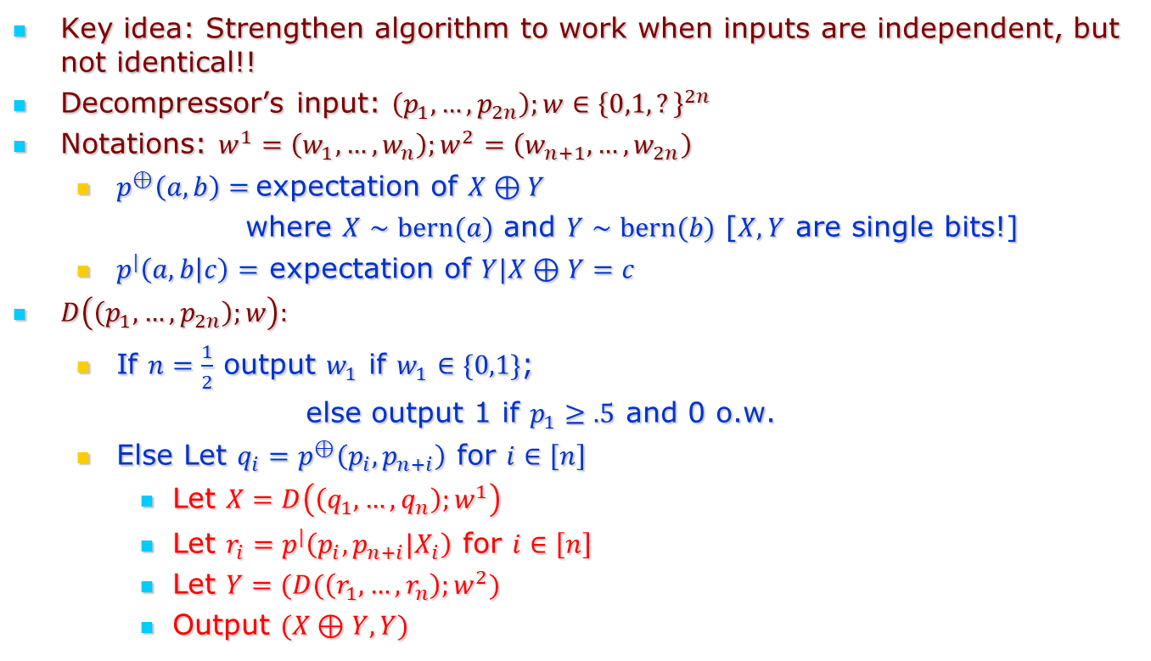
Algorithmics: Decoding
Key idea: Strengthen algorithm to work when inputs are independent, but not identical!!
Decompressor’s input: $\left(p_{1},…,p_{2n}\right);w∈{\left\{0,1,?\right\}}^{2n}$
Notations: $w^{1}=\left(w_{1},…,w_{n}\right);w^{2}=\left(w_{n+1}, …,w_{2n}\right)$
$p^{⊕}\left(a,b\right)=$expectation of $X⊕Y$
where $X∼bern(a)$ and $Y∼bern(b)$ [$X,Y$ are single bits!]
$p^{|}\left(a,b | c\right)=$ expectation of $Y|X⊕Y=c$
$D\left(\left(p_{1},…,p_{2n}\right);w\right):$
If $n=\frac{1}{2}$ output $w_{1}$ if $w_{1}∈\{0,1\}$;
else output 1 if $p_{1}≥.5$ and 0 o.w.
Else Let $q_{i}=p^{⊕}\left(p_{i},p_{n+i}\right)$ for $i∈\left[n\right]$
Let $X=D\left(\left(q_{1},…,q_{n}\right);w^{1}\right)$
Let $r_{i}=p^{|}\left(p_{i},p_{n+i}|X_{i}\right)$ for $i∈\left[n\right]$
Let $Y=(D(\left(r_{1},…,r_{n}\right);w^{2})$
Output $(X⊕Y,Y)$

Slide 24
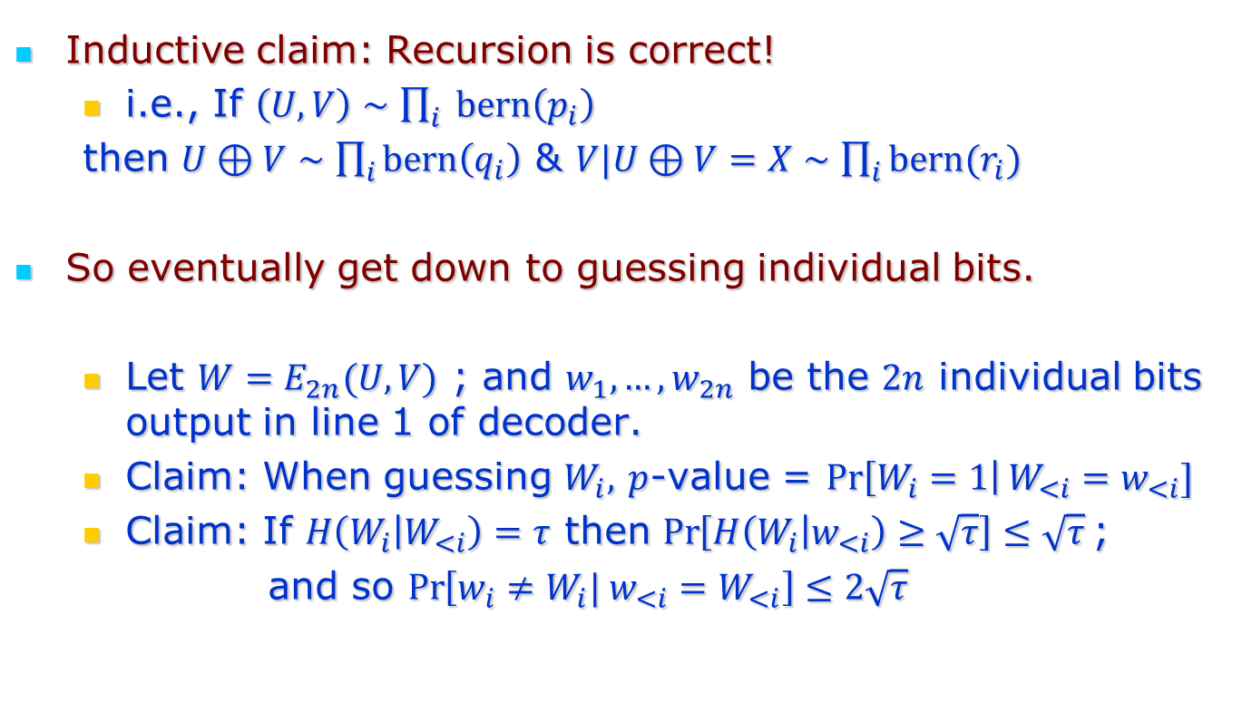
Algorithmics: Decoding Analysis
Inductive claim: Recursion is correct!
i.e., If $\left(U,V\right)∼\prod_{i}{ bern\left(p_{i}\right)}$
then $U⊕V∼\prod_{i}{bern\left(q_{i}\right)}$ & $V|U⊕V=X∼\prod_{i}{bern(r_{i})}$
So eventually get down to guessing individual bits.
Let $W=E_{2n}(U,V)$ ; and $w_{1},…,w_{2n}$ be the $2n$ individual bits output in line 1 of decoder.
Claim: When guessing $W_{i},$ $p$-value = $\operatorname{Pr}\left[W_{i}=1\right|W_{<i}=w_{<i}]$
Claim: If $H\left(W_{i} | W_{<i}\right)=τ$ then $\operatorname{Pr}\left[H\left(W_{i} | w_{<i}\right)≥\sqrt{τ}\right]≤\sqrt{τ}$;
and so $\operatorname{Pr}\left[w_{i}≠W_{i}| w_{<i}=W_{<i}\right]≤2\sqrt{τ}$
Back to talk

