Slide 1
Complexity of Pricing
Noam Nisan
Hebrew University

Slide 2
Circa 2004
Lens of Computation on the Sciences -- A workshop organized by Avi Wigderson
2014

Slide 3
Complexity in Economics

Slide 4
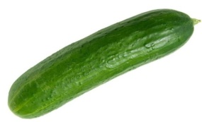
Complexity in Economics
Classical Economics
Economics and Computation

Slide 5
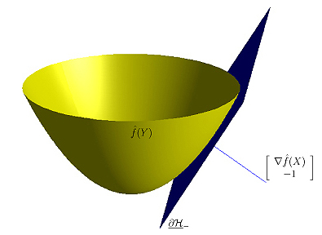
Optimization Perspective
Simplicity
Complexity

Slide 6
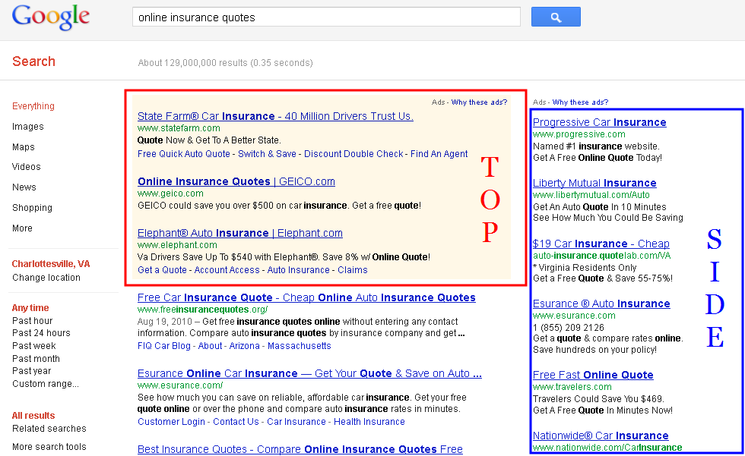
Ad auctions

Slide 7
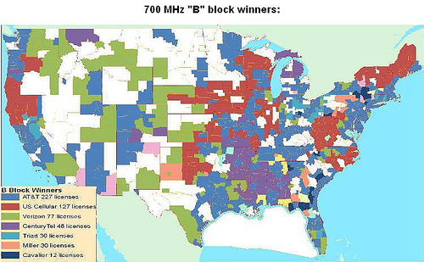
Spectrum Auctions

Slide 8
Cloud Computing

Slide 9
Our Setting

Slide 10
Selling independent items
A seller has n items for sale.
There is a single buyer that has private value v_{i} for each item i.
The buyer’s value is simply additive over the items.
The seller’s partial knowledge is captured by independent prior distributions F_{i} on v_{i}.
How does the seller maximize his (expected) revenue?

Slide 11
Single Item case: monopolist pricing
F
v
Buyer has value v
distributed according to F.
Seller knows F but not v and
wants to maximize expected revenue.
Sell at price p ➔ Revenue = p⋅ Pr_{v~F}[v≥p]
Seller maximizes for p
p

Slide 12
Single Item case: can we do better?
Is there a better way?
Interactive protocol
Randomization
…
Theorem (Myerson): No.
There are other protocols
They can all be put into a clean canonical form
Offer a menu of (Pr[win], price)
Revenue maximizing one still uses simple pricing
Generalizes to multiple bidders (“optimal auctions”)
F
…
v
…

Slide 13
Selling Two Items
One seller
One buyer
Values for the two items (v, u) are (independently) distributed according to F, G.
Value for bundle is additive
Challenge: find the revenue-maximizing selling mechanism.

Slide 14
Surely, just sell each item optimally…
Example: item values are IID uniformly on {1,2}
Selling a single item: optimal revenue = 1
Price=1 ➔ Pr[buy]=1 ➔ Revenue=1
Price=2 ➔ Pr[buy]=1/2 ➔ Revenue=1

Slide 15
Surely, just sell each item optimally…
Example: item values are IID uniformly on {1,2}
Selling a single item: optimal revenue = 1
Price=1 ➔ Pr[buy]=1 ➔ Revenue=1
Price=2 ➔ Pr[buy]=1/2 ➔ Revenue=1
Selling both items: you can get revenue > 2!
Price bundle at 3 ➔ Pr[buy]=3/4 ➔ Revenue = 2.25

Slide 16
Other Examples
IID Uniform on {0,1}
Selling each item separately is better than bundling
IID uniform on {0,1,2}
Buy any single item for $2 or both for $3
IID uniform on [0,1] Manelli-Vincent 2006
Buy any single item for $X or both for $Y
Uniform on {1, 2} × uniform on {1, 3} Daskalakis-Deckelbaum-Tzamos 2014
Buy (Item 1 & 50%-lottery for item 2) for $2.5, or both (surely) for $4
Beta(3,3) × Beta(3,4) Daskalakis-Deckelbaum-Tzamos 2013 Choose between infinitely many possible lotteries (each with its price)

Slide 17
Optimal Multi-item Auctions
May be complex
May be randomized
May have infinitely many outcomes
May be nonmonotone Hart-Reny 2012
Increasing players’ values may reduce revenue
May be very hard (#P-hard) to compute
Daskalakis-Deckelbaum-Tzamos 2014

Slide 18
Drawbacks of Complex Auctions
Harder to analyze
Harder to represent
Harder to participate in
Harder to “tweak”
for
Designer
Implementer
Human participant
Computerized participant

Slide 19
How much do we lose if we stick to simple auctions?

Slide 20
Simplicity vs Complexity
Qualitative measures:
Selling items separately vs. combinatorially
Selling full bundle vs. combinatorially
Selling packages additively vs. combinatorially
Selling deterministically vs. using lotteries
Quantitative Measures:
Number of “menu entries” in auction Hart-Nisan 2013
Number of “parameters” needed to “describe” auction Dughmi-Li-Nisan 2014, Morgenstern-Roughgarden 2015

Slide 21
Theorem: Selling two items separately always gives at least half of the optimal revenue. Hart-Nisan 2012

Slide 22
Proof Strategy: split the valuation space
An auction for the u item
E[v] is bounded by Rev(u)
v
u<v
v<u
u

Slide 23
Multiple Items
Revenue obtained by selling n items separately may be a factor of O(log n) smaller than the optimal revenue, but no less. Selling as a single bundle may be an O(n) factor smaller, but no less. Hart-Nisan 2012, Li-Yao 2013
The better of selling separately and of selling as a single bundle gives at least 1/6 of the optimal revenue. Babaioff-Immorlica-Lucier-Weinberg 2014

Slide 24
Menu-size Complexity
Canonical representation of any auction:
Pr[win item 1] Pr[win item 2] Price
0% 0% 0$
0% 100% 3$
20% 30% 4$
40% 60% 10$
… … …
100% 100% 20$
Menu
Menu Complexity
=
Number of entries

Slide 25
How Complex Must Auctions Be?
Revenue
(as fraction of OPT)
Menu Size

Slide 26
How Complex Must Auctions Be?
1
1-1/n
Revenue
(as fraction of OPT)
1-ε
O(1)
1/n
1 Poly Exp Finite Infinite
Menu Size

Slide 27
How Complex Must Auctions Be?
1
1-1/n^{c}
Revenue
(as fraction of OPT)
1-ε
O(1)
1/n
1 Poly Exp Finite Infinite
Menu Size

Slide 28
How Complex Must Auctions Be?
1
1-1/n^{c}
Revenue
(as fraction of OPT)
1-ε
O(1)
1/n
1 Poly Exp Finite Infinite
Menu Size

Slide 29
How Complex Must Auctions Be?
1
1-1/n^{c}
Revenue
(as fraction of OPT)
1-ε
O(1)
1/n
1 Poly Exp Finite Infinite
Menu Size

Slide 30
How Complex Must Auctions Be?
1
1-1/n^{c}
Revenue
(as fraction of OPT)
1-ε
O(1)
1/n
1 Poly Exp Finite Infinite
Menu Size

Slide 31
Theorem: For every n, ε, there exists C=exp(n,ε ⁻¹) such that auctions with menu size at most C suffice for getting (1- ε) fraction of the optimal revenue in every n item auction. Babaioff-Gonczarowski-Nisan 2016

Slide 32
Proof Strategy: Core vs. Tails Li-Yao
Double Tail: Ignore
M
Core: Nudge + Approximate
Tail: Ignore Small Item. Apply Myerson to Large Item
u
M
v

Slide 33
How Complex Must Auctions Be?
1
1-1/n^{c}
Revenue
(as fraction of OPT)
1-ε
O(1)
1/n
1 Poly Exp Finite Infinite
Menu Size

Slide 34
Theorem: An auction that extracts at least 1-1/n fraction of the optimal revenue from the uniform distribution on {0,1}^{n} requires 2^{Ω(n)} menu entries. Babaioff-Gonczarowski-Nisan 2016

Slide 35
Proof Idea: limitations of single entry
Menu Entry
Allocate items S* for price p*
Set S = {items with value 1} chooses this menu entry
S* contains
many S ➔
S* Contains their Union ➔ Low revenue on union
High revenue ➔ p*≈ |S|
➔ S ⊆ S*

Slide 36
How Complex Must Auctions Be?
1
1-1/n^{c}
Revenue
(as fraction of OPT)
1-ε
O(1)
1/n
1 Poly Exp Finite Infinite
Menu Size

Slide 37
The power of small menus
Theorem: For every ε, there exists d=poly(ε⁻¹) such that auctions with menu size O(C^{d}) suffice for getting (1- ε) fraction of the revenue of selling n items separately. Babaioff-Gonczarowski-Nisan 2016
Corollary: A menu size which is polynomial in n suffices for extracting at least 1/7 of the optimal revenue in any n item auction.
Babaioff-Immorlica-Lucier-Weinberg 2014

Slide 38
Auction with small menu-size
Item i is sold at price t_{i} and this happens with probability p_{i}.
Order items by increasing value of t
Very low
Very high
O(log n / ε) bundles
Don’t sell
Σp_{i} >> 1
Sell bundle for price:
t(1- ε) Σp_{i}
Σp_{i} << 1
Sell bundle for price t
sell at most one of these
item

Slide 39
Open Problem
1
1-1/n^{c}
Revenue
(as fraction of OPT)
1-ε
O(1)
1/n
1 Poly Exp Finite Infinite
Menu Size

