Slide 1
The Paulsen problem, continuous operator scaling, and smoothed analysis
Lap Chi Lau, University of Waterloo
Joint work with Tsz Chiu Kwok (Waterloo),
Yin Tat Lee (Washington),
Akshay Ramachandran (Waterloo)

Slide 2
Outline
Part I: Paulsen problem
Motivation from frame theory
Part II: Continuous operator scaling
Operator scaling, alternating algorithm, reduction
Analysis of dynamical system
Part III: Smoothed analysis
Proof outline, capacity lower bound
Part IV: Discussions

Slide 3
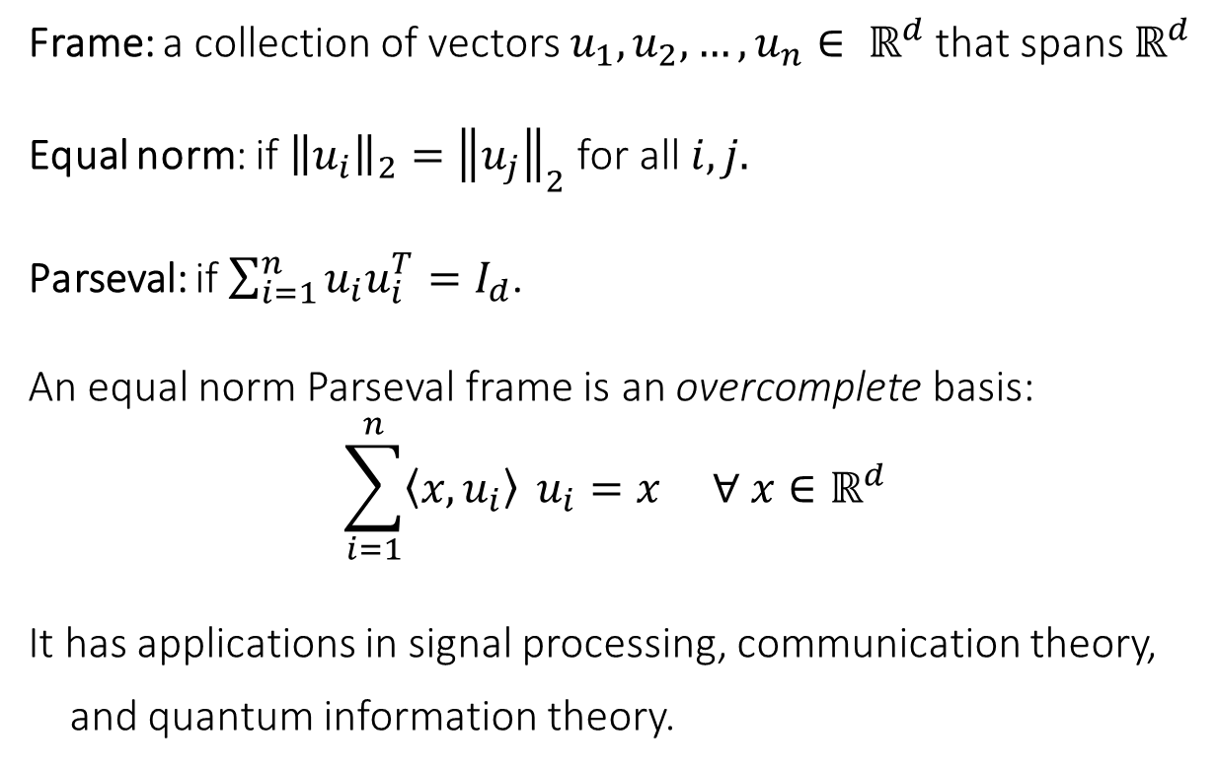
Frames
Frame: a collection of vectors $u_{1},u_{2},…, u_{n}∈ ℝ^{d}$ that spans $ℝ^{d}$
Equal norm: if ${\left\|u_{i}\right\|}_{2}={\left\|u_{j}\right\|}_{2}$ for all $i,j.$
Parseval: if $\sum_{i=1}^{n}{u_{i}u_{i}^{T}=I_{d}}$.
An equal norm Parseval frame is an overcomplete basis:
$$\sum_{i=1}^{n}{\left\langle x,u_{i}\right\rangle } u_{i}=x ∀ x∈ℝ^{d}$$
It has applications in signal processing, communication theory,
and quantum information theory.
Notes:
Think of n >> d.
Erasure code.

Slide 4
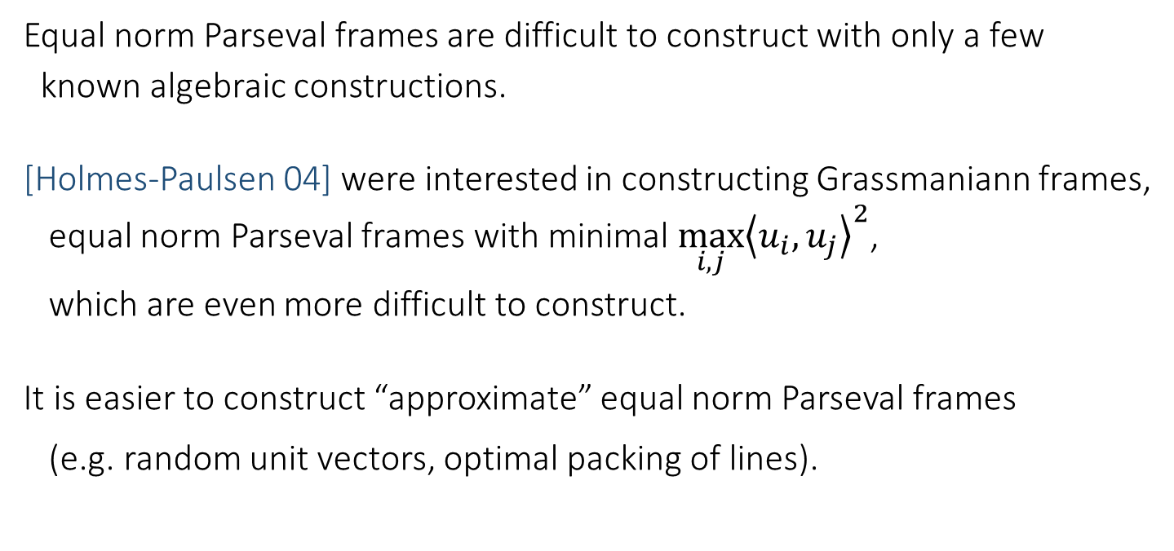
Motivation
Equal norm Parseval frames are difficult to construct with only a few
known algebraic constructions.
[Holmes-Paulsen 04] were interested in constructing Grassmaniann frames,
equal norm Parseval frames with minimal $\max_{i,j}{{\left\langle u_{i},u_{j}\right\rangle }^{2}}$,
which are even more difficult to construct.
It is easier to construct “approximate” equal norm Parseval frames
(e.g. random unit vectors, optimal packing of lines).
Question: Can we turn an “approximate” frame into an equal norm
Parseval frame by just moving the vectors “slightly”?
Notes:
Holmes Paulsen

Slide 5
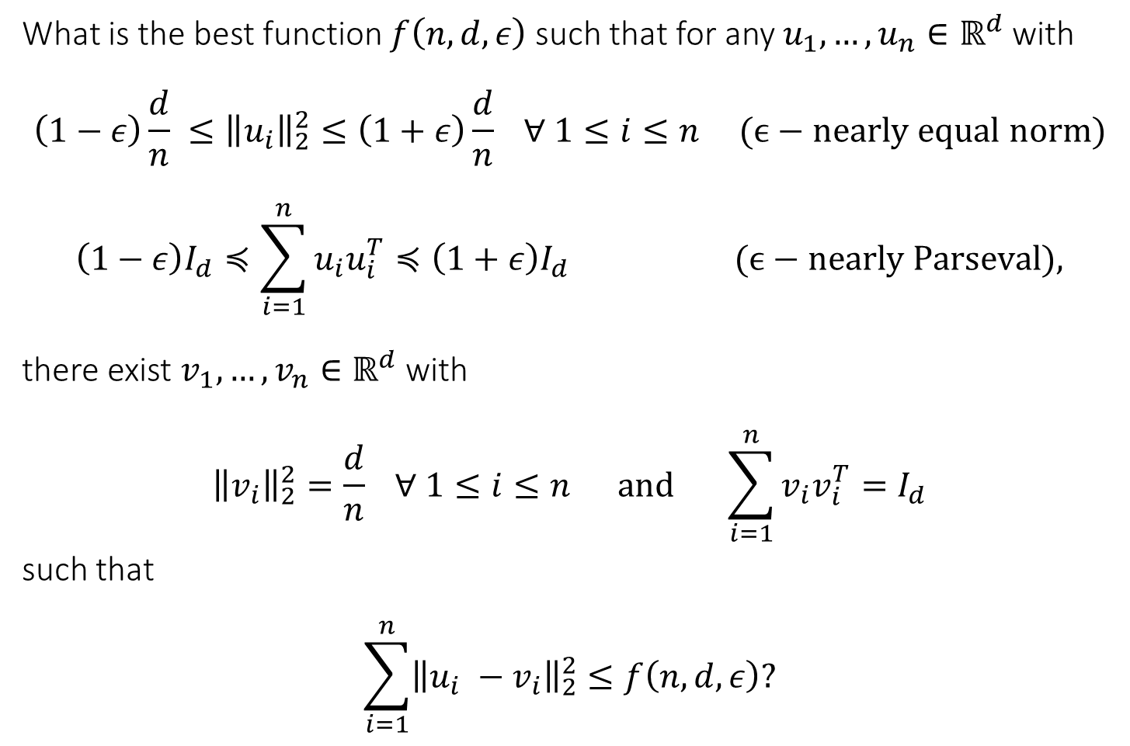
The Paulsen Problem
What is the best function $f\left(n,d,ε\right)$ such that for any $u_{1},…, u_{n}∈ℝ^{d}$ with
$$\left(1−ε\right)\frac{d}{n} ≤{\left\|u_{i}\right\|}_{2}^{2}≤\left(1+ε\right)\frac{d}{n} ∀ 1≤i≤n\text{ (}ϵ−\text{nearly} \text{equal} \text{norm}\text{)}$$
$$\left(1−ε\right)I_{d}≼\sum_{i=1}^{n}{u_{i}u_{i}^{T}≼\left(1+ε\right)I_{d}} \text{ (}ϵ−\text{nearly} \text{Parseval}\text{),}$$
there exist $v_{1},…, v_{n}∈ℝ^{d}$ with
$${\left\|v_{i}\right\|}_{2}^{2}=\frac{d}{n} ∀ 1≤i≤n \text{and} \sum_{i=1}^{n}{v_{i}v_{i}^{T}=I_{d}}$$
such that
$$\sum_{i=1}^{n}{{\left\|u_{i} −v_{i}\right\|}_{2}^{2}≤f\left(n,d,ε\right)?}$$
Notes:
Move the input to v.
Squared distance.

Slide 6
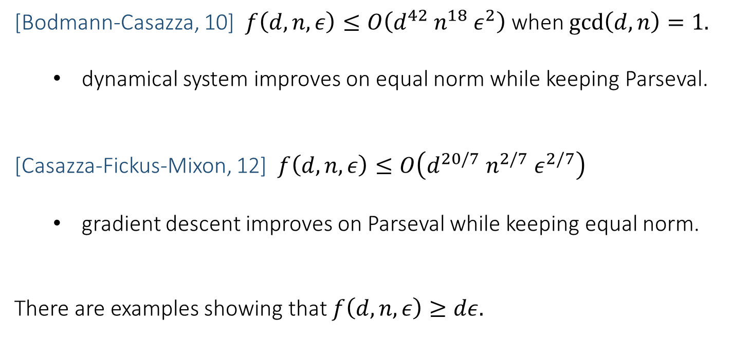
Previous work
[Bodmann-Casazza, 10] $f\left(d,n,ε\right)≤O\left(d^{42}{ n}^{18}{ ε}^{2}\right)$ when $\gcd\left(d,n\right)=1.$
  dynamical system improves on equal norm while keeping Parseval.
[Casazza-Fickus-Mixon, 12] $f\left(d,n,ε\right)≤O\left(d^{20/7} n^{2/7} ε^{2/7}\right)$
  gradient descent improves on Parseval while keeping equal norm.
There are examples showing that $f\left(d,n,ε\right)≥dε.$
Open question: Can the bound be independent of $n$?

Slide 7
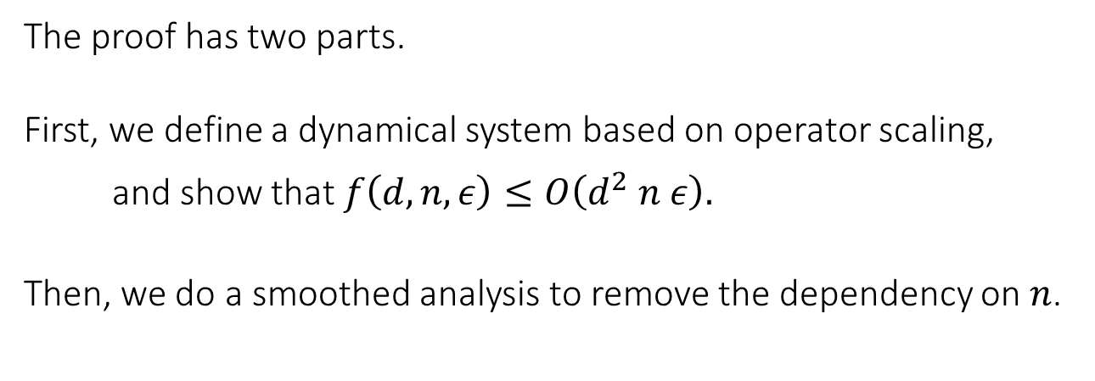
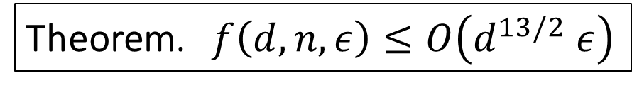
Main Result
Theorem. $f\left(d,n,ε\right)≤O\left(d^{13/2} ε\right)$
The proof has two parts.
First, we define a dynamical system based on operator scaling,
and show that $f\left(d,n,ε\right)≤O\left(d^{2} n ε\right).$
Then, we do a smoothed analysis to remove the dependency on $n$.

Slide 8
Outline
Part I: Paulsen problem
Motivation from frame theory
Part II: Continuous operator scaling
Operator scaling, alternating algorithm, reduction
Analysis of dynamical system
Part III: Smoothed analysis
Proof outline, capacity lower bound
Part IV: Discussions

Slide 9
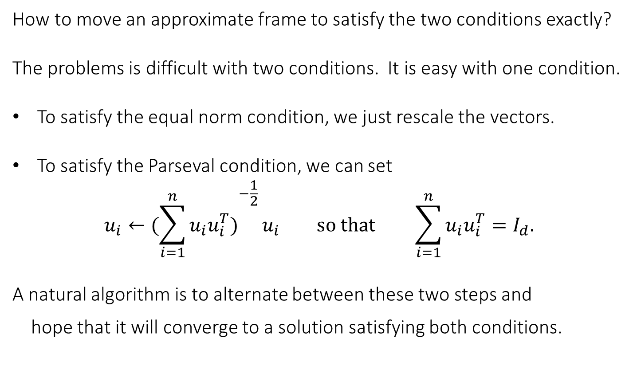
Alternating Algorithm
How to move an approximate frame to satisfy the two conditions exactly?
The problems is difficult with two conditions. It is easy with one condition.
To satisfy the equal norm condition, we just rescale the vectors.
To satisfy the Parseval condition, we can set
$$u_{i}←({\sum_{i=1}^{n}{u_{i}u_{i}^{T})}}^{−\frac{1}{2}}u_{i} so that \sum_{i=1}^{n}{u_{i}u_{i}^{T}=I_{d}.}$$
A natural algorithm is to alternate between these two steps and
hope that it will converge to a solution satisfying both conditions.

Slide 10




First Idea
This is a special case of the alternating algorithm for operator scaling,
which was analyzed in [Gurvits 04, Garg-Gurvits-Oliveira-Wigderson 16].
Our starting point is to bound the distance by the total movement in
the alternating algorithm (assuming it converges):
$$\{u_{i}^{\left(0\right)}\}$$
$$\{u_{i}^{\left(2\right)}\}$$
$$\{u_{i}^{\left(1\right)}\}$$
…
$$\{u_{i}^{\left(∞\right)}\}$$

Slide 11
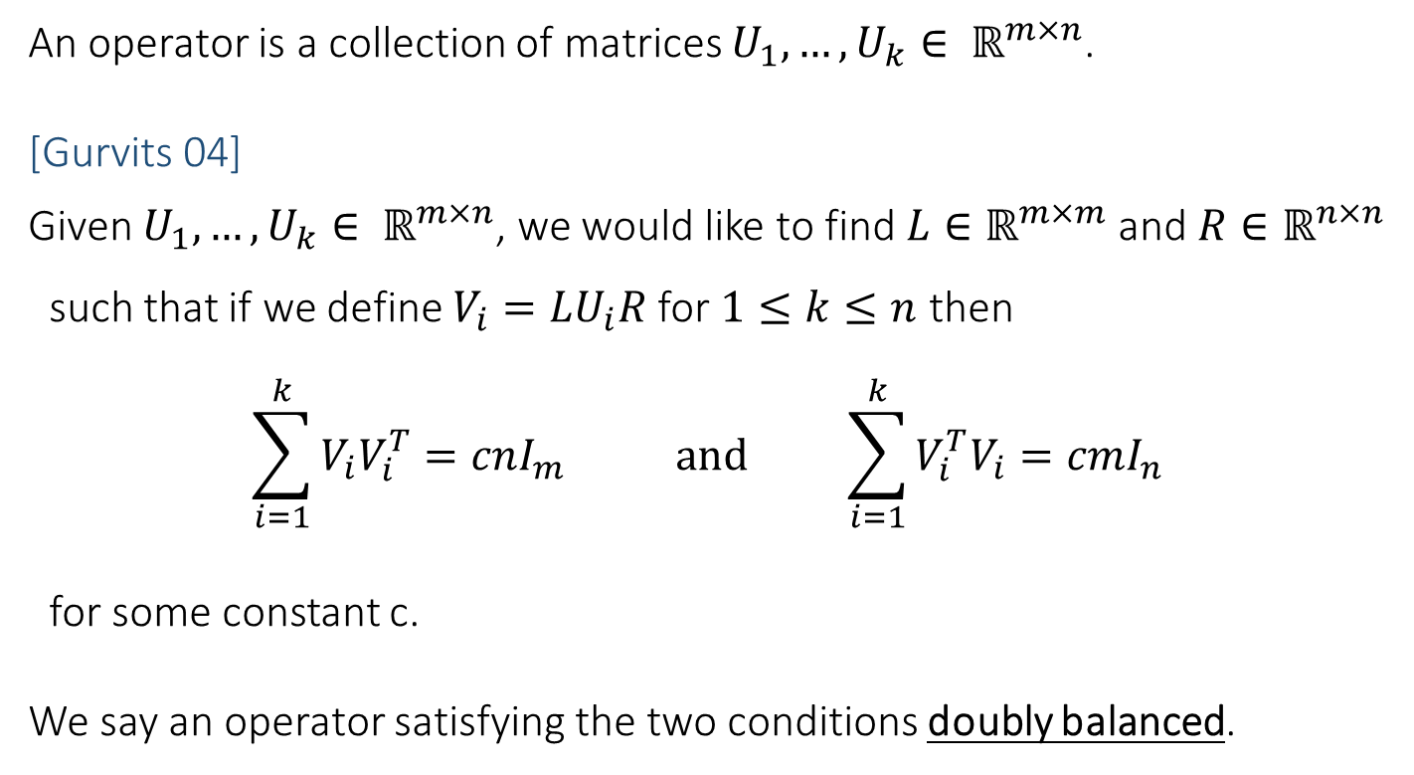
Operator Scaling
An operator is a collection of matrices $U_{1},…, U_{k}∈ ℝ^{m×n}$.
[Gurvits 04]
Given $U_{1},…, U_{k}∈ ℝ^{m×n}$, we would like to find $L∈ℝ^{m×m}$ and $R∈ℝ^{n×n}$
such that if we define $V_{i}=LU_{i}R$ for $1≤k≤n$ then
$$\sum_{i=1}^{k}{V_{i}V_{i}^{T}=cnI_{m} } and \sum_{i=1}^{k}{V_{i}^{T}V_{i}=cmI_{n} }$$
for some constant c.
We say an operator satisfying the two conditions doubly balanced.
Notes:
Before we go on, let me tell you operator scaling first.
Doubly stochastic.

Slide 12
Applications
Matrix Scaling:
Preconditioning for linear solvers [Osborne 60]
Optimal transportation [Wilson 69]
Bipartite matching
Deterministic approximation of permanents [Linial-Samorodnitsky-Wigderson 00]
Frame Scaling:
Sign rank lower bound [Forster 02]
Robust subspace recovery [Hardt-Moitra 13]
Paulsen problem
PSD scaling:
Approximation of mixed discriminants [Gurvits-Samorodnitsky 02]
Operator Scaling:
Computing non-commutative rank [Garg-Gurvits-Oliveira-Wigderson 16]
Computing Brascamp-Lieb constants [Garg-Gurvits-Oliveira-Wigderson 17]
Orbit intersection problem [AllenZhu-Garg-Li-Oliveira-Wigderson 18]
Operator Paulsen
Notes:
Matrix scaling, scale rows and columns to doubly stochastic
Frame scaling, linear transformation and normalize by length.
PSD scaling, common generalization of matrix scaling and frame scaling
Our result is used!

Slide 13
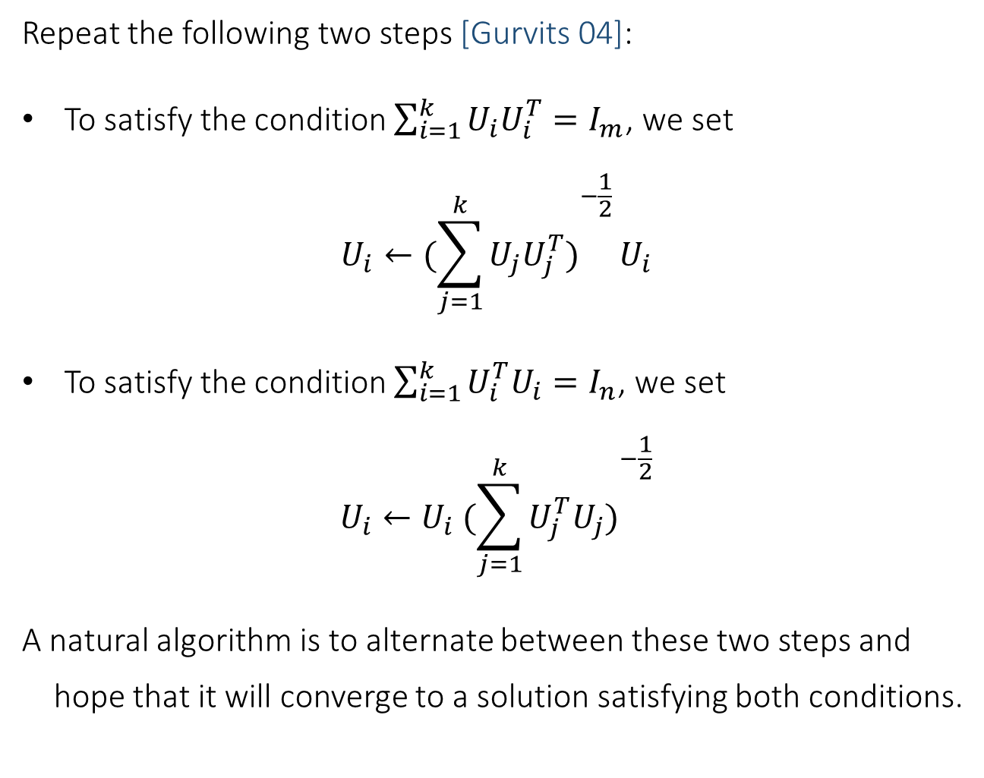
Alternating Algorithm
Repeat the following two steps [Gurvits 04]:
To satisfy the condition $\sum_{i=1}^{k}{U_{i}U_{i}^{T}=I_{m}}$, we set
$$U_{i}←({\sum_{j=1}^{k}{U_{j}U_{j}^{T})}}^{−\frac{1}{2}}U_{i}$$
To satisfy the condition $\sum_{i=1}^{k}{U_{i}^{T}U_{i}=I_{n}}$, we set
$$U_{i}←U_{i} ({\sum_{j=1}^{k}{U_{j}^{T}U_{j})}}^{−\frac{1}{2}}$$
A natural algorithm is to alternate between these two steps and
hope that it will converge to a solution satisfying both conditions.

Slide 14
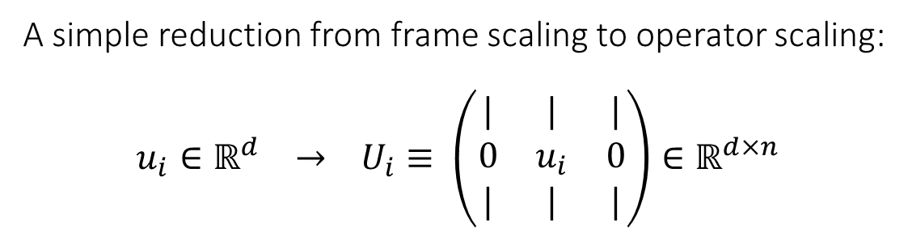
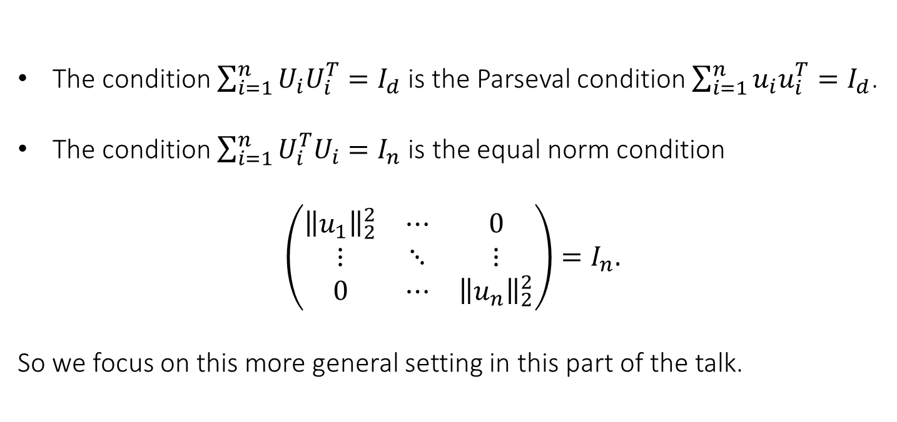
Reduction
A simple reduction from frame scaling to operator scaling:
$$u_{i}∈ℝ^{d} → U_{i}≡ \left(\begin{matrix}| & | & | \\ 0 & u_{i} & 0 \\ | & | & |\end{matrix}\right)∈ℝ^{d×n}$$
The condition $\sum_{i=1}^{n}{U_{i}U_{i}^{T}=I_{d}}$is the Parseval condition $\sum_{i=1}^{n}{u_{i}u_{i}^{T}=I_{d}}$.
The condition $\sum_{i=1}^{n}{U_{i}^{T}U_{i}=I_{n}}$ is the equal norm condition
$$\left(\begin{matrix}{\left\|u_{1}\right\|}_{2}^{2} & ⋯ & 0 \\ ⋮ & ⋱ & ⋮ \\ 0 & ⋯ & {\left\|u_{n}\right\|}_{2}^{2}\end{matrix}\right)=I_{n}.$$
So we focus on this more general setting in this part of the talk.
Notes:
The alternating algorithms are the same.
Nicer, symmetric.

Slide 15
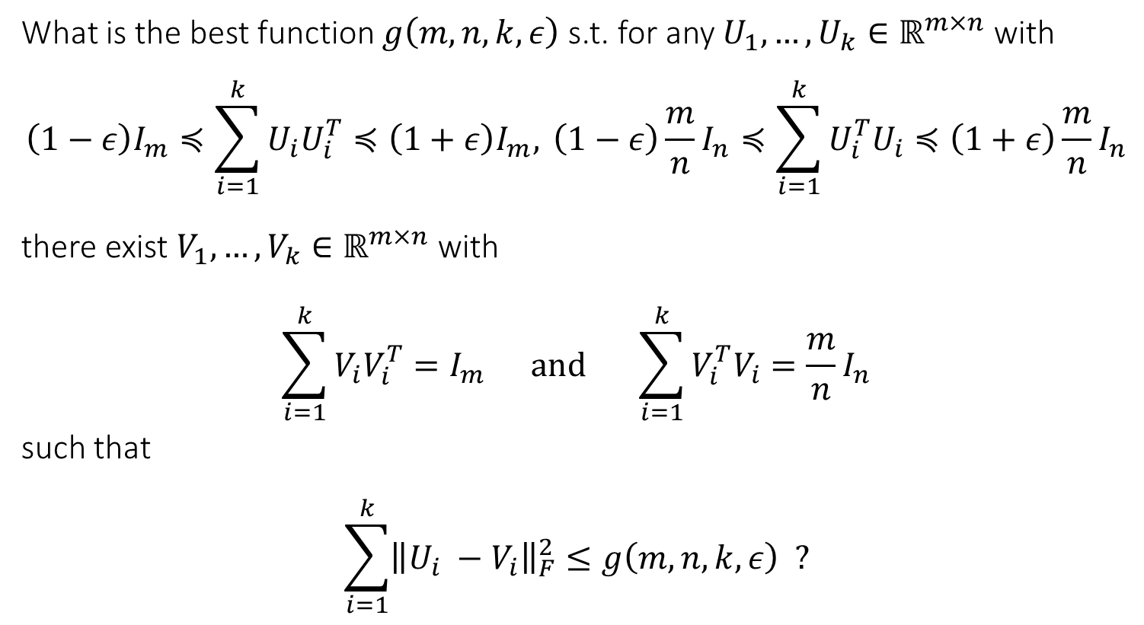

The Operator Paulsen Problem
What is the best function $g\left(m,n,k,ε\right)$ s.t. for any $U_{1},…, U_{k}∈ℝ^{m×n}$ with
$$\left(1−ε\right)I_{m}≼\sum_{i=1}^{k}{U_{i}U_{i}^{T}≼\left(1+ε\right)I_{m},} \left(1−ε\right)\frac{m}{n}I_{n}≼\sum_{i=1}^{k}{U_{i}^{T}U_{i}≼\left(1+ε\right)\frac{m}{n}}I_{n}$$
there exist $V_{1},…, V_{k}∈ℝ^{m×n}$ with
$$\sum_{i=1}^{k}{V_{i}V_{i}^{T}=I_{m}} \text{and} \sum_{i=1}^{k}{V_{i}^{T}V_{i}=\frac{m}{n}I_{n}}$$
such that
$$\sum_{i=1}^{k}{{\left\|U_{i} −V_{i}\right\|}_{F}^{2}≤g\left(m,n,k,ε\right) ?}$$
$≤m^{2}nε$
Notes:
m <= n.

Slide 16
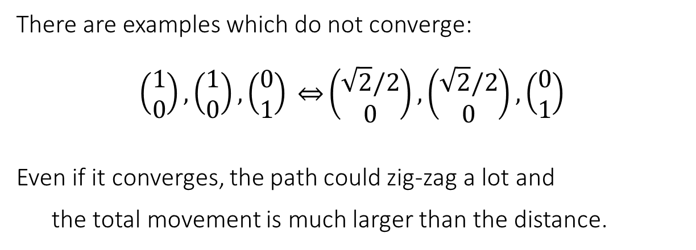
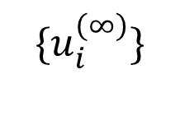


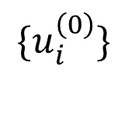
Issues in First Idea
$$\{u_{i}^{\left(0\right)}\}$$
$$\{u_{i}^{\left(2\right)}\}$$
$$\{u_{i}^{\left(1\right)}\}$$
…
$$\{u_{i}^{\left(∞\right)}\}$$
There are examples which do not converge:
$$\left(\begin{aligned}1 \\ 0\end{aligned}\right),\left(\begin{aligned}1 \\ 0\end{aligned}\right),\left(\begin{aligned}0 \\ 1\end{aligned}\right) \overset{⇔}{}\left(\begin{aligned}\sqrt{2}/2 \\ 0\end{aligned}\right),\left(\begin{aligned}\sqrt{2}/2 \\ 0\end{aligned}\right),\left(\begin{aligned}0 \\ 1\end{aligned}\right)$$
Even if it converges, the path could zig-zag a lot and
the total movement is much larger than the distance.
Notes:
We can use the convergence results, and we also know how much it moves in each step.
No nontrivial bound.

Slide 17
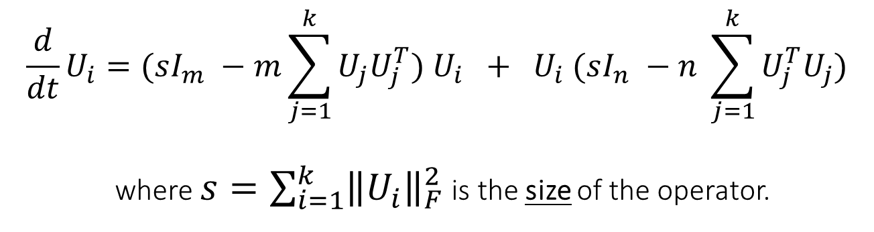
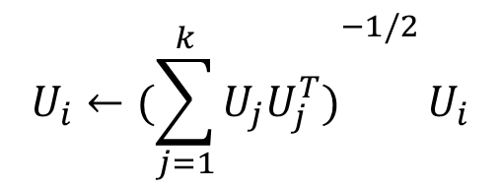
Continuous Operator Scaling
Dynamical System: Do both steps simultaneously and continuously.
$$\frac{d}{dt}U_{i}=(sI_{m} −m\sum_{j=1}^{k}{U_{j}U_{j}^{T}) U_{i} + U_{i} (sI_{n} −n \sum_{j=1}^{k}{U_{j}^{T}U_{j})}}$$
where $s=\sum_{i=1}^{k}{{\left\|U_{i}\right\|}_{F}^{2}}$ is the size of the operator.
$$U_{i}←({\sum_{j=1}^{k}{U_{j}U_{j}^{T})}}^{−1/2}U_{i}$$
Discrete:
Notes:
To avoid zig-zag.
Tell you the definition first.

Slide 18
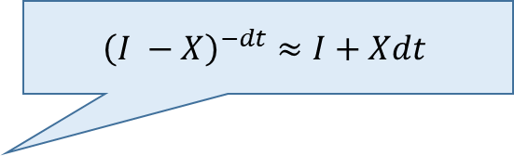
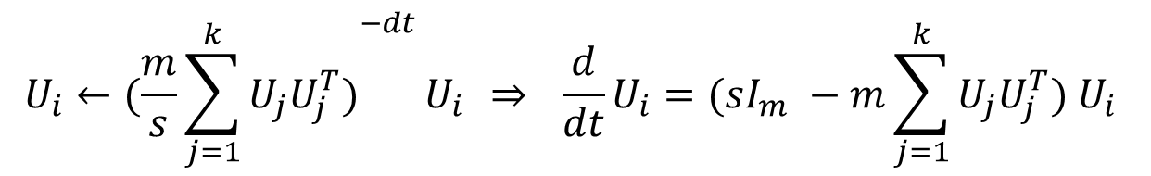
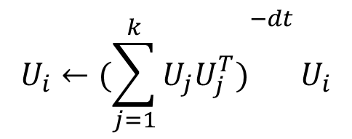
Continuous Operator Scaling
Dynamical System: Do both steps simultaneously and continuously.
$$\frac{d}{dt}U_{i}=(sI_{m} −m\sum_{j=1}^{k}{U_{j}U_{j}^{T}) U_{i} + U_{i} (sI_{n} −n \sum_{j=1}^{k}{U_{j}^{T}U_{j})}}$$
where $s=\sum_{i=1}^{k}{{\left\|U_{i}\right\|}_{F}^{2}}$ is the size of the operator.
$$U_{i}←({\sum_{j=1}^{k}{U_{j}U_{j}^{T})}}^{−dt}U_{i}$$
Continuous:
$${\left(I −X\right)}^{−dt}≈I+Xdt$$
$$U_{i}←({\frac{m}{s}\sum_{j=1}^{k}{U_{j}U_{j}^{T})}}^{−dt}U_{i} \overset{⇒}{} \frac{d}{dt}U_{i}=(sI_{m} −m\sum_{j=1}^{k}{U_{j}U_{j}^{T}) U_{i} }$$
Notes:
How we came up, not important whether it is precise.

Slide 19
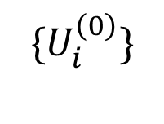
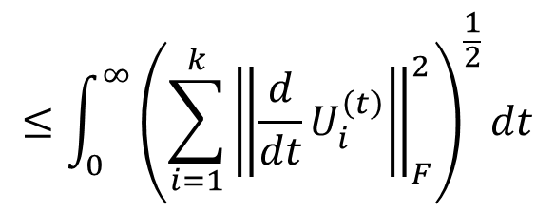
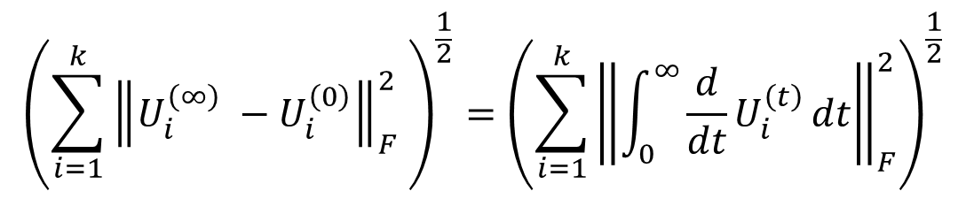


Total Movement
$$\{U_{i}^{\left(0\right)}\}$$
$$\{U_{i}^{\left(t\right)}\}$$
$$\{U_{i}^{\left(∞\right)}\}$$
We again bound the final distance by the total movement (the path length).
$${\left(\sum_{i=1}^{k}{{\left\|U_{i}^{\left(∞\right)} −U_{i}^{\left(0\right)}\right\|}_{F}^{2} }\right)}^{\frac{1}{2}}={\left(\sum_{i=1}^{k}{{\left\|\int_{0}^{∞}{\frac{d}{dt}U_{i}^{\left(t\right)}}dt\right\|}_{F}^{2}}\right)}^{\frac{1}{2}}$$
local movement
distance
$$≤\int_{0}^{∞}{{\left(\sum_{i=1}^{k}{{\left\|\frac{d}{dt}U_{i}^{\left(t\right)}\right\|}_{F}^{2}}\right)}^{\frac{1}{2}}dt}$$
(triangle inequality)
Notes:
Triangle inequality

Slide 20
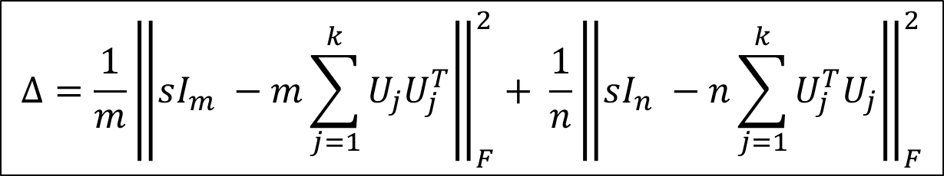
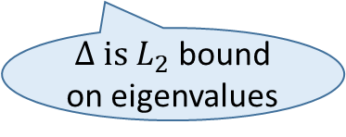
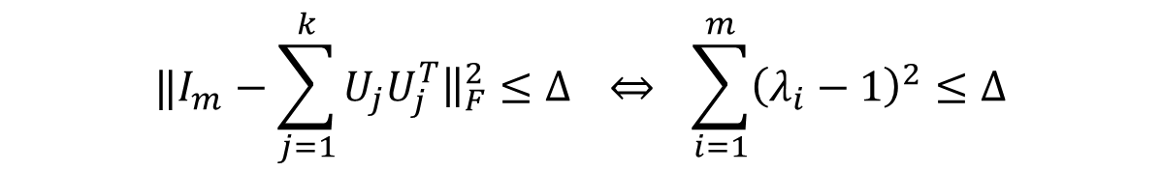
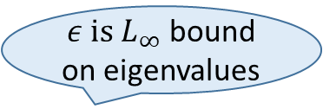
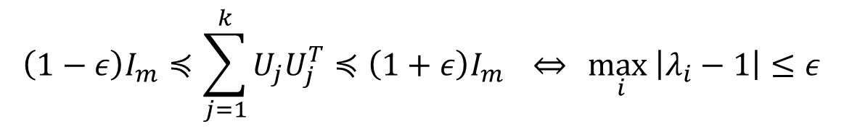
Error Measure
[Gurvits 04]
$$Δ=\frac{1}{m}{\left\|sI_{m} −m\sum_{j=1}^{k}{U_{j}U_{j}^{T}}\right\|}_{F}^{2}+ \frac{1}{n}{\left\|sI_{n} −n\sum_{j=1}^{k}{U_{j}^{T}U_{j}}\right\|}_{F}^{2}$$
Intuition:
In the Paulsen problem,
$ε \text{is} L_{∞}$ bound on eigenvalues
$$\left(1−ε\right)I_{m}≼\sum_{j=1}^{k}{U_{j}U_{j}^{T}≼\left(1+ε\right)I_{m}} \underset{⇔}{} \max_{i}\left|λ_{i}−1\right|≤ε$$
$$‖I_{m}−\sum_{j=1}^{k}{U_{j}U_{j}^{T}{\left.​\right\|}_{F}^{2}}≤Δ \overset{⇔}{} \sum_{i=1}^{m}{{\left(λ_{i}−1\right)}^{2}≤Δ}$$
$Δ \text{is} L_{2}$ bound on eigenvalues
Easier to work with 2-norm.
Notes:
An important quantity for our analysis is a new error measure.
Normalization
Intuition to remember this term.

Slide 21
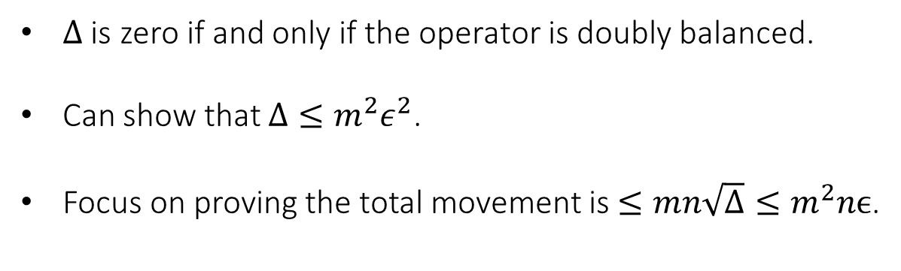
Error Measure
[Gurvits 04]
$$Δ=\frac{1}{m}{\left\|sI_{m} −m\sum_{j=1}^{k}{U_{j}U_{j}^{T}}\right\|}_{F}^{2}+ \frac{1}{n}{\left\|sI_{n} −n\sum_{j=1}^{k}{U_{j}^{T}U_{j}}\right\|}_{F}^{2}$$
$Δ$ is zero if and only if the operator is doubly balanced.
Can show that $Δ≤m^{2}ε^{2}$.
Focus on proving the total movement is $≤mn\sqrt{Δ}≤m^{2}nϵ$.
The dynamical system is moving in the direction that minimizes $Δ$.
Gradient flow.
Notes:
Forget about eps.
Gradient flow.

Slide 22

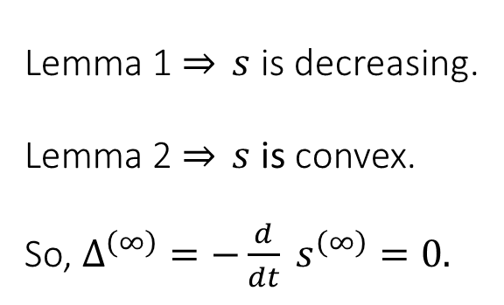
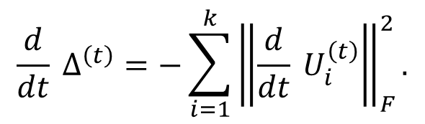
Convergence
local movement
We find some nice identities to analyze the convergence.
$$\frac{d}{dt} Δ^{\left(t\right)}=−\sum_{i=1}^{k}{{\left\|\frac{d}{dt} U_{i}^{\left(t\right)}\right\|}_{F}^{2}}.$$
$$\frac{d}{dt} s^{\left(t\right)}=−Δ^{\left(t\right)}.$$
Lemma 2.
Lemma 1.
Claim. The dynamical system converges to a doubly balanced operator.
size s
Lemma 1 $\overset{⇒}{} s$is decreasing.
Lemma 2 $\overset{⇒}{} s$is convex.
So, $Δ^{\left(∞\right)}=−\frac{d}{dt} s^{\left(∞\right)}=0.$
time t
Remark. For an operator that is not scalable, its size will shrink to zero.
Notes:
Now, with the definitions, we can start to analyze the convergence.
One issue is gone.

Slide 23
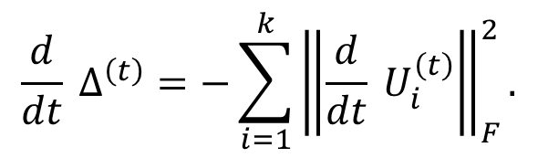
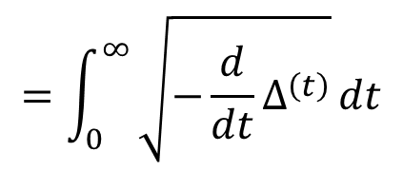
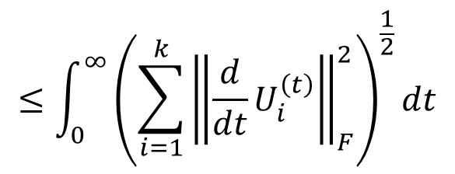
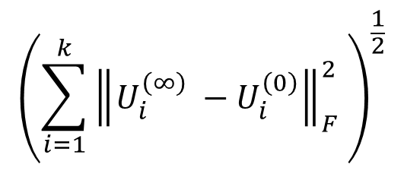
Local Movement
$$\frac{d}{dt} Δ^{\left(t\right)}=−\sum_{i=1}^{k}{{\left\|\frac{d}{dt} U_{i}^{\left(t\right)}\right\|}_{F}^{2}}.$$
Lemma 2.
local movement
$${\left(\sum_{i=1}^{k}{{\left\|U_{i}^{\left(∞\right)} −U_{i}^{\left(0\right)}\right\|}_{F}^{2} }\right)}^{\frac{1}{2}}$$
$$≤\int_{0}^{∞}{{\left(\sum_{i=1}^{k}{{\left\|\frac{d}{dt}U_{i}^{\left(t\right)}\right\|}_{F}^{2}}\right)}^{\frac{1}{2}}dt}$$
distance
$$=\int_{0}^{∞}{\sqrt{−\frac{d}{dt}Δ^{\left(t\right)}}}dt$$

Slide 24
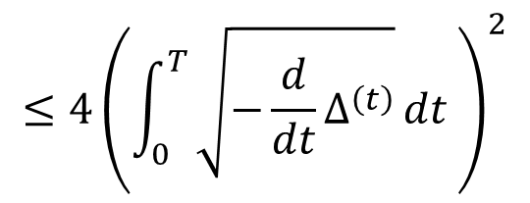
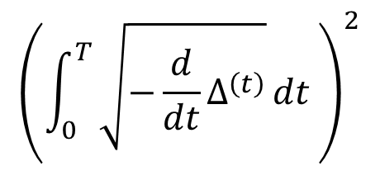
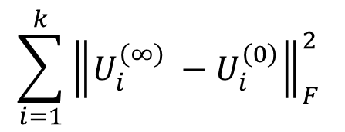

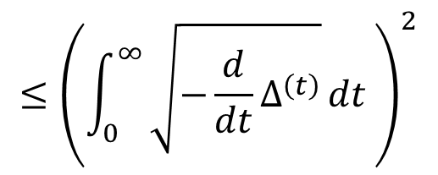
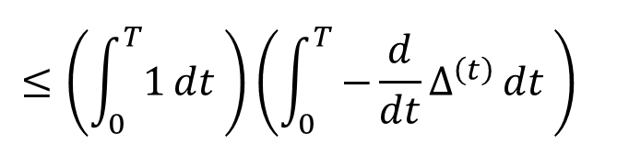
Local Movement
$$\frac{d}{dt} Δ^{\left(t\right)}=−\sum_{i=1}^{k}{{\left\|\frac{d}{dt} U_{i}^{\left(t\right)}\right\|}_{F}^{2}}.$$
Lemma 2.
local movement
squared
distance
$$≤{\left(\int_{0}^{∞}{\sqrt{−\frac{d}{dt}Δ^{\left(t\right)}}}dt \right)}^{2}$$
$$≤4{\left(\int_{0}^{T}{\sqrt{−\frac{d}{dt}Δ^{\left(t\right)}}}dt \right)}^{2}$$
$$\sum_{i=1}^{k}{{\left\|U_{i}^{\left(∞\right)} −U_{i}^{\left(0\right)}\right\|}_{F}^{2} }$$
Half time. The first time $T$ so that $Δ^{\left(T\right)}=Δ^{\left(0\right)}/2.$ Then use geometric sum.
$${\left(\int_{0}^{T}{\sqrt{−\frac{d}{dt}Δ^{\left(t\right)}}}dt \right)}^{2}$$
$$≤{\left(\int_{0}^{T}{1}dt \right)\left(\int_{0}^{T}{−\frac{d}{dt}Δ^{\left(t\right)}}dt \right)}^{}$$
$$≤T Δ^{\left(0\right)}.$$
So it remains to bound the half time.
Notes:
May not be clear why geometric sum now, but we will prove mn sqrt(Delta).

Slide 25
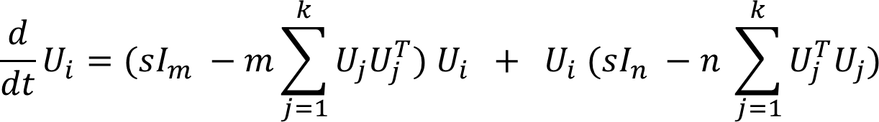
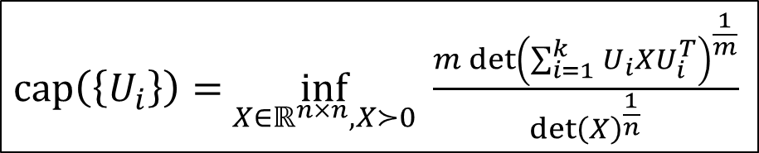



Capacity
[Gurvits 04] a potential function to analyze operator scaling
$cap\left(\left\{U_{i}\right\}\right)=$ $\inf_{X∈ℝ^{n×n}, X≻0} \frac{m{\det\left(\sum_{i=1}^{k}{U_{i}XU_{i}^{T}}\right)}^{\frac{1}{m}}}{\det{{\left(X\right)}^{\frac{1}{n}}}}$
Lemma 3. Capacity is unchanged over time.
$$cap\left(\left\{LU_{i}R\right\}\right)={\left(\det{L}\right)}^{\frac{2}{m}} {\left(\det{R}\right)}^{\frac{2}{n}} cap\left(\left\{U_{i}\right\}\right).$$
Capacity changes after scaling:
In our system:
trace zero
trace zero
Informally:
$$\frac{d}{dt}X=LX \overset{⇒}{} X=e^{\int{L}}{ X}^{\left(0\right)}.$$
$$tr\left(L\right)=0 \overset{⇒}{} \det\left(e^{\int{L}}\right)=1.$$
Notes:
Capacity max when doubly balanced. Upper bound, lower bound, increase.

Slide 26


Capacity
[Gurvits 04] a potential function to analyze operator scaling
$cap\left(\left\{U_{i}\right\}\right)=$ $\inf_{X∈ℝ^{n×n}, X≻0} \frac{m{\det\left(\sum_{i=1}^{k}{U_{i}XU_{i}^{T}}\right)}^{\frac{1}{m}}}{\det{{\left(X\right)}^{\frac{1}{n}}}}$
Lemma 4.
$$s^{\left(t\right)}≥{cap}^{\left(t\right)}≥s^{\left(t\right)}−mn\sqrt{Δ^{\left(t\right)}}.$$
We adapt the proof from [Garg-Gurvits-Oliveira-Wigderson 06].
One implication is that $s^{\left(∞\right)}=cap^{\left(∞\right)}=cap^{\left(0\right)}$.
We will come back to this lower bound in part III.
Notes:
LHS is easy. RHS is nontrivial. Ten pages long.

Slide 27







Bounding Half Time
Half time. Want to upper bound the first time $T$ so that $Δ^{\left(T\right)}=Δ^{\left(0\right)}/2.$
Lemma 3. Capacity is unchanged over time.
Lemma 4.
$$s^{\left(t\right)}≥{cap}^{\left(t\right)}≥s^{\left(t\right)}−mn\sqrt{Δ^{\left(t\right)}}.$$
$$s^{\left(T\right)}≥{cap}^{\left(T\right)}={cap}^{\left(0\right)}≥s^{\left(0\right)}−mn\sqrt{Δ^{\left(0\right)}}$$
size of the operator decreases by at most $mn\sqrt{Δ^{\left(0\right)}}$
$$\frac{d}{dt} s^{\left(t\right)}=−Δ^{\left(t\right)}.$$
size decreases by at least $\frac{1}{2} Δ^{\left(0\right)}T$
Lemma 1.
$$T≤ \frac{2mn}{\sqrt{Δ}}$$
total movement $≤TΔ≤mn\sqrt{Δ}.$
Notes:
Geometric sum

Slide 28










Summary of Analysis
$$\{U_{i}^{\left(0\right)}\}$$
$$\{U_{i}^{\left(t\right)}\}$$
local movement
$$\{U_{i}^{\left(∞\right)}\}$$
$$≤{\left(\int_{0}^{∞}{{\left(\sum_{i=1}^{k}{{\left\|\frac{d}{dt}U_{i}^{\left(t\right)}\right\|}_{F}^{2}}\right)}^{\frac{1}{2}}dt}\right)}^{2}$$
$$\sum_{i=1}^{k}{{\left\|U_{i}^{\left(∞\right)} −U_{i}^{\left(0\right)}\right\|}_{F}^{2} }$$
squared distance
$$≤{\left(\int_{0}^{∞}{\sqrt{−\frac{d}{dt}Δ^{\left(t\right)}}}dt \right)}^{2}$$
Lemma 2
half time, geometric sum, Cauchy-Schwarz
$$≤TΔ^{\left(0\right)}$$
Capacity argument, Lemma 1
$$≤mn\sqrt{Δ^{\left(0\right)}}$$
$L_{2}$ vs $L_{∞}$
$$≤m^{2}nε.$$

Slide 29
Outline
Part I: Paulsen problem
Motivation from frame theory
Part II: Continuous operator scaling
Operator scaling, alternating algorithm, reduction
Analysis of dynamical system
Part III: Smoothed analysis
Proof outline, capacity lower bound
Part IV: Discussions

Slide 30

Capacity and Total Movement
Remark: Smoothed analysis only works in the frame setting,
not (yet) in the operator setting.
Part II can be understood as a reduction from total movement
to capacity lower bound:
$$\text{cap}≥s −f\left(d,n,Δ\right) \overset{⇒}{\text{p}\text{art} \text{II}} \text{dis}{\text{t}}^{2}≤ f\left(d,n,Δ\right).$$
In Part II, we proved $f\left(d,n\right)≤dn\sqrt{Δ}.$
In Part III, we prove that $f\left(d,n,Δ\right)≤d^{c}\sqrt{Δ}$ in “perturbed” instances.
Notes:
So in this part we focus on the frame setting.

Slide 31




Smoothed Analysis
Intuition: operators with small capacity are rare.
Idea: perturb an operator, and apply the dynamical system.
perturbed input
$$\{{\tilde{U_{i}}}_{}^{\left(0\right)}\}$$
$$\{{\tilde{U_{i}}}_{}^{\left(t\right)}\}$$
$$\{{\tilde{U_{i}}}_{}^{\left(∞\right)}\}$$
$$\{U_{i}^{\left(0\right)}\}$$
doubly balanced output
original input
Notes:
Not every input is scalable, but linear independence input, which can be obtained by perturbation.

Slide 32





Plan
movement in dynamical system $≤ f\left(d,n,Δ(\tilde{U)}\right)$
perturbed input
doubly balanced output
$$\{{\tilde{U_{i}}}_{}^{\left(0\right)}\}$$
$$\{{\tilde{U_{i}}}_{}^{\left(t\right)}\}$$
original input
$$\{{\tilde{U_{i}}}_{}^{\left(∞\right)}\}$$
$$\{U_{i}^{\left(0\right)}\}$$
Upper bound the perturbation movement, i.e. $dist^{2}\left(\left\{U_{i}^{\left(0\right)}\right\}, \left\{{\tilde{U_{i}}}^{\left(0\right)}\right\}\right)$.
Error won’t increase too much, i.e. $Δ(\tilde{U)}≈Δ\left(U\right).$
Improved capacity in perturbed instances, i.e. $f\left(d,n,Δ\right)≤d^{c}\sqrt{Δ}.$

Slide 33


Perturbation Process
We first generate $g_{i}∈ℝ^{d}$ for $1≤i≤n$, each entry is i.i.d. $N(0,σ^{2})$.
We then project $g$ into a linear subspace $L$so that
$$\left\langle g_{i},u_{i}\right\rangle =0 ∀ 1≤i≤n and \sum_{i=1}^{n}{g_{i}u_{i}^{T}=0.}$$
We set $u_{i}←u_{i}+P_{L}(g_{i})$ for $1≤i≤n$, where $P$ is the projection into $L$.
The projection is to ensure that $Δ(\tilde{U)}≈Δ\left(U\right)$, as they are the “cross terms”.
There are $dn$ random variables, while the subspace is of $n+d^{2}$ dimensions.
There are enough degree of freedom, so pretend the noise is i.i.d. Gaussian.

Slide 34


Reduction to Matrix Capacity
The main work is in proving capacity lower bound.
There is a reduction from operator capacity to matrix capacity [GGOW 16].
$cap\left(\left\{U_{i}\right\}\right)=$ $\inf_{X∈ℝ^{n×n}, X≻0} \frac{m{\det\left(\sum_{i=1}^{k}{U_{i}XU_{i}^{T}}\right)}^{\frac{1}{m}}}{\det{{\left(X\right)}^{\frac{1}{n}}}}$
eigenvalue decomposition
$cap\left(A\right)=$ $\inf_{x∈ℝ^{n}, x>0} \frac{m{\left(\prod_{i=1}^{m}{{\left(Ax\right)}_{i}}\right)}^{\frac{1}{m}}}{{\left(\prod_{i=1}^{n}{x_{i}}\right)}^{\frac{1}{n}}}$
Notes:
A is an mxn matrix.
Eigenvalue decomposition
Our intuition comes from matrix scaling.

Slide 35

New Method in Capacity Lower Bound
New method: We use our dynamical system to bound matrix capacity.
capacity lower bound
part II
convergence of $Δ$
part III

Slide 36







New Method in Capacity Lower Bound
Suppose we can directly argue that $−\frac{d}{dt}Δ≥μΔ \overset{⇒}{} Δ^{\left(t\right)}≤e^{−μt}Δ^{\left(0\right)}$.
$$s^{\left(0\right)}−cap^{\left(0\right)}=s^{\left(0\right)} −cap^{\left(∞\right)}$$
// capacity unchanged (Lemma 3)
$$=s^{\left(0\right)}−s^{\left(∞\right)}$$
// $s^{\left(t\right)}≥{cap}^{\left(t\right)}≥s^{\left(t\right)}−mn\sqrt{Δ^{\left(t\right)}}$(Lemma 4)
$$=−\int_{0}^{∞}{\frac{d}{dt}s^{\left(t\right)}} dt$$
$$=\int_{0}^{∞}{Δ^{\left(t\right)}}dt$$
// Lemma 1
$$≤Δ^{\left(0\right)}\int_{0}^{∞}{e^{−μt}} dt$$
$$= \frac{Δ^{\left(0\right)}}{μ}$$

Slide 37

New Method in Capacity Lower Bound
New method: We use our dynamical system to bound matrix capacity.
capacity lower bound
part II
convergence of $Δ$
part III
$−\frac{d}{dt}Δ≥μΔ \overset{⇒}{} cap≥s − \frac{Δ}{μ}$.
Now we need to show the fast convergence for the perturbed instances.
Notes:
First part, indirectly argue about the convergence of Delta

Slide 38



Pseudorandom Property
The pseudorandom property that we use to prove fast convergence is that
“most” entries of the matrix is at least $σ^{2}.$
For a matrix with this property, we can prove that
Roughly speaking, the factor of $n$ gained here is the reason that
we can remove the dependency of $n$ in the total movement.
The proof is based on a combinatorial argument.
$$−\frac{d}{dt}Δ≥σ^{2}nΔ$$
$$cap≥s − \frac{Δ}{σ^{2}n}.$$

Slide 39


Big Picture
perturbation
capacity lower bound
total movement bound
frame
reduction
pseudorandom property
$$\text{capacity} \text{lower} \text{bound}$$
convergence of $Δ$
matrix

Slide 40







Summary
perturbation
$$cap≥s − \frac{Δ}{σ^{2}n}$$
$$\text{dis}{\text{t}}^{2}≤\frac{Δ}{σ^{2}n}$$
frame
reduction
pseudorandom property
$$cap≥s − \frac{Δ}{σ^{2}n}$$
$$−\frac{d}{dt}Δ≥σ^{2}nΔ$$
matrix
$$\overset{⇒}{} \text{dis}{\text{t}}^{2}({\tilde{U}}^{\left(0\right)},{\tilde{U}}^{\left(∞\right)})≤\frac{\sqrt{Δ}}{d}$$
$$σ^{2}= \frac{\sqrt{dΔ}}{n}$$
$$\overset{⇒}{} \text{dis}{\text{t}}^{2}(U^{\left(0\right)},{\tilde{U}}^{\left(0\right)})≤d^{\frac{3}{2}}\sqrt{Δ}$$
Notes:
Noise adding is the bottleneck for invariance lemma.
Technical reasons, n large enough, Delta small enough.

Slide 41
Outline
Part I: Paulsen problem
Motivation from frame theory
Part II: Continuous operator scaling
Operator scaling, alternating algorithm, reduction
Analysis of dynamical system
Part III: Smoothed analysis
Proof outline, capacity lower bound
Part IV: Discussions

Slide 42
Open Problems
New tools in bounding the mathematical quantities in scaling problems.
Bounding the condition number of scaling solutions.
  Used in fast algorithms for scaling problems.
Bounding operator capacity
  Equivalent in bounding Brascamp-Lieb constants.
Better pseudorandom conditions would lead to stronger results
for average case analysis and worst case analysis.
Notes:
Used in new GGOW18.

Slide 43

Open Problems
Proving the optimal bound $O(dε)$.
An efficient algorithm to solve the Paulsen problem.
Smoothed analysis of operator scaling.
Thank you

