Slide 1

Latent State Recovery in Reinforcement Learning
John Langford
Microsoft Research
@IAS August 13, 2020
(With Help from Many…)

Slide 2

Reinforcement Learning
Action
Action
Policy ?
Policy ?
Observation
Observation
Reward
Fundamental Natural problem

Slide 3


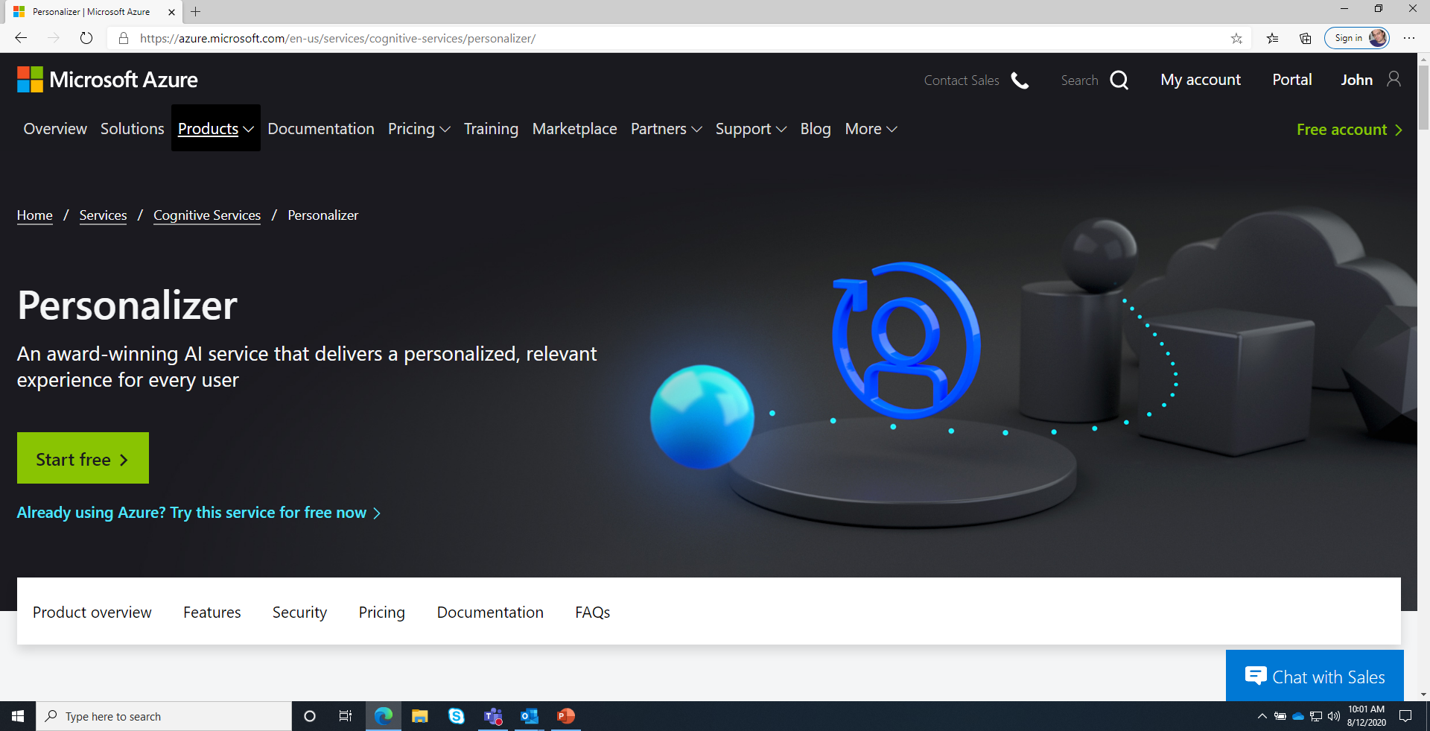
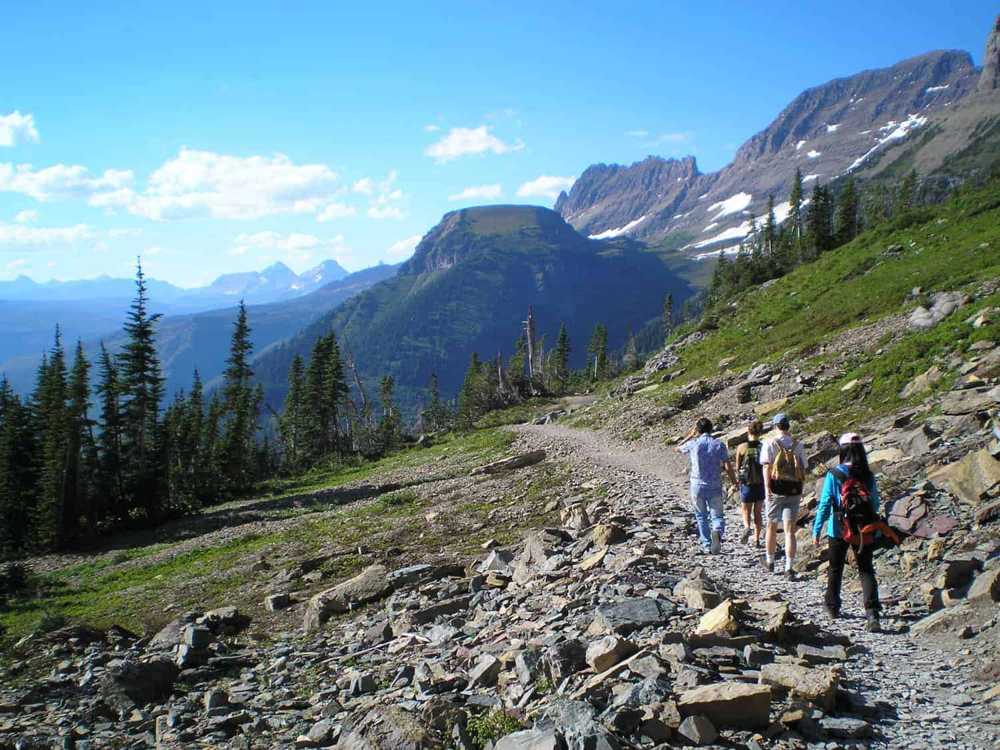
Reinforcement Learning problem Decomposition
Policy Optimization
??
MDP Learning
Contextual Bandits
Generalization
Credit
Exploration

Slide 4



Think about navigation

Slide 5
What’s hard here?
Need good policy to collect good data.
Need good data to create good policy.

Slide 6
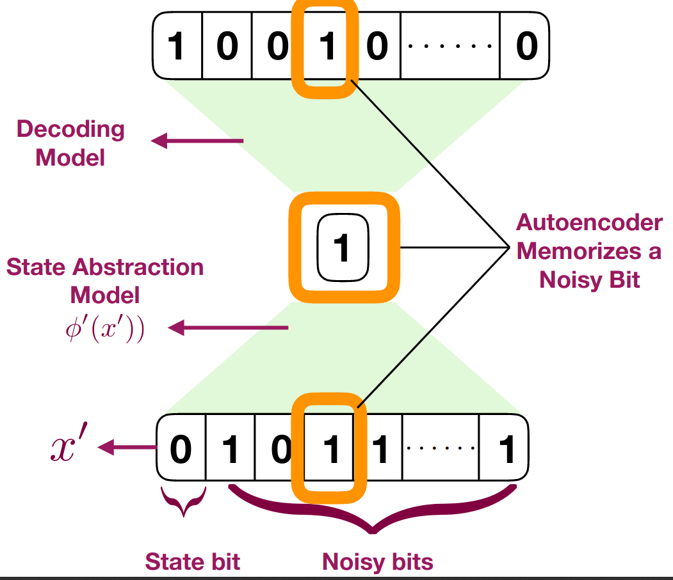
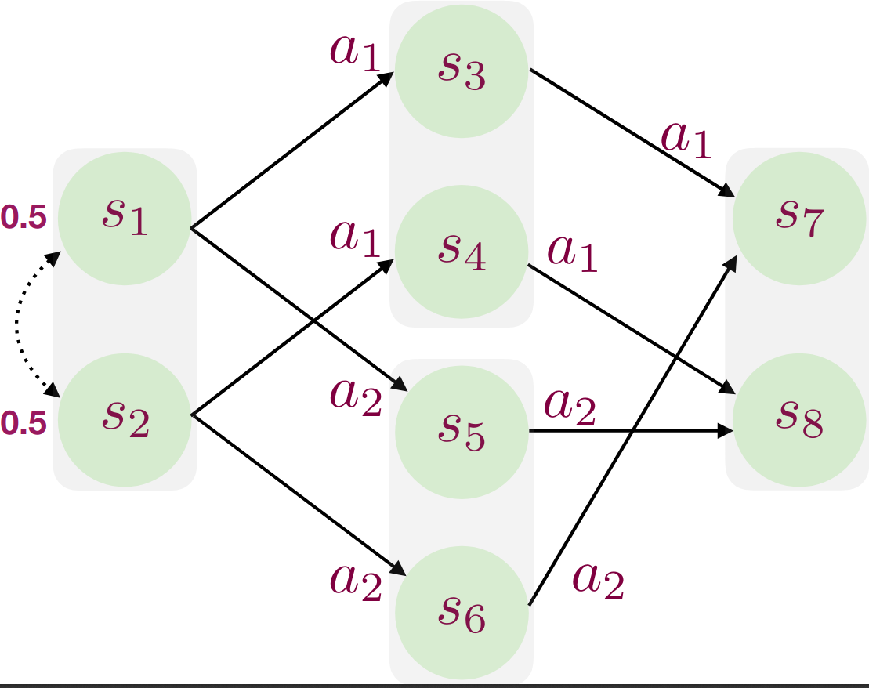
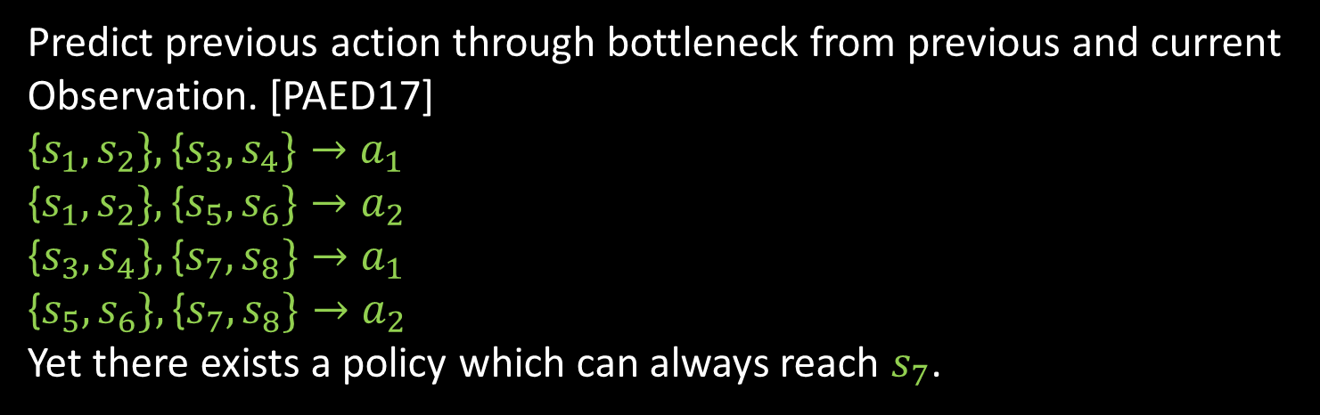
Some things that do not work in general
Bottleneck autoencoder and declare the bottleneck a state. [THFSCDSDA17]
Encoding “quality” is maximized by predicting pure noise bit.
Predict previous action through bottleneck from previous and current
Observation. [PAED17]
{$s_{1},s_{2}\},\text{\{}s_{3},s_{4}\}→a_{1}$
{$s_{1},s_{2}\},\text{\{}s_{5},s_{6}\}→a_{2}$
$$\text{\{}s_{3},s_{4}\},\text{\{}s_{7},s_{8}\}→a_{1}$$
$\text{\{}s_{5},s_{6}\},\text{\{}s_{7},s_{8}\}→a_{2}$
Yet there exists a policy which can always reach $s_{7}$.
“Bisimulation” [GDG03, LWL06]: Alias “states” with the same dynamics & rewards.
Statistically intractable to learn. [MJTS19, Appendix B]

Slide 7





Hard Reinforcement Learning problem
…
Two Start States with a 50% chance each
Every Observation is unique!:
Must generalize
Repeats 100 times with big reward at end:
Googol sparse
9 actions lead astray:
random exploration fails
Different actions leads to 50/50 next states: only closed loop solutions!
Local reward misleads:
must be nongreedy

Slide 8
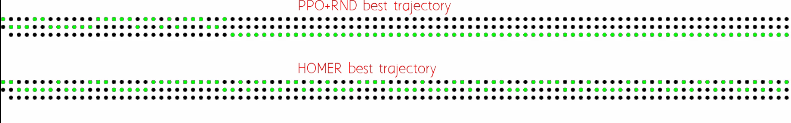
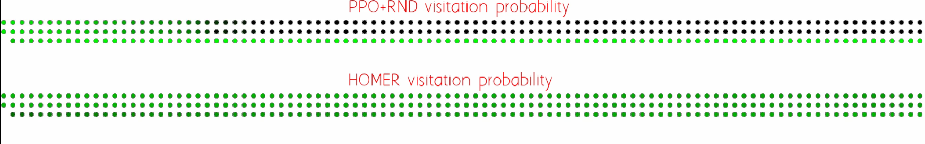
Homer [MHKL19] vs. best baseline on googol problem
Becomes stuck in a bad state
Gets the gold
Good Coverage

Slide 9
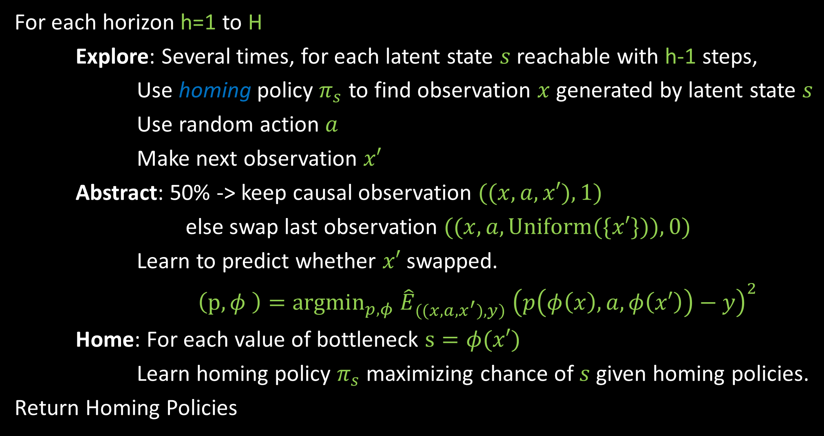
Homer
For each horizon h=1 to H
Explore: Several times, for each latent state $s$ reachable with h-1 steps,
Use homing policy $π_{s}$ to find observation $x$ generated by latent state $s$
Use random action $a$
Make next observation $x′$
Abstract: 50% -> keep causal observation $((x,a,x′),1)$
else swap last observation $((x,a,Uniform(\{x′\})),0)$
Learn to predict whether $x′$ swapped.
$\left(p,φ \right)={argmin}_{p,φ} {\hat{E}}_{((x,a,x^{′}),y)} {\left(p\left(φ\left(x\right),a,φ\left(x′\right)\right)−y\right)}^{2}$
Home: For each value of bottleneck $s=φ(x′)$
Learn homing policy $π_{s}$ maximizing chance of $s$ given homing policies.
Return Homing Policies

Slide 10
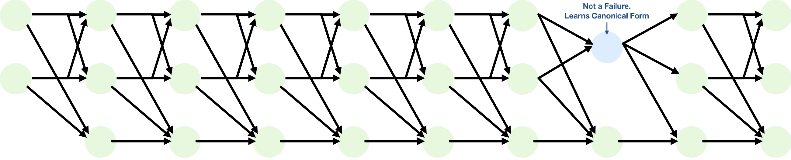
We can also extract the underlying state space!

Slide 11
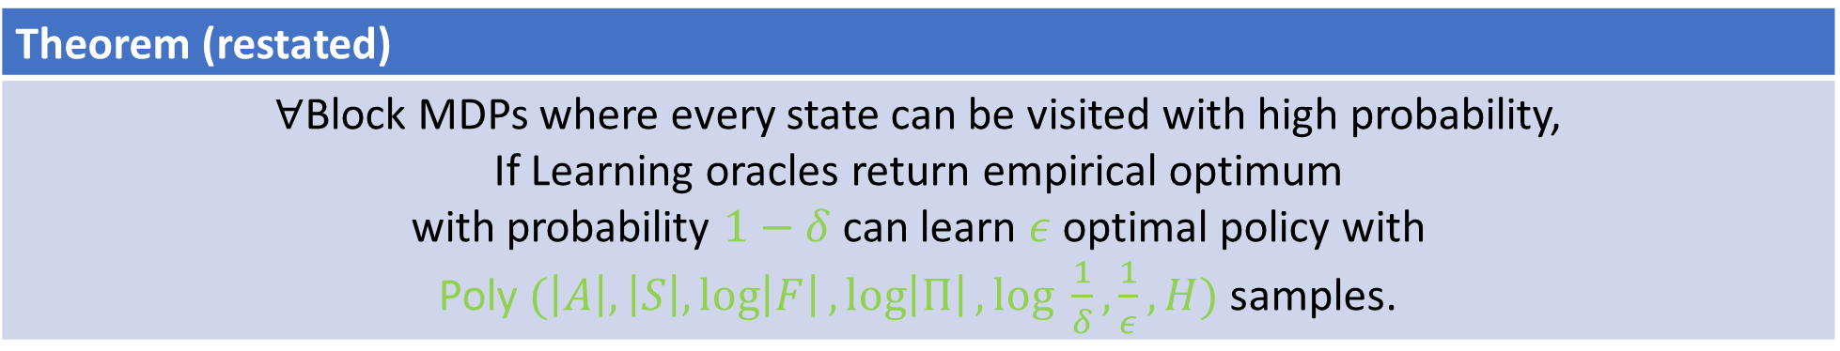
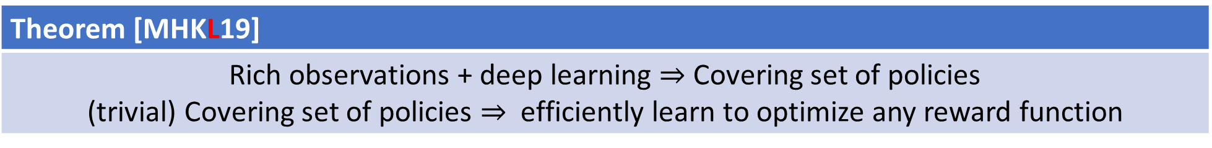
Theorem [MHKL19]
Rich observations + deep learning $⇒$ Covering set of policies (trivial) Covering set of policies $⇒$ efficiently learn to optimize any reward function
Block MDP
States S, Actions A, Transition Matrix T(s’| s, a), Observations q(x|s) with x disjoint over s.
Assumption: Realizability
For each bottleneck regression problem the regressor class can express the answer perfectly. For each contextual bandit learning problem, the policy class can express the answer perfectly.
Theorem (restated)
$∀$Block MDPs where every state can be visited with high probability, If Learning oracles return empirical optimum with probability $1−δ$ can learn $ε$ optimal policy with Poly $(\left|A\right|,\left|S\right|,\log\left|F\right|,\log\left|Π\right|, log \frac{1}{δ},\frac{1}{ε}, H)$ samples.

Slide 12




What if transitions low rank?
T(x’ | x, a)
$$φ(x,a)$$
$$μ(x′)$$
=
Generalizes Block MDP
Statistically Tractable[JKALS16]
Tractable when $φ$ known [JYWJ19]
Yes with FLAMBE [AKKS20].
Key idea: maximize $\sum_{\left\{x,a,x^{′}\right\}}{log φ\left(x,a\right)μ(x^{′})}$ when learning and range $φ(x,a)$ when planning

Slide 13

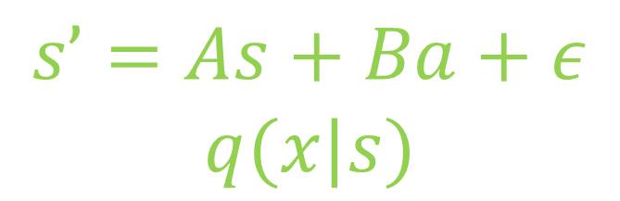
What if latent space has linear dynamics?
$$s’=As+Ba+ε$$
$$q(x|s)$$
Yes… (on arxiv someday soon…)

Slide 14
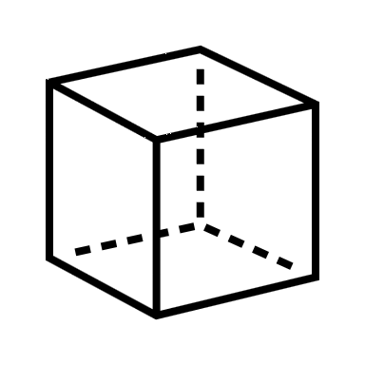
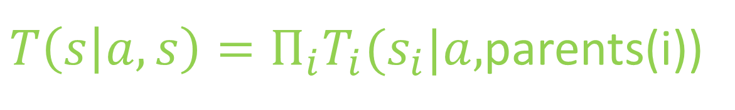
What if latent space is combinatorial?
$T\left(s | a,s\right)=Π_{i}T_{i}(s_{i}|a,$parents(i))
Maybe Yes… still cooking

Slide 15

Complaints (aka research questions)
Theory tractable $→$ practically tractable?
What are other state-deriving learning processes?
What are the qualitative differences between different state-deriving learning processes?
Are there important kinds of latent state which are not learnable?

Slide 16
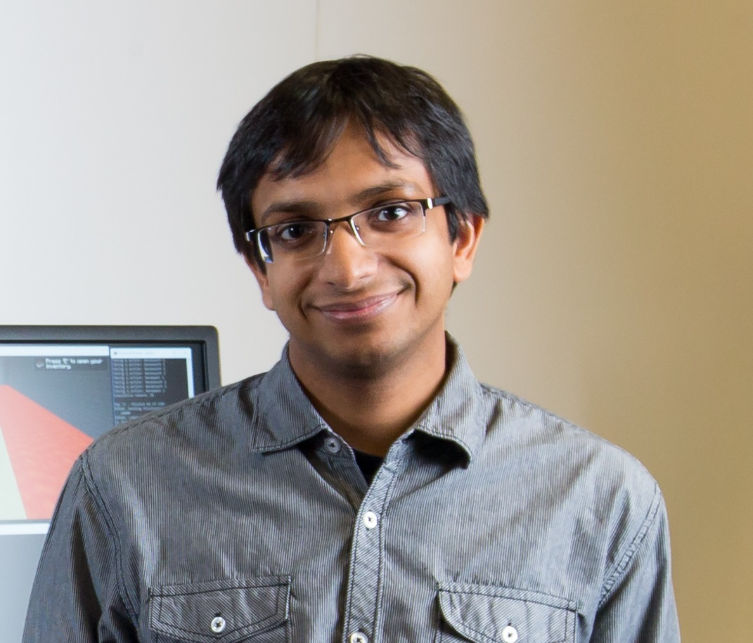
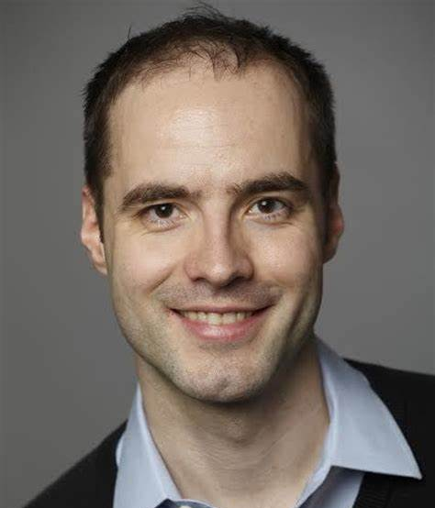
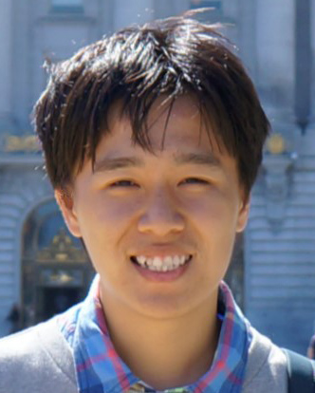
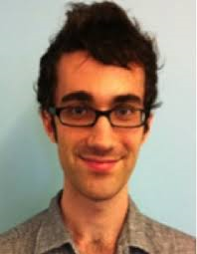
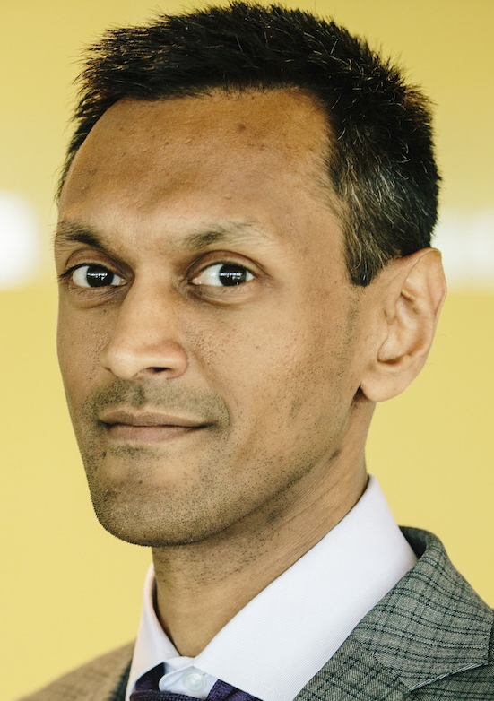



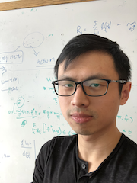
Some of the people I’ve worked with on this project
Alekh Agarwal
Miro Dudik
Nan Jiang
Mikael Henaff
Sham Kakade
Akshay Krishnamurthy
Dipendra Misra
Robert Schapire
Wen Sun

Slide 17
References:
GDG03 Givan, Dean, and Greig. Equivalence notions and model minimization in markov decision processes. Artificial Intelligence, 2003.
LWL06 Li, Walsh, Littman. Towards a unified theory of state abstraction for MDPs. ISAIM 2006.
JKALS16 Jiang, Krishnamurthy, Agarwal, Langford, Schapire. Contextual Decision Processes with Low Bellman Rank are PAC-Learnable, ICML 2017.
PAED17 Pathak, Agrawal, Efros, Darrell. Curiosity-driven exploration byself-supervised prediction. ICML 2017
THFSCDSDA17 Tang, Houthooft, Foote, Stooke, Chen, Duan, Schulman, DeTurck, Abbeel. #Exploration: A study of count-based exploration for deepreinforcement learning. NeurIPS 2017.
JYWJ19 Jin, Yang, Wang, Jordan. Provably Efficient Reinforcement Learning with Linear Function Approximation, Arxiv 2019.
MJTS19 Modi, Jiang, Tewari, Singh. Sample complexity of reinforcementlearning using linearly combined model ensembles. arXiv:1910.10597, 2019.
MHKL20 Misra, Henaff, Krishnamurthy, Langford. Kinematic State Abstraction and Provably Efficient Rich-Observation Reinforcement Learning, ICML 2020.
AKKS20 Agarwal, Kakade, Krishnamurthy, Sun. FLAMBE: Structural Complexity and Representation Learning of Low Rank MDPs, arXiv 2020.

