Slide 1
The Colorful Connected Graph Problem
Richard Karp
Manuel Rodriguez Torres

Slide 2
The Problem
Input: a graph G= (V,E), a set C of colors and a function c from V onto C. c(v) is the color of vertex v.
Problem: Find a connected subgraph with a minimum number of vertices containing at least one vertex of each color.
A perfect solution is a connected subgraph containing exactly one vertex of each color.
NP-complete decision problem: does a perfect solution exist?

Slide 3
A Generalization
Associated with each vertex is a set of eligible colors.
Problem: find a connected subgraph with |C| vertices such that its vertices can be assigned distinct eligible colors.

Slide 4
Applications
Protein-Protein Interaction Networks: the vertices are proteins, the edges indicate physical interactions between proteins, and the eligible colors of a protein are its possible functions in the cell. Each protein must be assigned one color.
Sensor Networks: the vertices are sensors in a distributed network, the edges represent direct communication between sensors, and the eligible colors of a sensor are the activities that it can be assigned to monitor. Each sensor must be assigned one color.
Recruiting a baseball team: the vertices are players, the edges represent acquaintanceships, and the colors of a player are the positions he/she can play.

Slide 5
Dynamic Programming Algorithm
Predicate A(v, S): vertex v lies in a connected subgraph whose vertices can be assigned exactly the set S of colors, without repetition.
Recursively, evaluate the predicate for all pairs (v,S), for increasing values of |S|.
Running time: polynomial in the size of the graph, exponential in the number of colors.

Slide 6
Linear Size Integer Programming Formulation
Choose
An assignment of the colors to distinct eligible vertices
|C|- 1 edges between pairs of chosen vertices
An integral flow on the chosen edges such that one vertex is a sink for |C| -1 units of flow, and the net flow out of each of the other vertices is 1.

Slide 7
The simple case: each vertex has a unique color
The gap of a subgraph H is the minimum number of vertices whose addition to H results in a connected graph.
A subgraph is pure if it contains at most one vertex of each color
A subgraph is colorful if it contains exactly one vertex of each color.
Our goal is to find a colorful subgraph of minimum gap.

Slide 8
Remoteness
The remoteness of vertex v from subgraph H is a list of the distances in G from v to the connected components of H, in increasing order.
The remoteness of color c from H is the lexicographically smallest remoteness from H of a vertex of color c.

Slide 9
Key Subroutine
Sort the colors in increasing order of their frequencies
Construct a nested sequence H₀, H₁, H₂, …
of pure subgraphs, where H₀ is the empty graph and H_{k+1} is obtained from H_{k} by inserting the vertex least remote from H_{k}, among those of color k+1.
Halt when all colors have been included.

Slide 10
A Refinement
Instead of sorting the colors in increasing order of frequency, let the (k+1)th color
be the color whose minimum remotenesss
from H_{k} is greatest.
This refinement is motivated by an analogy to the max-min insertion heuristic for the TSP, in which the next vertex inserted in a growing tour is the one whose cheapest insertion cost is greatest.

Slide 11
Example
L
G Q
E K
P I A J
O F C
H B N D M
R

Slide 12
Example
L
G Q
E K
P I A J
O F C
H B N D M
R

Slide 13
Example
L
G Q
E K
P I A J
O F C
H B N D M
R

Slide 14
Example
L
G Q
E K
P I A J
O F C
H B N D M
R

Slide 15
Example
L
G Q
E K
P I A J
O F C
H B N D M
R

Slide 16
Example
L
G Q
E K
P I A J
O F C
H B N D M
R

Slide 17
Example
L
G Q
E K
P I A J
N O F C
H B N D M
R

Slide 18
Example
L
G Q
E K
P I A J
N O F C
H B N D M
R

Slide 19
Example
L
G Q
E K
P I A J
N O F C
H B N D M
R

Slide 20
Example
L
G Q
E K
P I A J
O F C
H B N D M
R

Slide 21
Example
L
G Q
E K
P I A J
N O F C
H B N D M
R

Slide 22
Example
L
G Q
E K
P I A J
N O F C
H B N D M
R

Slide 23
Example
L
G Q
E K
P I A J
N O F C
H B N D M
R

Slide 24
Example
L
G Q
E K
P I A J
O F C
H B N D M
R

Slide 25
Example
L
G Q
E K
P I A J
O F C
H B N D M
R

Slide 26
Example
L
G Q
E K
P I A J
O F C
H B N D M
R

Slide 27
Example
L
G Q
E K
P I A J
O F C
H B N D M
R

Slide 28
Example
L
G Q
E K
P I A J
O F C
H B N D M
R

Slide 29
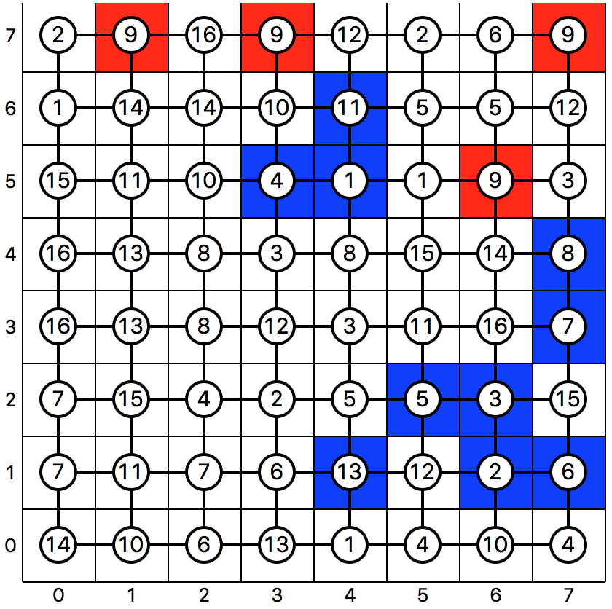
Example of Phase 1

Slide 30
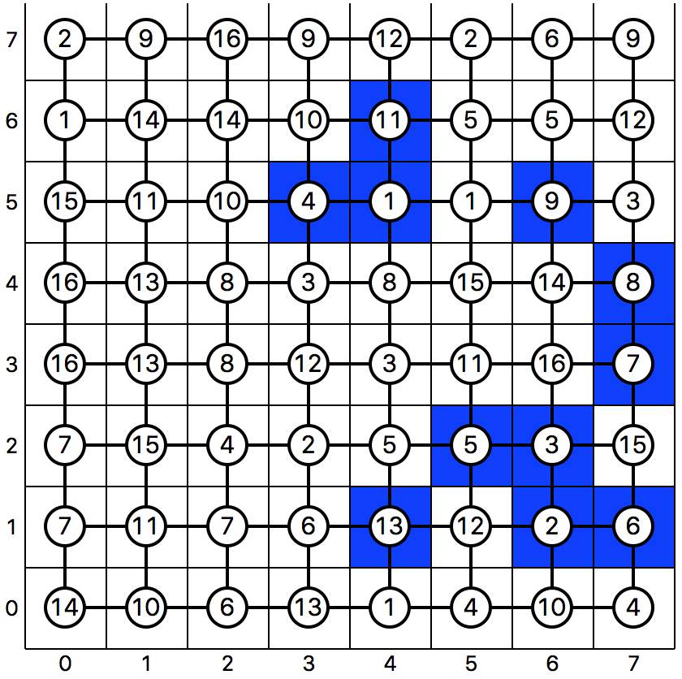
Example of Phase 1

Slide 31
Local Improvement
Start with the result of the key subroutine:
a graph containing one occurrence of each color, but not necessarily connected.
Cycle through the colors. Let the current graph be H. Upon considering color c, delete the vertex v of color c, obtaining H\v. Then insert a random vertex of color c adjacent to the maximum number of connected components of H\v. If no vertex of color c is adjacent to a component, choose a vertex with the lexicographically smallest remoteness from H\v.

Slide 32
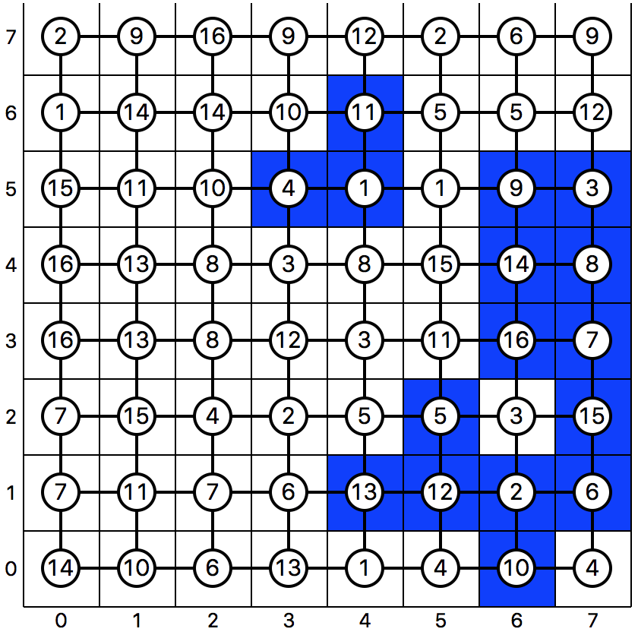
Example of Phase 2

Slide 33
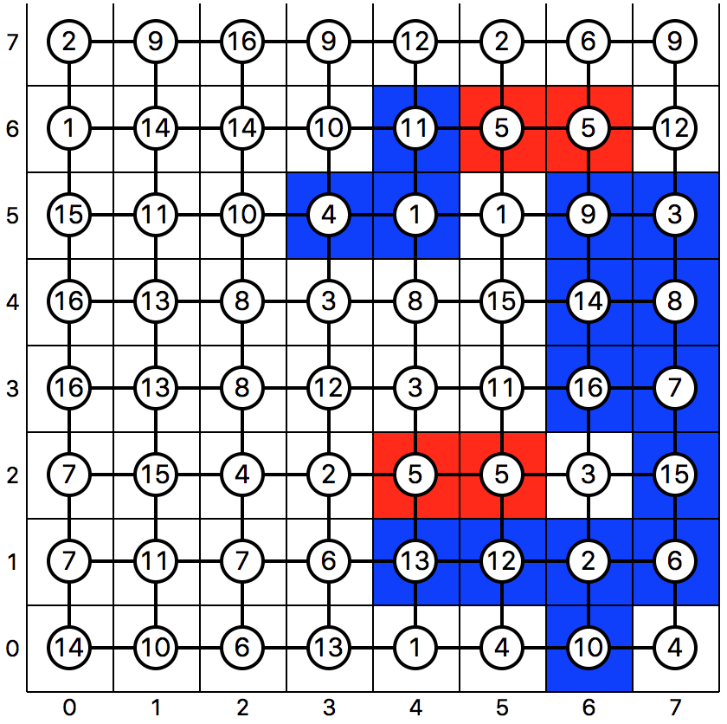
Example of Phase 2

Slide 34
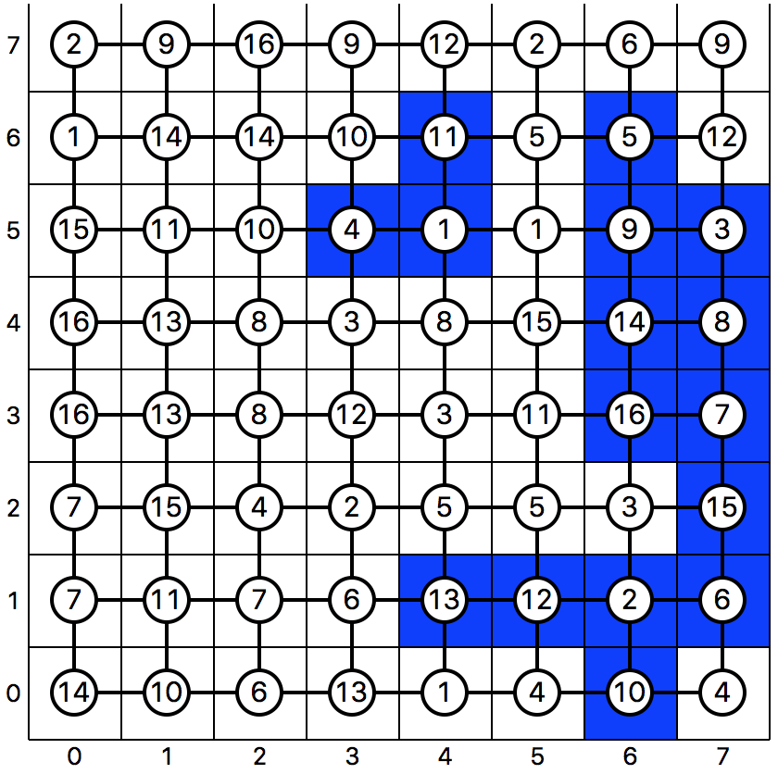
Example of Phase 2

Slide 35
Full Algorithm
Recall: the gap of a pure subgraph H as the minimum number of vertices whose insertion into H creates a connected structure.
Let T be the set of least frequent colors. Choose a set of start vertices whose colors are in T. For each such vertex, run the key subroutine until a t-vertex subgraph is obtained. Among these subgraphs, choose one with minimum gap, and run the key subroutine and local improvement to completion.

Slide 36
Extension to the case where a vertex may have several eligible colors.
A subgraph is assignable if its vertices can be assigned distinct eligible colors.
A subgraph is colorful if it is assignable and has |C| vertices.
Problem: find a colorful subgraph of minimum gap.

Slide 37
Key Subroutine
Sort the colors in increasing order of frequency.
A k-vertex subgraph is perfectly assignable if its vertices can be assigned distinct eligible colors drawn from the first k colors.
Construct perfectly assignable subgraphs H₀, H₁, …, H_{k},... Here H_{k+1}= H_{k} + x, where x is the least remote vertex whose addition to H_{k} yields a perfectly assignable subgraph.

Slide 38
Color Reassignment
The construction of H_{k+1} from H_{k} involves augmenting along an alternating path in the bipartite graph of the eligibility relation between the vertices and the first k+1 colors, starting at the (k+1)th color.
The color assignment to each vertex may change at each iteration.

Slide 39
Random Experimental Model
The graph is a 2-dimensional grid.
In each experiment the dimensions of the grid, the number of colors and the frequency distribution of the colors are chosen.
Colors are assigned randomly to the vertices, subject to the frequency distribution.

Slide 40
Results
In each experiment near-perfect solutions
are obtained in the great majority of runs, except when the number of frequency-1 vertices is large or some colors have extremely high frequency. The more even the frequency distribution, the better the results.

Slide 41
Nonexistence of Perfect Solution
A threshold result from percolation theory implies that a perfect solution is unlikely to exist when a single color is assigned to more than 41% of the nodes. More refined results from percolation theory should yield more refined impossibility results.

Slide 42
Planted Experimental Model
In every case the graph is a 2-dimensional grid.
In each experiment the dimensions of the grid, the number of colors and the frequency distribution of the colors are chosen.
A perfect solution is planted by choosing a random connected subgraph with |C| vertices, choosing a random 1-1 map from the set of colors onto this set of vertices, and completing the color assignment randomly subject to the frequency distribution.

Slide 43
Results
With high probability a perfect solution was found, but it usually was not the planted one.

Slide 44
Results

Slide 45
Finding many perfect solutions in the planted model
Using an oracle for solving the colorful subgraph problem, an implicit enumeration algorithm can list all the perfect solutions.
General step: given a subgraph, find a perfect solution if one exists. Then choose an ordering of the vertices in the solution, and recursively generate ICI subproblems, where the kth subproblem seeks a solution which includes the first k-1 vertices in the solution, and excludes the kth vertex in the solution.
This algorithm generates each perfect solution exactly once.

Slide 46
Generating Many Perfect Solutions
Run the implicit enumeration algorithm, but using our heuristic algorithm in place of the oracle.
Depending on the color frequency distribution, this algorithm generates the planted solution between 20% and 70% of the time. We infer that, if the planted solution is drawn randomly from the set of perfect solutions, then in expectation, the algorithm generates between 20% and 70% of the perfect solutions.

