Slide 1
Efficient reasoning in PAC Semantics
Brendan Juba Harvard University
Notes:
This talk concerns a framework for the analysis of reasoning based on (statistical) data… for use in applications of machine learning We provide principled alternatives to unsupervised learning in an overall application

Slide 2
Outline
What is PAC Semantics?
Validating rules of thumb part 1
Models of partial information
Utilizing partial information (validating rules of thumb part 2)
Algorithms for simpler distributions

Slide 3
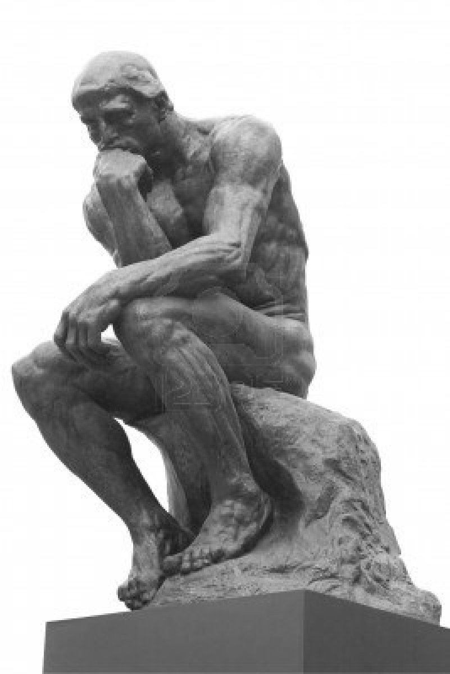
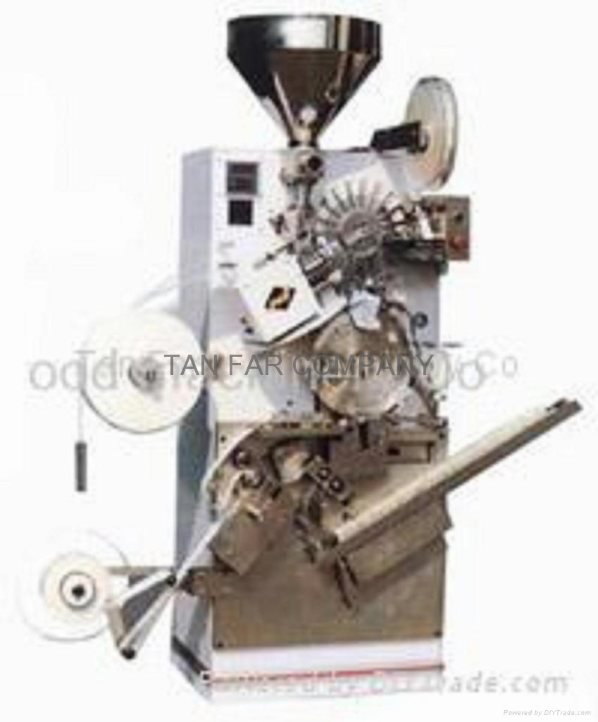
A silly application
Day | Bird no. | Food
107 | 48 | Seed
107 | 49 | Grubs
107 | 50 | Mouse
107 | 51 | Mouse
107 | 52 | Worm
107 | 53 | Seed
107 | 54 | Mouse
107 | 55 | Grubs
… | … | …
Do they FLY?
¬penguin⇒flY PENGUIN⇒EAT(FISH)
¬EAT(FISH) (p = .99)
∴ THEY DO FLY!
DATA MINING!
Notes:
Obtain a feeding log for an aviary. We wonder whether the birds in the aviary fly. We have some prior knowledge: the non-penguins fly and penguins eat fish Performing analytics (ML) on the log, we determine that the birds aren’t eating fish SO, we conclude that the birds of the aviary fly Neither the feeding log nor the prior knowledge alone permits such a conclusion.

Slide 4
SO, WHAT’S THE PROBLEM?

Slide 5
A silly application
Day | Bird no. | Food
107 | 48 | Seed
107 | 49 | Grubs
107 | 50 | Mouse
107 | 51 | Mouse
107 | 52 | Worm
107 | 53 | Seed
107 | 54 | Mouse
107 | 55 | Grubs
… | … | …
Not entirely true!!
Do they FLY?
¬penguin⇒flY PENGUIN⇒EAT(FISH)
¬EAT(FISH) (p = .99)
∴ THEY DO FLY!
DATA MINING!
Notes:
The first clue is the p-value.. Rules obtained from ML *don’t hold with certainty* As a consequence, the results we get are likewise not entirely true—a few penguins may have been recently acquired.

Slide 6
PAC Learning
D
w.p. 1-ε over…
(x’₁,x’₂,…,x’_{n})
C∈C
c(x’₁,x’₂,…,x’_{n})
(x⁽¹⁾₁,x⁽¹⁾₂,…,x⁽¹⁾_{n},c(x⁽¹⁾₁,x⁽¹⁾₂,…,x⁽¹⁾_{n}))
(x⁽²⁾₁,x⁽²⁾₂,…,x⁽²⁾_{n}, c(x⁽²⁾₁,x⁽²⁾₂,…,x⁽²⁾_{n}))
(x^{(m)}₁,x^{(m)}₂,…,x^{(m)}_{n}, c(x^{(m)}₁,x^{(m)}₂,…,x^{(m)}_{n}))
(x⁽¹⁾₁,x⁽¹⁾₂,…,x⁽¹⁾_{n},x⁽¹⁾_{t})
(x⁽²⁾₁,x⁽²⁾₂,…,x⁽²⁾_{n},x⁽²⁾_{t})
(x^{(m)}₁,x^{(m)}₂,…,x^{(m)}_{n},x^{(m)}_{t})
w.p. 1-δ
over…
…
f(x’₁,x’₂,…,x’_{n})
C
e.g., conjunctions, decision trees
f
Notes:
The source of the difficulty traces back to the guarantees provided by learning algorithms… PAC-learning algs take as input a sample of m labeled ex’s (x₁,x₂,…,x_{n},x_{t}) drawn ind. from a dist’n D.
They produce as output a rep’n of a Boolean fn. f(x₁,x₂,…,x_{n}).
If the target attribute x_{t} is produced by some fn. c(x₁,x₂,…,x_{n}) from the concept class C, then w.h.p. over the sample, f is s.t. w.h.p. over new examples drawn from D, f(x₁,x₂,…,x_{n})=x_{t}.

Slide 7
PAC-learning
RECALL: PAC-learning algorithms take as input a sample of m labeled examples (x₁,x₂,…,x_{n},x_{t}) drawn independently from a distribution D.
They produce as output a representation of a Boolean function f(x₁,x₂,…,x_{n}).
If the target attribute x_{t} is produced by some function c(x₁,x₂,…,x_{n}) from the concept class C, then w.h.p. over the sample, f(x₁,x₂,…,x_{n})=x_{t} w.h.p. over new examples drawn from D.
e.g., conjunctions, decision trees
Notes:
The source of the difficulty traces back to the guarantees provided by learning algorithms…

Slide 8
The core conflict
Learned rules are taken as fact in the analysis
What happens if we apply logical inference to the rule “f(x) = x_{t}” produced by PAC-learning?
PAC-learning f(x) for x_{t} only guarantees that f(x) agrees with x_{t} on a 1-ε fraction of the domain.
Knowledge derived from data (examples) is, in general, not “valid” in Tarski’s sense
THE USUAL SEMANTICS OF FORMAL LOGIC.
Notes:
sometimes in applications, such as information extraction, the learned “pattern” is added to a rule base
(because there may always be exceptions that we have not encountered) Other kinds of learning models all have similar caveats unless they utilize pure memorization.
Nevertheless, there *is* some kind of *objective* utility to learned rules, that is not captured in this sense The need for a “PAC” semantics (or something like it) is motivated by this conflict

Slide 9
Why not use…
Probability logic?
We aim for efficient algorithms (not provided by typical probability logics)
Bayes nets/Markov Logic/etc.?
Learning is the Achilles heel of these approaches: Even if the distributions are described by a simple network, how do we find the dependencies?
Notes:
You might have some alternatives in mind. For example, Prob. Logic (as studied by Halpern)… turns out to be *too rich*, and thus inherently intractable
Likewise, these currently popular approaches based on graphical models provide a framework for approaching many problems, but learning has never been achieved in any scalable way.

Slide 10
PAC Semantics (Valiant, 2000) is a weaker standard that captures the utility of knowledge derived from data, conclusions drawn from such knowledge, etc. and permits efficient algorithms

Slide 11
PAC Semantics (for propositional logic)
Recall: propositional logic consists of formulas built from variables x₁,…,x_{n}, and connectives, e.g., ∧(AND), ∨(OR), ¬(NOT)
Defined with respect to a background probability distribution D over {0,1}^{n} (Boolean assignments to x₁,…,x_{n})
Definition. A formula φ(x₁,…,x_{n}) is (1-ε)-valid under D if Pr_{D}[φ(x₁,…,x_{n})=1] ≥ 1-ε.
A RULE OF THUMB…

Slide 12
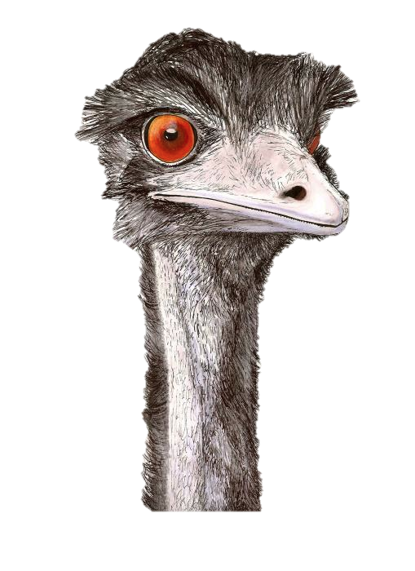
A silly application
Not entirely true!!
Day | Bird no. | Food
107 | 48 | Seed
107 | 49 | Grubs
107 | 50 | Mouse
107 | 51 | Mouse
107 | 52 | Worm
107 | 53 | Seed
107 | 54 | Mouse
107 | 55 | Grubs
… | … | …
Do they FLY?
¬penguin⇒flY PENGUIN⇒EAT(FISH)
¬EAT(FISH) (p = .99)
You forgot about emus!
∴ THEY DO FLY!
DATA MINING!
Notes:
This standard accommodates the kinds of imperfection we encountered in our silly application Explicit modeling of rules of thumb is also useful when even our premises may be sloppy. E.g., Maybe the aviary also acquired some emus, partially invalidating our “penguin rules.” (oops)

Slide 13
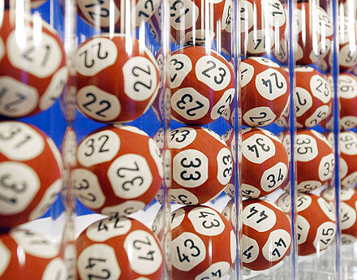
Lottery example (first-order)
Let the universe range over lottery ticket numbers 1,2,…,N
One predicate symbol W (atomic formula) W(i) : “ticket i wins” D: exactly one (uniformly chosen) W(i)=1
Then for every fixed i, ¬W(i) is (1-¹/_{N})-valid But at the same time, ∃t W(t) is 1-valid
Notes:
Here is a nice example using FO logic
it is a good “rule of thumb” that any given lottery ticket will not win, can learn this from experience…. But since the universe is finite, (if “N tickets” also asserted) these formulas are not consistent

Slide 14
Obligatory first-order logic slide
FEEL FREE TO IGNORE THIS SLIDE.
(i.e., expressions with Boolean relation symbols on constants or quantified variables—∀x_{i} or∃x_{j})
Extends to first-order logic by taking the background distribution D to be over Boolean assignments to grounded atomic formulae (relation symbol with all arguments bound).
Limited cases – poly-size universe, bounded arity expressions – tractable by “flattening”
Notes:
The propositional case captures the essence, and we’ll mostly stick to that (I am intentionally omitting function symbols…)
Essentially, we convert the FOL formulas into large propositional formulas, so in that sense the propositional setting captures the “essence.” I don’t know how to handle any cases of FOL other than the one described here.

Slide 15
Outline
What is PAC Semantics?
Validating rules of thumb part 1
Models of partial information
Utilizing partial information (validating rules of thumb part 2)
Algorithms for simpler distributions
Notes:
Now that I’ve said what PAC Semantics *is*, I want to show what one can do with it

Slide 16
Unintegrated
Integrated
Our question: given a query φ and sample of assignments (independently) drawn from D, is φ(x₁,…,x_{n}) (1-ε)-valid?
Examples: x¹,x²,…,x^{m}
Examples: x¹,x²,…,x^{m}
Learning Algorithm
Combined Learning+ Reasoning Algorithm
Such query validation is a useful primitive for
Predicting in special cases, e.g., “φ⇒¬x_{t}”
Policy evaluation (and construction)
Query: “Given ψ, intervention α produces outcome φ”
Rules: ψ₁,ψ₂,…,ψ_{k}
Reasoning Algorithm
Query: φ
Query: φ
Decision: accept/reject
Decision: accept/reject
Notes:
In a traditional “data mining approach” (as illustrated in the silly story), we’d approach the problem like so… we use some measure of “interestingness” to pick out some rules from the data, and then reason about those rules (actually: in many cases, a “data scientist” actually picks them out by hand and does the reasoning by hand!)

Slide 17
The basic theorem
“Theorem” For every “natural” tractable proof system, there is an algorithm that “simulates access” to all rules that “can be verified (1-ε)-valid on examples” when searching for proofs.
Notes:
Says that we can solve the problem of which rules to learn for data mining (CSR, etc.) the algorithm provides a principled alternative to blind unsupervised learning

Slide 18
The full-information setting is easy
For a set of query formulae Q of size |Q|, given O((¹/γ²)(ln|Q|+ln(¹/_{δ}))) examples from D, with probability 1-δ, the fraction of examples satisfying every φ∈Q is within γ of its validity
Notes:
Standard tail bounds give the following… so, any set of polynomial size queries is therefore decidable from a polynomial # of examples
almost all there is to say about estimating validity of queries in the complete information setting

Slide 19
But, in most situations where logical inference is of interest, only partial information is available…

Slide 20
Revisiting the silly application
Day | Bird no. | Food | Flies | Bird
107 | 48 | Seed | ? | ?
107 | 49 | Grubs | ? | ?
107 | 50 | Mouse | ? | ?
107 | 51 | Mouse | ? | ?
107 | 52 | Worm | ? | ?
107 | 53 | Seed | ? | ?
107 | 54 | Mouse | ? | ?
107 | 55 | Grubs | ? | ?
… | … | … | … | …
Day | Bird no. | Food
107 | 48 | Seed
107 | 49 | Grubs
107 | 50 | Mouse
107 | 51 | Mouse
107 | 52 | Worm
107 | 53 | Seed
107 | 54 | Mouse
107 | 55 | Grubs
… | … | …
Do they FLY?
¬penguin⇒flY PENGUIN⇒EAT(FISH)
¬EAT(FISH) (p = .99)
∴ THEY DO FLY!
DATA MINING!

Slide 21
But, in most situations where logical inference is of interest, only partial information is available…
Generally: situations where
Data is unavailable because it is hard to collect or was not collected …and…
A theory (background knowledge) exists relating the observed data to the desired data
Example: Medicine & Biology

Slide 22
Outline
What is PAC Semantics?
Validating rules of thumb part 1
Models of partial information
Utilizing partial information (validating rules of thumb part 2)
Algorithms for simpler distributions

Slide 23
Masking processes
Examples will be {0,1,*}-valued
The * corresponds to a hidden value (from {0,1})
A masking function m : {0,1} ^{n} → {0,1,*}^{n} takes an example (x₁,…,x_{n}) to a masked example by replacing some values with *
A masking process M is a masking function valued random variable
NOTE: the choice of variables to hide may depend on the example!

Slide 24
Example: independent masking
Ind_{μ}(x) = ρ s.t. for each i, ρ_{i} = x_{i} w.p. μ independently (and ρ_{i} = * otherwise)
Appears in (Decatur-Gennaro COLT’95),(Wigderson-Yehudayoff FOCS’12), among others…

Slide 25
Henceforth, we obtain ρ = m(x):
(Validity still defined using D as before)
D
M
(x₁,x₂,…,x_{n})
m
= ρ
Notes:
…by drawing an independent example x from D, and a mask m independently from a fixed masking process M and applying m to x.

Slide 26
Outline
What is PAC Semantics?
Validating rules of thumb part 1
Models of partial information
Utilizing partial information (validating rules of thumb part 2)
Algorithms for simpler distributions
Notes:
Now, on to the integrated algorithms for learning and reasoning. Reasoning algorithms are (ideally) designed with a guarantee that they are complete for a proof system fragment, such as…

Slide 27
Reasoning: Resolution (“RES”)
A proof system for refuting CNFs (AND of ORs)
Equiv., for proving DNFs (ORs of ANDs)
Operates on clauses—given a set of clauses {C₁,…,C_{k}}, may derive
(“weakening”) C_{i}∨l from any C_{i} (where l is any literal—a variable or its negation)
(“cut”) C’_{i}∨C’_{j} from C_{i}=C’_{i}∨x and C_{j}=C’_{j}∨¬x
Refute a CNF by deriving empty clause from it
Notes:
Refuting the CNF means: show that it is not satisfiable
The cut rule is essentially a proof by cases---either x is true or it is false, and either way if Ci and Cj were both sat., some literal in the rest of one of the clauses must be satisfied deriving the (unsat.) empty clause refutes the CNF since the rules are sound

Slide 28
Tractable fragments of RES
Bounded-width
Treelike, bounded clause space
∅
x_{i}
¬x_{i}
…
¬x_{i}∨x_{j}
¬x_{i}∨¬x_{j}

Slide 29
Since resolution is sound, when there is a proof of our query φ from a (1-ε)-valid CNF ψ under D, then φ is (1-ε)-valid under D as well.
…useful when there is another CNF ψ that is easier to test for (1-ε)-validity using data…
{0,1}^{n}
φ sat.
ψ sat.
Notes:
Model-theoretically: sat. assignments of psi are also sat. assignments of phi, so validity of phi can only be greater.

Slide 30
Testable formulas
Definition. A formula ψ is (1-ε)-testable under a distribution over masked examples M(D) if Pr_{ρ∈M(D)}[ψ|_{ρ}=1] ≥ 1-ε

Slide 31
Restricting formulas
Given a formula φ and masked example ρ, the restriction of φ under ρ, φ|_{ρ}, is obtained by “plugging in” the values of ρ_{i} for x_{i} whenever ρ_{i} ≠ * (i.e., φ|_{ρ} is a formula in the unknown values)

Slide 32
Testable formulas
Definition. A formula ψ is (1-ε)-testable under a distribution over masked examples M(D) if Pr_{ρ∈M(D)}[ψ|_{ρ}=1] ≥ 1-ε
We will aim to succeed whenever there exists a (1-ε)-testable formula that completes a simple proof of the query formula…
Observation: equal to “ψ is a tautology given ρ” in standard cases where this is tractable, e.g., CNFs, intersections of halfspaces; remains tractable in cases where this is not, e.g., 3-DNFs
Notes:
…testability is a “base case”—given a testable formula, we reason about its clauses, and we expect to be able to derive any conclusions that follow from a testable formula (according to our tractable proof system fragment)

Slide 33
Unintegrated
Integrated
Examples: x¹,x²,…,x^{m}
Examples: x¹,x²,…,x^{m}
Learning Algorithm
Combined Learning+ Reasoning Algorithm
Rules: ψ₁,ψ₂,…,ψ_{k}
Query: φ
Useful, testable rules: ψ₁,ψ₂,…,ψ_{k}
Reasoning Algorithm
Query: φ
Decision: accept/reject
Decision: accept/reject
Notes:
In analogy to the rules blindly produced by the learning algorithm in the two-stage setting,
We are setting some “completeness” condition for such rules, namely:
we expect the combined algorithm to be capable of learning such testable rules (as “premises” for reasoning); the benefit is that, moreover, using the query, we can also expect it to zero in on the useful “premises”

Slide 34
The basic theorem, revisited
We will distinguish the following:
The query φ is not (1-ε)-valid
There exists a (1-ε)-testable formula ψ for which there exists a [space-s treelike] resolution proof of the query φ from ψ
LEARN ANY ψ THAT HELPS VALIDATE THE QUERY φ.
N.B.: ψ MAY NOT BE 1-VALID
Notes:
…as, for example, our lottery “rules of thumb” weren’t. We would like to allow the use of such psi even if there are occasional counterexamples Similar to agnostic learning: we would like to validate phi even if it is not perfectly valid

Slide 35
Tractable fragments of RES
Bounded-width
Treelike, bounded clause space
Applying a restriction to every step of proofs of these forms yields proofs of the same form (from a refutation of φ, we obtain a refutation of φ|_{ρ} of the same syntactic form)

Slide 36
The basic algorithm
Given a query DNF φ and {ρ₁,…,ρ_{k}}
For each ρ_{i}, search for [space s] refutation of ¬φ|_{ρi}
If the fraction of successful refutations is greater than (1-ε), accept φ, and otherwise reject.
CAN ALSO INCORPORATE a “background knowledge” CNF Φ

Slide 37
Analysis
Note that resolution is sound…
So, whenever a proof of φ|_{ρi} exists, φ was satisfied by the example from D
If φ is not (1-ε-γ)-valid, tail bounds imply that it is unlikely that a (1-ε) fraction satisfied φ
On the other hand, consider the [space-s] proof of φ from the (1-ε+γ)-testable CNF ψ…
With probability (1-ε+γ), all of the clauses of ψ simplify to 1
The restricted proof does not require clauses of ψ
Notes:
(BRIEF VERSION: if we apply the restriction to the resolution proof, the testable formula “drops out”) …All we are doing is applying a tail bound for each of the p(n) size DNF falling in one of the two cases trivial counting gives the claimed bound on the number of size-p(n) DNF So, this is a natural, tractable special case of the problem

Slide 38
Also works for…
Bounded width k-DNF resolution
L₁-bounded, sparse cutting planes
Degree-bounded polynomial calculus
(more?)
Requires that restrictions preserve the special syntactic form
Such FRAGMENTS are “NaturaL” (Beame-Kautz-sabharwal, JAIR 2004)

Slide 39
Simultaneously reasoning and learning (1-ε)-testable formulas from partial information is no harder than classical reasoning alone in essentially all “natural” tractable fragments.
Are there cases where it is easier?

Slide 40
Outline
What is PAC Semantics?
Validating rules of thumb part 1
Models of partial information
Utilizing partial information (validating rules of thumb part 2)
Algorithms for simpler distributions

Slide 41
“Unsupervised parity learning”
Parity learning: assume x_{t} = ⊕_{i∈S}x_{i} for some S
Equivalently: 0 = x_{t}⊕(⊕_{i∈S}x_{i})
More generally: x satisfies Ax = b over F₂
“Affine distribution” the uniform distribution over solutions
We hope to learn to reason about the parity constraints using partial examples
Theorem. It is NP-hard to distinguish w.p. 1-δ, for p∈Q[x₁,…x_{n}] of O(log²(n))-degree and an affine distribution D, whether
[p(x₁,…,x_{n})=0] is (1-ε)-valid for D or at most ε-valid using quasipolynomially many examples from Ind_{μ}(D). (Even with 1/ε,1/δ∼poly(n))
Moral: still a hard example… but, PCR/RES get easier!
Notes:
“unsupervised” generalization of learning parities under unif. dist’n in restricted focus of attention model (Ben-David & Dichterman) that task is provably hard w.r.t. *this query-answering application,* the hardness can be circumvented more specifically “polynomial” queries are still hard to answer in general, but the efficiency of the theorem-proving algs. for PCR & RES improves

Slide 42
Theorem: There is a quasipolynomial-time algorithm that, given access to examples from Ind_{μ}(D) for affine distribution D distinguishes
(ε+γ)-valid CNF φ under D from
CNF φ for which there exists a CNF ψ that is (1-ε+γ)-testable and there is a resolution refutation of φ∧ψ of a given size p(n)
with probability 1-δ.
cf. n^{√n}-TIME ALGORITHMS
NOT:TREELIKE, BOUNDED-DEGREE, etc
Notes:
…again, that is, proving the negation of phi
Interesting because the best known algorithms (first by Clegg-Edmonds-Impagliazzo ’96) only “automatize” RES in time exp(sqrt(n)) conjectured not to be possible even in quasipolynomial time in the usual sense (cf. Alekhnovich-Razborov ’08)

Slide 43
Bias gap distributions
Suppose: given a tuple of literals (l*,l₁,…,l_{k}), Pr[l*=1|l₁,…,l_{k}] ≥ β and Pr[l*=0|l₁,…,l_{k}] ≥ β. We then say l* is β-balanced for (l₁,…,l_{k}).
Suppose: given a tuple of literals (l*,l₁,…,l_{k}), Pr[l*=b|l₁,…,l_{k}] ≥ 1-η for some b. We then say l* is (1-η)-implied by (l₁,…,l_{k}).
If for every tuple of distinct literals (l*,l₁,…,l_{k}), l* is either β-balanced or (1-η)-implied, then the distribution has a (β, 1-η)-bias gap
Notes:
The abstract property of these affine distributions we use is as follows… (e.g., the uniform distribution is ½-balanced)

Slide 44
Bias gap distributions
If for every tuple of distinct literals (l*,l₁,…,l_{k}), l* is either β-balanced or (1-η)-implied, then the distribution has a (β, 1-η)-bias gap
Uniform distribution over solutions to a system of parity constraints has a (½,1)-bias gap

Slide 45
PCR: derive [-1=0] using linear combination or multiplication by x_{i} or ¬x_{i}, given “Boolean axioms” [x_{i}²=x_{i}] and “complementarity axioms” [1-x_{i}=¬x_{i}]
Theorem: There is a quasipolynomial-time algorithm that, given access to examples from Ind_{μ}(D) for D with a (β, 1-q(n))-bias gap (for a quasipolynomially small q(n)) distinguishes
(ε+γ)-valid polynomial system φ under D from
Polynomial systems φ for which there exists a polynomial system ψ that is (1-ε+γ)-testable and there is a polynomial calculus with resolution refutation of φ∧ψ of size p(n)
with probability 1-δ.
Notes:
…again, that is, proving the negation of phi
Interesting because the best known algorithms (first by Clegg-Edmonds-Impagliazzo ’96) only “automatize” PCR in time exp(sqrt(n))

Slide 46
Theorem: There is a quasipolynomial-time algorithm that, given access to examples from Ind_{μ}(D) for (½, 1)-bias gap distribution D distinguishes
(ε+γ)-valid CNF φ under D from
CNF φ for which there exists a CNF ψ that is (1-ε+γ)-testable and there is a resolution refutation of φ∧ψ of a given size p(n)
with probability 1-δ.
Notes:
What I’ll try to argue is the following, simpler claim …again, that is, proving the negation of phi
the best known algorithms similarly only “automatize” RES in time exp(sqrt(n)) conjectured not to be possible even in quasipolynomial time in the usual sense (cf. Alekhnovich-Razborov ’08)

Slide 47
Warm-up: uniform distribution
Under Ind_{μ}(U_{n})… (constant μ)
Clauses of width Ω(log γ) are (1-γ)-testable
Theorem, uniform case: width-based alg…
ρ: x = 0
y = *
z = 0
x∨y∨¬z
y∨¬z
∅
ρ:
width O(log γ)…
Notes:
start by just considering the reasoning problem over unif. dist’n (no learning involved here) …Again, testable clauses “drop out” of the RES refutation, so the refutation consists only of narrow clauses

Slide 48
Generalizing to affine dist’ns
Clauses with subclauses of width Ω(log γ) containing only balanced tuples (l*,¬l₁,…,¬l_{k}) are also (1-γ)-testable
Suppose b=1 for all implied subclauses—that is, Pr[l*=1|¬l₁,…,¬l_{k}] = 1 for l*∨l₁∨…∨l_{k}
Clauses with Ω(log γ) such subclauses are also (1-γ)-testable
Final case: clauses s.t. every subclause of width Ω(log γ) contains a subclause with b=0
Notes:
So, if the clauses have only subclauses that are balanced or implied true, they are testable. The only interesting remaining case is when as soon as the subclause is sufficiently wide, it contains a literal that is implied false.

Slide 49
Handling negative bias
Final case: clauses s.t. every subclause of width Ω(log γ) contains a subclause with b=0
i.e. they have a subclause l*∨l₁∨…∨l_{k} of width O(log γ) with Pr[l*=0|¬l₁,…,¬l_{k}] = 1
¬l*∨l₁∨…∨l_{k} is 1-valid and of width O(log γ)
Use it to eliminate l* via cut rule
We can learn narrow (1-η)-valid clauses from examples where they are unmasked (Ind_{μ}(D))
Notes:
…for this to happen, subclauses right at the threshold for sufficient width O(log gamma) must have literals implied false. If we had these clauses, we use them to eliminate these “irrelevant,” false literals
But actually, we *can* learn these clauses directly and explicitly by testing them on ex’s

Slide 50
Learning all narrow clauses
Can learn narrow (1-η)-valid clauses from examples where they are unmasked (Ind_{μ}(D))
Clauses of width O(log n) are simultaneously unmasked with probability poly(n)
Independent masks ⇒ the validity of narrow clauses can be estimated from these examples
Setting η: the conjunction of all O(log n)-width (1-q(n))-valid clauses is (1-γ)-valid

Slide 51
The algorithm.
Learn all O(log n)-narrow (1-q(n))-valid clauses from examples with the clause unmasked.
Use these narrow clauses to eliminate literals from input query.
Search for O(log n)-narrow refutations of restrictions of the query + narrow clauses under masked examples. (Use basic alg.)
Notes:
(using the basic alg from the previous section with a width bound)

Slide 52
Why is there a narrow refutation?
∅
ρ:
width 2C log n
width C log n
width C log n
The only surviving wide clauses have, in every narrow subclause l*∨l₁∨…∨l_{k} a literal l* with Pr[l*=0|¬l₁,…,¬l_{k}] = 1
Notes:
Recall: Under a restriction, testable clauses in the proof vanish w.h.p.

Slide 53
Why is there a narrow refutation?
The only surviving wide clauses have, in every narrow subclause l*∨l₁∨…∨l_{k} a literal l* with Pr[l*=0|¬l₁,…,¬l_{k}] = 1
¬l*∨l₁∨…∨l_{k} is 1-valid & of width O(log n)
width 2C log n
width C log n
¬l*₃
¬l*₂
width C log n
Inductively… overall width 2C log n
¬l*₁
…
width C log n
Learned clauses
Notes:
so inductively, each time we simulate a proof step we may reach twice the “target” width bound but then we are guaranteed that we can reduce the width to the “target” bound by eliminating these l*

Slide 54
Why is there a narrow refutation?
Under a restriction, testable clauses in the proof vanish w.h.p.
The only surviving wide clauses have, in every narrow subclause l*∨l₁∨…∨l_{k} a literal l* with Pr[l*=0|¬l₁,…,¬l_{k}] ≥ 1-η
We can simulate the original proof in low-width by eliminating these superfluous l* after each proof step.
Notes:
…so inductively, each time we simulate a proof step we may reach twice the “target” width bound but then we are guaranteed that we can reduce the width to the “target” bound by eliminating these l*

Slide 55
Theorem: There is a quasipolynomial-time algorithm that, given access to examples from Ind_{μ}(D) for D with a (β, 1-q(n))-bias gap (for a quasipolynomially small q(n)) distinguishes
(ε+γ)-valid polynomial system φ under D from
Polynomial systems φ for which there exists a polynomial system ψ that is (1-ε+γ)-testable and there is a polynomial calculus with resolution refutation of φ∧ψ of size p(n)
with probability 1-δ.
Notes:
The stronger claim again… The argument is mostly just a generalization, using the CEI degree-based algorithm the main twist we didn’t show is that we can convert from one “reduction order” to another in low-degree

Slide 56
In summary…
PAC Semantics captures the utility of learnable “rules of thumb” in logical reasoning
For “natural” tractable fragments of proof systems, learned premises pose no extra cost
The complexity of proof systems may even improve under PAC Semantics

Slide 57
Open problems
Can we find an explicit (testable) formula ψ and a proof of the query φ from ψ?
Can easily find a (1-ε)-valid ψ’ when a 1-valid ψ actually exists using a different algorithm
Like “restriction access” (Dvir et al., ITCS’12) learning of decision trees, except that we don’t always get the same proof.
Notes:
(…so the challenge is finding some premise formula when we only have ones with noticeably imperfect validity—akin to the challenge in agnostic learning)

Slide 58
Open problems
Broadening the settings and classes of queries for which we can verify (1-ε)-validity
Can we generalize the “bias gap” to arbitrary distributions?
Can we weaken the assumption of Ind_{μ} masking processes to, e.g., merely uncorrelated masks?
Can we obtain analogues for cutting planes or k-DNF resolution?
Notes:
(uncorrelated seems important here since we want to infer something about the masked attributes to beat the “worst-case” behavior) (cutting planes are *very* natural from a learning perspective, so there is reason to hope)

Slide 59
J. Implicit learning of common sense for reasoning. IJCAI’13 (also arXiv:1209.0056)
J. Restricted distribution automatizability in PAC-Semantics. 2013. (http://people.seas.harvard.edu/~bjuba/papers/rdaut.pdf)
L. Michael. Partial Observability and Learnability. Artificial Intelligence 174:639—669, 2010.
L. Michael. Reading between the lines. IJCAI’09.
L. Valiant. Robust Logics. Artificial Intelligence 117:231—253, 2000.

