Slide 1
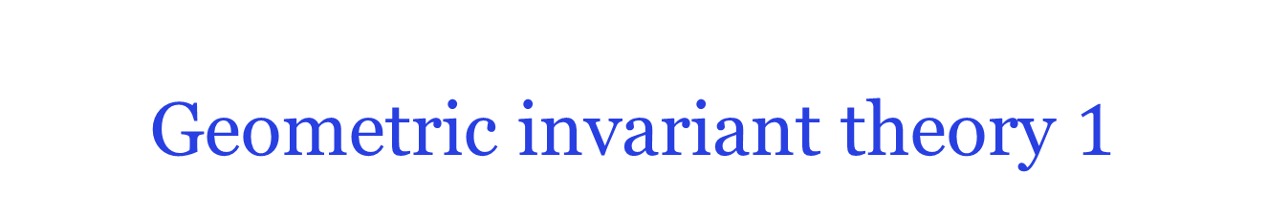
Geometric invariant theory $1$
Ankit Garg
Microsoft Research New England

Slide 2
Overview
Geometric invariant theory: geometric and analytic tools to study invariant theory.
General source of scaling theorems.
Matrix scaling, Forster’s theorem, operator scaling all special cases.
Non-commutative extension of Farkas’ lemma, LP duality.
Michael’s talk: GIT for orbit-closure intersection and moment polytopes.
Notes:
The hope is that after this tutorial, you will be able to invent your own scaling theorems and possibly even interesting ones.

Slide 3
Outline
Recall: null cone.
Hilbert-Mumford criterion.
Kempf-Ness theorem.
Examples: matrix, operator and tensor scaling.
Proofs.

Slide 4
Null cone: definition

Slide 5
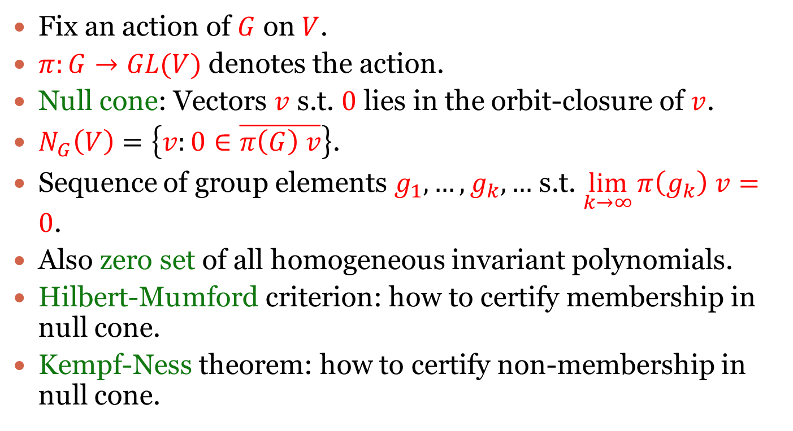
Null cone
Fix an action of $G$ on $V$.
$π:G→GL(V)$ denotes the action.
Null cone: Vectors $v$ s.t. $0$ lies in the orbit-closure of $v$.
$N_{G}\left(V\right)=\left\{v:0∈\overline{π\left(G\right) v}\right\}$.
Sequence of group elements $g_{1},…,g_{k},…$ s.t. $\lim_{k→∞}{π\left(g_{k}\right) v}=0$.
Also zero set of all homogeneous invariant polynomials.
Hilbert-Mumford criterion: how to certify membership in null cone.
Kempf-Ness theorem: how to certify non-membership in null cone.
Notes:
Group G = GL_n, SL_n, diagonal subgroups of these, direct products and so on.
G needs to be algebraic and reductive in general.

Slide 6
Hilbert-Mumford: certifying membership in null cone

Slide 7
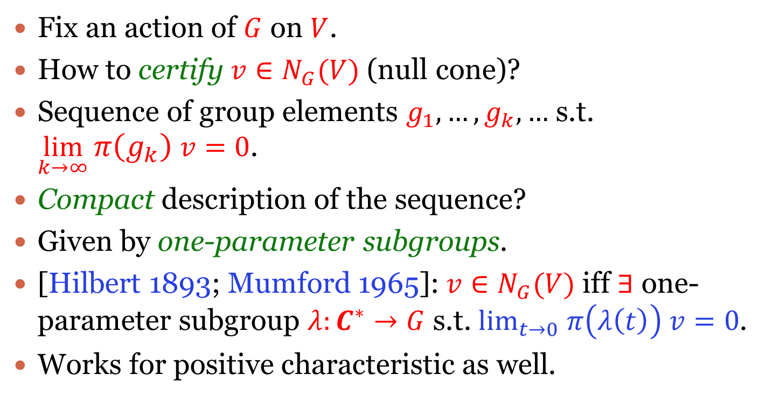
Hilbert-Mumford
Fix an action of $G$ on $V$.
How to certify $v∈N_{G}(V)$ (null cone)?
Sequence of group elements $g_{1},…,g_{k},…$ s.t. $\lim_{k→∞}{π\left(g_{k}\right) v}=0$.
Compact description of the sequence?
Given by one-parameter subgroups.
[Hilbert 1893; Mumford 1965]: $v∈N_{G}(V)$ iff $∃$ one-parameter subgroup $λ:C^{∗}→G$ s.t. $\lim_{t→0} π\left(λ\left(t\right)\right) v=0$.
Works for positive characteristic as well.

Slide 8
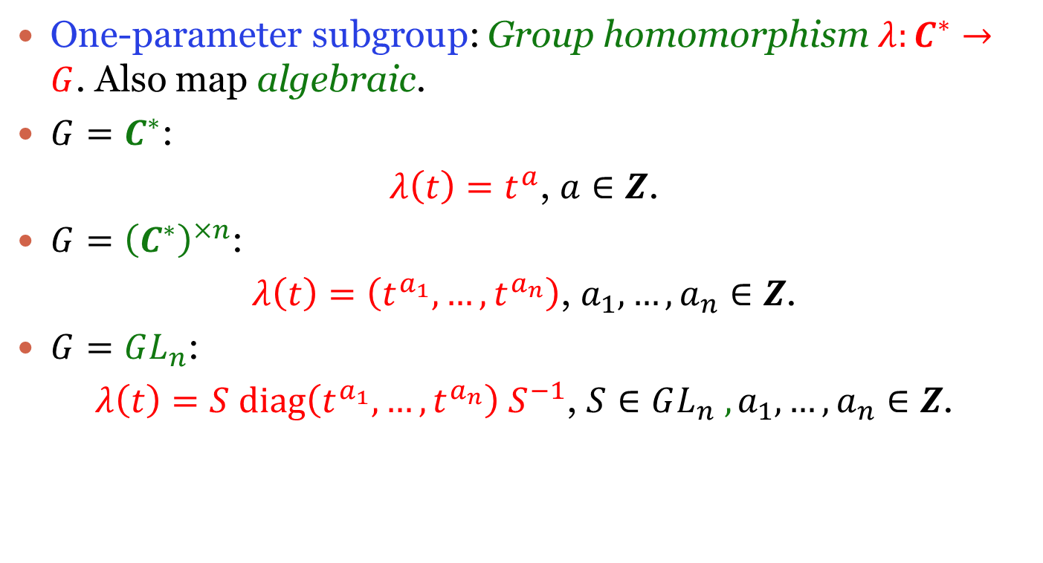
One-parameter subgroups
One-parameter subgroup: Group homomorphism $λ:C^{∗}→G$. Also map algebraic.
$G=C^{∗}$:
$λ\left(t\right)=t^{a}$, $a∈Z$.
$G={\left(C^{∗}\right)}^{×n}$:
$λ\left(t\right)=\left(t^{a_{1}},…,t^{a_{n}}\right)$, $a_{1},…,a_{n}∈Z$.
$G=GL_{n}$:
$λ\left(t\right)=S diag\left(t^{a_{1}},…,t^{a_{n}}\right) S^{−1}$, $S∈GL_{n} ,a_{1},…,a_{n}∈Z$.
Notes:
Entries of lambda(t) rational functions of t.

Slide 9
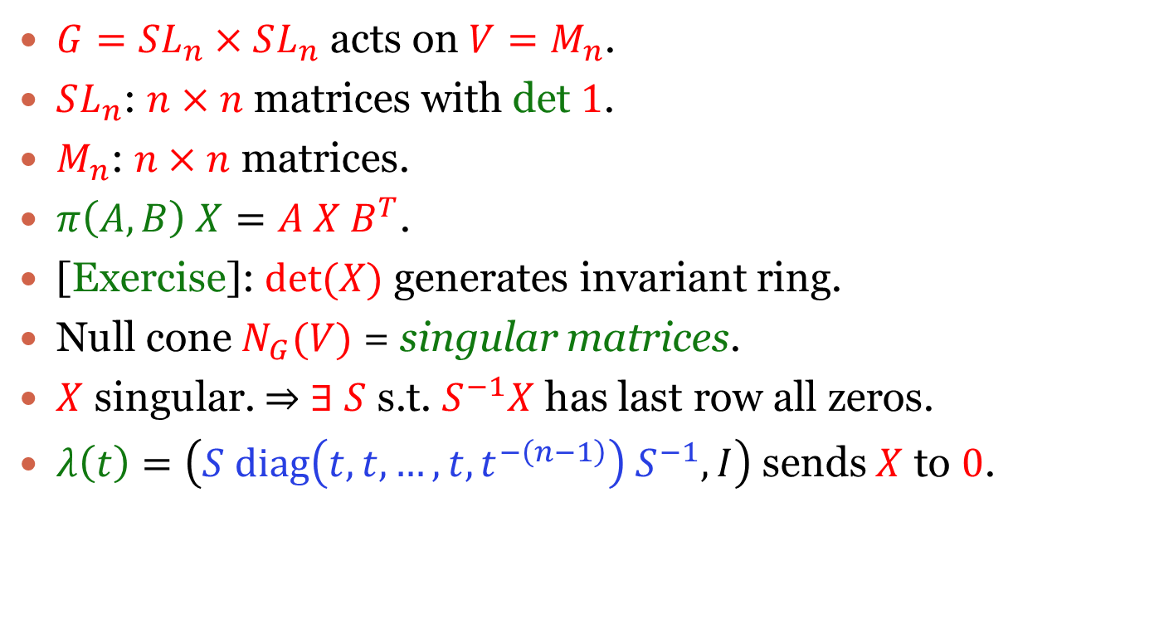

Example $1$
$G=SL_{n}×SL_{n}$ acts on $V=M_{n}$.
$SL_{n}$: $n×n$ matrices with det $1$.
$M_{n}$: $n×n$ matrices.
$π\left(A,B\right) X=A X B^{T}$.
[Exercise]: $det⁡(X)$ generates invariant ring.
Null cone $N_{G}(V)$ = singular matrices.
$X$ singular. $⇒$ $∃$ $S$ s.t. $S^{−1}X$ has last row all zeros.
$λ\left(t\right)=\left(S diag\left(t,t,…,t,t^{−\left(n−1\right)}\right) S^{−1},I\right)$ sends $X$ to $0$.

Slide 10
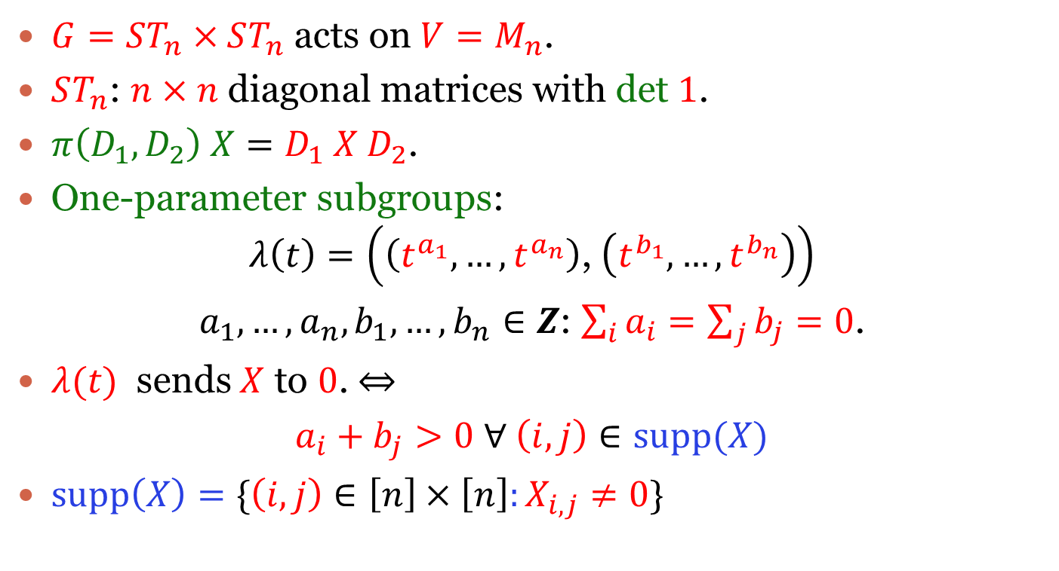

Example $2$
$G=ST_{n}×ST_{n}$ acts on $V=M_{n}$.
$ST_{n}$: $n×n$ diagonal matrices with det $1$.
$π\left(D_{1},D_{2}\right) X=D_{1} X D_{2}$.
One-parameter subgroups:
$$λ\left(t\right)=\left(\left(t^{a_{1}},…,t^{a_{n}}\right)\text{, }\left(t^{b_{1}},…,t^{b_{n}}\right)\right)$$
$a_{1},…,a_{n},b_{1},…,b_{n}∈Z$: $\sum_{i}{a_{i}=\sum_{j}{b_{j}=0}}$.
$λ(t)$ sends $X$ to $0$. $⇔$
$a_{i}+b_{j}>0$ $∀ \left(i,j\right)∈supp(X)$
$supp\left(X\right)=\{\left(i,j\right)∈\left[n\right]×\left[n\right]:X_{i,j}≠0\}$

Slide 11
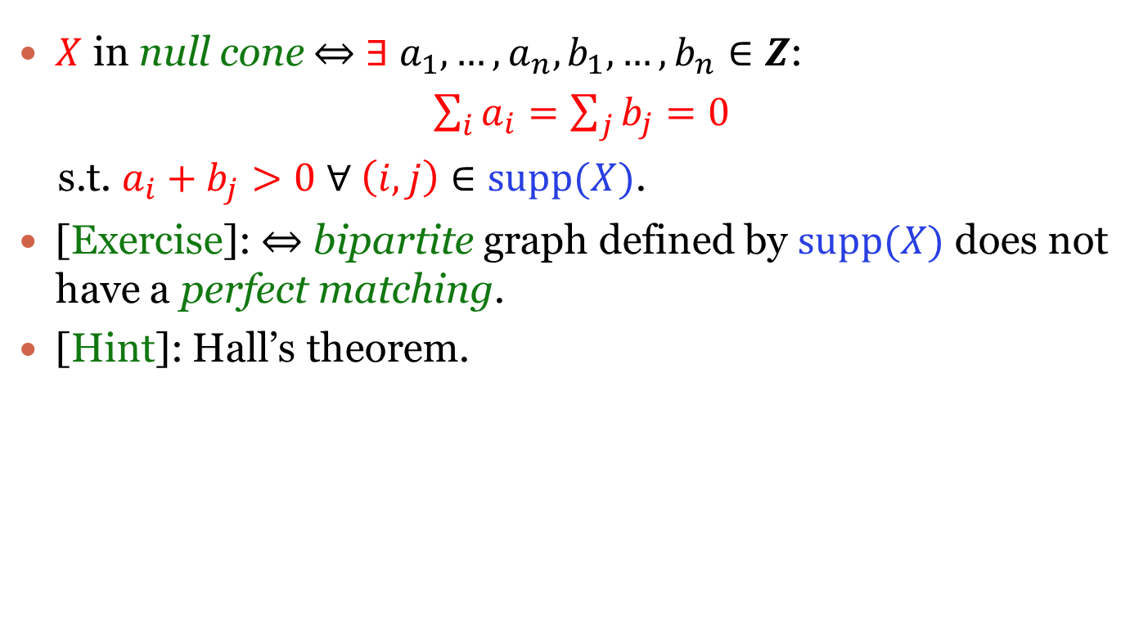
Example $2$
$X$ in null cone $⇔$ $∃$ $a_{1},…,a_{n},b_{1},…,b_{n}∈Z$:
$\sum_{i}{a_{i}=\sum_{j}{b_{j}=0}}$
s.t. $a_{i}+b_{j}>0$ $∀ \left(i,j\right)∈supp(X)$.
[Exercise]: $⇔$ bipartite graph defined by $supp(X)$ does not have a perfect matching.
[Hint]: Hall’s theorem.

Slide 12
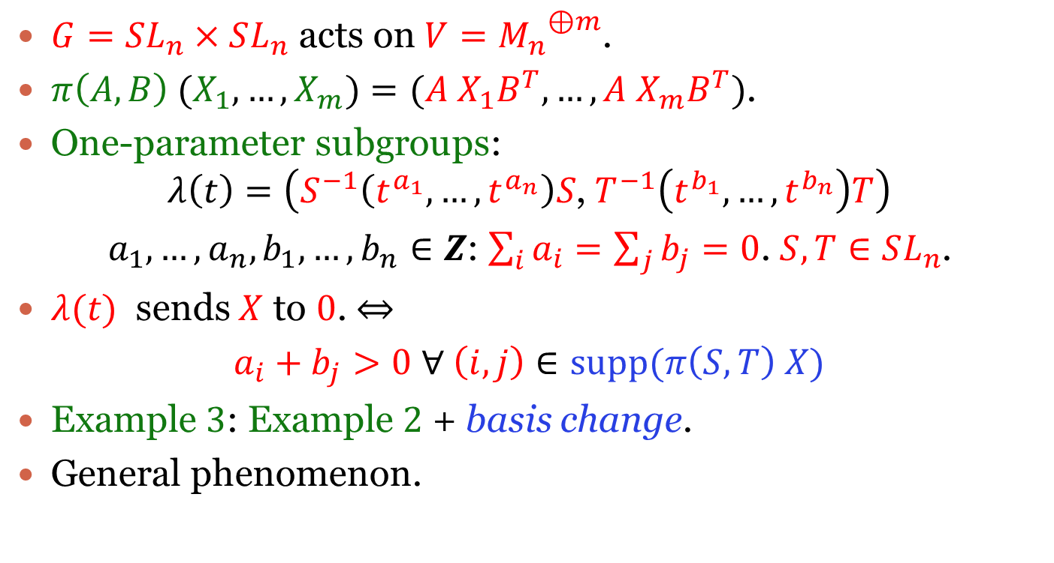

Example $3$
$G=SL_{n}×SL_{n}$ acts on $V={M_{n}}^{⊕m}$.
$π\left(A,B\right) (X_{1},…,X_{m})=(A X_{1}B^{T},…,A X_{m}B^{T})$.
One-parameter subgroups:
$$λ\left(t\right)=\left(S^{−1}\left(t^{a_{1}},…,t^{a_{n}}\right)S\text{, }T^{−1}\left(t^{b_{1}},…,t^{b_{n}}\right)T\right)$$
$a_{1},…,a_{n},b_{1},…,b_{n}∈Z$: $\sum_{i}{a_{i}=\sum_{j}{b_{j}=0}}$. $S,T∈SL_{n}$.
$λ(t)$ sends $X$ to $0$. $⇔$
$a_{i}+b_{j}>0$ $∀ \left(i,j\right)∈supp(π\left(S,T\right) X)$
Example $3$: Example $2$ + basis change.
General phenomenon.

Slide 13
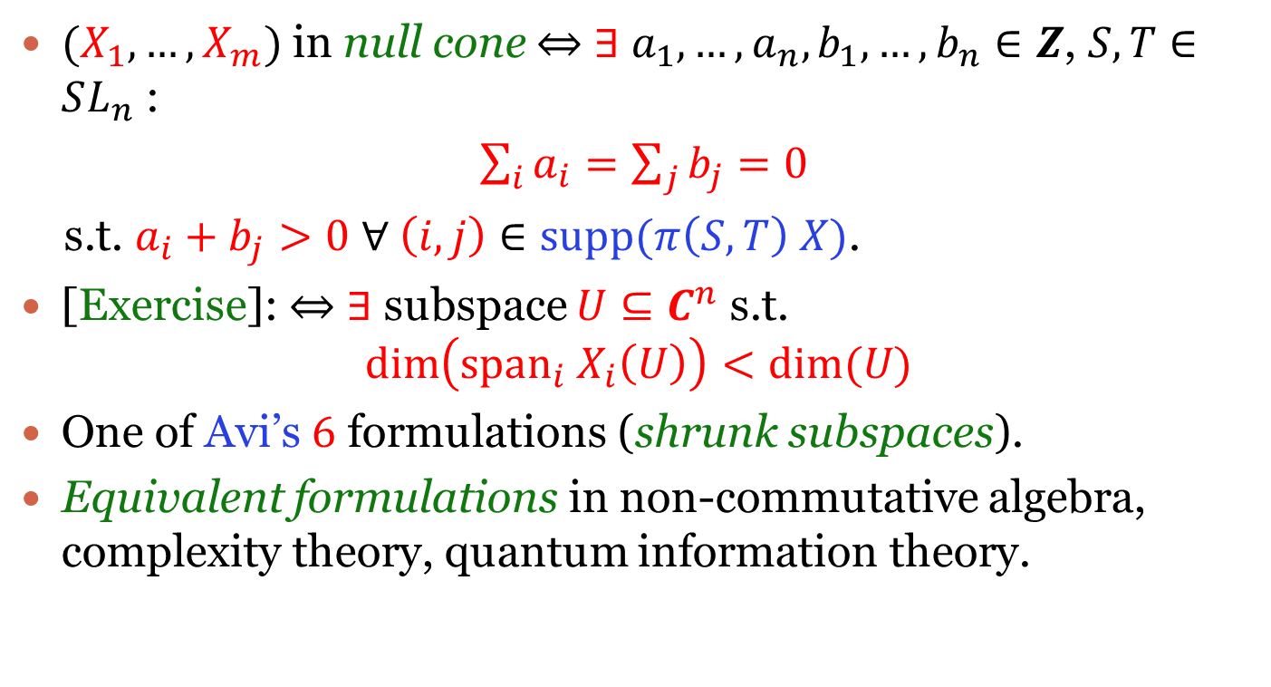
Example $3$
$(X_{1},…,X_{m})$ in null cone $⇔$ $∃$ $a_{1},…,a_{n},b_{1},…,b_{n}∈Z$, $S,T∈SL_{n}$ :
$\sum_{i}{a_{i}=\sum_{j}{b_{j}=0}}$
s.t. $a_{i}+b_{j}>0$ $∀ \left(i,j\right)∈supp(π\left(S,T\right) X)$.
[Exercise]: $⇔$ $∃$ subspace $U⊆C^{n}$ s.t.
$$\dim\left(span_{i} X_{i}\left(U\right)\right)<dim⁡(U)$$
One of Avi’s $6$ formulations (shrunk subspaces).
Equivalent formulations in non-commutative algebra, complexity theory, quantum information theory.

Slide 14



Example $4$
$G={\left(C^{∗}\right)}^{×n}$ acts on $V=C^{m}$.
Fix $ω_{1},…,ω_{m}∈Z^{n}$.
$π\left(t_{1},…,t_{n}\right) e_{j}=\prod_{i=1}^{n}{t_{i}^{ω_{j}(i)}}e_{j}$. Extend linearly.
$e_{j}=\{0,…,0,1,0,…,0\}$.
All actions of ${\left(C^{∗}\right)}^{×n}$look like this.
$j^{th}$ coordinate.
Notes:
It is m and not n.

Slide 15
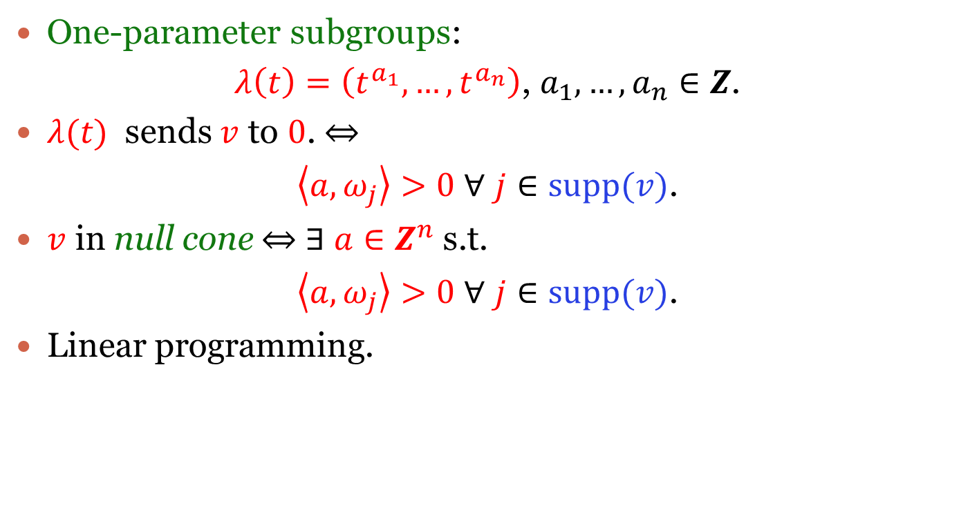
$$Example 4$$
One-parameter subgroups:
$λ\left(t\right)=\left(t^{a_{1}},…,t^{a_{n}}\right)$, $a_{1},…,a_{n}∈Z$.
$λ(t)$ sends $v$ to $0$. $⇔$
$\left\langle a,ω_{j}\right\rangle >0$ $∀$ $j∈supp(v)$.
$v$ in null cone $⇔$ $∃$ $a∈Z^{n}$ s.t.
$\left\langle a,ω_{j}\right\rangle >0$ $∀$ $j∈supp(v)$.
Linear programming.

Slide 16
Kempf-Ness: certifying non-membership in null cone

Slide 17
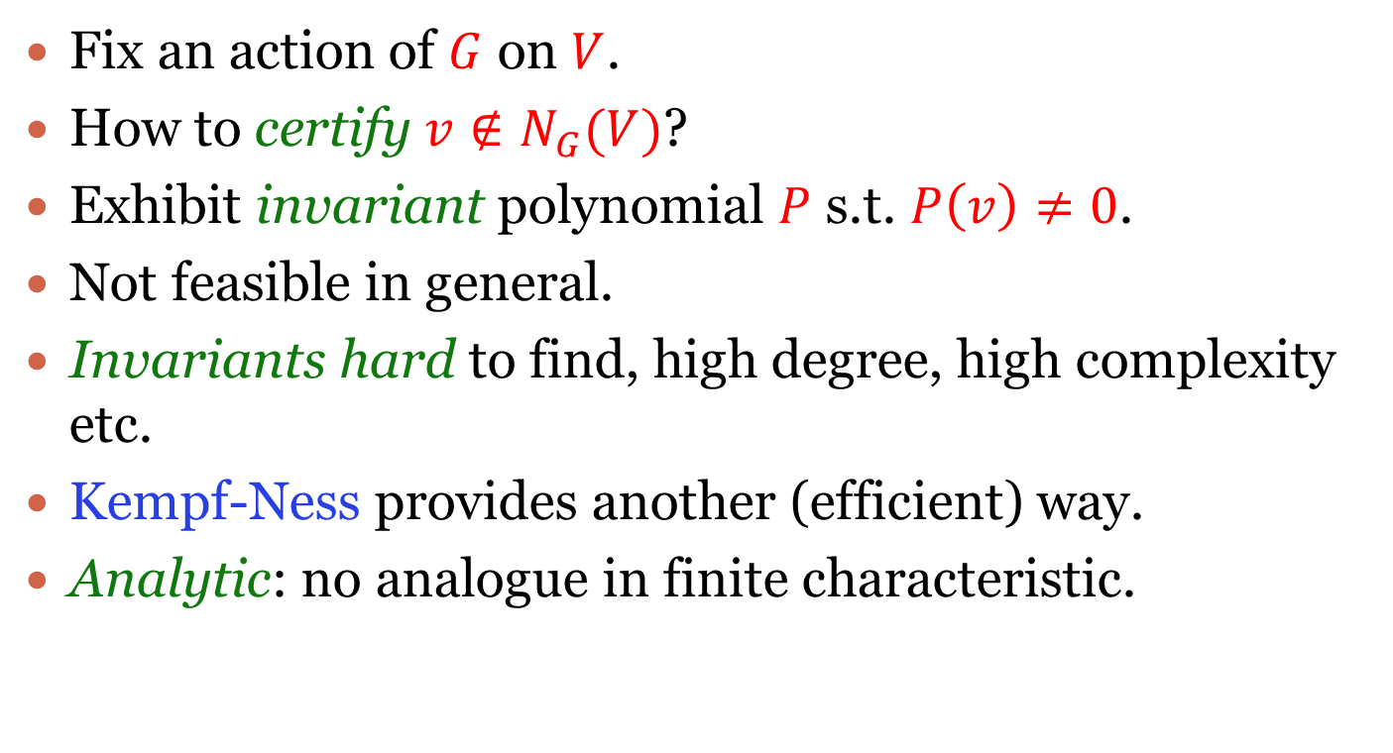
Kempf-Ness
Fix an action of $G$ on $V$.
How to certify $v∉N_{G}(V)$?
Exhibit invariant polynomial $P$ s.t. $P\left(v\right)≠0$.
Not feasible in general.
Invariants hard to find, high degree, high complexity etc.
Kempf-Ness provides another (efficient) way.
Analytic: no analogue in finite characteristic.
Notes:
Again algebraic and reductive. Good to keep G = GL_n in mind.
Many invariant theorists here. They can certify that this approach is not very feasible.

Slide 18
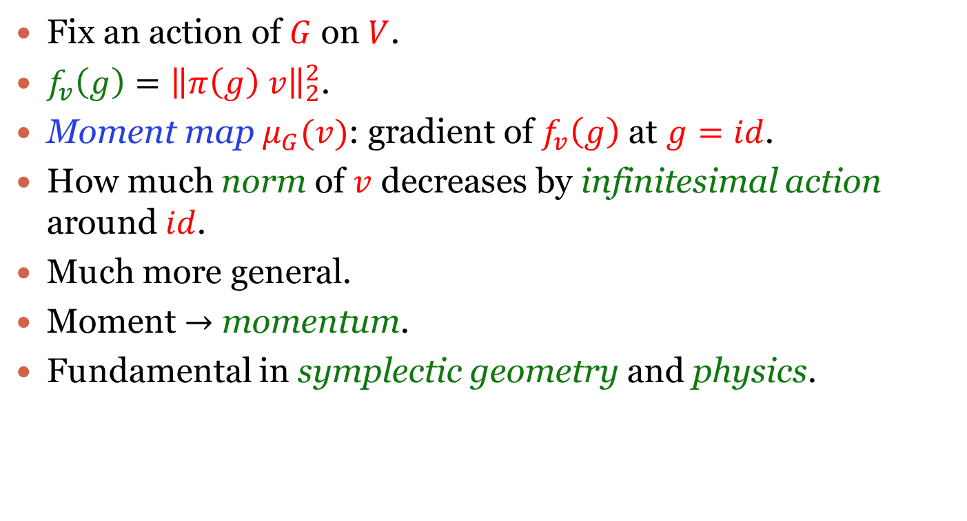
Moment map
Fix an action of $G$ on $V$.
$f_{v}\left(g\right)={\left\|π\left(g\right) v\right\|}_{2}^{2}$.
Moment map $μ_{G}(v)$: gradient of $f_{v}\left(g\right)$ at $g=id$.
How much norm of $v$ decreases by infinitesimal action around $id$.
Much more general.
Moment $→$ momentum.
Fundamental in symplectic geometry and physics.
Notes:
Norm invariant under the action of “maximal compact subgroup”. Just a fancy name for the analogue of unitary subgroup. For GL_n, just means the norm is invariant under the action of unitary subgroup.
Various definitions of moment map. Same up to constant factors.

Slide 19
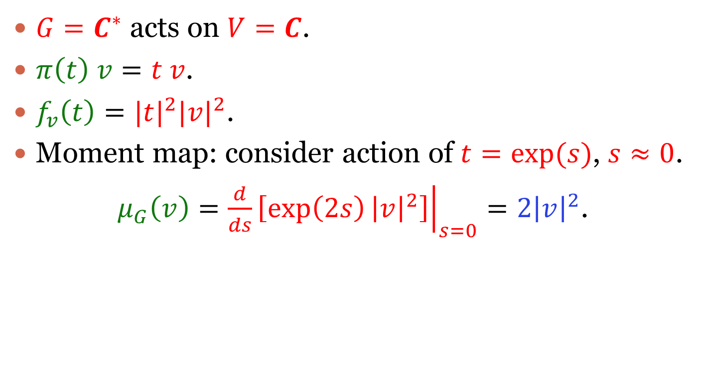
Example $1$
$G=C^{∗}$ acts on $V=C$.
$π\left(t\right) v=t v$.
$f_{v}\left(t\right)={|t|}^{2}{|v|}^{2}$.
Moment map: consider action of $t=exp⁡(s)$, $s≈0$.
$μ_{G}\left(v\right)={\left.\frac{d}{ds}\left[\exp\left(2s\right){\left|v\right|}^{2}\right]\right|}_{s=0}=2{\left|v\right|}^{2}$.
Notes:
Instructive example but not very useful.

Slide 20
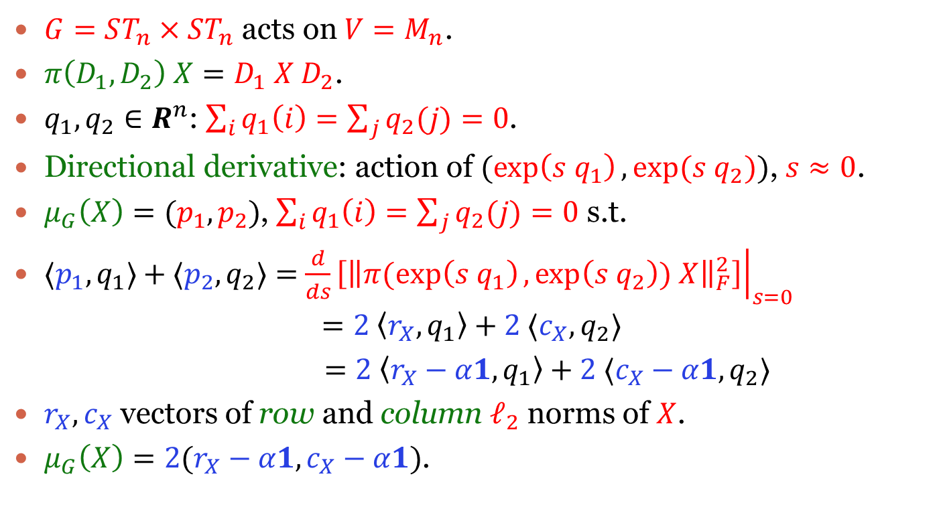
Example $2$
$G=ST_{n}×ST_{n}$ acts on $V=M_{n}$.
$π\left(D_{1},D_{2}\right) X=D_{1} X D_{2}$.
$q_{1},q_{2}∈R^{n}$: $\sum_{i}{q_{1}\left(i\right)=\sum_{j}{q_{2}(j)=0}}$.
Directional derivative: action of $(\exp\left(s q_{1}\right), exp⁡(s{ q}_{2}))$, $s≈0$.
$μ_{G}\left(X\right)=(p_{1},p_{2})$, $\sum_{i}{q_{1}\left(i\right)=\sum_{j}{q_{2}(j)=0}}$ s.t.
$⟨p_{1},q_{1}⟩+⟨p_{2},q_{2}⟩=$ ${\left.\frac{d}{ds}\left[{\left\|π(exp\left(s q_{1}\right),\exp\left(s q_{2}\right)) X\right\|}_{F}^{2}\right]\right|}_{s=0}$
$$=2 \left\langle r_{X},q_{1}\right\rangle +2 ⟨c_{X},q_{2}⟩$$
$=2 \left\langle r_{X}−α1,q_{1}\right\rangle +2 ⟨c_{X}−α1,q_{2}⟩$
$r_{X},c_{X}$ vectors of row and column $ℓ_{2}$ norms of $X$.
$μ_{G}\left(X\right)=2(r_{X}−α1,c_{X}−α1)$.
Notes:
Exponential is taken entrywise.
Relevance to matrix scaling as we will see later.

Slide 21
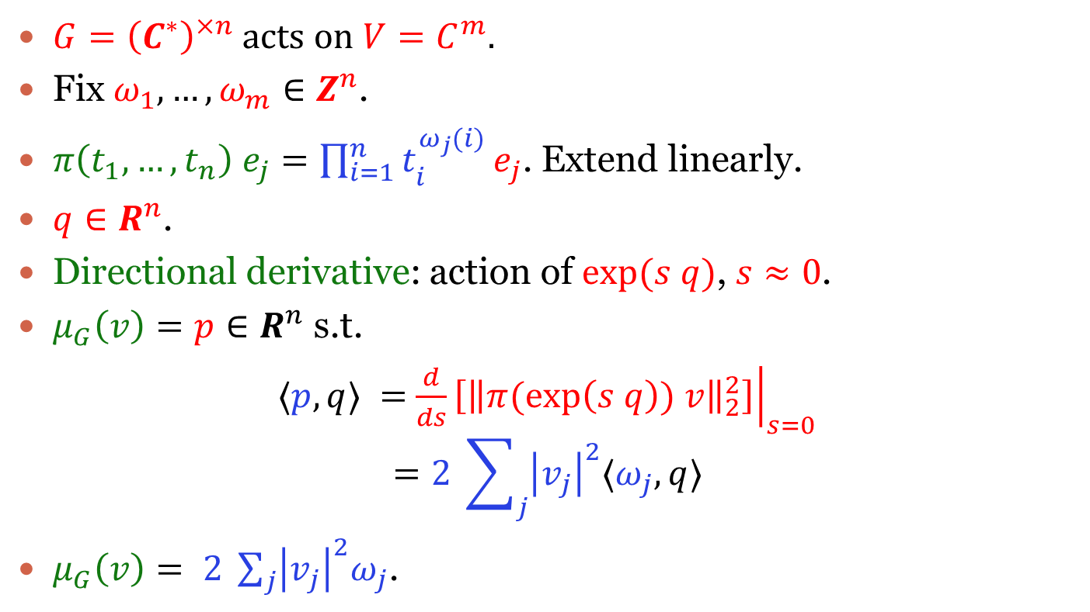
Example $3$
$G={\left(C^{∗}\right)}^{×n}$ acts on $V=C^{m}$.
Fix $ω_{1},…,ω_{m}∈Z^{n}$.
$π\left(t_{1},…,t_{n}\right) e_{j}=\prod_{i=1}^{n}{t_{i}^{ω_{j}(i)}}e_{j}$. Extend linearly.
$q∈R^{n}$.
Directional derivative: action of $exp⁡(s q)$, $s≈0$.
$μ_{G}\left(v\right)=p∈R^{n}$ s.t.
$⟨p,q⟩ =$ ${\left.\frac{d}{ds}\left[{\left\|π(exp\left(s q\right)) v\right\|}_{2}^{2}\right]\right|}_{s=0}$
$$=2 \sum_{j}{{\left|v_{j}\right|}^{2}⟨ω_{j},q⟩}$$
$μ_{G}\left(v\right)= 2 \sum_{j}{{\left|v_{j}\right|}^{2}ω_{j}}$.

Slide 22
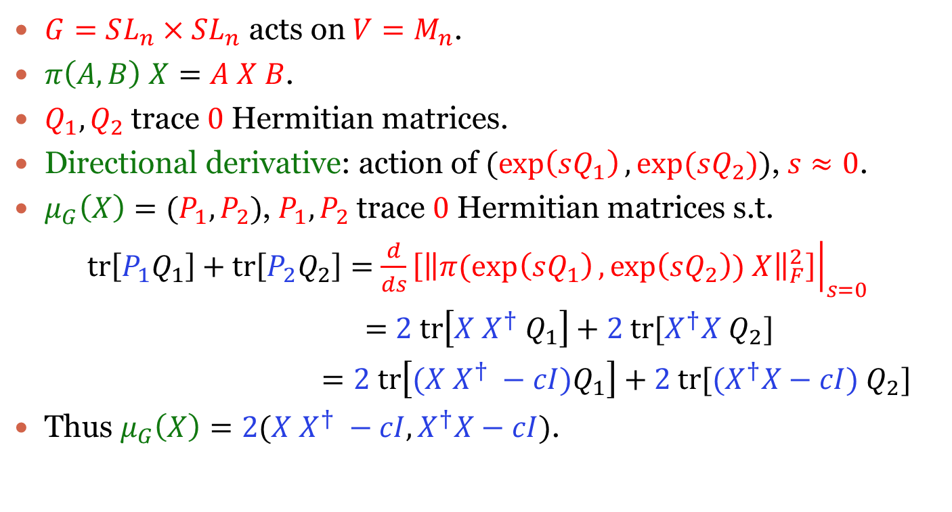
Example $4$
$G=SL_{n}×SL_{n}$ acts on $V=M_{n}$.
$π\left(A,B\right) X=A X B$.
$Q_{1},Q_{2}$ trace $0$ Hermitian matrices.
Directional derivative: action of $(\exp\left(sQ_{1}\right), exp⁡(sQ_{2}))$, $s≈0$.
$μ_{G}\left(X\right)=(P_{1},P_{2})$, $P_{1},P_{2}$ trace $0$ Hermitian matrices s.t.
$tr\left[P_{1}Q_{1}\right]+tr\left[P_{2}Q_{2}\right]=$ ${\left.\frac{d}{ds}\left[{\left\|π(exp\left(sQ_{1}\right),\exp\left(sQ_{2}\right)) X\right\|}_{F}^{2}\right]\right|}_{s=0}$
$=$ $2 tr\left[X X^{†} Q_{1}\right]+2 tr[X^{†}X Q_{2}]$
$=2 tr\left[(X X^{†} −cI)Q_{1}\right]+2 tr[{(X}^{†}X−cI) Q_{2}]$
Thus $μ_{G}\left(X\right)=2(X X^{†} −cI,X^{†}X−cI)$.
Notes:
Ignoring the transpose – creates unnecessary notation problems.
Suffices to consider these directions.

Slide 23

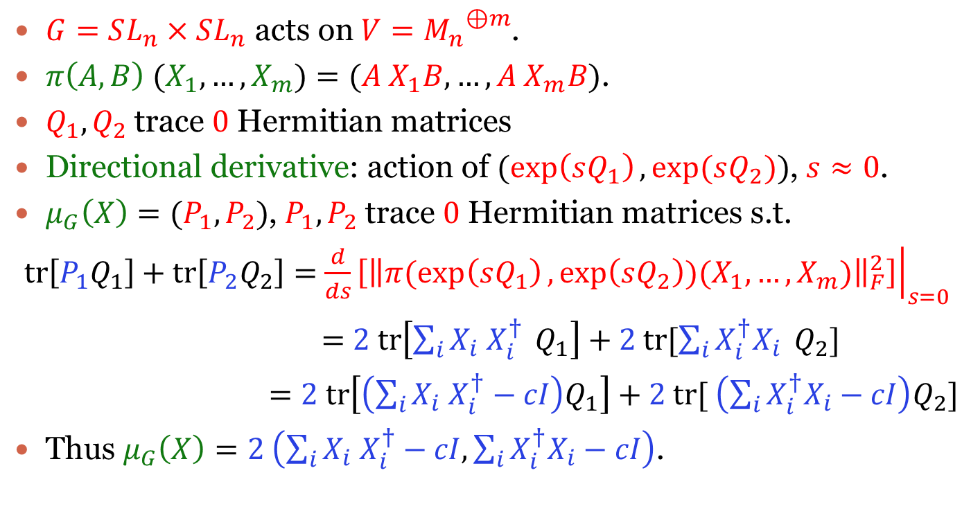
Example $5$
$G=SL_{n}×SL_{n}$ acts on $V={M_{n}}^{⊕m}$.
$π\left(A,B\right) (X_{1},…,X_{m})=(A X_{1}B,…,A X_{m}B)$.
$Q_{1},Q_{2}$ trace $0$ Hermitian matrices
Directional derivative: action of $(\exp\left(sQ_{1}\right), exp⁡(sQ_{2}))$, $s≈0$.
$μ_{G}\left(X\right)=(P_{1},P_{2})$, $P_{1},P_{2}$ trace $0$ Hermitian matrices s.t.
$tr\left[P_{1}Q_{1}\right]+tr\left[P_{2}Q_{2}\right]=$ ${\left.\frac{d}{ds}\left[{\left\|π(exp\left(sQ_{1}\right),\exp\left(sQ_{2}\right))(X_{1},…,X_{m})\right\|}_{F}^{2}\right]\right|}_{s=0}$
$=$ $2 tr\left[\sum_{i}{X_{i} X_{i}^{†}} Q_{1}\right]+2 tr[\sum_{i}{X_{i}^{†}X_{i}} Q_{2}]$
$=2 tr\left[\left(\sum_{i}{X_{i} X_{i}^{†}}−cI\right)Q_{1}\right]+2 tr[ \left(\sum_{i}{X_{i}^{†}X_{i}}−cI\right)Q_{2}]$
Thus $μ_{G}\left(X\right)=2 \left(\sum_{i}{X_{i} X_{i}^{†}}−cI,\sum_{i}{X_{i}^{†}X_{i}}−cI\right)$.
Notes:
Relevant to operator scaling.

Slide 24
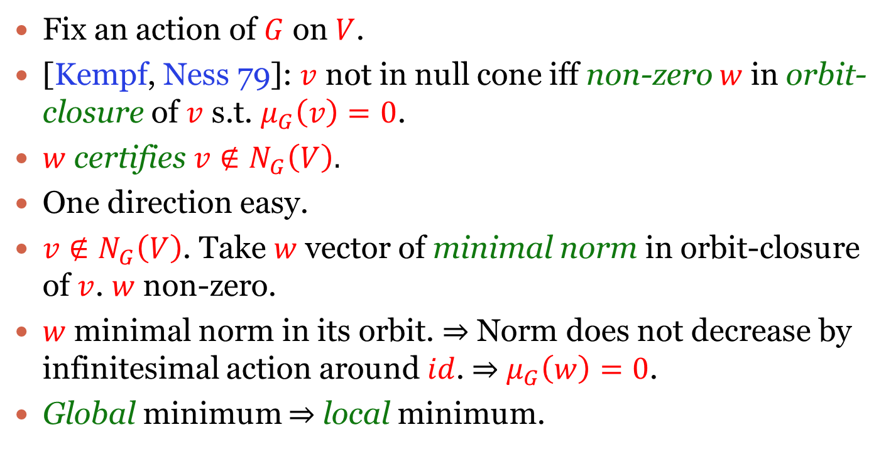
Kempf-Ness
Fix an action of $G$ on $V$.
[Kempf, Ness 79]: $v$ not in null cone iff non-zero $w$ in orbit-closure of $v$ s.t. $μ_{G}\left(v\right)=0$.
$w$ certifies $v∉N_{G}\left(V\right).$
One direction easy.
$v∉N_{G}\left(V\right)$. Take $w$ vector of minimal norm in orbit-closure of $v$. $w$ non-zero.
$w$ minimal norm in its orbit. $⇒$ Norm does not decrease by infinitesimal action around $id$. $⇒$ $μ_{G}\left(w\right)=0$.
Global minimum $⇒$ local minimum.
Notes:
There is some formulation in terms of one-parameter subgroups but not so clean.
How close to moment map zero one needs to get? See Rafael’s talk.

Slide 25
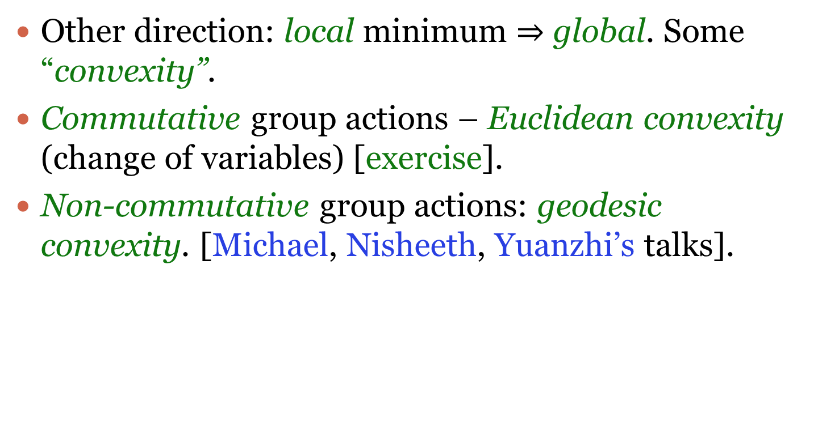
Kempf-Ness
Other direction: local minimum $⇒$ global. Some “convexity”.
Commutative group actions – Euclidean convexity (change of variables) [exercise].
Non-commutative group actions: geodesic convexity. [Michael, Nisheeth, Yuanzhi’s talks].

Slide 26
Back to examples

Slide 27

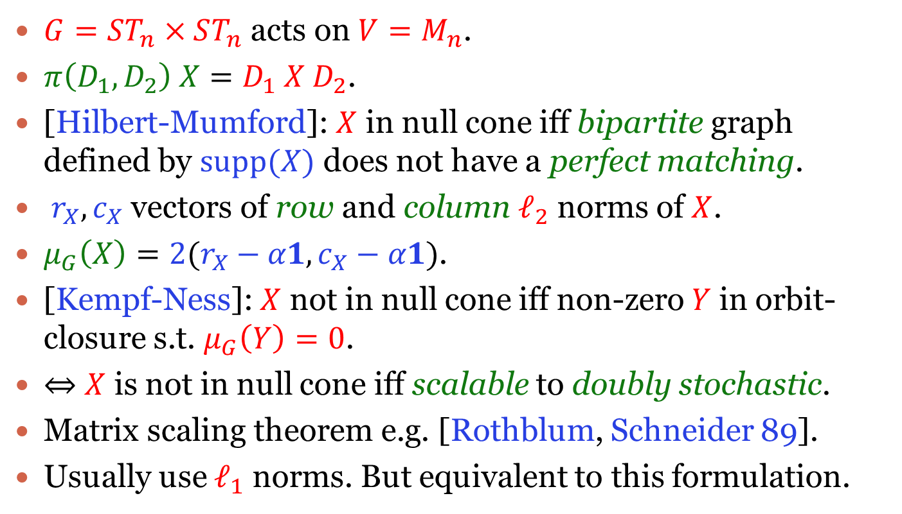
Example $1$: matrix scaling
$G=ST_{n}×ST_{n}$ acts on $V=M_{n}$.
$π\left(D_{1},D_{2}\right) X=D_{1} X D_{2}$.
[Hilbert-Mumford]: $X$ in null cone iff bipartite graph defined by $supp(X)$ does not have a perfect matching.
$r_{X},c_{X}$ vectors of row and column $ℓ_{2}$ norms of $X$.
$μ_{G}\left(X\right)=2(r_{X}−α1,c_{X}−α1)$.
[Kempf-Ness]: $X$ not in null cone iff non-zero $Y$ in orbit-closure s.t. $μ_{G}\left(Y\right)=0$.
$⇔$ $X$ is not in null cone iff scalable to doubly stochastic.
Matrix scaling theorem e.g. [Rothblum, Schneider 89].
Usually use $ℓ_{1}$ norms. But equivalent to this formulation.
Notes:
Alpha non-zero.

Slide 28

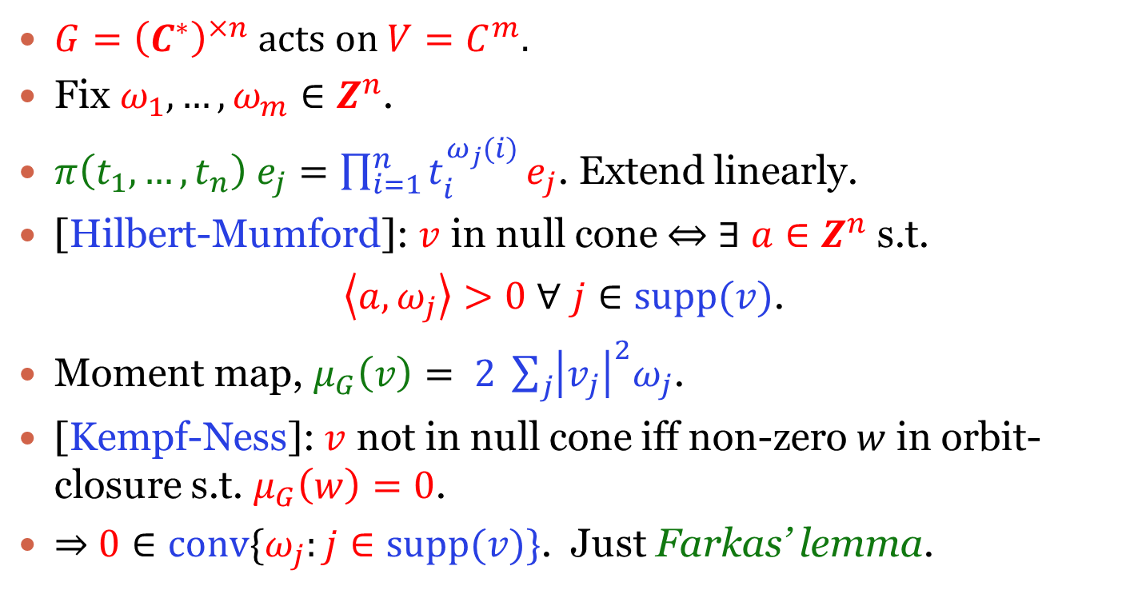
Example $2$: Farkas’ lemma
$G={\left(C^{∗}\right)}^{×n}$ acts on $V=C^{m}$.
Fix $ω_{1},…,ω_{m}∈Z^{n}$.
$π\left(t_{1},…,t_{n}\right) e_{j}=\prod_{i=1}^{n}{t_{i}^{ω_{j}(i)}}e_{j}$. Extend linearly.
[Hilbert-Mumford]: $v$ in null cone $⇔$ $∃$ $a∈Z^{n}$ s.t.
$\left\langle a,ω_{j}\right\rangle >0$ $∀$ $j∈supp(v)$.
Moment map, $μ_{G}\left(v\right)= 2 \sum_{j}{{\left|v_{j}\right|}^{2}ω_{j}}$.
[Kempf-Ness]: $v$ not in null cone iff non-zero $w$ in orbit-closure s.t. $μ_{G}\left(w\right)=0$.
$⇒$ $0∈conv\{ω_{j}:j∈supp(v)\}$. Just Farkas’ lemma.
Notes:
Kempf-Ness gives more structured linear combinations of omega_j’s to be 0. Does it have any applications. This duality theorem has so many applications throughout mathematics.

Slide 29
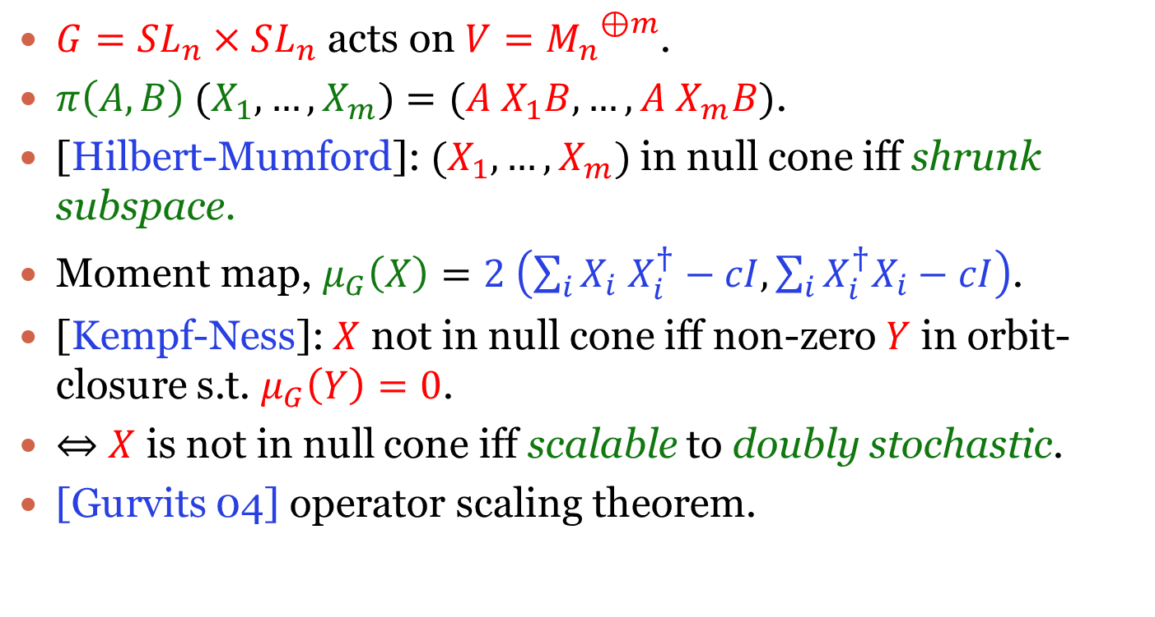

Example $3$: operator scaling
$G=SL_{n}×SL_{n}$ acts on $V={M_{n}}^{⊕m}$.
$π\left(A,B\right) (X_{1},…,X_{m})=(A X_{1}B,…,A X_{m}B)$.
[Hilbert-Mumford]: $(X_{1},…,X_{m})$ in null cone iff shrunk subspace.
Moment map, $μ_{G}\left(X\right)=2 \left(\sum_{i}{X_{i} X_{i}^{†}}−cI,\sum_{i}{X_{i}^{†}X_{i}}−cI\right)$.
[Kempf-Ness]: $X$ not in null cone iff non-zero $Y$ in orbit-closure s.t. $μ_{G}\left(Y\right)=0$.
$⇔$ $X$ is not in null cone iff scalable to doubly stochastic.
[Gurvits 04] operator scaling theorem.

Slide 30

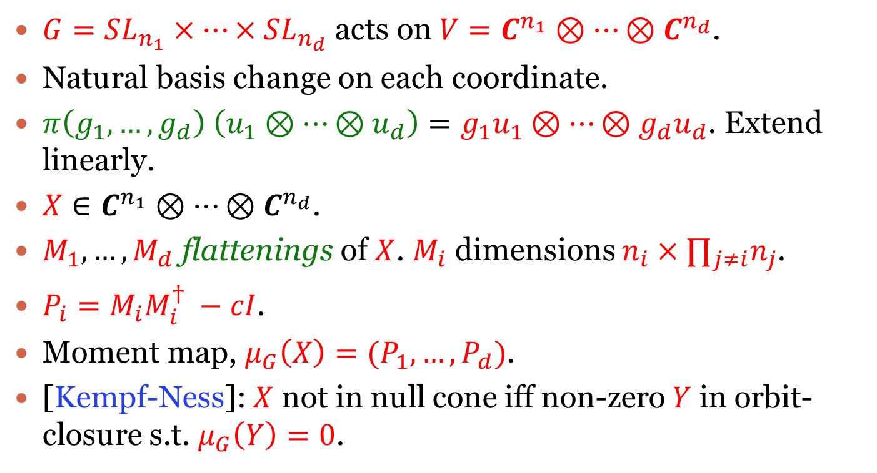
Example $4$: tensor scaling
$G=SL_{n_{1}}×⋯×SL_{n_{d}}$ acts on $V=C^{n_{1}}⊗⋯⊗C^{n_{d}}$.
Natural basis change on each coordinate.
$π\left(g_{1},…,g_{d}\right) \left(u_{1}⊗⋯⊗u_{d}\right)=g_{1}u_{1}⊗⋯⊗g_{d}u_{d}$. Extend linearly.
$X∈C^{n_{1}}⊗⋯⊗C^{n_{d}}$.
$M_{1},…, M_{d}$ flattenings of $X$. $M_{i}$ dimensions $n_{i}×∏_{j≠i}n_{j}$.
$P_{i}=M_{i}M_{i}^{†} −cI$.
Moment map, $μ_{G}\left(X\right)=(P_{1},…,P_{d})$.
[Kempf-Ness]: $X$ not in null cone iff non-zero $Y$ in orbit-closure s.t. $μ_{G}\left(Y\right)=0$.
Notes:
This will later show up in several talks.

Slide 31
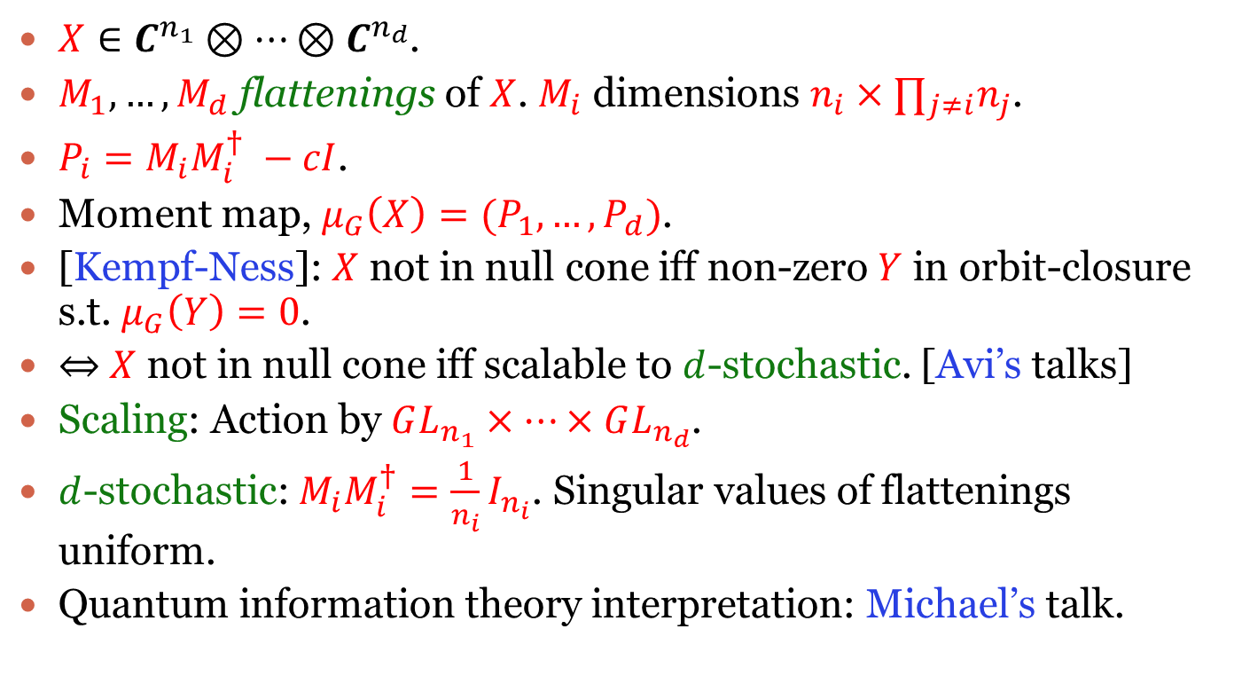
Example $4$: tensor scaling
$X∈C^{n_{1}}⊗⋯⊗C^{n_{d}}$.
$M_{1},…, M_{d}$ flattenings of $X$. $M_{i}$ dimensions $n_{i}×∏_{j≠i}n_{j}$.
$P_{i}=M_{i}M_{i}^{†} −cI$.
Moment map, $μ_{G}\left(X\right)=(P_{1},…,P_{d})$.
[Kempf-Ness]: $X$ not in null cone iff non-zero $Y$ in orbit-closure s.t. $μ_{G}\left(Y\right)=0$.
$⇔$ $X$ not in null cone iff scalable to $d$-stochastic. [Avi’s talks]
Scaling: Action by $GL_{n_{1}}×⋯×GL_{n_{d}}$.
$d$-stochastic: $M_{i}M_{i}^{†}=\frac{1}{n_{i}}I_{n_{i}}$. Singular values of flattenings uniform.
Quantum information theory interpretation: Michael’s talk.

Slide 32
Proof of Hilbert-Mumford

Slide 33
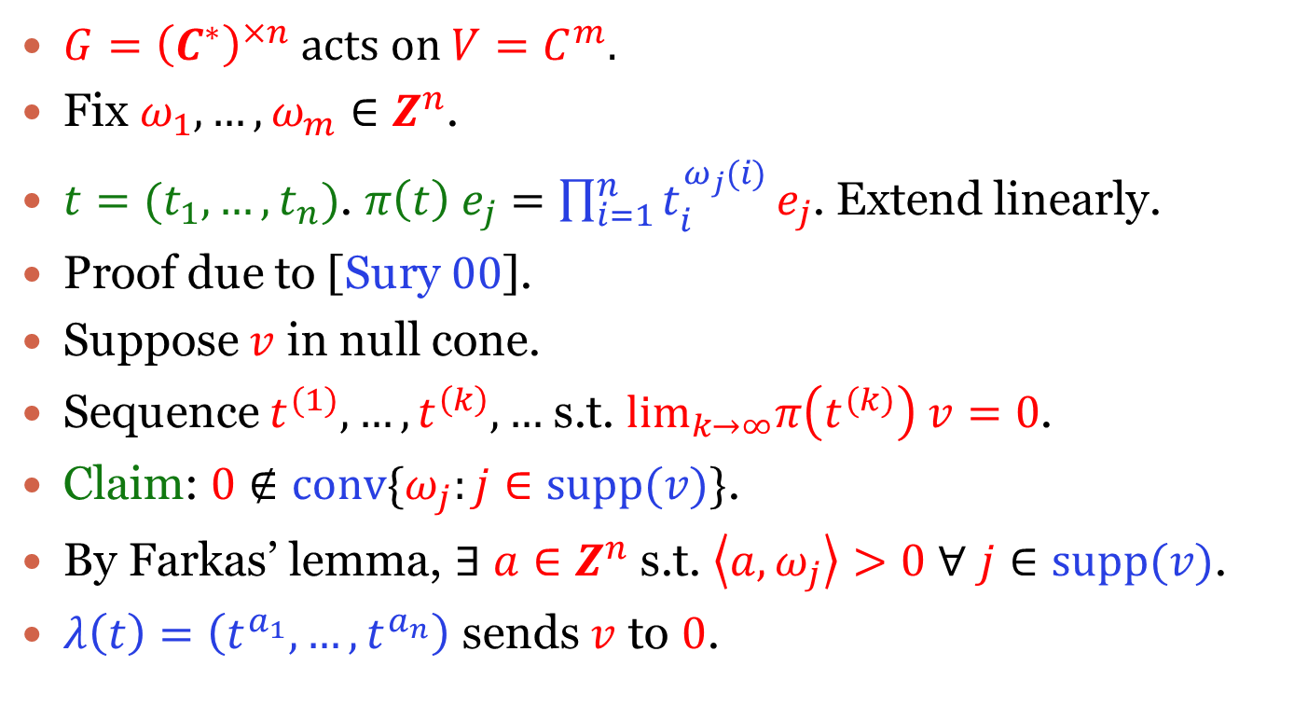
Commutative case
$G={\left(C^{∗}\right)}^{×n}$ acts on $V=C^{m}$.
Fix $ω_{1},…,ω_{m}∈Z^{n}$.
$t=(t_{1},…,t_{n})$. $π\left(t\right) e_{j}=\prod_{i=1}^{n}{t_{i}^{ω_{j}(i)}}e_{j}$. Extend linearly.
Proof due to [Sury $00$].
Suppose $v$ in null cone.
Sequence $t^{(1)},…,t^{\left(k\right)},…$ s.t. $\lim_{k→∞}π\left(t^{(k)}\right) v=0$.
Claim: $0∉conv\{ω_{j}:j∈supp(v)\}$.
By Farkas’ lemma, $∃$ $a∈Z^{n}$ s.t. $\left\langle a,ω_{j}\right\rangle >0$ $∀$ $j∈supp(v)$.
$λ\left(t\right)=\left(t^{a_{1}},…,t^{a_{n}}\right)$ sends $v$ to $0$.

Slide 34
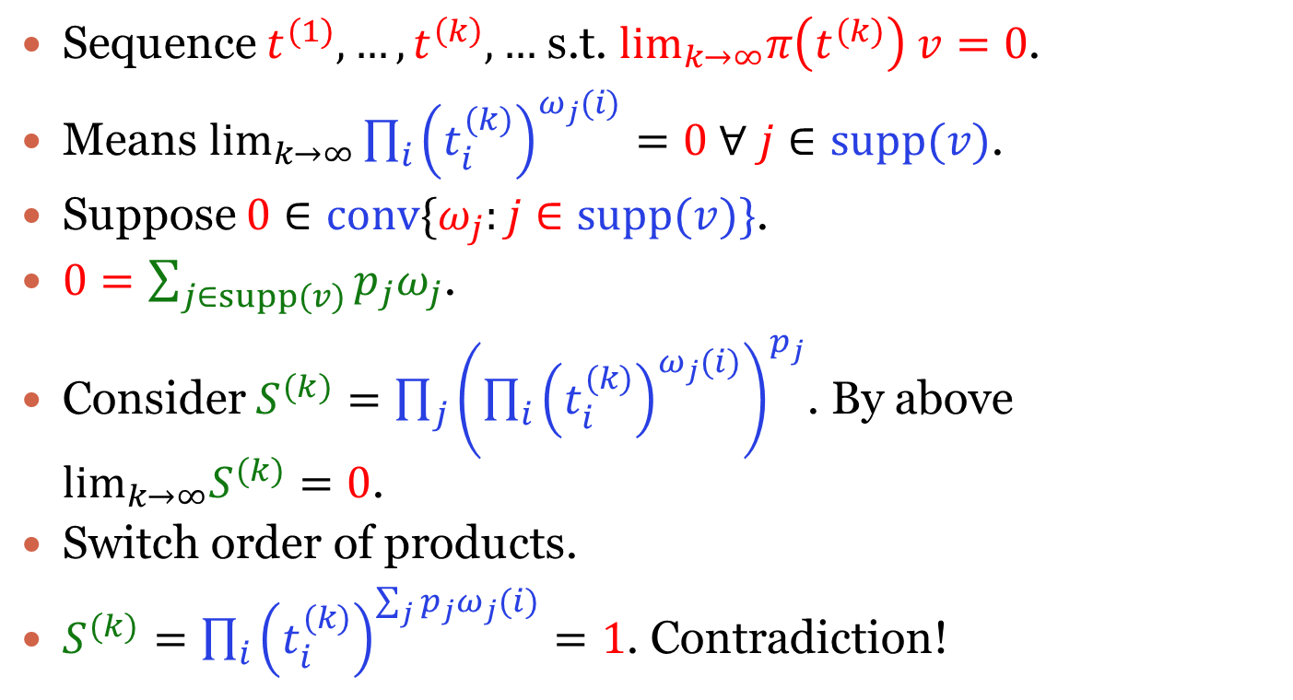
Proof of claim
Sequence $t^{(1)},…,t^{\left(k\right)},…$ s.t. $\lim_{k→∞}π\left(t^{(k)}\right) v=0$.
Means $\lim_{k→∞}\prod_{i}{{\left(t_{i}^{(k)}\right)}^{ω_{j}(i)}}=0$ $∀ j∈supp(v)\text{.}$
Suppose $0∈conv\{ω_{j}:j∈supp(v)\}$.
$0=\sum_{j∈supp(v)}{p_{j}ω_{j}}$.
Consider $S^{(k)}=\prod_{j}{{\left(\prod_{i}{{\left(t_{i}^{(k)}\right)}^{ω_{j}(i)}}\right)}^{p_{j}}}$. By above $\lim_{k→∞}S^{(k)}=0$.
Switch order of products.
$S^{(k)}=\prod_{i}{{\left(t_{i}^{(k)}\right)}^{\sum_{j}{p_{j}}ω_{j}(i)}}=1$. Contradiction!

Slide 35
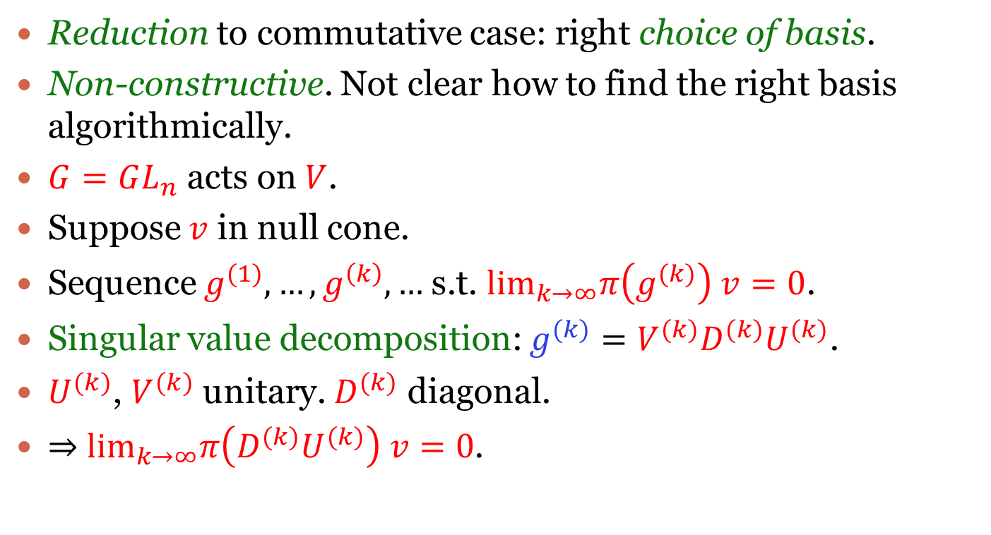
Non-commutative case
Reduction to commutative case: right choice of basis.
Non-constructive. Not clear how to find the right basis algorithmically.
$G=GL_{n}$ acts on $V$.
Suppose $v$ in null cone.
Sequence $g^{(1)},…,g^{\left(k\right)},…$ s.t. $\lim_{k→∞}π\left(g^{(k)}\right) v=0$.
Singular value decomposition: $g^{(k)}=V^{(k)}D^{(k)}U^{(k)}$.
$U^{(k)}$, $V^{(k)}$ unitary. $D^{(k)}$ diagonal.
$⇒$ $\lim_{k→∞}π\left(D^{(k)}U^{(k)}\right) v=0$.
Notes:
The main challenge in the null cone problem for non-commutative group actions!

Slide 36
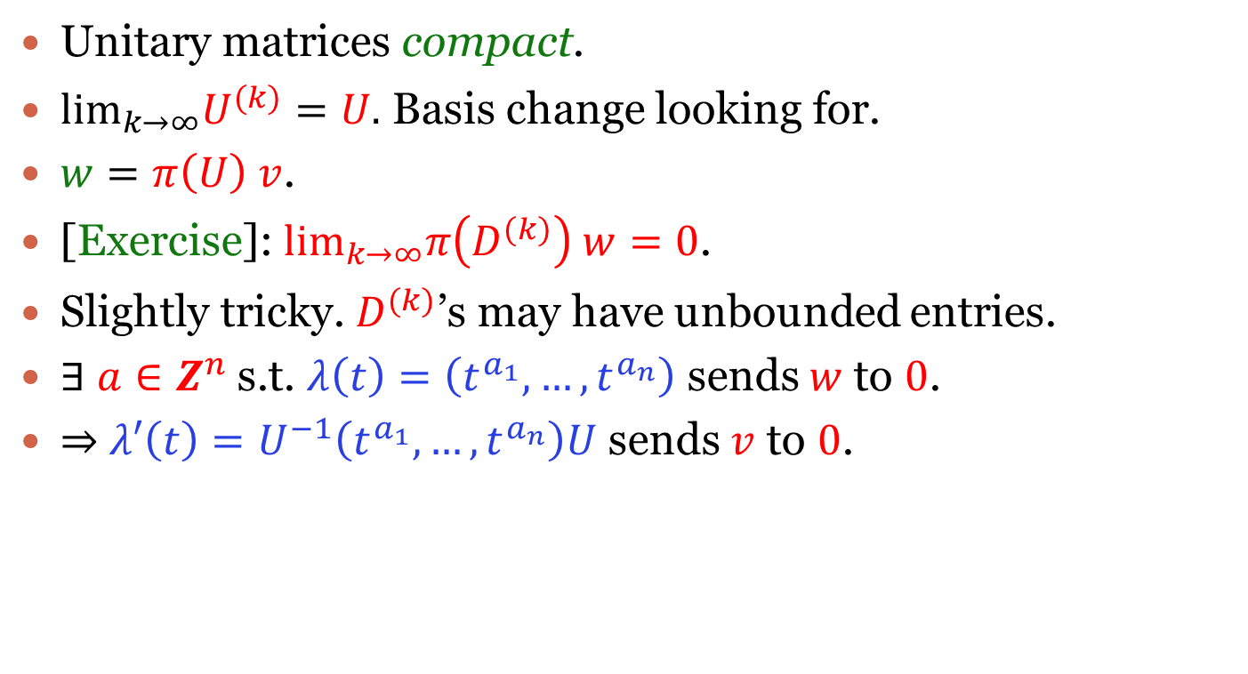
Non-commutative case
Unitary matrices compact.
$\lim_{k→∞}U^{(k)}=U.$ Basis change looking for.
$w=π\left(U\right) v$.
[Exercise]: $\lim_{k→∞}π\left(D^{(k)}\right) w=0$.
Slightly tricky. $D^{(k)}$’s may have unbounded entries.
$∃$ $a∈Z^{n}$ s.t. $λ\left(t\right)=\left(t^{a_{1}},…,t^{a_{n}}\right)$ sends $w$ to $0$.
$⇒$ $λ′\left(t\right)=U^{−1}\left(t^{a_{1}},…,t^{a_{n}}\right)U$ sends $v$ to $0$.

Slide 37

Thank You

