Slide 1
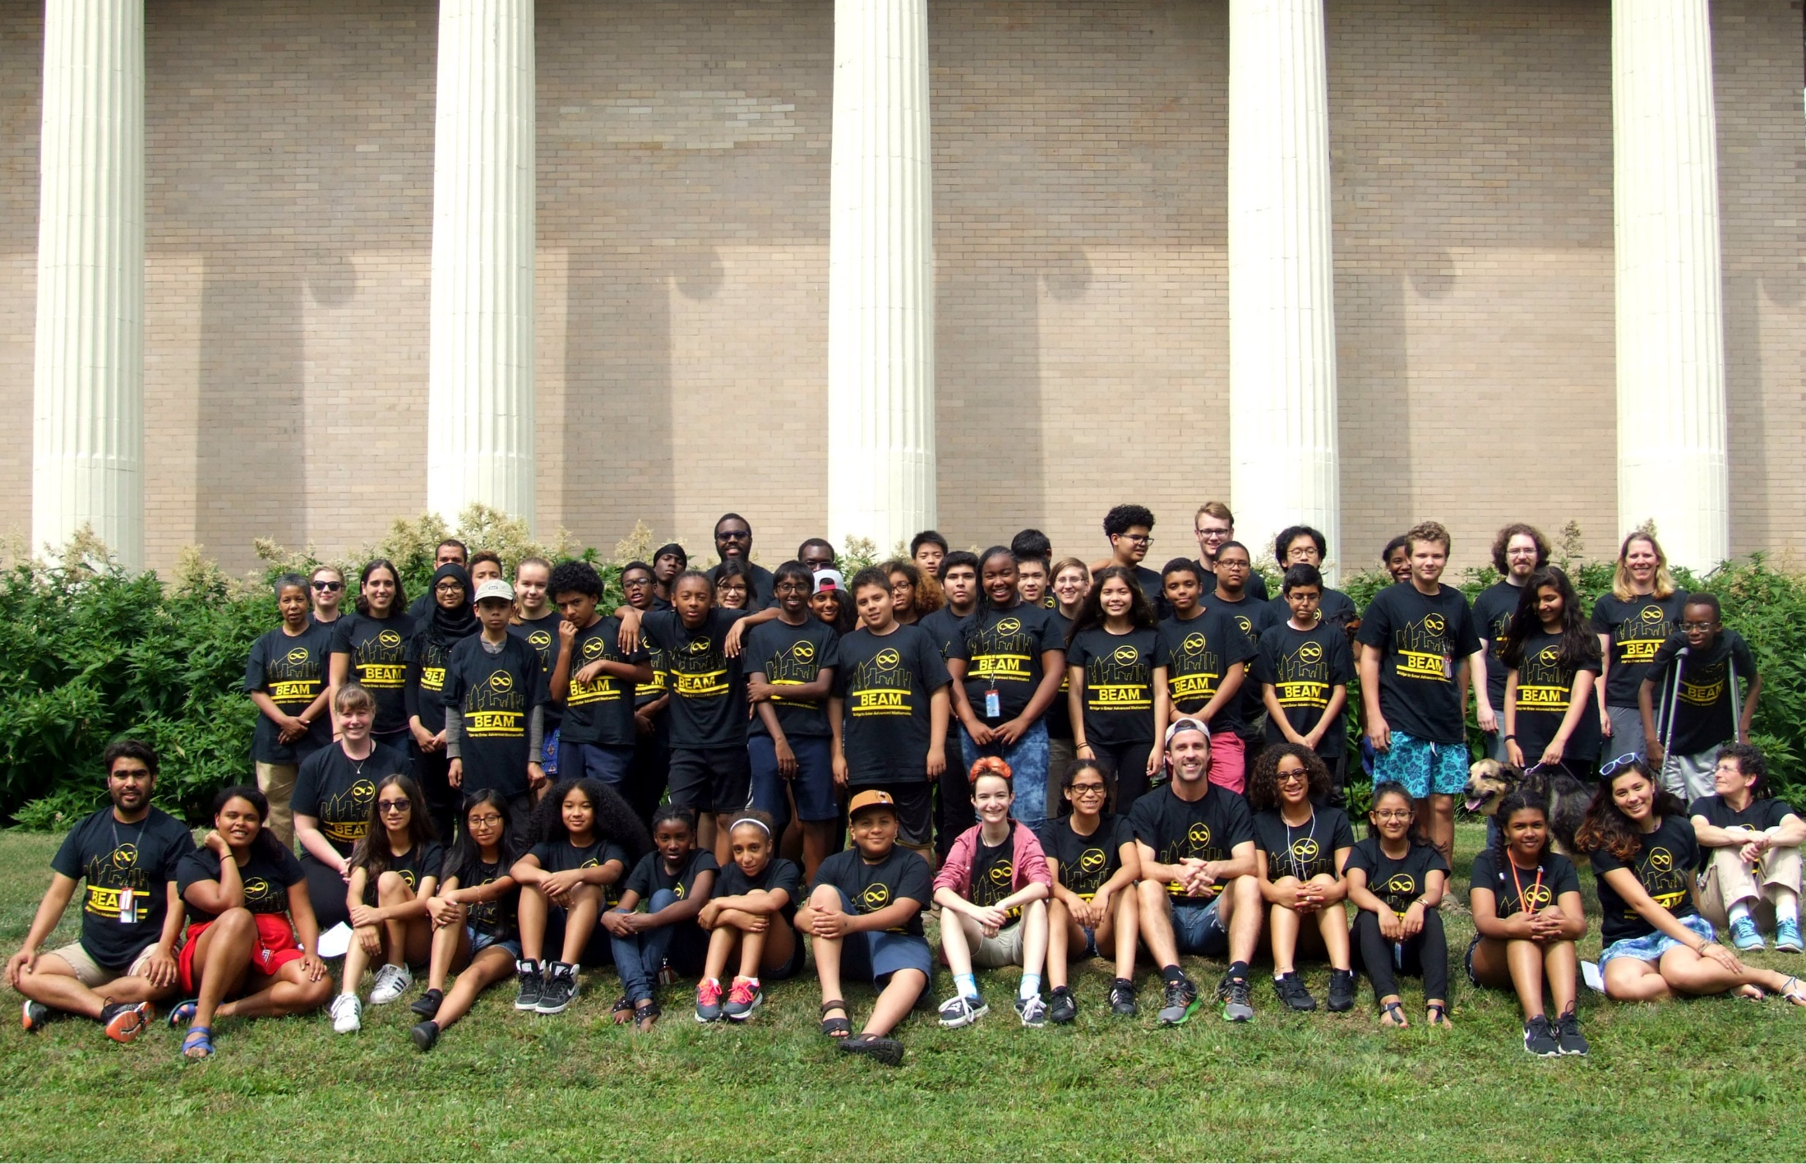
Developing Warm Mathematical Relationships with Students from Diverse Backgrounds
Notes:
Thank the organizers.
I have more to talk about than I really have time for. I will try to divide my time, but in general, I welcome questions and discussions.

Slide 2
Notes:
So, you see this article, and you think it must’ve been in The Onion, right? But no… the Wall Street Journal.
And yet, even though this article has such a hilarious title, the topic it touches on is critical, and underlies this whole talk.

Slide 4
Notes:
But somehow, when you ask educators, you hear that the path to success in math lies through getting good grades in school.
Well, how true is that?

Slide 5
From High School to College
NYS Regents, Algebra II/Trig, difficult question:
Using the identity $\sin^{2}{θ+\cos^{2}{θ}=1}$, find the value of $\tan{θ}$, to the nearest hundredth, if $\cos{θ}$ is $−0.7$ and $θ$ is in Quadrant II.
Notes:
This is obviously subjective, but I browsed the August 2016 NYS Regents Exam for Algebra II/Trig and picked the hardest question I could find.

Slide 6
From High School to College
Math 220, typical question:
Find the domain of the function
$f\left(x\right)=\frac{\sin{(x+5)}∙(x^{2} −121)}{2ln{(x)}−\ln{(23−2x^{2})}}$.
Notes:
I browsed some recent Math 220 exams, picked one, and modified it slightly since I don’t want to put anyone on the spot. Look at the difference in questions! In appearance, let alone actual mathematical thought. How many steps there are, how much you have to focus on what’s important, how you have to decide to set your own interim goals and do them. And we still think of this as mostly looking at facts and wish we could ask more sophisticated questions.
Imagine going from a place where this was the HARDEST question you faced, to one where this was a TYPICAL question. Now consider the difference in learning styles, the greater independence required, and the greater level of abstraction of the material.
To understand the chain rule or do a u-substitution in an integral, can't just rely on an algorithm anymore. Similarly, understanding what limits are is highly sophisticated, let alone more advanced stuff.

Slide 7
From High School to College
110.106 Calculus I, question 2(a):
Evaluate the following:
$\lim_{n→∞}{a_{n}}$, for $a_{n}=\frac{1+\sin{n}}{n^{2}}$.
Note: this requires proof/explanation.
Notes:
I browsed some recent Math 220 exams, picked one, and modified it slightly since I don’t want to put anyone on the spot. Look at the difference in questions! In appearance, let alone actual mathematical thought. How many steps there are, how much you have to focus on what’s important, how you have to decide to set your own interim goals and do them. And we still think of this as mostly looking at facts and wish we could ask more sophisticated questions.
Imagine going from a place where this was the HARDEST question you faced, to one where this was a TYPICAL question. Now consider the difference in learning styles, the greater independence required, and the greater level of abstraction of the material.
To understand the chain rule or do a u-substitution in an integral, can't just rely on an algorithm anymore. Similarly, understanding what limits are is highly sophisticated, let alone more advanced stuff.

Slide 8
Math
Enrichment
Underserved Students
Deep thinking, high level
Mostly white & Asian, affluent/connected
Test prep, minimum benchmarks
Often lacks mathematical expertise
Notes:
Math circles/math camps/etc. Although very open, frankly, reaches mostly affluent white & Asian kids with a few notable exceptions (e.g. Navajo Nations, MC^2)
Test prep, less expertise, minimum achievements
Math enrichment world can be so powerful; need to come together; this has been my work, enable all of you to bring your expertise to bear on these communities.

Slide 9
8th Grade Math on NAEP
 | Reporting Groups | Percentage of Student Population | Percentage at or Above Proficient | Percentage at Advanced
Race/Ethnicity | White | 10 | 45 | 4
 | Black | 8 | 18 | #
 | Hispanic | 75 | 14 | #
 | Asian | 6 | 47 | 7
Gender | Male | 51 | 16 | 1
 | Female | 49 | 23 | 1
National School Lunch Program Eligibility | Eligible | 85 | 15 | #
 | Not Eligible | 15 | 47 | 6

Slide 12
 | Asian | White | Black | Hispanic/ Latino
Percent who enter college | 92.5% | 86.5% | 82.1% | 78.8%
Percent with any bachelors’ degree | 63.4% | 39.7% | 20.6% | 15.1%
Percent of those who have a STEM degree | 60.9% | 37.6% | 37.2% | 37.8%
Overall percentage with STEM bachelors’ degree or better | 38.6% | 14.9% | 7.7% | 5.7%
Notes:
And so, comparably, consider what percentage are likely to get to the PhD level

Slide 13
Notes:
Intensely hopeful: it is getting better; not a plateau
Sources:
https://wayback.archive-it.org/5902/20160210152000/http://www.nsf.gov/statistics/doctorates/pdf/sed1995.pdf
https://www.nsf.gov/statistics/2015/nsf15311/tables/pdf/tab7-4-updated-2016-08.pdf

Slide 14
Pathways to STEM
Online Forums and Communities
Science Club/Science Olympiad/Odyssey of the Mind
Extra math practice
Computer Programming
Independent Reading/Viewing
Elementary School
Middle
School
High
School
College
Academic Summer Programs
Robotics Competitions
Math Contests, Math Circles
Research and Internships
Notes:
What’s the difference? Who’s prepared for college STEM classes?
Line (we've just seen that in many cases, school courses can be inadequate for STEM success) vs. ecosystem

Slide 15
Notes:
A big part of the issue is exposure to the kind of deeper thinking and problem solving work that we do - which prepares students for work in college. We know how important this work is, and we're the gatekeepers - we're the ones with the knowledge and experience to provide this content to underserved students. It's especially acute because everything you've ever complained about when students start your program - that they try to just memorize procedures, that they haven't learned how to solve problems creatively - is more acute in the training kids get at schools struggling to raise test scores, and when families don't hear about or have the resources to engage in extracurricular learning.

Slide 16
But…
it’s not just mathematics.
Notes:
Students need support in a number of directions to be successful. This is one of the biggest things we’ve learned. Anonymize Alex’s story, Andy’s story, L’s story.

Slide 17
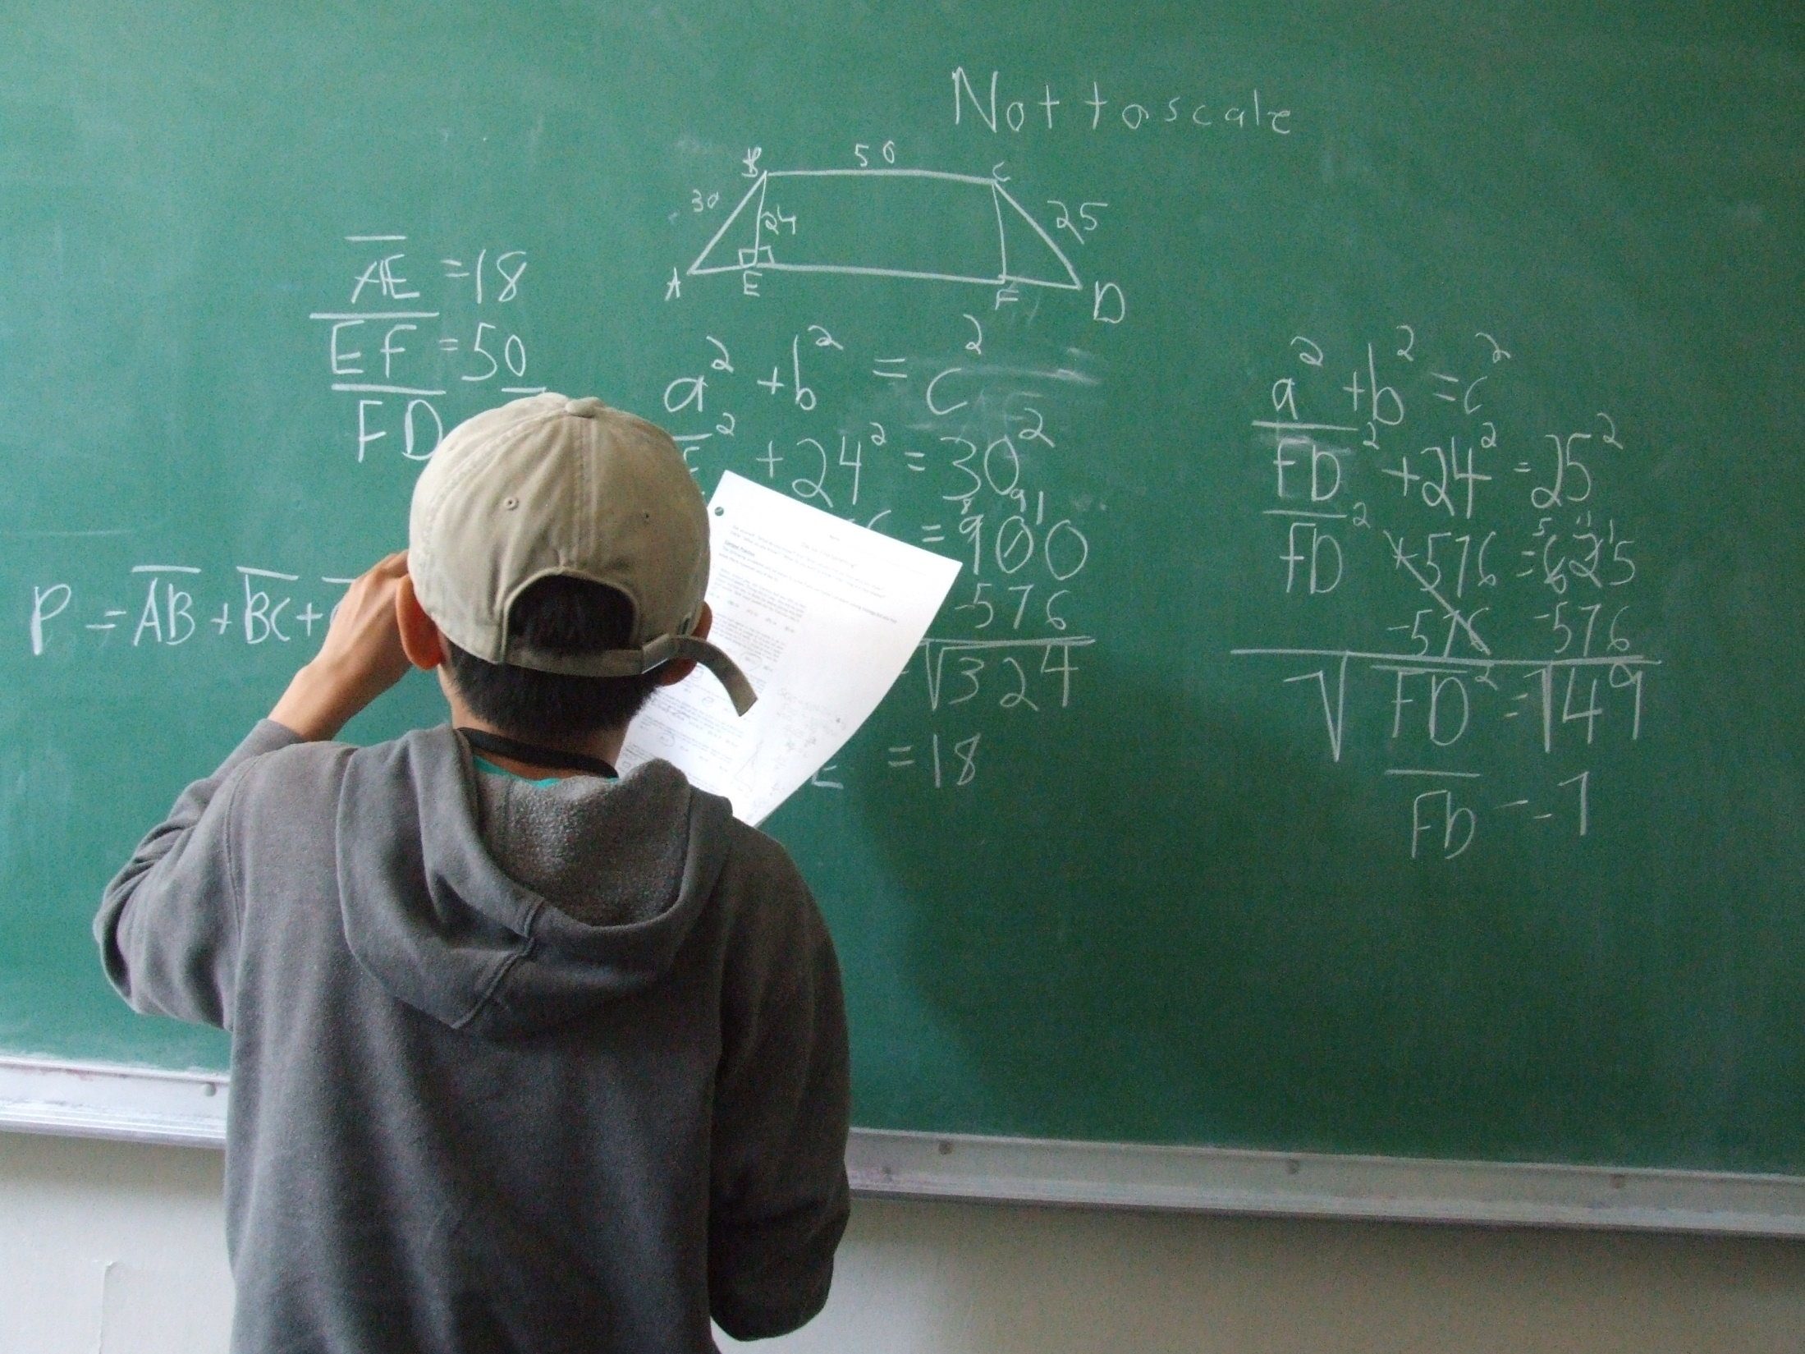
Not
an unsolvable
problem
Notes:
Not an unsolvable problem. Many students are ready to excel when given the support and mentoring. They're very capable of doing this work, and if you think you're changing lives now, just you wait! But to make sure the experience isn't frustrating, you have to approach with care, and be aware of where students are coming from.

Slide 18
Founded in 2011
A comprehensive 6th-12th grade program with summer programs, weekly courses, and personal advising.
Free for underserved students in NYC
Notes:
This is where I’m coming from: I started and run a program for underserved NYC students with talent in math.
My goal is to share some of the lessons we’ve learned; so that you have context, I’d like to tell you a little bit about it.
To be clear, this program is probably more extensive than your resources may allow. It’s not my goal to inspire replication, but rather to provide a framework for thought.

Slide 19
How
do we put low-income students on the pathway to advanced study?
FIRST: Academic preparation
SECOND: Social/emotional preparation
THIRD: Desire & access to opportunities
Notes:
We try to address as many challenges as we can that might be preventing student success.
3) In particular, the idea that many math and science students go far beyond what the school curriculum offers, and we must encourage our students to do the same.

Slide 20
Summer after 6th Grade | BEAM 6 – Introduction to advanced mathematical thinking, building an intellectual community.
Other Programs
Summer after 7th Grade | BEAM 7 – Residential summer program on a college campus learning proof-based mathematics and gaining once-in-a-lifetime experiences.
8th Grade | High school & summer program admissions, yearround programming.
9th-12th Grades | Advising on accessing other opportunities for advanced study, navigating high school, college admissions & financial aid. Monthly events that keep the community together.
Notes:
It’s not going to be easy. We need to provide the same resources that affluent students with talent and interest in STEM field gets. It has to be a comprehensive pathway that actually makes success in STEM realistic.
BEAM 6: Laying the groundwork.
Some won’t go on to BEAM 7. Maybe Prep for Prep is a better program for them if math is only sort-of their thing. Maybe BEAM 6 was as challenging as they were ready for. Maybe we weren’t quite able to light that fire inside them. That’s fine. We go out of our way to find students who wouldn’t ever have access to this; what we’ve found is that, because parent involvement is inconsistent, …

Slide 21
Union
Bard
New York

Slide 22
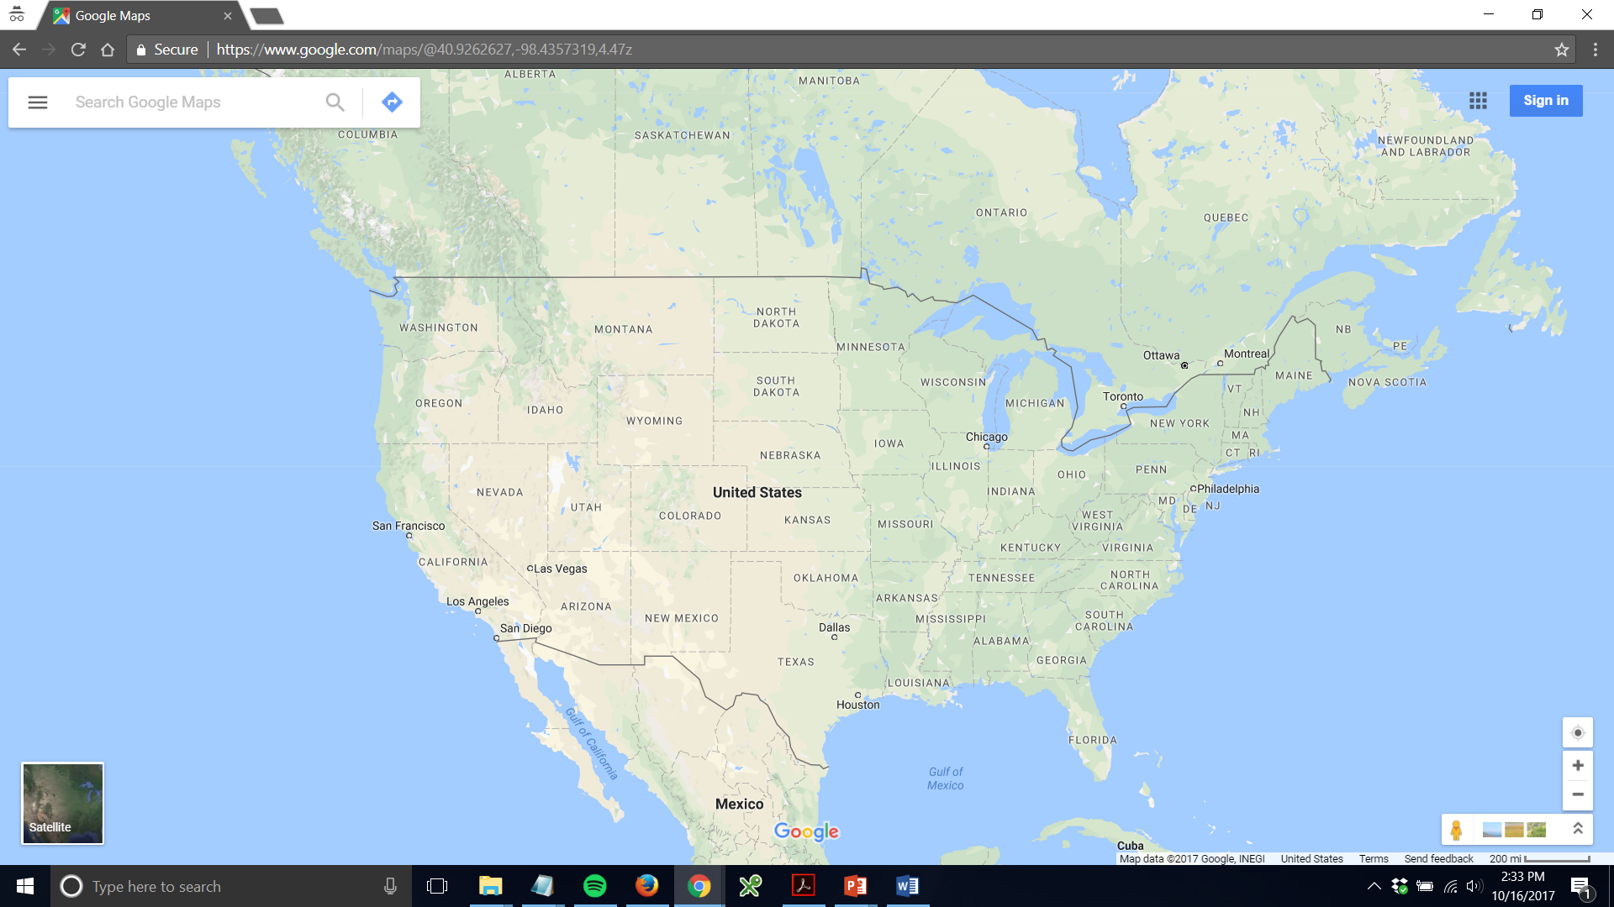
New York
Los Angeles

Slide 23
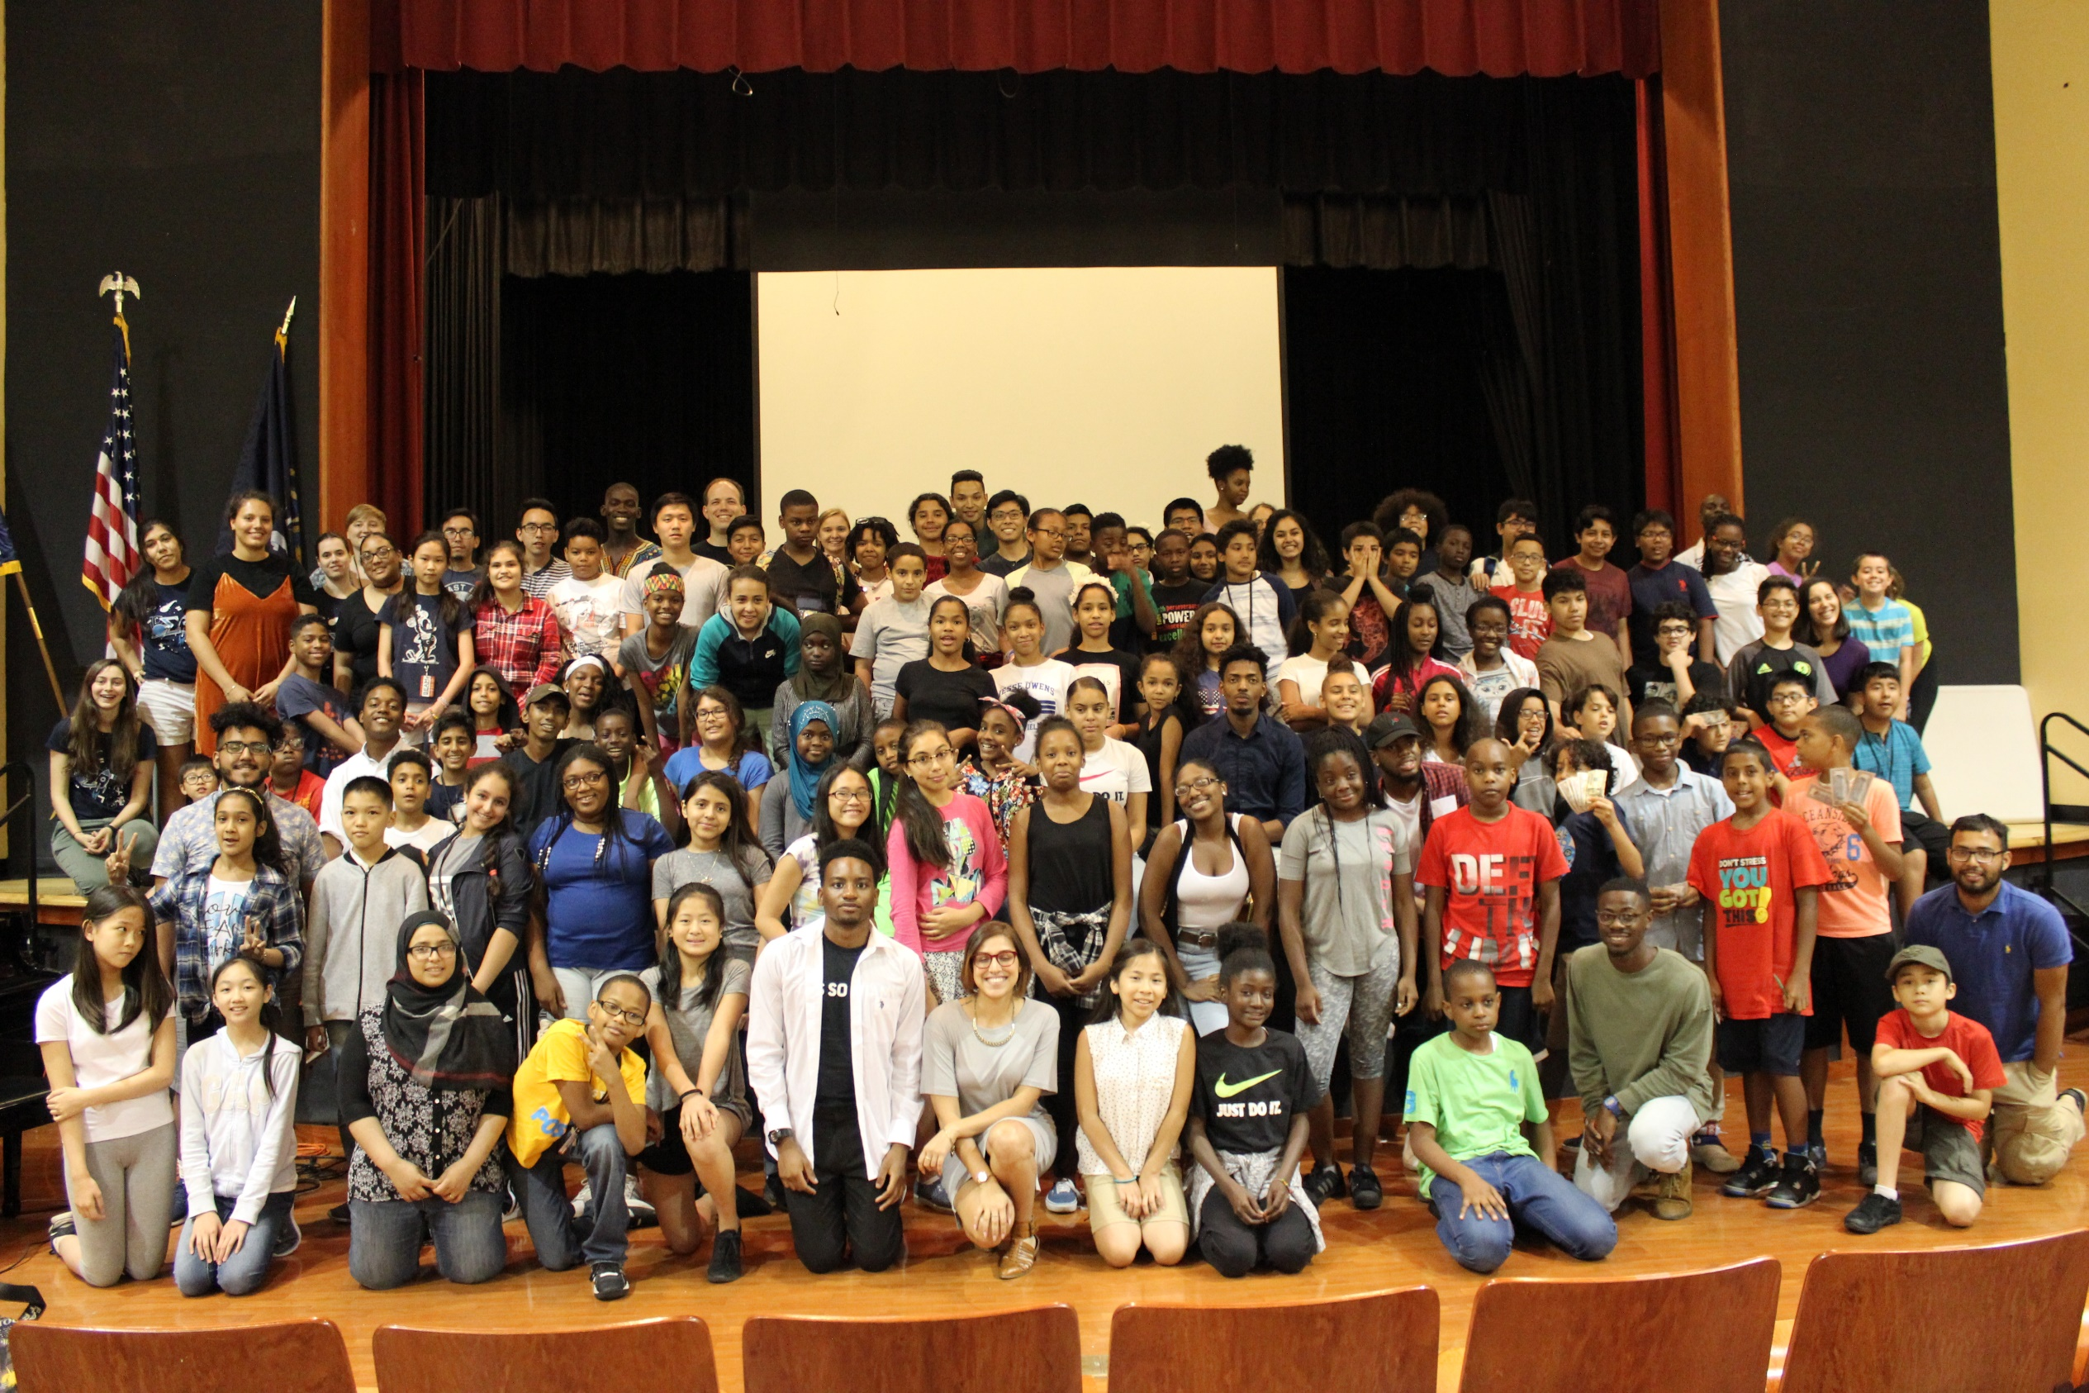
BEAM 6 – 100 students

Slide 24
Course Tracks, BEAM 6
Logical Reasoning
Math Fundamentals
Math Team Strategies
Applied Math (e.g. Astronomy, Programming, Coding Theory)
Math Circles

Slide 25
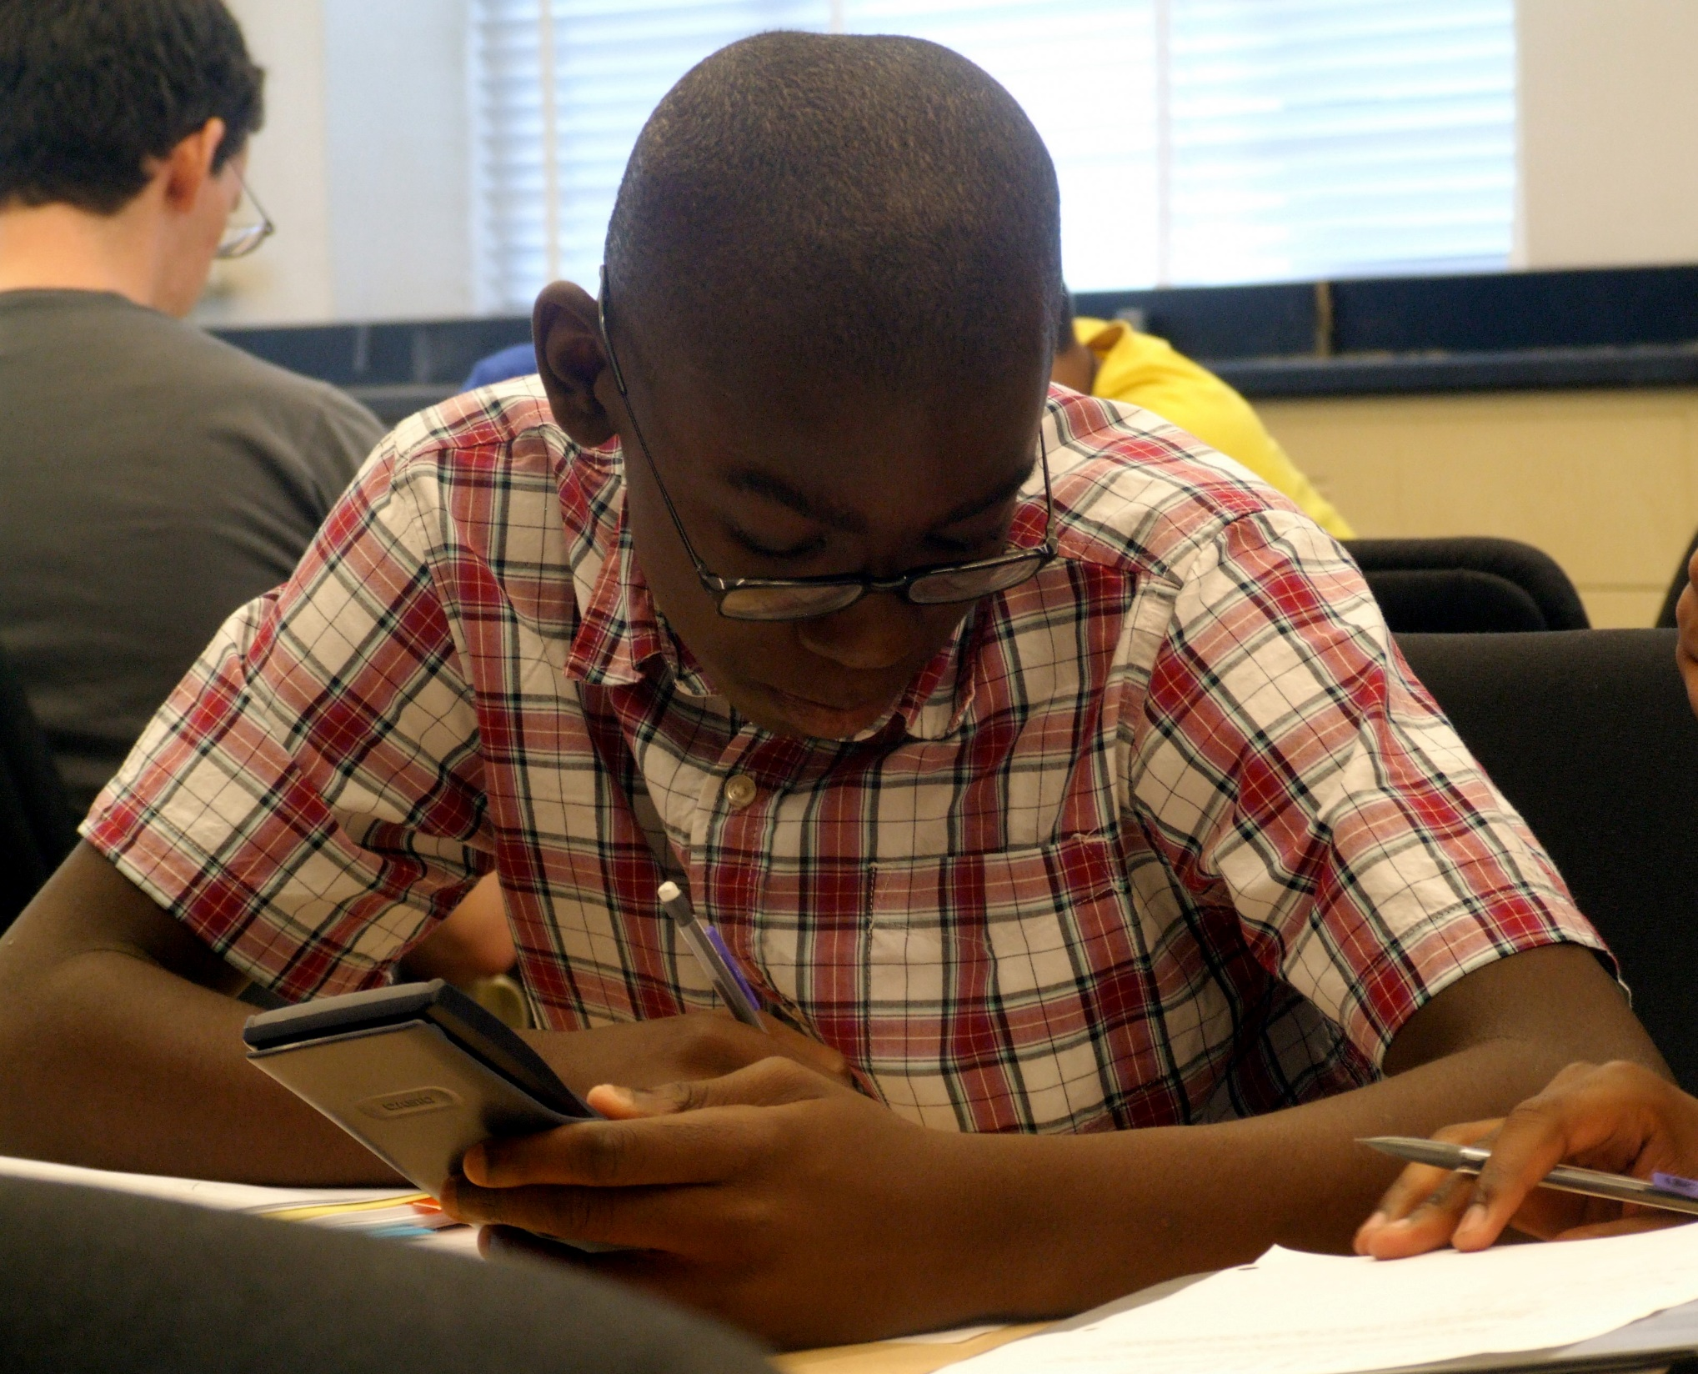
Irrelevant barriers:
Procedural training
Missing basic skills
Not used to creative problem solving
Lack of reading comprehension
Notes:
How we address each, incl. word-by-word process of understanding problems

Slide 26
MATHCOUNTS 2015, States
Using the figure of 15 circles shown, how many sets of three distinct circles A, B, and C are there such that circle A encloses circle B, and circle B encloses circle C?

Slide 27
MATHCOUNTS 2015, States
How many different ways are there to choose three circles of different sizes from the diagram at right so that the smallest circle you choose is inside the medium circle you choose, and the medium circle you choose is inside the largest circle you choose?

Slide 28
A number n is called squareable if it is possible to break a square into n smaller squares. For example:
4 squares
8 squares
9 squares
Describe the set of all squarable numbers.
Notes:
If you haven’t seen this problem before, it’s totally gorgeous and you should solve it!

Slide 29
It is possible to divide a square into 4 squares, 8 squares, or 9 squares as pictured below:
4 squares
8 squares
9 squares
What other numbers are possible? What numbers aren’t possible?
Notes:
At some point, you do want students to learn the more sophisticated language, but don’t scare them away with it!

Slide 30
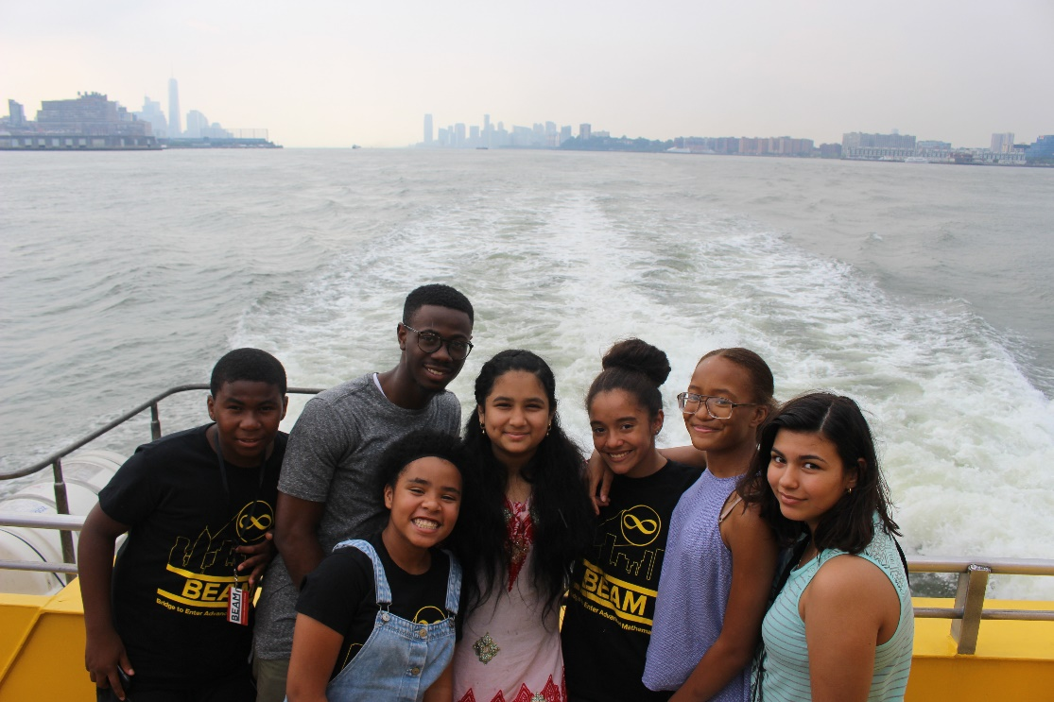
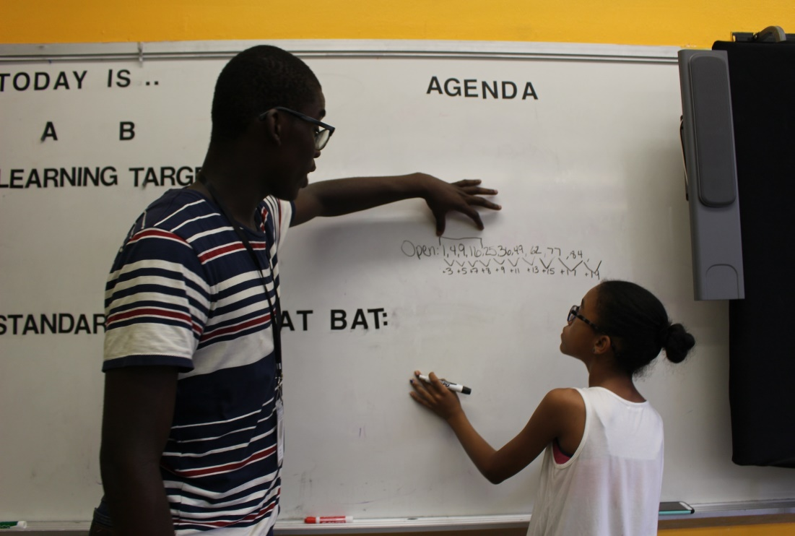

Slide 31
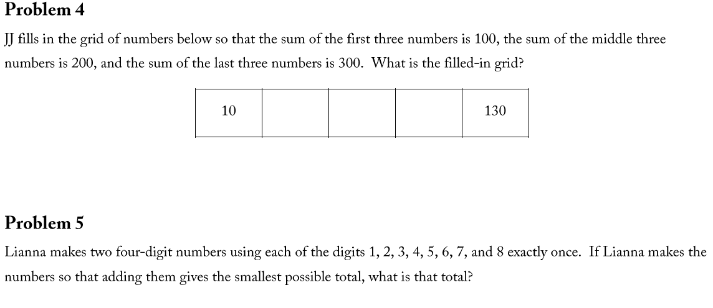
Monthly 7th Grade Challenge Sets

Slide 32
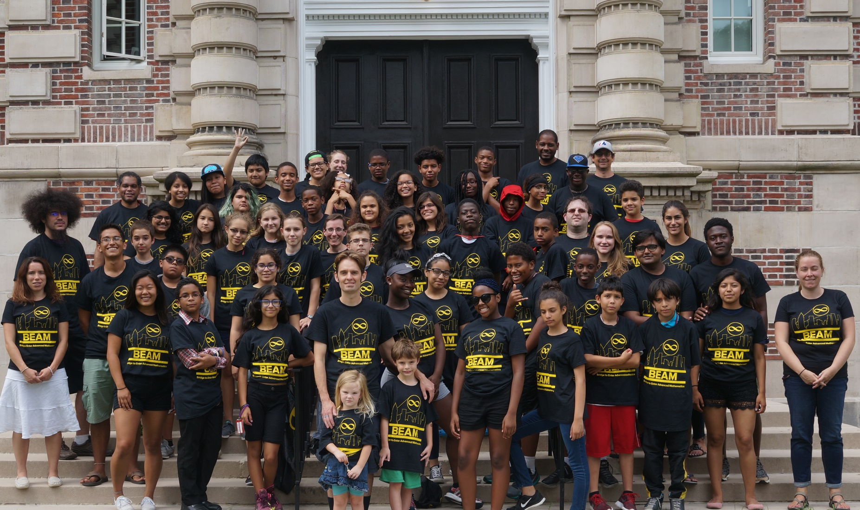
BEAM 7 – 2 sites, 40 students each

Slide 33
Classes (Bard, 2017)
Week 1:
Number Theory
Combinatorics: The Art of Counting
How To Train Your Machine?
From Doodles to Computer Networks: The Mathematics of Connections
Week 2:
Cryptography: Using Math to Have Private Conversations in Public
Group Theory
The Chinese Remainder Theorem
The Royal Family, Evil Guy, and Evolution of Number Kingdoms
Week 3:
Programming in Python
Mosaics, Symmetries, and ¿Dancing?
Knot Theory
Are Some Infinities Bigger Than Others?

Slide 34
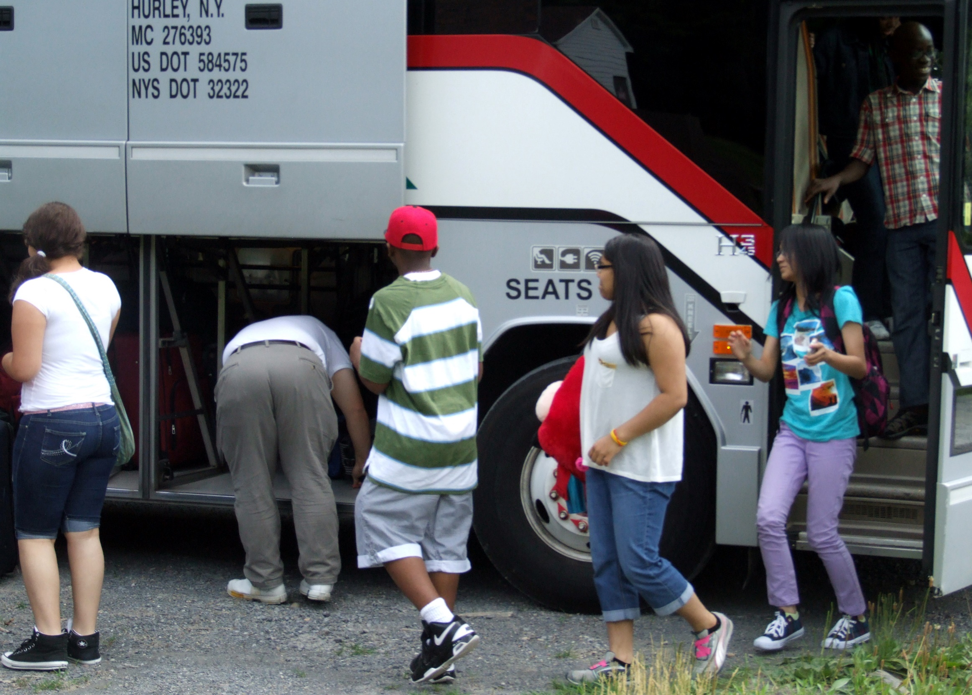
Logistics matter!
Parents: may not be able to provide transportation, may work long hours, may not have mathematical background to help, may not appreciate importance beyond school
Food, travel, books, t-shirts, fees, all cost money
Unexpected turbulence in their lives
Notes:
Parents may not speak English! May not have same value system on learning outside school, what is “enough”.
Asking for contest entry fees, t-shirts, etc. Travel may be too much
Alex F and family

Slide 35
Building a
complete
6-12 pathway to STEM
Notes:
Hold ourselves relentlessly accountable for getting our students to the same points of success as affluent students with talent in math.

Slide 36
Saturday Classes:
Enrichment

Slide 37
Saturday Classes: Life Skills

Slide 38
Office Hours

Slide 39
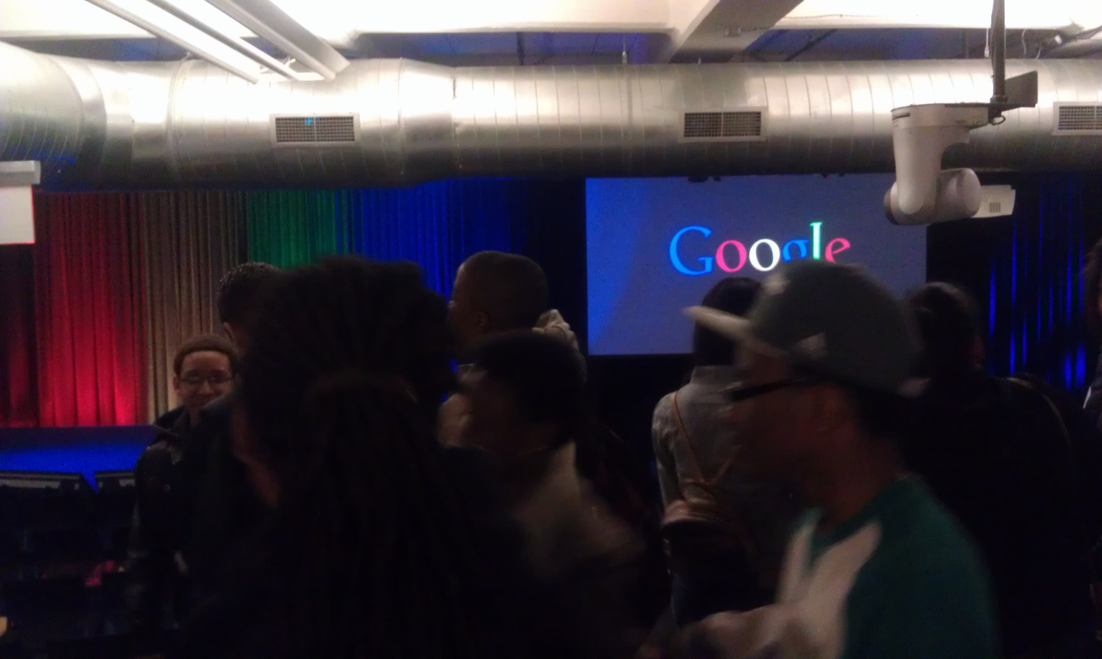

Slide 40
College Guidance

Slide 41
College Guidane

Slide 42
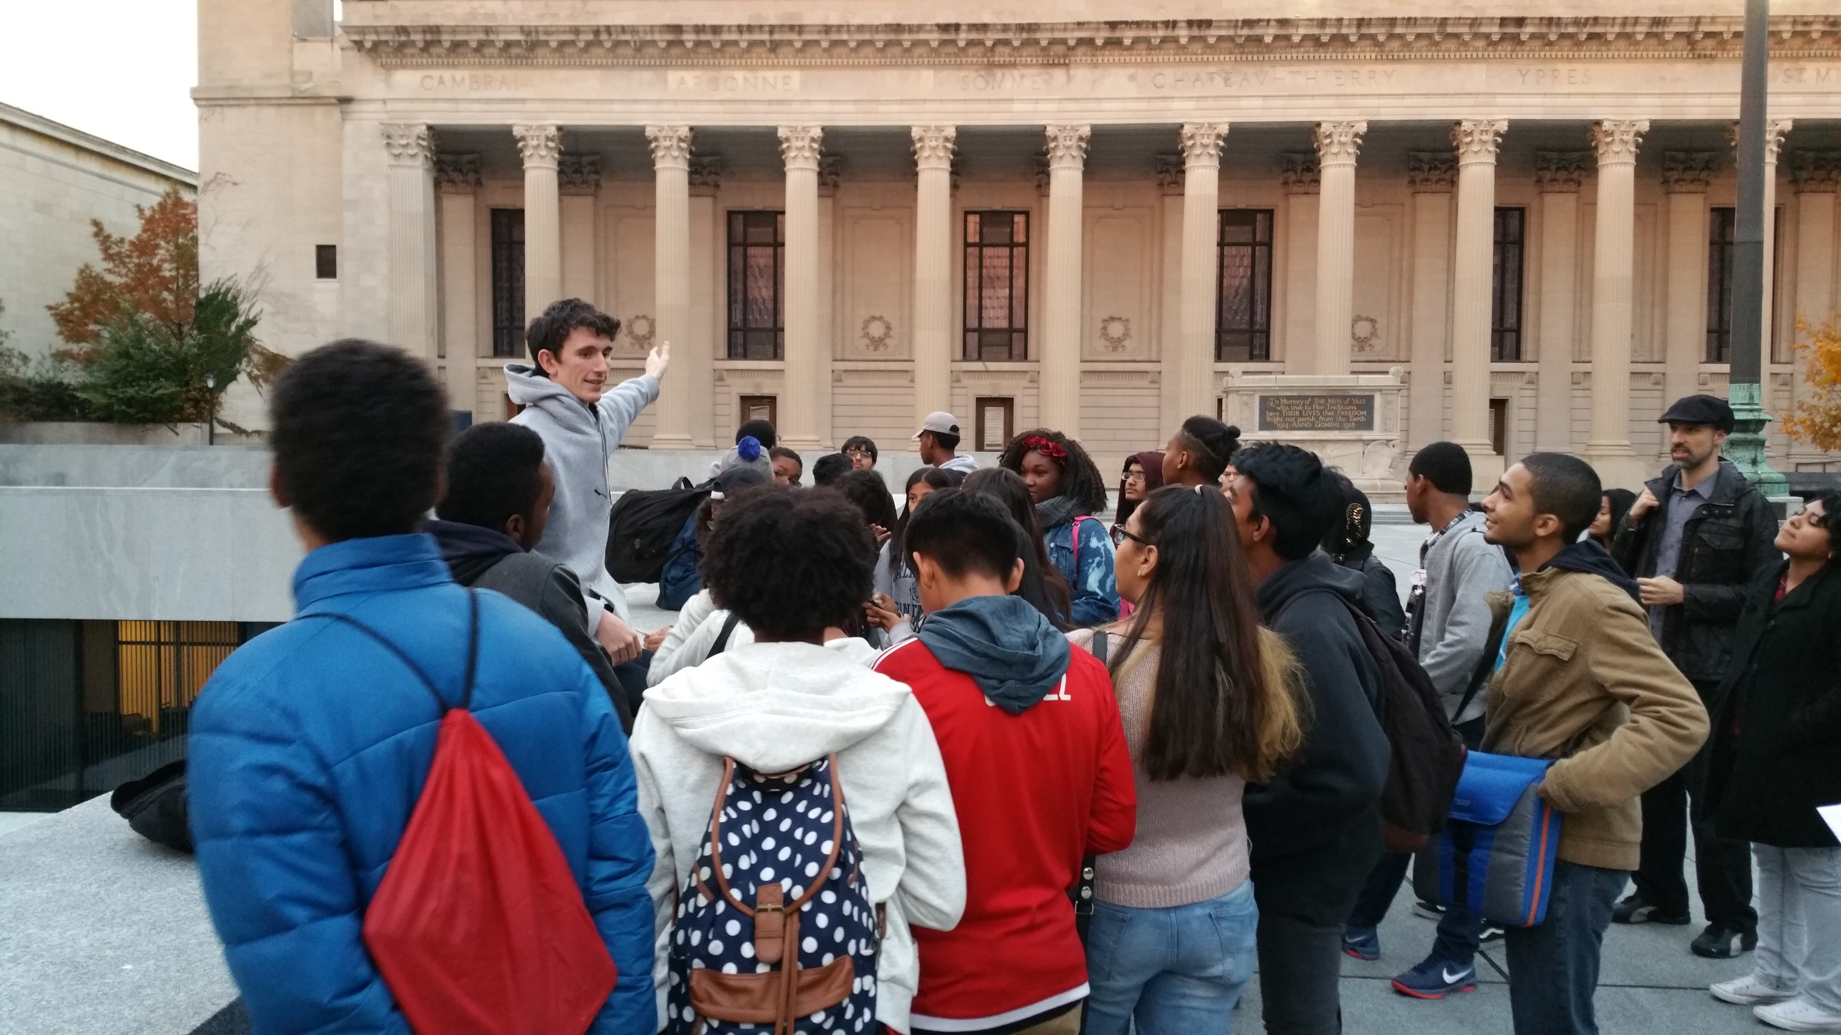
College Trips

Slide 43
HS Graduation

Slide 44
Results
Are they getting there?

Slide 45
AMC 8 Score Growth
 | Entering National Rank | National Rank After 3 Weeks
Bard 2015 | 36th percentile | 57th percentile
Siena 2015 | 35th percentile | 46th percentile

Slide 46
High School Placements
58% of 2015 alumni attending selective high schools, such as:
Bronx Science
Brooklyn Tech
High School of Math, Science, and Engineering at City College
Bard High School Early College
NEST+m
Manhattan Center for Science and Mathematics
Beacon High School

Slide 47
2016 Continued Advanced Study
# Students | Program
12 | New York Math Circle
15 | Center for Talented Youth (CTY)
2 | Carleton College Pre-College
1 | MIT MOSTEC
1 | Mathworks Honors Summer Math Camp at Texas State University
1 | Franklin & Marshall College Prep

Slide 48
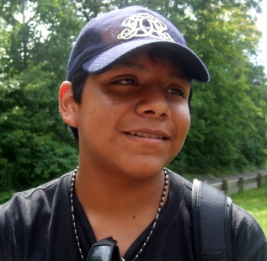
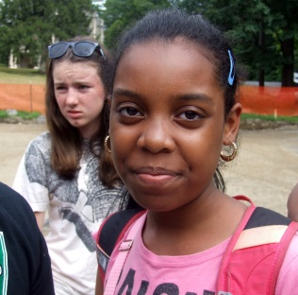
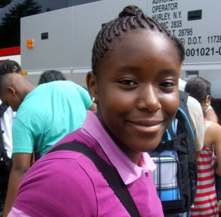
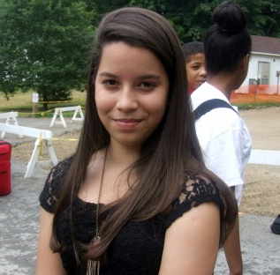
Student Feedback
Andy: Everything was just amazing... I learned to love math’s beauty.
Tanasia: I learned more math than I ever thought I would... This math was fun and interesting!
Faith: Math is the best subject in the world.
Concepcion: [Math is] a wonderful collection of questions left unanswered and statements left unproved.
Melany: I met great friends who have helped me be more outgoing and secure.
Kwabe: I didn’t have to be bored in class and could actually have a challenge.

Slide 49
Questions?

