Slide 1
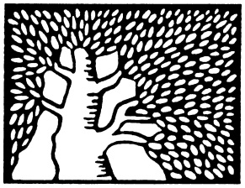
Bi-Lipschitz Bijection between the Boolean Cube and the Hamming Ball
Gil Cohen
Joint work with Itai Benjamini and Igor Shinkar

Slide 2
Cube vs. Ball
$$f :$$
$${\left\{0,1\right\}}^{n}$$
$$→$$
$$B_{n}=\left\{x∈{\left\{0,1\right\}}^{n+1} :\left|x\right|>n/2\right\}$$
Majority
$$\left\{x∈{\left\{0,1\right\}}^{n+1} :x_{n+1}=1\right\}$$
Dictator
n
Strings with Hamming weight k
k
0

Slide 3
The Problem
Open Problem [LovettViola11]. Prove that for any bijection $f:{\left\{0,1\right\}}^{n}→B_{n}$,
$E_{x\sim y}\left[dist\left(f\left(x\right),f\left(y\right)\right)\right]>{\left(\log{n}\right)}^{ω\left(1\right)}$.
Motivation. Related to proving lower bounds for sampling a natural distribution by $AC^{0}$ circuits.
The “Naïve” Upper Bound.
$$f\left(x\right)=\left\{\begin{matrix}x∘0 \left|x\right|>n/2 \\ flip\left(x\right)∘1 otherwise\end{matrix}\right.$$
Average stretch $Θ\left(\sqrt{n}\right)$

Slide 4
Main Theorem
Theorem. $∃ ψ : {\left\{0,1\right\}}^{n}→B_{n}$ such that
1) $∀x\sim y$
of
${ \left\{0,1\right\}}^{n} dist\left(ψ\left(x\right),ψ\left(y\right)\right)≤4$
1) $∀x\sim y$
of
$$B_{n}$$
$dist\left(ψ^{−1}\left(x\right),ψ^{−1}\left(y\right)\right)≤5$

Slide 5
Main Theorem
Theorem. $∃ ψ : {\left\{0,1\right\}}^{n}→B_{n}$ such that
1) $∀x≠y$
$$\frac{1}{5}≤\frac{dist\left(ψ\left(x\right),ψ\left(y\right)\right)}{dist\left(x,y\right)}≤4$$
2) $ψ$ is computable in DLOGTIME-uniform $TC^{0}$
(Majority is ${NC}^{0}$-reducible to $ψ$)
3) $ψ$ is very local
$$∀i∈\left[n\right] \underset{x}{Pr}\left[ψ{\left(x\right)}_{i}≠x_{i}\right]≤O\left(\frac{1}{\sqrt{n}}\right)$$

Slide 6
The BTK Partition [DeBruijnTengbergenKruyswijk51]
Partition of ${\left\{0,1\right\}}^{n}$ to symmetric chains.
A symmetric chain is a path $c_{k},c_{k+1},…,c_{n−k}$.
1 0 0 1 1 0 0 1
1 0 _ 1 1 0 0 _
^
^
1 0 0 1 1 0 0 1
1
1
1 0 _ 1 1 0 0 _
^
^
^
^
1 0 0 1 1 0 0 1
0
1 0 _ 1 1 0 0 _
1
^
^
^
^
^
^
1 0 0 1 1 0 0 1
0
1 0 _ 1 1 0 0 _
0

Slide 7
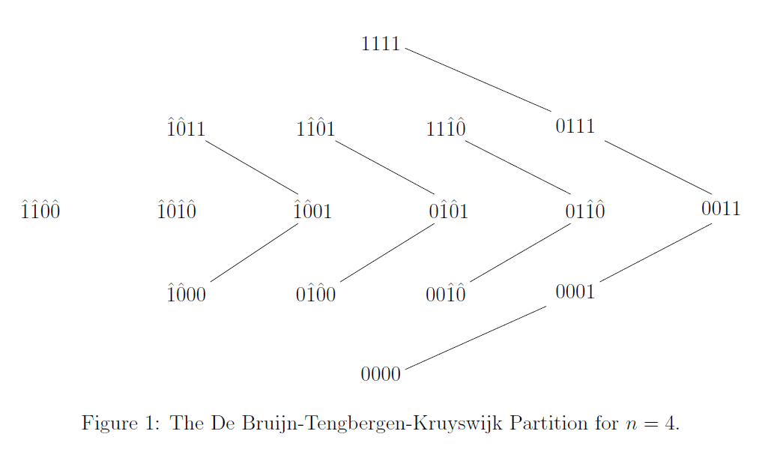
The BTK Partition

Slide 8
The Metric Properties
$$C_{y}$$
1) $\left|length\left(C_{x}\right)−length\left(C_{y}\right)\right|=O\left(1\right)$
$$C_{x}$$
y
x

Slide 9
The Metric Properties
$$C_{y}$$
1) $\left|length\left(C_{x}\right)−length\left(C_{y}\right)\right|=O\left(1\right)$
$$C_{x}$$
2) $distance\left({\left(C_{x}\right)}_{i},{\left(C_{y}\right)}_{i}\right)=O\left(1\right)$
y
x

Slide 10
The Metric Properties
$$C_{x}$$
$$C_{y}$$
1) $\left|length\left(C_{x}\right)−length\left(C_{y}\right)\right|=O\left(1\right)$
2) $distance\left({\left(C_{x}\right)}_{i},{\left(C_{y}\right)}_{i}\right)=O\left(1\right)$
y
x

Slide 11
The Metric Properties – Proof
$$i$$
$$i$$
$$x=s 0 t$$
$$y=s 1 t$$
..$0^{a}..1^{b}.. 0 .. 0^{c}..1^{d}..$
..$0^{a}..1^{b}.. 1 .. 0^{c}..1^{d}..$
$$0^{a}1^{b}0^{c+1}1^{d}$$
$$0^{a}1^{b+1 }0^{c}1^{d}$$
$$b>c$$
^
^
^
^
$$0^{a}{1^{b−c−1}1}^{c+1}0^{c+1}1^{d}$$
$$0^{a}{1^{b+1−c}1}^{c}0^{c}1^{d}$$
$$length=a+b−c+d$$
$$length=a+b−c+d+2$$

Slide 12
$$ψ$$
$$ψ : {\left\{0,1\right\}}^{n}→B_{n}=\left\{x∈{\left\{0,1\right\}}^{n+1} :\left|x\right|>n/2\right\}$$
$$C_{x}$$
$$C_{y}$$
1
$$c_{1}$$
$$ψ\left(c_{1}\right)=c_{1}∘1$$
0
$$c_{2}$$
$$ψ\left(c_{2}\right)=c_{1}∘0$$
0
$$c_{3}$$
1
$$ψ\left(c_{3}\right)=c_{2}∘1$$
$$c_{4}$$
$$ψ\left(c_{4}\right)=c_{2}∘0$$
1
0
$$c_{5}$$
$$ψ\left(c_{5}\right)=c_{3}∘1$$
$$y$$
1
$$x$$
$$c_{6}$$
$$ψ\left(c_{6}\right)=c_{3}∘0$$
$$c_{7}$$
$$ψ\left(c_{7}\right)=c_{4}∘1$$

Slide 13
The Hamming Ball is bi-Lipschitz Transitive
Defintion. A metric space M is called k bi-Lipschitz transitive if for any $x,y∈M$ there is a bijection $f :M→M$ such that $f\left(x\right)=y$, $f\left(y\right)=x$ and $∀z≠w∈M$
$$\frac{1}{k}≤\frac{distance\left(f\left(z\right),f\left(w\right)\right)}{distance\left(z,w\right)}≤k$$
Example. ${\left\{0,1\right\}}^{n}$is 1 bi-Lipschitz transitive.
$$f\left(u\right)=u+x+y$$

Slide 14
The Hamming Ball is bi-Lipschitz Transitive
Corollary. $B_{n}$ is 20 bi-Lipschitz transitive.
$$f\left(u\right)=ψ\left(ψ^{−1}\left(u\right)+ψ^{−1}\left(x\right)+ψ^{−1}\left(y\right)\right)$$
$B_{n}$ is convex in ${\left\{0,1\right\}}^{n+1}$

Slide 15
Open Problems

Slide 16
The Constants
Are the 4,5 optimal ?
We know how to improve 4 to 3 at the expense of unbounded inverse.
Does the 20 in the corollary optimal ?

Slide 17
General Balanced Halfspaces
Switching to $±1$ notation
$$ψ : \left\{x : x_{n+1}>0\right\}→\left\{x : {x_{1}+⋯+x}_{n+1}>0\right\}$$
Does the result hold for general balanced halfspaces ?
$$ψ_{a} : \left\{x : x_{n+1}>0\right\}→\left\{x : {a_{1}x_{1}+⋯+a_{n+1}x}_{n+1}>0\right\}$$
$$a_{1},…, a_{n+1}∈R$$
One possible approach: generalize BTK chains.
Applications to FPTAS for counting solutions to 0-1 knapsack problem [MorrisSinclair04].

Slide 18
Lower Bounds for Average Stretch
Exhibit a density half subset $A⊂{\left\{0,1\right\}}^{n+1}$ such that any bijection $f : {\left\{0,1\right\}}^{n}→A$ has super constant average stretch.
Even average stretch 2.001 ! (for 2 take XOR).
Conjecture: monotone noise-sensitive functions like Recursive-Majority-of-Three (highly fractal) should work.
We believe a random subset of density half has a constant average stretch.

Slide 19
Goldreich’s Question
Is it true that for any $A,B⊂{\left\{0,1\right\}}^{n}$ with density, say, half there exist $A^{′}⊂A$ and $B^{′}⊂B$, both with density half, with bi-Lipschitz bijection between them ?

Slide 20
Thank you
for your attention!

