Slide 1
Fooling intersections of low-weight halfspaces
Rocco Servedio
(Columbia)
Joint work with Li-Yang Tan (TTI Chicago / Stanford)
IAS
October 2017
Notes:
Thanks for the invitation to speak
Joint work with Rocco Servedio at Columbia

Slide 2
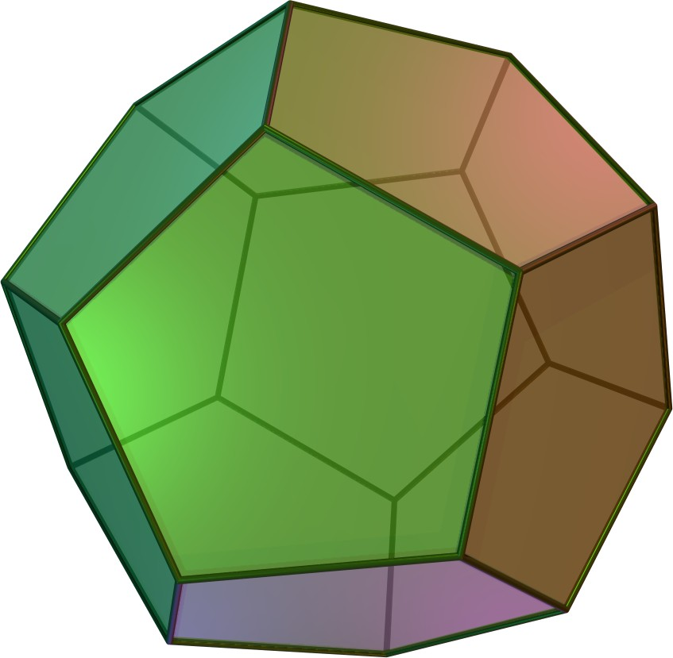
Intersections of Boolean halfspaces a.k.a. Polytopes over {−1,1}^{n}
weight vector:
threshold:
Within CS: feasible solutions of {0,1}-integer programs
Beyond CS: large body of work spanning combinatorics, discrete geometry, optimization, etc.
Notes:
Interested in a basic object, the intersection of halfspaces, or polytopes, over the discrete cube.
As we know, these objects show up in a variety of contexts.
Of course been studied not just in CS but in combinatorics, geometry, optimization and so on.

Slide 3
The weight of a halfspace
weight vector:
threshold:
Definition: Weight of halfspace h := max{|w_{j}| : j in [n]}
Fact: Every n-variable halfspace has a weight ≤ n^{O(n)} representation
Notes:
Since working over the discrete cube, not hard to see that we can assume …
And indeed we’ll adopt this convention for the rest of the talk, that the weights are integers
With this convention in place, we can state a definition and a standard fact
Weight of a halfspace is the magnitude of the largest coordinate its weight vector

Slide 4
This talk: two complexity measures of polytopes
k = number of halfspaces
t = maximum weight of any halfspace
The larger k and t are, the more “complex” F is
Intersections of weight-(t=1) halfspaces (every coefficient {−1,0,1}):
CNF formulas, Intersections of Majorities
Notes:
In this talk, we will focus on just two complexity measures
k = number of halfspaces, the number of bounding hyperplanes of our polytope
Our results will have a dependence on both k and t
Before moving on, just want to comment that even the intersection of weight-1 halfspaces capture interesting functions

Slide 5
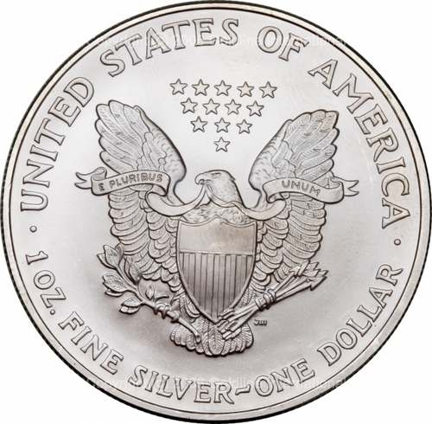

This talk:
Pseudorandom Generators for Intersections of Halfspaces
n bits
Pseudorandom output:
PRG
Truly random input:
m bits
Notes:
Many questions one can ask about intersections of halfspaces, this talk will be about Pseudorandom Generators

Slide 6
Pseudorandom Generators
Definition: An ε-PRG for the class of intersections of halfspaces is an explicit function G : {−1,1}^{m} {−1,1}^{n} satisfying:
For every F = intersection of halfspaces,
Expectation under uniform distribution
Expectation under distribution induced by G
Notes:
Quickly recall a standard definition
Stretching m truly random bits into many more bits,
In such a way that no intersection of halfspaces can “tell the difference”

Slide 7
PRG = set of points in {−1,1}^{n}
Useful to view range of PRG as 2^{m} points in {−1,1}^{n} satisfying:
For all F = intersection of halfspaces,
if F accepts Δ fraction of inputs in {−1,1}^{n}
then F accepts (Δ + ε) fraction of points
{−1,1}^{n}
Random set of points works great; we want an explicit set of points.

Slide 8
Our main result
We give an ε-PRG for the intersections of k weight-t halfspaces over {−1,1}^{n} with seed length:
poly(log n, log k, t, 1/ε).
Consider fooling intersections of k = poly(n) weight-(t=1) halfspaces to constant accuracy (ε = 0.1):
No non-trivial (seed length < n) PRG previously
Our seed length is polylog(n)
Notes:
Will a more detailed comparison to previous work in a couple of slides, but let me just state one point of comparison

Slide 9
One algorithmic application:
Counting # of solutions of {0,1}-integer programs
maximize
Given a {0,1}-IP with k constraints where
subject to
t
,
and
there is a deterministic algorithm that runs in time
poly(log n, log k, t, 1/ε)
2
and outputs an estimate of the fraction of feasible solutions, accurate to + ε.
−
Consider k = poly(n) and t = 1 (ε = 0.1):
No non-trivial (< 2^{n} time) algorithm previously
We get quasipoly(n)-time algorithm
Notes:
There’s a simple randomized algorithm for this task – random sampling -- the name of the game here is to do it deterministically.

Slide 10
Comparison with two most relevant prior results
Class of functions: | Seed length for ε-PRG:
Arbitrary function of k arbitrary halfspaces [Gopalan, O’Donnell, Wu, Zuckerman 10] | poly(log n, k, log(1/ε))
Intersections of k weight-t halfspaces (This work) | poly(log n, log k, t, 1/ε)
Intersections of k “τ-regular” halfspaces [Harsha, Klivans, Meka 10] | poly(log n, log k, 1/ε)
if τ ≤ poly(ε/(log k))
F(x) = x₁
Regular halfspaces
Low-weight halfspaces
weight t = 1
but regularity τ = 1
(bad for [HKM10] )
Our result actually captures both
Notes:
We’ll discuss [HKM] and this notion of regularity -- a technical condition -- but for now, tau is a number between 0 and 1, the smaller tau is, the nicer.
It is natural to wonder how our result relates to HKM’s, how low weight halfspaces compare to regular ones.
The answer is that they are incomparable.

Slide 11
Outline for the rest of this talk
Part I: The connection to Central Limit Theorems
Versatile and powerful framework for obtaining PRGs from central limit theorems
[Meka, Zuckerman 10; Harsha, Klivans, Meka 10]
Part II: Our work
New techniques within this PRGs-via-CLTs framework
Notes:
Start with some background and context. The role of probabilistic Central Limit Theorems
As you may have guessed regularity is crucial to this whole framework
Our work, extending this framework beyond regularity

Slide 12
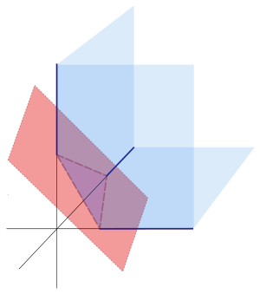
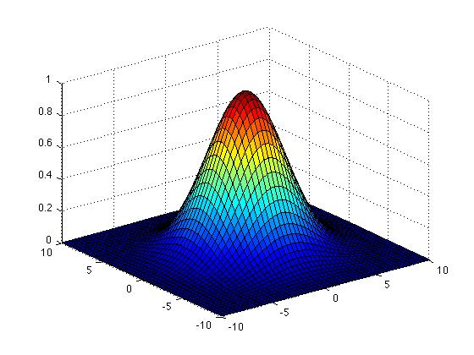
Part I: Background and Context
PRGs via Central Limit Theorems
Notes:
Versatile and powerful framework for obtaining

Slide 13
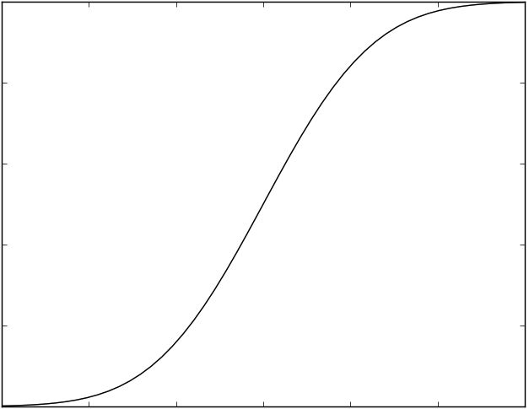
Central Limit Theorems
The sum of many independent “reasonable” random variables converges to Gaussian of same mean and variance.
CDF distance (a.k.a. Kolmogorov distance):
For all θ in R,
CDFs of S vs. Gaussian
Notes:
We’ll see in a slide what we mean by reasonable.
Many notions of convergence, in this talk: CDF distance.
Perfectly suited for halfspaces where w.x<=\theta determines value of halfspace.

Slide 14
Berry–Esséen Central Limit Theorem
Consider an “ε-regular” linear form S : {−1,1}^{n} R
,
No weight is too dominant:
Theorem: for x uniform from {−1,1}^{n},
Observation:
Regularity crucial; consider S(x) = x₁
CDF of x₁ ≈ Gaussian
Notes:
Let’s recalling the classic BE central limit theorem

Slide 15
Proof of Berry–Esséen
Lindeberg replacement trick: the “hybrid method” in TCS
Simple but key observation:
Proof suggests itself:
Replace X_{i}’s by G_{i}’s one by one;
Argue each swap incurs small error
Notes:
Sum of Gaussians is Gaussian
This is why its called the replacement method

Slide 16
Three crucial aspects of the Berry–Esséen proof
Replace X_{i}’s by G_{i}’s one by one; argue each swap incurs small error
Regularity: no coordinate X_{i} is too dominant
Matching moments
Independence among coordinates
Error incurred for i-th swap ≈ how dominant X_{i} is
,
Notes:
1) We have already seen that regularity is crucial to statement being true.
Also shows up in the proof.
2) Matching moments: natural to want G_i to “look like” X_i
3) Independence: Arises in analysis (done using Taylor’s Theorem)

Slide 17
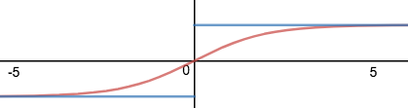
Leaving out details…
Replace X_{i}’s by G_{i}’s one by one; argue each swap incurs small error
Actual proof involves:
a ”nice” differentiable “test function”
Ψ: R [-1,1] that approximates sign( )
Taylor’s theorem: small change to argument
of Ψ leads to small change in its output value
Anti-concentration (to pass from Ψ( ) to sign( ) )
Notes:
Range of ingredients at technical level that we won’t need to worry about, but just mention them

Slide 18
The connection between CLTs and pseudorandomness
Berry–Esséen CLT: S(x) converges to Gaussian in CDF
for all θ
versus
Pseudorandomness: Fool the halfspace sign(S(x)-θ)
Pseudorandom version of Berry–Esséen CLT?
Notes:
So, what’s the connection between central limit theorems and the problem we care about, that of fooling halfspaces?
Connection becomes quite clear when we write them as follows:

Slide 19
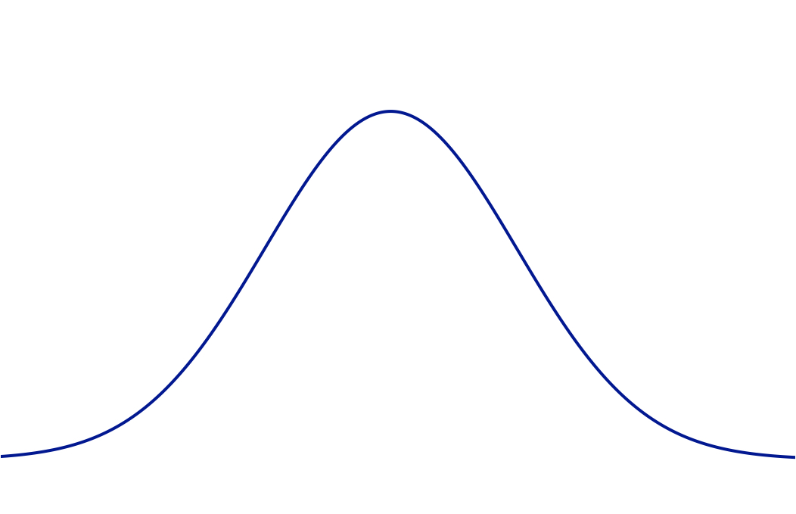
Meka–Zuckerman: PRGs via CLTs
Berry–Esséen CLT
[MZ]’s derandomization of Berry–Esséen
Uniform
Pseudorandom
CDF-close by Δ-inequality
CDF-close
(Berry–Esséen)
CDF-close
(Meka–Zuckerman)
Standard Gaussian
Notes:
Suitable pseudorandom y

Slide 20
Meka–Zuckerman’s PRG for ε-regular halfspaces
Pseudorandomly hash n variables into 1/ε² buckets
x₁₀
x₆
x₃
. . .
x₉
x₄
Each bucket ≈ ε²n variables
x₁₂
x₂
x₇
x₁₁
B₁
B₂
B
1/ε²
Independently fill each bucket with O(1)-wise independent distribution
Theorem [Meka–Zuckerman]
This is an ε-PRG for ε-regular halfspaces with seed length
O((log n)/ε²).
Proof: Berry–Esséen over 1/ε² mega-variables (1 bucket = 1 mega-variable)
Notes:
Hash: Pairwise independent; O(log n) bits of seed. Enough to spread weights. Each bucket: O(log n) bits of seed, so log(n)/\eps^2 in total. 4-wise independence in each bucket suffices because that’s moment bound that allows BE proof to go through (over mega-variables).
Very few buckets, can afford to be independent across them.
Starting point of their paper, many other results/improvements.

Slide 21
Fooling general halfspaces?
Weights of a regular halfspace:
(No weight too dominant)
Halfspace Regularity Lemma
[S 07]
Every halfspace can be made regular* by restricting a small number of variables
Weights of a general halfspace:
*or close to constant
Notes:
Not surprisingly, want to kill off those the largest weights

Slide 22
MZ’s PRG for general halfspaces via regularity lemma
Õ(1/ε²) “head” variables
Pay full fare with Õ(1/ε²)-wise independence;
seed length: Õ((log n)/ε²)
[MZ]’s seed length for ε-regular halfspaces: O((log n)/ε²)
ε-regular “tail”
Weights of a halfspace sorted by magnitude
Notes:
Here’s what the regularity lemma says.
If the weights of a halfspace are sorted according to magnitude, then there is head comprising very few … followed by a tail

Slide 23
Recap:
Meka–Zuckerman’s 3-step program for fooling halfspaces
Central Limit Theorem for regular halfspaces [Berry–Esséen]
Derandomize the CLT to get PRG for regular halfspaces
Regularity Lemma: reduce general halfspaces to regular ones
Notes:
I should say that this is just the starting point of their paper, plenty of other cool results. Not enough time to do it justice

Slide 24
Fooling intersections of halfspaces?
Natural approach: Try the same three-step program.
Central Limit Theorem for intersections of k regular halfspaces
Derandomize the CLT to get PRG for intersections of k regular halfspaces
Regularity Lemma: reduce intersections of k general halfspaces to intersections of k regular ones
Both [GOWZ 10] and [HKM 10] follow this general approach. Recall
[GOWZ 10]: seed length poly(log n, k, log(1/ε))
[HKM 10]: seed length poly(log n, log k, 1/ε) (assuming regularity)

Slide 25
Central limit theorem for regular polytopes
F = Single regular halfspace
F = Intersection of k regular halfspaces
Gopalan, O’Donnell, Wu, Zuckerman (2010),
Harsha, Klivans, Meka (2010)
Berry–Esséen CLT
F(uniform {−1,1}^{n}) ≈ F(Gaussian)
F(uniform {−1,1}^{n}) ≈ F(Gaussian)
[Mossel 08, GOWZ 10]: CLT where error bound scales as poly(k)
[HKM 10]: CLT where error scales as polylog(k)
Notes:
[Mossel08, GOWZ10]: k = o(n) halfspaces, whereas [HKM] can handle k = exponential-in-n

Slide 26

Harsha–Klivans–Meka:
Fooling intersections of regular halfspaces
[HKM]
Central Limit Theorem for intersections of k regular halfspaces
Derandomize the CLT to get PRG for intersections of k regular halfspaces
Regularity Lemma: reduce intersections of k general halfspaces to intersections of k regular ones
[HKM]
Can be done for k = o(n) halfspaces [GOWZ10] but fundamental barrier at k = Ω(n)
Notes:
[HKM] have polylog(k) dependence in CLT. Get same dependence in derandomized version. And get polylog(k) dependence in anticoncentration bound (recall technical stuff). So get through (2): PRG for intersection of regular.
Would love to have result for general halfspaces, but obstacle.

Slide 27

Simple example illustrating the k = Ω(n) barrier
Consider the following k = n many halfspaces
...
...
1st halfspace
2nd halfspace
n^{th} halfspace
Observe that none of them are regular
Want to make all of them regular by restricting a small number of variables
Impossible in this case: need to restrict all n variables
Notes:
Observe that none of them are regular
If you do not restrict the i-th variable, the i-th halfspace will remain non-regular

Slide 28
[HKM]
Central Limit Theorem for intersections of k regular halfspaces
Derandomize the CLT to get PRG for intersections of k regular halfspaces
Regularity Lemma: reduce intersections of k general halfspaces to intersections of k regular ones
[HKM]
Fundamental barrier at k = Ω(n) halfspaces
The upshot:
This program is “stuck” at k = o(n) halfspaces, and new ideas needed to handle k = Ω(n) halfspaces.
Notes:
In my remaining time, I’d like to tell you about our work overcoming this barrier in the case of low-weight halfspaces
Can even handle exponentially many

Slide 29
Our work:
PRG for intersections of low-weight halfspaces
Regular halfspaces
Low-weight halfspaces
This work

Slide 30
Simple fact about low-weight halfspaces
Regular-or-Sparse dichotomy
Every weight-t halfspace over {−1,1}^{n} can be represented as either:
OR:
ε-regular
S = (t/ε)² sparse
Easy to see this: if not sparse, then even the “worst possible”
weight-t halfspace will be somewhat regular.
weight-t
all weight-1

Slide 31
Simple fact about low-weight halfspaces
Regular-or-Sparse dichotomy
Every weight-t halfspace over {−1,1}^{n} can be represented as either:
Corollary
Every F = intersection of weight-t halfspaces can be expressed as:
F = G and H
ε-regular
where
OR:
G = intersection of ε-regular
halfspaces
H = width-S CNF formula,
where S=(t/ε)²
S = (t/ε)² sparse
Notes:
And this is the class we will fool

Slide 32
Are we done?
G = intersection of regular halfspaces
Goal is to fool:
F = G and H
[HKM] PRG
H = small-width CNF formula
[AW85, Nis92, … , Baz07, Raz09, DETT10] PRGs
Far from done…
No known generic technique to “combine PRGs” in this way
Here specifically have good reason to be skeptical, since
techniques for fooling G are very different from those for H
Our proof fuses these 2 lines of work
Overall strategy: hybrid method, as in [HKM] PRG for G
Hybrid r.v.’s carefully coupled based on PRGs for H
Notes:
First of all, generically, if we know how to fool a function G, and fool a function H, it is far from clear we have
Especially unclear in this setting
One of our main contributions in this work is to bring together

Slide 33
Recall three crucial properties for the proof:
Part I: Fooling a single regular halfspace via Berry–Esséen
Replace X_{i}’s by Y_{i}’s one by one; argue each swap incurs small error
No coordinate X_{i} is too dominant
X_{i} and Y_{i} have matching moments
Independence among coordinates
For us, none of the three will hold!
Likewise, [HKM]’s proof of the k-dimensional case crucially relies on k-dimensional analogues of all three
Notes:
HKM has all 3 conditions for k-dimensional BE

Slide 34


Key difficulty the CNF poses for the hybrid method
Single ε-regular linear form [BE,MZ]
S(x) = w₁ x₁ + … + w_{n} x_{n}
Flipping x_{i} changes S(x) by ≤ 2ε
k many ε-regular linear forms [HKM]
S₁(x), … , S_{k}(x)
Flipping x_{i} changes each S_{j}(x) by ≤ 2ε
This work: k many ε-regular linear forms + CNF formula H
S₁(x), … , S_{k}(x), H(x)
Flipping x_{i} can change H by 2
{−1,1}-valued output
(that is: x_{i} can be very dominant)
Notes:
Why the CNF formula does not jive with the hybrid method
Recall we need that none of the variables are dominant.

Slide 35
Our hybrid argument vs. standard hybrid arguments
Like [MZ,HKM], first pseudorandomly hash variables. For each bucket i:
x₁₀
x₆
x₃
x₁₂
. . .
x₇
x₄
. . .
x₁₁
x₉
x₁
x₁₅
x₂
x₈
x₅
B₁
B₂
B_{i}
B_{(1/ε)-1}
B_{1/ε}
Independently fill each bucket with uniform distribution
Independently fill each bucket with r-wise independence
Standard hybrid argument
[Berry–Esséen,…,MZ,HKM]
Our argument
Fill B_{i} with uniform X vs. r-wise independent Y, where Y is carefully coupled with X
Fill B_{i} with uniform X vs. r-wise independent Y
Notes:
Usual BE proof: No notion of a joint distribution between X and Y
We do consider them as jointly distributed

Slide 36
Coupling adjacent hybrid random variables
Consider F’ = F restricted to this bucket B_{i} of variables:
x₇
x₄
F’ = G’ and H’
x₈
where G’ = intersection of ε-regular halfspaces and
H’ = width-S CNF formula
B_{i}
Theorem (Fooling CNFs)
[Bazzi 07, Razborov 09]
If X = uniform and
Y = poly(S,log(1/ε))-wise indep., there is a coupling (X,Y) such that
H’ is ε-fooled by poly(S,log(1/ε))-wise independence
Pr[H’(X) ≠ H’(Y)] ≤ ε.
This is the coupling (X,Y) we’ll use

Slide 37
Why this coupling is useful
each uniform
each r-wise independent
x₁₀
x₆
x₃
x₁₂
. . .
x₇
x₄
. . .
x₁₁
x₉
x₁
x₁₅
x₂
x₈
x₅
B₁
B₂
B_{i}
B_{(1/ε)-1}
B_{1/ε}
The two key distributions over {-1,1}^{n}: fill B_{i} with either uniform X or
r-wise independent Y.
Coupling these distributions induces coupling over two (k+1)-dimensional vector random variables
(S₁(x), … , S_{k}(x), H(x))
regular linear forms
CNF
Thanks to coupling, last coordinates almost always agree – can (hope to) apply multidimensional Taylor’s Theorem.

Slide 38
x₁₀
x₆
x₃
x₁₂
. . .
x₇
x₄
. . .
x₁₁
x₉
x₁
x₁₅
x₂
x₈
x₅
B_{i}
Independently fill each bucket with uniform distribution
Independently fill each bucket with r-wise independence
The key lemma (i-th step of our hybrid argument)
Let F = G and H where G = intersection of regular halfspaces, and H = CNF formula. Let Z₁, Z₂ be r.v.’s supported on {−1,1}^{n}:
Z₁ := Fill B_{i} with uniform X, other buckets as above
Z₂ := Fill B_{i} with r-wise independent Y, other buckets as above
Then
E[F(Z₁)] ≈ E[F(Z₂)].
Proof crucially uses coupling of (X,Y) as described on previous slide.

Slide 39
This coupling introduces additional challenges…
Challenge 1: Dependence across buckets
Our coupling for the i-th bucket depends on
CNF formula H’ := H restricted to the i-th bucket,
which in turn depends on our assignment to the other buckets
Solution 1: Express/approximate each distribution by mixture of two distributions in which i-th bucket is indeed independent of rest
D ≈ π₁D₁ + π₂D₂
i-th bucket not independent of others
i-th bucket is independent of others
Notes:
The way this manifests itself in the formal proof is that in Taylor expansion of Phi(v+Delta), in usual proof v and Delta are independent, for us they’re not. Express v+Delta as mixture of two or three things, in each component it’s a sum of two independent things.

Slide 40
Another challenge…
Challenge 2: While (uniform X, r-wise Y) match moments in overall distribution, they do not in the mixture components
D ≈ π₁D₁ + π₂D₂
(X,Y) match moments
(X,Y) do not match moments
Solution 2: Moments in the components do not match exactly,
but can show they are close enough

Slide 41
Summary
Our main result:
An ε-PRG for the intersections of k weight-t halfspaces over {−1,1}^{n} with seed length:
poly(log n, log k, t, 1/ε).
Previously, no non-trivial PRG for intersections of k = poly(n) weight-(t=1) halfspaces. Our seed length is polylog(n)
New coupling-based ingredients into standard hybrid method for obtaining PRGs from central limit theorems
Notes:
… whereas we achieve seed length polylog(n)

Slide 42
Goal for future work
Explicit ε-PRG for intersections of k halfspaces with seed length
poly(log n, log k, 1/ε)
or even
poly(log n, log k, log(1/ε))
?
Thanks for listening!
Notes:
… whereas we achieve seed length polylog(n)

