Slide 1
Composition: The Key to Differential Privacy’s Success
Guy Rothblum

Slide 2
Differential Privacy (DP) [DMNS06]
Auxiliary Information even if adversary has partial information, protect against further privacy loss
Composition even w. multiple analyses, privacy maintained (smooth gradual degradation)
Contrast
“just” releasing statistics
De-identifying the data [GKS08]

Slide 3
Composition
Privacy maintained even under multiple analyses
Core issue
The key to differential privacy’s success
Unavoidable In reality, there are multiple analyses
Programmable Private subroutines make for private algorithms

Slide 4
Composition
Privacy maintained even under multiple analyses
How do we define it? [DRV10]
Adaptive, adversarial DBs and algorithms
$$(x10,x11), M1$$
$$b∈\{0,1\}$$
Adversary
$$M1(x1b)$$
…
$b=0$: real world
$b=1$: my data replaced w. junk
Views under $b=0$ / $b=1$ are DP
$$(x_{k}0,x_{k}1),M_{k}$$
$$Mk(xkb)$$
Notes:
Talk about why composition is important

Slide 5
This Talk: Survey on DP Composition
Basic composition
Advanced composition
A more refined understanding

Slide 6
This Talk: Survey on DP Composition
Basic composition
$k$ (adaptively chosen) algorithms, each $ε_{0}$-DP, taken together still $k⋅ε_{0}$-DP
application: answering multiple queries
Advanced composition
A more refined understanding

Slide 7
Basic Composition [DMNS06]
P[z₁] = Pr _{z~A1(D)}[z=z₁]
P’[z₁] = Pr _{z~A1(D’)}[z=z₁]
$A1(D)$is $ε1$-diffP
for all $z1, A2(D,z1)$is $ε2$-diffP,
Then $A_{2}(D,A1(D))$is $(ε1+ε2)−$diffP
Proof:
for all adjacent $D,D’$ and $(z1,z2):$ $$e^{−ε_{1}}≤ P[z1] / P’[z1] ≤ eε1 \\ e^{−ε_{2}}≤ P[z2] / P’[z2] ≤ eε2$$
$$e^{−{(ε}_{1}+ε_{2})}≤\frac{P\left[\left(z1,z2\right)\right]}{P′\left[\left(z1,z2\right)\right]}≤ eε1+ε2$$
P[z₂] = Pr _{z~A2(D,z1)}[z=z₂]
P’[z₂] = Pr _{z~A2(D’,z1)}[z=z₂]

Slide 8
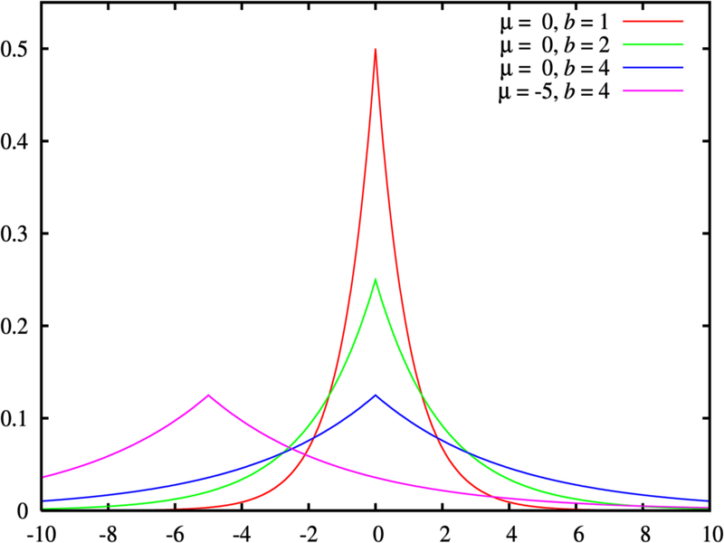
Application: Answering Queries
Laplace Mechanism [DMNS06]
Given query $q$,
compute $q(D)$
output $q\left(D\right)+Lap(1/ε0)$
$$\max_{D,D′}{|q\left(D\right)−q(D^{′})|}$$
Fact: If $q$ has sensitivity 1, Laplace guarantees $ε0$-differential privacy

Slide 9
Multiple Queries: Basic Composition
$k$ queries, each with sensitivity $1$
add indep. noise $Lap(k/ε)$ per query
$ε_{0}=ε/k$-privacy per query
$ε$-privacy for all $k$ answers
error $Õ(k/ε)$
Error depends linearly on num of queries
E.g., can answer $√n$ queries w. $Õ(\sqrt{n})$ error
Composition!

Slide 10
This Talk: DP Composition
Basic composition $k$ analyses, each $ε_{0}$-DP $⇒$ $Õ(ε_{0}⋅k)$-DP
Advanced composition $k$ analyses, each $ε_{0}$-DP $⇒$ $Õ(ε_{0}^{2}⋅k)$-DP*
A more refined understanding

Slide 11
Advanced Composition [DRV10]
Composing $k$ algorithms, each $ε_{0}$-DP:
$ε_{g}=O\left(\sqrt{k⋅\ln{\frac{1}{δ_{g}}}}⋅ε_{0}+k⋅ε_{0}^{2}\right)$
with all but $δ_{g}$ probability.
Compare with: $ε_{g}=k⋅ε_{0}$ (basic composition)
?

Slide 12
What is Privacy Loss?
Fix adjacent $D,D′$, draw$C←M\left(D\right)$
$$PrivacyLoss\left(C\right)=ln\left[\frac{\operatorname{Pr}\left[M\left(D\right)=C\right]}{Pr⁡[M\left(D′\right)=C\text{] }}\right]$$
can be positive, negative (or infinite)
19
20

Slide 13
What is Privacy Loss?
Fix adjacent $D,D′$, draw$C←M\left(D\right)$
$$PrivacyLoss\left(C\right)=ln\left[\frac{\operatorname{Pr}\left[M\left(D\right)=C\right]}{Pr⁡[M\left(D′\right)=C\text{] }}\right]$$
random variable, has a mean ([DDN03]…)
$\left(ε,0\right)−DP:w.p. 1 over C,$ $\left|PrivacyLoss\left(C\right)\right|≤ε$
$\left(ε,δ\right)−DP^{∗}:w.p. 1−δ over C,$ $\left|PrivacyLoss\left(C\right)\right|≤ε$

Slide 14
Advanced Composition [DRV10]
Composing $k$ algorithms, each $ε_{0}$-DP:
$ε_{g}=O\left(\sqrt{k⋅\ln{\frac{1}{δ_{g}}}}⋅ε_{0}+k⋅ε_{0}^{2}\right)$
with all but $δ_{g}$ probability.
Better composition, better DP algorithms
Answer $n$ queries, error $Õ(\sqrt{n⋅ln{(1/δ_{g}})}$) (independent Laplace noise)
Answer $k$ queries, error $Õ\left(\sqrt{\log{k }⋅n⋅ln{(1/δ_{g}})}\right)$ (coordinated noise [HR10])
Fundamental law of information recovery [DN03]: Must have error $Ω(\sqrt{n})$
For all $δ_{g}$ simultaneously

Slide 15
Advanced Composition Proof
If $M$ is DP, then privacy loss RV has:
$E\left[PrivacyLoss\left(C\right)\right]=O\left(ε^{2}\right)$ (down to $ε^{2}/2$ [DR15])
$\left|PrivacyLoss\left(C\right)\right|≤ε$
Model cumulative loss from $M_{1}…M_{k}$ as Martingale
$$\operatorname{Pr}\left[\left(\sum_{i=1}^{k}{Loss\left(C_{i}\right)}\right)>kε^{2}+\sqrt{k}ε⋅t\right]≤exp⁡(−t^{2}/2)$$

Slide 16
Advanced Composition of $(ε,δ)$
Composing $k$ algorithms, each ${(ε}_{0},δ_{0}$)-DP:
$ε_{g}=O\left(\sqrt{k⋅\ln{\frac{1}{δ_{err}}}}⋅ε_{0}+k⋅ε_{0}^{2}\right)$
with all but $δ_{g}=δ_{err}+k⋅δ_{0}$ probability.
Generally: $δ$’s add up

Slide 17
This Talk: DP Composition
Basic composition $k$ analyses, each $ε_{0}$-DP $⇒$ $Õ(ε_{0}⋅k)$-DP
Advanced composition $k$ analyses, each $ε_{0}$-DP $⇒$ $Õ(ε_{0}^{2}⋅k)$-DP*
A more refined understanding
Tight bounds
The complexity of composition
An alternative: Concentrated Differential Privacy

Slide 18
Optimal DP Composition
For given mechanisms $\left(M_{1},M_{2},…,M_{k}\right)$, what are best $(ε_{g},δ_{g})$ we can claim? (best: over all events)
For given bounds $(\left(ε_{1},δ_{1}\right),…,(ε_{k},δ_{k}))$, what are best $(ε_{g},δ_{g})$ we can claim? (best, over all mechanisms, events)

Slide 19
Optimal DP Composition
30-50% improvement over [DRV10]
Best $(ε_{g},δ_{g})$ for given $(\left(ε_{1},δ_{1}\right),…,(ε_{k},δ_{k}))$ (best, over all mechanisms, events)
Homogeneous case [KOV15]
Tight bounds when ${∀i, ε}_{i}=ε,δ_{i}=δ$
Heterogeneous case [MV16]
Tight bounds for general $ε_{i},δ_{i}$
Computing $ε_{g}$ is $\#P$-complete (unlikely to take less than $exp⁡(k)$ time)
Approximate $ε_{g}$ up to additive $η$ in time $poly(k,η)$

Slide 20
This Talk: DP Composition
Basic composition $k$ analyses, each $ε_{0}$-DP $⇒$ $Õ(ε_{0}⋅k)$-DP
Advanced composition $k$ analyses, each $ε_{0}$-DP $⇒$ $Õ(ε_{0}^{2}⋅k)$-DP*
A more refined understanding
Tight bounds
The complexity of composition
An alternative: Concentrated Differential Privacy

Slide 21
Composition Goals
Efficient composition
Better bounds, smaller error Not all $(ε,δ)$ mechanism are created equal
$δ$ of death and destruction w.p. $δ$ we really are doomed (PTR [DL09])
$δ$ of concentration playing it safe: in fact, loss usually smaller than $ε$ (Gaussian noise, advanced composition)
“Worst case over mechanisms”: ties our hands

Slide 22
Concentrated Differential Privacy [DR15,BS16]
Fix adjacent $D,D′$, draw$C←M\left(D\right)$
$$PrivacyLoss\left(C\right)=ln\left[\frac{\operatorname{Pr}\left[M\left(D\right)=C\right]}{Pr⁡[M\left(D′\right)=C\text{] }}\right]$$
$(μ,τ^{2})$-concentrated differential privacy [DR15]
Intuition: $PrivacyLoss\left(C\right)$ is concentrated
$E_{C←M(D)}\left[PrivacyLoss\left(C\right)\right]≤μ$
concentration “no worse than” $N\left(μ,τ^{2}\right)$
Alternative : bound Renyi divergences [BS16]

Slide 23
Comparison: Privacy Loss (cdf)
(ε,δ)
(ε,0)
Notes:
\mu=1/2, \tau=1, delta=0.1

Slide 24
Concentrated Differential Privacy
Intuition: privacy loss “no worse than” $N(μ,τ^{2})$
Formally: privacy loss is Subgaussian random variable, rich theory to draw on
$E_{C←M(D)}\left[PrivacyLoss\left(C\right)\right]≤μ$
$(PrivacyLoss(C)−μ)$ is “Subgaussian”
$\operatorname{Pr}\left[|PrivacyLoss(C)−μ | ≥ t⋅τ \right]≤e^{−t^{2}/2}$

Slide 25
Concentrated Differential Privacy
Intuition: privacy loss “no worse than” $N(μ,τ^{2})$
Formally: privacy loss is Subgaussian random variable, rich theory to draw on
Maintains many advantages of differential privacy:
composes automatically $μ$ and $τ^{2}$ add up
handles linkage / auxiliary data (similarly to standard differential privacy)

Slide 26
Concentrated Differential Privacy Summary: Improved Utility, Relaxed Privacy
Privacy (CDP vs. $\left(ε,δ\right)$-DP)
Per study: weaker/relaxed guarantee
Composition over many studies: (roughly) identical behavior!
Accuracy (answering $k$ queries, $ε=1$)
$\left(ε,0\right)$-DP: noise $≈k$
$\left(ε,δ\right)$-DP: noise $≈\sqrt{k⋅ln\left(1/δ\right)}$
$\left(ε^{2}/2,ε^{2}\right)−$CDP: noise $≈\sqrt{k}$
Notes:
Main point: privacy relaxation is fairly benign

Slide 27
Comparison: Composed Privacy Loss (cdf)
(ε,δ)
(ε,0)
Notes:
K=10, M=0.16, V=0.4, Eps=0.4, delta=0.1

Slide 28
Comparison: Noise Magnitude (pdf)
(ε,δ)
(ε,0)
Notes:
K=10, Cohort = 200, 2/3 consent

Slide 29
CDP Advantages
Tight, efficient composition bounds
sharper analysis for private algorithms
Group privacy
Groups of size $g$: $\left(g^{2}μ⋅\left(1+o\left(1\right)\right),g^{2}τ^{2}⋅\left(1+o\left(1\right)\right)\right)$-CDP
compare: $(gε,{ge}^{O(gε)}δ)$-DP
Applications
private deep learning [ACGMMTZ16]
energy use statistics
Tightened in [BS16]

Slide 30
CDP Open Questions
Post processing
CDP parameters can degrade under post-processing
Alternative formalizations do not, e.g. [BS16]
Sub-sampling
For DP, sub-sampling “amplifies” privacy
For CDP, this isn’t the case
Goal: one framework to rule them all
Sharp analysis of algorithms’ privacy losses

Slide 31
Summary and Challenges
THANK YOU!
Composition: core issue in study of privacy
Basic, advanced, optimal composition for DP
CDP: refined understanding
Grand challenge: when $k$ gets too large
“Programming templates” how private is $f(M_{1}\left(D\right),M_{2}\left(D\right),…,M_{k}\left(D\right))$?
Internet-scale composition can we leverage scale of data for better privacy?

