Slide 1
Test
This is a test, just a test, nothing but a test
Test
Testing testing testing testing testing testing te
Test
Test
This is a test, just a test, nothing but a test

Slide 2
The Mathematics of
Natural Algorithms
Bernard Chazelle
Princeton University

Slide 3
1 dynamic networks
2 the curse of equilibrium

Slide 4
Hegselmann-Krause systems

Slide 5
authoritarian
left
right
libertarian
Notes:
ETANT DONNE UNE POPULATION SUR L’ECHIQUIER POLITIQUE ….

Slide 6
Notes:
ETANT DONNE UNE POPULATION SUR L’ECHIQUIER POLITIQUE ….

Slide 7
Notes:
ETANT DONNE UNE POPULATION SUR L’ECHIQUIER POLITIQUE ….

Slide 8
Notes:
ETANT DONNE UNE POPULATION SUR L’ECHIQUIER POLITIQUE ….

Slide 9
Each agent moves to mass center of neighbors
Notes:
ETANT DONNE UNE POPULATION SUR L’ECHIQUIER POLITIQUE ….

Slide 10
Notes:
ETANT DONNE UNE POPULATION SUR L’ECHIQUIER POLITIQUE ….

Slide 11
20,000 agents

Slide 12
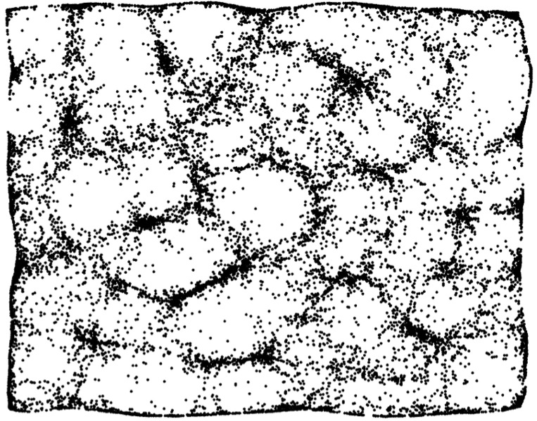

Slide 13
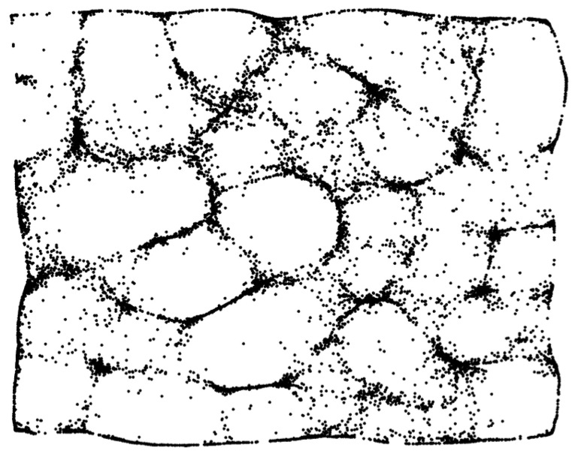

Slide 14
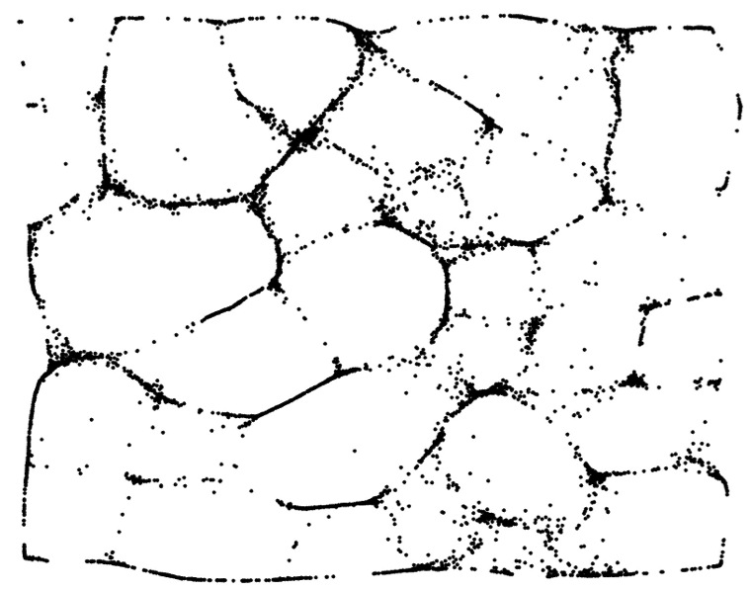

Slide 15
Hegselmann-Krause in 1D
with Bhattacharyya, Braverman, Nguyen (2013)
Wedin-Hegarty (2015)
Notes:
ETANT DONNE UNE POPULATION SUR L’ECHIQUIER POLITIQUE ….

Slide 16
Stubborn Hegselmann-Krause
If agent i is stubborn:
If agent i is open-minded:
Notes:
ETANT DONNE UNE POPULATION SUR L’ECHIQUIER POLITIQUE ….

Slide 17
Inertial Hegselmann-Krause
with C. Wang (2015)
always converges
Notes:
ETANT DONNE UNE POPULATION SUR L’ECHIQUIER POLITIQUE ….

Slide 18
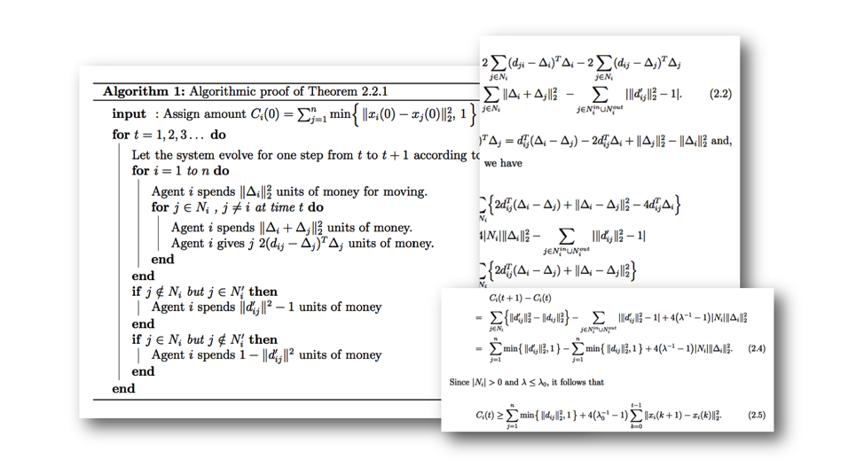
Algorithmic proof: distributed Lyapunov function

Slide 19
2R-Conjecture
Blondel, Hendrickx, Tsitsiklis (2007)
random initial configuration

Slide 20
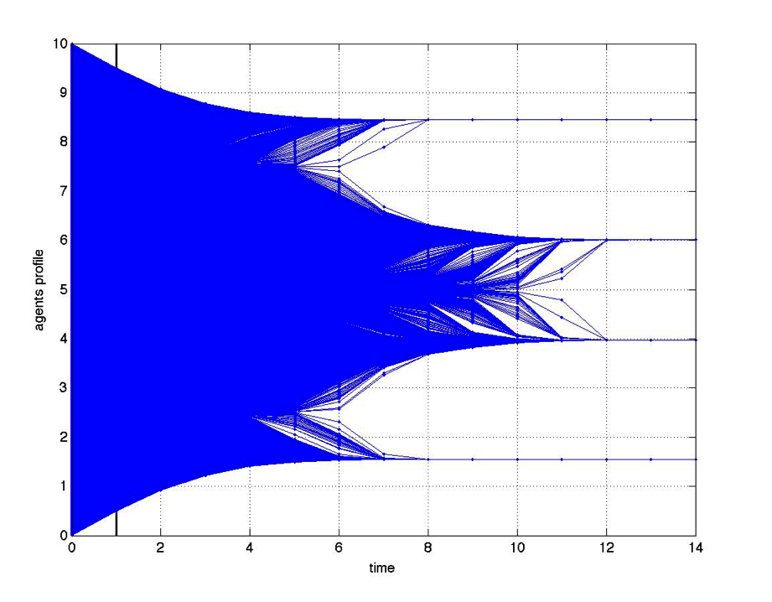
Final clusters are 2R away
?

Slide 21
Simulation: final clusters are ~ 2.3R away

Slide 22
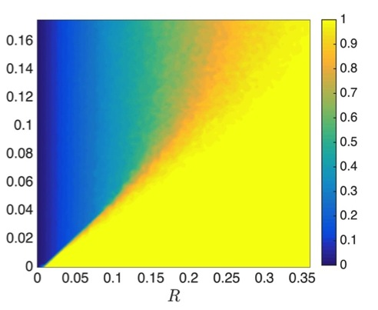
SDE :
Phase transition
order parameter
graph density

Slide 23
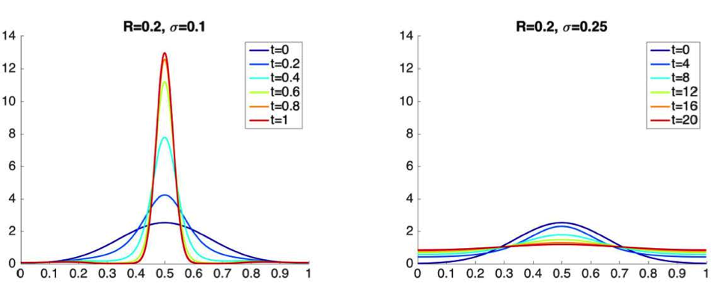
Clustering vs. diffusion

Slide 24
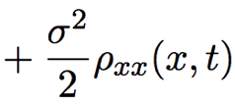
Fokker-Planck PDE
Take thermodynamic limit
J. Garnier, G. Papanicolaou, T-W. Yang (2015)

Slide 25
Fokker-Planck PDE
Well-posed
with Q. Jiu, Q. Li, C. Wang (2015)

Slide 26
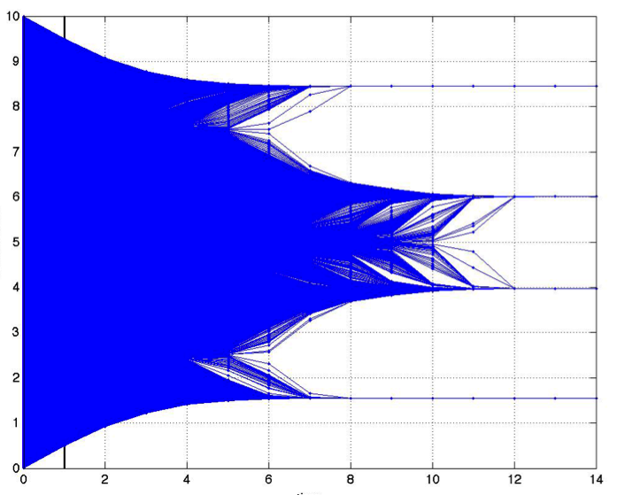
with Q. Li, Weinan, E., C. Wang (2015)

Slide 27
Perturbation Method
Ansatz
Intercluster distance
, where

Slide 28
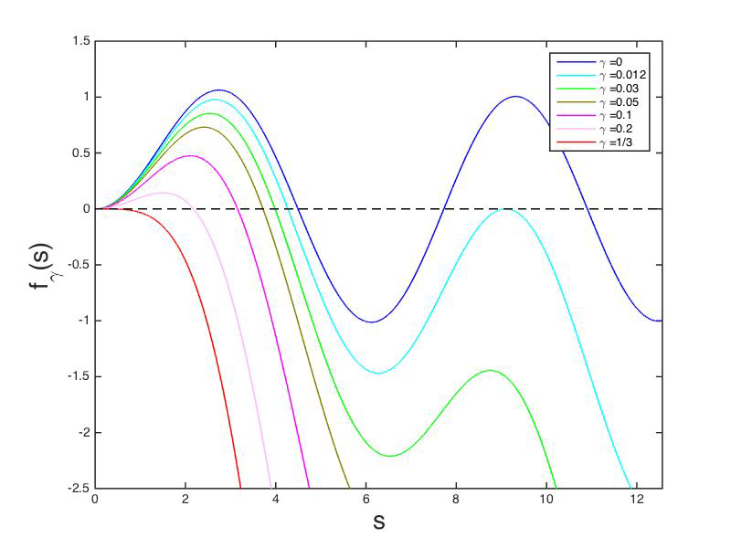
follows a much more general result
Notes:
ETANT DONNE UNE POPULATION SUR L’ECHIQUIER POLITIQUE ….

Slide 30
Hegselmann-Krause in higher dim
Always converges if
same radius
Notes:
ETANT DONNE UNE POPULATION SUR L’ECHIQUIER POLITIQUE ….

Slide 31
follows a much more general result
Notes:
ETANT DONNE UNE POPULATION SUR L’ECHIQUIER POLITIQUE ….

Slide 32
For stochastic n-by-n matrices
The kinetic s-energy

Slide 33
The type-symmetric case
if s = 1
if 0 < s < 1
C. (2011)
s-energy as partition function
& use Legendre transform

Slide 34
Hegselmann-Krause for n = 2

Slide 36
4
in R

Slide 38
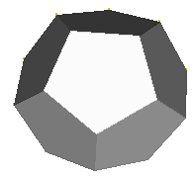

Slide 42
local
Lyapunov exponents spectral gap diameter volume width etc.

Slide 43
s-energy
global

Slide 44
Hegselmann-Krause in higher dim
Fixed-point attractor
Notes:
ETANT DONNE UNE POPULATION SUR L’ECHIQUIER POLITIQUE ….

Slide 45
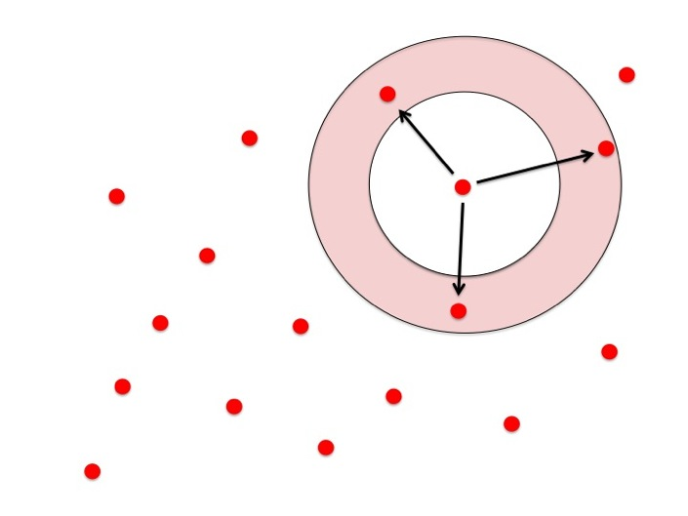
Limit cycle
Notes:
ETANT DONNE UNE POPULATION SUR L’ECHIQUIER POLITIQUE ….

Slide 46
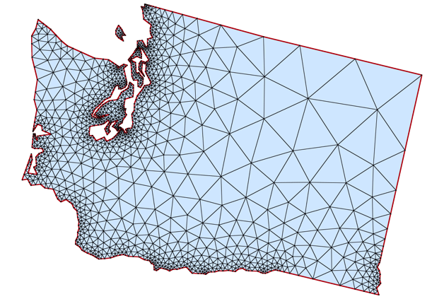
Constrained Delaunay triangulation

Slide 47
Diffusive Influence Systems
first-order sentence
Notes:
ETANT DONNE UNE POPULATION SUR L’ECHIQUIER POLITIQUE ….

Slide 48
Diffusive Influence Systems
first-order sentence 1
first-order sentence 2
Notes:
ETANT DONNE UNE POPULATION SUR L’ECHIQUIER POLITIQUE ….

Slide 49
Diffusive Influence Systems
Notes:
ETANT DONNE UNE POPULATION SUR L’ECHIQUIER POLITIQUE ….

Slide 50
Each agent moves to mass center of neighbors
Update graph and Rinse & Repeat
Notes:
ETANT DONNE UNE POPULATION SUR L’ECHIQUIER POLITIQUE ….

Slide 51
Fixed-point or periodic attractor
Chaotic
Turing-complete

Slide 52
C. (2014) under technical assumptions
Fixed-point or periodic attractor
Chaotic
perturbation
Turing-complete

Slide 53
The emergence of long-term memory

Slide 54
1
-1
1

Slide 55
1
-1
1
-1

Slide 56
1
1
-1

Slide 57
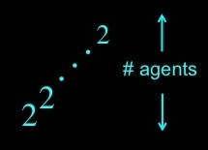
New period =
Iterate construction recursively
limit cycle of length ~

Slide 58
clusters
Key concepts
recursion

Slide 59
We have a dynamical system
stochastic matrix
specified by first-order sentence

Slide 60
One may assume d = 1
stochastic matrix
specified by first-order sentence

Slide 61
by Tarski & Collins
System is piecewise-linear
with semi-algebraic atoms

Slide 62
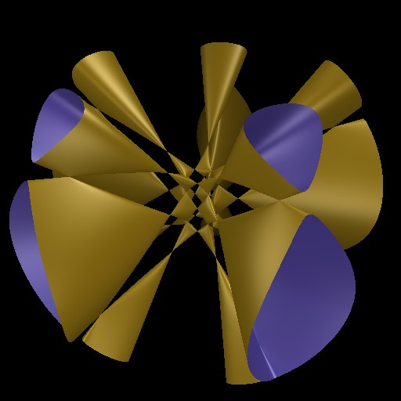

Slide 63
Limit cycle means population stops growing

Slide 64
Splits at next step only when hitting cell wall

Slide 65
Throw ball at random Pr [ hit ] ~ ball volume (?)

Slide 66
then asymptotic periodicity requires
population growth rate < ball shrinking rate
entropy
energy

Slide 67
Throw ball at random Pr [ hit ] ~ ball volume (?)

Slide 68
Throw ball at random Pr [ hit ] ~ diameter
We must “ factor out ” eigenspace for 1

Slide 69
It’s not about linear algebra
It’s about how information flows
across time-varying networks

Slide 71
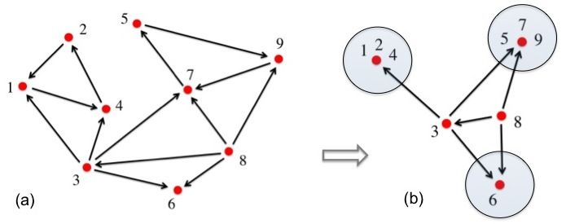
Suppose that the graph is fixed
Every vertex moves to mass center
of its neighbors and itself

Slide 72
Suppose that the graph is fixed
Every vertex moves to mass center
of its neighbors and itself

Slide 73
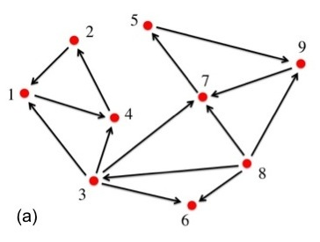
Clusters are the essential communicating classes

Slide 74
super-agent
Markov chain theory yields
suitable renormalization

Slide 75
Parse infinite sequence
using message passing

Slide 77
Grammar
Space of orbits as a recursive structure

Slide 78
Grammar

Slide 88
Everybody has
learned the tune

Slide 99
Everybody has learned
the tune a second time

Slide 105
Suppose song no
longer propagates

Slide 110
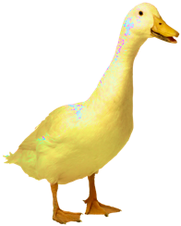

Slide 111
1 dynamic networks
2 the curse of equilibrium

Slide 112
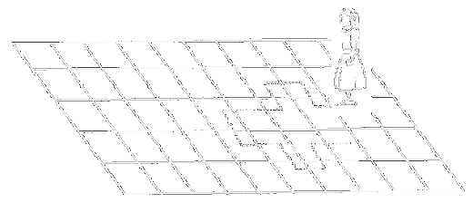
Rapid mixing is good
Slow mixing is bad

Slide 113
Rapid mixing is good
Torpid mixing is bad

Slide 114
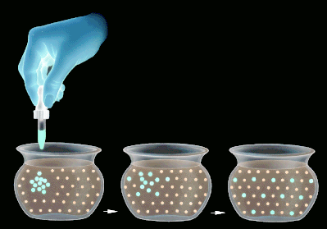
diffusion
Rapid mixing is good
Torpid mixing is bad

Slide 115
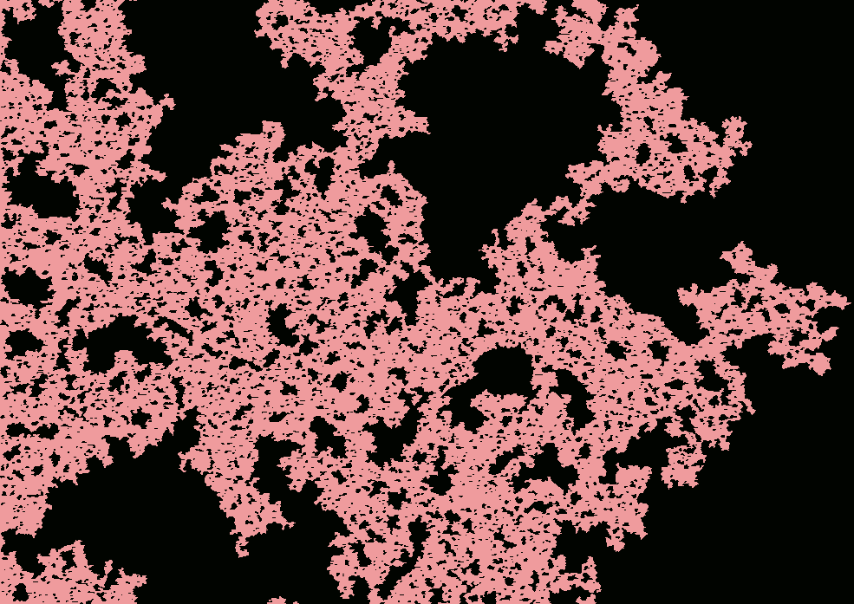
percolation
Rapid mixing is good
Torpid mixing is bad

Slide 116
All stories about equilibrium

Slide 117
In living matter, equilibrium means death

Slide 118
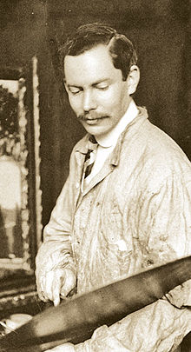
Iterated learning
Frederic C. Bartlett 1932

Slide 119
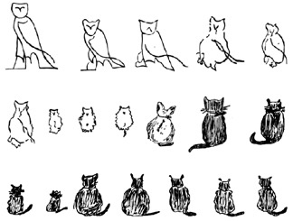

Slide 124
Kalish, Griffiths, Lewandowsky (2007)

Slide 125
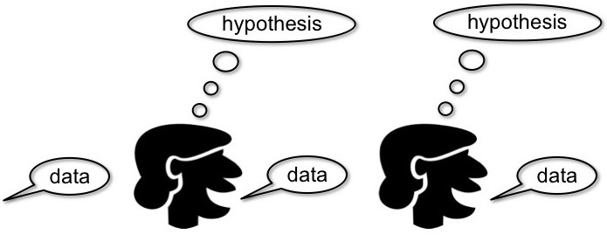
Kalish & Griffiths (2005)
Gibbs sampling: mixes to prior

Slide 126
with C. Wang (2016)
Lengthen learning sessions

Slide 127
FINITE CASE : n = # hypotheses ; s = # data items
For any learner, with prob > ,
total variation between and random
from posterior is at most

Slide 128
FINITE CASE : n = # hypotheses ; s = # data items
For any learner, with prob > ,
total variation between and random
from posterior is at most

Slide 129
ROOT-SINE DISTANCE

Slide 130
Easier to achieve sustainability if teacher is randomized

Slide 131
LINEAR REGRESSION

Slide 133
RANDOM MATRIX THEORY
Davidson & Szarek (2001)

Slide 134
Curse of mid-dimensionality
low-dim mid-dim high-dim
stat. mech.
dyn. sys.
universality
calculus
natural algorithms
dynamic graphs

Slide 135
Thank you !

Slide 138
Huygens 1665
Notes:
LE MODELE GENERALISE UNE EXPERIENCE TRES VIEILLE

Slide 140
Large distributed sync systems

Slide 141
In biology
ribosomal RNA … gene expression … metabolism
billions of years
minutes
microseconds
huge timescale ratios
no timescale separation

Slide 142
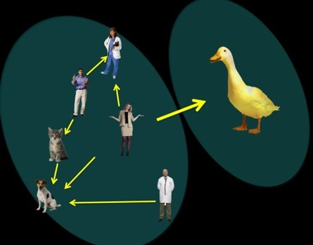
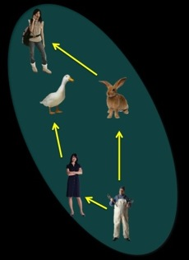
+

Slide 143
+
If song resumes
propagating

