Slide 1
The symmetry and simplicity of the laws of physics and the Higgs boson
Juan Martín Maldacena
Institute for Advanced Study

Slide 2
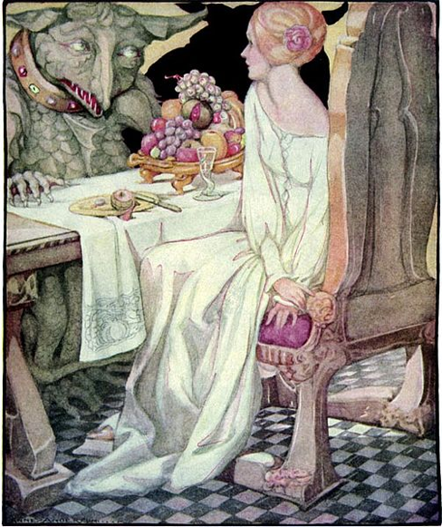
The beauty and the beast

Slide 3

Symmetry
Simplicity
elegance
Forces of nature
Electromagnetic
Weak
Strong
Gravity
Complicated
Mysterious
Higgs mechanism
We need both to understand nature.
We are the children of this marriage

Slide 4
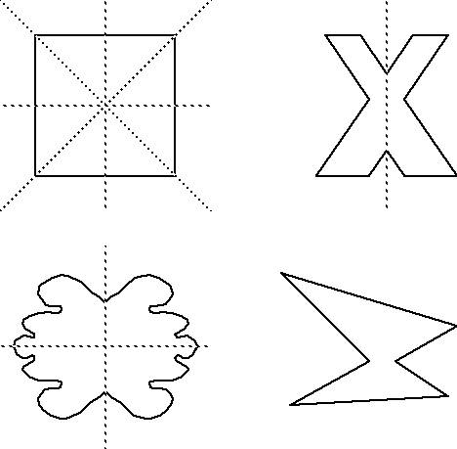
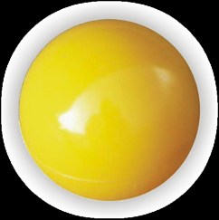
Symmetry

Slide 5
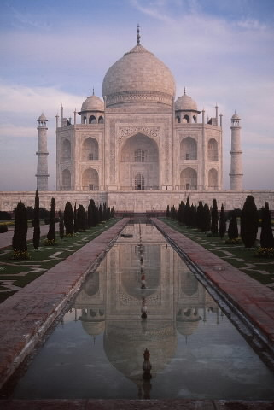

Slide 6
The symmetries of nature are hidden and it
has taken a long time to uncover them.
They are so hidden that, in some sense, they are not even symmetries!
But just a convenient way to describe the system!
We will try to explain these symmetries, and why
the Higgs mechanism, and the Higgs particle, are necessary.

Slide 7
4 Forces:
Electromagnetic
Weak
Strong
Gravity

Slide 8
Electromagnetism
Electricity and magnetism
Dominant force for everyday life: atoms, chemistry, etc
It was essentially hidden until about 300 years ago, due to the fact that positive and negative charges cancel out almost completely in ordinary matter.
Understanding it lead to a huge amount of technological progress.

Slide 9
High school electromagnetism
Electric Field
Pushes a charged particle
Magnetic Field
Acts on moving charges
and makes them turn
Relativity → relates electric and magnetic fields

Slide 10
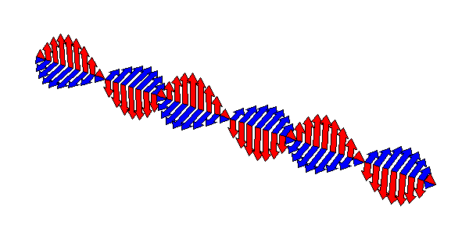
Maxwell 1865
The electromagnetic field has its own dynamics. Its oscilations are waves that propagate in empty space:
Light, radio waves, X-rays, gamma rays, etc.

Slide 11
Electromagnetism is based on a ``gauge’’ symmetry
H. Weyl, 1918
Based on
Einstein’s gravity
Monetary analogy:
- Countries
- Each country has its own currency
- When you go from one country to the next you need to
change all your money to the new currency.
- At the border you have banks that will change your money
(no comission) . Each bank fixes the exchange rate it wants.
- There is nothing to buy.

Slide 12



dolar
1 dolar= 1 euro
euro
6,000 pesos = 1 dolar
6 A = 1 dolar
6 A = 1 euro
6,000 pesos = 1 euro
Peso
1,000 pesos = 1 A

Slide 13
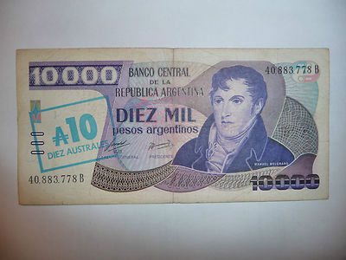
1 current peso = 10,000,000,000,000 pesos when I was born

Slide 14
Exchange rates are arbitrary.
Banks do not coordinate them.

Slide 15
1 $
dolar
1 €
1 dolar= 1 euro
euro
4 A = 1 dolar
6 A = 1 euro
4 A
6 A
Australes

Slide 16
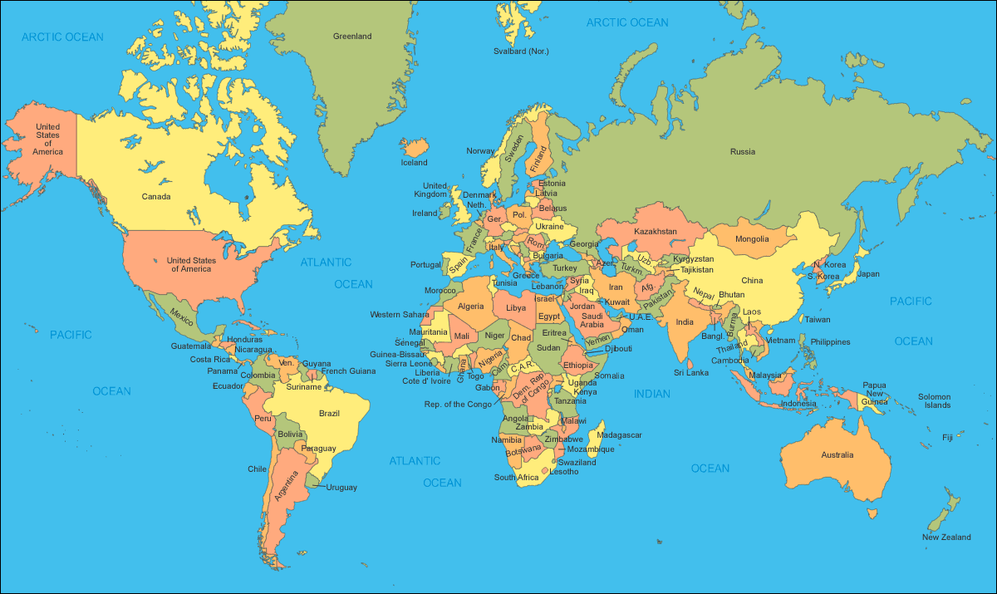

Slide 17
Countries are arranged in a regular pattern
They are all the same. The exchange rates can be all different

Slide 18
You cannot fly. You can only walk from one country to the next,
from there to the next and so on

Slide 19
You cannot fly. You can only walk from one country to the next,
from there to the next and so on

Slide 20
Physics is simpler than economics !

Slide 21
Gauge symmetry of electromagnetism:
Rotations of a circle.

Slide 22
Change in currency → rotations of the circles = gauge transformation
Exchange rates → electromagnetic potential
Speculators → electrons
Opportunities to speculate→ magnetic field
Figura

Slide 23
Quantum Mechanics
At short distances the laws of physics are probabilistic.
In the analogy: The exchange rates are random with a probability distribution that depends on the opportunity to speculate (magnetic field). Configurations with large opportunities to speculate are less probable. Nature does not like speculation
Energies of many systems are quantized.
Electromagnetic waves are quantized.
Quantum of field excitation = particle.

Slide 24
Electrodynamics
Based on a gauge symmetry.
Massless photon.
Electron is massive.
Nuclei + electrons plus their electromagnetic interactions explains most of what we see in everyday life.
Tamaño de un átomo ~ 1/(masa del electrón)

Slide 25
Weak Interactions
It is important for certain radioactive decays.
proton
electron
anti-neutrino
neutron
Important for historians → C¹⁴ dating
Cooked the chemical elements in stars
Can move mountains: Radioactive decays heat the earth,
moves continents → forms mountains

Slide 26
The gauge symmetry for weak interactions
We have the symmetries of a sphere at each point in space.
Rotations: 3 variables → 3 weak “gauge bosons”
The gauge symmetry determines the interactions among all these particles.
Yang, Mills 54
Pauli’s objection to Yang at an IAS seminar by Yang

Slide 27
Pauli’s objection to Yang:
The gauge bosons would be massless !
Another beautiful theory killed by an ugly fact ?

Slide 28
Why massless particles ?

Slide 29
Energy of waves
More energy
Less energy
Massive particle → E = m c²
Energy → related to the opportunity to speculate
More energy → less probable .
Large opportunities to speculate are less probable

Slide 30
1 →1
1.1→1
1→1
3.3→1
3→1
1→1
A very long wavelength configuration
gives you little local opportunity to speculate → less energy

Slide 31
How do we solve the mass problem ?

Slide 32
Anderson, Nambu, Goldstone, Higgs,
Brout, Englert, Guralnik, Hagen, Kibble 60’s
The Higgs mechanism
There is an object sitting on each of the weak spheres.
In the vacuum !
Deforma la esfera
Rompe la simetría
Le da masa al electrón
Hace que los átomos tenga un tamaño finito
Tratar de hacer rotar la esfera en otras direcciones
es muy difícil, las partículas tendrán una masa muy
grande Bosones W y Z , fueron descubiertos en el CERN en 1983.
Su masa sería un valor muy “extraño”.

Slide 33
Back to the monetary analogy
Now there is something to buy in each country, say Gold.
We can take it from one country to its neighbor

Slide 34

= 1 $
1,000 P = 1 $
New opportunities to speculate!
= 6,000 P

Slide 35
= 1 $
1 A = 1 $
Gauge symmetry still present
= 6 A

Slide 36
= 1 $
Choose the currencies
so that the price of gold is one.
The exchange rates remain.
The opportunities to speculate are
clearer now.
1 P = 6 $
= 1 P

Slide 37
Without Gold: Exchange rates between two countries were arbitrary
Only comparing nearby countries could we speculate
With Gold: The exchange rate between two countries
has a preferred value, the one where you cannot
speculate between two neighboring countries.
Once we fix the price of gold to one everywhere, any fluctuation of
the exchange rate brings opportunity to speculate,
even if it has long wavelength → Mass for gauge bosons
Higgs Field→ The price of gold in each country
Preferential value for the exchange rates→ masses for the
weak gauge bosons (Z & W)

Slide 38
The mass of the weak gauge bosons explains the
weakness of the weak force.
Z
photon
electron
electron
neutrino
Large mass → less probable. Smaller interaction
A few percent of the energy of the sun comes out in neutrinos.
These neutrinos, just go through us, the go through the whole earth!

Slide 39
The weak force has some other strange features…

Slide 40
Before continuing we need to talk more about rotations
First start with rotations in space

Slide 41

Rotations in space
An elementary particle can rotate.
But with a minimal amount of rotation.

Slide 42
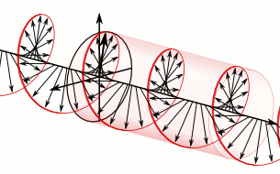
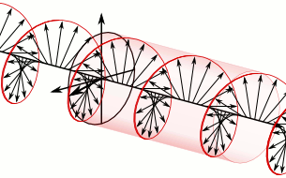
Circularly polarized electromagnetic waves
Direction of motion

Slide 43
Electron
The electron has spin too

Slide 44
Surprise!
Weak interactions depend on the spin of the electron.
They are stronger when the spin is antiparallel to the direction of motion.

Slide 45
For massless particles we can distinguish particles depending on whether the spin is in the direction of motion or in the opposite direction.
For massive particles this is not possible.
Electron at rest ?

Slide 47
Let us first pretend that the electron is massless.

Slide 48
For the weak force there are two types of electrons:
Left –handed electron
Weak spin
Ordinary spin
neutrino
Right-handed
electron
Ordinary spin
(does not move in the weak sphere)
Neutrino flux. About 10^(11) per cm^2 per second . Energy about .5 Mev

Slide 49
Rotation is reversed when we look at it in a mirror

Slide 50
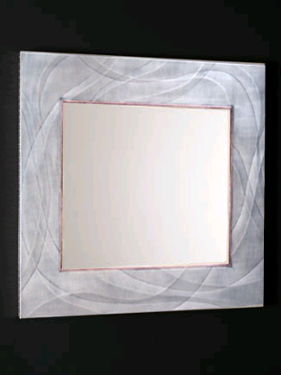
Lee , Yang 1956
neutrino
Right handed
Left handed
The laws of nature are not symmetric under a mirror reflection

Slide 51

(with no Higgs field)
Forces
Electromagnetism
Weak
particles
Left-handed electron and neutrino
Right-handed electron
Strong
Quarks (left and right handed)
Very simple
All particles are massless
Based on symmetries.
The strength of interactions is fairly similar

Slide 52
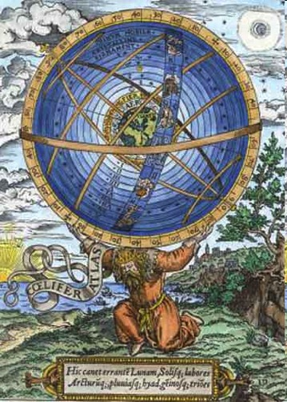
Old
New
One sphere at each point in space
Celestial spheres

Slide 53
The electron mass
Due to its interaction with the Higgs field

Slide 54
Right handed electron
Left handed electron
The left and right handed electrons can interact with the Higgs field.
This interaction gives the electron a mass.
(Mass of neutrinos → Interactions of the neutrino with the
anti-neutrino and the Higgs field )

Slide 55
Why ``electro-weak’’ ?
Glashow, Salam, Weinberg 60’s
We have the symmetries of the circle plus the symmetries of the sphere.
The symmetry of electromagnetism is a combination of a rotation on a circle and a rotation on the sphere.
This is why the neutrino and the electron have different charges.

Slide 56
The Higgs Boson
The mechanism we have just discussed explains the masses of all particles, but does not yet predict the existence of a new one.
In the monetary analogy, the Higgs boson would arise when we have two things we can buy in each country, say Gold and Silver.
The relative price of Gold and Silver are the Higgs boson.
This ratio leads to a new massive particle.

Slide 57
Why do we need at least two?
It is a subtle reason related to the possibility of taking the limit when the distances between countries become very small, while retaining interesting interactions at long distances.

Slide 58
Continuum limit: In physics all of this is
happening at very, very short distances

Slide 62
With no extra particles →
masses of the W and Z would go to infinity in this limit

Slide 63
Before July 2012
We new that there HAD to be new particles with masses below 1,000 Gev. (proton ~ 1 Gev)
The Higgs boson was the simplest possibility.
There were many others, thanks to the prolific imagination of theorists…
July 2012, 1 particle, mass = 125 Gev (proton ~ 1 Gev )

Slide 64
How are we exploring the origin of mass for the weak partícles ?
Collide particles at high energies to produce the Higgs boson.

Slide 65
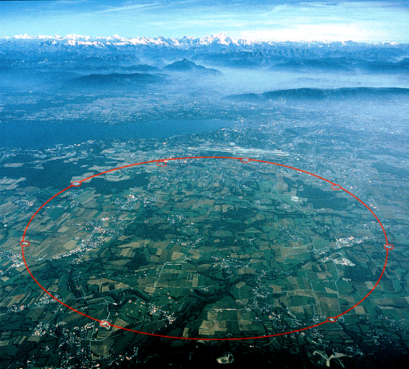
L H C
Geneva
27 Km long

Slide 66
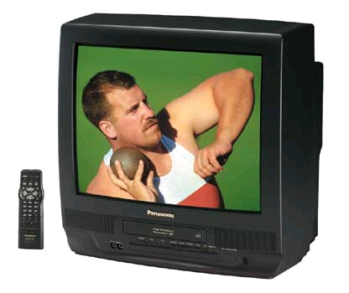
Small electron collider

Slide 67
TV vs LHC
Energy given to the particles
TV: 8,000 Volts
LHC 8,000,000,000,000 Volts
The LHC gives them a billion times more
energy than a TV.

Slide 68
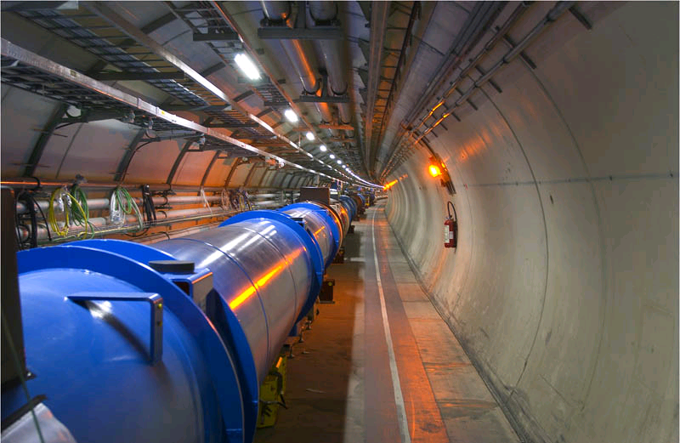

Slide 70
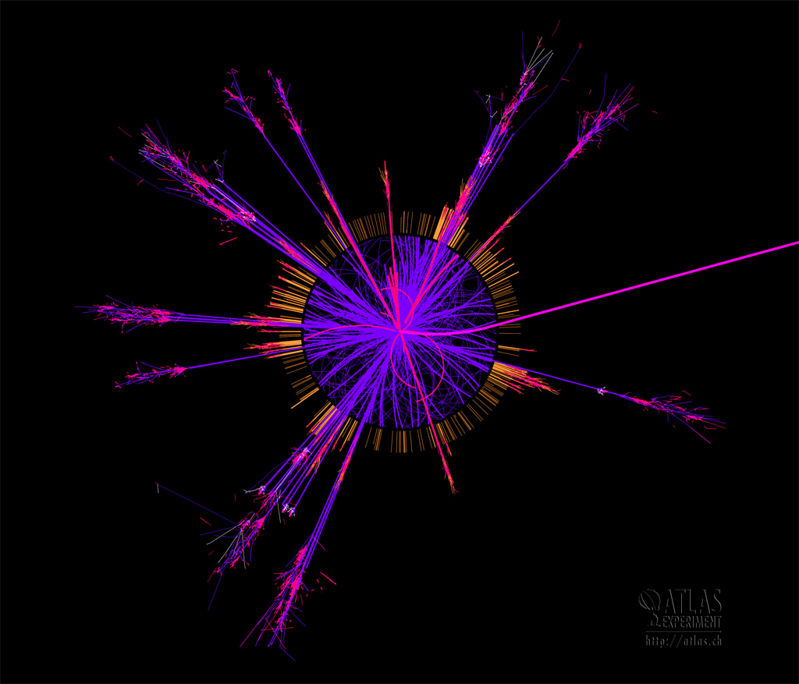
There is a lot of energy, which can produce many particles.
This shower of particles is determined by these simple gauge symmetries.

Slide 71
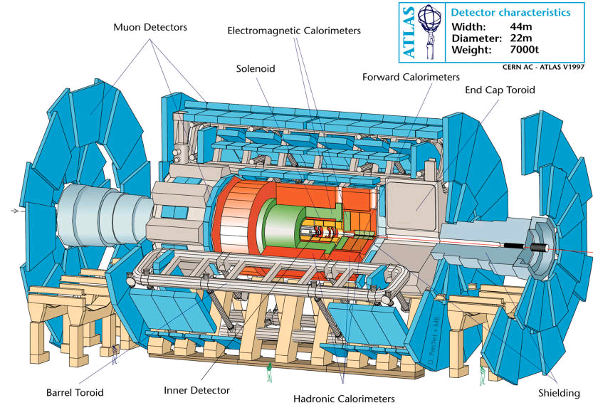
ATLAS

Slide 72
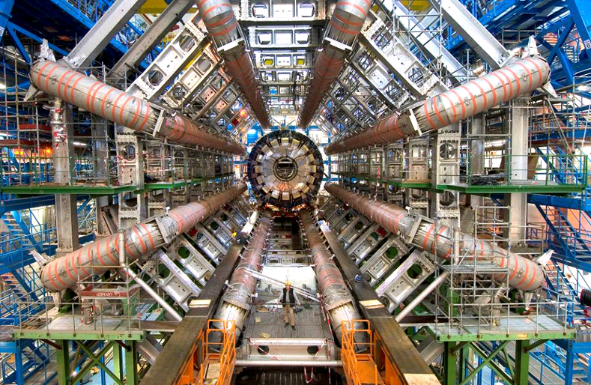

Slide 73
Protons collide and produce many particles
Very rarely they produce Higgs bosons.
These Higgs bosons decay very quickly into other known particles
leaving a special imprint

Slide 74
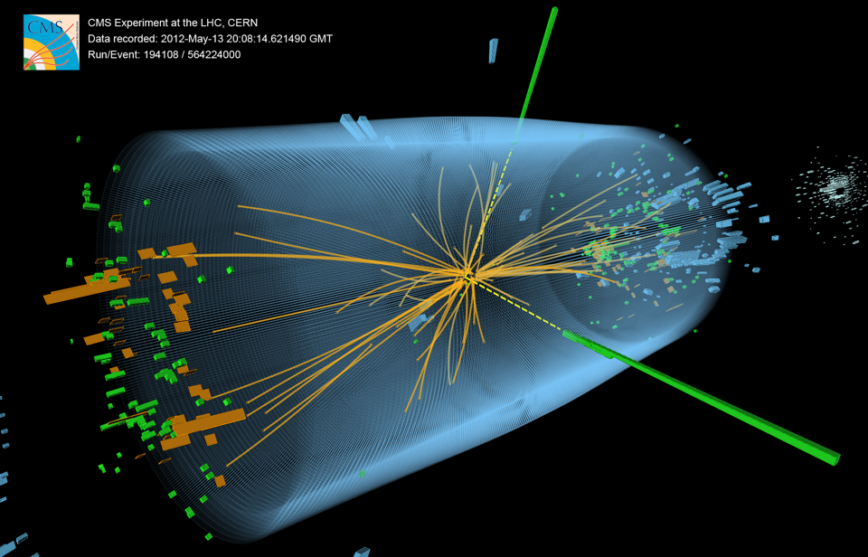

Slide 75
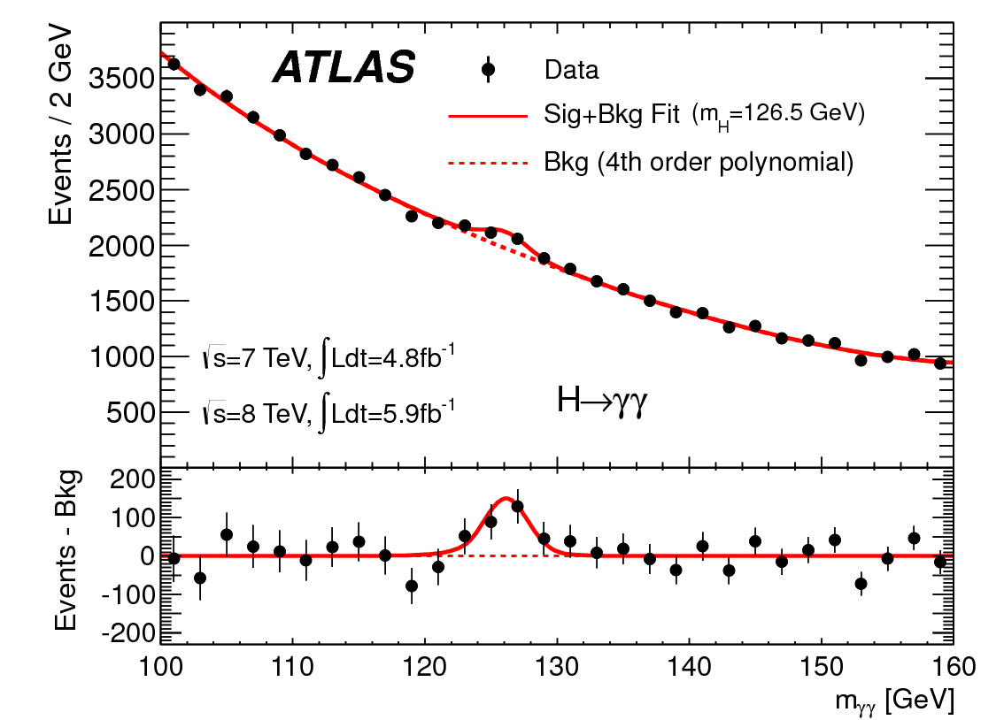

Slide 76
What is it useful for?
I do not know of any possible technological application
It is helping us understand what happens in nature at very short distances. We are finally understanding how the electro-weak force works at short distances.

Slide 77
Why is the Higgs Ugly?
Introduces lots of new parameters in the Standard Model.
It is not based on any symmetry.
Why is its mass so much smaller than the mass scale of gravity?

Slide 78
And now what?
There are reasons to think that there will be new particles.
Theoretical: Higgs is Ugly.
Experimental: Dark Matter.

Slide 79
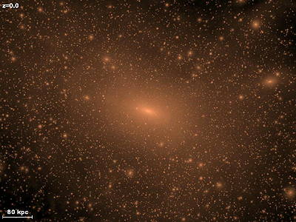

Dark Matter
There is more matter than what we see. This other matter is different from ours.

Slide 80
The particles of dark matter might or might not be produced
at the LHC.
Other experiments are looking for dark matter in
other ways.

Slide 81
We will probably have more exciting experimental discoveries in particle physics in the next few years.

Slide 82
And we will understand how:
… they lived happily ever after
A written version can be found in:
http://arxiv.org/abs/1410.6753

