Slide 1
The quark-antiquark potential in N=4 Super Yang Mills
Juan Maldacena
N =4 super Yang Mills, 35 years after
Based on: arXiv:1203.1913, arXiv:1203.1019, arXiv:1202.4455

Slide 2
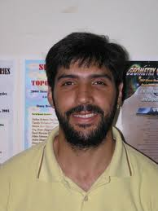


Diego Correa
(Also similar paper by
Drukker)
Amit Sever
Johannes Henn

Slide 3
Polyakov
Drukker Gross Ooguri
JM
Rey Yee

Slide 4
When θ=φ the configuration is BPS and the potential vanishes.
When δ=π-φ → 0 , we get the quark-antiquark potential in flat space.
When i φ= ϕ → Infinity,
Zarembo
Witten-Kapustin (Langlands)
Computed by
Beisert, Eden
Staudacher

Slide 5
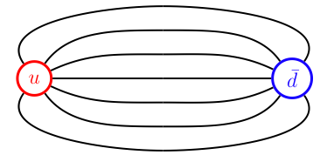

Motivations
Flux lines going between quark and anti-quark → become a string. Understand this string and its excitations.

Slide 6
It is a function of an angle + the coupling
Similar to amplitudes
In fact, it controls the IR divergencies of amplitudes for massive particles.

Slide 7
Final Answer
Write integral equations for a set of functions Y_{A}(u):
Compute the potential as:

Slide 8

Method
How did Coulomb do it ?
We will follow a less indirect route, but still indirect..

Slide 9
Integrability in N=4 SYM
Minahan Zarembo
Bena Polchinski Roiban
Beisert, etc…
N=4 is integrable in the planar limit.
Large number of symmetries→ How do we use them ?
There is a well developed method that puts these symmetries to work and has lead to exact results.

Slide 10
It essentially amounts to choosing light-cone gauge for the string in AdS, and then solving the worldsheet theory by the bootstrap method.
First we consider a particular SO(2) in SO(6) and consider states carrying charge L under SO(2) . Operator Z = φ₅ + i φ₆
States with the lowest dimension carrying this charge → Lightcone ground state for the string

Slide 11
Infinite chain or string
L= ∞
Ground state: chain of ZZ….ZZZ..ZZZ
Impurities that propagate on the state ZZ…ZWZ…ZZZ
Symmetries
Elementary worldsheet excitations 4 x 4 under this symmetry.
p
Beisert

Slide 12
Fix dispersion relation
Fix the 2 → 2 S matrix. Matrix structure by symmetries + overall phase by crossing.
Solves the problem completely for an infinite (or very long) string.
Beisert Janik
Hernandez Lopez
Eden Staudacher
Beisert Staudacher equations

Slide 13
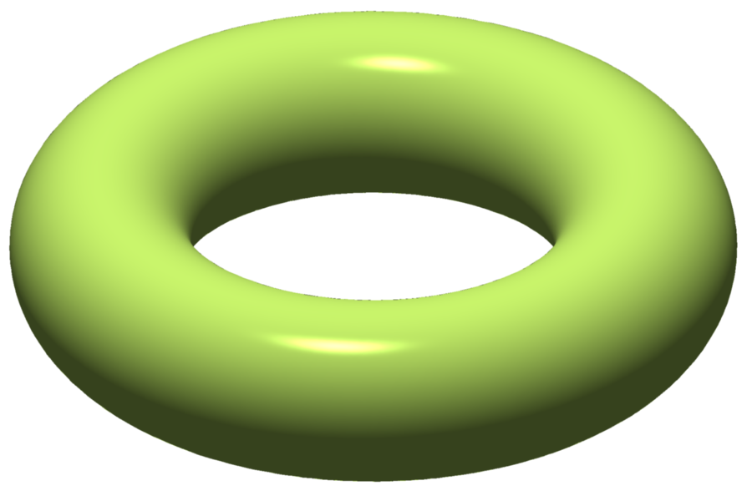
Short strings
Consider a closed string propagating over a long time T
View it as a very long string of length T, propagating over eucildean time L = Thermodynamic configuration.
In our case the physical theory and the mirror theory are different.
L
TBA trick:
Zamolodchikov
T

Slide 14
Yang-Yang
Solve it by the Thermodynamic Bethe Ansatz = sum over all the solutions of the mirror Bethe equations over a long circle T weighed with the Boltzman factor.
Arutyunov Frolov
Gromov Kazakov Vieira
Bombardelli, Fioravanti, Tateo
Y_{A}= (densities of particles)/(densities of holes) as a
function of momentum
A runs over all particles and bound states of particles
in the fully diagonalized nested bethe ansatz

Slide 15
Back to our case
Where is the large L ?
Nowhere ? Just introduce it and then remove it !
Operators on a Wilson line: For large L = same chain but with two boundaries.
Z^{L}
x
Drukker Kawamoto

Slide 16
Need to find the boundary reflection matrix.
Constrained by the symmetries preserved by the boundary = Wilson line
Bulk magnon = pair of magnons of

Slide 17
p
-p
p
Half line with
SU(2|2)² in bulk
full line, single SU(2|2)_{D}

Slide 18
Reflection matrix = bulk matrix for one SU(2|2) factor up to an overall phase
We used the method given by
Volin, Vieira
Determined via a crossing equation.
This is the hardest step, and the one that is not controlled by a symmetry.
In involves a certain degree of guesswork. We checked it in various limits.

Slide 19
We solve the problem for large L: add the two boundaries
Z^{L}
x
Z^{L}
x
Rotate one boundary → Introduce extra phases in the reflection matrix.

Slide 20
Going to small L

Slide 21
Boundary TBA trick:
LeClair, Mussardo, Saleur, Skorik
Closed string between two boundary states.

Slide 22
Bulk magnons emanate from the boundary with amplitude given by the
(analytic continued) reflection matrix.
Using the bulk crossing equation we can untangle the lines and cancel the bulk
S matrix factors.
We are left with a pair of lines on the cylinder. This looks like a thermodynamic
computation restricted to pairs with p and –p .

Slide 23
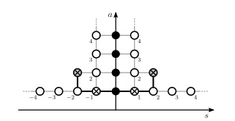
Then we essentially get the same as in the bulk for a thermodynamic
computation with
And a constraint on the particle densities:

Slide 24
Final Equations

Slide 25
Now we can set L =0 and get Γ_{cusp}
We did not solve the equations in general.
We expanded for weak coupling. The leading order in weak coupling is easy and it reproduces the known result.

Slide 26
A simplified limit
At φ=θ=0 , we have a BPS situation. Near this point we have
Simplified equations lead to a set of integral equations for B(λ). Still non-linear but less complicated.

Slide 28
We know the answer by localization
It is just given by a Bessel function:
The expansion agrees with the result in the integral equation.
Also gives the power emitted by a moving quark
Correa, Henn, JM
Fiol, Garolera, Lewkowycz
Pestun, Drukker, Giombi,
Ricci, Trancanelli

Slide 29
The integral equations, at least for this case, can be simplified!
Hopefully the same is the case for the general case.
The TBA equation are complicated, but they contain the information also about all excited states.

Slide 30
Discussion
Integral equations for excited states should be very similar.
These equations can be studied numerically
The next goal → Simplify!
The connection between integrability and localization is useful to fix one possible undetermined function of the coupling. It is thought to be trivial in N=4 SYM. But it is known to be non-trivial for ABJM.
Gromov, Kazakov, Vieira
Finite number of function:
Gromov, Kazakov, Leurent, Volin

Slide 31

Happy birthday N=4 SYM

Slide 32
Do we know all N=4 theories?
Classify all theories with N=4 susy in four dimensions
Without assuming that they have a weak coupling limit.
Derive the existence of the weak coupling limit…

