Slide 1
25th Women and Mathematics
Reflections on the program from alumni

Slide 2
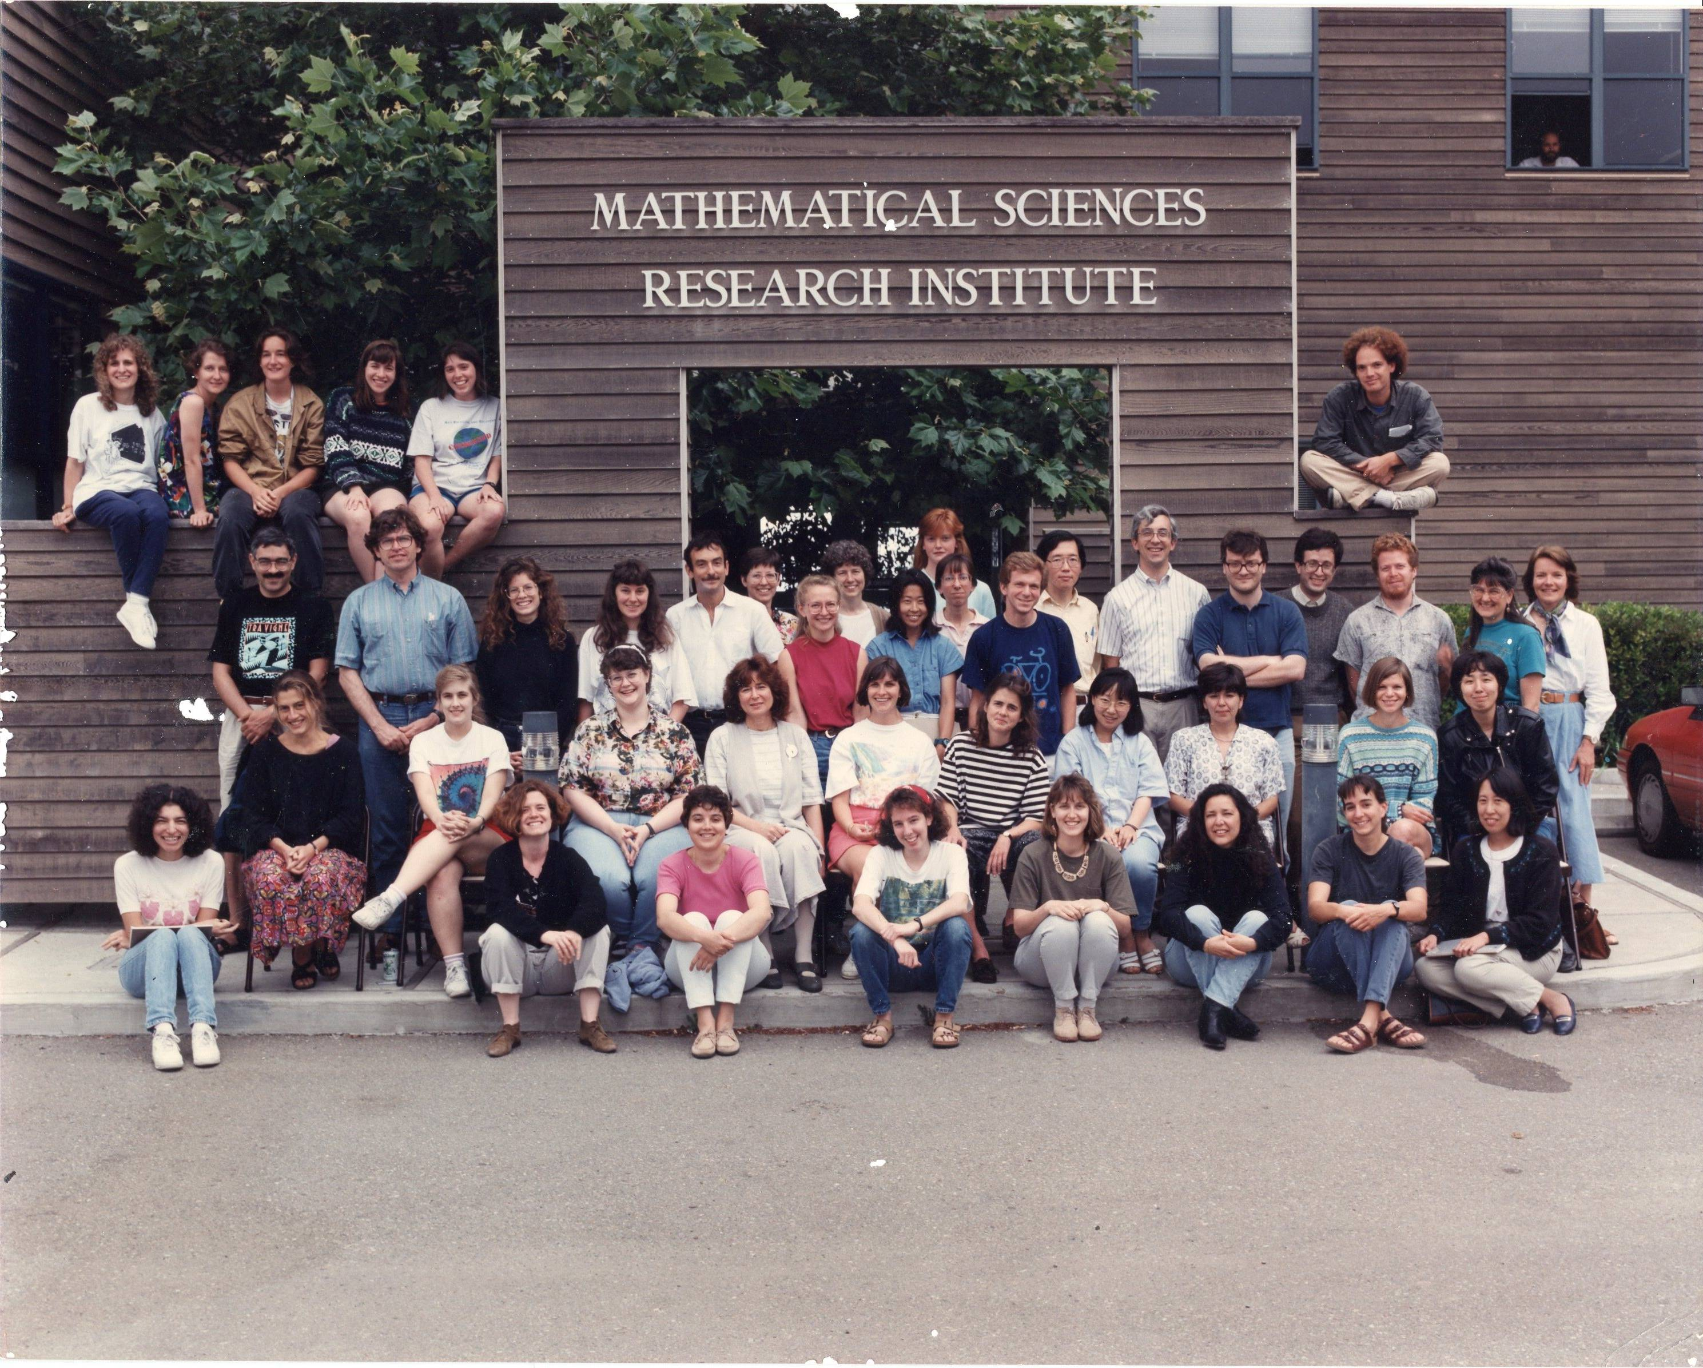
Antonella Grassi, UPenn
In the Spring of 1993 I was a postdoc at MSRI, when Herb Clemens and Karen Uhlenbeck asked me to organize a program for women, in connection with the Special Year in Algebraic Geometry at MSRI. It was the first program for Women and Mathematics. Later I was on the steering committee. After that I organized three other different programs, all connected to Algebraic Geometry, the last one in 2015. It has been a great opportunity to get to know so many talented mathematicians.

Slide 3
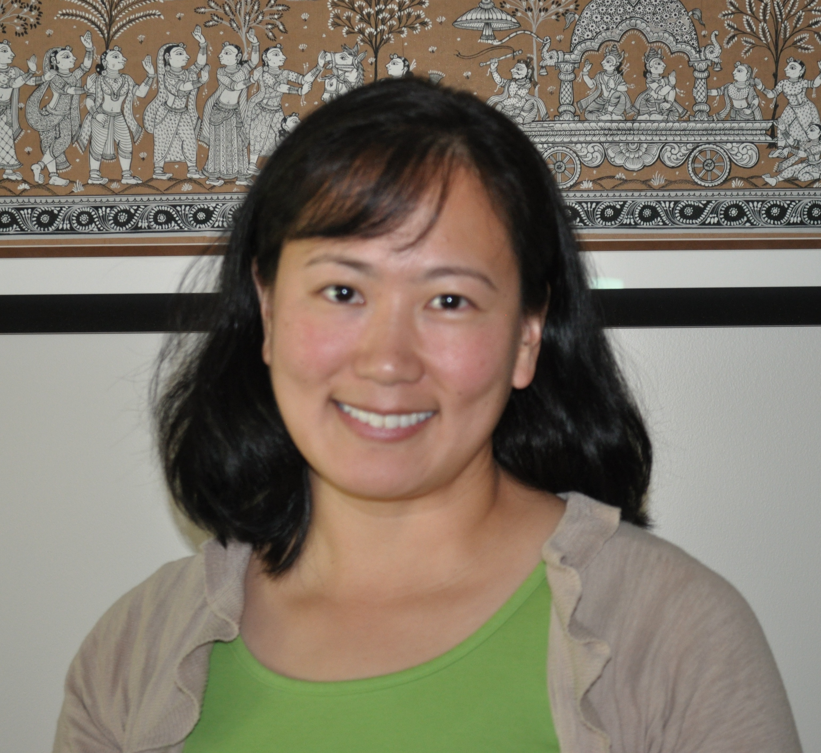
Theresa Kim
1999
The WAM program encouraged me to become a leader in STEM and in public service. My mentor was so wonderful that I decided to become a mentor for another young woman in STEM while she was in middle school while I was living in Seattle. She is now graduating from college this year. Additionally, I joined the Women in Public Service Project, an NGO founded by former US Secretary of State, Hillary Rodham Clinton, to increase women's participation in public service to 50% by 2050 worldwide. I completed my MS in Biostatistics from the University of Washington and my PhD in Health Services and Global Health at the University of Maryland. I was awarded a Fulbright (declined in 2017) and made it to the final round of the AAAS Science and Technology Policy Fellowship. I now serve as a Program Officer of Clinical Effectiveness and Decision Science at the Patient–Centered Outcomes Research Institute in Washington, DC. None of my achievements would have materialized without the supportive mentorship I gained from the Women in Mathematics Program at the Institute for Advanced Study.

Slide 4
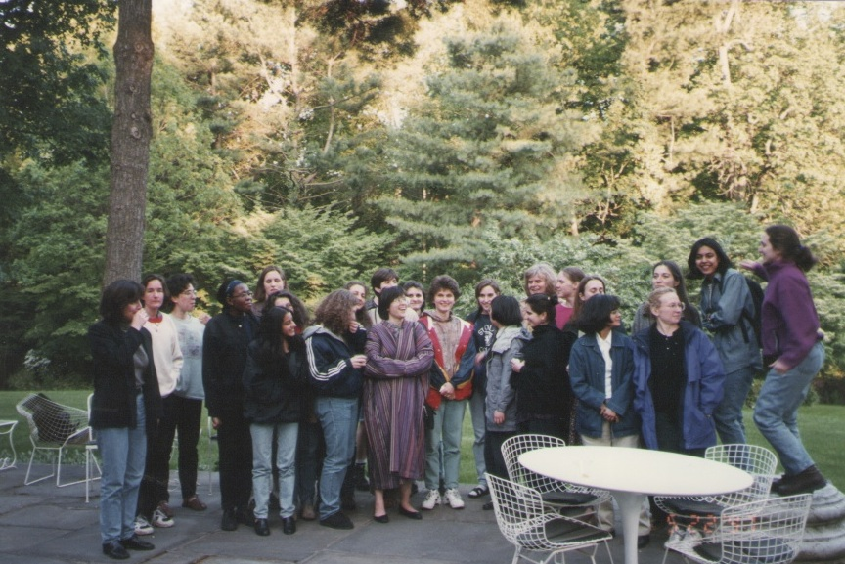
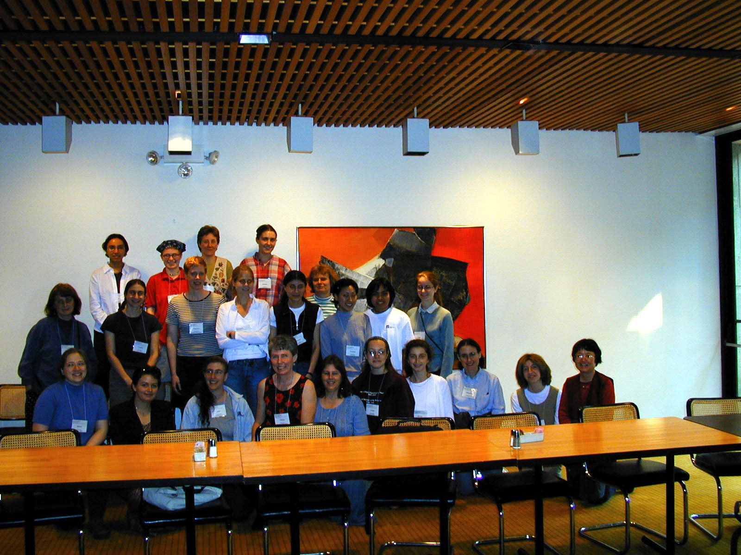
Chuu-Lian Terng
I was a co-organizer with Karen Uhlenbeck from 1994 to 2011. It was exciting to have the chance to get to know many woman mathematicians and learned about different research fields each year. IAS also provided Karen and me excellent opportunity to work on our joint research projects on "integrable systems and geometry" over those years.

Slide 5
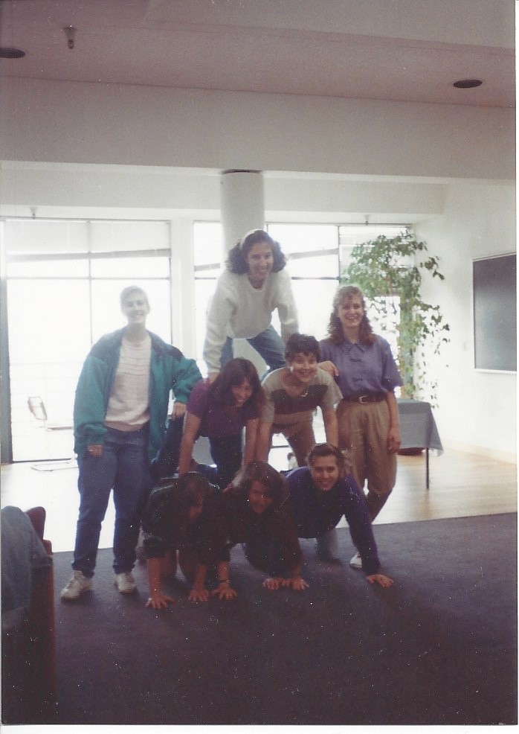
Amy Ksir
1993, 2001, 2003, 2007
I attended the Program for Women in Mathematics in its very first year, 1993, when it was held at MSRI in Berkeley, CA. I had just finished my undergraduate degree and was about to start graduate school. The topic for the program was algebraic geometry, and I remember fondly the small working group I was in doing “blow-up” calculations. I met a lot of wonderful people there. Attending the program really helped me feel like a part of the mathematical community, and I ended up becoming an algebraic geometer. While I was in graduate school, I remember a few times making a day trip from Philadelphia to Princeton to visit while the program was going on. I still remember a lecture on Brownian motion I attended in 1996. As a postdoc in 2001, I made a longer, more official visit when the scientific topic, “Quantum Field Theory, Supersymmetry, and Enumerative Geometry,” was close to my own research. I remember giving a seminar talk that described the math I was doing while also outlining the role of the program in getting me into that research area. My mathematical younger brother attended the talk and said afterwards he wished I’d stuck to the math. In 2003, I attended the 10 year reunion and presented a poster about my research.
In 2007 I had the privilege of giving a series of lectures in the undergraduate program, on enumerative algebraic geometry and connections to string theory. My memories of that year’s program are foggy and many of them revolve around my daughter, who was three months old at the time.
I’m very glad that the program is still going strong, and encouraging more women to be a part of the mathematics research community!

Slide 6
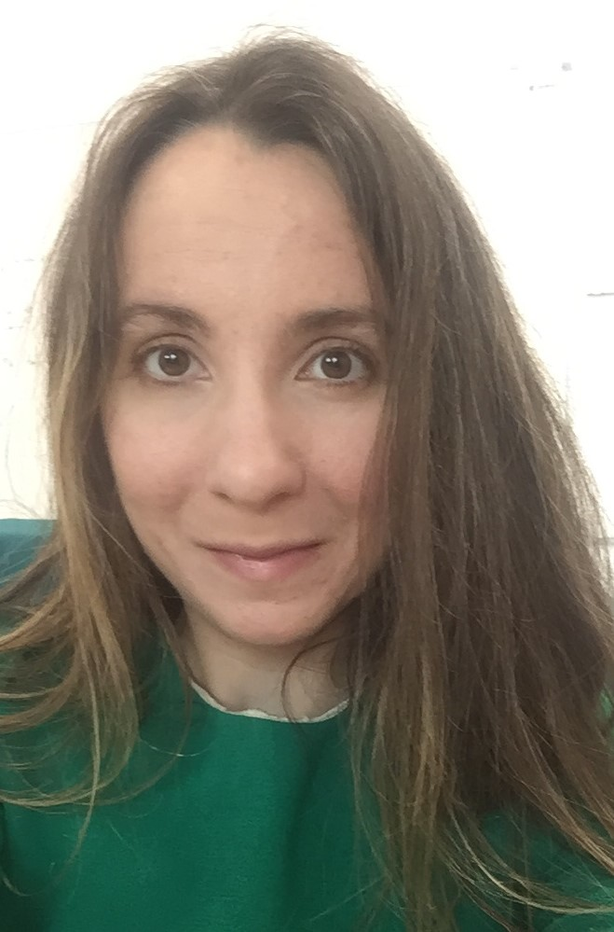
Ana Caraiani
2010
I was the course assistant for Marie-France Vigneras, who taught a course on p-adic Langlands. It was great to meet and talk one-on-one with a renowned female mathematician in my field. This experience encouraged me to expand my area of research to the p-adic Langlands program and had a very positive impact on my career.

Slide 7
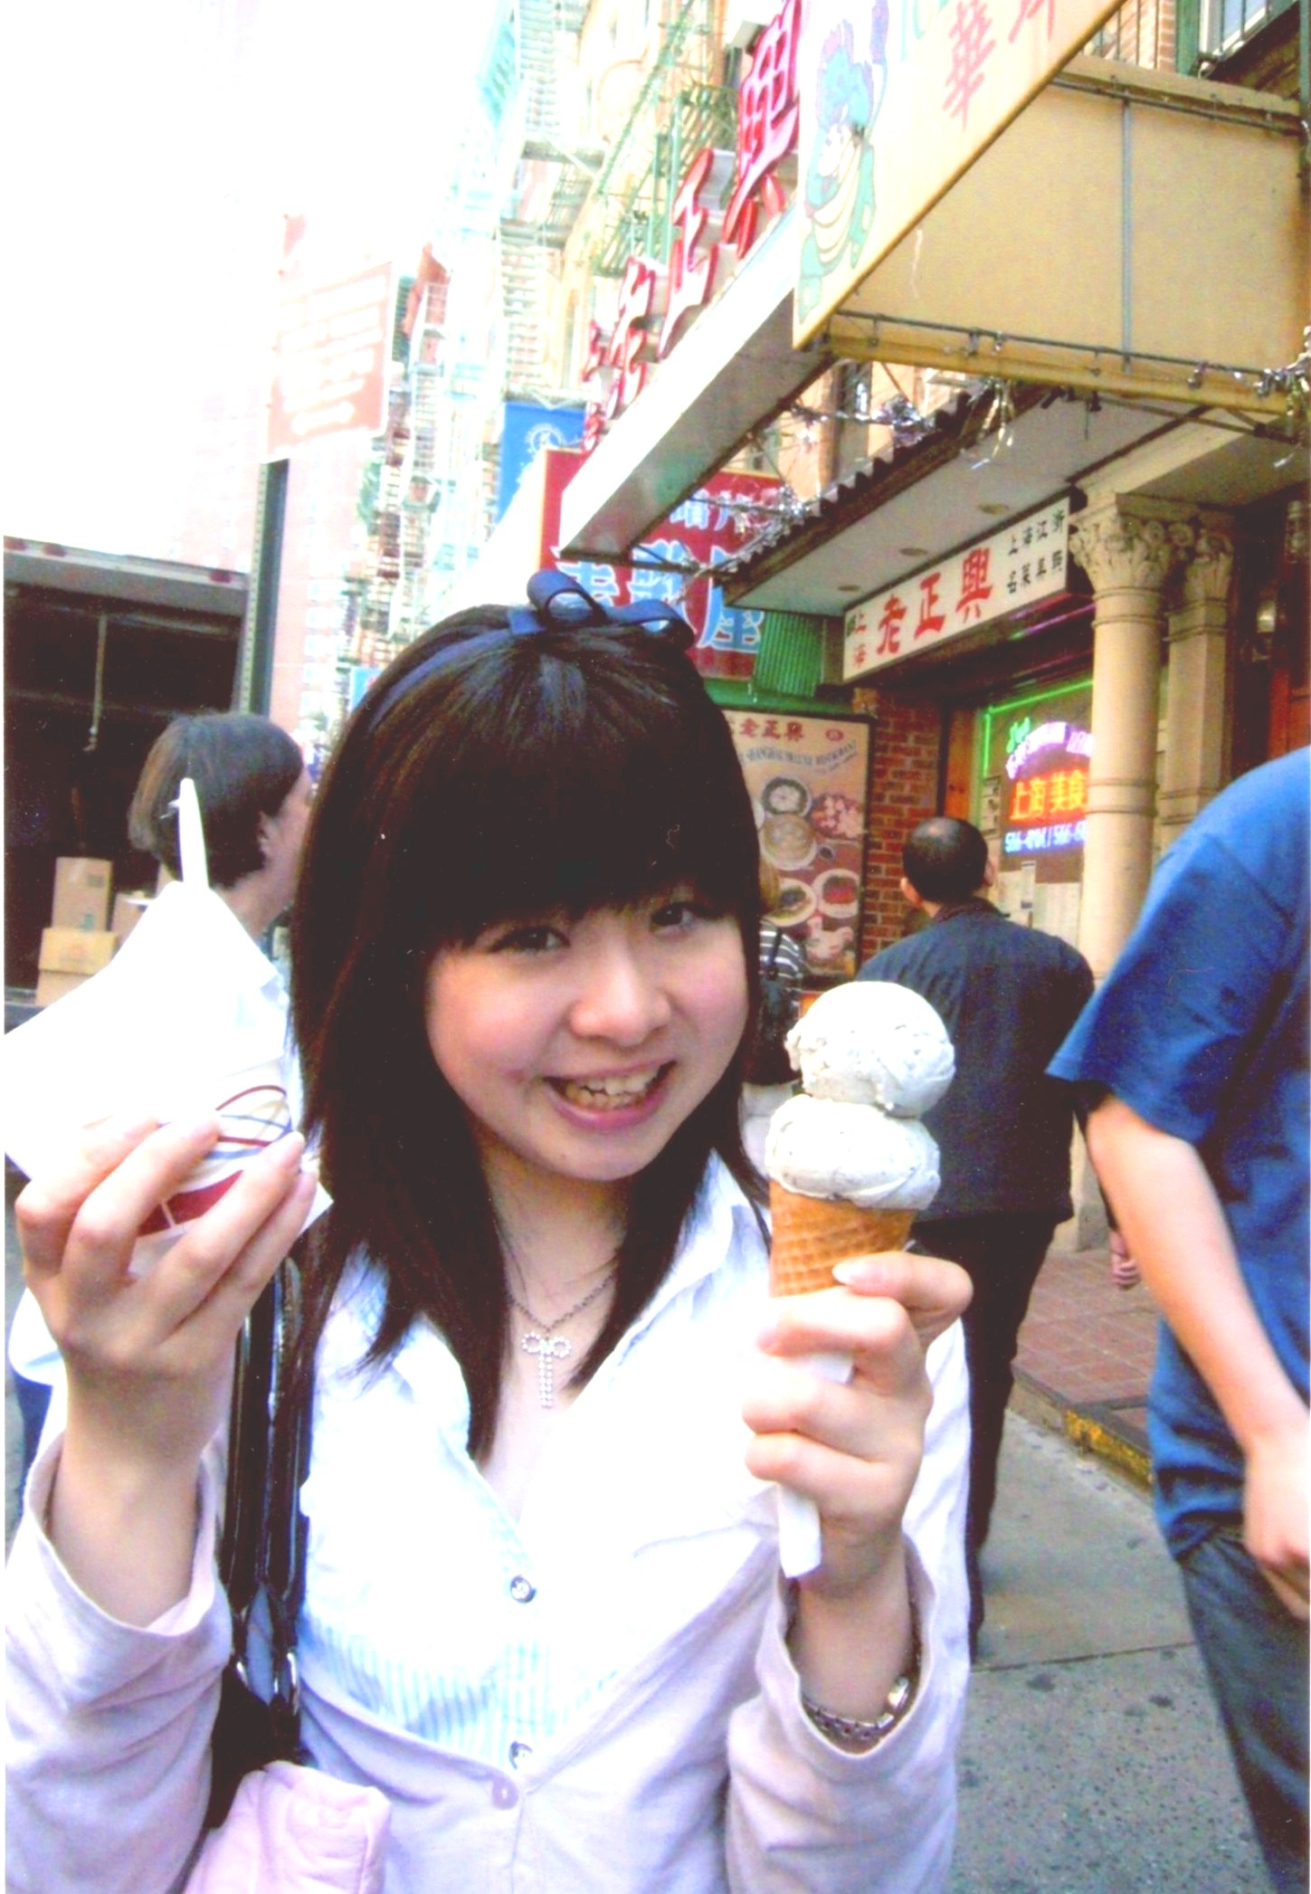
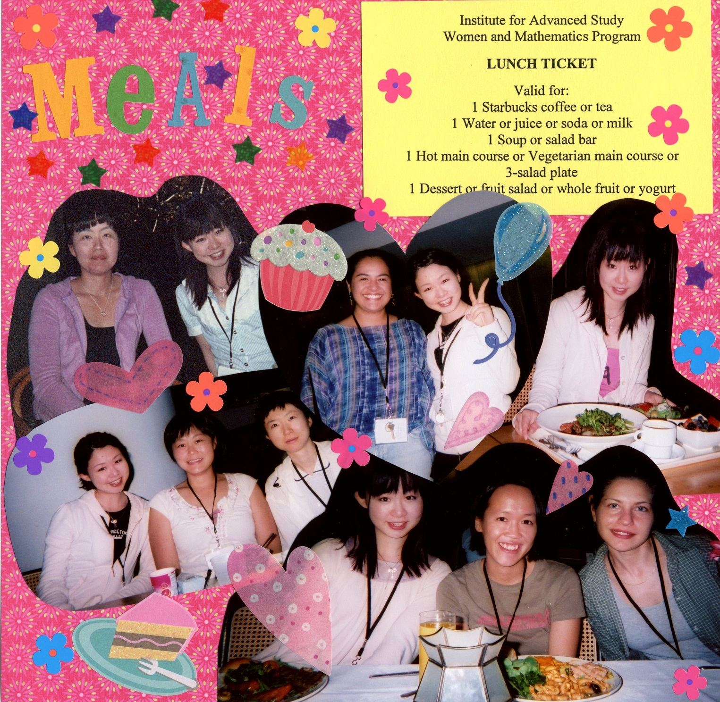
Ayaka Shimizu
Assistant Professor at National Institute of Technology, Gunma College, Japan
It was a great experience in my life!

Slide 8
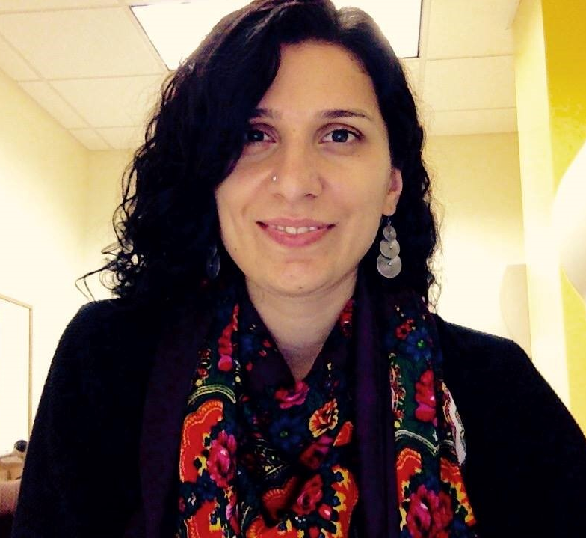
Bahar Acu
2012
WAM program at IAS has been one of the most influential programs that I’ve ever attended in my academic career. I was a first year graduate student at the time and have met almost all my female colleagues (including my postdoc mentor) in my field at this conference. Inspired by this conference, I’m currently a part of a strong and enthusiastic team of organizers putting a research collaboration conference for women in contact and symplectic geometry at ICERM in Summer 2019. Proud to be a WAM alumni!

Slide 9
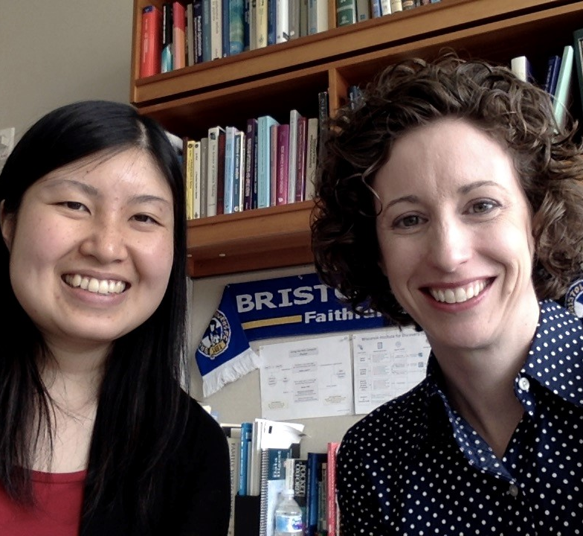
Rebecca Willet
2011
I was one of the instructors for the 2011 program on Sparsity and Computation. Participating in this program had a lasting impact on my career. First, developing my lecture notes helped me develop new strategies for communicating complex ideas to an audience with a diversity of backgrounds. I learned a lot through this effort and have leveraged those techniques in technical talks and lectures ever since. Second, I had the pleasure of getting to know many very talented young researchers. In fact, one of the attendees that year was Po-Ling Loh, who would later become my colleague at the University of Wisconsin.

Slide 10
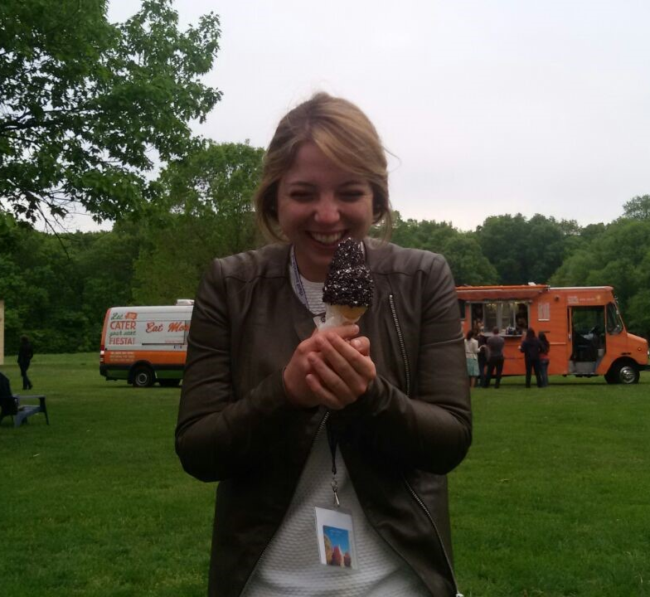
Camilla Felisetti
2015
This program played a crucial role in shaping me as a mathematician. It made me understand that this was I wanted to do in my life. Also I met some of my actual collaborators!

Slide 11
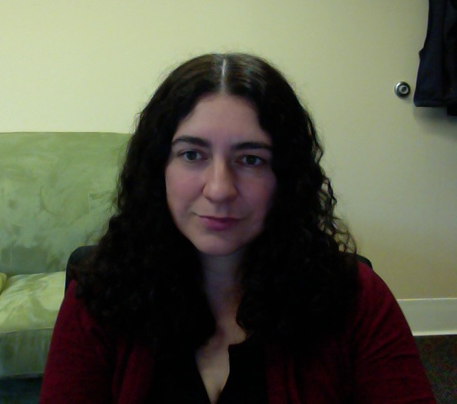
Carina Curto
2001, 2002
My first year of graduate school, I was the only woman in my incoming class of 13 at Duke. It was a very isolating experience, as none of my classmates or professors were women. Then I went to the IAS Women's Program in the summer of 2001, and was suddenly surrounded by fun and talented women doing math. It was a magical, life-changing experience for me.

Slide 12
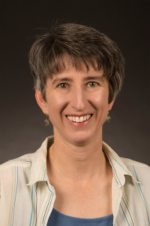
Cathy Kriloff
1998
I was extremely energized and encouraged by being a part of the program and connecting with fellow female mathematicians. The most tangible impact on my research was meeting Arun Ram for the first time and beginning discussions with him that led to our paper on Representations of graded Hecke algebras and a collaboration which I very much valued. Visiting him in Wisconsin in the summer of 2000 in turn led to meeting and interacting with Anne Shepler and more recently her student Briana Foster-Greenwood, with whom I now enjoy collaborating and have two joint papers.

Slide 13
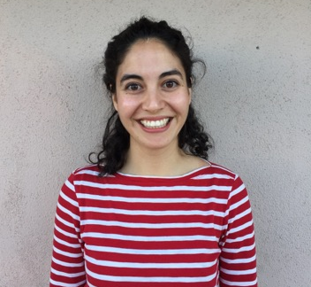
Carmen Galaz-Garcia
2017
The WAM program on Geometric Group theory has been one of the most relevant experiences of my PhD, both for the beautiful math I learnt there and the amazing mathematicians I met. The knowledge and charisma of the lecturers have become an inspiration for me. This year through the IAS Women and Math Ambassador I've had the opportunity to bring the spirit of the program back to UCSB. Thank you, IAS!

Slide 14
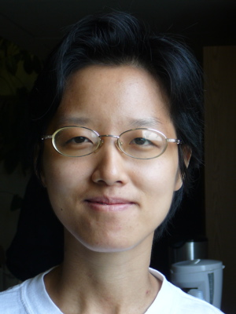
Chiu-Chu Melissa Liu
2007
I participated in the 2007 IAS Women And Mathematics Program "Algebraic Geometry and Group Action". I gave a seminar talk on May 15, 2007, which is also the day I first met Elizabeth Gasparim, the Research Seminar organizer. Elizabeth Gasparim and I started to collaborate during the program and finished a joint paper "The Nekrasov Conjecture for Toric Surfaces" in 2008.

Slide 15
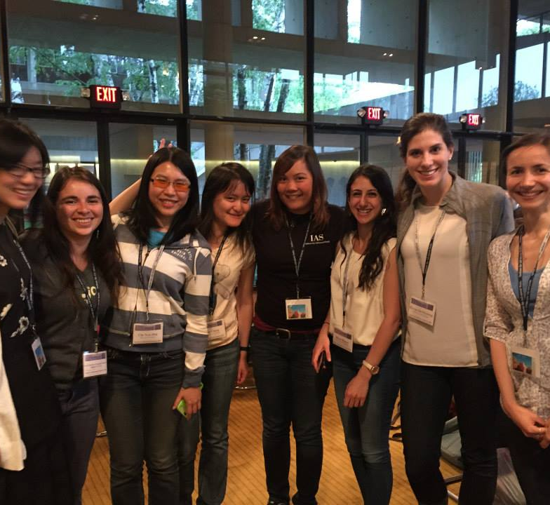
Chi-Yun Hsu
2015
The atmosphere of the Women and Mathematics program was very encouraging for interaction among participants. I met female mathematicians who continue to be friends. I was also inspired when Richard Taylor talked to us and emphasized the importance of his hard work rather than talent.

Slide 16
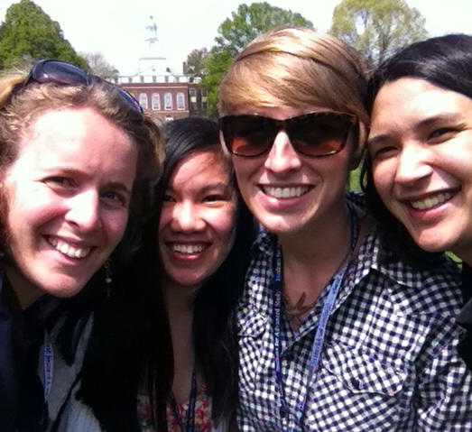
Courtney Paquette
2014
The WAM program introduced me to so many wonderful friends and established connections with the mathematics community I continue to use today. For me, the most important thing I learned was how to interact with both male and female mathematicians.
Photo: A group of us went walking around the IAS during the WAM program in 2014. Left to right: Evita Nestoridi, Chloe Ondracek, Hailee Peck, and Courtney Paquette

Slide 17
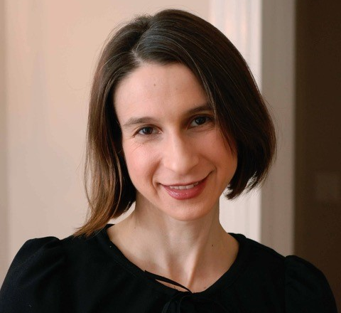
Cynthia Rudin
MIT
The IAS Women in Mathematics Program was instrumental as a part of my graduate education in Princeton; the quality of lectures was amazing, and the atmosphere was wonderful. I hope it keeps going forever!

Slide 18
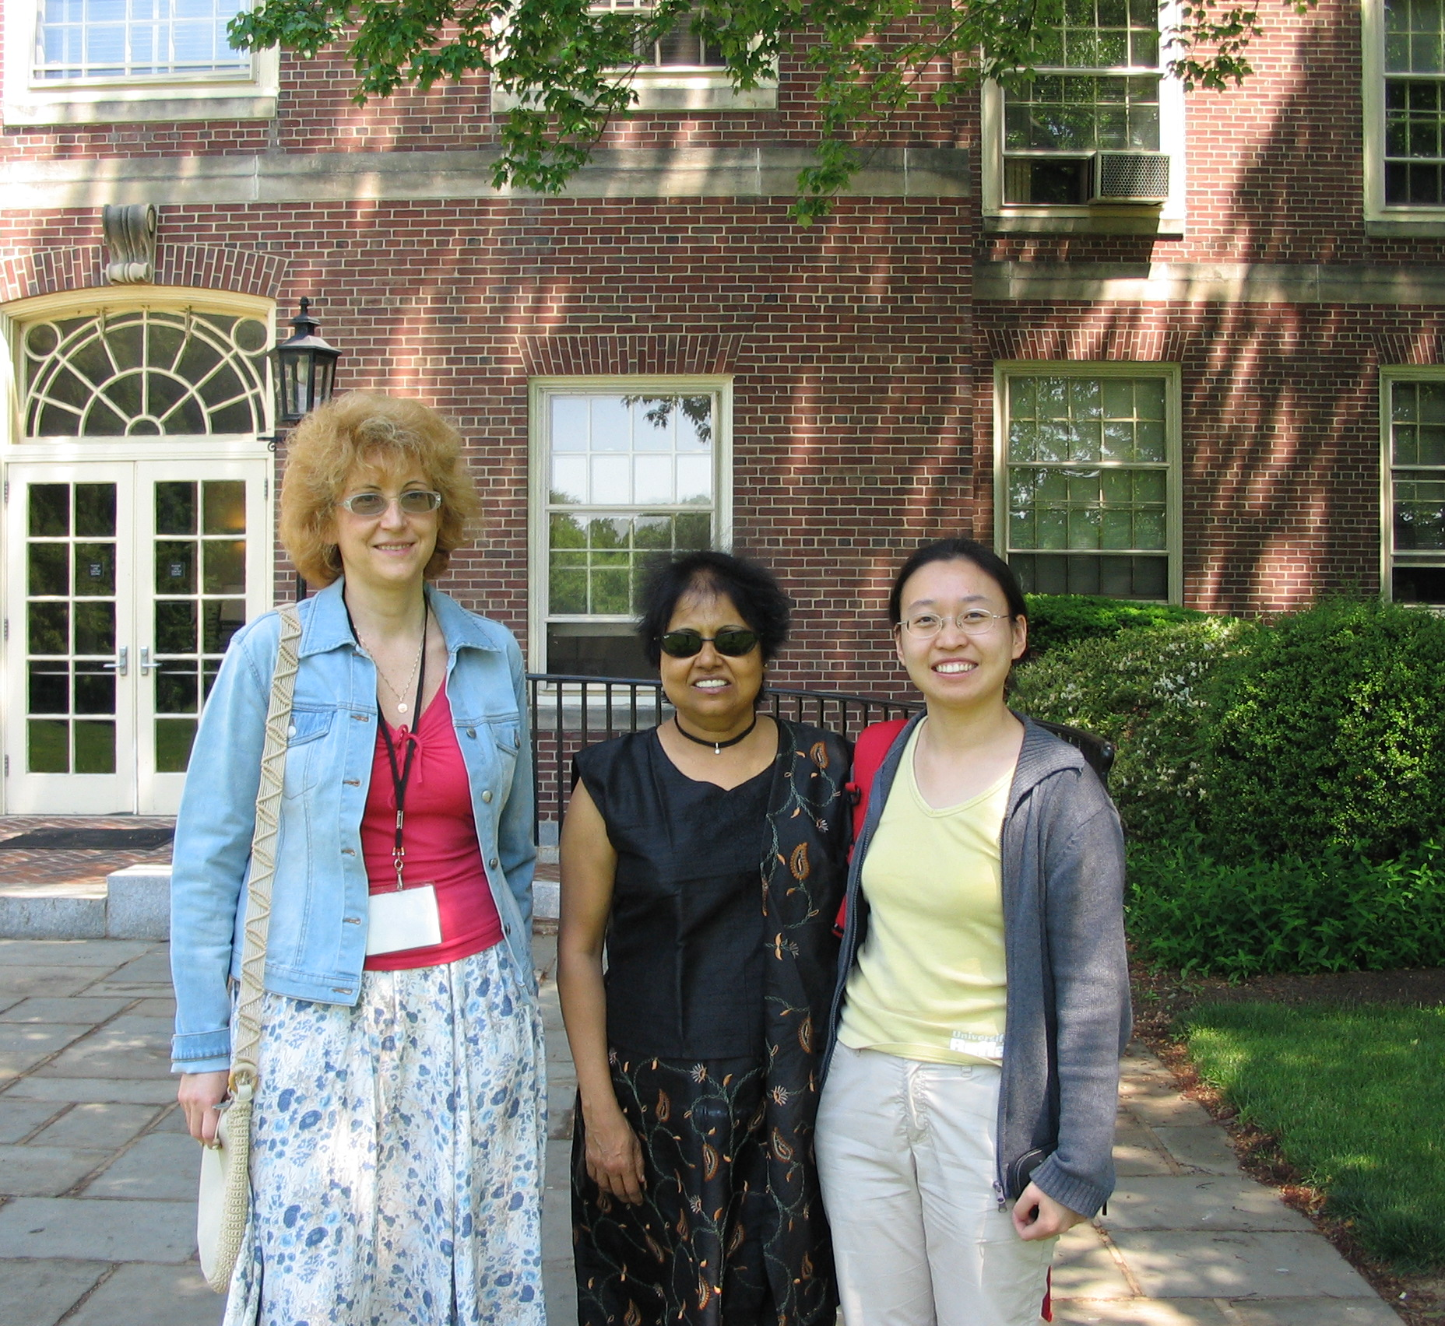
Elena Poletaeva
2007
I visited the IAS as a Member in January-August 2007. I had the privilege of participating in the Program Women and Mathematics, organized by Professor K. Uhlenbeck in May 2007. I learned a lot from four courses, colloquia, and seminars during this Program. I gave a talk in the Research Seminar on May 21, 2007: Lie algebras and superalgebras of vector elds". My visit to the IAS was very important for my research and career. During that time I wrote three articles. Now I am a Professor at the Schools of Mathematical and Statistical Sciences, the University of Texas Rio Grande Valley.

Slide 19
Elizabeth Meckes 2014
The opportunity to participate in the WAM program was absolutely fantastic. I loved the program itself, and it also served as an important starting point for me: I couldn't find good references to suggest for my series of lectures, so I wrote up lecture notes, which have now grown into a monograph to appear in summer 2019 in the series "Cambridge Tracts in Mathematics". I've sent one student to the program so far, and certainly will send others in the future.

Slide 20
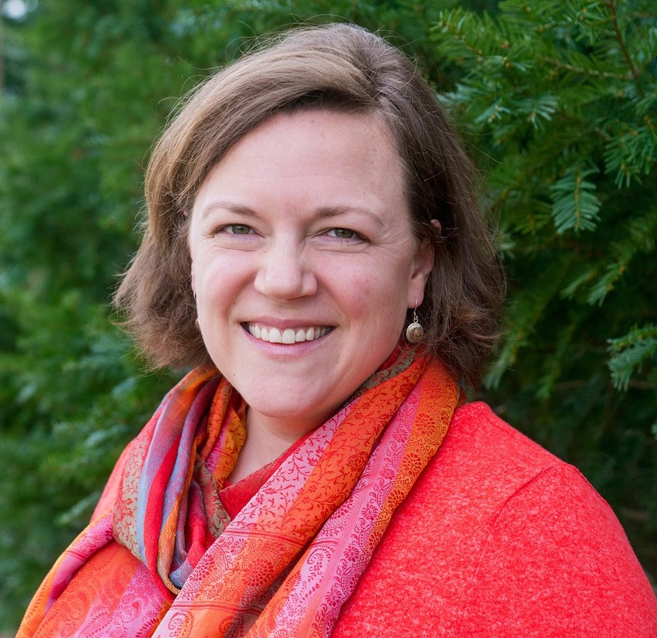
Elizabeth Milicevic
Haverford College
Attending WAM in 2007 two years before completing my PhD represented a distinct and formative turning point in my mathematical development. Those two weeks offered my very first opportunities for open-ended collaborative explorations, including conversations with several postdocs who took an interest in my work and subsequently became important mentors. Later, as both a lecturer and member of the program committee, I aim to give back by offering similar opportunities for women to experience distinct growth in their professional development in an open and encouraging environment framed by cutting-edge mathematics.

Slide 21
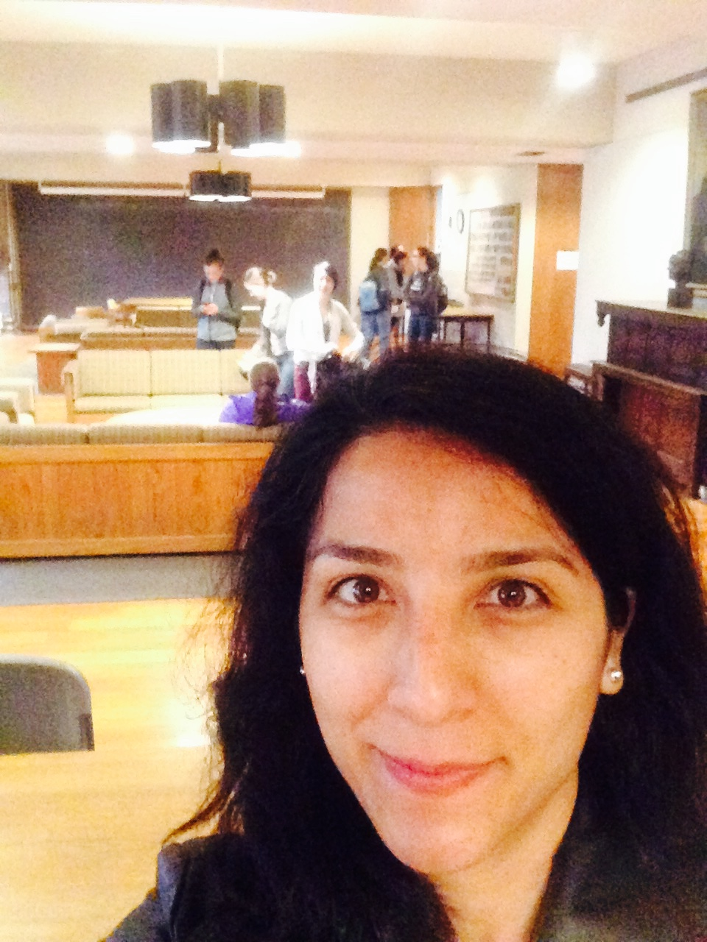
Funda Gul
2017
I do not know how to thank the organizers of this wonderful program. This amazing program helped me connect with many fellow women mathematicians all over the country and provided great boost in my research and mathematics career.

Slide 22
Geertje Hek 2001
I attended the Women and Maths program in 2001, together with my friend and former room mate Clíona Golden. I had just had the opportunity to learn to know Ingrid Daubechies, and was then at IAS very much inspired by Karen Uhlenbeck. I was really influenced by meeting these outstanding female full professors in maths. Until then I didn’t believe in special programs for women, but in Princeton I understood that applying for special ‘female’ tenure tracks did not mean I would be a second-class mathematician. In 2005, I became assistant professor in Amsterdam, partly on a grant for female mathematicians.

Slide 23
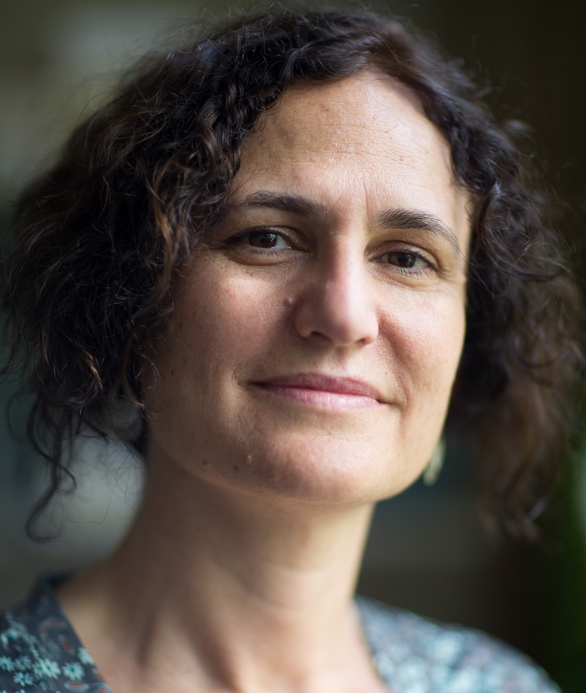
Gigliola Staffilani
1995
I attended the Women and Mathematics program at the IAS at the end of my graduate school. I had been lucky enough to be a graduate student at the University of Chicago where there was a critical mass of women in my years. Still being at the IAS for two weeks with a much larger number of women interested in mathematics was a fantastic experience. I also remember having a impromptu “panel discussion” under a tree near the pond, with some of the most respected and successful role models: Susan Friedlander, Karen Uhlenbeck and Barbara Kyefitz.
Also being in the Institute's grounds, living in one of the lovely apartments scattered around, walking the halls that Einstein had walked, seeing some of the “gods” of mathematics such as Bombieri, Bourgain, Deligne and so on, gave me the realization that I was actually in the eye of the cyclone of mathematics. Those were the mathematicians who had “made it”. Having them pointing the direction towards which I should set my path certainly helped me in focusing my work, overcome obstacles and arriving to my current position at MIT.

Slide 24
Genevieve Walsh 2008
It felt normal to be a pregnant math expert.

Slide 25
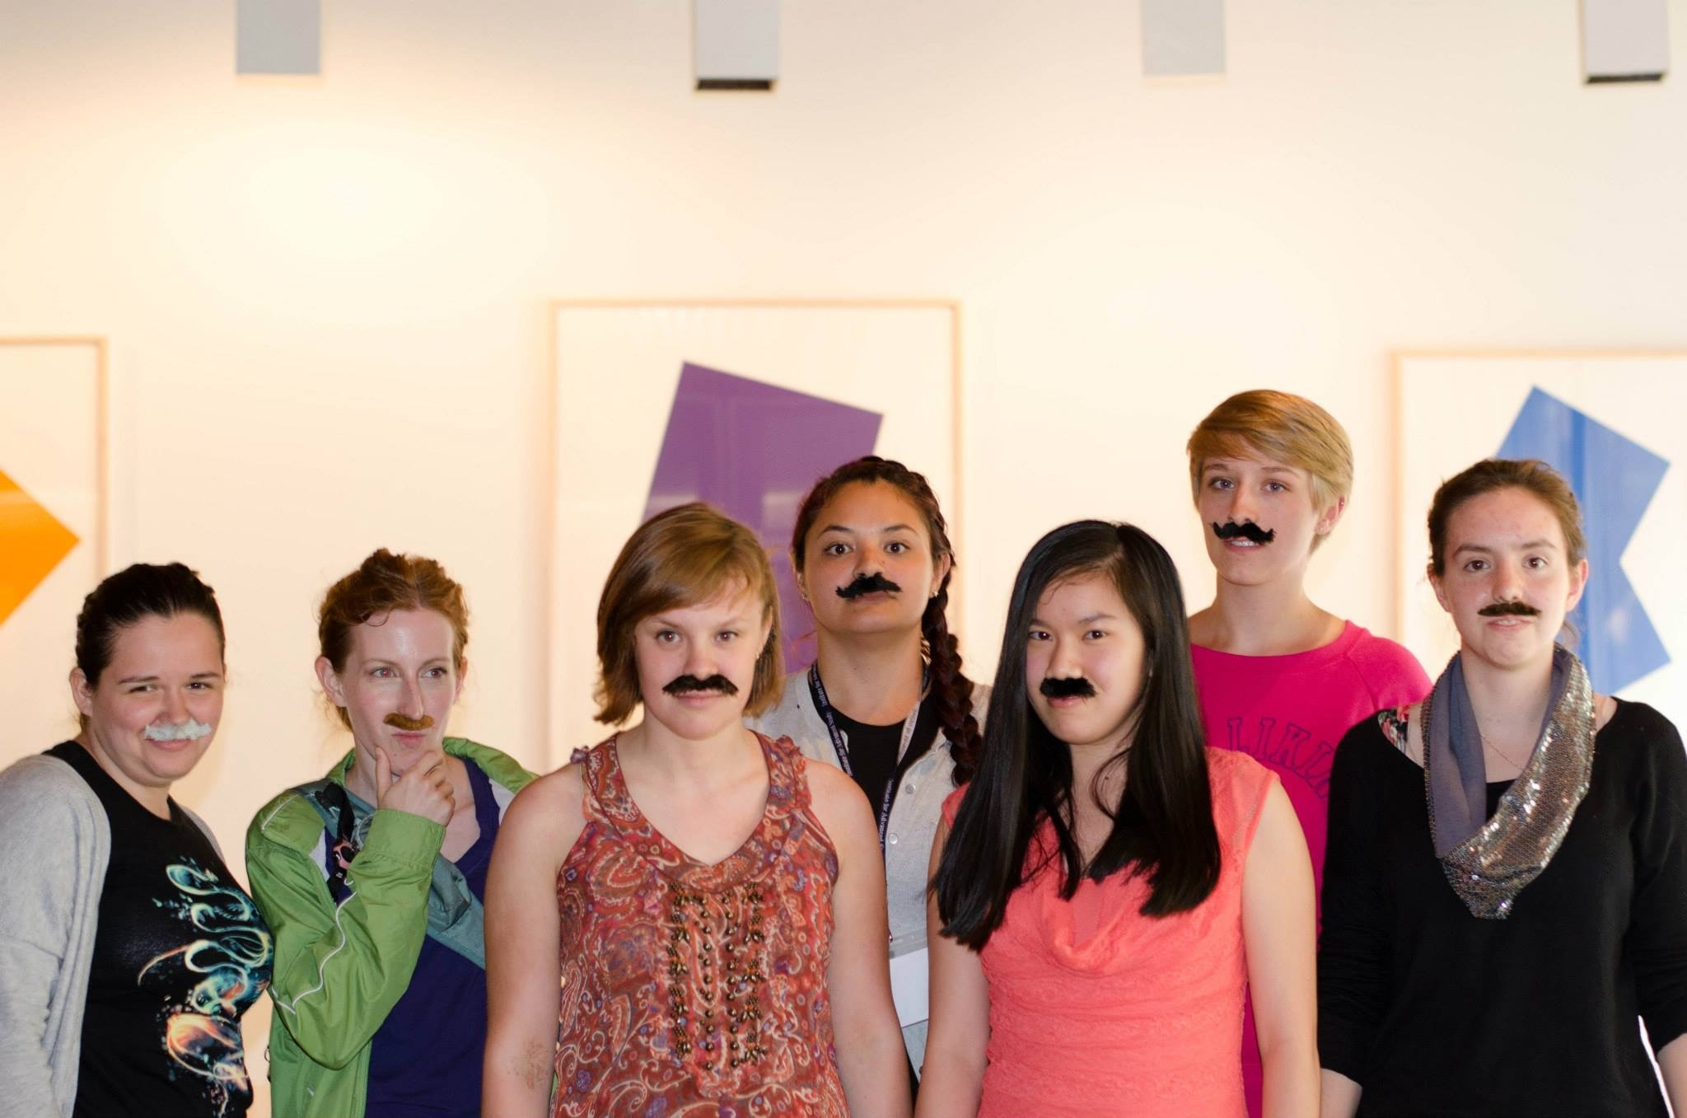
Hailee Peck
2014
Participating in the Women in Mathematics program provided me the opportunity to connect with some awesome females who are making their way through the ranks of academia and industry in mathematics. It has really helped me as I am pursuing my graduate degree in mathematics to have people who have been through the same types of situations and struggles that I am experiencing as a female in the field because I can ask their advice or lean on them for support when I need it. Most of the people I encounter on a day-to-day basis in my program are males, so being in a program specifically to connect females in mathematics was incredibly beneficial for me.

Slide 26
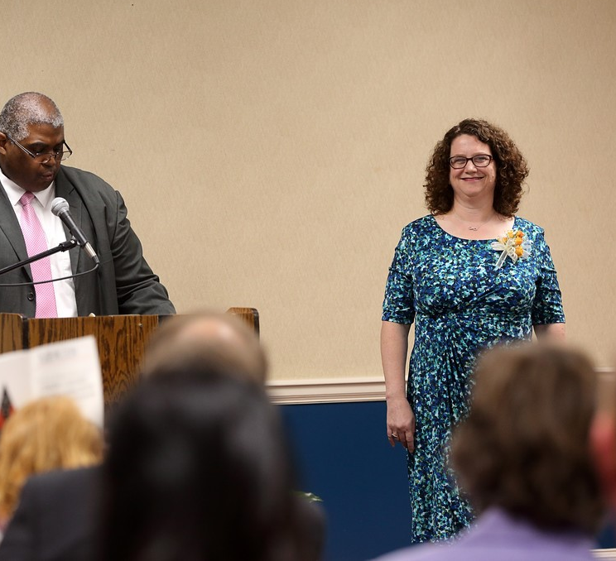
Hope McIllwain
1996
When I attended the Women and Mathematics program at IAS as a graduate student, I had completed my qualifying exams but was struggling to find an area in which to work. As a part of the program, I attended an intriguing lecture by Fan Chung on discrete Fourier transforms. I was so engaged by the topic that I returned to my home institution, found an advisor, and completed my degree. I am grateful to the program for helping direct my studies and for the friendships with many interesting women mathematicians I met there.

Slide 27
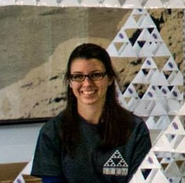
Jane Long
2005
The summer program was one of the most important enrichment experiences I had during graduate school. Having the distractions of day-to-day life lifted, doing mathematics I’d never seen before in a comfortable and collaborative atmosphere, hearing successful mathematicians say that the pressures and concerns I felt were real and meaningful, and meeting people I can now call upon professionally gave me a big boost during a critical time. I’m now a tenured professor in a teaching job and am grateful for the summer program’s contribution to my success in earning my dream job.

Slide 28
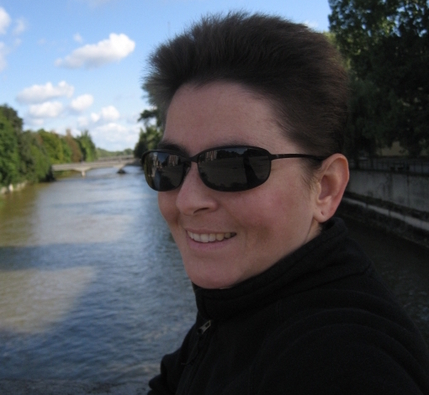
Jane Pratt
2002
Currently an assistant professor in the Department of Physics and Astronomy at Georgia State University. Her research centers on theoretical and computational investigations at the intersection of fluid turbulence, convection, and magnetohydrodynamics, which define the nonlinear dynamics of astrophysical and fusion plasmas.

Slide 29
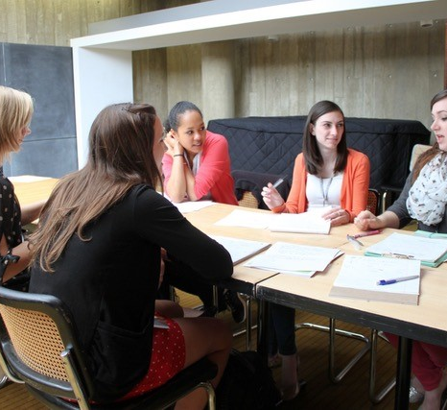
Jessica De Silva
2013
The most impactful part of this program was the people I had the opportunity to meet. This program taught me that I can learn so much more by working with others who have had both more and less experience than me. Looking through pictures from my program year, there are so many people who I have stayed connected with and even more who I am now realizing I've reconnected with through other experiences.

Slide 30
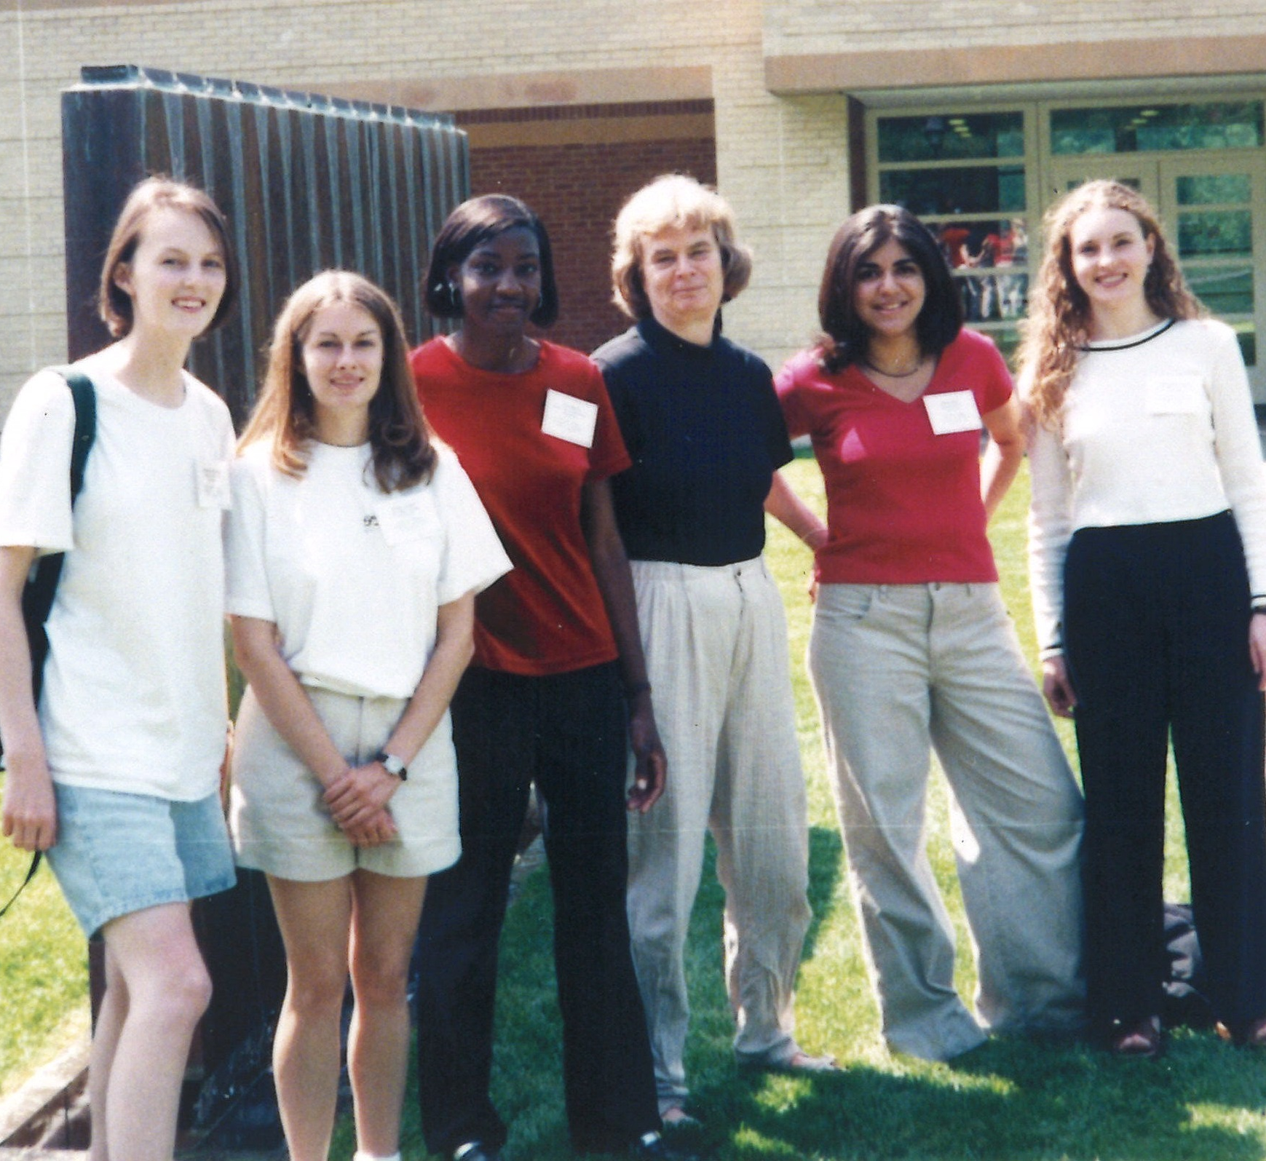
Jessica Purcell
1998
I was an undergraduate in the Women and Mathematics program at the IAS in 1998, then as Jessica Shepherd. I'm standing on the far left in the attached photo. Karen Uhlenbeck is in the center (3rd from right). The rest are other undergraduates whose names I have forgotten.
I remember the IAS undergraduate program as challenging, and yet encouraging. While I haven't kept in touch, I made friends that year who could empathize with my experiences during my first, most difficult years of graduate school. Now I'm an associate professor at Monash University in Australia, striving to encourage women in mathematics from a different place in life.

Slide 31
Joan Licata Australian National University
Beginning Course Lecturer 2012
Advanced Course TA 2008
One of my favorite features of teaching at the WAM program is the fact that there are many people I met as students who are now my colleagues!

Slide 32
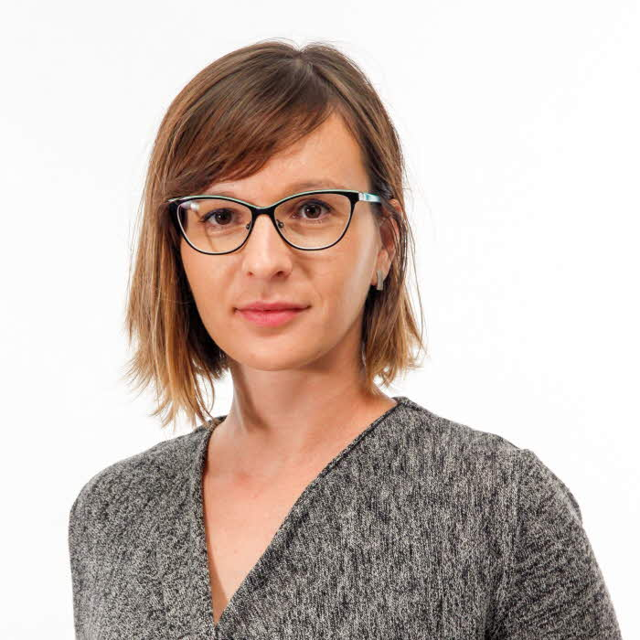
Jolanta Pielaszkiewicz 2014
Currently I am working as Postdoctoral Fellow at Linnaeus University in Växjö, Sweden. I am glad that I could participate in the 2014 Program for Women and Mathematics on Random Matrix Theory, that was an excellent platform for studying subject under supervision of prominent female lecturers. My current publications on results related to Wishart matrices (and not only) are strongly related to the topics we discussed. I appreciate also exchange of views during "Women in Science" seminar, that were coming back to me while I was considering my future academic plans.

Slide 33
Julia Arciero 2003
I attended the program for women in mathematical biology at the Institute for Advanced Study the summer before entering graduate school at the University of Arizona. Now as an associate professor at Indiana University-Purdue University Indianapolis, these women are my colleagues and collaborators who I continue to see at numerous conferences and campus visits each year. IAS was a very special place that fostered both academic and social camaraderie and was a great kick-start to my academic career!

Slide 34
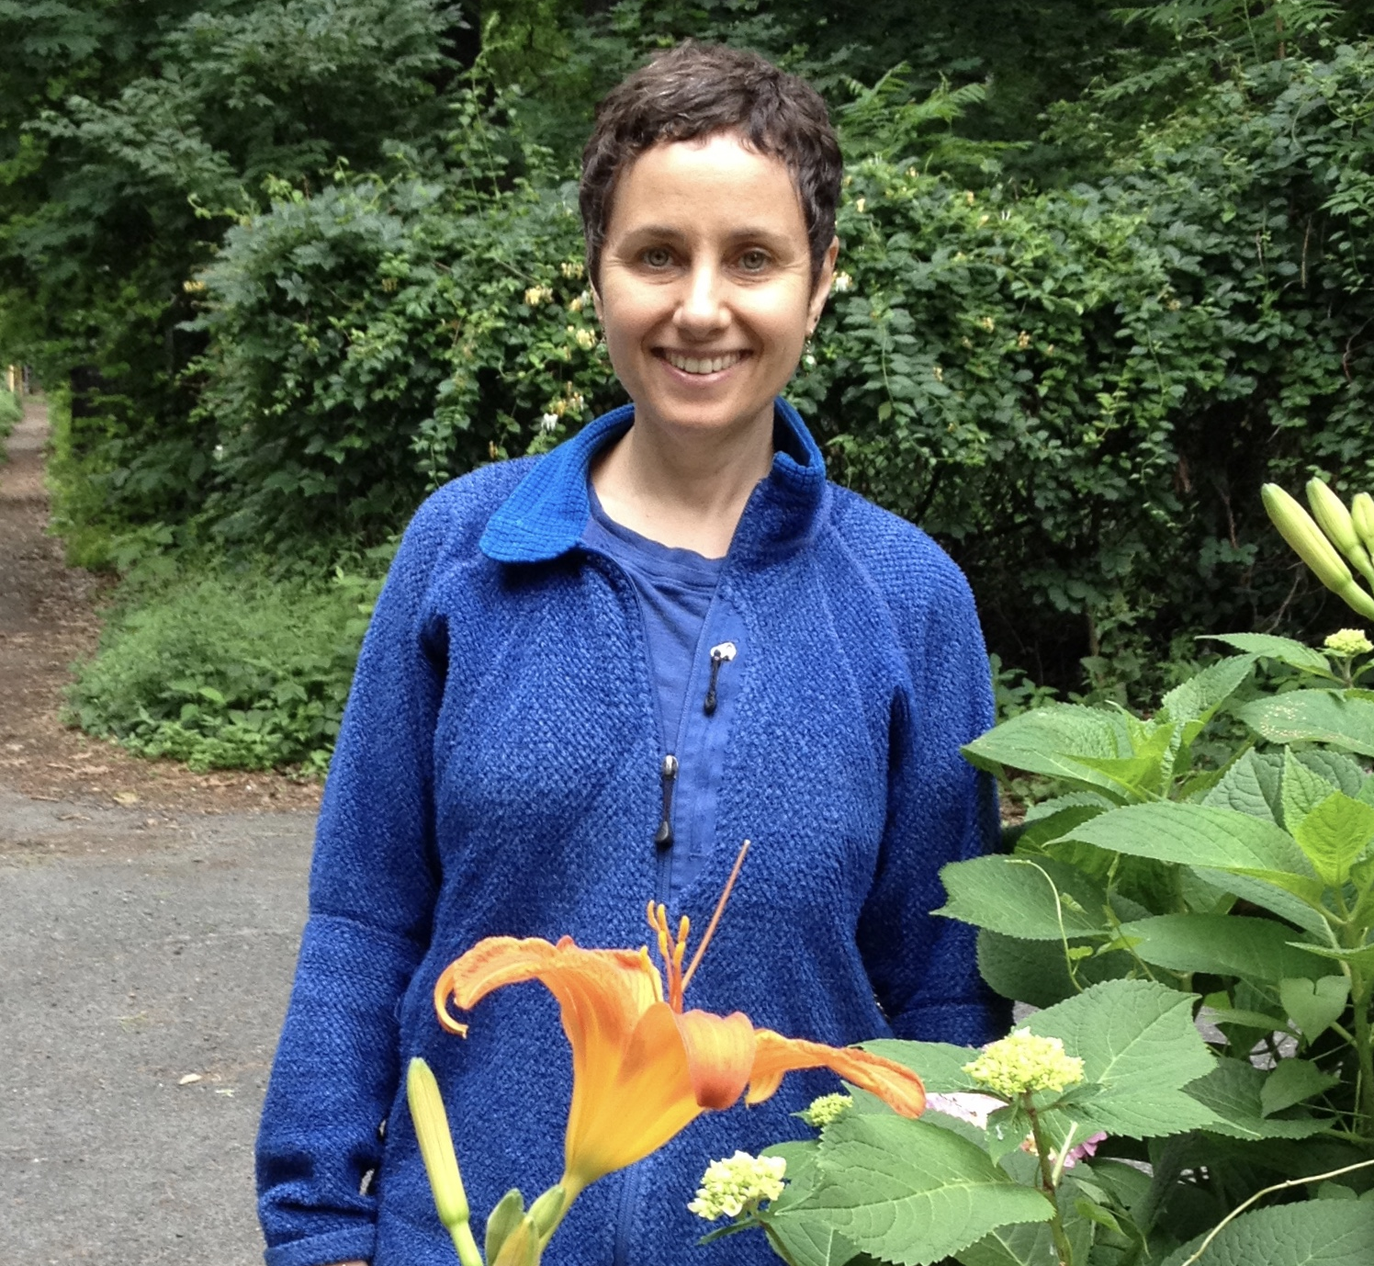
Julia Brainin
1999, 2001
The program encouraged me to continue in graduate school and inspired some academic work I did about gender and the culture of mathematics. I also participated in starting a women and mathematics group at UT-Austin. I now live in Austin, Texas, and work as a math editor in educational publishing.

Slide 35
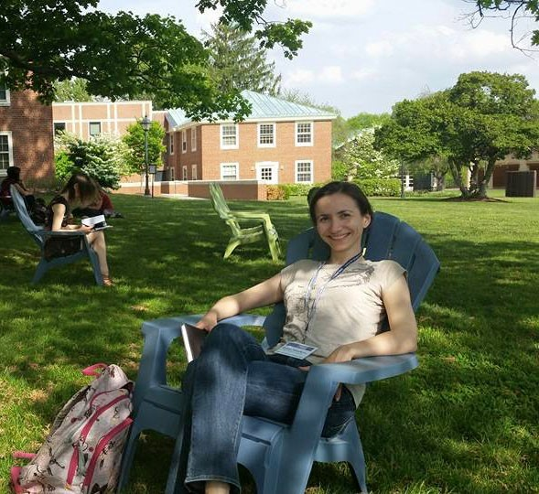
Kalina Mincheva
2015
This program is a wonderful experience for young female mathematicians! For me it was a chance to learn a lot, present some of my work, make many lifelong friends and meet some of my (future) collaborators.

Slide 36
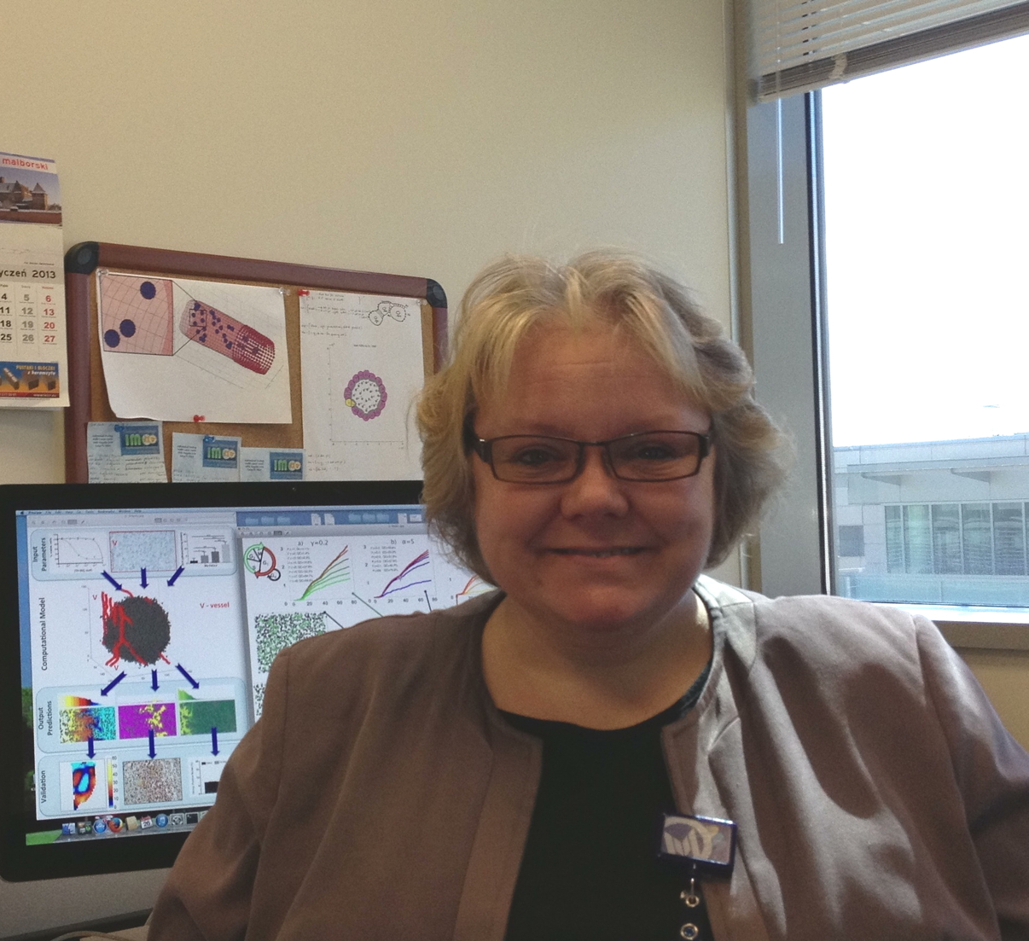
Katarzyna Rejniak
2003
I participated in the program in the summer of 2003. I was conducting hands-on exercises to the lectures of Prof. Lisa Fauci
While I was participating only in a part of the 2003 summer program as an instructor, I made several scientific connections and personal friendships. The perfect place to start professional life.

Slide 37
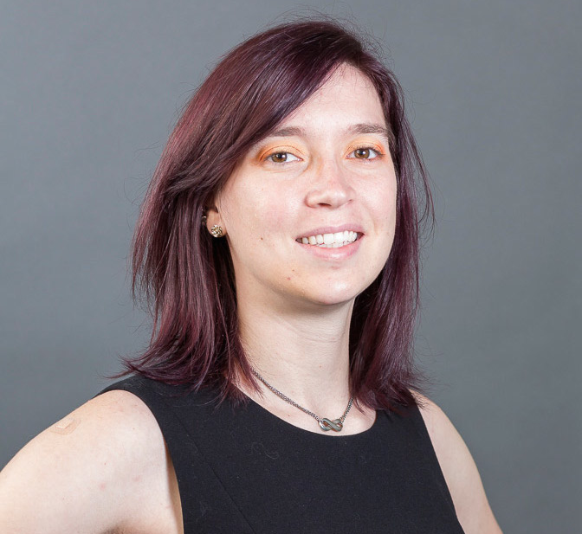
Katherine Kinnaird
2011
The Sparsity and Computation WAM at IAS program shaped the main direction of my research program. Through this program, I was introduced to dictionary learning which led me to machine learning, which is one of the fields that I now work in. The connections that I made at IAS have been invaluable and keep showing up in my life over and over again.

Slide 38
Katherine McCall 1995
The invitation to be a part of the 1995 session of Women and Mathematics at IAS was an important affirmation of my work at the beginning of my career. I will always be grateful for the opportunity to spend time with brilliant women in a beautiful location (Park City, Utah).

Slide 39
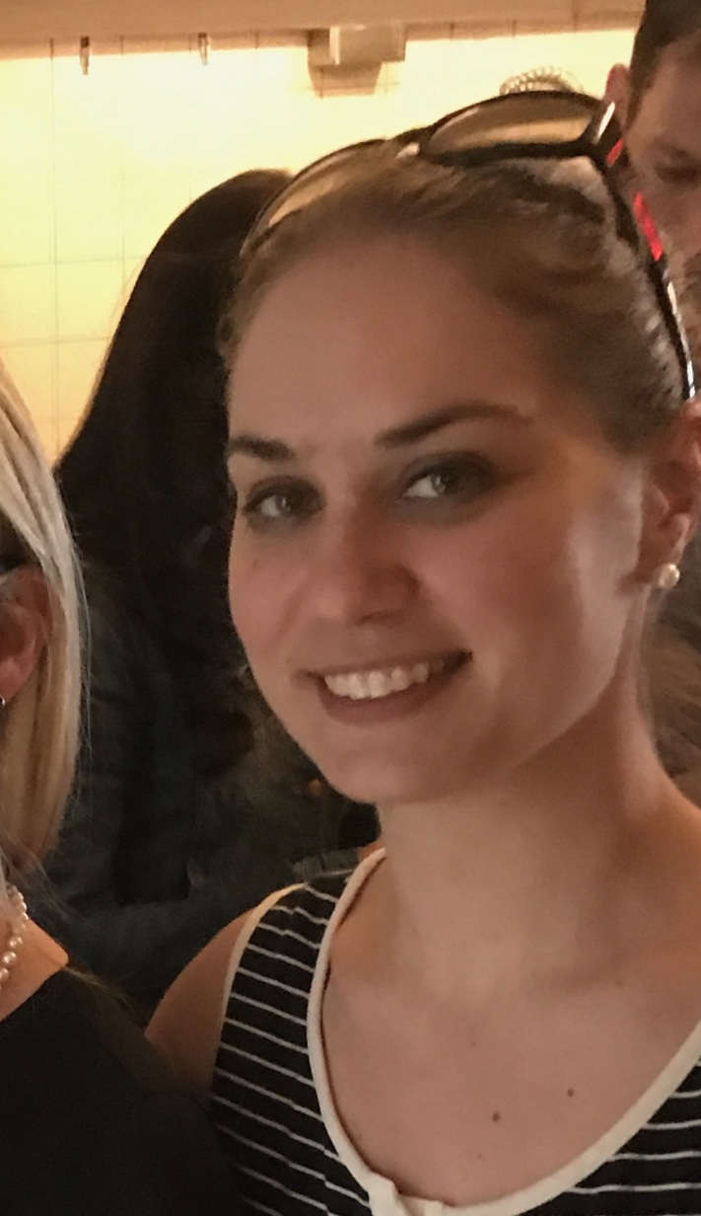
Katherine Kirkwood
2003
As a sophomore in college, the Women and Mathematics program gave me a valuable introduction to mathematical biology. While the program did help confirm I was interested in pursuing a career applying mathematics to biological problems (I attended graduate school at Yale University and now work as a biostatistician), meeting other female graduate students and faculty may have been the most valuable part of the experience. It was encouraging and confidence-boosting to meet mathematicians and physicists whose work I had read and admired, to get advice about how to navigate graduate school applications and choosing an advisor, and to hear how the senior mentors had dealt with discrimination and balancing careers with their personal lives.

Slide 40
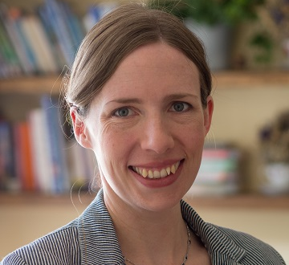
Kitty Meeks
2013
I participated in WAM in 2013, shortly after completing my PhD. At this time I was unsure whether I wanted to pursue a career in academia, but the very fact that the programme provided a safe space to discuss these uncertainties with other like-minded individuals helped me realise that a career in academic research could be the right choice for me. Five years on, I hold a faculty position at the University of Glasgow; I keep in touch with several other WAM alumni, and have even published a joint paper with one of them.

Slide 41
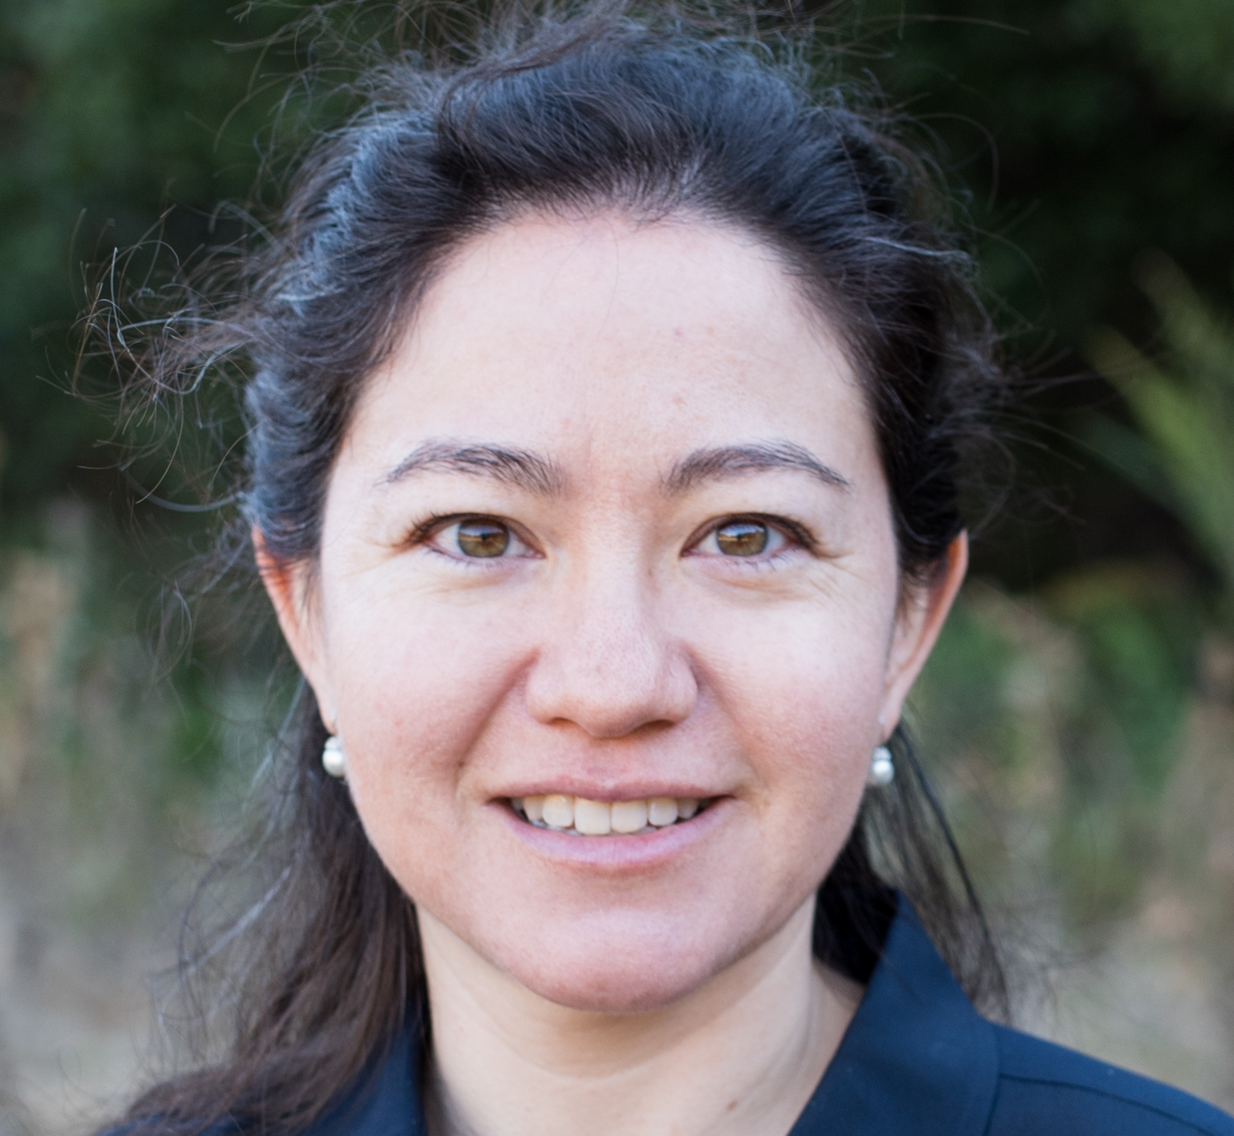
Lauren Williams
UC Berkeley
I've attended the IAS Women and Mathematics program three times, as an undergraduate student (1999), as a teaching assistant (2007), and as a faculty lecturer (2013). It's always a pleasure to participate in this program, and IAS in May is idyllic.

Slide 42
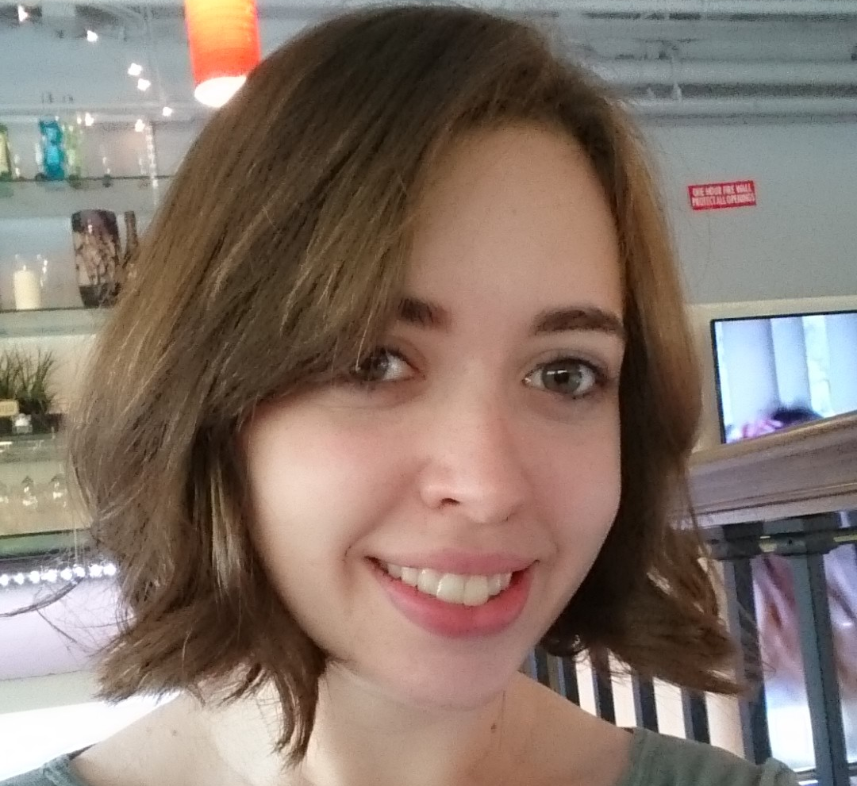
Lea Beneish
2014, 2015
I found out about Women and Math when I was applying for REUs as an undergraduate. I applied mainly because I thought the topic sounded interesting. At the time, there were very few women in the honors math program at my institution, and more often than not, they were not in enrolled in my classes. When I applied to the program, I was rather isolated at my home institution, and as much as I wanted to continue studying Math, I wasn’t sure I would. When I got there I was surprised by how supportive the atmosphere was, and I met so many interesting and intelligent women who I could talk to about math. I still keep in touch with several of them, and I am very glad I attended the program.

Slide 43
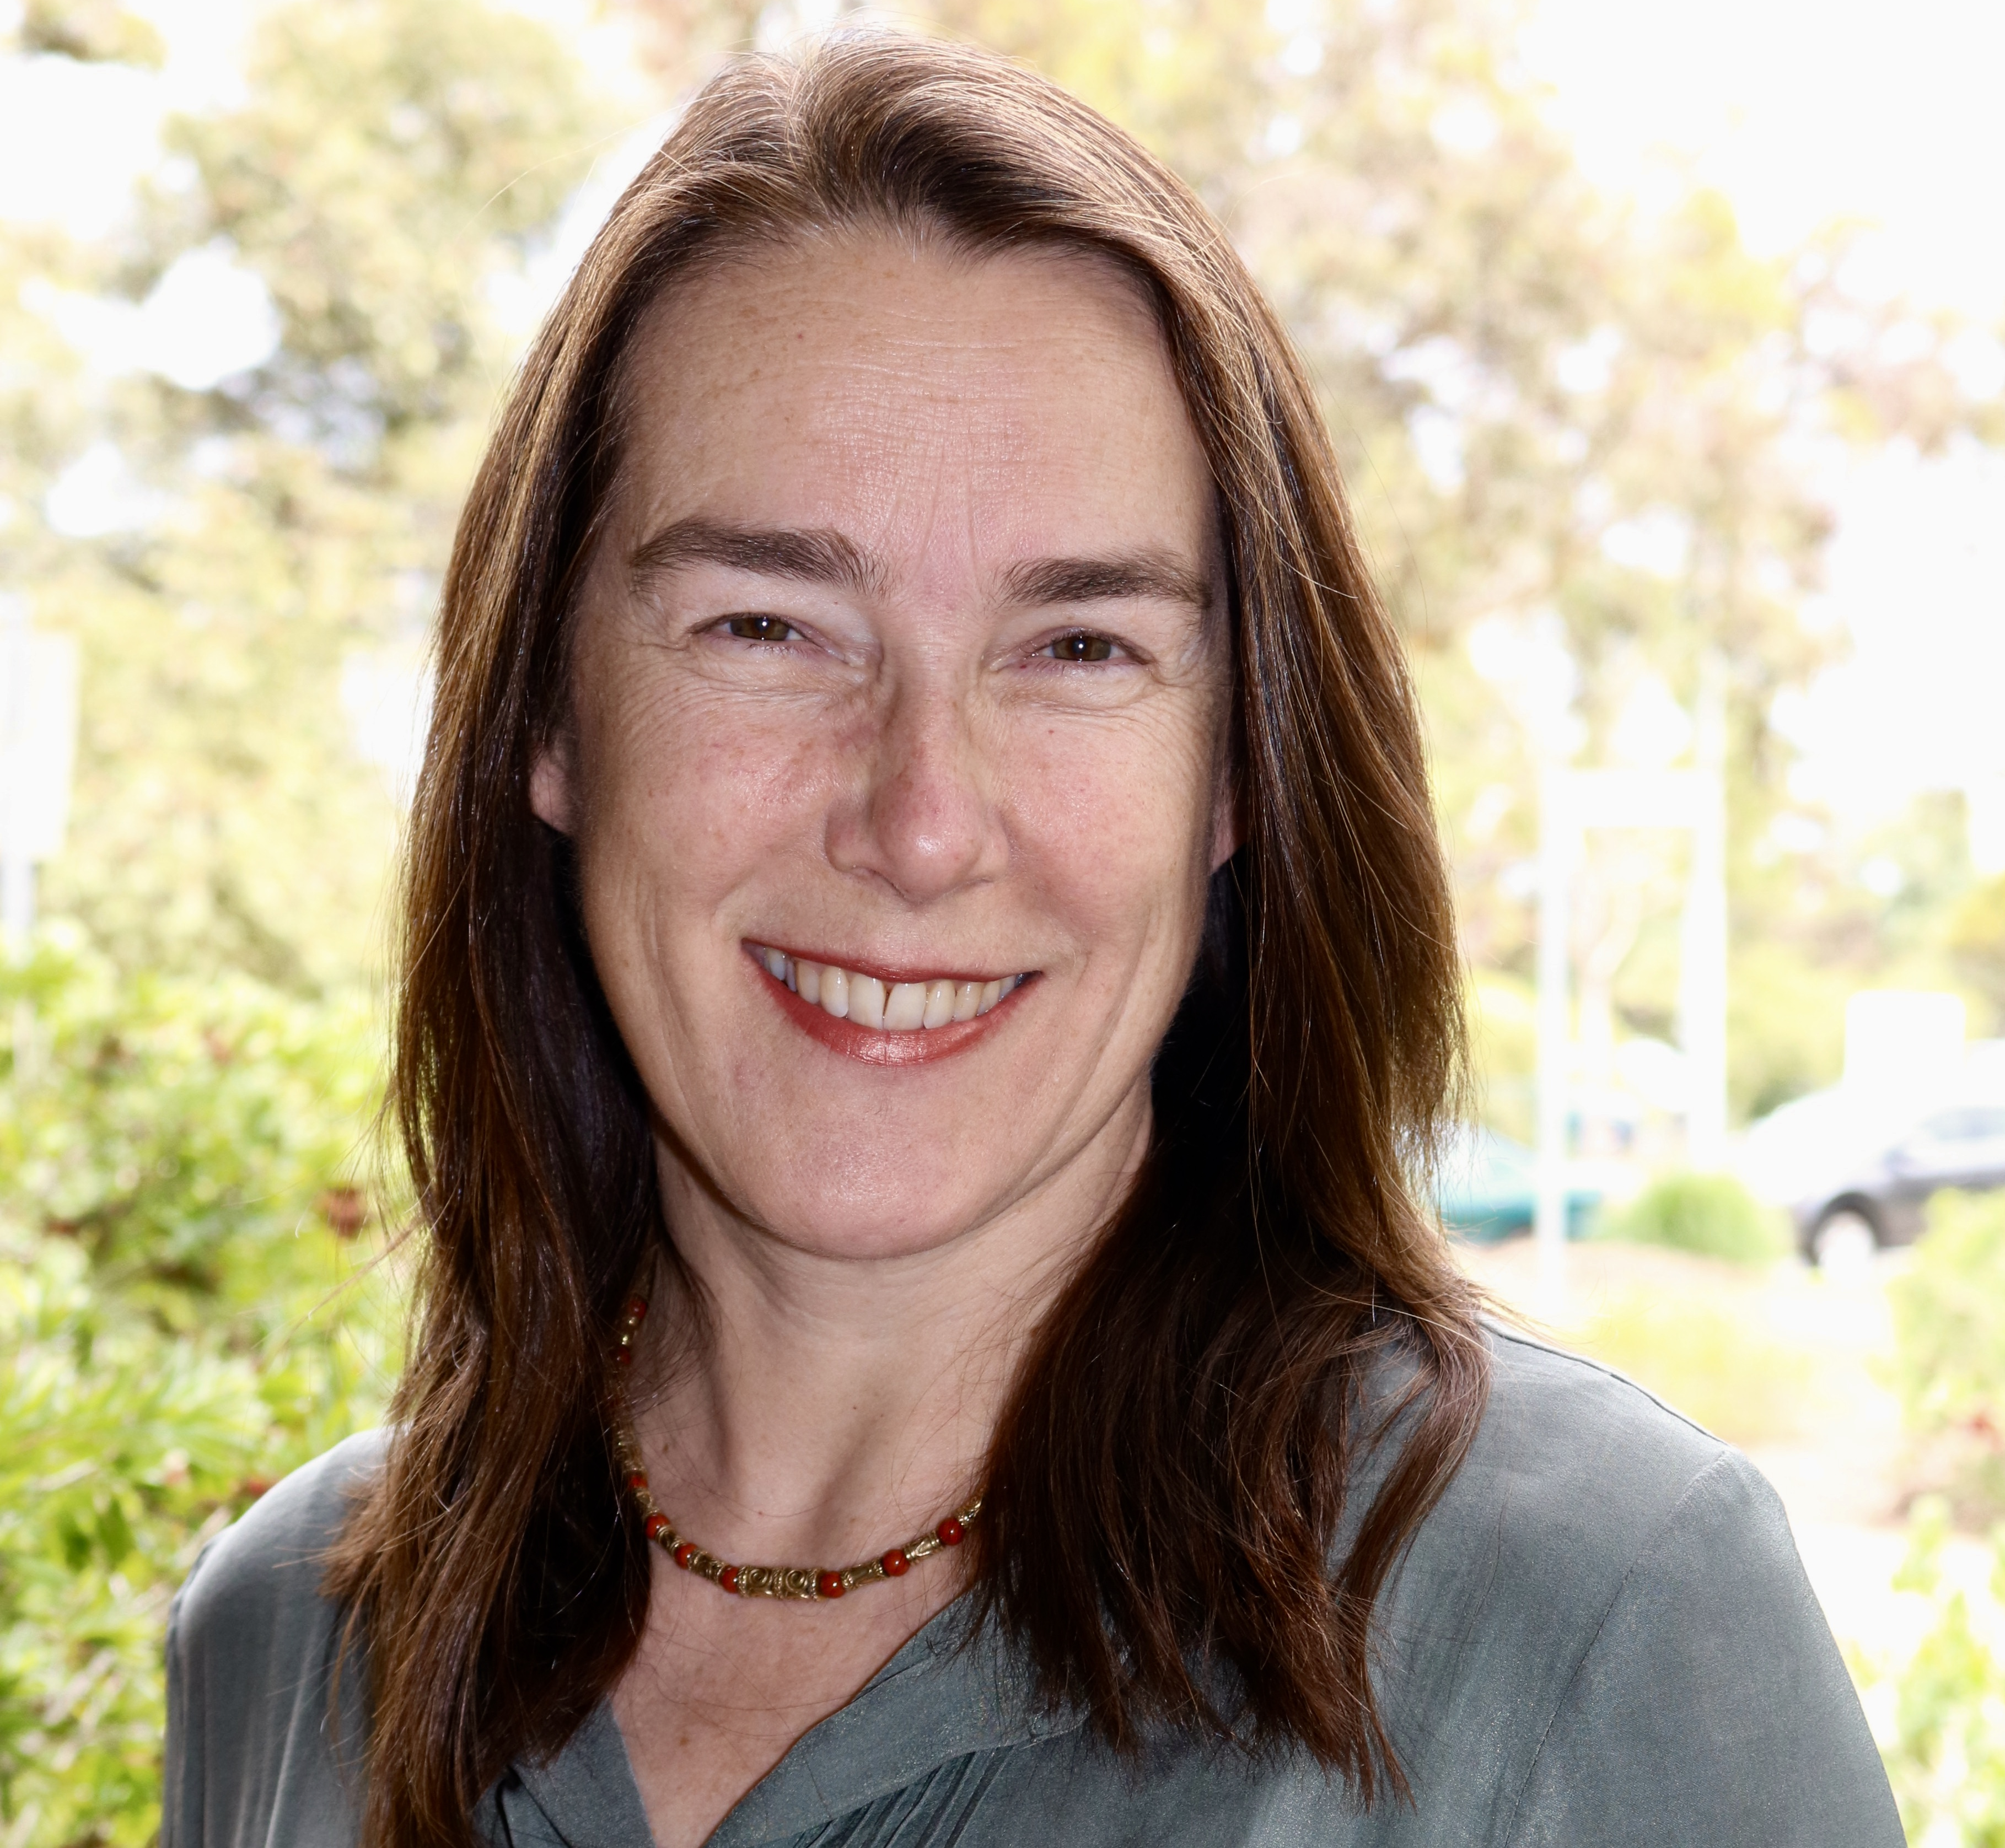
Lesley Ward
2004
Cristina Pereyra and I taught the Beginning Lecture Course at PWM 2004. It was a marvellous, encouraging experience to enjoy the majority-female mathematics environment offered by PWM—such a rarity. When I raised the Impostor Syndrome in class, you could have heard a pin drop. Later on, Cristina and I expanded our course content into a book, “Harmonic Analysis: From Fourier to Wavelets”, which was published by the American Mathematical Society in 2012. Since moving to Australia, I’ve worked with the Women in Mathematics group (WIMSIG) of the Australian Mathematical Society, set up a WIMSIG Travel Awards scheme modelled on the AWM/NSF travel and mentoring awards, and directed the WIMSIG Conference 2017: Celebration of Women in Australian Mathematical Sciences, which attracted 190 participants and had about 100 research talks, all given by women.

Slide 44
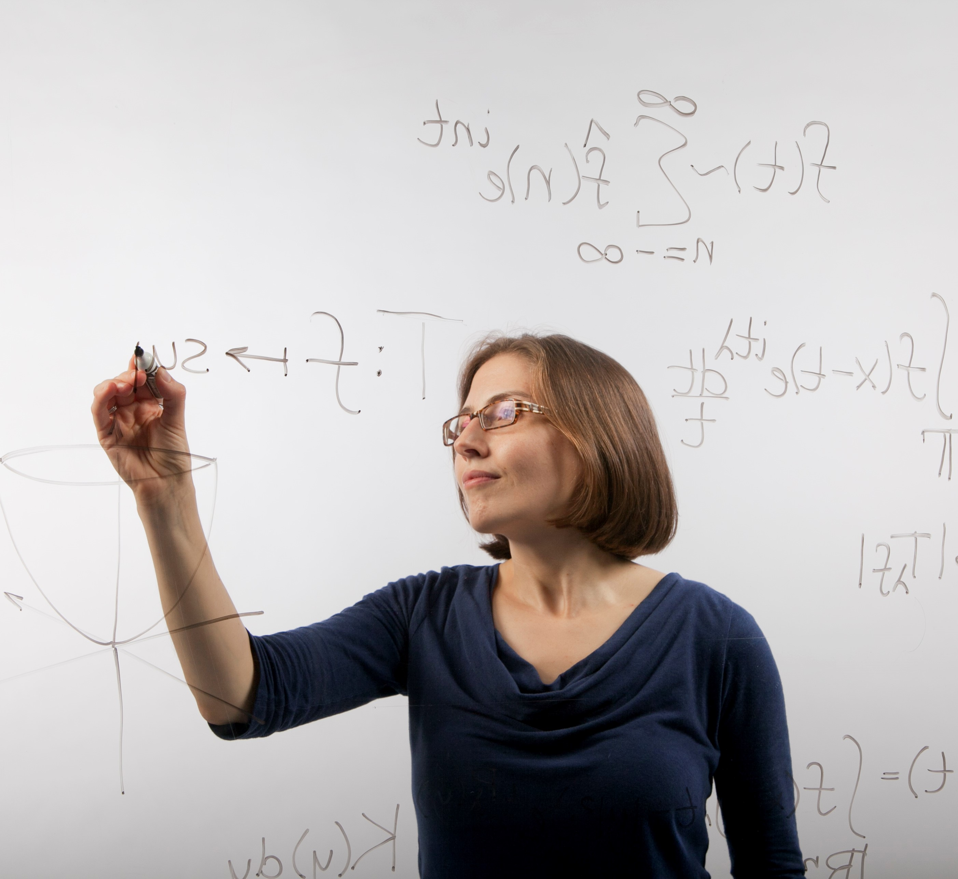
Lillian Pierce
Duke University
If I recall correctly, about 17 years ago, at the end of my junior year, it was at a talk during the Women and Math program that I made my final decision not to apply to medical schools but to math graduate programs instead. I remember feeling relaxed in a room of female mathematicians, and enchanted by the idea that we were all interested in the same abstract ideas. I think the atmosphere of community and belonging made that moment of decision feel light and joyful.

Slide 45
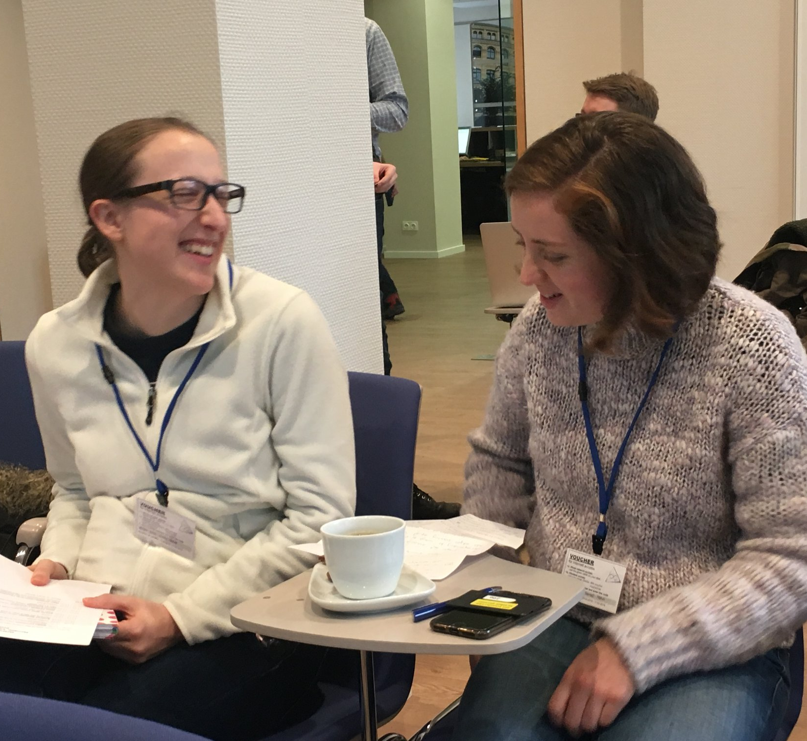
Madeline Brandt & Madeleine Weinstein
2016
The WAM program was very meaningful for both of us; we made friendships that persist and engaged in many interesting conversations. This year, (through the WAM ambassadorship) we started a program at Berkeley called Gender Equity in Mathematical Studies which was very much inspired by our time at the IAS.

Slide 46
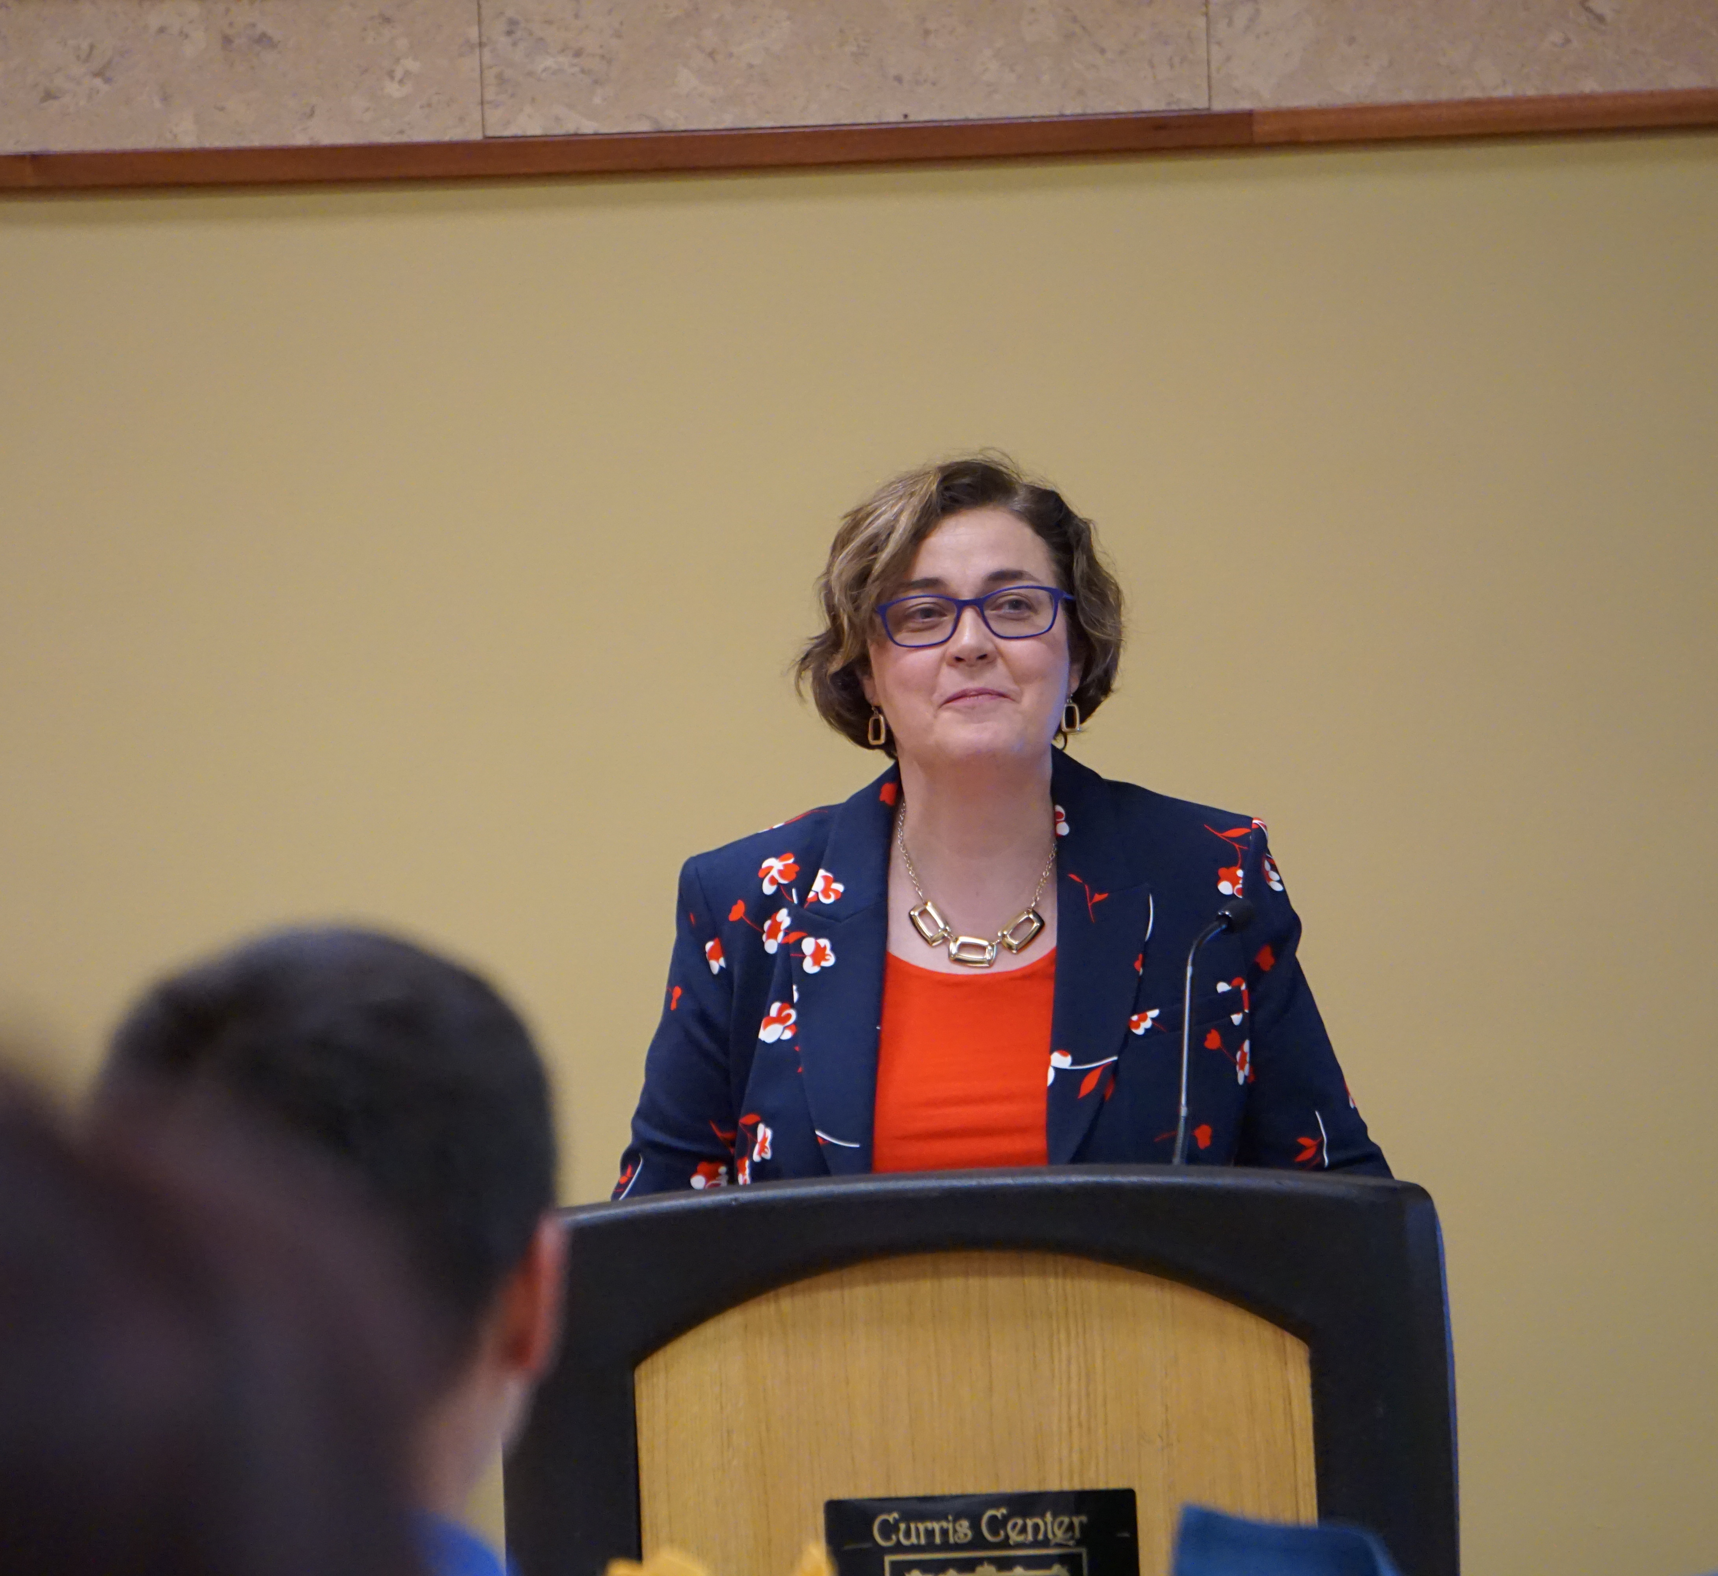
Maeve McCarthy
1995
I earned a PhD in Computational and Applied Mathematics from Rice University in 1997. I am now the Jesse D. Jones Endowed Professor of Mathematics at Murray State University in Kentucky, where I have been for 20 years. My research area is mathematical biology, specifically the application of differential equations to salamander species. I have been here for 20 years. I am also the Director of MSU ADVANCE, an NSF program to study the recruitment and retention of women STEM faculty.

Slide 47
Margaret Robinson Mt Holyoke College
I gave the undergraduate lectures with Giuliana Davidoff in 2006 as part of the "Zeta functions all the way" program when Kate Okikiolu and Audrey Terras gave the graduate lectures. The program was a wonderful experience for me. I came to know so many young mathematicians at the program and I have used the lectures I prepared there in my classes and for other workshops and small courses over the years.

Slide 48
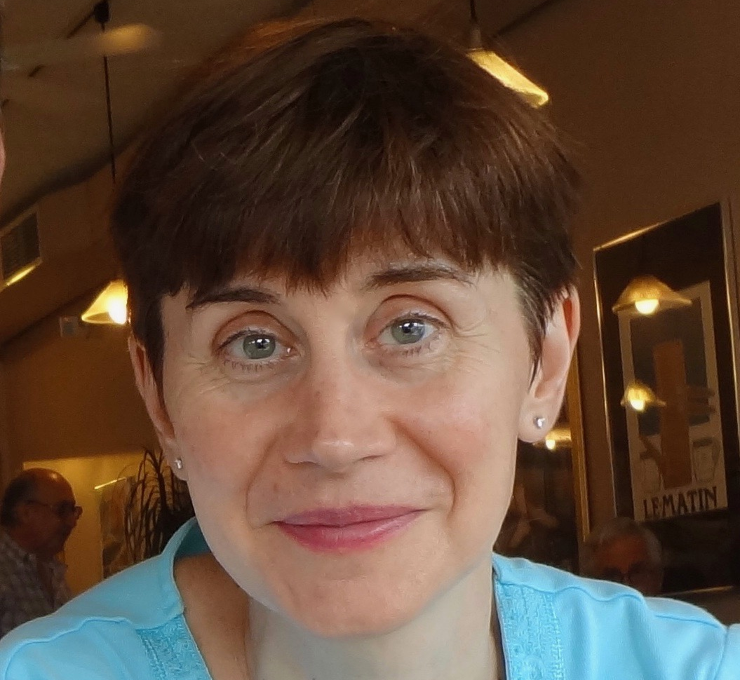
Margaret Readdy
Univ of Kentucky
The WAM program plays a vital role to train the next generation of mathematicians. I have been very lucky to have had a number of key mentors throughout my career, starting when I was an undergraduate. The WAM program is a way for me to thank these individuals.

Slide 49
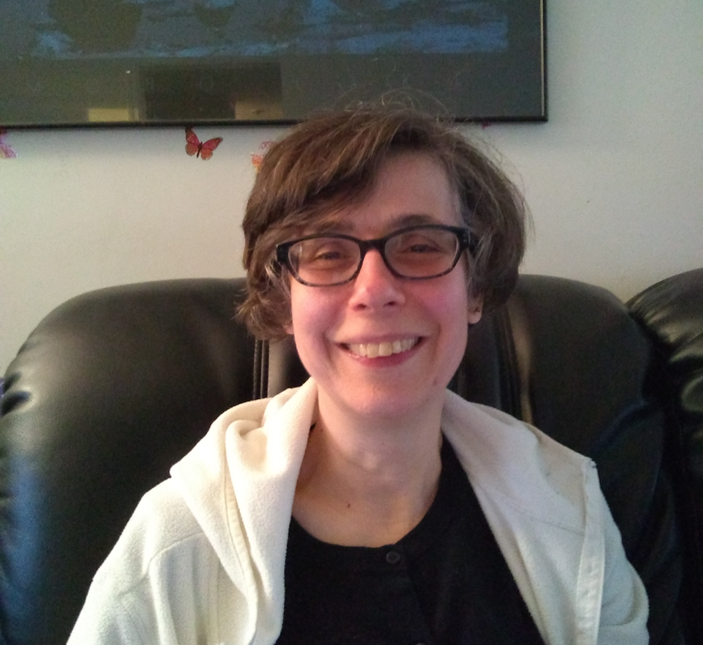
Maria Fung
1998
The program was a very inspirational experience--I met women colleagues and made connections with others in my field. During my career, I have repeatedly organized Sonia Kovalevsky Days and other outreach activities for high school girls--I consider my role in encouraging young women to go into STEM fields a direct consequence of my participation in the Institute.

Slide 50
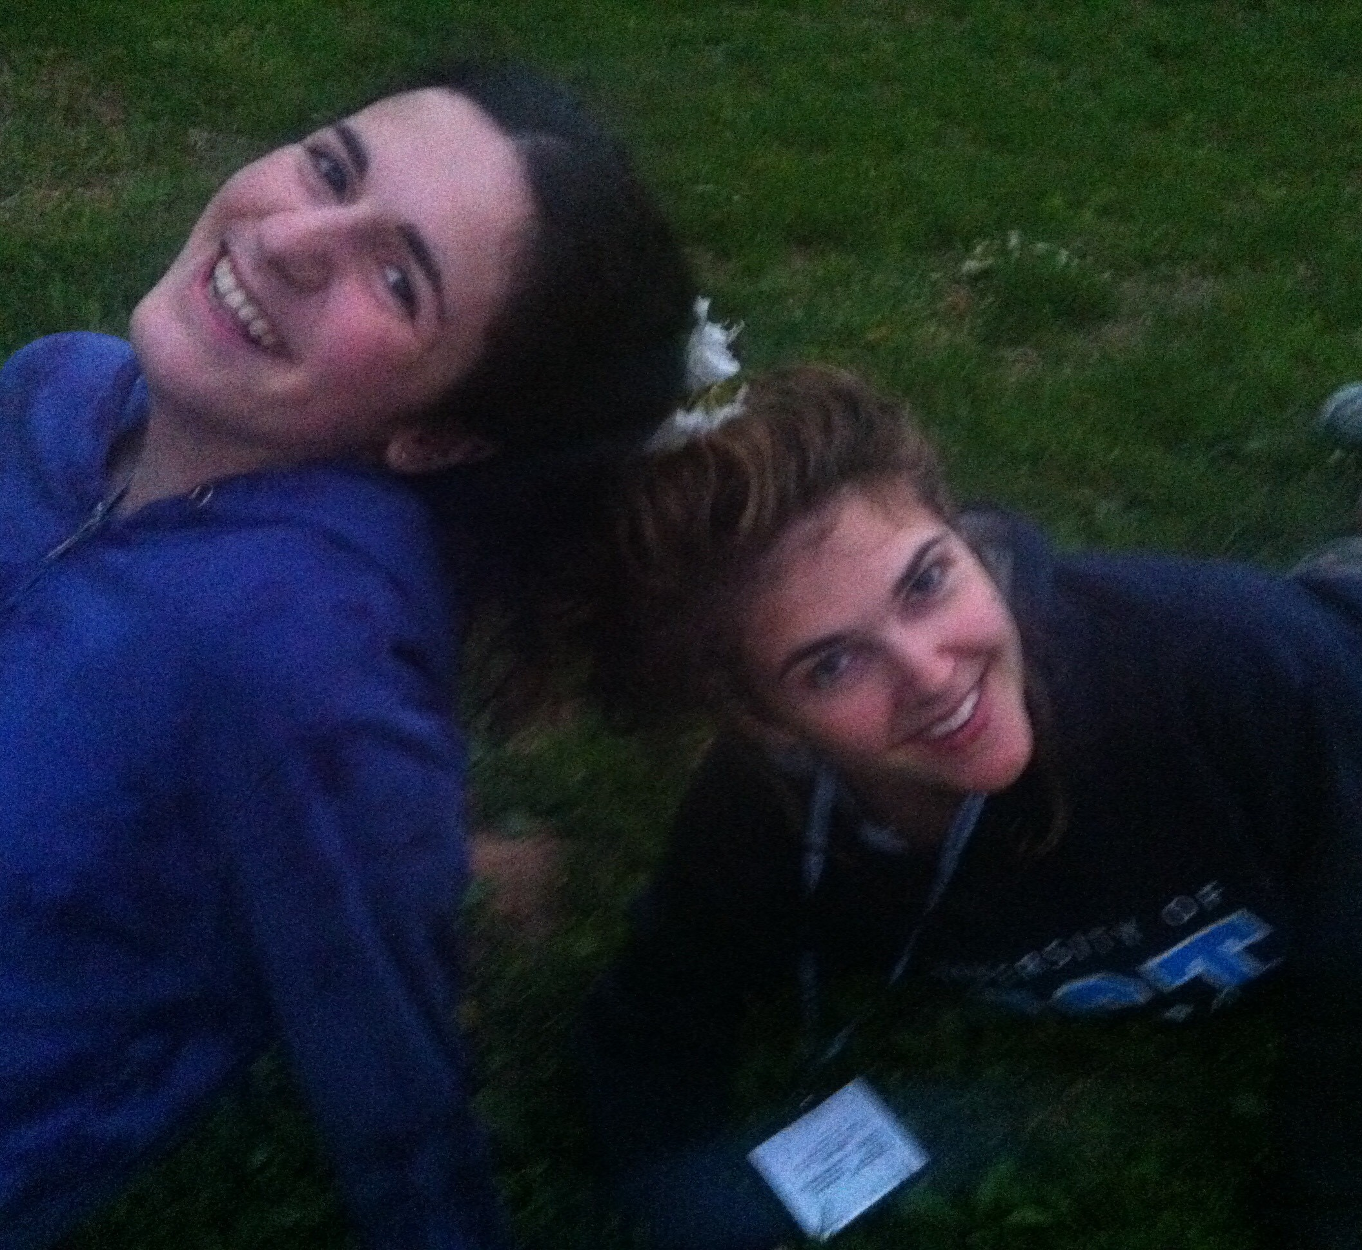
Maria Yakerson
2015
WAM program has shown me that algebraic geometry can be very enjoyable, when lecturers explain the material in a user-friendly way. For the first time I found myself not only asking people around math questions, but also answering. I also realized that my psychological difficulties on the way of building an academic career are common for women allover the world. Not to mention that I was lucky to make few close friends at the program!

Slide 51
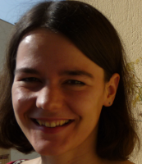
Marthe Bonamy
2013
I attended WAM as a second-year PhD student, and I am now a tenured researcher in Bordeaux with PhD students. Looking back, I honestly believe the program helped me be more comfortable about who I was and who I wanted to be.

Slide 52
Yaim Cooper Harvard
My junior year of college, my academic advisor mentioned to me at one of our meetings that I could consider applying for a 2-week program for women in math at the IAS. I'd only heard about the IAS in books - it hadn't occurred to me that it was a place I might actually visit myself. But I did apply, and attending the program was eye opening. The existence of an institute dedicated entirely to research, the beauty of the Institute woods in May, meeting many female mathematicians, visiting Princeton University and meeting many math graduate students there - it all made a strong impression on me. So much so that I returned two years later as a graduate student at Princeton, and later still, as a visitor to the Institute. I hope this program will continue for many more years, and give many more undergraduates the idea that they, too, might become a mathematician.

Slide 53
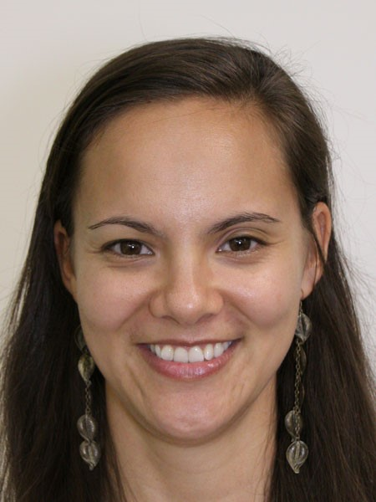
Maureen Kearns
2017
WAM not only provided me with tools that have helped me with my mathematical thinking and career, but also gave me the opportunity to meet strong, diligent, and dedicated people - who happen to be women - in the field of mathematics. The lectures and collaborative work undoubtedly have supplied a significant contribution to my mathematical life. Resources for mathematical outreach, undergraduate support, and conference organizing given at WAM have helped furnish me a foundation for a well-rounded mathematical career. Moreover, and perhaps most importantly at this point in time, the stories of what these women have done and are doing to push for equality, safety, and support for marginalized people in mathematics inspire me daily to keep fighting the good fight. Mahalo nui loa WAM for your impact.

Slide 54
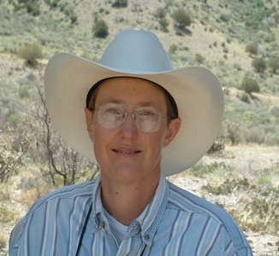
Melanie Martin
1994
The Women and Mathematics program was a dream come true for me in the summer between my Master's and Ph.D. programs. The women I met there were a real source of inspiration during hard times. I still miss the great walks in the woods at IAS.

Slide 55
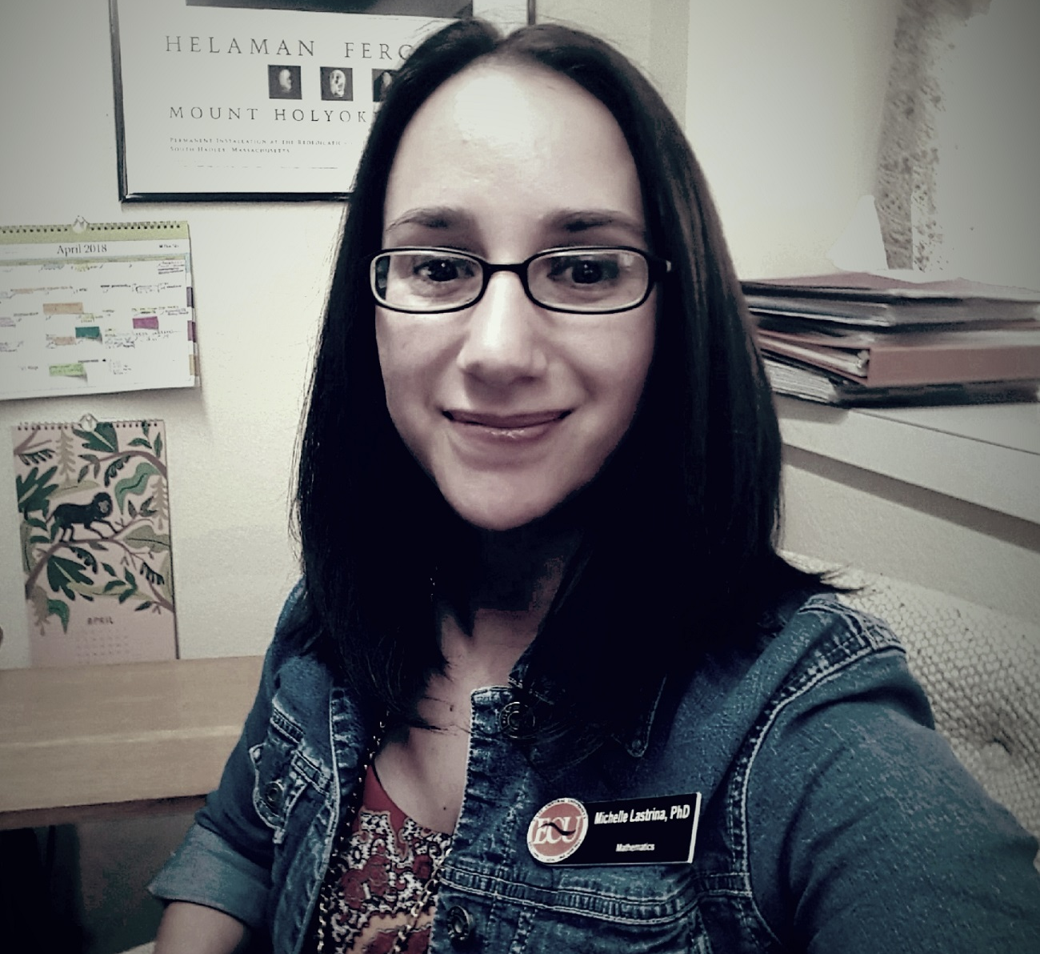
Michelle Lastrina
2006, 2013
The Women and Mathematics program at IAS exposed me to many wonderful role models in mathematics and life. As a beginning graduate student, and later as a beginning faculty member, the program and its participants gave me tools to be successful and persistent, as well as encourage aspiring young female mathematicians to continue on their path. I look forward to seeing the impact this program has on myself and others for years to come!

Slide 56
Monica Nevins 1998
I’m now a professor at the University of Ottawa. I attended the Women and Mathematics Program at IAS at the end of my last year of graduate studies in 1998, in preparation for the Park City Mathematics program on the same theme. Besides great mathematics, what I remember most was meeting, for the first time, so many female mid-career researchers in my field. I’d developed the impression that the women all disappeared after graduation, so this was a perfectly-timed boost as I contemplated my own academic career. The week was amazing; I made many friends who are now at universities around the world. Congratulations to Women and Mathematics at IAS for 25 successful years!

Slide 57
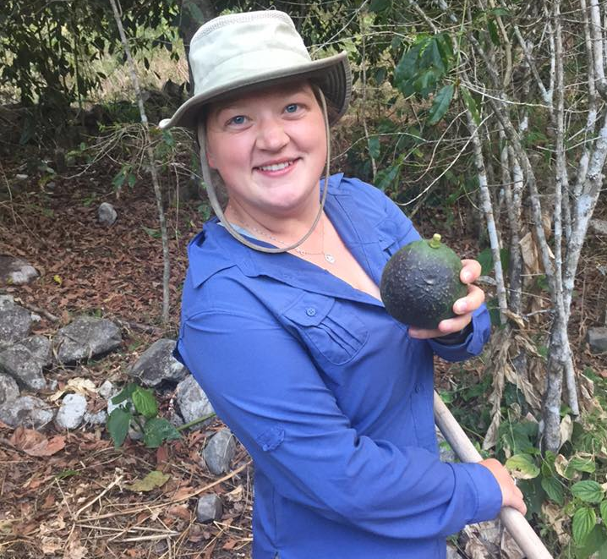
MurphyKate Montee
2017
I loved attending this program; as I continue my career I see fewer and fewer women around me, and it's such a relief to get to spend two weeks with women who are doing phenomenal math. The friends I met at this program continue to inspire me and have been a lasting connection.

Slide 58
Noriko Yui 1999
I am a Professor of Mathematics at Queen's University in Kingston, Canada. I took part in the Mentoring Program for Women in Mathematics portion of PCMI at IAS in May 1999. I was one of the invited lectures. I gave three lectures on ``Arithmetic of Certain Calabi-Yau Varieties and Mirror Symmetry. The lecture Notes have been published in IAS/Park City Mathematics Series Volume 9: Arithmetic Algebraic Geometry. I met a number of women graduate students and postdoctoral fellows at the meeting. I think the program has encouraged many young participants, and in fact, some are now professors at various universities in the world.

Slide 59
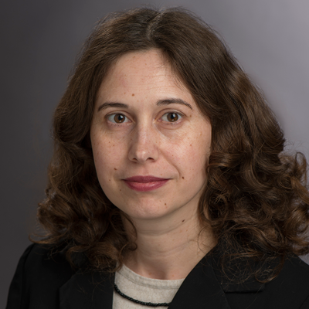
Raluca Falea
2004
I enjoyed this program at IAS a lot. It was the first time for me to visit IAS and I was overwhelmed to be there. Both undergraduate and graduate lectures were very well organized and inspiring. The discussions we had about the lives of women in math were very interesting and eye opening. I hope you will continue this series of workshops.

Slide 60

Rebecca Patrias
2013
The best part of attending the program for me was meeting so many female research mathematicians. When I was starting out in graduate school, there were only 2 or 3 in our department, and I didn't personally know any of them. It really helped me to get to talk to such successful women.

Slide 61

Rebecca Rohrlich
2016
I cannot thank the organizers of WAM enough for the opportunity they provided me. WAM not only exposed me to areas of math I had never seen before, but also gave me a community of women mathematicians to socialize with. With the daily tea-times and problem sessions, I made several good friends at WAM (at all different stages of their professional careers) who I am still in contact with today.

Slide 62
Sarah Sword EDC.org
I loved the WAM program in the late 90s – getting to do mathematics with a group of women was an experience I had never had before, and not one that I could have conceived of before I attended. And a couple of the friendships I made there have informed my professional life ever since.

Slide 63

Rediet Abebe
2013
The topic of the program I attended was combinatorics and graph theory, which eventually inspired my graduate work in algorithms and social networks. It was an incredible opportunity to meet and get to know some wonderful women in mathematics, and to learn about the work of some inspiring researchers. Thank you for all the work you put into organizing this program!

Slide 64

Renee Hoekzema
2016
Participating in the Women and Mathematics program at IAS was a deeply forming experience for me. More than I'd anticipated, it gave me a huge confidence boost to be surrounded by other women doing math, and I still think back frequently to the insightful discussions we had throughout the weeks about gender issues and other topics.

Slide 65

Ruth Charney & Karen Vogtman
In 2005, we taught the advanced mini-courses for the IAS Women in Mathematics Program on the Geometry of Groups. Geometric group theory was a relatively new area at the time and was attracting many young people. In retrospect, the program had an amazing impact on the field. The community of young women created at the IAS program has remained a strong and cohesive network to this day and several of the women we first encountered there have become leaders in the field. Moreover, the innovative structure of the workshop, with problem session and mentoring events, has influenced the way we, and many others, have designed subsequent workshops aimed at young people. As a result, the field has maintained a welcoming atmosphere for young people, both male and female, and continues to attract a strong and diverse cohort.

Slide 66


Samantha Pezzimenti 2012
Of all the math conferences I have been to, the Women and Mathematics program was probably the most influential on my career path. I attended WAM the summer before starting graduate school, and was a bit nervous about what I was getting myself into. Coming from a small undergraduate institution, the WAM program was my first real introduction to the world of math research. Even more important, however, were the connections I made with the other participants and mentors. I can remember one of the organizers telling us on the last day that she expected all of us to get our Ph.D. Hearing someone so confident in my ability was empowering. I keep in touch with many of the people I met at the program, including the woman who became my academic advisor!

Slide 67

Amber Smith
2003
I attended the program the summer between finishing my undergraduate degree and starting graduate school in Mathematical Biology. This was a prime time to be learn about different areas of MathBio and meet other Mathematical Biologists as these were the people who later became colleagues and great friends. Memories to be cherished forever!

Slide 68

Stephanie Singer
City Commissioner Philadelphia
Each day at IAS, when I sat down to plan my next day's lecture for the Women and Mathematics program, prose poured onto the paper. At the end of the two weeks, I had the first draft of a book. Who knew I was a writer?

Slide 69

Sue Generazzo
2002
When I attended the WAM program, I was intrigued by the mysterious and beautiful mathematics I was introduced to. I felt so privileged to be at the prestigious IAS, it was like a dream. I had only just recently started thinking about graduate school, and the time I spent with the amazing women at WAM inspired me and filled me with excitement at the thought of continuing my studies and eventually becoming a professor of mathematics.

Slide 70

Susan Xia
2011, 2013
The program made me saw the success of some of the more senior female mathematicians, and encouraged me to pursue a PhD in math (right here in Princeton!). I made some friends there who I kept in touch with long after the program ended.

Slide 71

Taniecea Arceneaux Mallery
2004
The Women and Mathematics Program was instrumental in laying the groundwork for my pursuit of a graduate degree in a mathematics field. It exposed me to colleagues, role models and inspirational women who shared the unique challenges and joys of being a mathematician. I am thrilled to celebrate the program's 25th anniversary, and I look forward to its next 25 years of empowering women to pursue careers in mathematics.

Slide 72
Tara Brendle 2005
Lecturing and participating in the Women and Mathematics program was a enriching experience in every respect. I learned a great deal of mathematics while there, particularly from students in my course who ask, and continue to benefit from the mentoring of the other faculty there.

Slide 73

Widad Abdalla Mukhaimer
2009, 2010
Everything about the program was excellent, but I have to say that one of the most memorable experiences of my life was meeting John F. Nash Jr. He gave me an autograph (I happened to be carrying his book in that moment) and took a picture with me. This experience was one of the reasons I was inspired to do my master's thesis in game theory.

Slide 74


Wanlin Li 2015
It's the best conference I ever attended. I made so many friends in my research area and the "Ambassador Program" gave me the chance to organize a conference as a graduate student. I kept getting new reasons to feel grateful for this program all the time.

Slide 75

Yen Duong
2016, 2017
Participating in, and then TAing for, WAM greatly increased my self-confidence and belief that I can do interesting, thoughtful work adjacent to the math world. I found many opportunities within the program to talk about math, organize small programs, and mentor younger students. I also brought my six week old and my mom when I was TAing there, which was a blast- I felt like a cool role model even if I wasn't sleeping very much. Honestly I'm still figuring out how much WAM has impacted me--it's a lot.

Slide 76

Sara Lamboglia
2015
Those have been two amazing weeks! I enjoyed it a lot for the very interesting mini courses and the exercise sessions. The company was also very nice and I met there some people that became my collaborators afterwards. I really want to thank the organisers for this amazing opportunity.

Slide 77
Shabnam Beheshti 2012, 2013
While I was an Assistant Professor at Rutgers University, I was active in two IAS WAM programs, as a participant, postdoc speaker, panelist, and (impromptu!) panel organizer. Each of these programs and activities impacted my career in different ways. Here are a few concrete examples:
In the 2012 program on 21st Century Geometry, I enjoyed learning new open problems in geometry as well as presenting my own research to supportive experts. I also discovered that I had plenty of experiences to share and advice to give to my younger colleagues in the pipeline. It was also during these two weeks that I met Prof. Christina Sormani, a Riemannian Geometer with whom I became good friends; since then, we have continued to have meaningful scientific interactions (at the MSRI, AMS Meetings, etc.) on problems in Mathematical Relativity, my current area of research. In terms of scientific content, I used the introductory lectures given that year as a starting point for delivering my own lecture series during the Rutgers Math REU program, for which I received feedback that it was many students’ favorite part of their research experience.
After that summer, I started working on a project with a fellow postdoc at the interface of PDEs and Combinatorics. When I saw the 2013 program theme on Combinatorics and Graph Theory, I suggested that we participate, not only to learn new techniques, but also to lead by example as a two-woman collaboration, doing our research in the beautiful setting of the Institute; it is worth mentioning that we completed most of our joint paper during those weeks. In fact, for me, the new research direction set from that time has continued to bear fruit. Last year, I successfully secured a London Mathematical Society Research in Pairs grant to bring a new collaborator to Queen Mary in order to investigate novel connections between classes of integrable PDEs and combinatorial structures such as Young diagrams.
I remember cycling to the Institute in both years, looking forward to each day of lectures, activities, teatime chats and panel discussions. It felt special to be a female mathematician for all the right reasons.

